Slide 1
EDA Case Study - Lending Club
Author: Konda Reddy Golamaru
konda_100@yahoo.com

Slide 2
Business Overview
Lending Club is a marketplace for personal loans that matches borrowers who are seeking a loan with investors looking to lend money and make a return.
When the company receives a loan application, the company has to make a decision for loan approval based on the applicant’s profile. Two types of risks are associated with the bank’s decision:
If the applicant is likely to repay the loan, then not approving the loan results in a loss of business to the company
If the applicant is not likely to repay the loan, i.e. he/she is likely to default, then approving the loan may lead to a financial loss for the company

Slide 3
Problem Statement
The aim is to identify patterns which indicate if a person is likely to default, which may be used for taking actions such as denying the loan, reducing the amount of loan, lending (to risky applicants) at a higher interest rate, etc.

Slide 4
Driver variables/attributes
Based on the EDA, It was determined that the below attributes can influence the outcome of loan status i.e. Fully Paid or Charged Off
=> Loan_amt
=> Term
=> Interest_rate
=> Grade
=> Annual Income
=> Purpose of loan
=> DTI (Debt to Income)
=> Emp_Lenght
=> Home_Ownership
=> Verification_Status

Slide 5
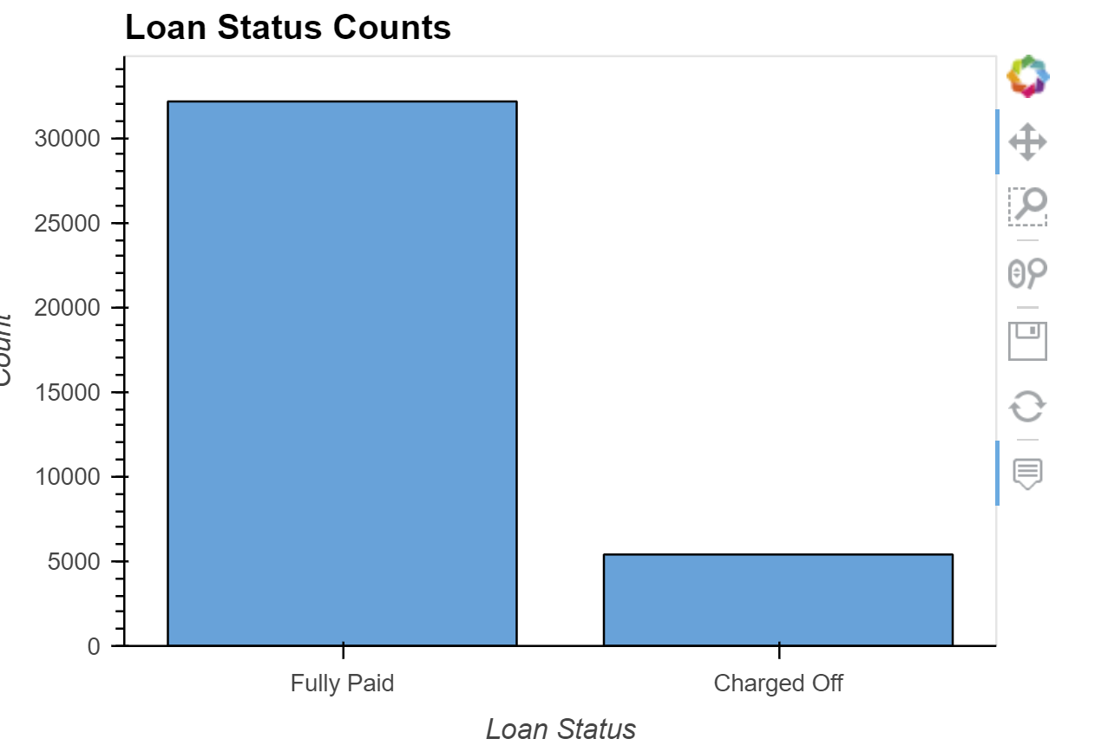
Insights
From above bar plot, observe that around 14% of the loan applicants are defaulted on the loan.

Slide 6
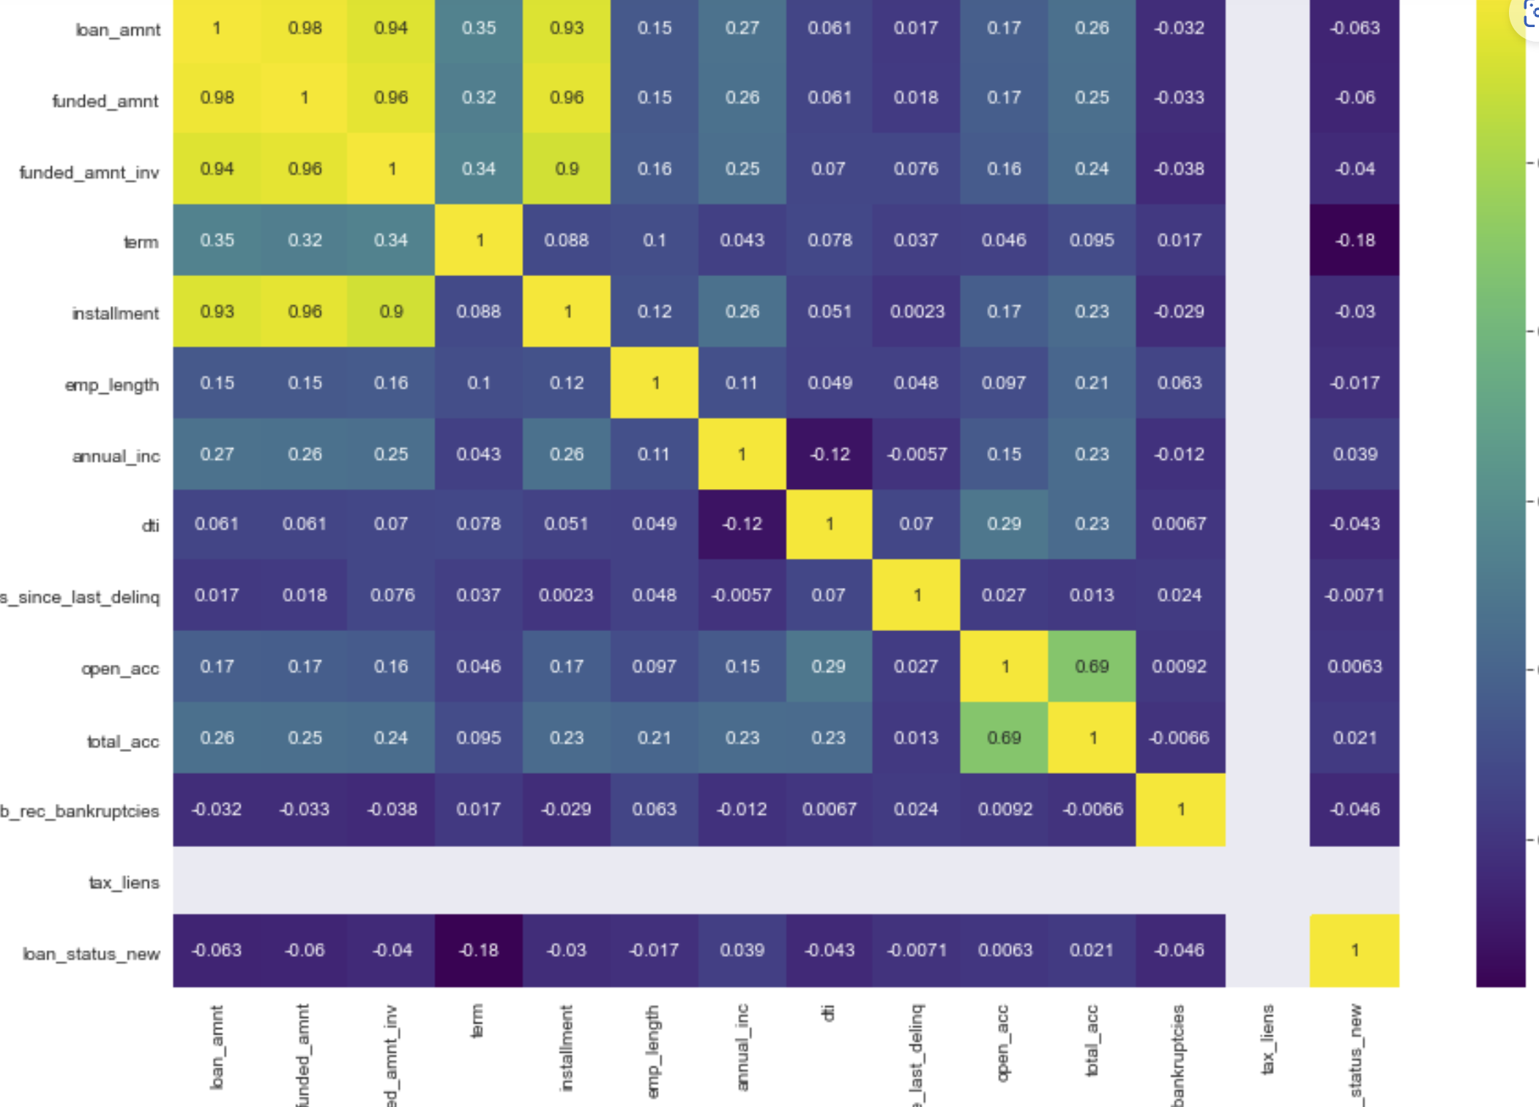
Insights – continued…
From above plot, observe that high correlation between 'loan_amnt' and 'installment' attributes.

Slide 7
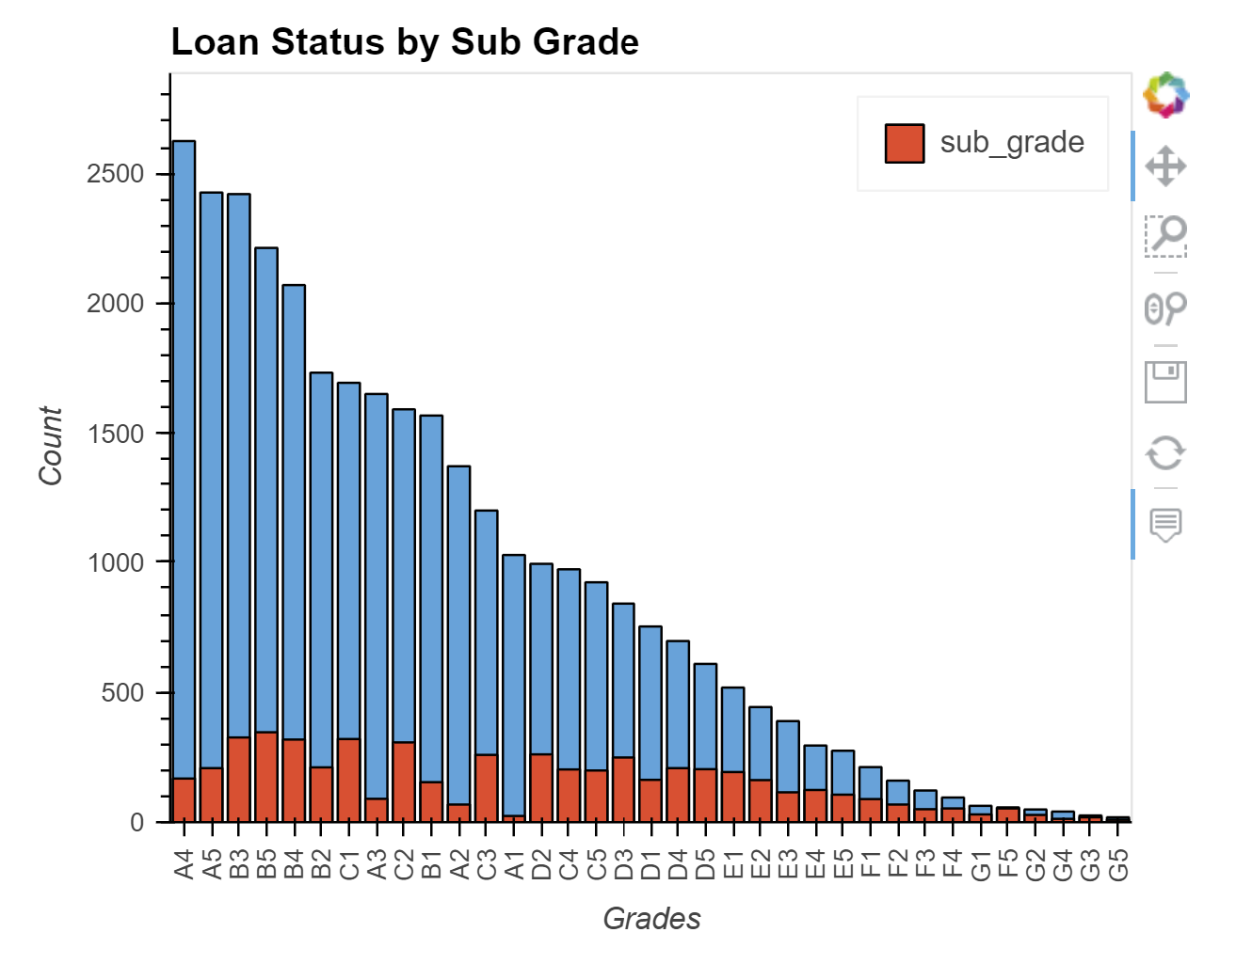
Insights-continued…
F and G subgrades don't get paid back that often

Slide 8
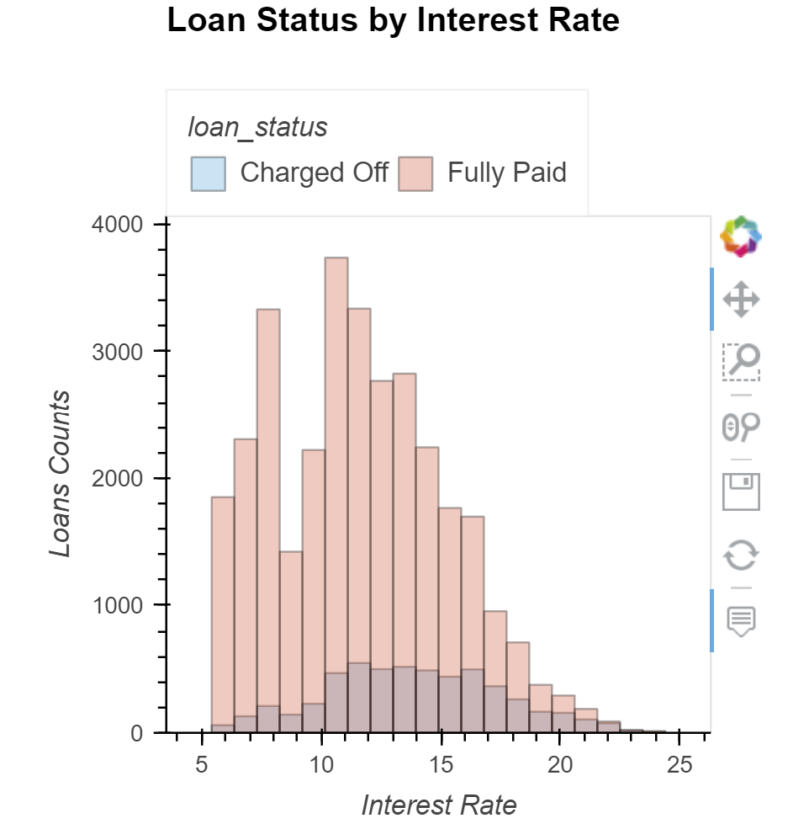
Insights-continued…
Observation is that loans with high intersest rate are more likely to be defaulted.

Slide 9
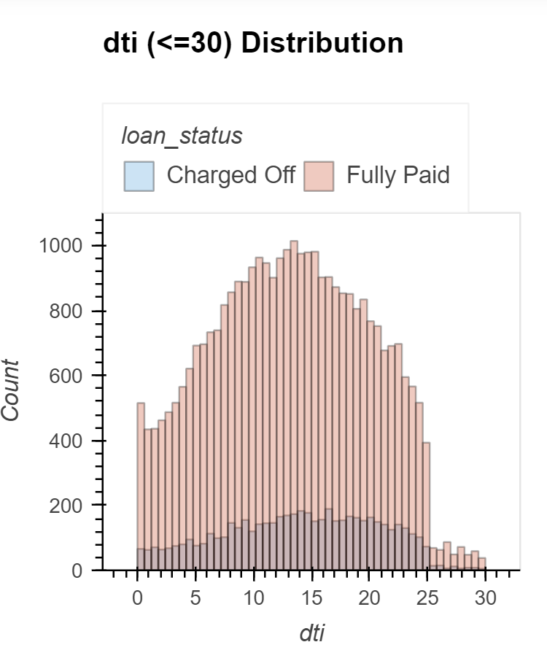
Insights-continued…
Observation is that smaller the dti the more likely that the loan will not be paid.

Slide 10
Thank You!

