Slide 1

Project Title -
Seasonal Agriculture Performance Analysis
Student Name: K Niveditha Sai College Name: ACE Engineering College
AICTE STU ID : STU67e29e9cae87e1742904988

Slide 2

Problem Statement
Agricultural activities are influenced by seasonal variations in environmental conditions, farming practices, resource availability and market conditions. As a result, agricultural performance may differ from one season to another. However, raw agricultural data does not clearly explain how agricultural performance changes across seasons or what patterns can be observed in different seasonal conditions.
The problem is to analyze the given agricultural dataset and investigate seasonal differences in agricultural performance by identifying meaningful patterns, trends, relationships and variations within the available data.

Slide 3
Project Description
This project analyzes agricultural data across different seasons, crops, states and farming conditions to understand variations in agricultural performance.
The analysis focuses on:
Exploring and understanding the agricultural dataset
Checking data quality and preparing the data
Comparing agricultural performance across Kharif, Rabi and Zaid seasons
Analyzing crop-wise and state-wise yield patterns
Studying environmental conditions such as rainfall, temperature and soil moisture
Examining seasonal usage of water, fertilizer and pesticides
Comparing revenue, cost and profit across seasons
Investigating relationships between environmental conditions and yield
Identifying unusual observations and outliers
Applying statistical and visualization techniques
Developing evidence-based conclusions for seasonal agricultural planning .

Slide 4

Who Are The End Users?
Farmers
Can use seasonal performance insights to support crop and resource planning.
Agricultural Planners & Policymakers
Can use seasonal and regional patterns for agricultural planning and resource allocation.
Agricultural Analysts & Researchers
Can use the analysis to study relationships between environmental conditions, resources and agricultural outcomes.
Agri-business Stakeholders
Can use economic insights such as revenue, cost and profit to understand seasonal performance.

Slide 5

Technology Used
Python — Data analysis and statistical analysis
Pandas — Data manipulation and aggregation
NumPy — Numerical operations
Matplotlib — Data visualization
Seaborn — Statistical visualizations
SciPy — Statistical testing
Jupyter Notebook — Analysis and documentation
VS Code — Development environment

Slide 6
Results

Slide 7
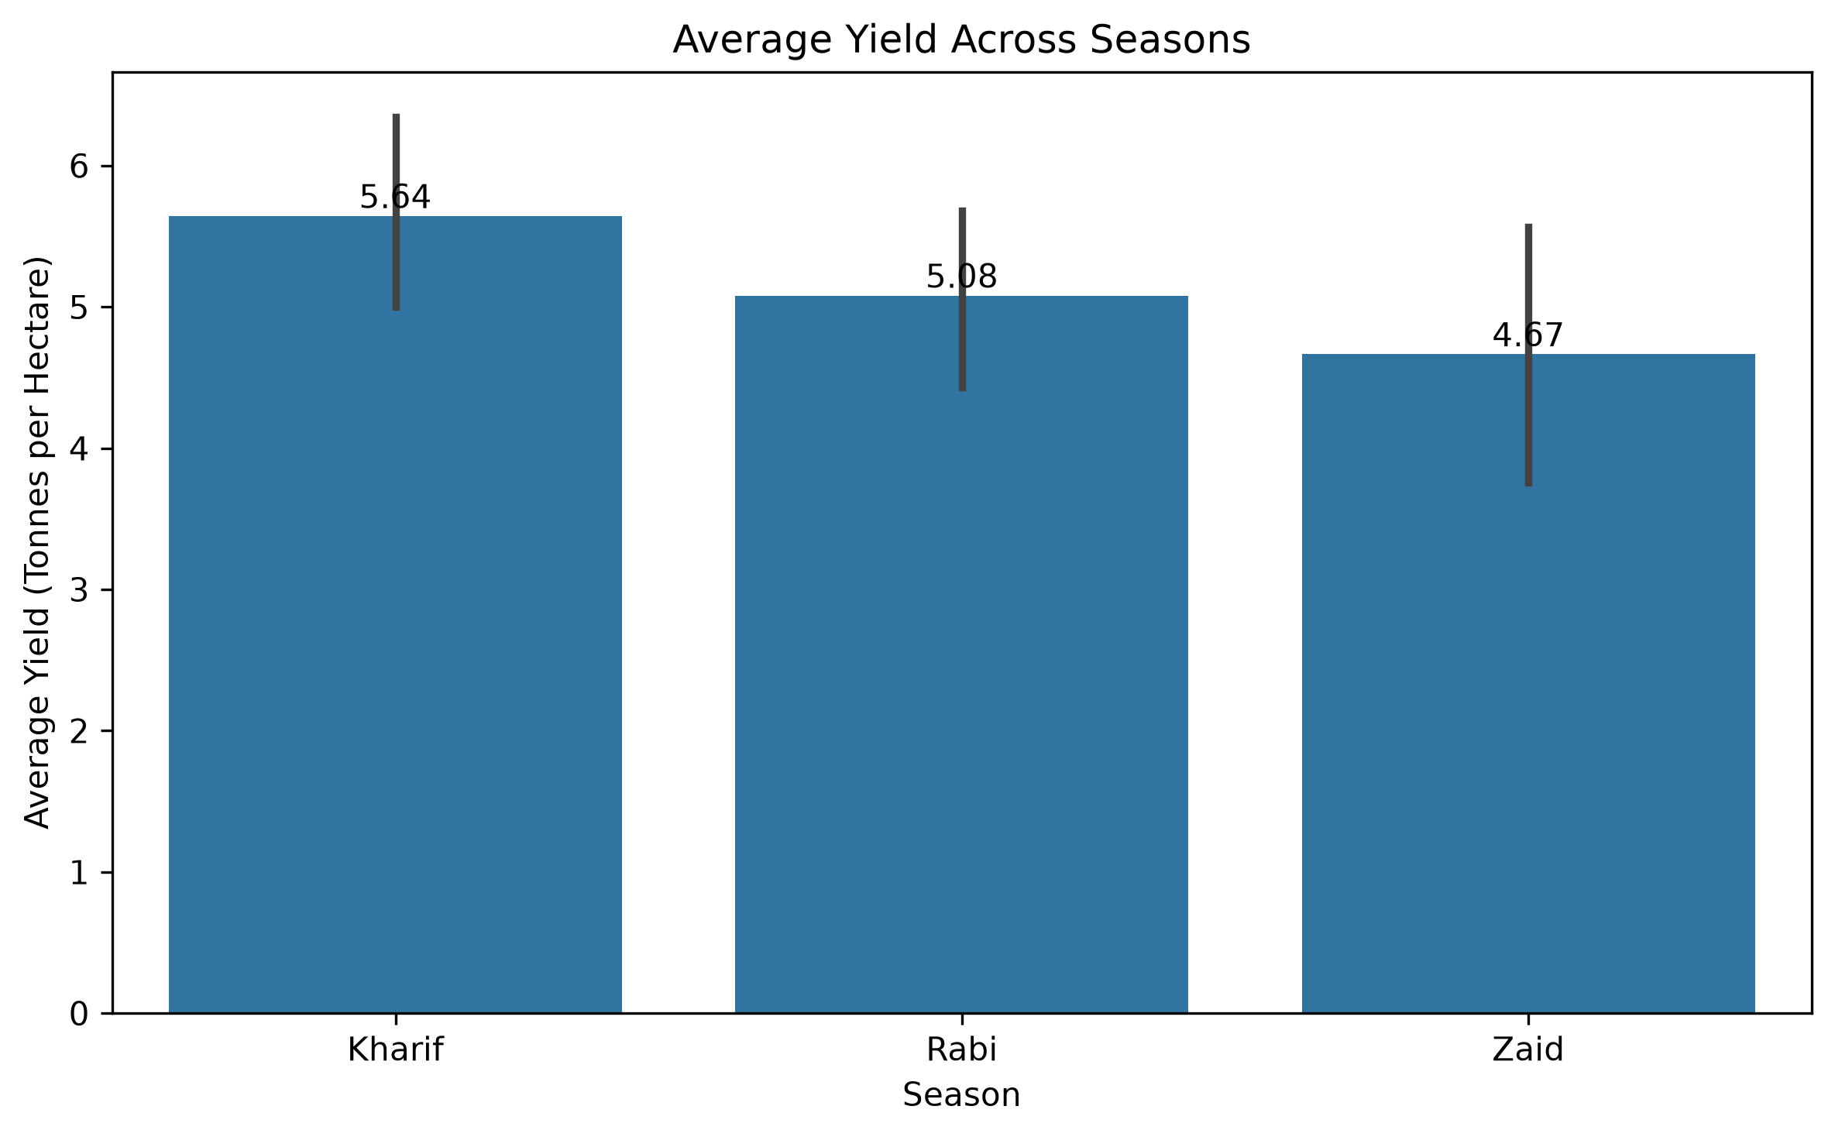
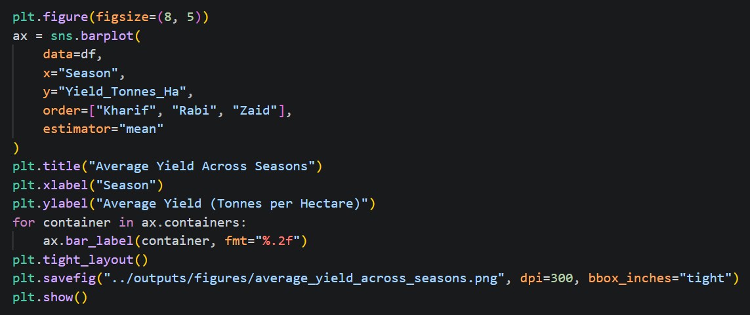
Average Yield Across Seasons
Kharif shows the highest average yield, followed by Rabi and Zaid. However, the ANOVA test indicates that the difference in mean yield across seasons is not statistically significant at the 5% level.

Slide 8
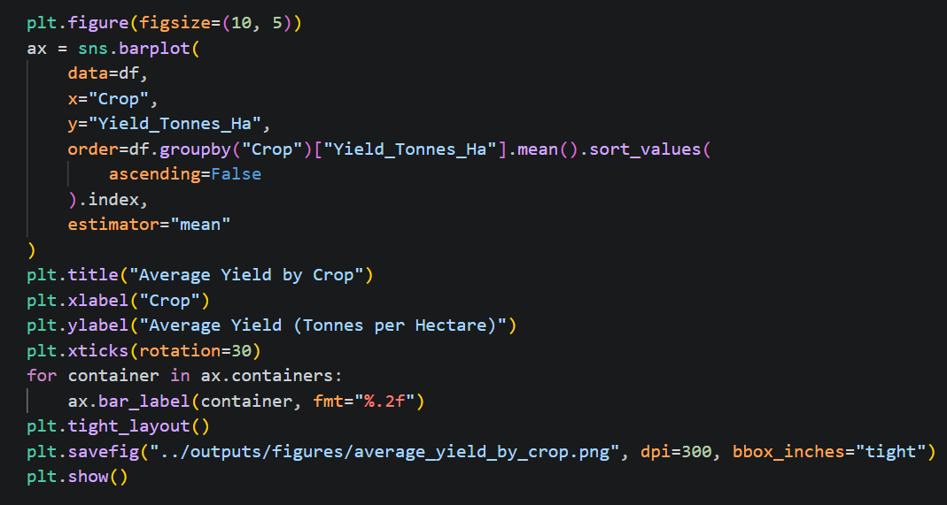
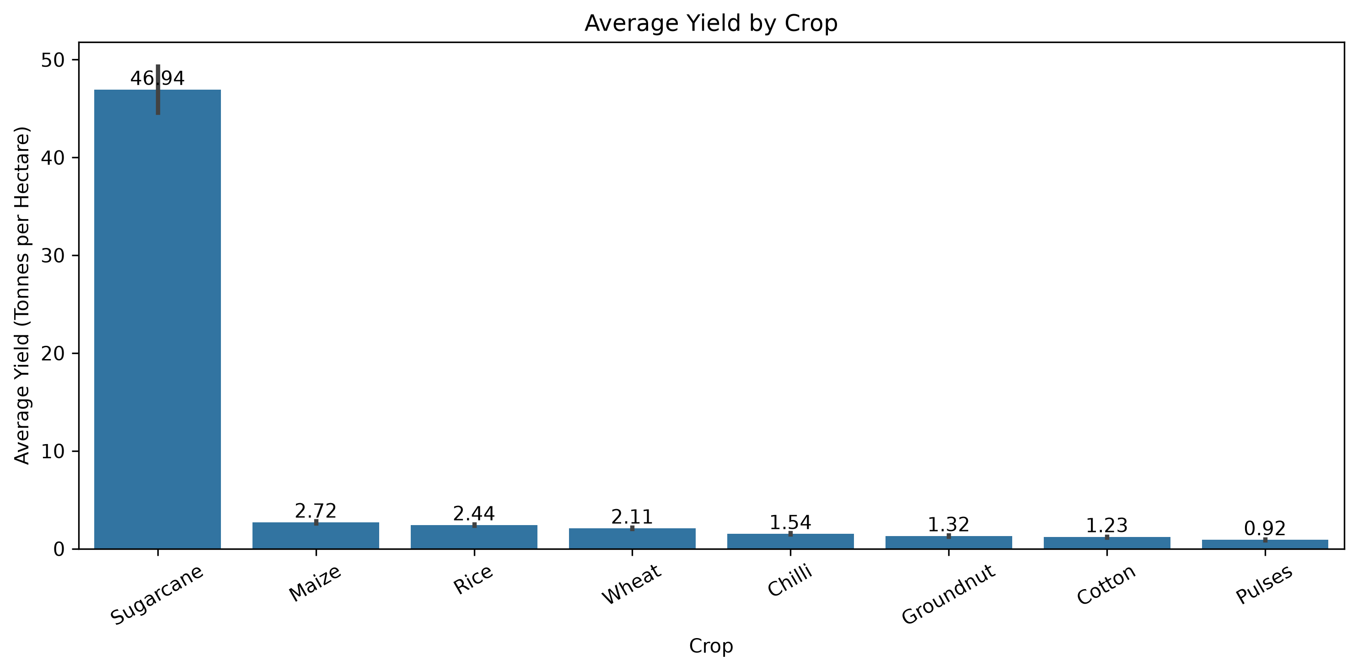
Average Yield by Crop
Yield varies substantially across crops. Sugarcane has the highest average yield in the dataset at approximately 46.94 tonnes/ha, while the remaining crops show much lower average yields.
Average Yield by Crop

Slide 9
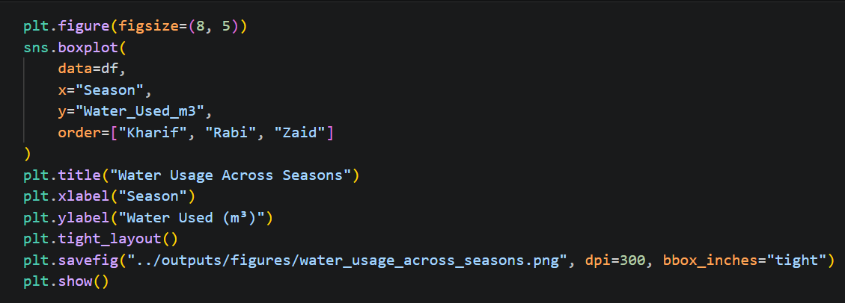
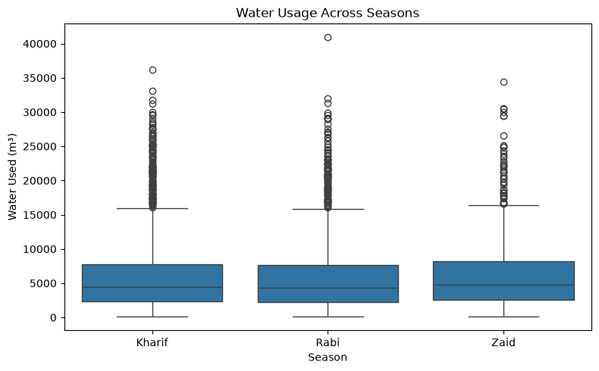
Water Usage Across Seasons
Water usage shows considerable variation within each season. The distributions overlap substantially, with Zaid showing a somewhat higher central usage compared with Kharif and Rabi.

Slide 10
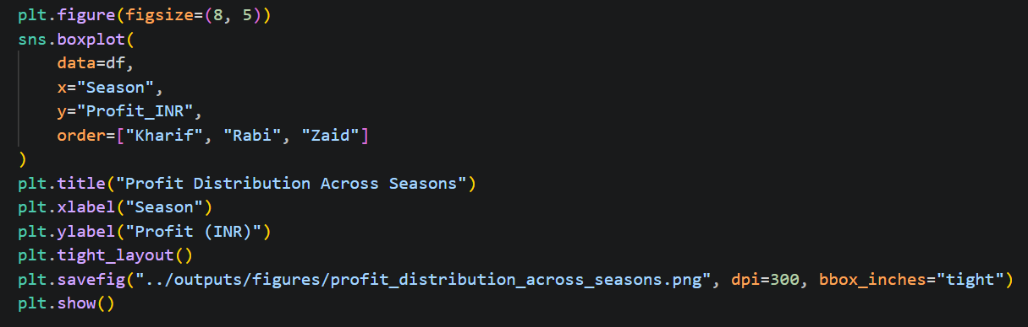
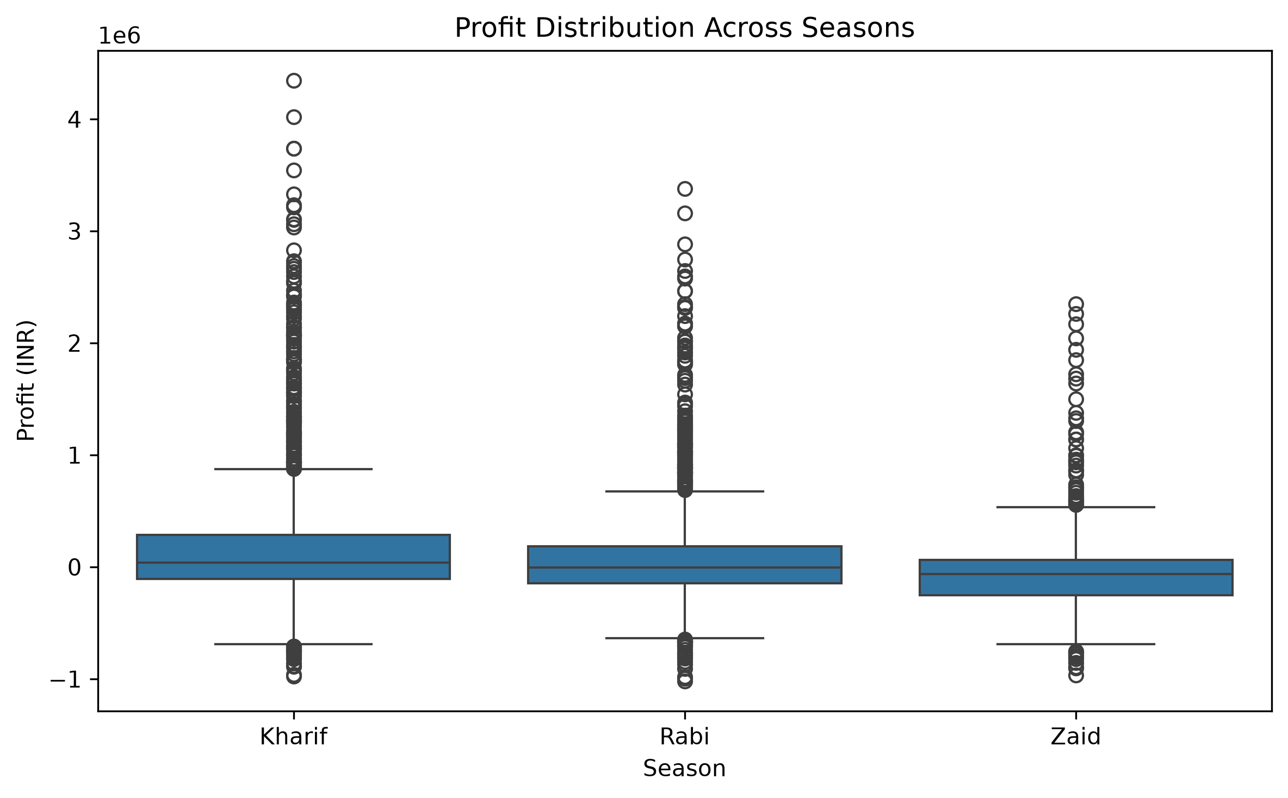
Profit Distribution Across Seasons
Profit varies considerably across seasons, with both positive and negative observations. Kharif has the highest average profit, while Zaid has a negative average profit.

Slide 11
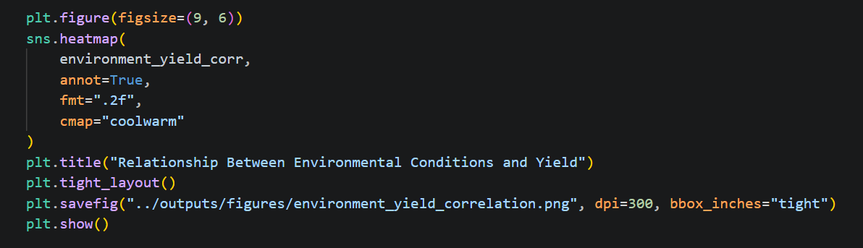
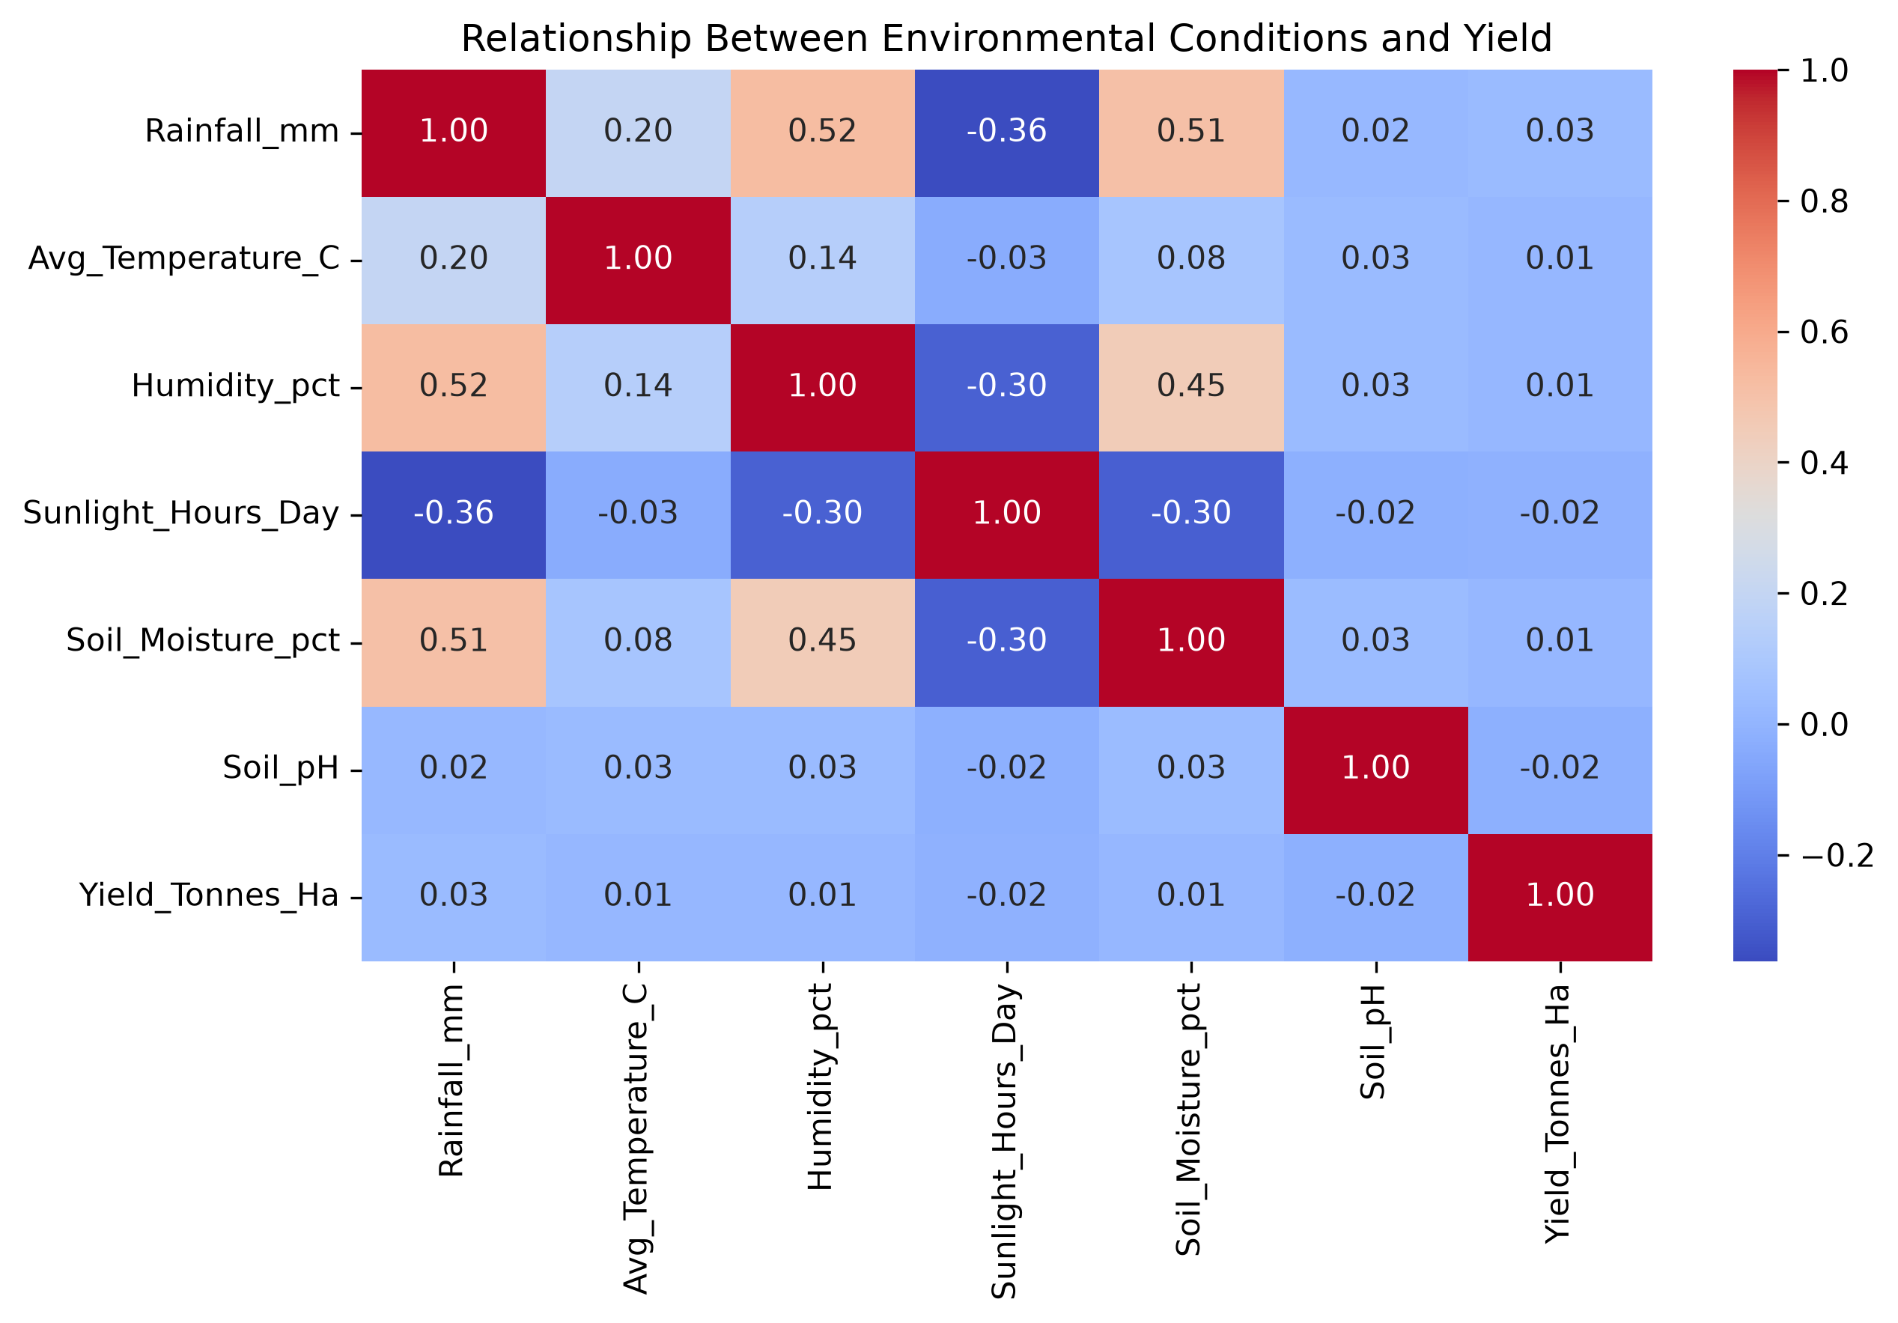
Environmental Conditions and Yield
The heatmap shows that the relationships between individual environmental variables and yield are weak in this dataset. This suggests that yield variation is not strongly explained by any single environmental factor.

Slide 12
Future scope
Yield Prediction — Develop predictive models for crop yield.
Resource Forecasting — Predict water, fertilizer and pesticide requirements.
Crop Recommendation — Recommend suitable crops based on seasonal and environmental conditions.
Weather Integration — Incorporate real-time rainfall and temperature data.
Interactive Dashboard — Develop a dashboard for easier exploration of agricultural trends.
Larger Datasets — Extend the analysis using larger and more recent agricultural datasets.
Future development can combine agricultural, environmental and economic data to support more data-driven and sustainable seasonal planning.

Slide 13
GitHub Link
https://github.com/kondalaniveditha/Seasonal-Agriculture-Performance-Analysis.git

Slide 14
VOIS Course completion certificate - Course name- Data Visualization

Slide 15
Thank You
.
Seasonal Agriculture Performance Analysis
K Niveditha Sai

