Slide 1

TIC TAC TOE AI USING MINIMAX ALGORITHM
KONDAMIDHA NAGALAKSHMI

Slide 2

OVERVIEW
This presentation provides an overview of the implementation of an AI opponent for the game of Tic Tac Toe using the Minimax algorithm. We'll discuss the problem statement, the solution approach, key implementation details, and the achievements of the project.

Slide 3

PROBLEM STATEMENT
Create an AI opponent that can play Tic Tac Toe against a human player. The AI opponent should make intelligent moves and aim to win or achieve a draw in the game.

Slide 4
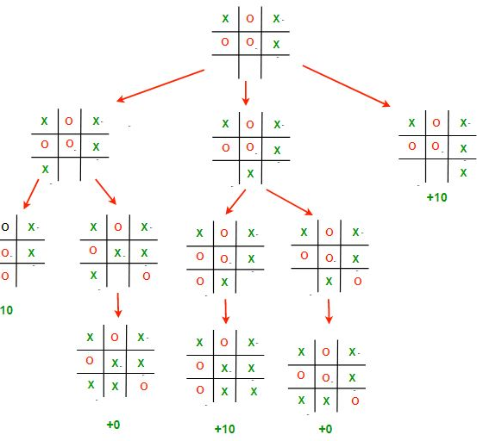
MINMAX ALGORITHM
The min max algorithm in AI, popularly known as the minimax, is a backtracking algorithm used in decision making, game theory and artificial intelligence (AI). It is used to find the optimal move for a player, assuming that the opponent is also playing optimally.

Slide 5
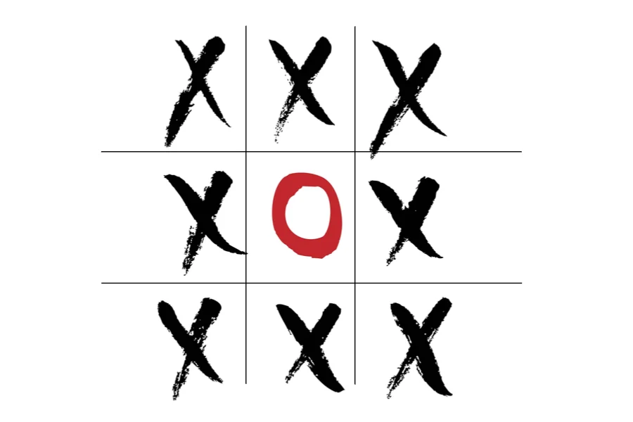
SOLUTION APPROACH
Implement the game logic including the game board, evaluation of game states, win-checking, and empty cell detection.
Utilize the Minimax algorithm, a decision-making algorithm commonly used in game theory, to determine the best possible moves for the AI opponent.
Allow the human player to make moves and provide an interactive game experience.

Slide 6
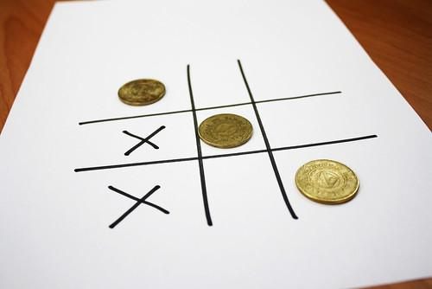
IMPLEMENTATION
The game board is represented as a 3x3 grid with each cell holding a value of 0, representing an empty cell.
The evaluation function assigns scores to different game states: +1 for AI win, -1 for human win, and 0 for a draw.
The win-checking function verifies if a player has won the game by checking rows, columns, and diagonals.
The Minimax algorithm is recursively applied to search through all possible moves and evaluate the scores for each move.
Utility functions handle console clearing, rendering the game board, and handling turns for both the human player and the AI opponent.
The main game loop allows the human player to choose their symbol and the order of play, alternates between turns, and displays the game result.

Slide 7
ADVANTAGES/DISADVANTAGES
Advantages
Disadvantages
The AI opponent makes intelligent moves using the Minimax algorithm, providing a challenging gameplay experience.
The game is interactive and allows human players to make moves.
The implementation is modular and extensible, making it easy to enhance or modify the game logic.
The implementation is limited to the game of Tic Tac Toe and may not be directly applicable to other games.
The Minimax algorithm has a high time complexity, making it less suitable for more complex games with larger search spaces.

Slide 8
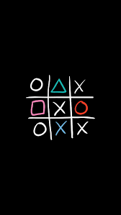
ACHIEVEMENTS
Successfully implemented the Tic Tac Toe game logic and AI opponent using the Minimax algorithm.
Created an interactive and engaging gameplay experience for human players.
Demonstrated the application of decision-making algorithms in game development.

Slide 9
PSEUDO CODE
1. Set up initial variables
2. Implement evaluation function
3. Implement win-checking function
4. Implement game-over function
5. Implement empty-cells function
6. Implement valid-move function
7. Implement set-move function
8. Implement Minimax algorithm
9. Implement utility functions
10. Implement main game loop
10.1. Allow human player to choose symbol (X or O)
10.2. Allow human player to choose order of play
10.3. Alternate between human player's turn and AI opponent's turn
10.4. Display game result after game ends
11. Exit

Slide 10
CONCLUSIONS
The implementation of a Tic Tac Toe AI opponent using the Minimax algorithm provides an engaging and challenging gameplay experience. By intelligently analyzing possible moves, the AI opponent aims to win or achieve a draw in the game. The project demonstrates the application of decision-making algorithms in game development and provides a foundation for further exploration and enhancement of AI opponents in various games.

Slide 11
