Slide 1


Understanding Semantics
Full-Stack Web Development Bootcamp

Slide 2

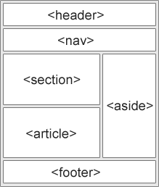
What is Semantic Markup
What Is Semantic Markup
Semantic HTML uses meaningful tags that describe the purpose of content on a webpage, enhancing accessibility, SEO, and readability by clearly conveying the structure to browsers and assistive technologies.

Slide 3
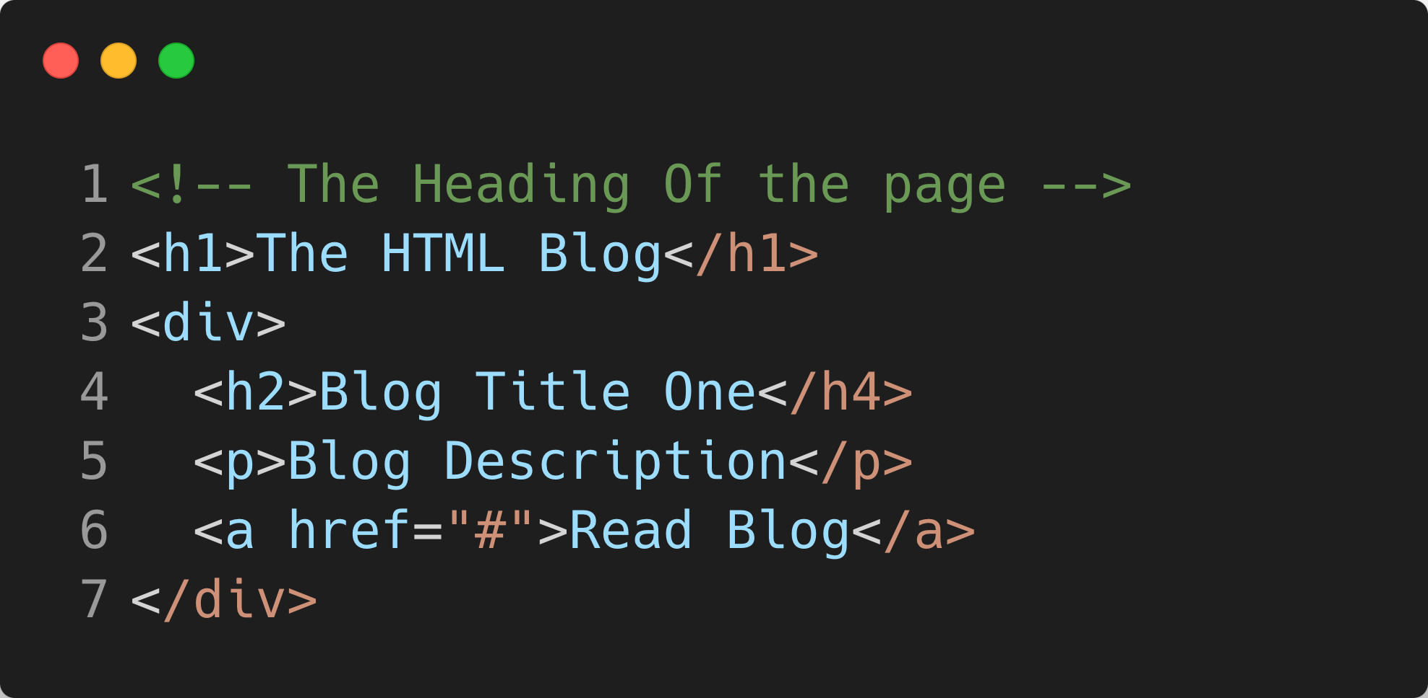
The Problem With Markup
Non-Semantic HTML Example
The HTML code lacks semantic structure, providing no meaningful information to browsers or screen readers about its content. This makes it harder for assistive technologies to interpret the page's structure and purpose.

Slide 4
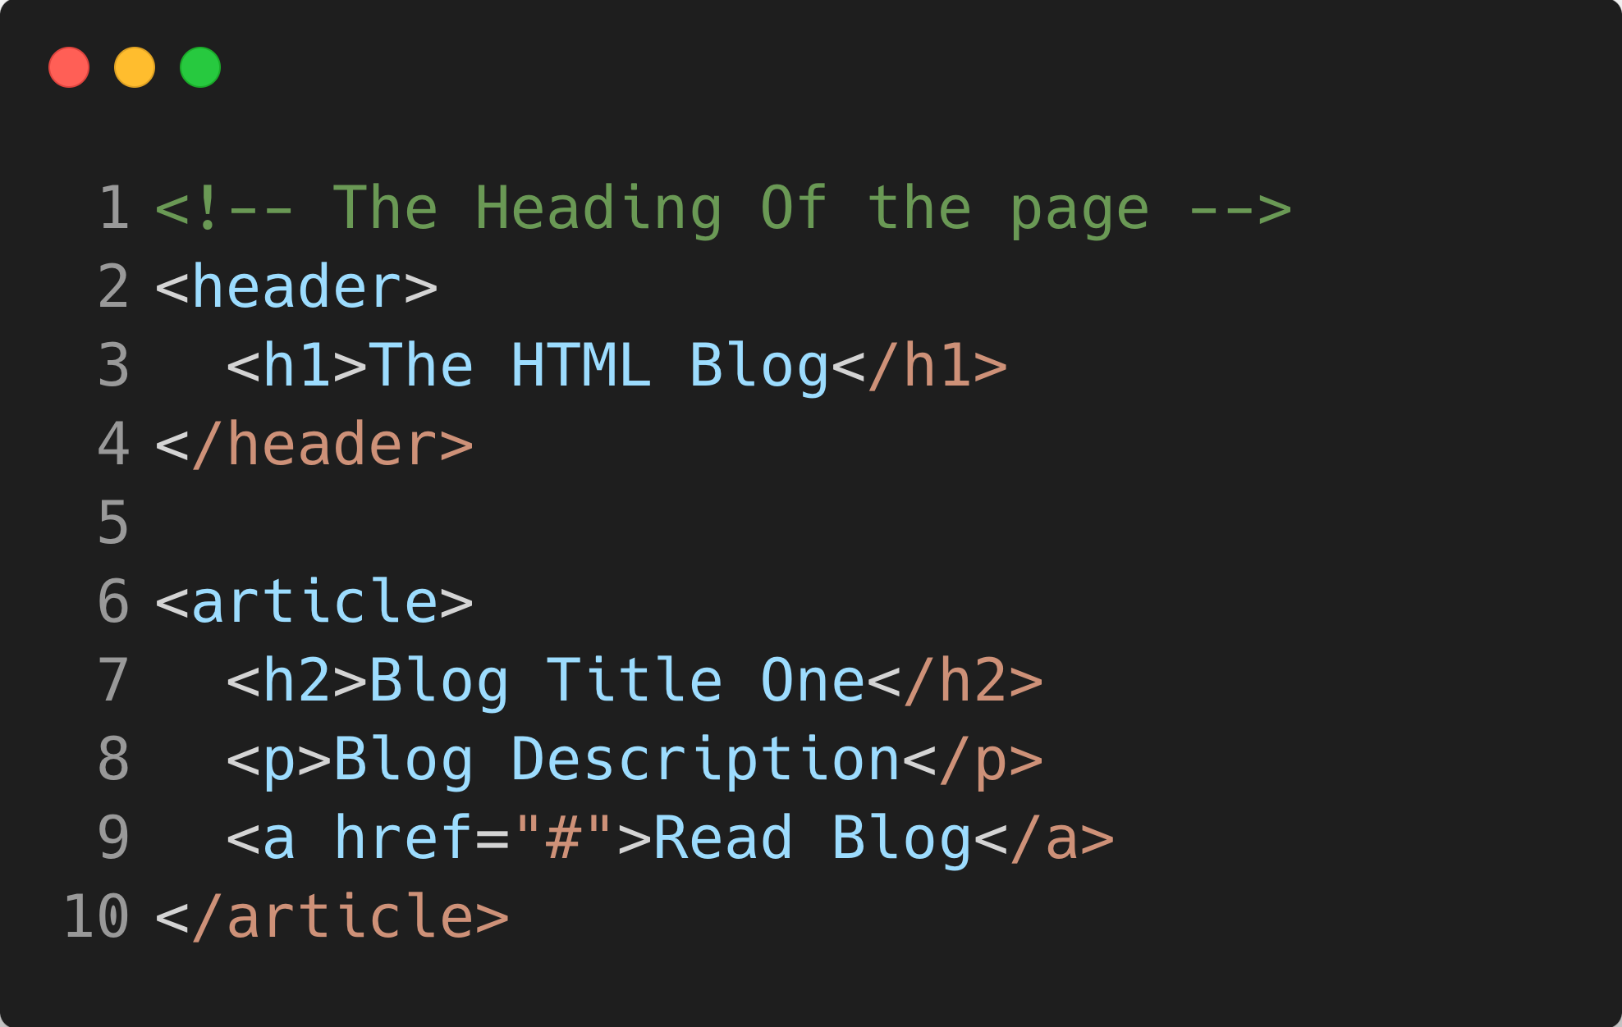
Looking at Semantic Markup
Improved Semantic HTML Structure
The code is now semantic, using <header> and <article> tags to define the structure clearly. This enhances accessibility, making it easier for screen readers to interpret, and improves SEO by giving meaningful context to the content.

Slide 5
Available Semantic Tags
<article>
<aside>
<details>
<figcaption>
<figure>
<footer>
<header>
<main>
<mark>
<nav>
<section>
<summary>
<time>

Slide 6
Available Semantic Tags
<header> - The <header> tag defines the top section of a webpage or section, typically containing titles or navigational links.
<footer> - The <footer> tag defines the bottom section of a webpage or section, typically containing copyright information, links, or disclaimers.
<nav> - The <nav> tag defines a section of navigation links, helping users and search engines understand the structure and hierarchy of the website.

Slide 7
Available Semantic Tags
<main> - The <main> tag designates the primary content of a webpage, focusing on the main topic and excluding repeated elements like headers, footers, or sidebars.
<section> - The <section> tag defines a distinct section of content within a webpage, typically grouping related content together with its own heading.
<article> - The <article> tag represents a self-contained piece of content, such as a blog post or news article, that can stand alone or be distributed independently.

Slide 8
Available Semantic Tags
<details> - The <details> tag creates a collapsible section that users can expand to view additional information, improving content organization and user interaction.
<aside> - The <aside> tag represents content related to the main content but placed separately, like sidebars, pull quotes, or related links.
<summary> - The <summary> tag provides a clickable summary or heading for a <details> element, which expands to reveal additional content when clicked.

Slide 9


Assets You Can Use
Boundary Caption
users.post.e2e-spec.ts
@Post
@Patch
Test Database
Lorem Isum Dolor Site Emite Liu Guiaugj
Definition of a Computer
A computer is an electronic device
API Endpoints

