Slide 1
Introduction To Spring Boot
Takes an opinionated view of building production-ready Spring applications. Spring Boot favors convention over configuration and is designed to get you up and running as quickly as possible.
http://projects.spring.io/spring-boot/

Slide 2
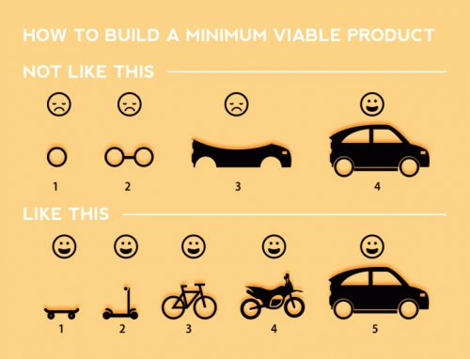

Slide 3
How did we get here?
Spring 1.0: XML configuration (DTD)
Spring 1.1: value and ref attributes
Spring 2.0: XML namespaces
Spring 2.5: @Component / @Autowired
Spring 3.0: Java configuration Spring
3.1: Profiles
Spring 3.2:
Spring 4.0: Conditional beans

Slide 4
What is Spring Boot?
Towards simpler configuration / no configuration
Takes away boilerplate configuration
Heavily opinionated
(but allows you to override opinions)
Can run with Groovy at the command line
Can build to JAR or WAR

Slide 5
Spring Boot Starters ?
Pre-Baked pom files
http://docs.spring.io/spring-boot/docs/current-SNAPSHOT/reference/htmlsingle/#using-boot-starter-poms

Slide 6
Override defaults?
application.properties / application.yml
http://docs.spring.io/spring-boot/docs/current/reference/html/common-application-properties.html

Slide 7
Actuator?
Adds production ready features such as metrics and monitoring.
http://docs.spring.io/spring-boot/docs/current-SNAPSHOT/reference/htmlsingle/#production-ready-enabling
http://localhost:8080/metrics
http://localhost:8080/beans
http://localhost:8080/mappings
http://localhost:8080/autoconfig

Slide 8
Jetty Instead Of Tomcat?
<dependency>
<groupId>org.springframework.boot</groupId>
<artifactId>spring-boot-starter-web</artifactId>
<exclusions>
<exclusion>
<groupId>org.springframework.boot</groupId>
<artifactId>spring-boot-starter-tomcat</artifactId>
</exclusion>
</exclusions>
</dependency>
<dependency>
<groupId>org.springframework.boot</groupId>
<artifactId>spring-boot-starter-jetty</artifactId>
</dependency>

Slide 9
References
http://docs.spring.io/spring-boot/docs/current-SNAPSHOT/reference/htmlsingle/#boot-documentation
http://start.spring.io/
http://www.webjars.org/
http://www.thymeleaf.org/doc/thymeleafspring.html
https://github.com/spring-projects/spring-boot/tree/master/spring-boot-autoconfigure/src/main/java/org/springframework/boot/autoconfigure

