Slide 1
Introduction To Spring Boot
Takes an opinionated view of building production-ready Spring applications. Spring Boot favors convention over configuration and is designed to get you up and running as quickly as possible.
http://projects.spring.io/spring-boot/

Slide 2
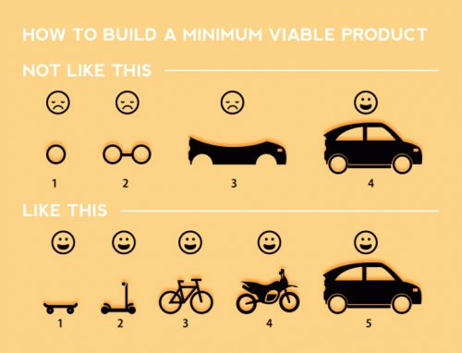

Slide 3
How did we get here?
Spring 1.0: XML configuration (DTD)
Spring 1.1: value and ref attributes
Spring 2.0: XML namespaces
Spring 2.5: @Component / @Autowired
Spring 3.0: Java configuration Spring
3.1: Profiles
Spring 3.2:
Spring 4.0: Conditional beans

Slide 4
What is Spring Boot?
Towards simpler configuration / no configuration
Convention over Configuration
Takes away boilerplate configuration
Heavily opinionated
(but allows you to override opinions)
Automatic configuration
Can run with Groovy at the command line
Can build to JAR or WAR
Production ready features for monitoring and metrics

Slide 5
Spring Boot Starters ?
Pre-Baked pom files
http://docs.spring.io/spring-boot/docs/current-SNAPSHOT/reference/htmlsingle/#using-boot-starter-poms

Slide 6
AutoConfiguration ?
@EnableAutoConfiguration
@ConditionalOnClass
@ConditionalOnBean
@ConditionalOnExpression
@Configuration
@ConditionalOnClass({ MBeanExporter.class })
@ConditionalOnMissingBean({ MBeanExporter.class })
https://github.com/spring-projects/spring-boot/tree/master/spring-boot-autoconfigure/src/main/java/org/springframework/boot/autoconfigure

Slide 7
Override defaults?
application.properties / application.yml
http://docs.spring.io/spring-boot/docs/current/reference/html/common-application-properties.html

Slide 8
Actuator?
Adds production ready features such as metrics and monitoring.
http://docs.spring.io/spring-boot/docs/current-SNAPSHOT/reference/htmlsingle/#production-ready-enabling
http://localhost:8080/metrics
http://localhost:8080/beans
http://localhost:8080/mappings
http://localhost:8080/autoconfig

Slide 9
Jetty Instead Of Tomcat?
<dependency>
<groupId>org.springframework.boot</groupId>
<artifactId>spring-boot-starter-web</artifactId>
<exclusions>
<exclusion>
<groupId>org.springframework.boot</groupId>
<artifactId>spring-boot-starter-tomcat</artifactId>
</exclusion>
</exclusions>
</dependency>
<dependency>
<groupId>org.springframework.boot</groupId>
<artifactId>spring-boot-starter-jetty</artifactId>
</dependency>

Slide 10
Are we using boot?
//OpenPlatform/services/GenericToolsService/trunk/modules/WebsitesDomainService/
//ProfessionalServices/FeedParsers/IOMOffersParser-v1

Slide 11
References
http://docs.spring.io/spring-boot/docs/current-SNAPSHOT/reference/htmlsingle/#boot-documentation
http://start.spring.io/
http://spring.io/guides
http://www.webjars.org/
http://www.thymeleaf.org/doc/thymeleafspring.html
https://github.com/spring-projects/spring-boot/tree/master/spring-boot-autoconfigure/src/main/java/org/springframework/boot/autoconfigure

