Slide 1

Seasonal Agriculture Performance Analysis
KONDETI PALLAVI
CMR TECHNICAL CAMPUS
AICTE STU ID:STU6580023cd8f631702887996

Slide 2

PROBLEM STATEMENT
Agricultural activities are influenced by seasonal variations in environmental conditions, farming practices, resource availability and market conditions. As a result, agricultural performance may differ from one season to another. However, raw agricultural data does not clearly explain how agricultural performance changes across seasons or what patterns can be observed in different seasonal conditions. The problem is to analyze the given agricultural dataset and investigate seasonal differences in agricultural performance by identifying meaningful patterns, trends, relationships and variations within the available data.

Slide 3
Project Description
This project studies seasonal patterns in Indian agriculture using a dataset of 4,000 farm records spanning 8 states, 8 crops, and 4 irrigation types. The core focus is on whether farm performance actually differs between the Kharif, Rabi, and Zaid seasons, and how.
To find out, the data was cleaned and analyzed in Python (Pandas, Seaborn, Matplotlib, SciPy) inside Google Colab. The analysis looks at weather conditions, water and fertilizer use, crop yields, disease/pest risk, and profitability across each season and each state, then runs a statistical test (one-way ANOVA) to check whether the seasonal yield gaps are real or just random noise.
The end result is a set of practical, data-backed conclusions about which seasons perform best, where the risks are highest, and how that could inform smarter seasonal planning for farmers and policymakers.

Slide 4

WHO ARE THE END USERS?
Farmers & farming cooperatives — to plan crop and irrigation choices by season.
Agricultural extension officers — to advise farmers on season-specific best practices.
State agriculture departments — to plan resource allocation and subsidies regionally.
Agri-finance & insurance providers — to assess seasonal risk when pricing loans/insurance.
Researchers & agri-tech startups — to build on the seasonal patterns for further modeling.

Slide 5

Technology Used
  Python — core language for data analysis
  Pandas & NumPy — data cleaning, aggregation, pivot tables
  Matplotlib & Seaborn — visualizations (boxplots, heatmaps, bar charts)
  SciPy — ANOVA significance testing
  Google Colab — development & documentation environment

Slide 6
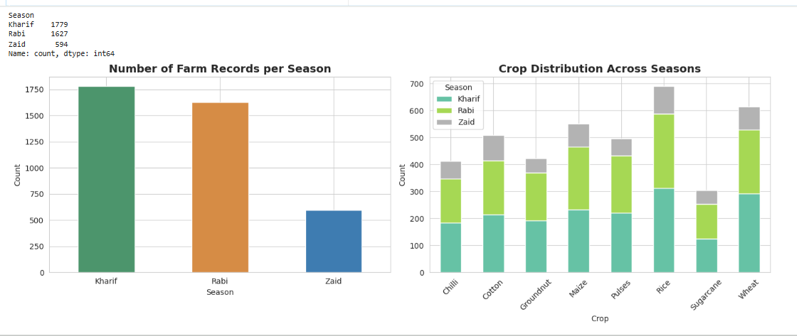
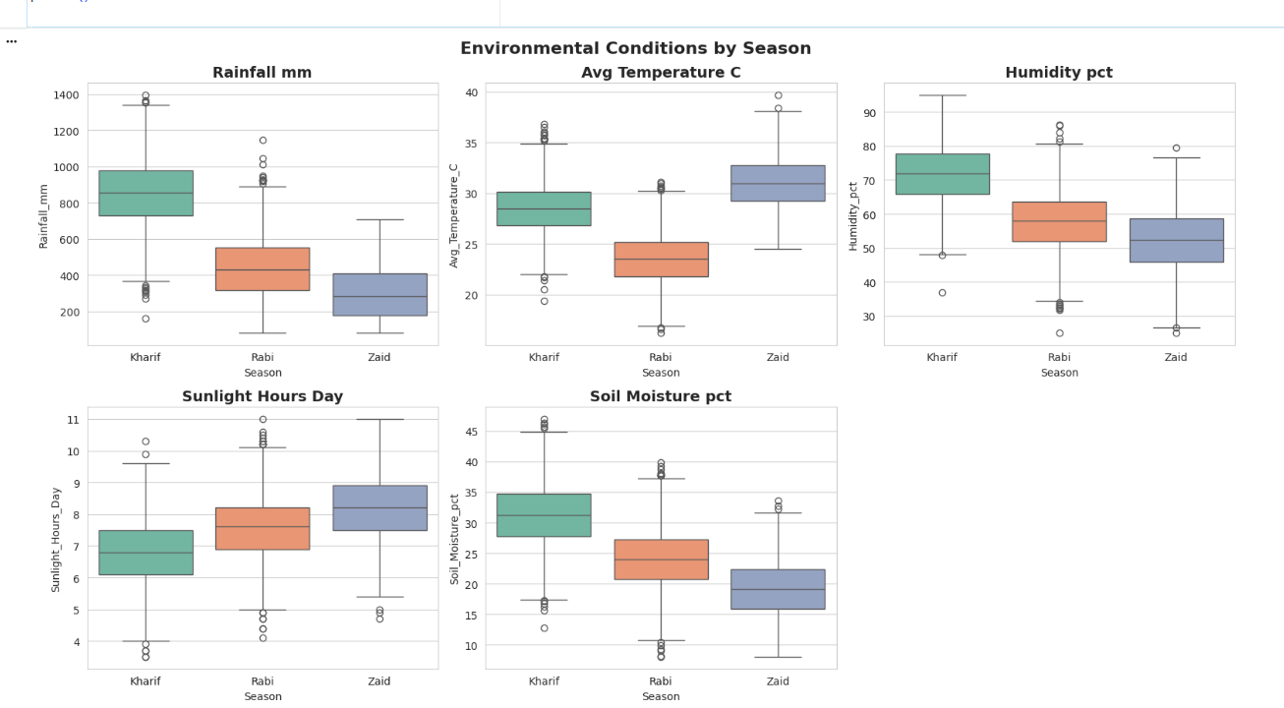
RESULTS

Slide 7
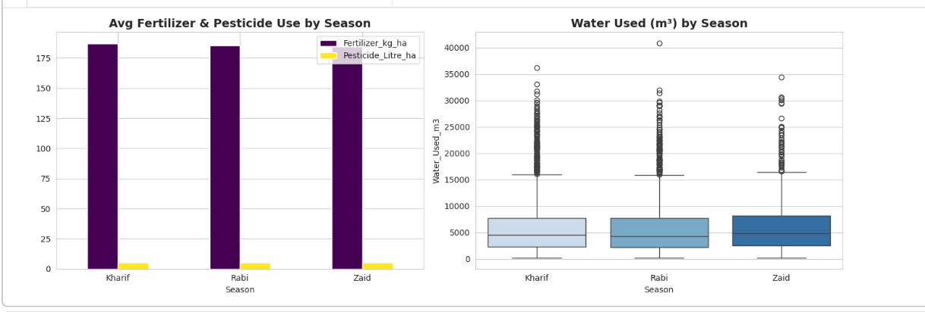
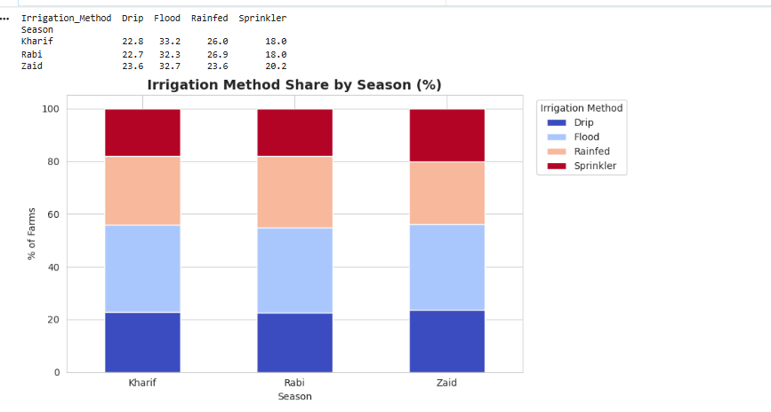
RESULTS

Slide 8
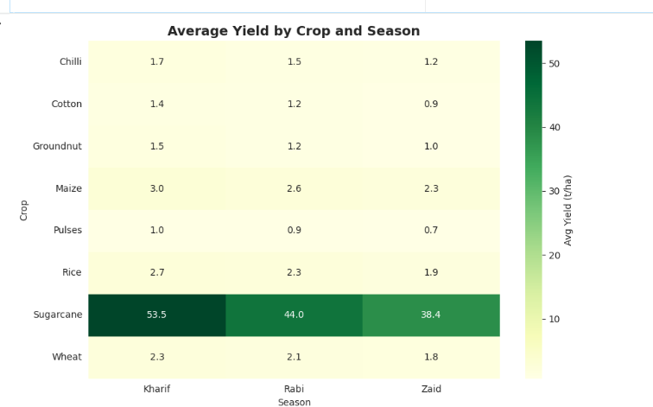
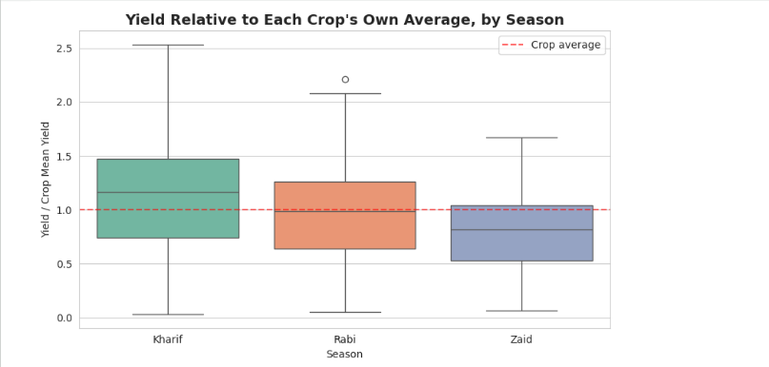
RESULTS

Slide 9
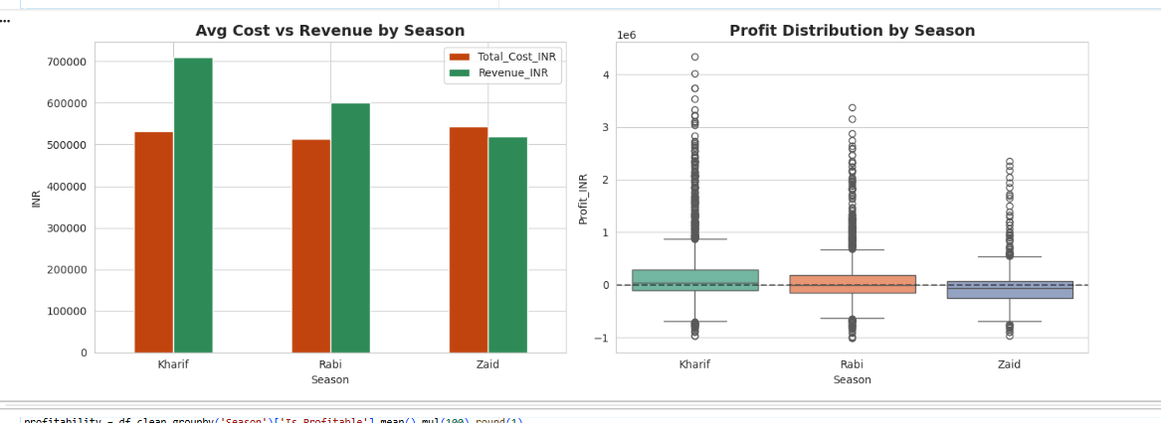
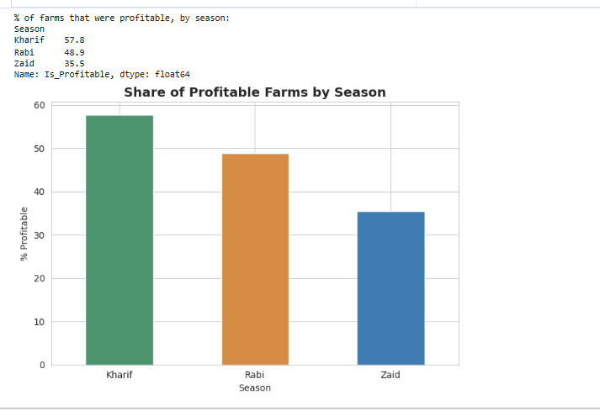
RESULTS

Slide 10
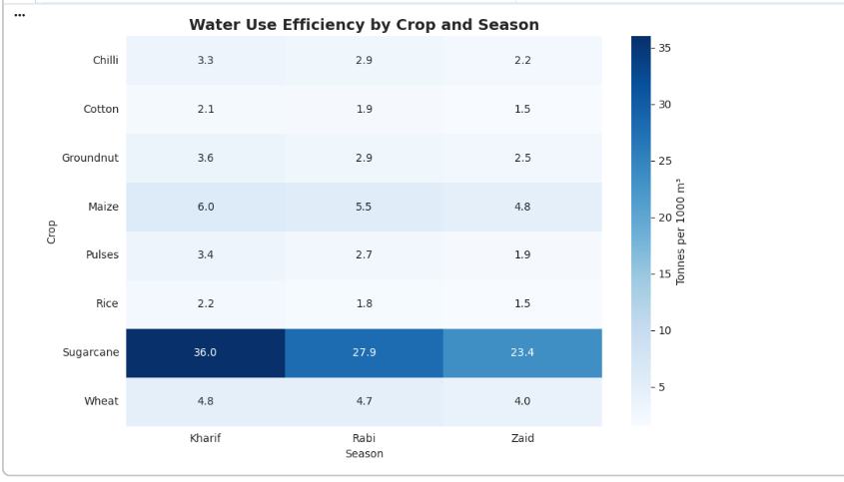
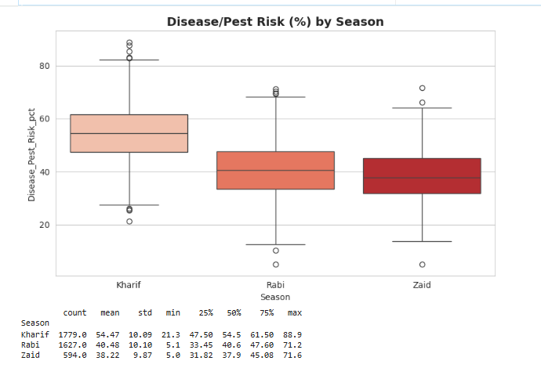
RESULTS

Slide 11
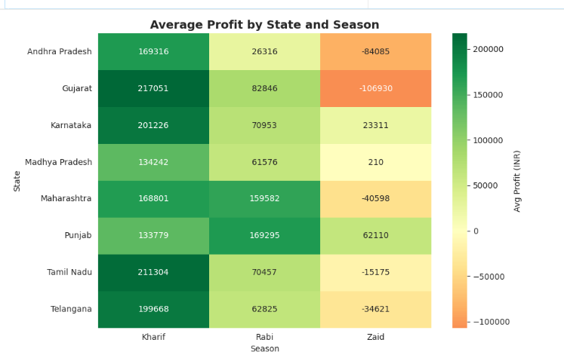
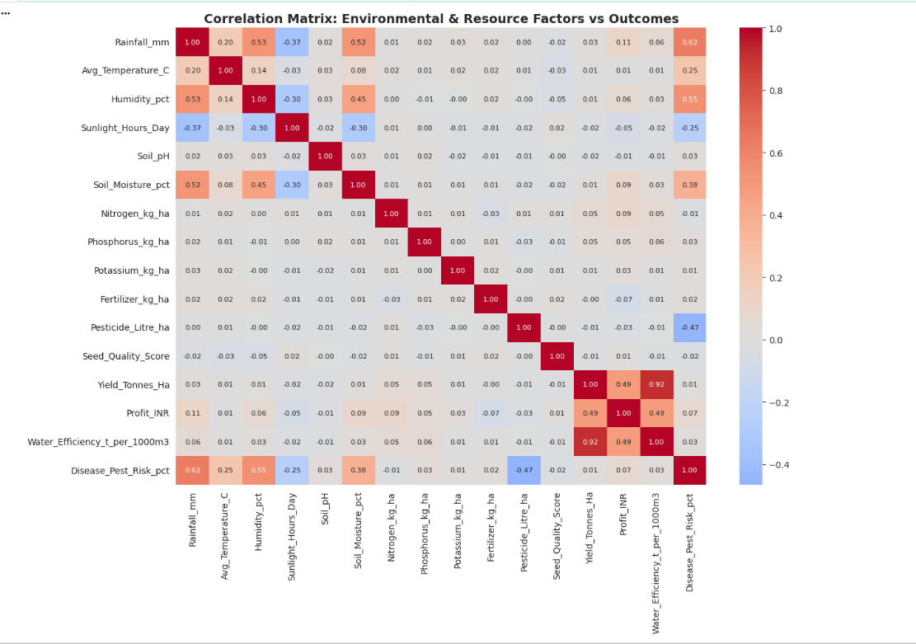
RESULTS

Slide 12
Future scope
▪ Incorporate real-time weather/satellite data for live seasonal forecasting.
▪ Build a predictive model to estimate yield and profit before a season starts.
▪ Extend the dataset to more states/districts for finer regional recommendations.
▪ Develop a dashboard for farmers/officers to compare seasonal strategies interactively.
▪ Study the root causes of the high share of loss-making farms to guide interventions.

Slide 13
GitHub Link
https://github.com/kondetipallavi/Seasonal-Agriculture-Performance-Analysis
Google colab Link:
https://colab.research.google.com/drive/1IfijytwTNn5hz0888AtQC3lly9Uz0gWv?usp=sharing

Slide 14
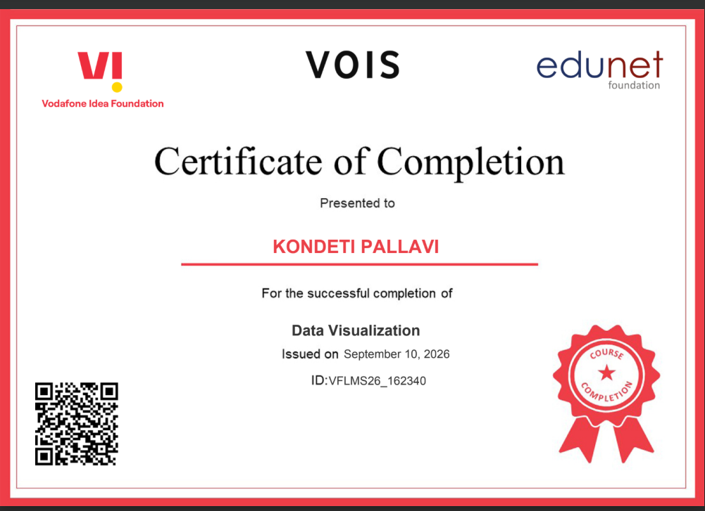
VOIS Course completion certificate - Course name- Data Visualization

Slide 15
Thank you
.
.

