Slide 1

AI Data Platform - AskDB
From Natural Language Questions to Actionable Business Insights

Slide 2

Agenda
Business Problem
Our Solution
Solution Framework
Implementation Framework
Key Features & Comparison
Live Demo / Use Cases
Future Roadmap

Slide 3
Business Problem
Current Workflow
Current Problems
Business problem
Analyst
Answer
SQL
Dashboard
“I don’t know how to use SQL”
“…oh! Are there multiple sources of truth?”
“…Data team, when will I get my answers”, “How long will you take?”
Leadership Layer
Analyst/DE
“I don’t know what you mean by FTR, pls explain”
“This is too much to process, can’t manage alone”
“Hey… I got the same request from another business analyst”
Turn around time

Slide 4




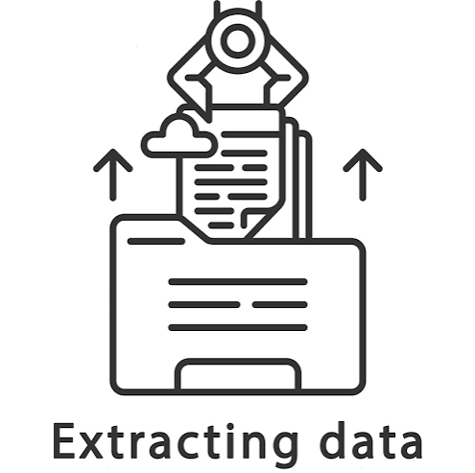

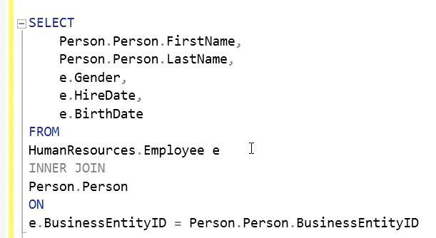
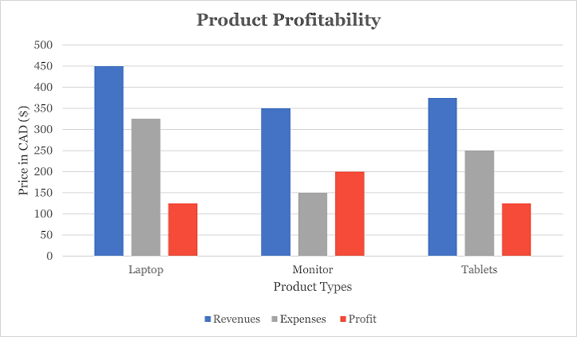


Our Solution
Enable Natural Language Access to Enterprise Data and Insights
Question
Semantic
Understand
Query
Planning
Retrieve Data
Validate SQL
Generate SQL
Show results
Analyse
Summarise

Slide 5
Our Solution
Enable Natural Language Access to Enterprise Data and Insights
Semantic Layer
Use
User
SQL
Chat UI
Query Brain
Duck DB
Result
Narration
Answer

Slide 6
How User Questions Become Business Insights
User Layer
Intelligence Layer
Execution and Cache Layer
Data Layer
Visualization Layer
Query Cache Check
Business Semantic Model Creation
Semantic Model Lookup
Results & Charts
Fetch Cached SQL
Generate SQL
Natural Language Question
Model Update
Semantic Model Update
AI Analysis
SQL Generation + Metadata Enrichment
SQL Generation + Metadata Enrichment
Retry & Self-Heal
SQL Generation + Metadata Enrichment
Insights

Slide 7
Solution Framework
User Intent → Semantic Layer → SQL Engine → Insight
💬
📂
⚙️
Natural Language Query
Multi-format Data Upload
Config JSON Loader
INPUT LAYER
→
→
User asks in plain English
CSV · Excel · JSON · Parquet
Industry/domain config
⬇
⬇
⬇
🔗
📐
🧠
🛡️
SEMANTIC LAYER
Auto-Join Engine
Schema Analyser
LLM Orchestrator
SQL Guardrail Layer
→
→
→
Score-based multi-pass
Rich column metadata
GPT-4o · LangChain
Blocks DDL/DML ops
⬇
⬇
⬇
⚡
🔄
🗄️
EXECUTION LAYER
DuckDB Engine
Retry & Self-Heal
Query Cache
→
→
In-process SQL runtime
Auto-corrects failed SQL
Session-level memory
⬇
⬇
⬇
📊
🔢
🔬
💡
PRESENTATION LAYER
Plotly Charts
KPI Dashboard
DQ Intelligence
AI Insights
→
→
→
Auto chart selection
Executive metrics
Statistical health check
Summary · Facts · Reco
TECH STACK:
Python 3.11
Streamlit
DuckDB
LangChain
OpenAI GPT-4o
Pandas
Plotly
DotEnv
NumPy
Regex

Slide 8


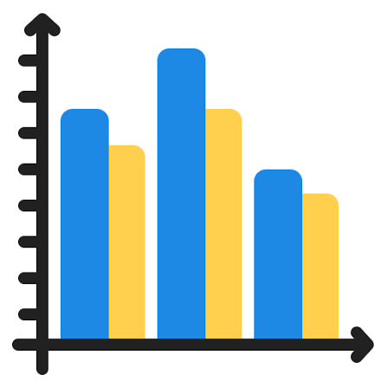




Implementation Approach
Data and AI interaction
Presentation Layer
Yes
Read SQL query from Cache
Processing Layer
Answered Ques?
Create/ Update Semantic Model
Final SQL Query
Extract Metadata
Ask Question
AI Payload prep
Self heal SQL Query
Results & Charts
Insights
No
AI Layer
Database Layer

Slide 9
Key Features
Intent Recognition
Understands 'top performers' means ORDER BY revenue DESC LIMIT 10 - not literal keyword match
🔍
💬
Follow-up Memory
Session memory enriches short follow-up questions - 'show only Ford' builds on previous query
Schema-Aware Context
Injects column types, value ranges and top-values into prompt - LLM knows your data before answering
📐
🛡️
SQL Guard Rails
Only SELECT statements are passed, no DDL statements allowed. (ALTER, DELETE, TRUNCATE etc)
Auto Relationship Discovery
Detects foreign key relationships across tables using normalized name + value overlap scoring
🔗
📊
KPI Dashboard
Auto detects revenue, YoY, Volume, sales columns and build KPI based on underlying data ready for review once file uploaded
Self-Healing SQL
When generated SQL fails, LLM auto-corrects with the error message — no manual intervention
🔄
🔬
Data Quality Intelligence
Performs automated data quality checks covering nulls, duplicates, outliers, type mismatches, cardinality issues, and date-gap validation.
Config-Driven Domain
JSON config maps domain terms: 'revenue' - actual column name per industry/client deployment
⚙️
🌐
Smart Auto Join
Uses a multi-pass join engine to intelligently detect column relationships and automatically map star and snowflake schemas.

Slide 10

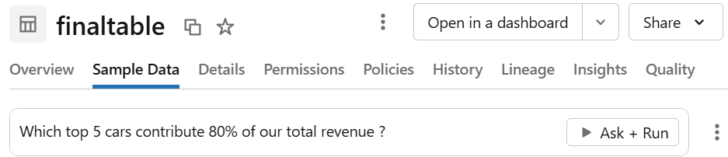
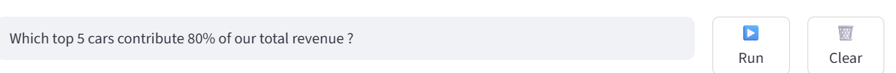
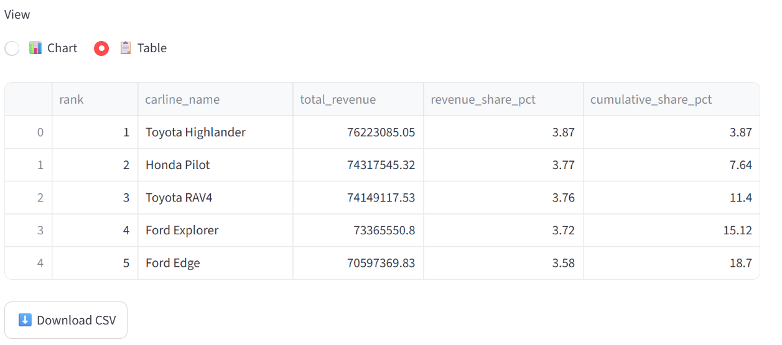
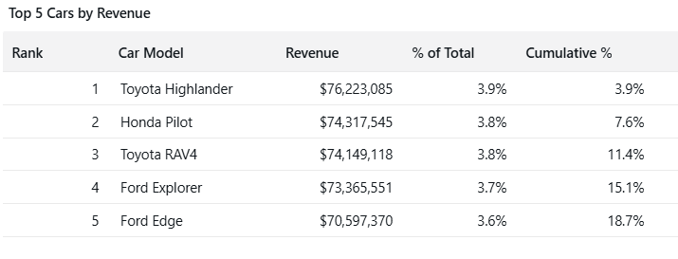
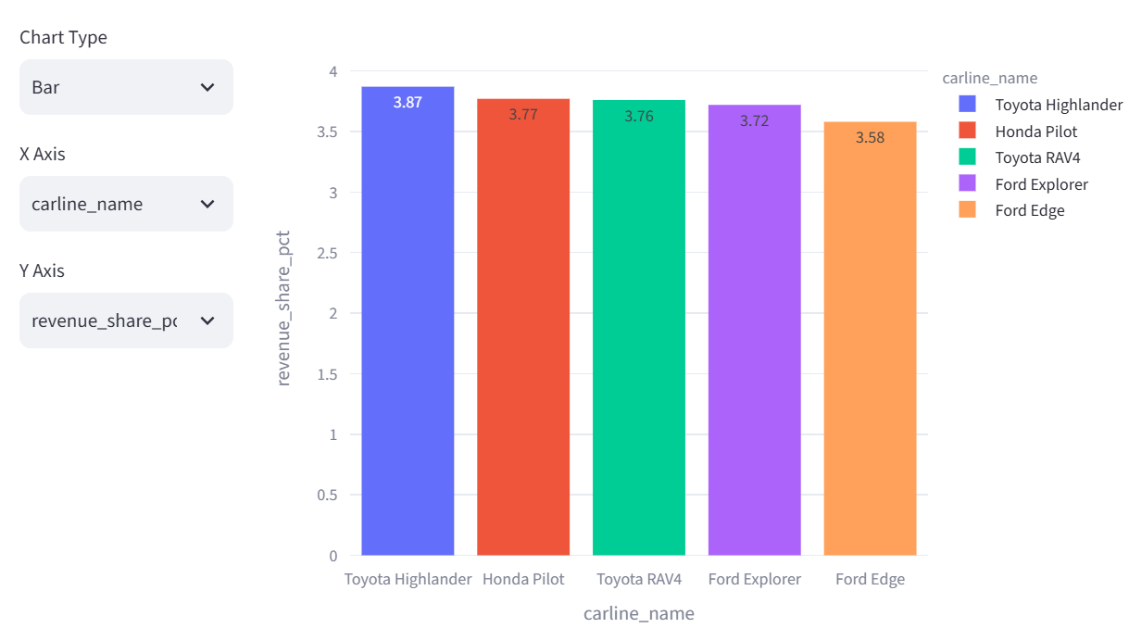
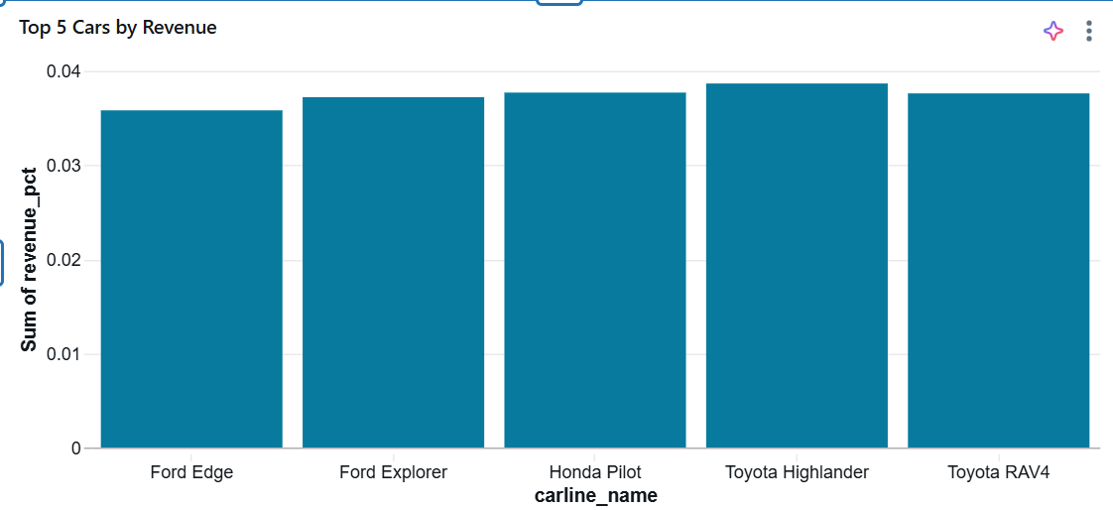
Databricks Genie vs AskDB
Databricks Genie
AskDB

Slide 11
Demo Link
Databricks Geni Demo Link
AskDB Link
Click here for Link
Click here for Link

Slide 12

Future Roadmap
Cloud Integrations
Auto Anomaly Detection
Deployment compatibility for AWS, Azure & GCP
Post ingestion, automatically define the quality of the input data
Query Optimization Layer/Agents
Connectors (DB & Other GPT)
Cost estimation, Materialized view for recurring queries
Multiple AI Agents
Connectors for other external databases like SQL, Oracle etc
Options to use other GPT clients like Claude, copilot etc
Vector Based Schema retrieval
Different agents for planner, SQL, Analysis, Visualization
Send only limited schema based on the user questions

Slide 13

Questions?

Slide 15
AI Data Platform vs Databricks Genie
Feature / Parameter
🚀 AI Data Platform
🧱 Databricks Genie
Deployment
Any SQL Warehouse
Databricks workspace only
Database Compatibility
Any SQL-based DB
Databricks Delta Lake only
Setup Cost
Open-source · Zero licence
Databricks subscription
Natural Language to SQL
✅ Any LLM powered
✅ Built-in Genie AI
Schema Auto-Detection
✅ Rich column metadata
✅ Unity Catalog
Multi-Table Auto-Join
✅ Score-based engine
⚠️ Manual config required
SQL Guardrails
✅ Regex + LLM validation
⚠️ Limited
Industry Config (JSON)
✅ Fully configurable
❌ Not supported
Data Quality Intelligence (Beta)
✅ Built-in DQ engine
❌ Separate tool needed
KPI Auto-Detection
✅ Column-pattern based
⚠️ Manual dashboard build
Self-Healing SQL Retry
✅ Auto LLM retry
❌ Manual re-prompt
Session Memory
✅ Follow-up awareness
✅ Supported
Deployment on ADLS/Azure
✅ Native support
⚠️ Via Databricks only
Open Source Customisable
✅ Fully extensible Python
❌ Proprietary platform
PII Masking (Roadmap)
🔜 Next version
⚠️ Enterprise add-on
Capgemini AI Data Platform | Confidential
7 / 12

