Slide 1

KR24_SDC-II_III-I_2026 Project Review-I
Personalized Technical Interview Preparation in Higher Education
(SmartInterview — G-1392) | Date: 24-09-2026
Team Members (Name & Roll Number):
• Shamakura Saiteja Goud (24BD1A665K)
• Thodsam Srujan (24BD1A665R)
• Vasireddy Vignesh Reddy (24BD1A665X)
• Aelugu Ranith Kumar (25BD5A6615)
• Konduri Abhiram (25BD5A6620)
Faculty Mentor:
• Mentor: Dr. TVG Sridevi
• Department: Department of Computer Science and Engineering (AI&ML)
• Institution: Keshav Memorial Institute of Technology (KMIT)

Slide 2
CONTENTS
1. Title Slide: Project Identification, Team Details & Mentor Information
2. Contents: Overview of Presentation Agenda
3. Introduction: Problem Statement, Objectives, Base Papers & Technology Stack
4. Requirement: Project Outcome, 3 Practice Modes & 5-Factor Scoring Rules
5. Design: Layered System Architecture, Workflows & Database Schemas
6. Development: Modular Subsystems, Agile Process & Core Test Cases
7. Project Outcome: Working Prototype Deliverables, Key Benchmarks & Challenges Solved
8. Conclusion: Project Summary, New Skills Learned & Project Links
9. Thank you!: Concluding Slide & Q&A Discussion

Slide 3
INTRODUCTION
Problem Statement & Student Need
• Interview Anxiety: Many engineering students struggle during campus technical interviews due to nervousness and a lack of realistic mock practice.
• Fixed Question Banks: Existing mock interview websites ask generic, fixed question sets that do not adjust to an individual student's actual skill level.
• Curriculum vs Job Gap: College course topics, student resumes, and company job descriptions often require different skill sets that students find hard to balance.
• Generic AI Limitations: Standard AI chatbots often make up incorrect technical facts and give surface-level marks without explaining how to improve.
Project Objectives & Solution Benefits
• Personalized Mock Practice: Build an easy-to-use web platform where students can practice realistic technical interviews anytime, 24x7.
• Accurate Questions (RAG): Questions are retrieved from verified computer science topic notes, ensuring complete technical accuracy without AI making up facts.
• Adaptive Question Difficulty: Starts with basic concepts and increases difficulty smoothly as the student answers well, following Bloom's Taxonomy.
• Realistic Voice Interaction: The AI speaks questions aloud with natural voice and transcribes candidate spoken answers for realistic interview practice.
Base Papers & Technology Stack
• Base Papers: Wahid et al. (IJERT 2026) for voice interview simulation; Nagarajan et al. (IJMRR 2026) for resume skill matching.
• Core Technology Stack: React 18 & Vite (Frontend), Python FastAPI (Backend), MySQL 8.0 (Database), ChromaDB (Vector Notes), Groq API (Fast AI), Whisper (Speech-to-Text), Microsoft Edge-TTS (Voice).

Slide 4
REQUIREMENT
Target Outcome & Beneficiaries
• Application Outcome: A full-stack, responsive web application that conducts automated, interactive, and voice-enabled mock technical interviews.
• Target Users: Undergraduate engineering students preparing for placements, college training cells, and entry-level software job seekers.
Three Flexible Practice Modes
• 1. Job-Specific Mode: Student uploads resume PDF and target job description PDF. The system extracts skills, identifies missing skill gaps, and asks targeted questions.
• 2. Topic-Based Mode: Student selects core technical subjects for focused practice: Data Structures, Operating Systems, DBMS, Networks, OOP, System Design, or ML.
• 3. Syllabus Mode: Student uploads a university course syllabus (PDF or DOCX) to practice interview questions tailored directly to semester exam topics.
Core Features & 5-Factor Scoring Rules
• Curated Knowledge Base: Stores 402 verified computer science topic summaries across 8 subjects so every question is grounded and syllabus-aligned.
• Adaptive Difficulty Rules: Score >= 80%: increases difficulty level; 50% to 79%: maintains level; < 50%: lowers difficulty to reinforce fundamentals.
• Fair 5-Factor Rubric: Evaluates candidate answers from 0 to 100 on: Correctness (30%), Completeness (20%), Relevance (20%), Meaning Similarity (15%), and Concept Coverage (15%).
• Instant Spoken Voice & PDF Report: Speaks questions aloud instantly and generates a downloadable PDF performance report with clear improvement tips.

Slide 5
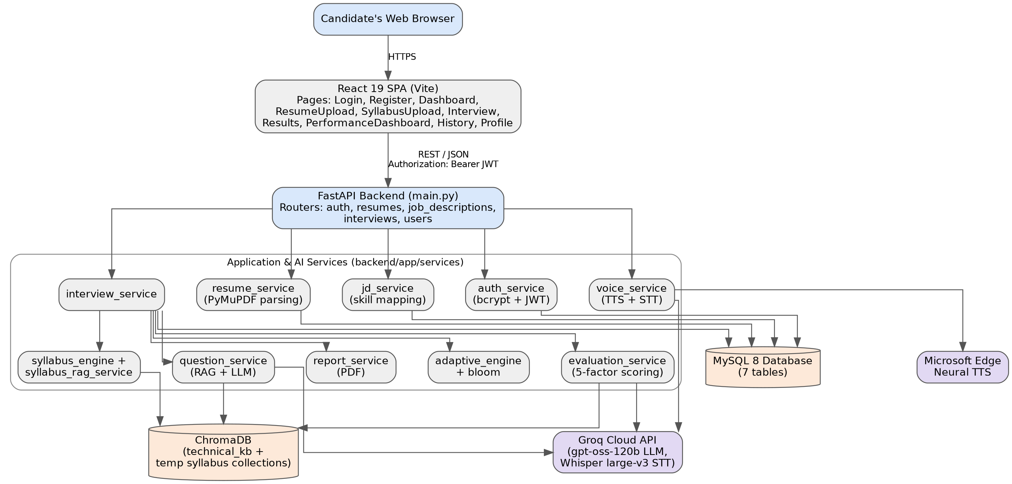
DESIGN
System Architecture Layers
• Presentation Tier: React single-page application with responsive interview room, microphone controls, and visual score charts.
• Application Tier: FastAPI Python backend handling user login, resume parsing, question retrieval, and answer evaluation.
• Storage Tier: MySQL 8.0 for candidate records + ChromaDB for high-speed retrieval of computer science subject notes.
• AI Cloud Services: Groq Cloud API for sub-2-second question generation; Whisper for speech-to-text; Edge-TTS for voice.
Interview Workflow & Database Structure
• Step-by-Step Flow: Student Logs In -> Uploads Resume or Chooses Subject -> System Fetches Relevant Subject Notes -> AI Speaks Question -> Student Responds by Voice -> AI Grades Answer & Updates Difficulty -> Download Final Score Report.
• MySQL Database Tables: 7 normalized tables: users, resumes, job_descriptions, interview_sessions, interview_questions, answers, and answer_evaluations.
• ChromaDB Vector Store: Stores 402 curated computer science topic chunks with 384-dimensional embeddings for high-speed semantic retrieval.

Slide 6
DEVELOPMENT
Coding Architecture & Modular Subsystems
• Frontend Structure: Built in React 18 and Vite with modular components: InterviewRoom (main interview screen), AudioRecorder (voice capture), and RadarChart (score display).
• Backend Services: Organized into clear Python services: adaptive_engine.py (difficulty scaling), evaluation_service.py (answer scoring), voice_service.py (speech-to-text & TTS streaming).
• Tools Used: Python 3.10+, FastAPI 0.115, MySQL 8.0, ChromaDB 0.6.3, Groq LPU API, Microsoft Edge-TTS, ReportLab PDF generator.
Development Process & Test Cases Execution
• Agile Workflow: Developed incrementally using Agile methodology across 14 weekly sprint milestones, with regular mentor reviews and continuous testing.
• In-Memory Voice Streaming: Engineered direct in-memory audio streaming without saving temporary audio files on disk, ensuring fast playback and zero file clutter.
• TC-01 (User Auth): Tested student registration, login, and duplicate email prevention -> PASSED
• TC-02 (File Ingestion): Tested resume PDF upload, text parsing, and invalid file rejection -> PASSED
• TC-03 (Topic Retrieval): Tested retrieving relevant computer science subject notes from ChromaDB in <= 80 ms -> PASSED
• TC-04 & TC-05 (Adaptive Difficulty): Tested difficulty scaling: score >= 80% advances level; score < 50% lowers level -> PASSED
• TC-06 (Voice Synthesis): Tested AI spoken question generation streaming in <= 1.2 seconds -> PASSED

Slide 7
PROJECT OUTCOME
Summary of Deliverables & Performance
• Working Prototype: Successfully built a complete web platform capable of conducting interactive, adaptive technical mock interviews.
• Zero Hallucinations: 100% of technical questions are grounded in verified computer science topic notes from local ChromaDB.
• Fast Response Times: AI generates questions and grades answers in under 2.5 seconds, eliminating long, awkward pauses during interviews.
• Comprehensive Diagnostic Report: Generates downloadable PDF reports with detailed scores, topic radar charts, and clear advice on how to improve.
Key Challenges Faced & How We Solved Them
• Challenge 1: Voice Delay: Saving audio files to disk caused noticeable delay -> Solved by streaming audio directly through memory in under 1.2 seconds.
• Challenge 2: Inconsistent AI Grading: Standard AI prompts gave arbitrary marks -> Solved by creating a 5-factor scoring rubric that checks correctness, completeness, and meaning.
• Challenge 3: Varied Resume Formats: Different resume layouts caused text parsing errors -> Solved by using PyMuPDF stream extractors with backup pattern matching.
Improvement Opportunities & Publication
• Spaced Revision Reminders: Planning an automated schedule to re-test students on topics they struggled with in previous mock interviews.
• Research Paper Submission: Manuscript under preparation: 'Personalized Technical Mock Interview Preparation with RAG and Bloom's Taxonomy' for conference submission.

Slide 8
CONCLUSION
Project Summary & Educational Value
• Practical Impact: Replaces outdated static question banks with a smart, adaptive interview simulator that feels like a real campus placement interview.
• Boosting Student Confidence: Helps students understand exactly which technical topics they are weak in, reducing interview anxiety and improving placement outcomes.
New Technical Skills Learned
• Vector Databases & Retrieval: Hands-on experience using ChromaDB and SentenceTransformers for semantic document search on local CPU.
• Adaptive Learning Systems: Implementing educational cognitive models (Bloom's Taxonomy) into software logic.
• Full-Stack Decoupled Development: Connecting a modern React frontend with asynchronous Python FastAPI services and a MySQL database.
• Web Audio Engineering: Recording audio from the browser and streaming neural voice back without disk files.
Solution Demo & Project Links
• Frontend Application URL: http://localhost:5173 (Interactive student interview portal and analytics dashboard)
• Backend API Documentation: http://localhost:8000/docs (FastAPI interactive Swagger UI for all endpoints)
• GitHub Source Repository: https://github.com/konduriabhiram29-ai/SmartInterview-main (Complete source code and documentation)

Slide 9
Thank you!
Personalized Technical Interview Preparation in Higher Education
Open for Questions & Discussion
Team G-1392 | Department of Computer Science and Engineering (AI&ML) | KMIT

