Slide 1
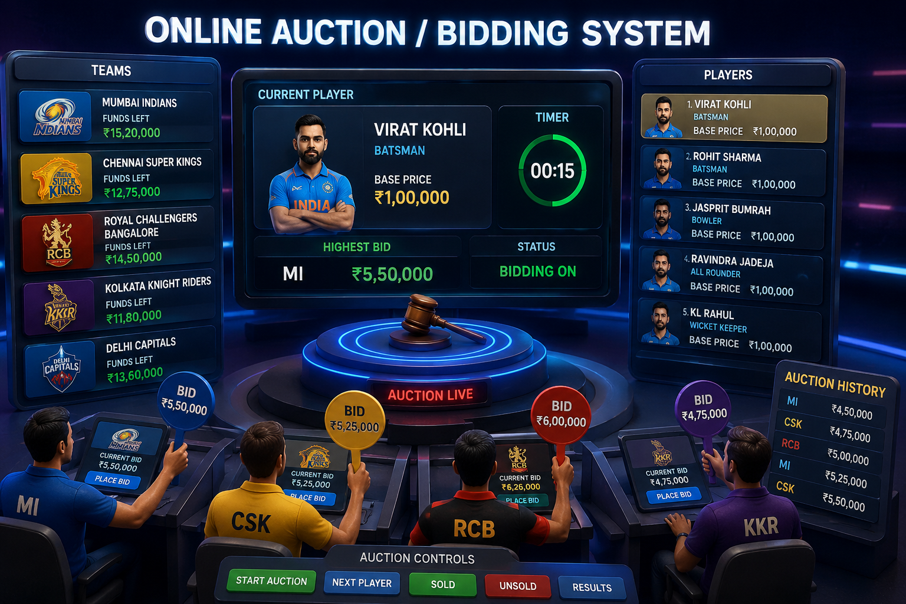

Slide 2
Problem Statement Traditional cricket player auctions are often managed manually, making the process time-consuming, difficult to track, and prone to errors. Maintaining player records, team selections, bid amounts, and auction results manually can lead to data inconsistency and reduced efficiency. To overcome these challenges, an Online Auction/Bidding System is developed that automates the player auction process by providing a user-friendly graphical interface for managing teams, players, bids, and auction results.

Slide 3
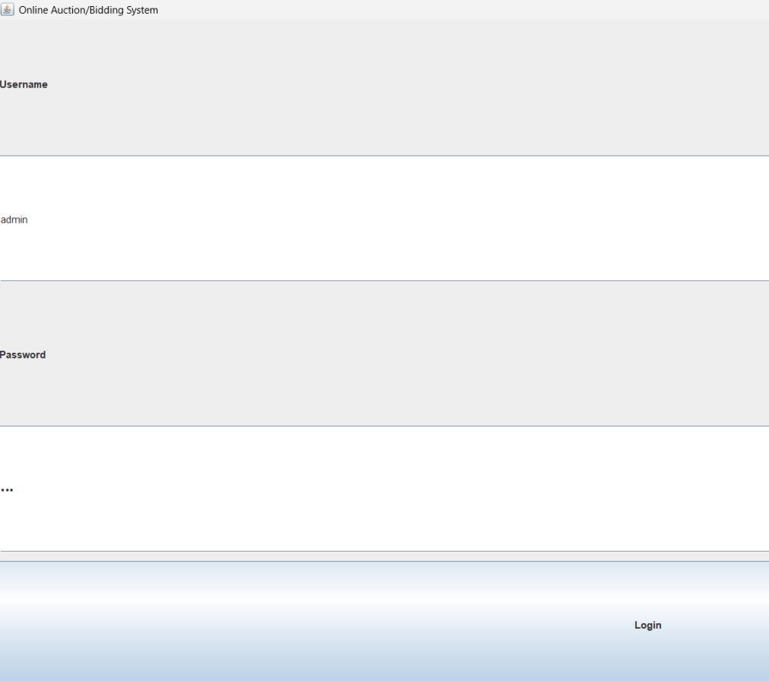
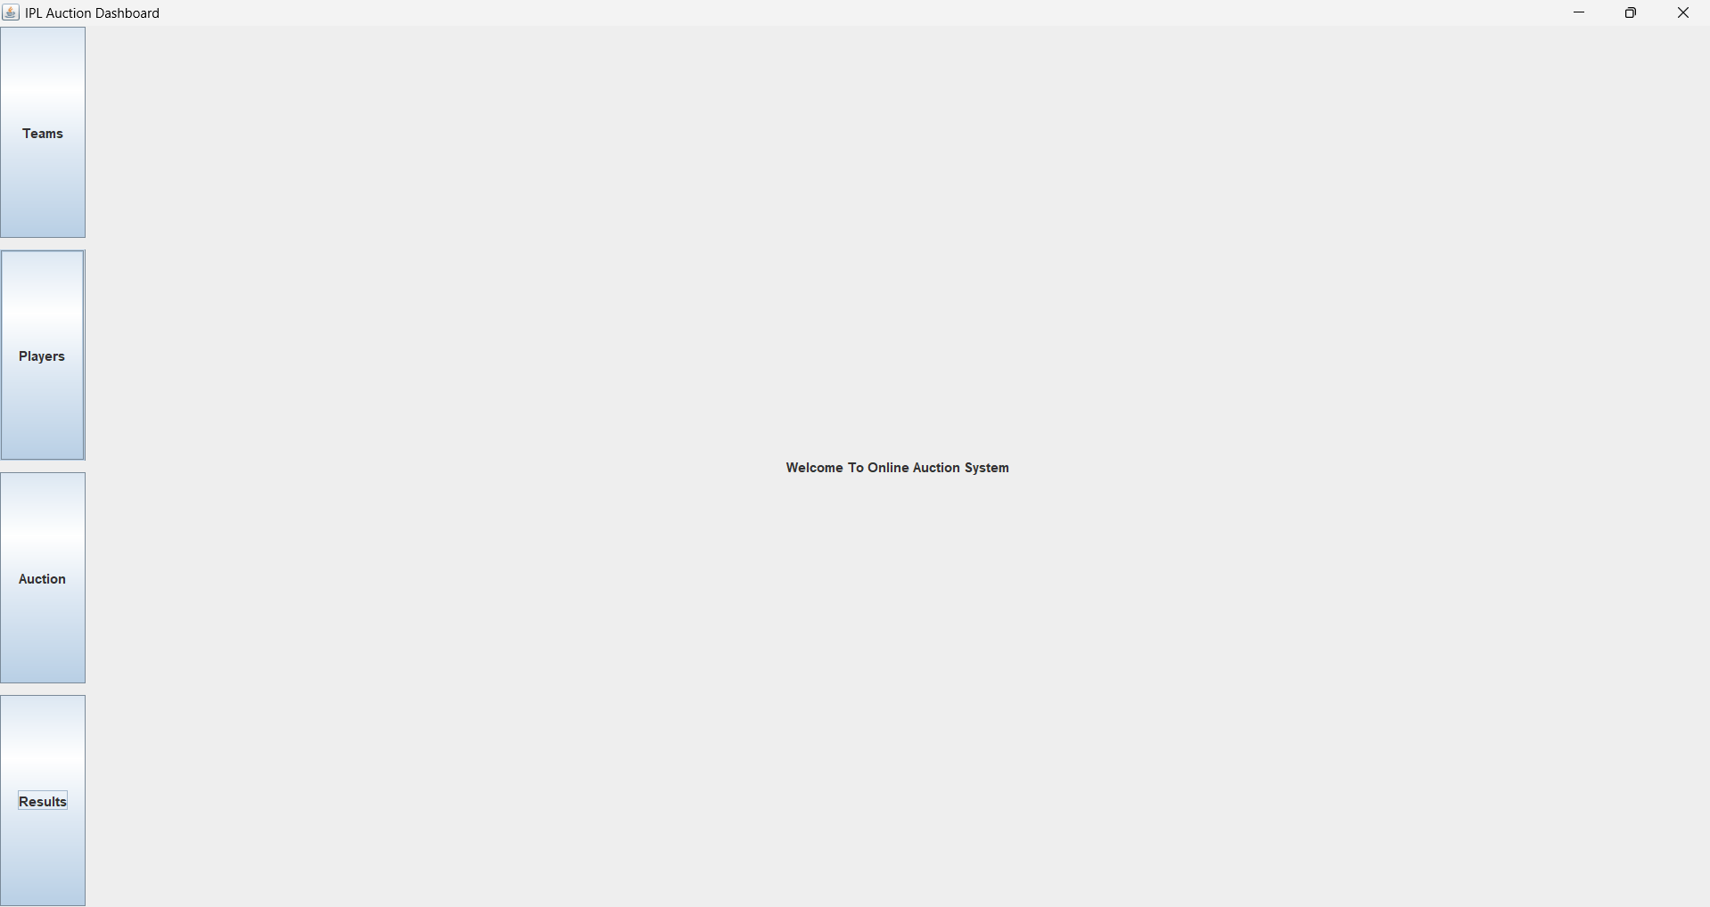
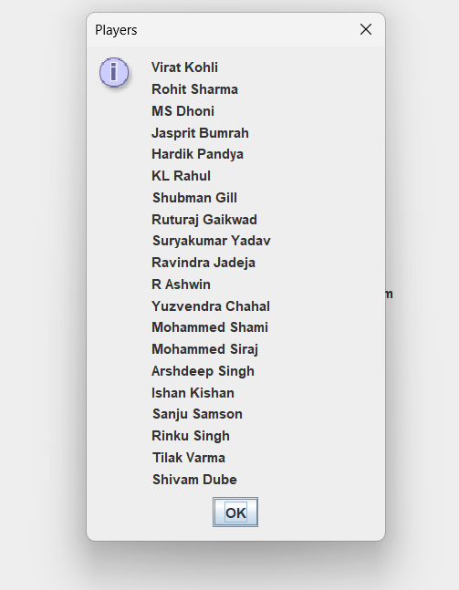
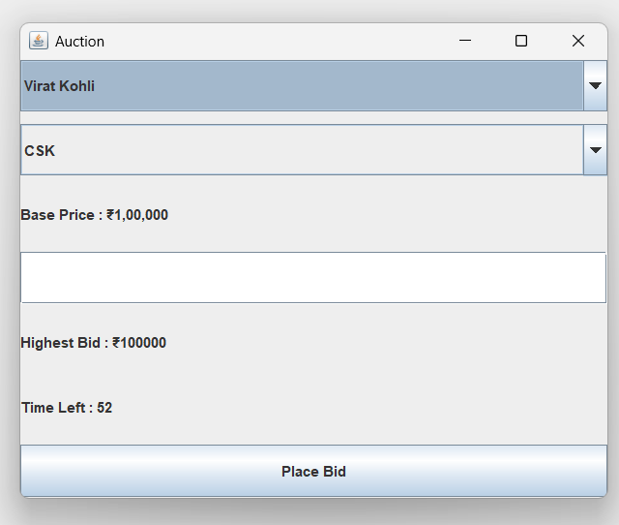
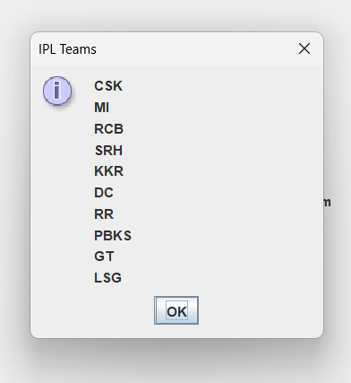
Methodology / Approach The Online Auction/Bidding System is developed using java swing Step 1: User Authentication User enters Username and Password. System validates login credentials. Authorized users are redirected to the Dashboard. Step 2: Dashboard Navigation The dashboard contains: Teams Module Players Module Auction Module Results Module Step 3: Team Management Displays 10 IPL teams. User can select a team for bidding. Step 4: Player Management Displays a scrollable list of players. Players can be selected for auction. Step 5: Auction Process User selects a player. User selects a team. Bid amount is entered. A 10-second timer controls the bidding process. Multiple bids can be placed before the timer expires. The highest bidder wins the player. Step 6: Result Generation Winning team and bid amount are stored. Auction history is maintained. Results can be viewed anytime.

Slide 4
Results / Outcomes The Online Auction/Bidding System was successfully developed using java swing and provides a user-friendly interface for managing cricket player auctions. Achieved Results ✅ Secure Login Authentication System ✅ Interactive Dashboard with Navigation Menu ✅ IPL Team Management Module ✅ Player Management Module with Scrollable Interface ✅ Real-Time Auction Module ✅ 10-Second Auction Timer Functionality ✅ Bid Placement and Tracking ✅ Automatic Storage of Auction Results ✅ User-Friendly Graphical User Interface (GUI)

Slide 5
conclusion The Online Auction/Bidding System developed using java swing successfully automates the cricket player auction process. It provides secure login, team and player management, bidding functionality, and result tracking through an easy-to-use graphical interface. The system improves efficiency, accuracy, and transparency in auction management. 🏏💻🚀

