Slide 1
Doorlock Homes
By Nicholas konecny and devan houlihan

Slide 2

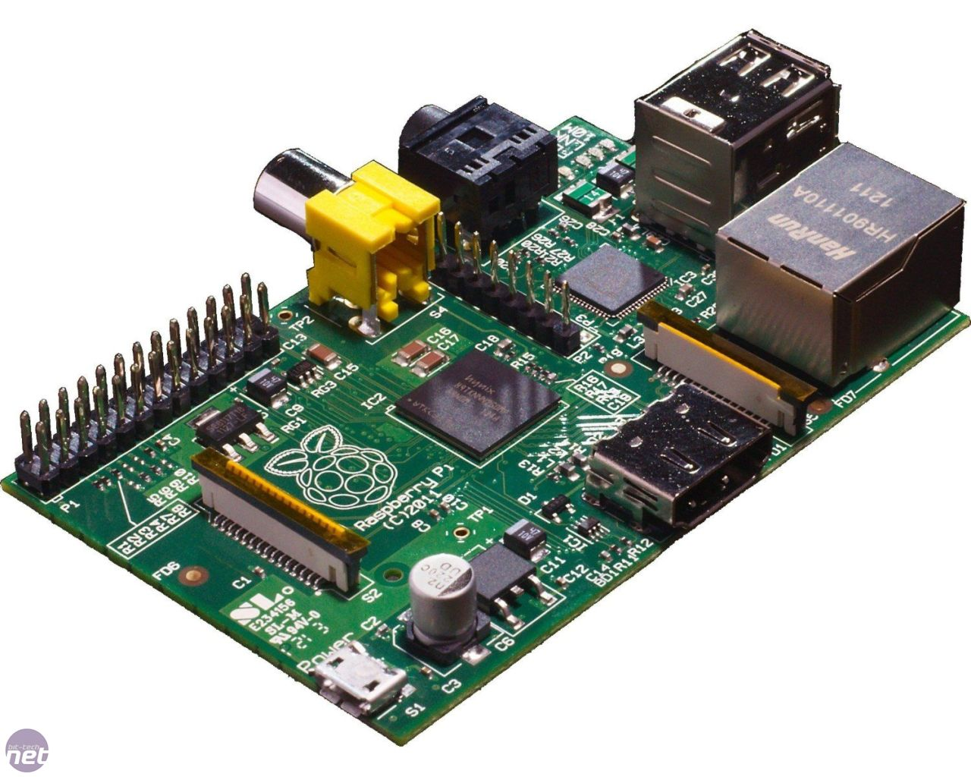
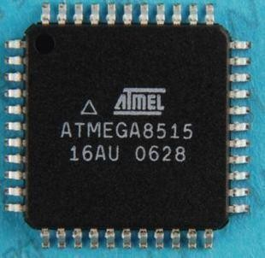
What is Doorlock Homes?

Slide 3
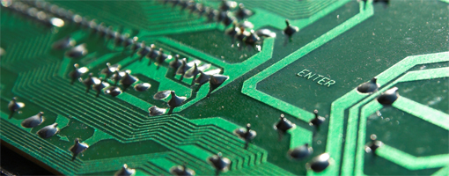
Currently Built:
Model door with deadbolt.
Skeleton for necessary PHP code.
Serial communication between the Raspberry Pi and AVR.
Pulse width modulation to move the motor.
Hardware interrupts for feedback when motor is moving.

Slide 4
Currently Tested:
Website has working pages with navigation between them. However, buttons don’t do anything.
Successful messages have been sent through serial communication, including a lock and unlock code.
Correct voltage levels are being sent to the H-bridge, however the H-bridge melts every time the AVR receives power.
Pulse width modulation is operational.

Slide 5

Management
Microsoft team foundation server is used for version control, bug tracking, task management, and team collaboration.
Both team members can work independently and asynchronously on code without issue.
When code is being tested, the group gets together.
This system will be used for the remainder of the project.

Slide 6

Course of Action, What’s Next?
Prevent the H-bridge from melting.
Mount the motor and connect it to the deadbolt.
Solve hardware interrupt problem.

Slide 7

Down the Road
Integrate feedback to control the motor.
Tie the web server into the project.
Create a log that tracks all actions.

Slide 8
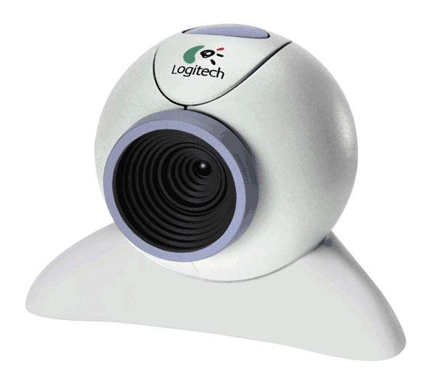
Possibilities
Webcam/Facial recognition
Knock detector
More complex logging system
Alert System

Slide 9

Questions?

