Slide 1
CAR RENTAL
Reservation & Vehicle Return Management System
FINAL PRESENTATION – REVIEW III
Working Python + Tkinter + MySQL Application
Live CRUD • Availability • Reports • Validation
PRESENTED BY
Koneri Mithul
25WU0102129
AIML Panthers
Guide: Dr. Kiran Mayee Adavala

Slide 2
Project Objective & Final Deliverable
01
THE PROBLEM
THE SOLUTION
REVIEW III GOAL
Manual/disconnected rental tracking can cause double-booking, licence issues, missing damage records and revenue leakage.
A normalized multi-branch rental database with a live Python UI connected directly to MySQL.
Demonstrate working insertion, deletion and viewing of records, with changes reflected in the database.
Final system combines database design + implementation + live application.
UI includes all 11 project tables plus availability and reporting.
CORE FLOW
Customer → Reservation → Rental → Inspection → Damage → Invoice → Payment

Slide 3
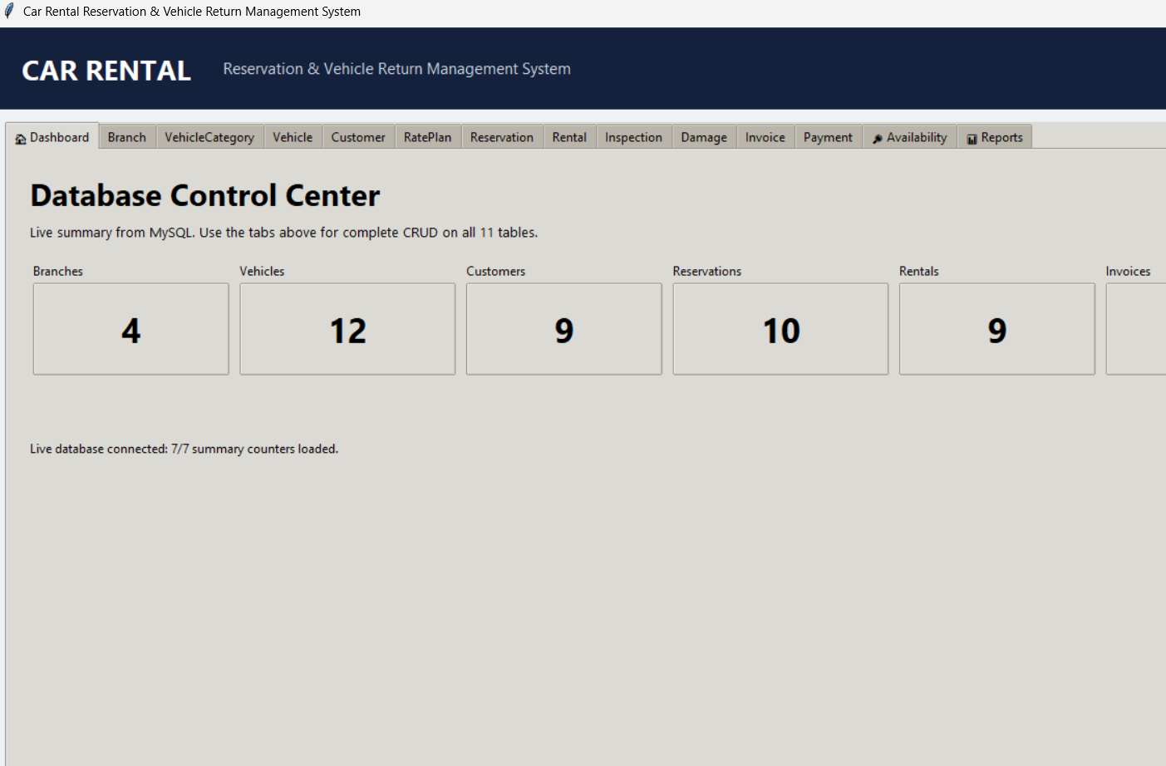
Working UI – Dashboard
04
LIVE DATABASE
7/7 summary counters loaded
MODULES
11 table tabs
Availability
Reports
Live MySQL connection
CRUD READY
INSERT / UPDATE / DELETE / VIEW
with refresh after each operation
Car Rental Reservation & Vehicle Return Management System • Review III
3

Slide 4
Live CRUD Demonstration Plan
05
INSERT
MYSQL VERIFICATION
Create a test Customer
USE car_rental_db;
SELECT * FROM customer;
SELECT * FROM customer
WHERE license_no='TESTDL1001';
Expected: row exists after INSERT and no row after DELETE.
VIEW
Refresh and show it
VERIFY
SELECT in MySQL
DELETE
Delete the test record
VERIFY
SELECT again – no row
Car Rental Reservation & Vehicle Return Management System • Review III
4

Slide 5
Validation & Database Integrity
07
Referential integrity
Licence validation
PK/FK relationships prevent invalid references.
Pickup is blocked for an invalid/expired licence.
No overlap
Return validation
Rental issue logic checks conflicting rental periods.
Return time and odometer rules protect data quality.
Safe charges
Transactions
Charges/payments use non-negative or positive checks.
Commit/rollback keeps multi-step operations consistent.
Car Rental Reservation & Vehicle Return Management System • Review III
5

Slide 6
Availability & Reporting
08
AVAILABILITY SEARCH
REPORTS
Search by pickup/return dates, branch and vehicle category.
Output: vehicles available for the requested rental window.
Fleet availability
Overdue rentals
Customer rental history
Branch revenue
Vehicle utilization
Damage report
Car Rental Reservation & Vehicle Return Management System • Review III
6

Slide 7
Final 10-Minute Demonstration Sequence
11
1. Dashboard – prove live MySQL connection
2. Customer – INSERT a test record
3. Customer – VIEW the inserted record
4. MySQL Workbench – SELECT to prove the database change
5. Customer – DELETE the test record
6. MySQL Workbench – SELECT again to prove deletion
7. Show Vehicle / Reservation / Rental CRUD screens
8. Demonstrate Availability search
9. Demonstrate Reports
10. Conclude with database + UI + integrity
CLOSING LINE
“Our Python UI is directly connected to MySQL, and changes are reflected in the database.”
Car Rental Reservation & Vehicle Return Management System • Review III
7

Slide 8
THANK YOU
FINAL TAKEAWAY
A normalized MySQL database + working Python application supporting rental operations, CRUD, integrity validation, availability and reporting.
Koneri Mithul • 25WU0102129 • AIML Panthers

