Slide 1
BEGINNER-FRIENDLY JAVA PROJECT
MUNICIPAL WASTE
COLLECTION OPTIMIZER
ORGANIC
PLASTIC
METAL
A simple program that helps decide which bins need pickup and which type of truck should collect them.
CHECK FULLNESS
CHOOSE PRIORITY
ASSIGN TRUCK
Team No: __________ Student names & roll numbers: ______________________________
MUNICIPAL WASTE COLLECTION OPTIMIZER
01 / 17

Slide 2
PROJECT OVERVIEW
Abstract
What the program does, in three easy steps.
1
1. INPUT
2
2. CHECK
3
3. RESULT
Enter the number of bins, fullness percentage and waste type.
The program checks how full each bin is.
It shows pickup priority and the suitable truck type.
MAIN AIM
Make waste collection decisions easier, clearer and more organized.
MUNICIPAL WASTE COLLECTION OPTIMIZER
02 / 17

Slide 3
PROBLEM
Why is this project needed?
Manual collection can waste time when workers do not know which bins need pickup.
1
NO CLEAR PRIORITY
2
EXTRA FUEL & TIME
3
WASTE MIX-UP
A nearly empty bin may be collected before a full bin.
Unnecessary trips increase travel and work.
Different waste types may need different trucks.
THE GOAL
Collect urgent bins first and identify the right truck for each waste type.
MUNICIPAL WASTE COLLECTION OPTIMIZER
03 / 17

Slide 4
SOLUTION
How does our program help?
It uses information entered by the user to make simple collection decisions.
1
2
3
CHECK
DECIDE
ASSIGN
Read the bin fullness.
Set the pickup priority.
Choose the truck by waste type.
MUNICIPAL WASTE COLLECTION OPTIMIZER
04 / 17

Slide 5
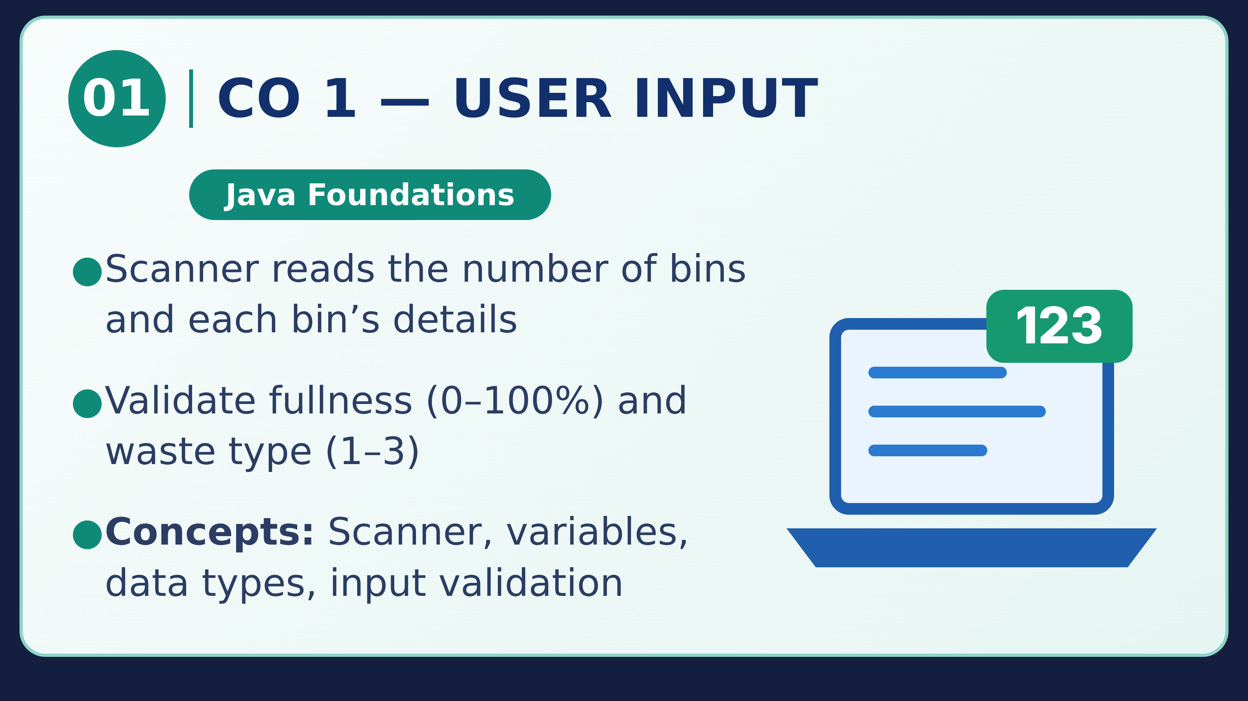
MUNICIPAL WASTE COLLECTION OPTIMIZER

Slide 6
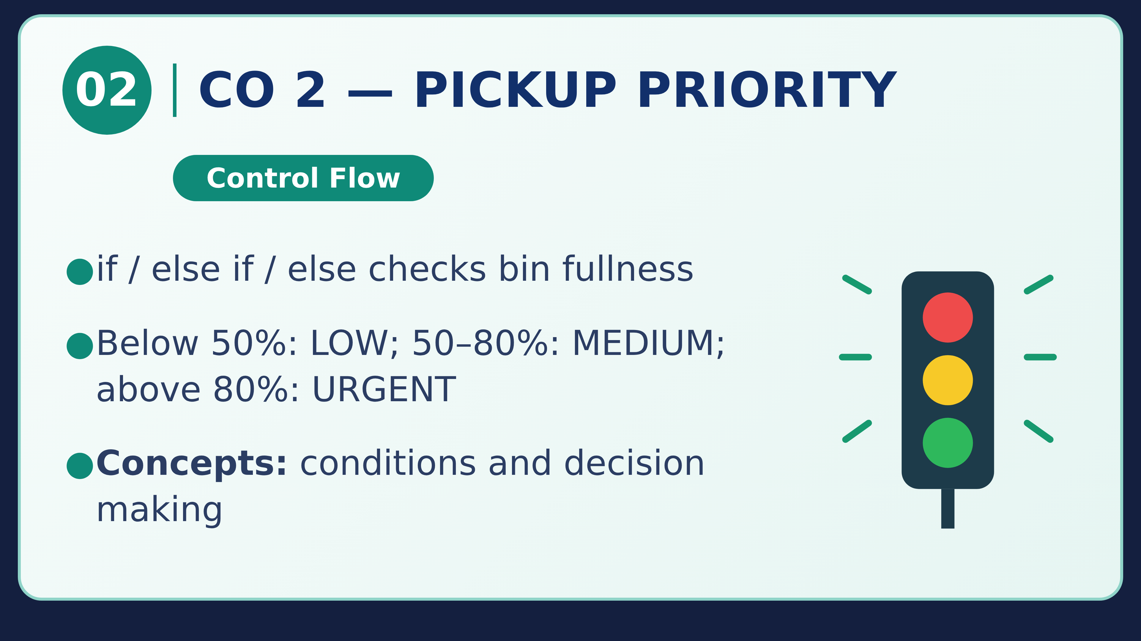
MUNICIPAL WASTE COLLECTION OPTIMIZER

Slide 7
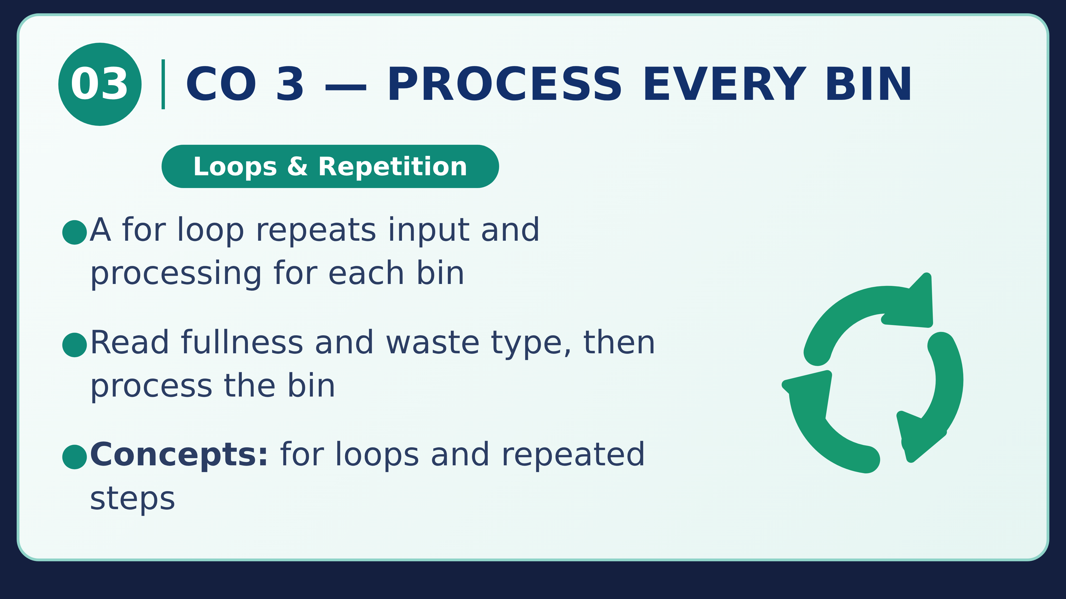
MUNICIPAL WASTE COLLECTION OPTIMIZER

Slide 8
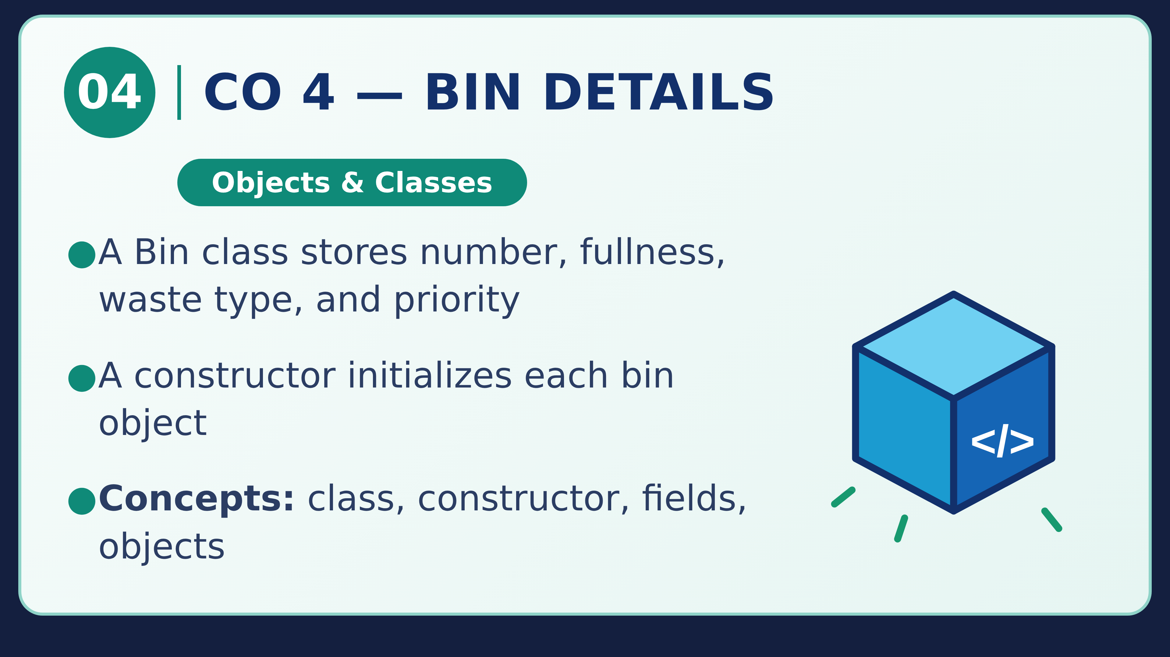
MUNICIPAL WASTE COLLECTION OPTIMIZER

Slide 9
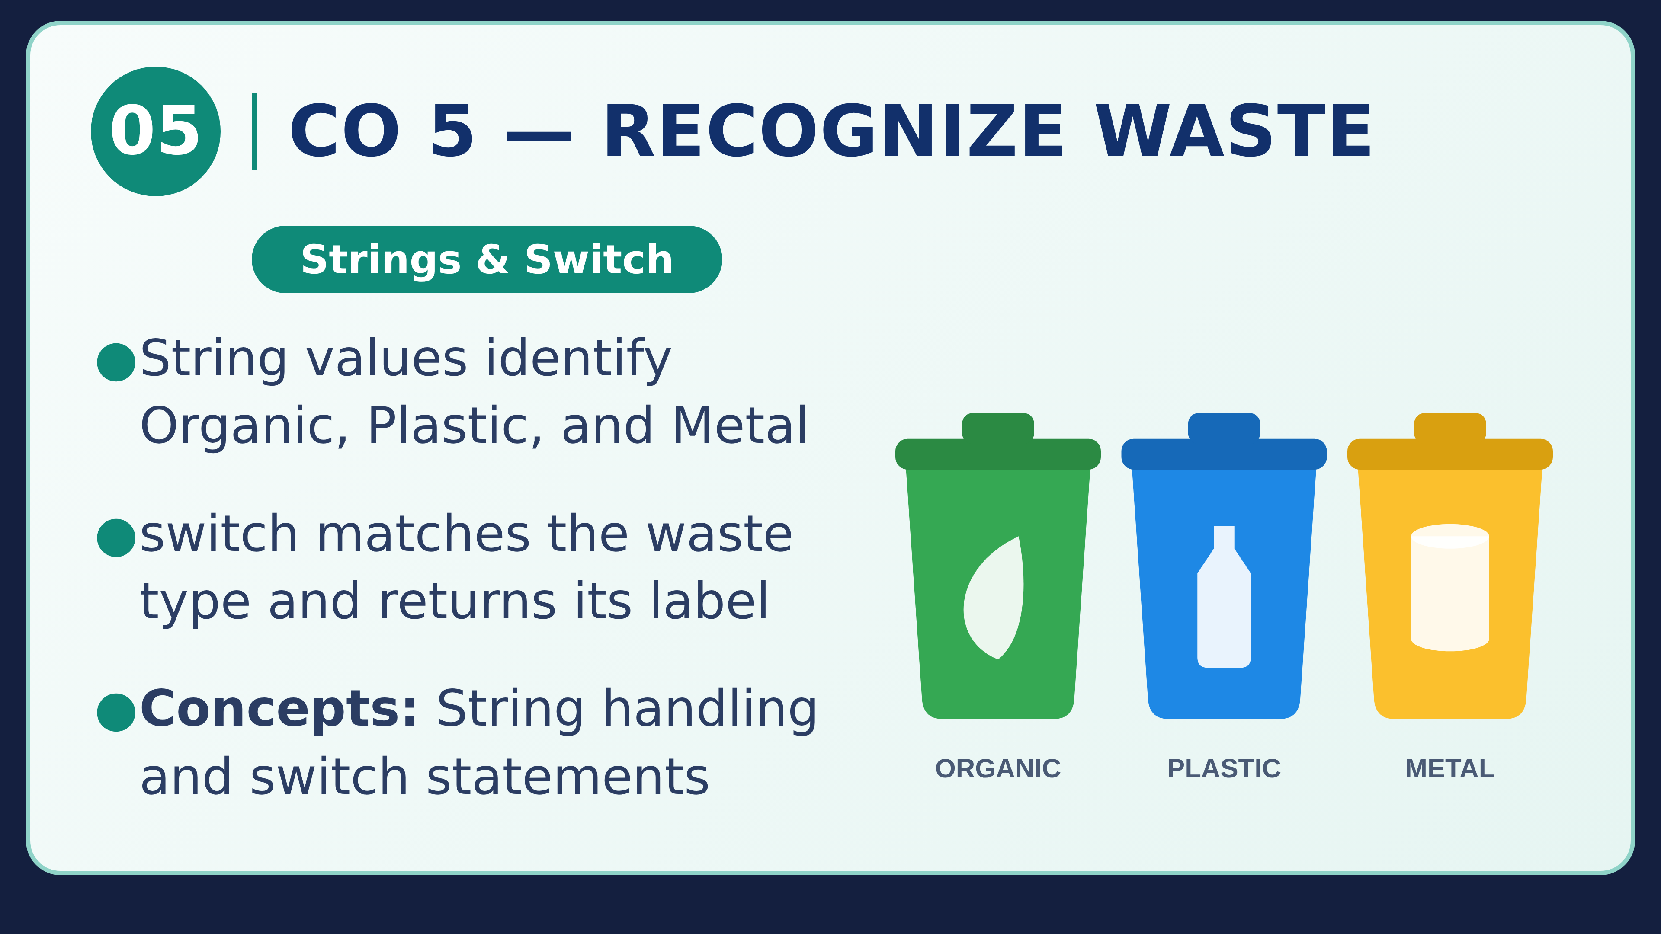
MUNICIPAL WASTE COLLECTION OPTIMIZER

Slide 10
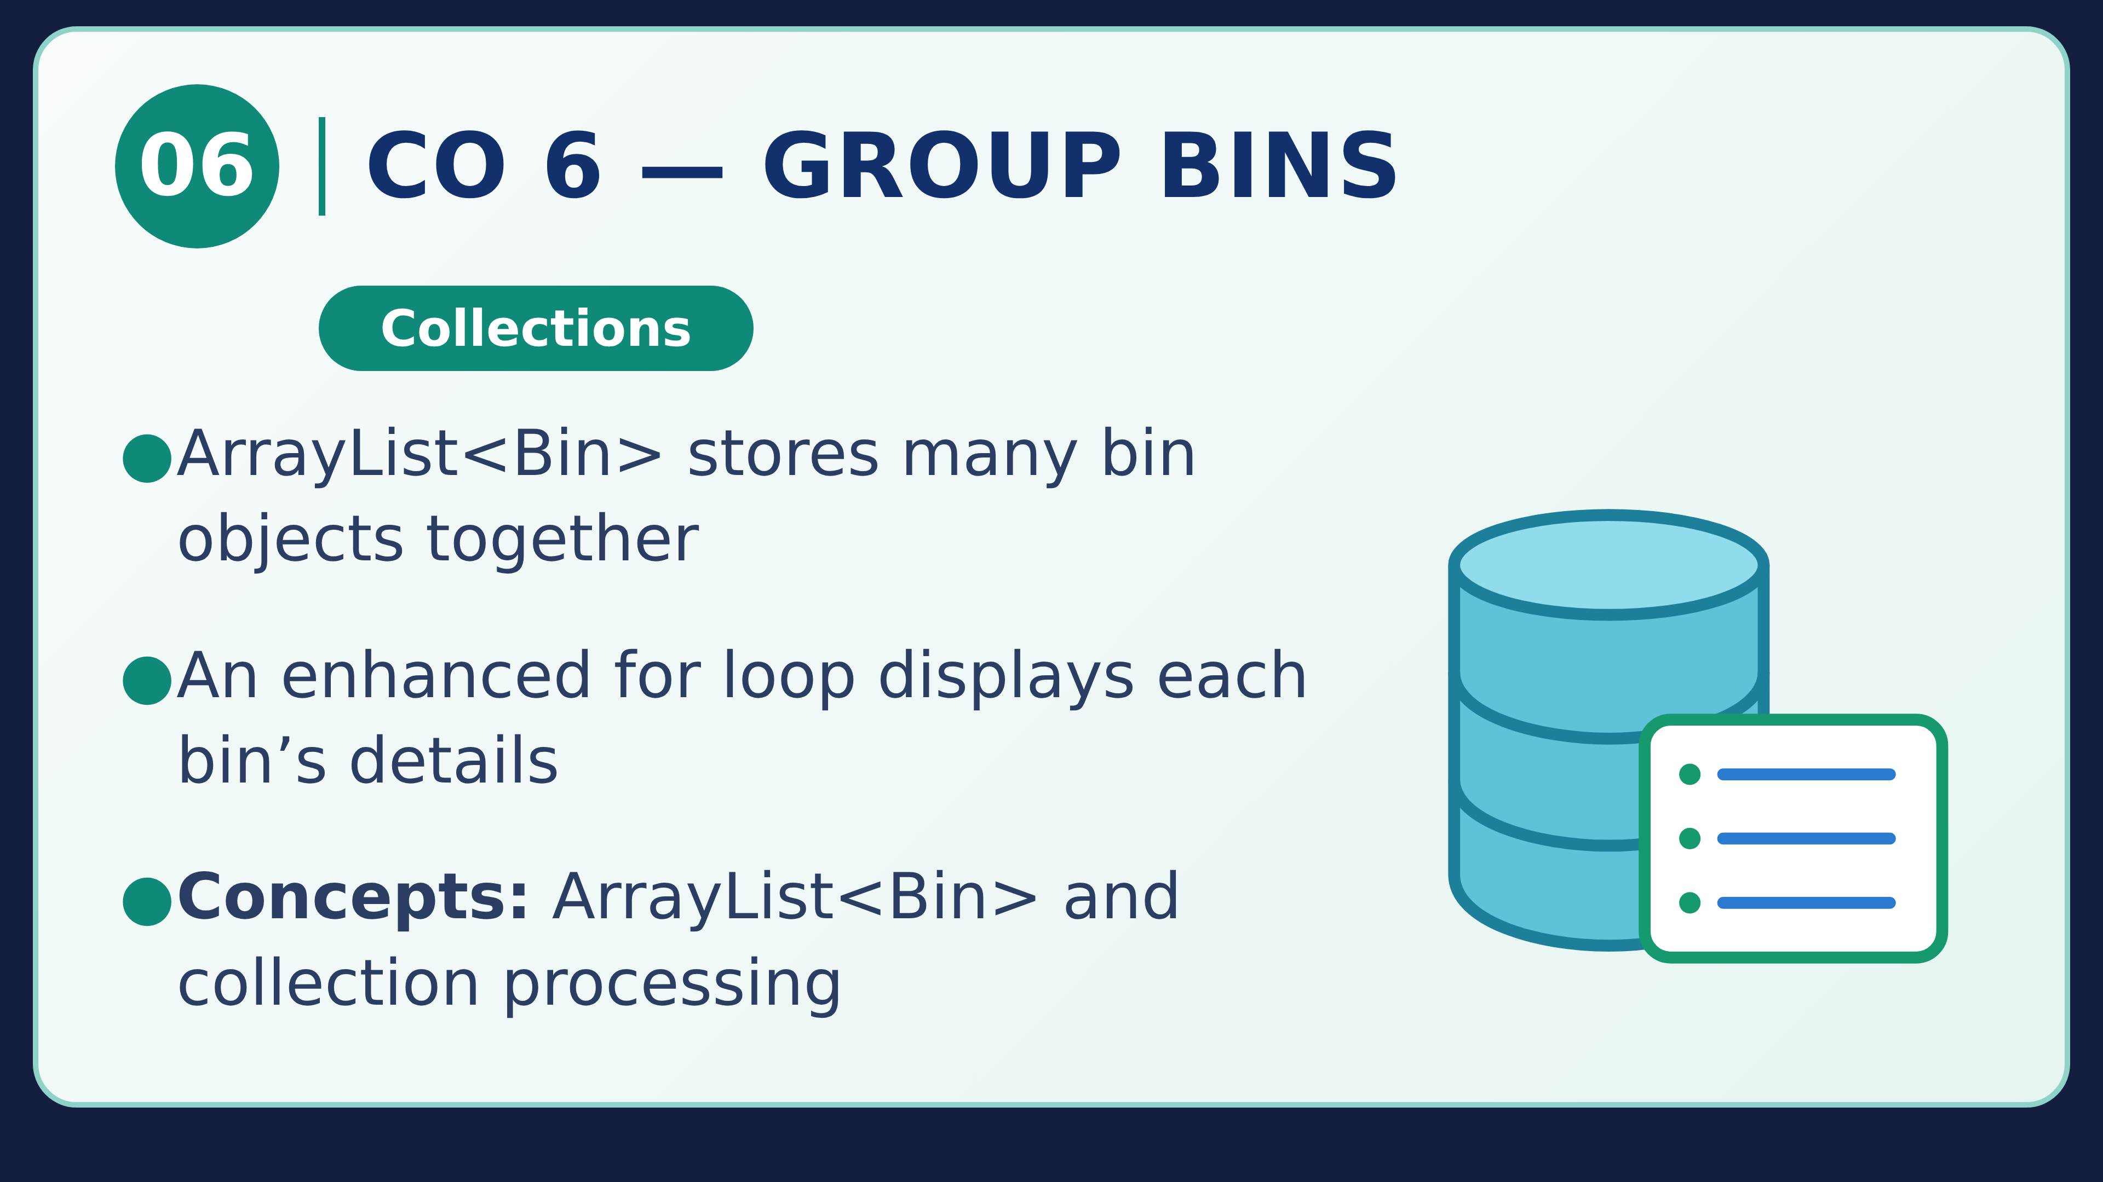
MUNICIPAL WASTE COLLECTION OPTIMIZER

Slide 11
SYSTEM WORKFLOW
How the whole program works
Follow the steps from the user's input to the final result.
1
2
3
4
5
Enter number
of bins
Enter fullness
and waste type
Decide pickup
priority
Choose waste
truck
Show result
The program repeats steps 2–5 for every bin.
MUNICIPAL WASTE COLLECTION OPTIMIZER
11 / 17

Slide 12
EXAMPLE
A sample result
These made-up values show how the rules work. Replace them with your actual program output.
Bin 1
Bin 2
Bin 3
Fullness: 35%
Waste: Organic
Fullness: 72%
Waste: Plastic
Fullness: 91%
Waste: Metal
Decision: No pickup
Decision: Schedule soon
Decision: Urgent
The priority follows the thresholds shown on the CO 2 slide.
MUNICIPAL WASTE COLLECTION OPTIMIZER
12 / 17

Slide 13
CONCLUSION
What have we learned?
The project uses simple Java ideas to solve a practical community problem.
1
2
3
INPUT
DECISION
CLASSIFICATION
Read bin information
Check how full it is
Choose the right truck
Future idea: add sensors and map-based routing to make the system smarter.
MUNICIPAL WASTE COLLECTION OPTIMIZER
13 / 17

Slide 14
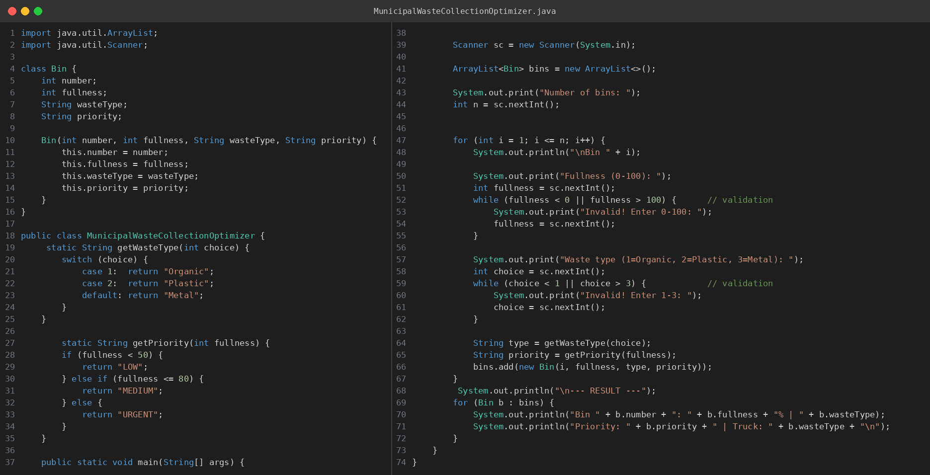
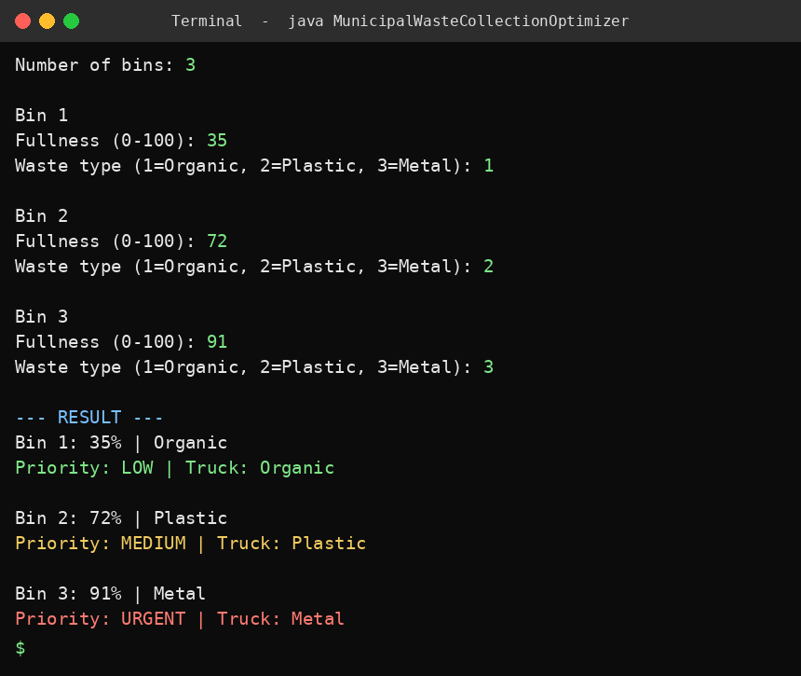
SCREENSHOTS
Program code and output
Screenshot 1 shows the complete Java source code; Screenshot 2 shows the program run with sample input.
SCREENSHOT 1: JAVA SOURCE CODE
SCREENSHOT 2: PROGRAM OUTPUT
MUNICIPAL WASTE COLLECTION OPTIMIZER
14 / 17

Slide 15
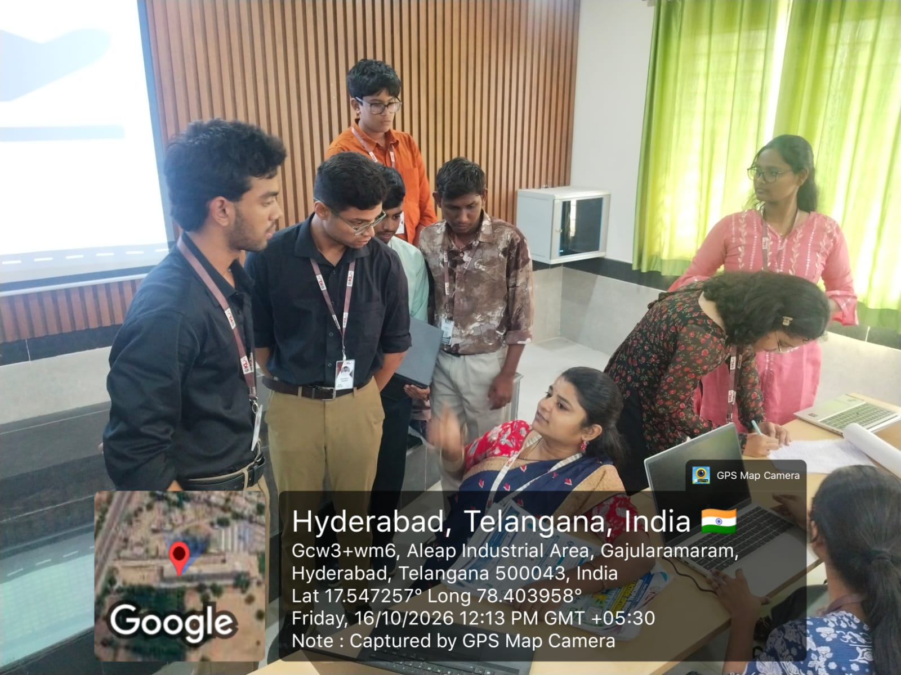
SUBMISSION DETAILS
Geo-tag photo and GitHub link
Complete these details before presenting or submitting.
GITHUB REPOSITORY
Include:
• Java source code
• Short README
• Sample input and output
• Screenshots
GEO-TAGGED PROJECT PHOTO
GitHub URL: __________________________
THANK YOU!
MUNICIPAL WASTE COLLECTION OPTIMIZER
15 / 17

Slide 16
ALL COs TOGETHER
How the concepts connect in one Java program
CO 1
Taking input from the user
CO 2
Deciding pickup priority
`Scanner` and input validation
`if`, `else if`, `else`
CO 3
Repeating steps for every bin
CO 4
Keeping bin details together
`for` loop
`Bin` class, constructor and objects
CO 5
Recognizing waste types
CO 6
Grouping bins in a collection
`String` and `switch`
`ArrayList<Bin>` and enhanced `for` loop
MUNICIPAL WASTE COLLECTION OPTIMIZER
16 / 17

Slide 17
RUN THE PROGRAM
How to run the complete Java code
1. Save the file
Save the source as MunicipalWasteCollectionOptimizer.java.
1
2. Compile
Open a terminal in that folder and run: javac MunicipalWasteCollectionOptimizer.java
2
3. Run
Type: java MunicipalWasteCollectionOptimizer
3
Note: the examples on CO slides are short teaching snippets. Use the complete .java file for the full working program.
MUNICIPAL WASTE COLLECTION OPTIMIZER
17 / 17

