Slide 1
Classification Modelling
Learn Programming
Learn Machine Learning
Emily Kong

Slide 2
What exactly is Reddit and SubReddit?
In short, Reddit is the entire site of Reddit.com.
However, people were allowed to create their own reddit, which over time, was commonly called the SubReddits.
SubReddits is a specific online community, dedicated to a particular topic, denoted by /r/, followed by the subreddit’s name.
For this presentation, posts from /r/learnmachinelearning and /r/learnprogramming are scraped.

Slide 3
Problem Statement
Business Objective
Select a classification model which best identifies posts from the subreddit Learn Programming and Learn Machine Learning from the various models selected for testing.
The application of Natural Language Processing Models ('NLP') to correctly classify the post contents to the named subreddits based on the words used most and related to respective subreddit. This will allow for more accurate search results of the related posts based on the keywords entered by users.

Slide 4
Data Gathering and Cleaning of Data
The process includes the following steps:
Web Scraping using Requests Library
Data Cleaning using the following libaries:-
Beautiful Soup
NLTK (Stopwords)
Regex
Python’s string manipulation

Slide 5
Exploratory Data Analysis

Slide 6
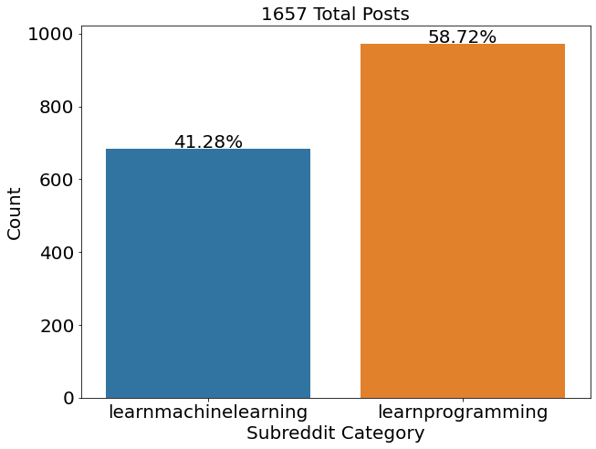
Exploratory Data Analysis
Baseline Accuracy:
0.5867

Slide 7
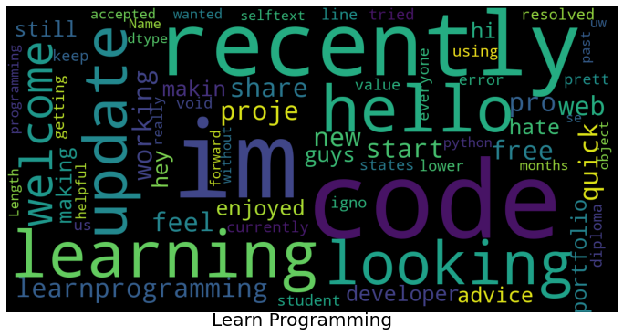
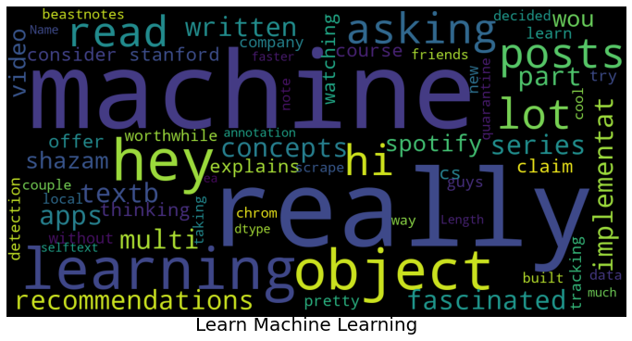
Exploratory Data Analysis
“Learning” and “Selftext” are some of the common words which appears frequently in both subreddits.
As the common words may affect the classification of the posts, we will explore these further.

Slide 8
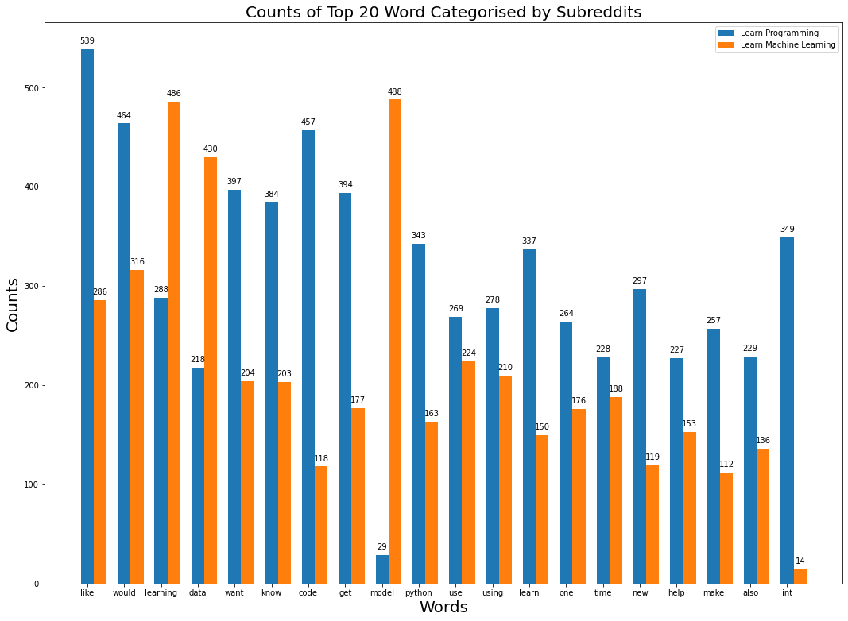
Exploratory Data Analysis

Slide 9
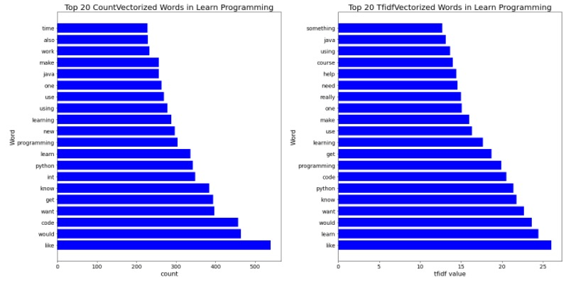
Exploratory Data Analysis

Slide 10
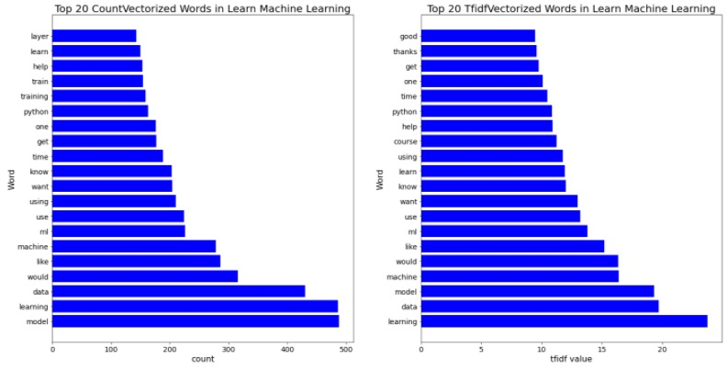
Exploratory Data Analysis

Slide 11
Features Engineering

Slide 12
Features Engineering
Stemming
Stemming is the process of reducing inflection in words to their root forms such as mapping a group of words to the same stem even if the stem itself is not a valid word in the Language
Lemmatization
Lemmatization, unlike Stemming, reduces the inflected words properly ensuring that the root word belongs to the language
Stop Words
Stop Words are words which do not contain important significance to be used in Search Queries. Usually, these words are filtered out from search queries because they return a vast amount of unnecessary information. Mostly they are words that are commonly used in the English language such as 'as, the, be, are' etc.

Slide 13
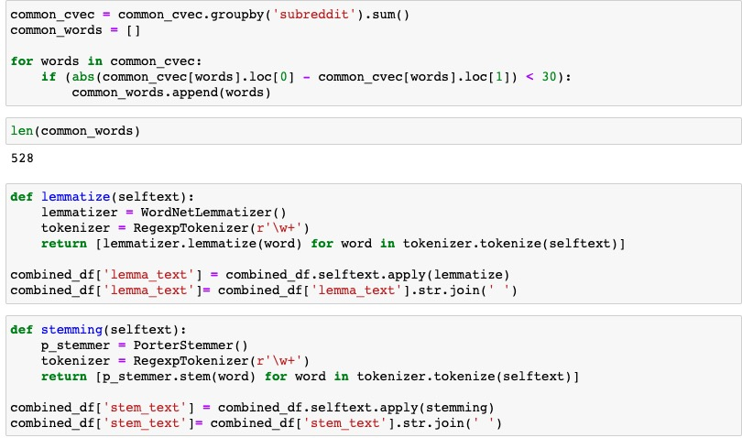
Features Engineering

Slide 14
Modelling

Slide 15
Modelling
Count Vectorizer with Naïve Bayesian’s Multinomial NB
Tfidf Vectorizer with Naïve Bayesian’s Multinomial NB
Tfidf Vectorizer with Logistic Regression
Count Vectorizer with Logistic Regression
Count Vectorizer with Random Forest
Tfidf Vectorizer with Random Forest

Slide 16
Scores
Precision can be seen as a measure of exactness or quality. High precision means that an algorithm returned substantially more relevant results than irrelevant ones.
Recall is a measure of completeness or quantity. High recall means that an algorithm returned most of the relevant results.
F-Measure provides a single score that balances both the concerns of precision and recall in one number

Slide 17
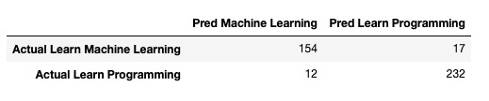

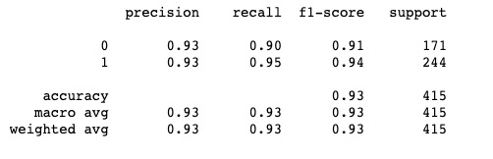
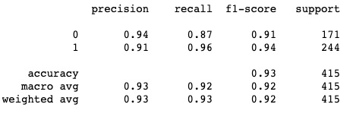
Model 1
Model 4

Slide 18
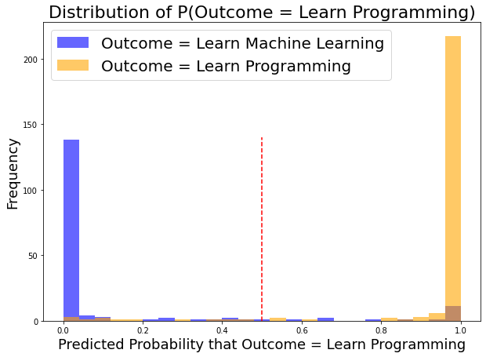
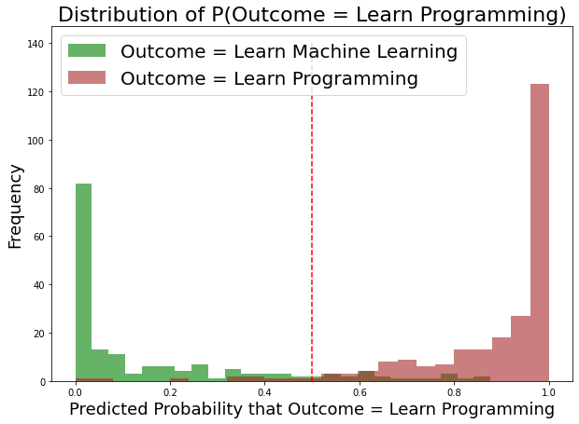
Model 1
Model 4

Slide 19
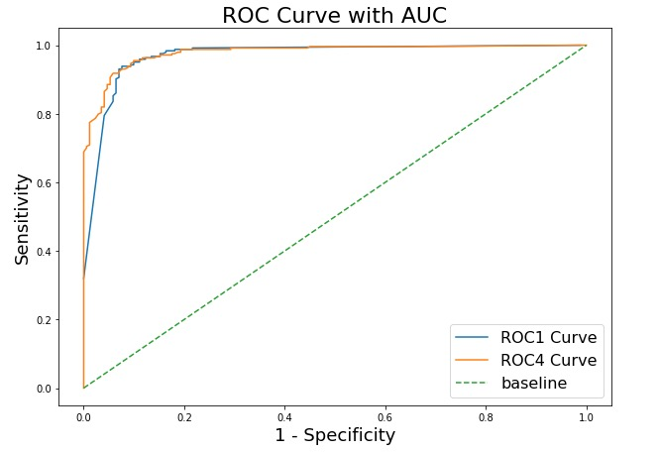
ROC Curve with AUC
AUC Score for Model 1 = 0.973
AUC Score for Model 4 = 0.978

Slide 20
Conclusions
All 6 models have higher cross-validated mean train scores when compared to their respective test scores which could indicate overfitting and the test scores were also in the approximately 0.9 range. This could have been a result of the 2 subreddits being vastly unrelated.
For the next iteration, the classifier model should be applied on unseen data to validate the scoring and further validated using other subreddits.
Apply lemmatization and use other stop words to lower the overfitting results
Observations

