Slide 1
PRESENTATION FOR FINAL YEAR PROJECT "HAND SIGN DETECTION USING MACHINE LEARNING" DEPARTMENT OF COMPUTER SCIENCE AND ENGINEERING, GIMT GUWAHATI
SUBMITTED BY,
AMBAR KASHYAP
BEDANTA PROTIM DEKA
KONGKON PRATIM SAIKIA

Slide 2
AIM OF THE PROJECT : SIGN LANGUAGE DETECTION USING MACHINE LEARNING
OBJECTIVE:
THE OBJECTIVE OF THIS PROJECT IS TO IDENTIFY THE SYMBOLIC EXPRESSION THROUGH IMAGES SO THAT THE COMMUNICATION GAP BETWEEN A NORMAL AND A HEARING IMPARED PERSON CAN BE EASILY BRIDGED .

Slide 3
What is American Sign Language?
American Sign Language (ASL) is a complete, natural language that has the same linguistic properties as spoken languages, with grammar that differs from English. ASL is expressed by movements of the hands and face.There is no universal sign language. Different sign languages are used in different countries or regions.

Slide 4
CNN
A Convolutional Neural Network is a Deep Learning algorithm which can take in an input image, assign importance (learnable weights and biases) to various aspects/objects in the image and be able to differentiate one from the other.
The pre-processing required in a ConvNet is much lower as compared to other classification algorithms. While in primitive methods filters are hand-engineered, with enough training, ConvNets have the ability to learn these filters/characteristics.

Slide 5
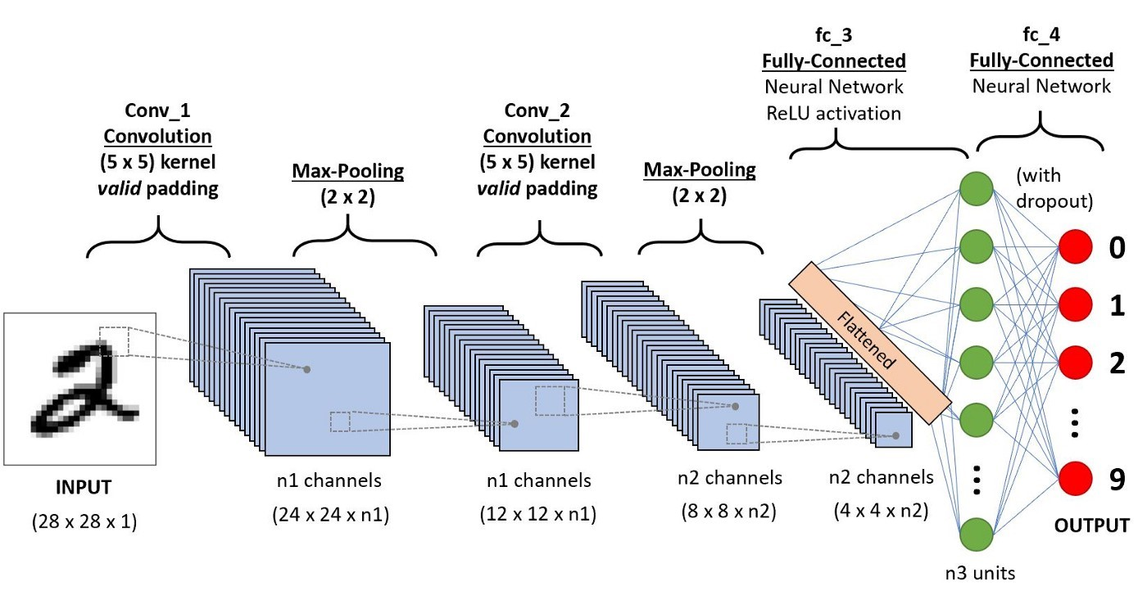
Fig 1: A CNN sequence to classify handwritten digits[3]

Slide 6
Convolution Layer — The Kernel
Fig 2: Convoluting a 5x5x1 image with a 3x3x1 kernel to get a 3x3x1 convolved feature

Slide 7
Similar to the Convolutional Layer, the Pooling layer is responsible for reducing the spatial size of the Convolved Feature. This is to decrease the computational power required to process the data through dimensionality reduction. Furthermore, it is useful for extracting dominant features which are rotational and positional invariant, thus maintaining the process of effectively training of the model.
Fig 3: 3x3 pooling over 5x5 convolved feature

Slide 8
Scope of the work
Human beings interact with each other either using a natural language channel such as words, writing, or by body language (gestures) e.g., hand gestures, head gestures, facial expression, lip motion and so on. The sign language is the basic communication method within hearing disable people. People with hearing disabilities face problems in communicating with other hearing people without a translator. For this reason, the implementation of a system that recognize the sign language would have a significant benefit impact on deaf people social live.

Slide 9
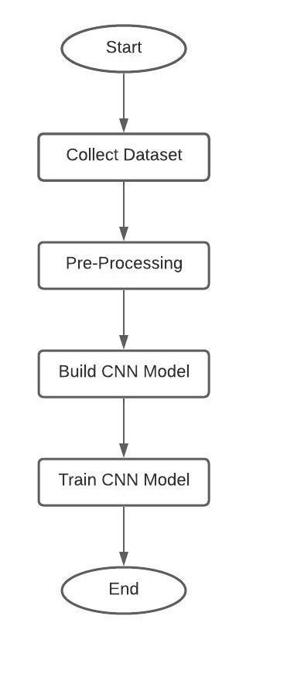
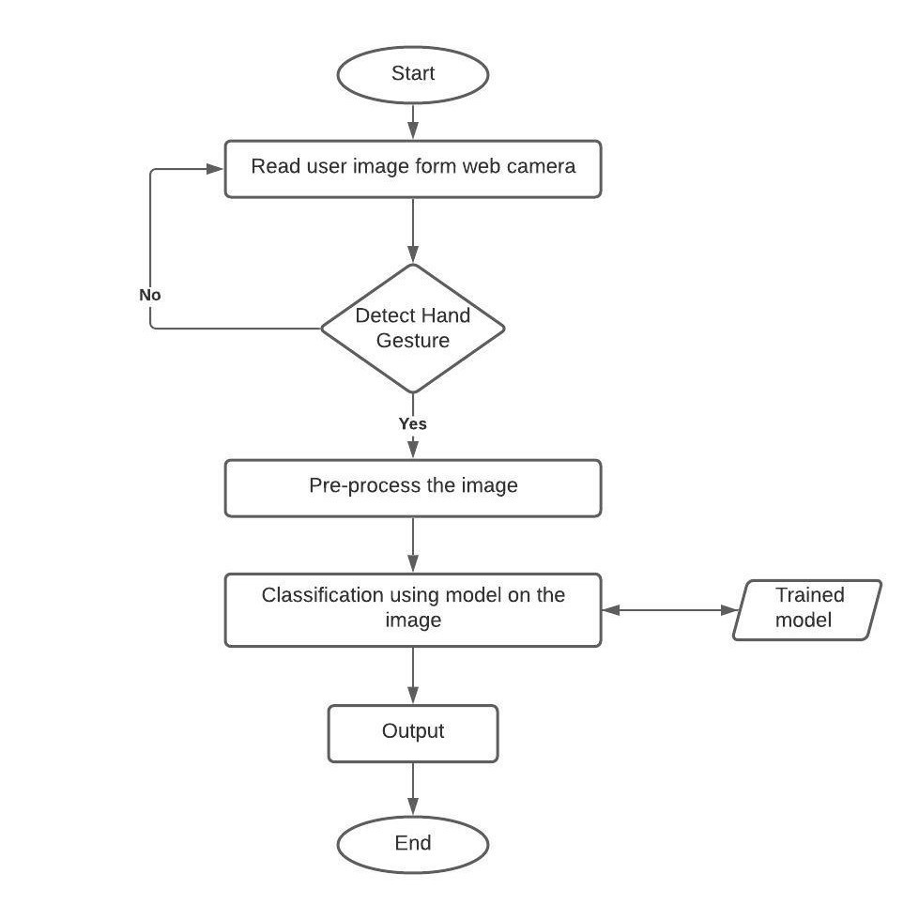
System design
Fig 4: system flow diagram for training
Fig 5: system flow diagram for evaluation

Slide 10
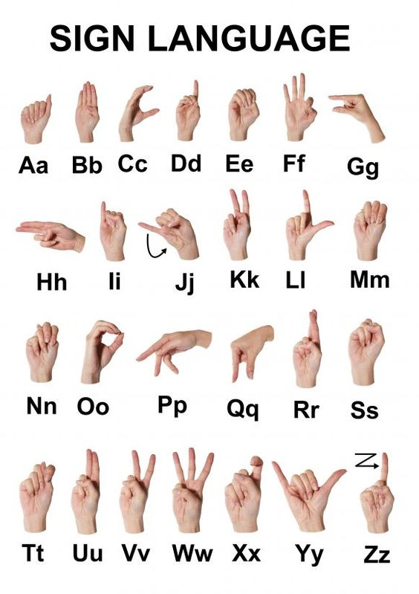
Datasets
The datasets have been taken from the kaggle website where for the alphabet dataset there are 45,500 training samples and 6500 testing samples. For the numbers dataset, there are a total of 2661 samples.
Fig 6: Dataset for alphabetical signs

Slide 11
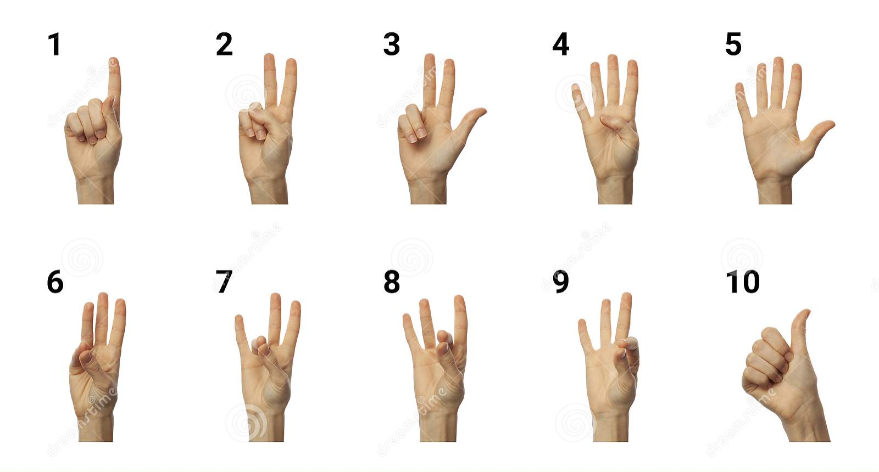
Fig 7: Dataset for numerical signs

Slide 12
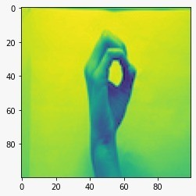
Pre-processing
The alphabet dataset was already pre-processed and hence did not require any pre-processing. All the samples were already threshold images. The pre-processing steps applied to the numerical dataset are as follows.
Changing the RGB colours to greyscale.
Resizing the image into 100x100 pixels.
Removing the zero arrays and shuffling the data.
Visualizing the images.
Fig 8: Pre-processed image

Slide 13
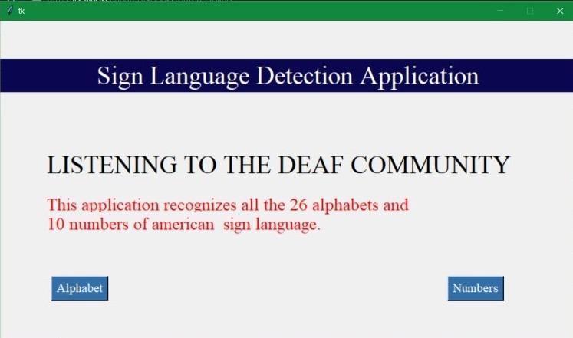
Fig 9: Welcome page

Slide 14
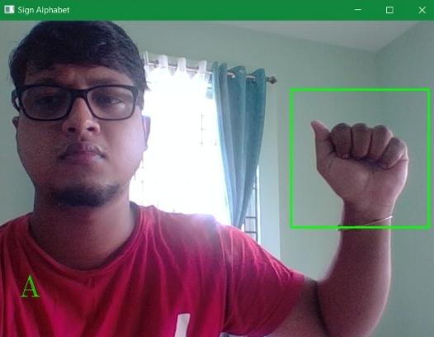
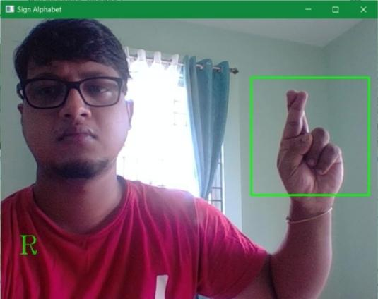
Testing output
Fig 10: Testing-The letter ‘A
Fig 11: Testing-The letter ‘R’

Slide 15
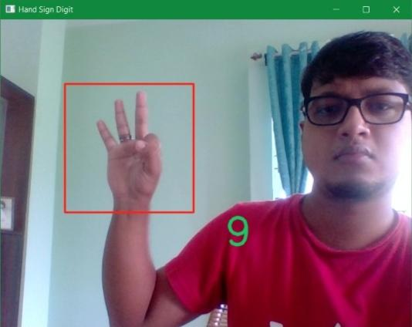
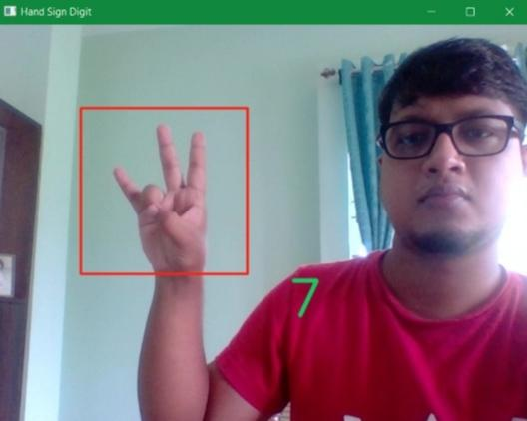
Fig 12: Testing-The number ‘9’
Fig 13: Testing-The number ‘7’

Slide 16
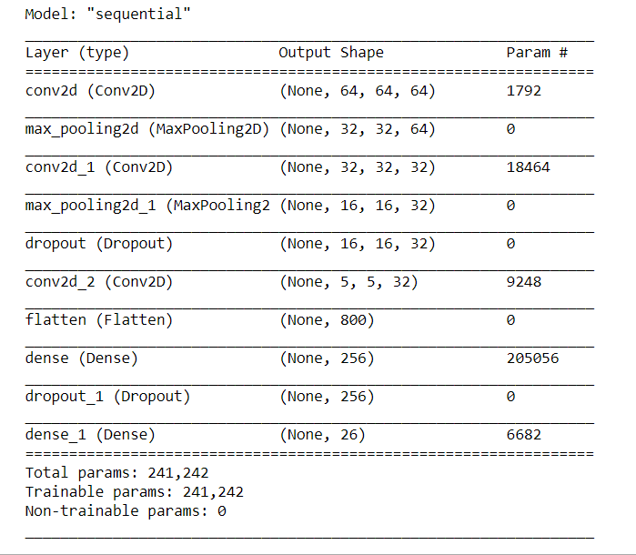
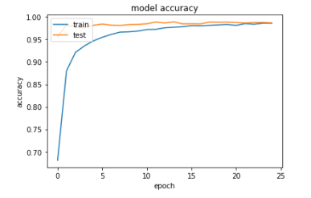
Fig 15: model accuracy graph
Fig 14: CNN model summary of alphabets

Slide 17
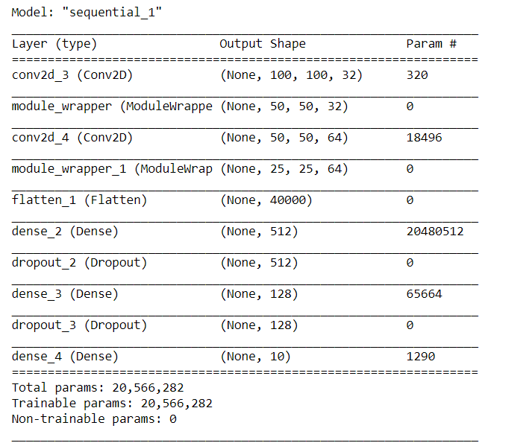
Fig 16: CNN model summary of numbers

Slide 18
Applications
It can be integrated with smart robots so that, along with verbal input, they can also take inputs using hand signs for people who can’t speak.
It can be used in home automation software so that people who can’t speak can also give commands with hand signs.
Another application of this hand sign detection can be used in the gaming industry. It can provide a fully contactless gaming experience in terms that no keyboard, mouse, joystick, gamepad etc. has to be used.

Slide 19
Conclusion
Hand gesture recognition addresses a fault in interaction systems. Controlling things by hand is more natural, easier, more flexible, and cheaper, and there is no need to fix problems caused by hardware devices, since none is required. It was clear to need to put much effort into developing reliable and robust algorithms with the help of a camera sensor that has a certain characteristic to encounter common issues and achieve a reliable result. Each technique, however, has its advantages and disadvantages and may perform well in some challenges while being inferior in others.

Slide 20
Advantages:
1. A free of cost platform for the verbally disabled.
2. Simple user interface and very easy to use for anyone.
Limitations:
The model can only recognize static hand signs for the moment. Words or sentences that need hand movements still cannot be recognised by the model.
The accuracy of skin segmentation algorithms is limited because of objects in the background that are similar in colour to human skin.

Slide 21
Future Scope
The model can be further developed to adapt to fast moving hand signs and eventually understanding video feeds containing continuously changing hand signs relating to a sentence. It can be used in various applications such as gaming, home automation, robotic control, creating a virtual environment etc.

Slide 22
Reference
https://towardsdatascience.com/a-comprehensive-guide-to-convolutional-neural-networks-the-eli5-way-3bd2b1164a5
https://en.wikipedia.org/wiki/Convolutional_neural_network
https://www.nidcd.nih.gov/health/american-sign-language
https://towardsdatascience.com/a-comprehensive-guide-to-convolutional-neural-networks-the-eli5-way-3bd2b1164a53

