Slide 1
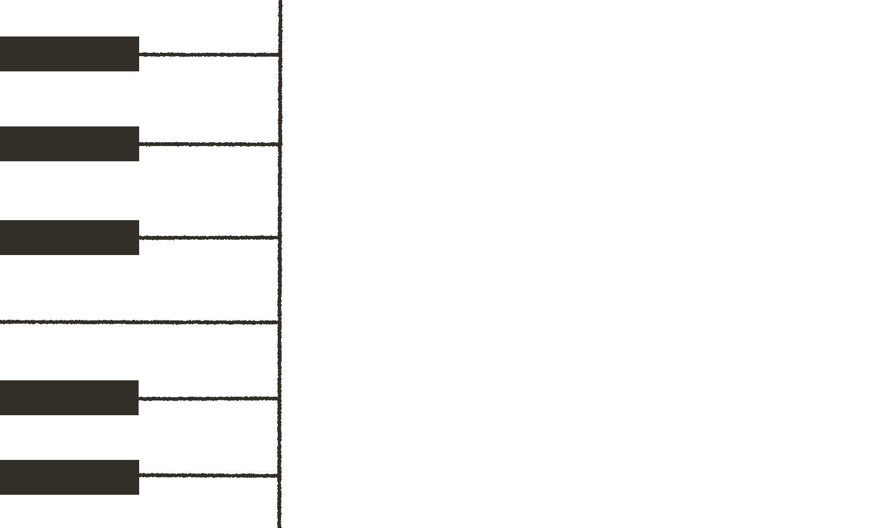
Smart Piano
Lo Sek Kong 230154279
Pang Wang Chun 230088026
Chow Ho Yeung 250589584
Li Wan Yeung 250276094
Cheung Yat Yan 250543742

Slide 2
Background
More and more people want to learn music, but too expensive to buy a piano, and it needs lots of spaces to place the piano at home.
Too expensive for lessons to learn to play piano.

Slide 3
The real-world question to solve
Don't know where to start when self learning, as there are no person to tutor
Lack of visual rhythm assistance tools, users are hard to distinguish they plays correct or not
Lack of practice records and review mechanisms to know the process of learning

Slide 4
Research
Hard to reading both clefs simultaneously
"I can read treble clef okay, and bass clef separately. But when I have to read both at the same time while playing, it's like trying to read two different books at once. My eyes jump back and forth and I lose my place constantly."
Source:
Reddit r/piano, User: "NewPianoPlayer2022", January 2023
Beginners are hard to keep the beat and timing
"Beginning piano students often struggle with maintaining consistent tempo, particularly when shifting attention between hands. The cognitive load of reading notation while executing motor commands disrupts internal timing mechanisms."
Source:
"The Psychology of Music" (3rd Edition) by Diana Deutsch

Slide 5
Solution of real-world question
Lights on top the keys
It helps users to know which key they should press to follow up the songs of the tutorial, to improve the accuracy of practices.
Metronome
Metronome can help users to follow the correct beat of the songs in the tutorial, it shows the beat by sound and the screen of the mobile app, easier for users to practice songs in correct rhythm.
Recording
The recording function can let users easier to revise their practices before and targeting mistakes they made, to fix the mistakes easily.

Slide 6
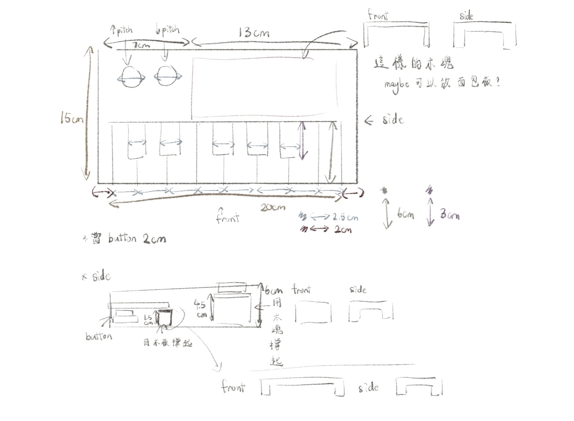
First draft ( Product design )

Slide 7
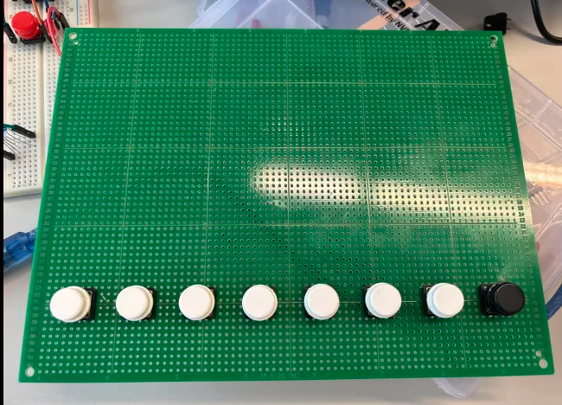
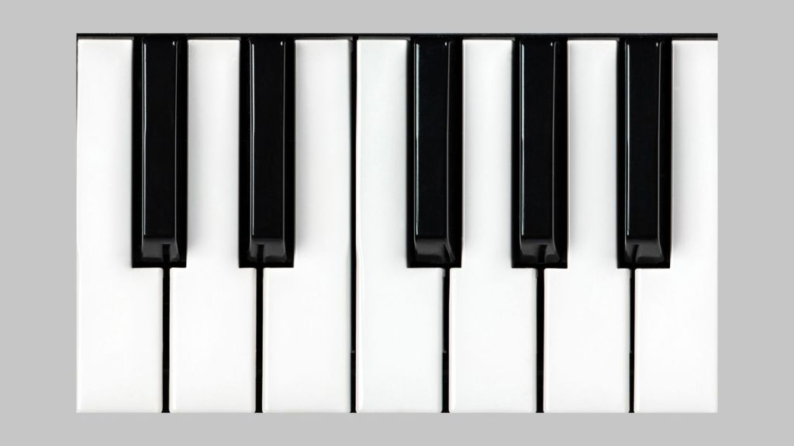
Technical challenges & Solution
Piano Keyboard (Black/White Keys)

Slide 8
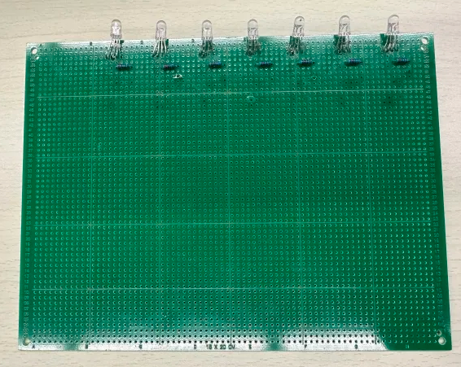
Technical challenges & Solution
RGB LED

Slide 9
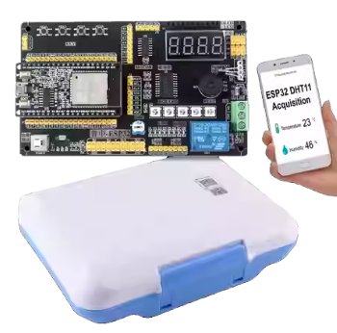
Technical challenges & Solution
ESP 32 does not have enough Pins.
The IDE is not supplying enough power to drive the ESP32.

Slide 10

Technical challenges & Solution

Slide 11
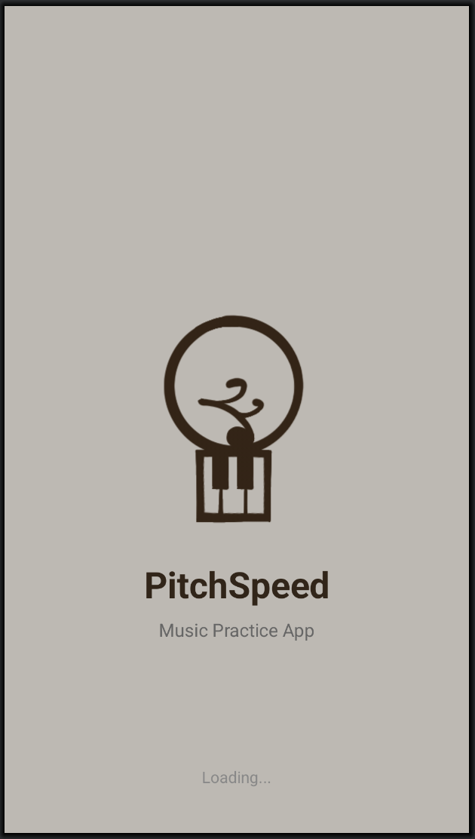
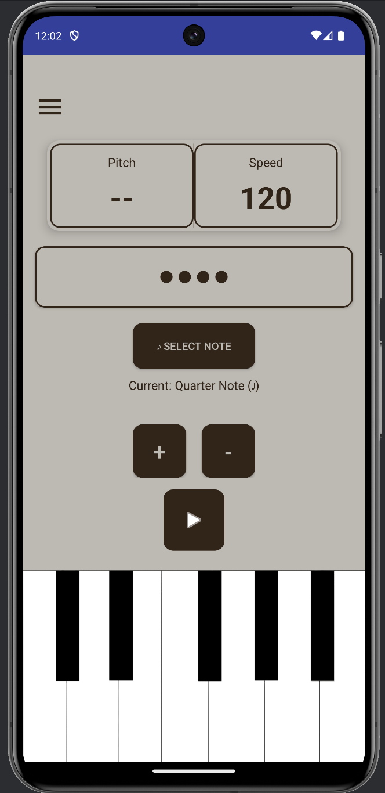
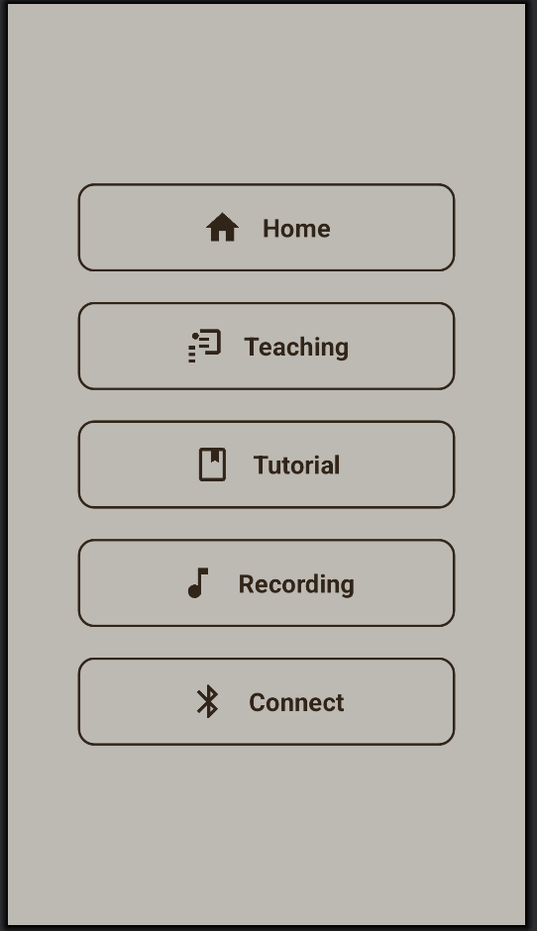
Future work ( UI Design )

Slide 12
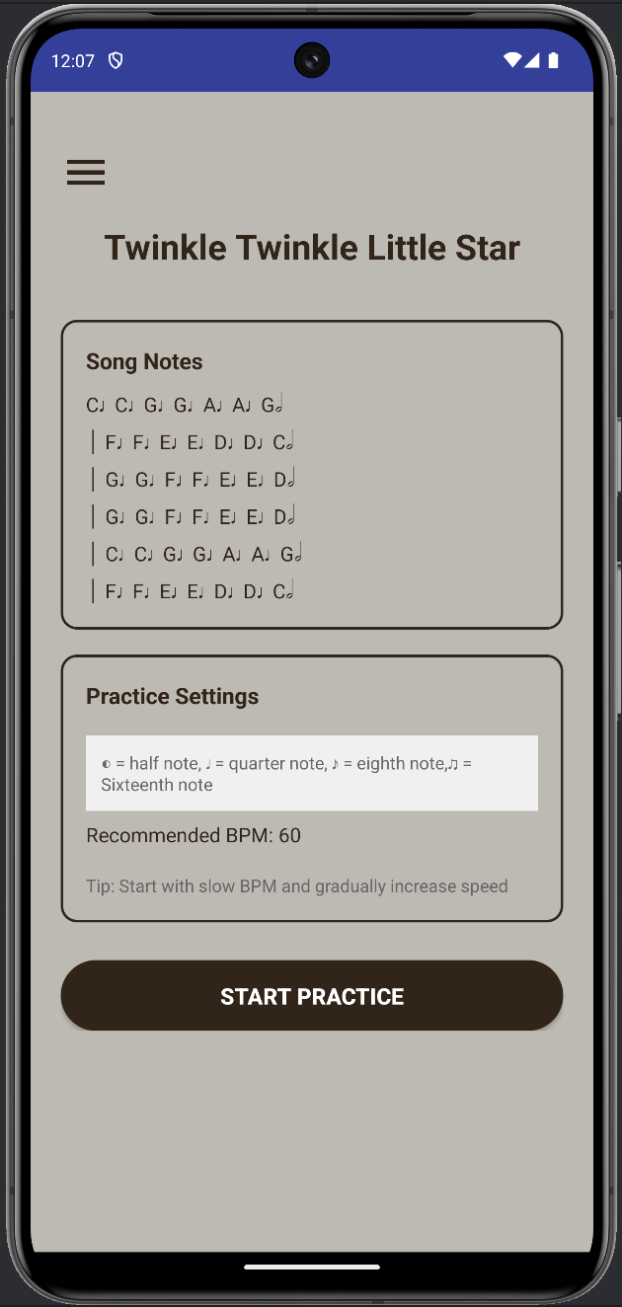
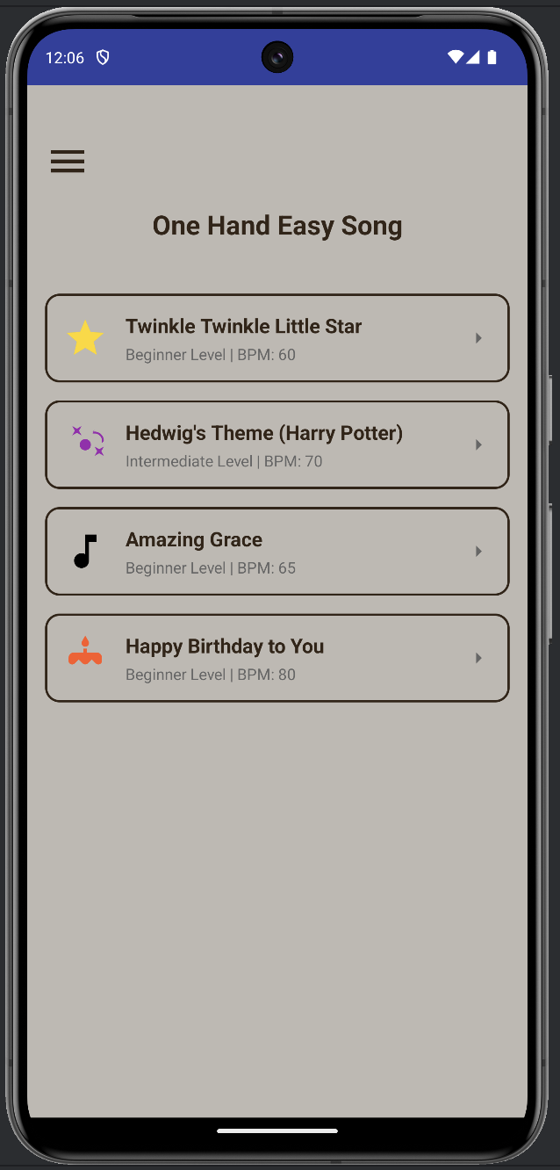
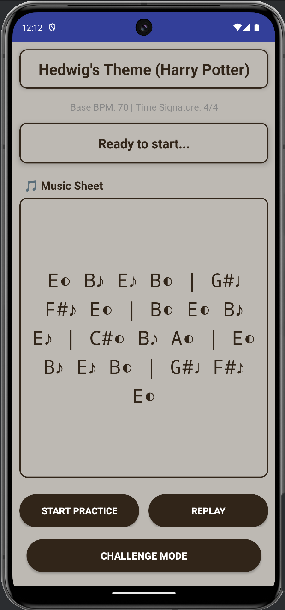

Slide 13
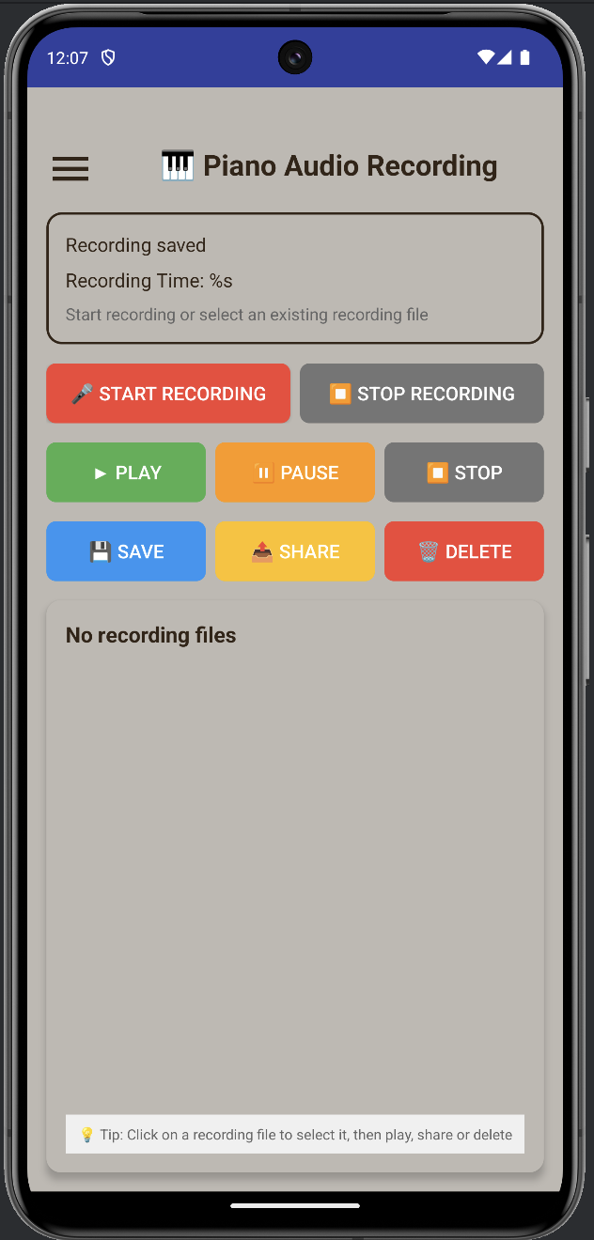
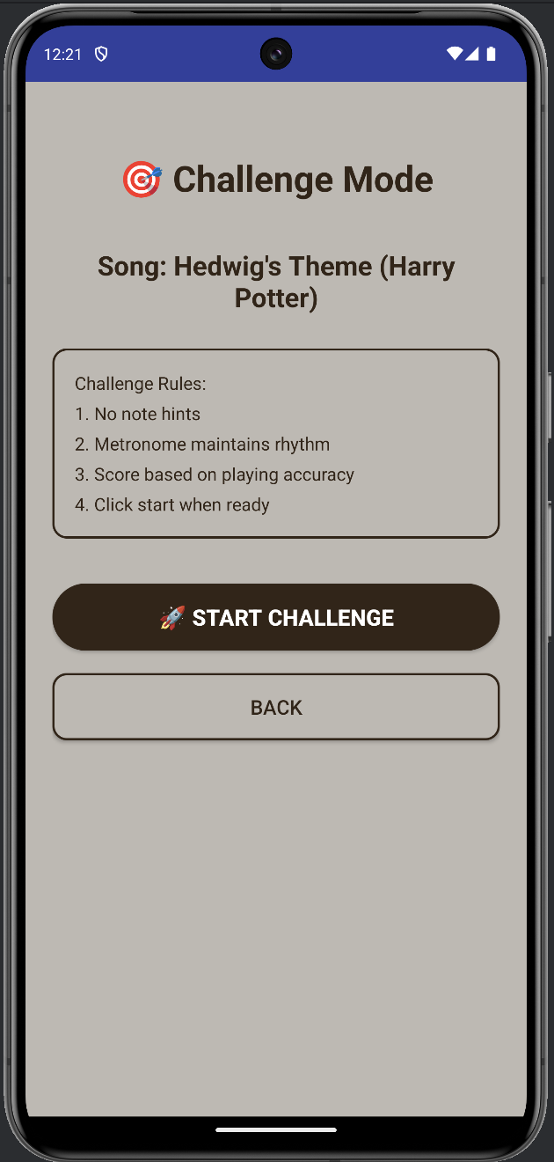
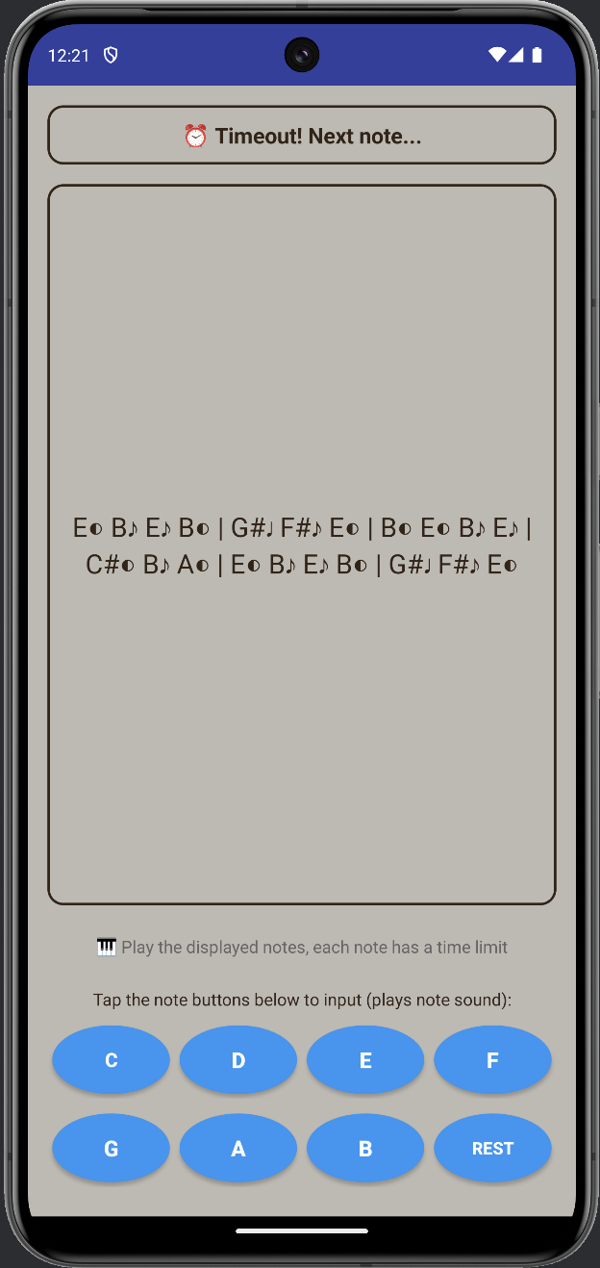
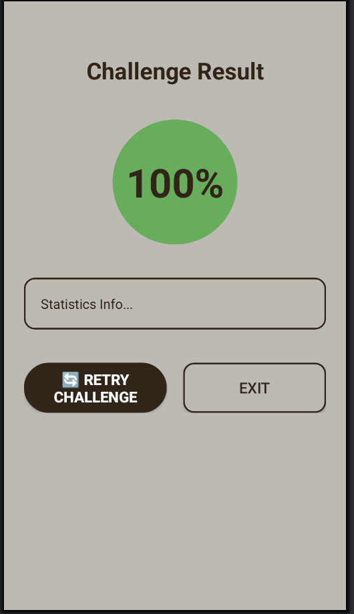

Slide 14
Demo

Slide 15
Q＆A

