Slide 1



MPI + OpenMP
February 9th, 2018
Presenters:
TBD

Slide 2
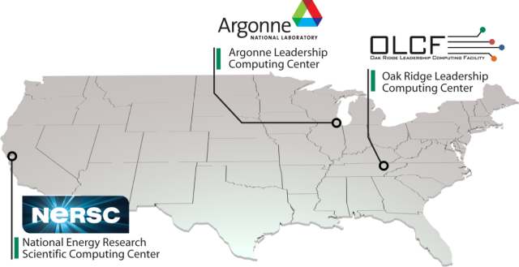



DOE’s Office of Science Computation User Facilities
DOE is leader in open High-Performance Computing
Provide the world’s most powerful computational tools for open science
Access is free to researchers who publish
Boost US competitiveness
Attract the best and brightest researchers
NERSC
Edison is 2.57 PF
ALCF
Mira is 10 PF
OLCF
Titan is 27 PF
Notes:
DOE is leader in HPC
8 of 14 fastest computers in the world
EVERY US #1 computer has been at a DOE laboratory

Slide 3
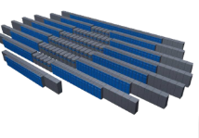
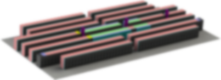

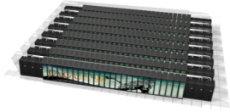
Roadmap to Exascale (ORNL)
Since clock-rate scaling ended in 2003, HPC performance has been achieved through increased parallelism. Jaguar scaled to 300,000 CPU cores. | Titan and beyond deliver hierarchical parallelism with very powerful nodes. MPI plus thread level parallelism through OpenMP or OpenACC plus vectors
OLCF5: 5-10x Summit
~20 MW
Summit: 5-10x Titan
Hybrid GPU/CPU
10 MW
Titan: 27 PF
Hybrid GPU/CPU
9 MW
Jaguar: 2.3 PF
Multi-core CPU
7 MW
CORAL System
2010
2012
2017
2022

Slide 4
Two Architecture Paths for Today and Future Leadership Systems
Power concerns for large supercomputers are driving the largest systems to either Heterogeneous or Homogenous (manycore) architectures
Heterogeneous Systems (e.g. Titan, Summit)
CPU(s) / GPU(s)
Likely to have multiple CPUs and GPUs per node
Small number of very powerful nodes
Expect data movement issues to be much easier than previous systems – coherent shared memory within a node
Multiple levels of memory – on package, DDR, and non-volatile
Homogenous (e.g. Sequoia/Mira)
10’s of thousands of nodes with millions of cores
Homogeneous cores
Multiple levels of memory – on package, DDR, and non-volatile
Unlike prior generations, future products are likely to be self hosted

Slide 5
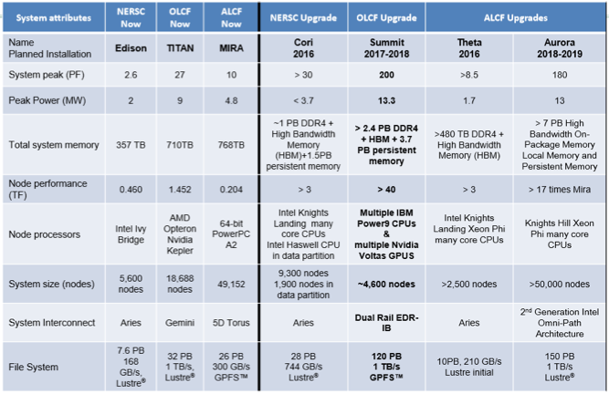
We need to redo this slide

Slide 6
Programming Model: MPI + OpenMP
Efficient programming for clusters of shared memory nodes
Hierarchical system layout
Parallelism across nodes, within node (threads, simd, accelerators)
Hybrid programming
MPI between nodes
Shared memory programming inside the node
OpenMP
MPI-3 shared memory
Accelerator support in OpenMP

Slide 7
MPI and OpenMP
Pure MPI Pro
Portable to distributed and shared memory machines
Scales beyond one node
No data placement problem
Pure MPI Cons
Difficult to developed and debug
High latency, low bandwidth
Explicit communication
Large granularity
Difficult load balancing
Pure OpenMP pros
Easy to implement parallelism
Low latency, high bandwidth
Implicit communication
Coarse and fine granularity
Dynamic load balancing
Pure OpenMP Cons
Only on shared memory systems
Scale within one node
Possibly data locality problem
No specific thread order

Slide 8
Why Hybrid MPI + OpenMP?
Homogenous and Heterogeneous systems have large core counts per node
Cori: Xeon Phi (KNL) – Total of 240 threads per node
Summit: Total 176 (SMT4) Power9 threads + 6 Volta GPUs per node
Application likely to run with MPI but not with good performance
Needs hybrid programming to manage threading, improve SIMD, accelerator programming
Many applications will not fit into the node memory using Pure MPI (e.g. per core) because of the memory overhead for each MPI task
Hybrid MPI/OpenMP is the recommended programming model to achieve scaling capability and code portability, new trend
Incremental parallelism with OpenMP for cores and accelerators
Avoids extra communication overhead within the node
Improves load-balancing across MPI tasks

Slide 9
Choices for Programming models
Pure MPI (one MPI process on each core)
Hybrid: MPI + X
Shared memory (OpenMP)
Accelerator programming (OpenMP 4.5 shared memory + offload, CUDA, etc)
Other
MPI message passing + MPI shared memory
PGAS: UPC/UPC++, CAF, GA, etc
Runtime tasks
MPI + OpenMP tend to be slower than pure MPI
Why? Many factors affect this

Slide 10
Hybrid MPI+OpenMP Programming Styles
MPI
MPI + OpenMP
OpenMP Only
Hybrid MPI +
MPI-3 (Shared Memory)
No overlap of Communication and Computation
Overlapping Communication and Communication
Material
Not covered
Master only
(outside omp parallel regions)
All threads call MPI
(inside omp parallel region)
Single Thread call MPI
(inside omp parallel region)
Offload to Accelerator(s) – (if available)
(e.g. OpenMP target regions, CUDA)

Slide 11
Slides to be added: MPI + OpenMP Programming Styles
These set of slides need to talk about:
Introducing the hybrid programming styles
Give short examples

Slide 12
MPI + OpenMP: Affinity / Placement
These set of slides needs to talk about how to control affinity and placement

Slide 13
OpenMP Thread Affinity
OpenMP provides a mechanism to map threads to hardware execution units (e.g. hardware threads, cores, sockets)
Its goal:
Maximize resource utilization
Minimize thread contention for the same hardware resource
Maximize local accesses and minimize remote memory accesses in NUMA
Develop strategies for memory latency programs vs memory bandwidth bound.
Cache reuse by threads
Bandwidth aggregation
Reduce thread synchronization overheads
Bind OpenMP threads to the hardware threads or cores

Slide 14
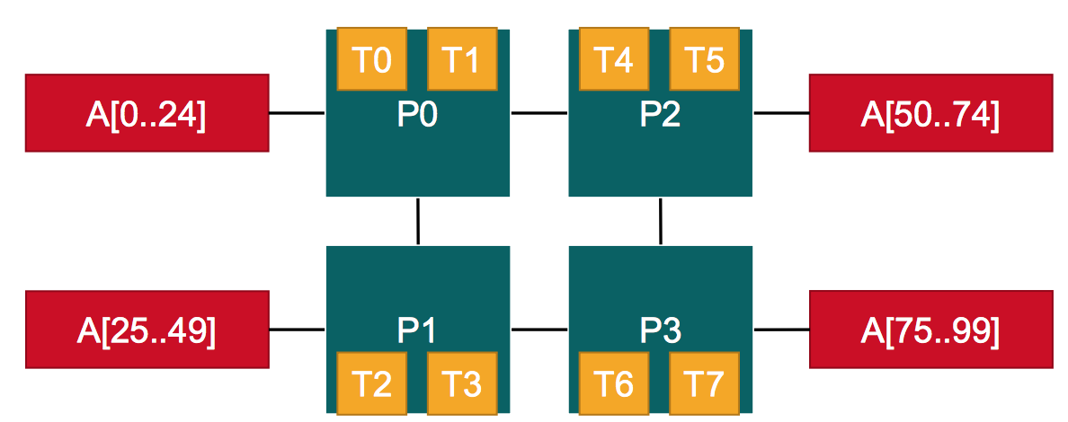
OpenMP Thread Affinity
Optimizing Thread Affinity depends on the target architecture and the application
How hw threads, cores and sockets are layout on the system and NUMA domains
How data is place in the system
How work is schedule to the threads
Hardware threads
Numa domains
Data

Slide 15
OpenMP Thread Affinity
Three main concepts:
Hardware
Abstraction
Mapping Strategy
OpenMP
Threads
OMP_PROC_BIND
Environment Variable
Or
proc_bind() clause
of parallel region
OMP_NUM_THREADS
Environment Variable
Or
num_threads() clause
of parallel region
OMP_PLACES
Environment Variable

Slide 16
Thread placement in OpenMP
Selecting the “right” binding is dependent on the architecture topology but also on the application characteristics
Putting threads apart (e.g. different sockets)
can help to improve aggregated memory bandwidth
Combine the cache sizes across cores
May increase the overhead of synchronization across far apart threads
Putting threads near (e,g. hardware threads or cores sharing caches)
Good for synchronization and data reuse
May decrease total memory bandwidth
Mapping Strategies for thread placement in OpenMP
Spread: Put threads apart from each other
Close: Put threads close to each other
Master: Put threads on the same place where the master thread runs

Slide 17
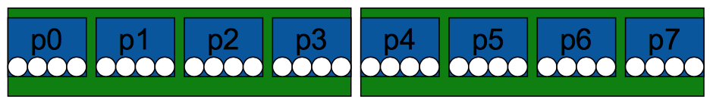
OpenMP Places – This slide needs to be improved
OpenMP places is an abstraction for a location where a thread or group of threads can run
Assume a machine with 2 sockets, 4 cores per socket, 4 hardware threads per core
A place can be mapped to a thread or set of hardware thread, core or sockets.
The use needs to define a set of places (or executing set of resources) where the OpenMP threads will be mapped to.

Slide 18
Abstract names for OMP_PLACES
Threads – abstracts a single hardware thread on a node
Cores – abstracts a single core (which can have 1 or more hardware threads) on a node
Sockets – abstracts a single processors on the node

Slide 19
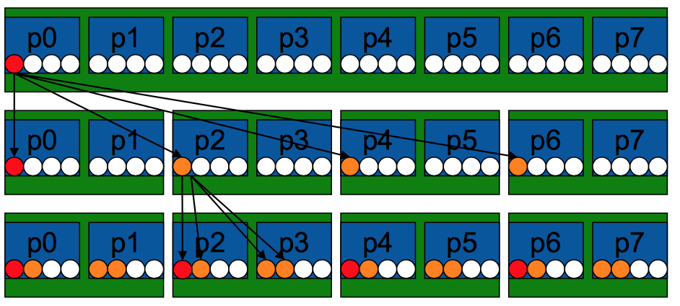
Thread Placement in OpenMP
Example’s Objective:
Separate cores for outer loop and near cores for inner loop
Outer Parallel Region: proc_bind(spread), Inner: proc_bind(close)
Spread creates partition, compact binds threads within respective partition
OMP_PLACES={0,1,2,3,}, {4,5,6,7}, … = {0:4}:8:4 = cores
#pragma omp parallel proc_bind(spread)
#pragma omp parallel proc_bind(close)
Example
intial
spread
close

Slide 20
Example: MPI + OpenMP affinity on Cori
Slides from Helen

Slide 21
OpenMP MPI+OpenMP affinity on Summit
A Summit Node: cores, hardware threads and GPUs
Node characteristics:
2 POWER9 per node
22 cores per P9
4 hardware threads per core
6 Volta GPUs connected NVLINK2
Node Configuration:
2 cores reserved for OS
Applications will have 42 cores;
168 threads hardware threads
7 cores per GPU; 28 hw threads
per GPU
GPU
GPU
POWER 9
GPU
GPU
POWER 9
GPU
GPU
Core
Hardware thread (SMT4)

Slide 22
Summit – MPI+OpenMP Affinity
jsrun is used to launch MPI, MPI+OpenMP, OpenMP (only) applications
jsrun utility controls MPI task placement and OpenMP places
MPI+OpenMP affinity set by jsrun
MPI task placement
Sets OpenMP places ICV and environment variable
Sets one OpenMP place per hardware thread.
OpenMP thread binding is set by OMP_PROC_BIND or proc_bind() clause
mpirun is also available (not preferred)
For more information on jsrun:
https://beta.olcf.ornl.gov/for-users/system-user-guides/summit/running-jobs/

Slide 23
Summit - JSRUN – Resource Sets
A resource set
Controls how resources are managed within the node
Can create one ore more resource sets within a node
Each resource set contain 1 or more cores and 0 or more GPUs
Understand how the application interacts with the system
How many tasks/threads per GPU
Does each task expect to see a single GPU? (or multiple GPUs)
Create resource sets to specify:
GPUs per resource set
Cores per resource set
MPI tasks per resource set
Distribution
Decide the # of resource set needed in applications

Slide 24
Resources sets in Summit Node
A Summit Node: cores, hardware threads and GPUs
A resource set
GPU
Resource Set (example)
1 GPU
7 cores per P9
(28 Hardware Threads (SMT4))
Node resources
A node can have up to 6 resource sets of this type
MPI tasks are distributed across resource sets. Example:
1 MPI task per resource set
2 MPI tasks per resource set
Or with other distributions (cyclic)
GPU
POWER 9
GPU
GPU
POWER 9
GPU
GPU
Core
Hardware thread (SMT4)

Slide 25
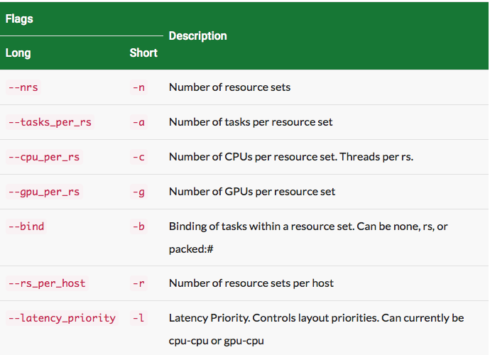
JSRUN Command
jsrun [ -n #resource sets ] [tasks, threads, and GPUs within a resource set] exec [ program args ]

Slide 26
Example of MPI+OpenMP Affinity (Dirac, GTC, HACC, NWCHEM)
1 MPI task per GPU and 28 OpenMP threads (hw threads – SMT4).
1 MPI task per GPU
NVIDIA Volta GPUs
GPU
MPI Task
OS
GPU
OpenMP thread
POWER 9
GPU
GPU
OS
POWER 9
GPU
GPU
%jsrun -n6 -g1 -a1 –c7 –brs ./a.out
Notes:
Titan Mode

Slide 27
Example of MPI+OpenMP Affinity (E3SM)
2 MPI task per GPU and 7 OpenMP threads (hw threads – SMT2).
2 MPI task access a GPU
NVIDIA Volta GPUs
GPU
MPI Task
OS
GPU
OpenMP thread
POWER 9
GPU
GPU
OS
POWER 9
GPU
GPU
%jsrun -n6 -g1 –a2 –c7 –b packed:4 ./a.out

Slide 28
Example of MPI+OpenMP Affinity (QMCPack)
1 MPI task per GPU and 7 OpenMP threads (SMT1).
All MPI tasks access all GPUs (MPS)
NVIDIA Volta GPUs
All MPI Tasks Access all GPUs
GPU
OS
MPI Task
GPU
OpenMP thread
POWER 9
GPU
GPU
OS
POWER 9
GPU
GPU
%jsrun –n1 –g6 –a6 –c42 –b packed:7 ./a.out
Notes:
1 resource set since all MPI/threads access all GPUs
Do we want MPI tasks to be contiguous within a resource set.

Slide 29
MPI+OpenMP: Affinity (LS-Dalton) / Tasking
1 MPI task per node and 42 OpenMP threads (SMT1).
One MPI task access all GPUs
NVIDIA Volta GPUs
1 MPI Task Access all GPUs
GPU
MPI Task
OS
GPU
POWER 9
OpenMP thread
GPU
GPU
OS
POWER 9
GPU
GPU
%jsrun –n1 –g6 -a1 –c42 –brs ./a.out

Slide 30
Example of MPI+OpenMP Affinity (NAMD)
10 MPI task per 3 GPU and 8 OpenMP threads (hw threads – SMT4).
10 MPI tasks access 3 GPU (MPS)
NVIDIA Volta GPUs
GPU
MPI Task
OS
3 GPUs
GPU
OpenMP thread
POWER 9
GPU
GPU
OS
3 GPUs
POWER 9
GPU
GPU
%jsrun –n2 –g3 –a10 –c21 –b packed:2 ./a.out

Slide 31
Application Case Studies
Cori
Titan
(Summit is to early)

Slide 32
Current and Future Direction of OpenMP
Barbara Slides

Slide 33
Overview: OpenMP 4.5 Update
Released at SC’15
Many refinements to device support
Clarifications and minor enhancements, including:
Reductions for C/C++ arrays
Runtime routines to support cancelation and affinity
Some new features have been added
Support for doacross loops
Divide loop into tasks with taskloop construct

Slide 34
OpenMP 4.5 substantially improves device support
Unstructured data mapping
Asynchronous execution
Scalar variables are firstprivate by default
Device runtime routines: allocation, copy, etc.
Clauses to support device pointers
Ability to map structure elements
New combined constructs
New way to map global variables (link)

Slide 35
OpenMP 4.5 has many other refinements to recent additions
Many clarifications and minor enhancements
SIMD extensions
SIMD and SIMD parallel loop chunk size control
Addition of schedule modifiers: simd, monotonic, nonmonotonic
Clarifications of thread affinity policies
Grammar for OMP_PLACES
Support for if clause on combined/composite constructs
Hints for locks and critical sections
Continues to increase Fortran 2003 support
Ten limitations remain until 5.0
Task priorities
Improved support for C++ reference types
Compiler support: http://www.openmp.org/resources/openmp-compilers/

Slide 36
OpenMP 5.0 Preview – TR6 released November 2017 Slide Needs to be updated
Major new feature is performance tool support (TR2+) -
Some significant extensions to existing functionality
Support for task reductions, including on taskloop construct
Implicit declare target directives and other verbosity reducing changes
Many clarifications and minor enhancements, including:
Use of any C/C++ lvalue in depend clauses
Addition of depend clause to taskwait construct
Addition of conditional modifier to lastprivate clause
Permits declare target on C++ classes with virtual members
Clarification of declare target C++ initializations

Slide 37
OpenMP 5.0 will significantly extend TR6 & TR5
Main Topics for 5.0
Memory locality, affinity and working with complex memory hierarchies
Updates to support latest C/C++ standards, completion of Fortran 2003
Continued improvements to device support and tasking, including:
Deep copy for mapped variables; Improved support for multiple devices
Unshackled threads, major extensions for task dependences
Interoperability and composability
Debugging tools support
OpenMP 5.0 is scheduled to be released by SC18
TR6 (TBD – SC’17) will document most additions for 5.0

Slide 38
Memory Management --- TR6 released November 2017
Language features for managing memory on systems with heterogeneous memories.
Main Concepts:
Memory Spaces --- Represents memory resources
Memory Traits --- {Location, Distance, Bandwidth, Latency, Persistence, etc}
Allocator Traits
Allocator and Directives APIs

Slide 39
Help us shape the future of OpenMP
Connect with the SOLLVE project --- WBS# 1.3.1.15
Complete our survey on the confluence site!
Application engagement via shared milestones for FY17,18,19
OpenMP continues to grow
28 members currently
You can contribute to our now planned annual TR or complete specification releases
Attend IWOMP, become a cOMPunity member
Become a member in the OpenMP ARB
OpenMP membership types will become more accessible
Please let us know if you would be interested

Slide 40
Addition Slides
Discuss tasking
Discuss accelerator model

Slide 41
OpenMP 4.5 target
Presenters:
Oscar Hernandez
Credits for some of the material
IWOMP 2016 tutorial – James Beyer, Bronis de Supinski
OpenMP 4.5 Relevant Accelerator Features – Alexandre Eichenberger
OpenMP 4.5 Seminar – Tom Scogland

Slide 42
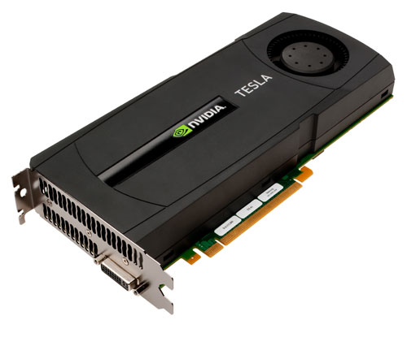
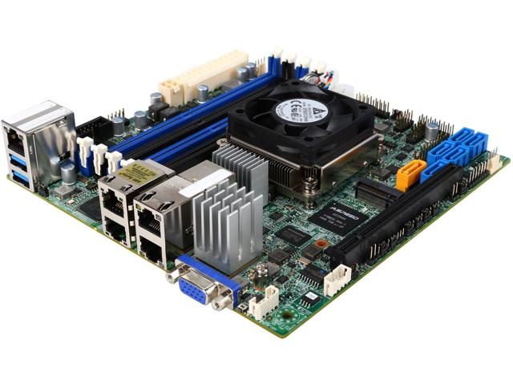
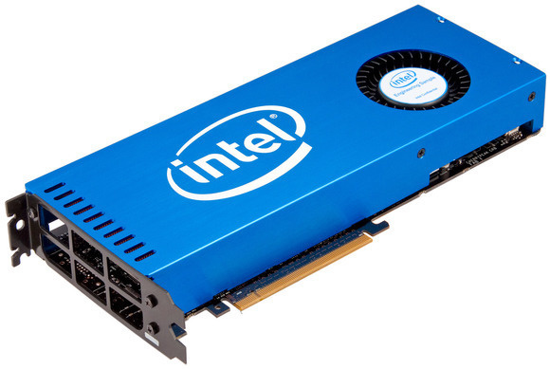
OpenMP 4.0/4.5 – Accelerator model
OpenMP 4.0/4.5 supports heterogeneous systems (accelerators/devices)
Accelerator model
One host device and
One or more target devices
Multiple devices attached
Single device attached
With attached accelerator(s)
Host Device
(CPU Multicore)
Xeon Phi(s) –
(Accelerator and self-hosted)
GPU(s)

Slide 43
OpenMP Target
Device:
An implementation-defined (logical) execution unit (or accelerator)
Device data environment
Storage associated with the device
The execution model is host-centric (or initial device)
Host creates/destroys data environment on device(s)
Host maps data to the device(s) data environment
Host offloads OpenMP target regions to target device(s)
Host updates the data between the host and device(s)

Slide 44
OpenMP 4.5 Device Constructs
Execute code on a target device
omp target [clause[[,] clause],…]
structured-block
omp declare target
[function-definitions-or-declarations]
Manage the device data environment
map ([map-type:] list)
map-type := alloc | tofrom | to | from | release | delete
omp target data [clause[[,] clause], …]
structured-block
omp target enter/exit data [clause[[,] clause], …]
omp target update [clause[[,] clause],…]
omp declare target
[variable-definitions-or-declarations]
Parallelism & Workshare for devices
omp teams [clause[[,] clause],…]
structured-block
omp distribute [clause[[,] clause],…]
for-loops
Device Runtime Support
void omp_set_default_device(int dev_num)
int omp_get_default_device(void)
int omp_get _num_devices(void)
int omp_get_team_num(void)
int omp_is_initial_device(void)
…
Environment variables
OMP_DEFAULT_DEVICE
OMP_THREAD_LIMIT

Slide 45
OpenMP target example
host thread
An example of OpenMP 4.5 for accelerators
initialize device
allocates: u, uold on device data environment
copies in: u
..
!$omp target map(to:u) map(from:uold)
!$omp parallel do collapse(2)
do j=1,m
do i=1,n
uold(i,j) = u(i,j)
enddo
enddo
!$omp end target
..
initial device thread
Device
Execute target
code
!$omp parallel do
barrier
Executed on
the device
copies out: uold
deallocates: u, uold
Use target construct to:
Transfer control from the host to the target device
Map variables to/from the device data environment
Host thread waits until target region completes
Use nowait for asynchronous execution
host thread

Slide 46
OpenMP Target and Data Regions
The map clauses determine how an original (initial device) variable in a data environment is mapped to a corresponding variable in a device data environment
Mapped variable:
An original variable in a (host) data environment has a corresponding variable in a device data environment
Mapped type:
A type that is amenable for mapped variables
Bitwise copy-able plus additional restrictions
Device(s) Data Environment
Device Mapped
Variables
Device Data Environment
Host Data Environment
Variables
Device Data Environment

Slide 47
League and teams of threads
League
Set of thread teams created by a teams construct
Contention group
Threads of a team in a league and their descendant threads
Threads can synchronize in the same contention group
#pragma omp target
// creates initial target thread
#pragma omp teams
// creates N teams of size 1
League
// creates M threads within a team
#pragma omp parallel
team
Contention Group

Slide 48
teams construct
The teams construct creates a league of thread teams
The master threads of all teams executes the team region
The number of teams is specified by the num_teams clause
Each team executes with thread_limit threads
Threads in different teams cannot synchronize with each other
Must be perfectly nested in a target construct
No statements or directives between teams and target constructs
Only special openmp constructs can be nested inside a teams construct
distribute
parallel
parallel for
parallel sections

Slide 49
distribute construct
Work-sharing construct for target and teams regions
Distribute the iterations of a loop across the master threads of the teams executing the region
No implicit barrier at the end of the construct
dist_schedule(kind[, chunk_size])
kind must be static scheduling
Chunks are distribute in round-robing fashion with chunk_size
Each team receives at least one evenly distributed chunk (if no chunk_size is specified)
#pragma omp target map(tofrom: A)
#pragma omp teams
#pragma omp distribute
for (i=0; i< N; i ++)
A[i] = ….

Slide 50
Writing Portable Device code
#pragma omp target map(tofrom: A)
#pragma omp teams distribute parallel for simd collapse(3) // combined directive
for(i=0; i<N; i++)
for(j=0; j<N; j++)
for(k=0; k<N; k++)
A[i][j][k] = ….
Use OpenMP 4 “Accelerator Model” to target multiple architectures:
GPUs, Intel Xeon Phi, and multicore CPUs, etc.
Make your OpenMP adaptable or using defaults for:
# of teams,
dist_schedule,
thread_limit #,
# of threads in parallel regions,
parallel for loop schedules,
SIMD length
Example:
Xeon Phi implementation may chose num_teams(1), thread_limit(1) and simdlen(V)
GPUs implementation may chose num_teams(N), thread_limit(M) and simdlen(V)

Slide 51
Target combined constructs (C/C++)
target parallel
target parallel for
target parallel for simd
target simd
target teams
target teams distribute
target teams distribute simd
target teams distribute parallel for simd
teams distribute
teams distribute simd
teams distribute parallel for simd

Slide 52
Questions?
#pragma omp target teams distribute
for (i=0;i<n;i++)
a[i] =
#pragma omp target teams distribute
for(i=0;i<n;i++)
c[i] = a[i];
}

