Slide 1
Agenda
Part 1 (ca. 1 hour):
Background
Parallel Regions
Sharing Work
Handling Data
Part 2 (ca. 1 hour 40 minutes):
Synchronization, Tasks, and Cancellation
Locality and Affinity
Using GPUs and SIMD features
Hybrid Programming with MPI and OpenMP
Wrap Up
Presenter:
Alice Koniges
Computational Research Division
Berkeley Lab

Slide 2
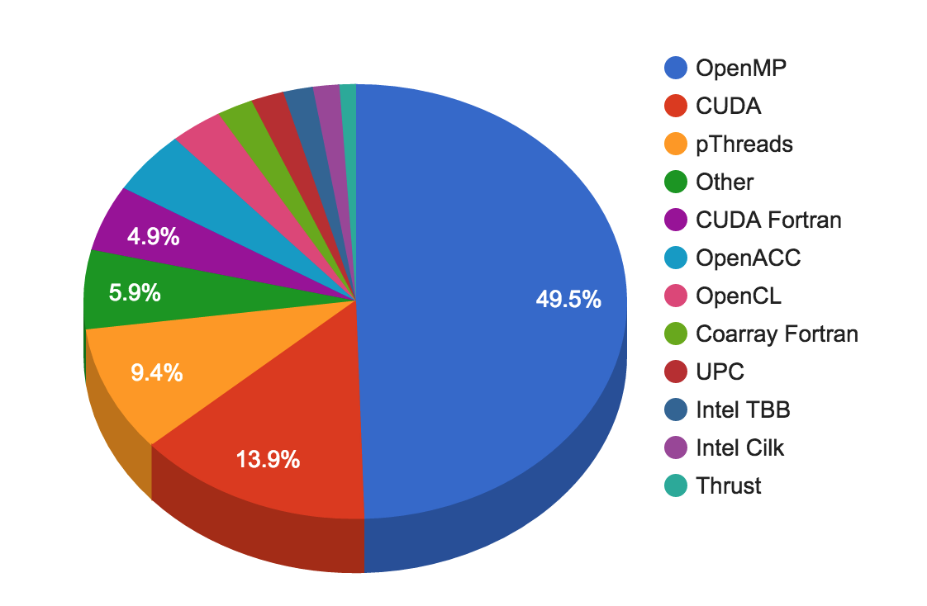
On Modern HPC systems, we need a solution to enable parallelism across nodes
MPI was developed primarily for inter-address space (inter means between or among)
OpenMP was developed for shared memory or intra-node, and now supports accelerators as well (intra means within)
Several solutions including
MPI + OpenMP
MPI + MPI
MPI + other languages
Non-MPI solutions such as HPX
Hybrid Programming is when we use a solution with different programming models for inter vs intra-node parallelism
Recall NERSC data from 2015:
When asked: If you use MPI + X,
what is X ?

Slide 3
Many Computations are amenable to a Hybrid (often MPI + OpenMP) approach
For Example:
Domains (often resulting from the decomposition of PDE’s) are spread across the large system and only need to communicate “ghost zone” information as time advances
MPI is used to communicate these ghost zone values in the form of messages passed among the nodes
In various hybrid approaches, different programming models can be used for the shared memory region. OpenMP is one choice.

Slide 4
MPI + OpenMP has been targeted for optimzed use on many systems
For example: NERSC “Cori” has many threads to keep busy
>60 cores/node, 4 hardware threads.core, 240 threads/node.
MPI + OpenMP is one obvious programming model
Potential advantages
may not fit into node using pure MPI across all HW cores and threads because of the memory overhead for each MPI task.
Conceptually nice: OpenMP within node, MPI between
Provides a way to increase fine-scale parallel granularity
Some problems have natural two-level parallelism; advanced OpenMP features extend beyond the two-level model
Some problems have a natural restriction on the number of MPI tasks

Slide 5
Hybrid Programming Models can take various forms to deal with shared memory
MPI on each core (not hybrid)
Halos between all cores
MPI uses internally shared memory and cluster communication protocols
MPI+OpenMP
Multi-threaded MPI processes
Only Halos information is communicated between MPI processes
MPI cluster communication + MPI shared memory communication
Same as “MPI on each core”, but
within the shared memory nodes, halo communication through direct copying with C or Fortran statements
MPI cluster comm. + MPI shared memory access
Similar to “MPI+OpenMP”, but
shared memory programming through work-sharing between the MPI processes within each SMP node
MPI inter-node communication
MPI intra-node communication
Intra-node direct Fortran/C copy
Intra-node direct neighbor access
Adapted from Rolf Rabenseifner (HLRS)
2014, Author:
Rolf Rabenseifner

Slide 6
The MPI+MPI model can use MPI-3.0 shared memory to reduce the memory needs for replicated data.
R
= Replicated data in each MPI process
R
R
R
R
R
R
R
R
R
R
R
R
Cluster of SMP nodes without using MPI shared memory methods
Adapted from Rolf Rabenseifner (HLRS)
[6A]
April 2016, Author:
Rolf Rabenseifner

Slide 7
The MPI+MPI model can use MPI-3.0 shared memory to reduce the memory needs for replicated data.
R
= Replicated data in each MPI process
R
R
R
R
R
R
R
R
R
R
R
R
Cluster of SMP nodes without using MPI shared memory methods
R
= Shared memory → replicated data only once within
each SMP node
new
R
R
R
Direct loads & stores, no library calls
Adapted from Rolf Rabenseifner (HLRS)
[6A]
April 2016, Author:
Rolf Rabenseifner

Slide 8
OpenMP in a simple hybrid implementation Pseudo Code is fairly easy
Program hybrid
call MPI_INIT (ierr)
call MPI_COMM_RANK (…)
call MPI_COMM_SIZE (…)
… some computation and MPI communication
call OMP_SET_NUM_THREADS(4)
!$OMP PARALLEL DO PRIVATE(i)
!$OMP& SHARED(n)
do i=1,n
… computation
enddo
!$OMP END PARALLEL DO
… some computation and MPI communication
call MPI_FINALIZE (ierr)
end
What is required to get started? Next slide.

Slide 9
The MPI Standard Defines 4 Levels of Thread Safety that affect Hybrid
Note that these are not specific to Hybrid OpenMP Models
The are in the form of commitments that the multithreaded application makes to the MPI implementation
MPI_THREAD_SINGLE: only one thread in the application
MPI_THREAD_FUNNELED: only one thread makes MPI calls, the Master Thread in the OpenMP context (next slide)
MPI_THREAD_SERIALIZED: Multiple threads make MPI calls, but only one at a time (not concurrently)
MPI_THREAD_MULTIPLE: Any thread may make MPI calls at any time, no restrictions
MPI-2 defines an alternative to MPI_Init
MPI_Init_thread(requested, provided)
Allows applications to say what level it needs, and the MPI implementation to say what it provides
Notes:
Mostly for calling MPI within a parallel region. It depends on which version you have available.

Slide 10
Use MPI_INIT_Thread to specify how the interaction will take place
MPI_INIT_THREAD (required, provided, ierr)
IN: required, desired level of thread support (integer).
OUT: provided, provided level of thread support (integer).
Returned provided may be less or more than required.
Environment Variable MPICH_MAX_THREAD_SAFETY | Thread support level
not set | MPI_THREAD_SINGLE
single | MPI_THREAD_SINGLE
funneled | MPI_THREAD_FUNNELED
serialized | MPI_THREAD_SERIALIZED
multiple | MPI_THREAD_MULTIPLE

Slide 11
What This Means in the OpenMP Context
MPI_THREAD_SINGLE
No OpenMP multithreading in the program.
MPI_THREAD_FUNNELED
All of the MPI calls are made by the master thread i.e., all MPI calls are
Outside OpenMP parallel regions, or
Inside OpenMP master regions, or
Guarded by call to MPI_Is_thread_main MPI call.
(same thread that called MPI_Init_thread)
MPI_THREAD_SERIALIZED
#pragma omp parallel
…
#pragma omp critical
{
…MPI calls allowed here…}
MPI_THREAD_MULTIPLE
Anything goes; any thread may make an MPI call at any time
Notes:
There are no threads in the system
♦ E.g., there are no OpenMP parallel regions

Slide 12
MPI Calls Inside OMP MASTER
MPI_THREAD_FUNNELED is required.
OMP MASTER does not include any barrier. If the application needs a barrier (e.g., to prevent race conditions between the buffer usage in the MPI call and some numerical buffer read or write in other threads) then explicit OMP BARRIERs may be needed.
Such barriers would imply that all other threads are sleeping
!$OMP BARRIER
!$OMP MASTER
call MPI_xxx(…)
!$OMP END MASTER
!$OMP BARRIER

Slide 13
MPI Calls Inside OMP SINGLE
MPI_THREAD_SERIALIZED is required.
OMP_BARRIER may be needed at the beginning since OMP_SINGLE only guarantees synchronization at the end.
This would also imply that all other threads are sleeping!
!$OMP BARRIER
!$OMP SINGLE
call MPI_xxx(…)
!$OMP END SINGLE

Slide 14
Overlapping communication and computation is a critical performance tool
Need at least MPI_THREAD_FUNNELED.
Many “easy” hybrid programs only need MPI_THREAD_FUNNELED
While this single master is making MPI calls, other threads are computing
Must be able to separate codes that can run before or after ghost zone or halo info is received. Can be very hard conceptually
May lose compiler optimizations such as vectorization
!$OMP PARALLEL
if (my_thread_rank < 1) then
call MPI_xxx(…)
else
do some computation
endif
!$OMP END PARALLEL

Slide 15
Hybrid Parallelization Strategies
From sequential code, decompose with MPI first, then add OpenMP.
From OpenMP code, treat as serial code.
From MPI code, add OpenMP.
Simplest and least error-prone way is to use MPI outside parallel region, and allow only master thread to communicate between MPI tasks. MPI_THREAD_FUNNELED is usually the best choice.
Could use MPI inside parallel region with thread-safe MPI.
Avoid MPI_THREAD_MULTIPLE if you can. It slows down performance due to the usage of global locks for thread safety.

Slide 16
Programming Tips for Adding OpenMP
Choose between fine grain or coarse grain parallelism implementation.
Use profiling tools to find hotspots. Add OpenMP and check correctness incrementally.
Parallelize outer loop and collapse loops if possible.
Minimize shared variables, minimize barriers.
Decide whether to overlap MPI communication with thread computation.
Simplest and least error-prone way is to use MPI outside parallel region, and allow only master thread to communicate between MPI tasks.
Could use MPI inside parallel region with thread-safe MPI.
Consider OpenMP TASKing.

Slide 17
Why Hybrid MPI/OpenMP Code is Sometimes Slower?
All threads are idle except one while MPI communication.
Need overlap comp and comm for better performance.
Critical Section for shared variables.
Thread creation overhead
Cache coherence, false sharing.
Data placement, NUMA effects.
Natural one level parallelism problems.
Check performance of pure OpenMP in a node to pure MPI in a node

Slide 18
If a Routine Does Not Scale Well
Examine code for serial/critical sections, eliminate if possible.
Reduce number of OpenMP parallel regions to reduce overhead costs.
Perhaps loop collapse, loop fusion or loop permutation is required to give all threads enough work, and to optimize thread cache locality. Use NOWAIT clause if possible.
Pay attention to load imbalance. If needed, try dynamic scheduling or implement own load balance scheme.
Experiment with different combinations of MPI tasks and number of threads per task. Less MPI tasks may not saturate inter-node bandwidth.
Test different process and thread affinity options.
Leave some cores idle on purpose, for memory capacity or bandwidth capacity.

Slide 19
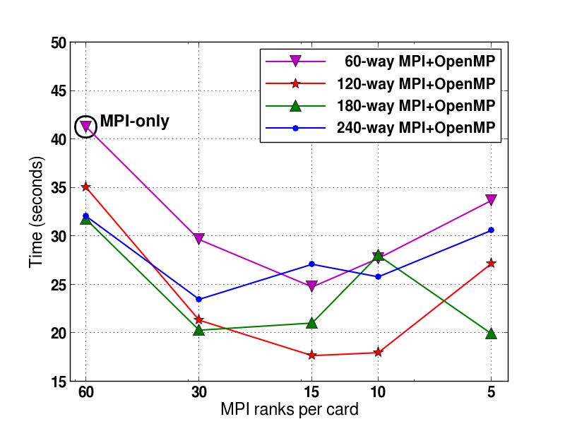
Varying MPI ranks and OpenMP threads can help find optimal configuration
Flash Kernel on Babbage
Each line represents multiple runs using fixed total number of cores = #MPI tasks x #OpenMP threads/task.
Scaling may depend on the kernel algorithms and problem sizes.
In this test case, 15 MPI tasks with 8 OpenMP threads per task is optimal.
Lower is Better
Courtesy of Chris Daley, NERSC
Find the sweet spot for hybrid MPI/OpenMP.

Slide 20
New Directions are Emerging for Hybrid Programming with MPI + OpenMP
MPI Endpoints (part of the proposal only)
Dan Holmes (EPCC) & Hybrid Programming Group of MPI Forum
Idea is to have multiple addressable communication entities within a single MPI process
These would be instantiated as multiple ranks per MPI process
Each of these could be associated with one or more threads
More flexible interface
Individually addressable threads
Multiple threads concurrently in MPI without needing full MPI_THREAD_MULTIPLE support
Multiple threads active in collective operations
Multi-thread packing/unpacking
Multi-thread processing of reduction
operations
Application
User Endpoint
User Endpoint
User Endpoint
MPI
CTX
CTX
Hardware

Slide 21
Hybrid programming with MPI + OpenMP is a viable and efficient model
MPI+OpenMP interoperability can happen in multiple ways – Funneled and Serialized modes are most common where a single thread makes MPI calls at a time
THREAD_MULTIPLE is becoming increasingly common where multiple threads can make MPI calls simultaneously (“fully multi‐threaded”)
Now provided by almost all implementations
Optimization is important
Other options such as “MPI everywhere” are also possible, especially with advanced MPI options
Solutions with no MPI (not covered here) are also emerging (HPX)
Improvements such as “endpoints” may eventually lead to more options than just funneled, serialized and multiple

