Slide 1
Syntactic Analysis

Slide 2
Compilation Overview
Front End
Back End
Semantic
Analysis and
Intermediate
Code Generation
Lexical
Analysis
(aka Scanning)
Syntactic
Analysis
(aka Parsing)
Machine Independent Optimizations
Target
Code
Generation
Target
Specific
Optimizations
Symbol Table
Output
(for instance, a binary file)
Input (*.c file)

Slide 3
Syntactic Analysis (Parsing)
x + 4 * y;
start
Syntactic rules of programming language defined in a Context Free Grammar (or just grammar)
Conceptually, attempts to construct a parsing tree:
e
e
+
t
PASS
Simple arithmetic grammar:
start → e ;
e → e + t
e → t
t → t * f
t → f
f → ID
f → NUM
t
t
f
*
f
f
ID
ID
NUM

Slide 4
Syntactic Analysis (Parsing)
x + 4 * ;
start
Syntactic rules of programming language defined in a Context Free Grammar (or just grammar)
Conceptually, attempts to construct a parsing tree:
e
e
+
t
FAIL
Simple arithmetic grammar:
start → e ;
e → e + t
e → t
t → t * f
t → f
f → ID
f → NUM
// rule f does not produce the empty string
t
t
f
*
f
f
ε
ID
NUM

Slide 5
Overview
Grammars
Parsing and derivation trees
Building LL and LR parsers

Slide 6
Context Free Grammars
Regular Expressions are unable to specify nested constructs
Consider the following:
expr → id | number | - expr | ( expr )
| expr op expr
op → + | - | * | /
Need the ability to represent recursion, something in terms of itself
For instance, cannot describe matching parenthesis with RE alone
Tokens in bold
Non-terminals in italic
| means “or”
→ means “can be replaced by”

Slide 7
Context Free Grammars (CFG)
expr → id
| number
| - expr
| ( expr )
| expr op expr
op → +
| -
| *
| /
CFG or grammar for short
”Context Free” means that rules are applicable independently of the context or surroundings
Each rule in a CFG is a production
Symbols on the left-hand side are variables or non-terminals
A variable can have any number of productions
Tokens (symbols in bold) are also known as terminals (because they don’t have a right-hand sides or productions)
Tokens cannot appear on the left-hand side of productions
Some non-terminal is chosen as the start symbol
Notation known as Backus-Naur Form (BNF)
Owed to John Backus and Peter Naur who designed it for Algol-60

Slide 8
Context Free Grammars (CFG)
expr → id
number
expr → - expr
| ( expr )
| expr op expr
op → +
| -
| *
| /
If I forget to mark some symbol in bold or italic, the role of the symbol can be easily determined from its context
It’s totally fine to write productions either with → or with |

Slide 9
Context-Free Grammars
In summary, a CFG consists of:
a set of terminals T
a set of non-terminals N
a non-terminal S identified as the start symbol
a set of productions

Slide 10
Scanning and Parsing
Recall that tokens such as IDENTIFIER and NUMBER actually represent sets of strings acceptable by a language
The parser, however, does not distinguish between “1.5”, “1” or “10000.0000”.
The actual values (as number, strings or names) are stored in the symbol table along the parsing process

Slide 11
Derivation and Parse Trees
A CFG allows to generate syntactically valid string of terminals, i.e. a valid program:
Begin with start symbol
Choose a production with the start symbol on the left-hand side
Replace start symbol with right-hand side of production
Choose a non-terminal A in resulting string
Choose a production P with A on the left-hand side, and replace A with the right-hand side of P

Slide 12
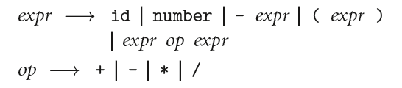
Context-Free Grammars
Consider the previous grammar for arithmetic expressions:
How could we produce the string “slope * x + intercept” ?

Slide 13
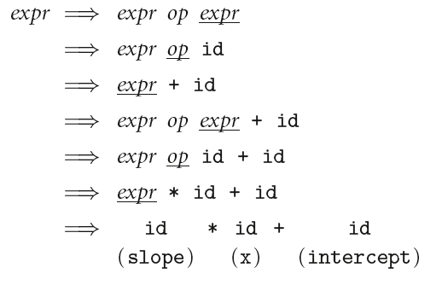
Context-Free Grammars
slope * x + intercept

Slide 14
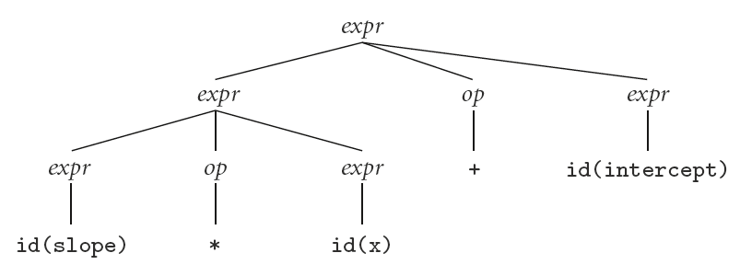
Context-Free Grammars
slope * x + intercept
Sentential forms
A parse tree

Slide 15
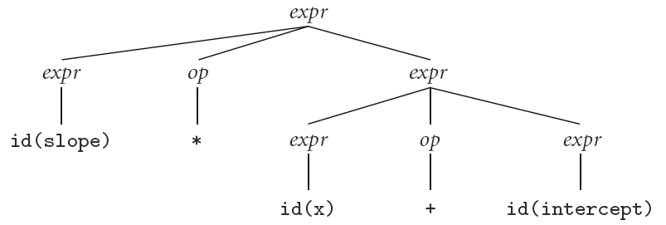
Context-Free Grammars
slope * x + intercept
Another parse tree

Slide 16
Context-Free Grammars
slope * x + intercept
Is there any difference?
Thoughts?

Slide 17
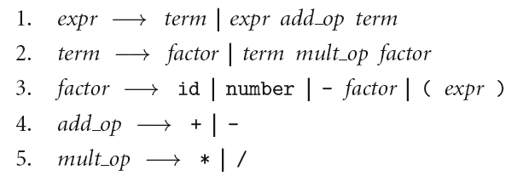
Context-Free Grammars
How about we re-write the grammar as:

Slide 18
Context-Free Grammars

Slide 19
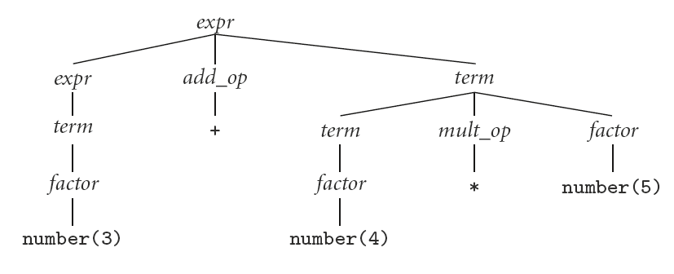
Context-Free Grammars
Left-recursion

Slide 20
Derivations
Left-most vs right-most derivation: which non-terminal is chosen for the next derivation step
Left-most derivation: always derive the first non-terminal found in the sentential form, moving from left-to-right
Right-most derivation: always derive the first non-terminal found in the sentential form, moving from right-to-left
Do not confuse left-recursion or right-recursion with left-most derivation and right-most derivation

Slide 21
Capturing Structure
Languages can be designed to capture several aspects, for example associativity and precedence
Associativity: the order in which a sequence of instances of the same operator is computed
Example :
10 – 4 – 3 is computed as (10 – 4 ) – 3 ➔ (left associative operator)
rather than 10 – (4 – 3) ➔ (right associative operator)
Precedence: some operators are applied before others
Example:
3 + 4 * 5 = 3 + (4 * 5) instead of (3 + 4) * 5

Slide 22
Capturing Structure
In a parse tree, operators with higher precedence appear closer to the leaves of the tree
Equivalently, operators with lower precedence appear closer to the root of the tree
In bison/yacc, associativity is managed with a directive:
%left '<‘
%left '-’
%left '*'
More info in: http://web.mit.edu/gnu/doc/html/bison_8.html

Slide 23
Exercises
Design a grammar for defining lists of equalities, inequalities and logical expressions.
Create a grammar for drawing points, lines, circles, rectangles. Language should allow to place figures in a plane.
Define a grammar for set operations, with variables and assignments.
Extend the arithmetic grammar to handle rational numbers.

Slide 24
Recapping Terminology
Context-Free Grammar (CFG)
Symbols: terminals (tokens) and non-terminals
Productions
Derivations (left-most and right-most)
Parse trees
Sentential form

Slide 25
Context-Free Grammars
By analogy to RE and DFAs, a context-free grammar (CFG) is a generator for a context-free language (CFL)
a parser is a language recognizer
There is an infinite number of grammars for every context-free language
not all grammars are created equal, however

Slide 26
Parsing
We can create parsers that run in O(n^3) time for any CFG
Two well-known parsing algorithms that permit this
Early's algorithm
Cooke-Younger-Kasami (CYK) algorithm
O(n^3) time is clearly unacceptable for a parser in a compiler - too slow

Slide 27
Parsing
Fortunately, there are large classes of grammars for which we can build parsers that run in linear time
The two most important classes are called LL and LR
LL stands for 'Left-to-right, Leftmost derivation'.
LR stands for 'Left-to-right, Rightmost derivation’

Slide 28
Parsing
LL parsers are also called “top-down”
LR parsers are also called “bottom-up”, include “shift-reduce” parsers
There are several important sub-classes of LR parsers, for example:
SLR (Simple LR)
LALR (Look-Ahead LR)
We won't be going into detail on the differences between them

Slide 29
LL vs LR Parsing: Visually
1
Assumes input string was produced via a left-most derivation
Top-down discovery
In general: moves down and right
8
Assumes input string was produced via a right-most derivation
Bottom-up discovery
In general: moves up and left
2
4
7
5
3
6
5
8
4
1
6
7
3
2

Slide 30
Parsing
Class | Direction of Scanning | Derivation Discovered | Parse Tree Construction | Algorithms Used
LL | Left-to-right | Left-most | Top-down | Predictive, Recursive-Descent
LR | Left-to-right | Right-most | Bottom-up | Shift-reduce
Main classes of O(n) parsing algorithms

Slide 31
Parsing
Will commonly see LL(K) or LR (K)
K indicates how many tokens of look-ahead are required in order to parse
Almost all real compilers use one token of look-ahead
The expression grammar (with precedence and associativity) previously seen is LR(1), but not LL(1)

Slide 32
Parsing
Every LL(1) grammar is also LR(1), though right recursion in production tends to require very deep stacks and complicates semantic analysis
Every CFL (Context Free Language) that can be parsed deterministically has an SLR(1) grammar (which is LR(1))
Every deterministic CFL with the prefix property (no valid string is a prefix of another valid string) has an LR(0) grammar

Slide 33
Top-down and Bottom-up Parsing
Go over the string:
“A, B, C;”
With the grammar:
id_list → id id_list_tail
id_list_tail → , id id_list_tail
id_list_tail → ;

Slide 34
Top-Down Parsing
Starts at the root of the parsing tree
Reads input from left to right
Recursive Descent Parsers: Use one procedure (function/sub-routine) for each non-terminal (can use for terminals too, but that’s overkill)
Recursive rules → recursive procedural calls
Optional use of back-tracking:
Trial and Error
Make recursive call, if error found, back-track and test another production
Certain assumptions on grammar: left-factored, no left-recursion, not ambiguous
If no back-tracking, then must be a predictive parser:
Uses token to “predict”, really just decide wisely
Leverage parsing table (every possible decision appears in table)

Slide 35
LL Parsing
An example of an LL(1) grammar:
program → stmt_list $$
stmt_list → stmt stmt_list
| ε
stmt → id := expr
| read id
| write expr
expr → term term_tail
term_tail → add op term term_tail
| ε
term → factor fact_tail
fact_tail → mult_op fact fact_tail
| ε
factor → ( expr )
| id
| number
add_op → +
| -
mult_op → *
| /

Slide 36
LL Parsing
Consider the program:
read A
read B
sum := A + B
write sum
write sum / 2

Slide 37
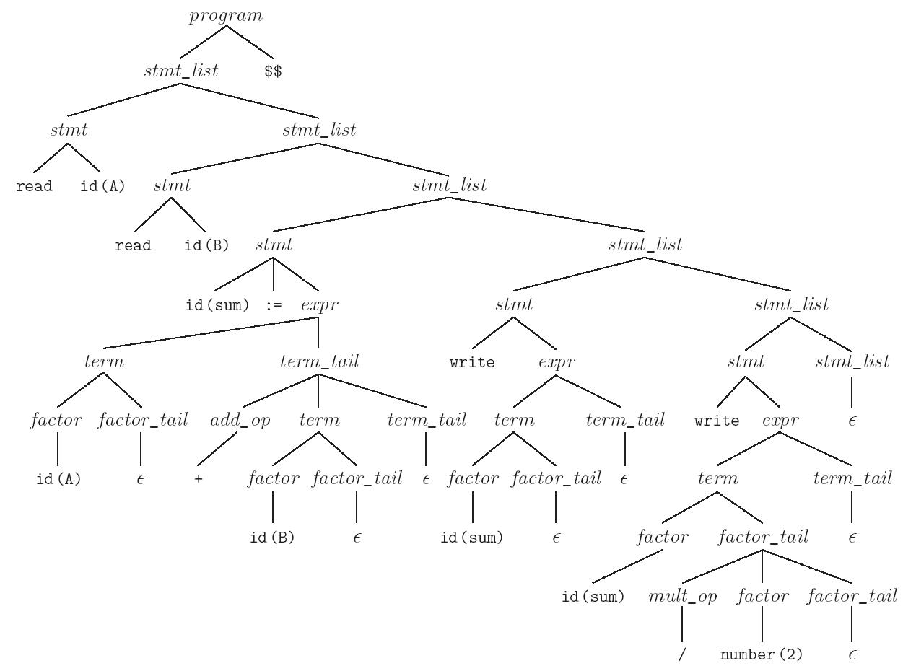
LL Parsing

Slide 38
LL Parsing
Process tokens in a loop
Repeatedly look up an action in a two-dimensional table based on current leftmost non-terminal and current input token.
The actions are
(1) match a terminal
(2) predict a production
(3) announce a syntax error

Slide 39
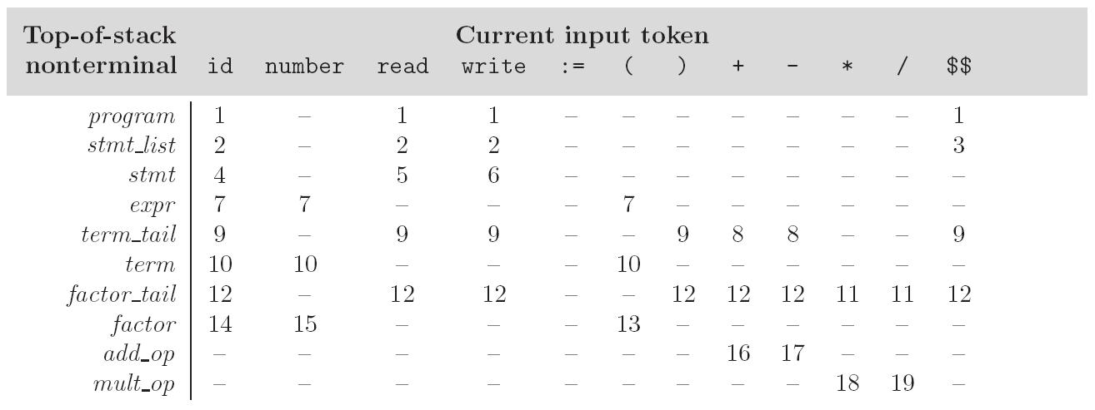
LL Parsing
LL(1) parse table for calculator grammar
Taken from book: Programming Language Pragmatics

Slide 40
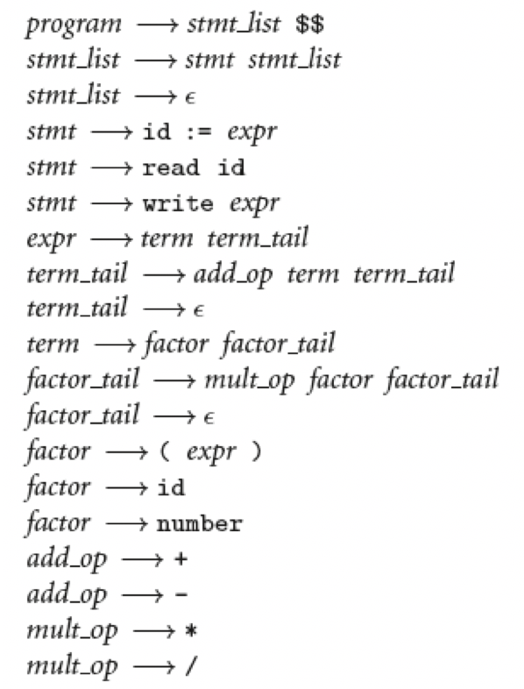
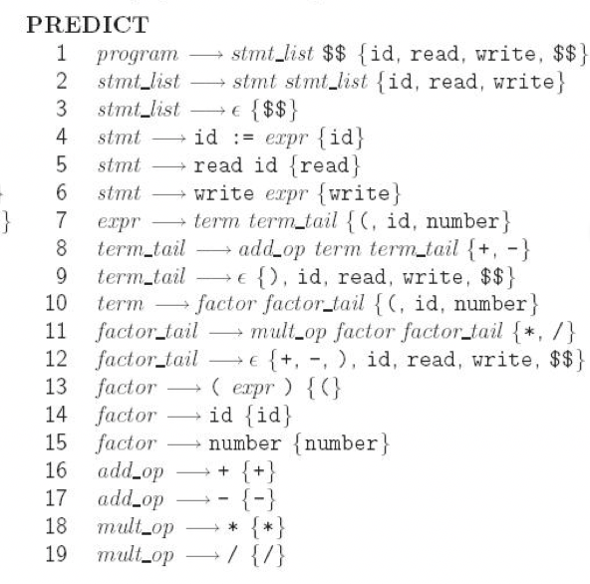
LL Parsing
Grammar
Predict Sets
Example string:
read a;
write a + b * 2;
LL(1) parse table for calculator grammar
Taken from book: Programming Language Pragmatics

Slide 41
LL Parsing
To keep track of the left-most non-terminal, you push the as-yet-unseen portions of productions onto a stack
for details see Figure 2.21
The key thing to keep in mind is that the stack contains all the stuff you expect to see between now and the end of the program
what you predict you will see

Slide 42
LL Parsing
Some issues with LL parsing:
Left-recursion
Common prefixes
Dangling else
NOTE: eliminating left recursion and common prefixes alone does NOT guarantee that the resulting grammar will be LL:
there are infinitely many non-LL LANGUAGES, and the mechanical transformations work on them just fine
the few that arise in practice, however, can generally be handled with kludges

Slide 43
LL Parsing
Fixing left recursion:
id_list → id
| id_list , id
Becomes
id_list → id id_list_tail
id_list_tail → , id id_list_tail
| epsilon

Slide 44
LL Parsing
Common prefixes: solved by "left-factoring”
Example:
stmt → id := expr
| id ( arg_list )
equivalently
stmt → id id_stmt_tail
id_stmt_tail → := expr
| ( arg_list)
we can eliminate the left-factor mechanically

Slide 45
LL Parsing
The “dangling else” problem prevents grammars from being LL(1) (or in fact LL(K) for any K)
The following natural grammar fragment is ambiguous (Pascal)
stmt → if cond then_clause else_clause
| other_stmt
then_clause → then stmt
else_clause → else stmt
| ε

Slide 46
LL Parsing
The less natural grammar fragment can be parsed bottom-up but not top-down
stmt → balanced_stmt
| unbalanced_stmt
balanced_stmt → if cond then balanced_stmt
else balanced_stmt | other_stuff
unbalanced_stmt → if cond then stmt | if cond then balanced_stmt
else unbalanced_stmt

Slide 47
LL Parsing
Usual fix (top-down OR bottom-up): use the ambiguous grammar together with a disambiguating rule that says
else goes with the closest then or
more generally, the first of two possible productions is the one to predict (or reduce)

Slide 48
LL Parsing
Better yet, languages (since Pascal) generally employ explicit end-markers, which eliminate this problem
In Modula-2, for example, one says:
if A = B then
if C = D then E := F end
else
G := H
end
Ada says 'end if'; other languages say 'fi'

Slide 49
LL Parsing
Overall parsing algorithm
Build First and Follow sets
First set: terminals that can start some symbol (including terminals)
Follow set: terminals that can appear after replacing some non-terminal; focuses on the right-hand side of a production.
Example: A → B C D
What terminals will Follow C? Intuitively, those that D can start with
What terminals can A start with? By inspection, at least the same as B
Build parsing table and driver with sets (NOTE: We will not cover this in class, but please try to read about this somewhere)

Slide 50
LL Parsing
repeat
next_sym = stack.pop ()
if (next_sym in Terminals)
match (next_sym) // removes symbol from input and compares against expected token
if (next_sym == $) return ACCEPT
else if (table[next_sym,next_token].action == ERROR)
parse_error
else
prod = table[next_sym,next_token].prod
foreach sym in reverse(rhs(prod))
tack.push (sym)
until stack.top () == $ // $ is the End-of-File; typical convention in compilers

Slide 51
Example of LL parsing Table
Stack | id | Num | Read | Write | := | ( | ) | + | - | * | / | $
prog | 1 |  | 1 | 1 |  |  |  |  |  |  |  | 1
s_list | 2 |  | 2 | 2 |  |  |  |  |  |  |  | 3
stmt | 4 |  | 5 | 6 |  |  |  |  |  |  |  | -
expr | 7 | 7 |  |  |  | 7 |  |  |  |  |  | -
t_tail | 9 |  | 9 | 9 |  |  | 9 | 8 | 8 |  |  | 9
term | 10 | 10 |  |  |  | 10 |  |  |  |  |  | -
f_tail | 12 |  | 12 | 12 |  |  | 12 | 12 | 12 | 11 | 11 | 12
factor | 14 | 15 |  |  |  | 13 |  |  |  |  |  | -
add_op | -- |  |  |  |  |  |  | 16 | 17 |  |  | -
mul_op | -- |  |  |  |  |  |  |  |  | 18 | 19 | -

Slide 52
LL Parsing
Consider the following simpler grammar:
E → T E’
E’ → + E
E’ → ε
T → NUM T’
T → ( E )
T’ → * T
T’ → ε

Slide 53
LL Parsing: Building the First Sets
Building the FIRST set
FIRST(a): set of terminals that can start a string of terminals
T: Set of terminal symbols
N: Set of non-terminal symbols
Rules:
If t in T: First(t) = {t}
If X in N and X → ε exists: add ε to First(X)
If X in N and X → Y₁ Y₂ … Y_{m} then:
for i in 1..m:
if (i = 1 or Y₁…Y_{i-1} is nullable)
First(x) = First(x) U First(Y_{i})

Slide 54
LL Parsing: Building the First Sets
foreach t in T
Eps(t) = false
First(t) = { t }
foreach X in N
Eps(X) = if X → ε then true else false
First(X) = {}
repeat
foreach production X → Y1 Y2 … Yk,
for i in 1..k
add First(Yi) to First(X)
if (not Eps(Yi)) continue with foreach loop
Eps(X) = true
until no further progress
Algorithm to build First sets

Slide 55
Building the First Sets: Example
Apply rule (1):
Symbol | First
( | (
) | )
+ | +
* | *
NUM | NUM
T’
E’
T
E

Slide 56
Building the First Sets: Example
Apply rule (2), we have E’ → ε and T’ → ε
Symbol | First
( | (
) | )
+ | +
* | *
NUM | NUM
T’ | ε
E’ | ε
T
E

Slide 57
Building the First Sets: Example
Non-terminal set
Symbol | First
( | (
) | )
+ | +
* | *
int | NUM
T’ | ε
E’ | ε
T | {NUM, ( }
E | {NUM, ( }
Rule (3):
3. If X in N and X → Y₁ Y₂ … Y_{m}, then:
for i in 1..m:
if (i = 1 or Y₁…Y_{i-1} is nullable)
First(x) = First(x) U First(Y_{i})
E → T E
First(E) = First(E) U First(T)
Computing First(T) = {NUM, ( } (By rule a)
So First(E) = First(T)
We don’t include First(E’) because T is not nullable
E → T E’
E’ → + E
E’ → ε
T → NUM T’
T → ( E )
T’ → * T
T’ → ε

Slide 58
Building the First Sets: Example
Symbol | First
( | (
) | )
+ | +
* | *
int | NUM
T’ | ε
E’ | ε, +|
T | NUM, (
E | NUM, (
Rule (3):
3. If X in N and X → Y₁ Y₂ … Y_{m} then:
for i in 1..m:
if (i = 1 or Y₁…Y_{i-1} is nullable)
First(x) = First(x) U First(Y_{i})
E → T E’
E’ → + E
E’ → ε
T → NUM T’
T → ( E )
T’ → * T
T’ → ε
First (E’) = { ε, + }

Slide 59
Building the First Sets: Example
Symbol | First
( | (
) | )
+ | +
* | *
int | NUM
T’ | ε, ∗
E’ | ε, +
T | NUM, (
E | NUM, (
Rule (3):
3. If X in N and X → Y₁ Y₂ … Y_{m}, then:
for i in 1..m:
if (i = 1 or Y₁…Y_{i-1} is nullable)
First(x) = First(x) U First(Y_{i})
E → T E’
E’ → + E
E’ → ε
T → NUM T’
T → ( E )
T’ → * T
T’ → ε
First (T’) = { ε, * }

Slide 60
LL Parsing: Building the Follow Sets
Computing the Follow sets of non-terminals
If $ is the input end-marker, and S is the start symbol, $ ∈ FOLLOW(S).
Intuition: The only symbol that can follow a complete program, is the end of file.
If there is a production, A → αBβ, then (FIRST(β) – ε) ⊆ FOLLOW(B).
Intuition: The symbols that follow B are those that start β (skip ε)
If there is a production, A → αB, or a production A → αBβ, where ε ∈ FIRST(β), then Follow(A) ⊆ Follow(B).
Intuition: B is (effectively) the last symbol on the right-hand side of the production,
so its Follow set should include the Follow of A
NOTE: α and β are any sequence of symbols (terminals and non-terminals)

Slide 61
LL Parsing: Building the Follow Sets
foreach symbol X
Follow(X) = { } // Initialize to empty set
repeat
foreach production A → α B β
Follow(B) = Follow(B) U First(b)
foreach production A → α B or A → α B β with Eps(b)=True
Follow(B) = Follow(B) U Follow(A)
until no further progress
Predicate that evaluates
if a symbol can derive in the
empty string ε
This is a fixed point
algorithm: continue to (re-)compute until nothing changes

Slide 62
LL Parsing: Building the Follow Sets
Computing the Follow set of non-terminals
If $ is the input end-marker, and S is the start symbol, $ ∈ FOLLOW(S).
→ Include $ in Follow(S)
E → T E’
E’ → + E
E’ → ε
T → NUM T’
T → ( E )
T’ → * T
T’ → ε

Slide 63
LL Parsing: Building the Follow Sets
If there is a production, A → αBβ, then (FIRST(β) – ε) ⊆ FOLLOW(B).
We look at the occurrences of non-terminals on the right-hand side of productions which are followed by something
2a. E → T E’
Follow(T) contains First(E’) = {ε,+} – {ε} = {+}
2b. T → ( E )
Follow(E) contains (at least) First(‘)’) = { ) }
Follow(E) now becomes {$, ) }
The . (DOT) is not part of the grammar.
It marks the end of a
non-terminal,
i.e. what we are trying to compute

Slide 64
LL Parsing: Building the Follow Sets
Step 3
Rule 3 says, given A → αB, or A → αBβ and ε in FIRST(β), then add FOLLOW(A) to FOLLOW(B)
E → T E’ Follow( E’ ) contains (at least) Follow( E ), so Follow(E’) = { ), $ } (from step 2b)
ε in First( E’ ), so rule 3 applies to T: Follow( T ) contains (at least) Follow( E ), so Follow(T) = { ), $, +} (from step 2a and 2b)
E’ →+ E Follow( E ) contains (at least) Follow( E’ ), so Follow(E) = { ), $ } (from step 3a)
T → NUM T’ Follow( T’ ) contains (at least) Follow( T ), so Follow(T’) = { ), $, +}. (from step 3b)
T’→*T Follow( T ) contains (at least) Follow( T’ ), so Follow(T) = { ), $ } (from step 3d)

Slide 65
LL Parsing: Building the Follow Sets
Rule 3 says, given A → αB, or A → αBβ and ε in FIRST(β), then add FOLLOW(A) to FOLLOW(B)
[Continuation of Step 3] We do this whole process again until no more additions happen:
E→T E’ Follow( E’ ) contains (at least) Follow( E ), Follow(E’)= { ), $ } (no change)
ε in First( E’ ) , to rule 3 applies to T again: Follow( T ) contains (at least) Follow( E ), Follow(T) = { ), $, +} (no change)
E’ → + E Follow( E ) contains (at least) Follow( E’ ), Follow(E) = { ), $ } (no change)
T → NUM T’ Follow( T’ ) contains (at least) Follow( T ), Follow(T’) = { ), $, +} (no change)
T’ →* T Follow( T ) contains (at least) Follow( T’ ), Follow(T) = { ), $ } (no change)

Slide 66
LL Parsing: Building the First and Follow Sets
Symbol | First | Follow
( | ( | N/A
) | )
+ | +
* | *
int | int
T’ | ε, ∗ | ), $, +
E’ | ε, + | ), $
T | int, ( | ), $, +
E | int, ( | ), $
Final First and Follow sets

Slide 67
LR Parsing
Builds a forest of partial subtrees of the parse tree
Performs a replacement of the form Y₁ Y₂ … Y_{k} → A when the production A → Y₁ Y₂ … Y_{k} is recognized
Table driven
Roots of partially recognized sub-trees stored in a stack
Produces reversed right-most (canonical) derivations

Slide 68
LL vs LR Parsing: Visually
1
Assumes input string was produced via a left-most derivation
Top-down discovery
In general: moves down and right
8
Assumes input string was produced via a right-most derivation
Bottom-up discovery
In general: moves up and left
2
4
7
5
3
6
5
8
4
1
6
7
3
2

Slide 69
LR Parsing
Shift action: performed when a new token is found in the input, it’s shifted to the stack
Reduce action: performed when the right-hand side of a production is recognized, pop symbols from stack and insert non-terminal of the left-hand side of the production
Role of stack is the main difference between LL and LR parsing:
Top-down parsing: stack contains symbols that expects to see in the future
Bottom-up parsing: stack contains symbols of what the parsing already has seen

Slide 70
LR Parsing
Stack Contents (Sentential Forms) | Remaining Input String | Action
$ | A , B , C ; | SHIFT
$ ID (A) | , B , C ; | SHIFT
$ ID (A) , | B , C ; | SHIFT
$ ID (A) , ID (B) | , C ; | SHIFT
$ ID (A) , ID (B), | C ; | SHIFT
$ ID (A) , ID (B) , ID (C) | ; | SHIFT
$ ID (A), ID (B) , ID (C) ; |  | REDUCE
$ ID (A), ID (B) , ID (C) id_list_tail |  | REDUCE
$ ID (A) , ID (B) id_list_tail |  | REDUCE
$ ID (A) id_list_tail |  | REDUCE
$ id_list |  | REDUCE
A grammar producing list of identifiers:
id_list → ID id_list_tail
id_list_tail → , ID id_list_tail
id_list_tail → ;
Symbols in right-hand side of
production that are being replaced
by the left-hand side (non-terminal)
constitute the handle of the sentential form

Slide 71
LR Parsing
Left recursion allows the parser to collapse lists as it goes along (contrast with previous example by trying a list from e → e + t)
Left recursion also captures left associativity while keeping operators and operands together in the same right-hand side
This wasn’t possible in top-down grammars
e → t e’
e’ → + t e’
e’ → ε
t → f t’
t’ → * f
t’ → ε
f → ( e )
f → ID
f → NUM
e → e + t
e → t
t → t * f
t → f
f → ( e )
f → ID
f → NUM
LL Grammar
LR Grammar

Slide 72
LR Parsing Example
Remaining Input String | Stack Contents (Sentential Forms) | Action
ID + NUM * ID $ | $ (0) | SHIFT ID, GOTO 1
+ NUM * ID $ | $ (0) ID (1) | REDUCE by 6 (fact → ID)
+ NUM * ID $ | $ (0) fact | Back to state 0
+ NUM * ID $ | $ (0) fact | GOTO 7
+ NUM * ID $ | $ (0) fact (7) | REDUCE by 4 (term → fact)
+ NUM * ID $ | $ (0) term | GOTO 6
+ NUM * ID $ | $ (0) term (6) | REDUCE by 2 (expr → term)
+ NUM * ID $ | $ (0) expr | GOTO 5
+ NUM * ID $ | $ (0) expr (5) | SHIFT +, GOTO 11
NUM * ID $ | $ (0) expr (5) + (11) | SHIFT NUM, GOTO 2
* ID $ | $ (0) expr (5) + (11) NUM (2) | REDUCE by 5 (fact → NUM)
* ID $ | $ (0) expr (5) + (11) fact | GOTO 7
Use together with grammar in canvas (.output file)

Slide 73
LR Parsing Example
Remaining Input String | Stack Contents (Sentential Forms) | Action
* ID $ | $ (0) expr (5) + (11) fact | GOTO 7
* ID $ | $ (0) expr (5) + (11) fact (7) | REDUCE by 4 (term → fact)
* ID $ | $ (0) expr (5) + (11) term | GOTO 14
* ID $ | $ (0) expr (5) + (11) term (14) | SHIFT *, GOTO 12
ID $ | $ (0) expr (5) + (11) term (14) * (12) | SHIFT ID, GOTO 1
$ | $ (0) expr (5) + (11) term (14) * (12) ID (1) | REDUCE by 6 (fact → ID)
$ | $ (0) expr (5) + (11) term (14) * (12) fact | GOTO 15
$ | $ (0) expr (5) + (11) term (14) * (12) fact (15) | REDUCE by 3 (term → term * fact)
$ | $ (0) expr (5) + (11) term | GOTO 14
$ | $ (0) expr (5) + (11) term (14) | REDUCE by 1 (expr → expr + term)
$ | $ (0) expr | GOTO 5
$ | $(0) expr (5) | SHIFT $, GOTO 10
 | $ (0) expr (5) $ (10) | ACCEPT

Slide 74
LR Parsing
Key: keeping track of the set of productions on which the parser might be, and the position within the productions
At the beginning, the stack’s parser is empty; our state is at the beginning of the start non-terminal symbol
We represent the position in some production (i.e. the location associated to the top of the parser stack) with a dot symbol (.) in some position of the right-hand side of a production:
A → . B β
A → α B . β

Slide 75
LR Parsing
When augmented with a (.) a production becomes an LR item
The LR item tells us in which production we can be, and it what position:
e →. e + t
e → t
t → t * f
t → f
f → ( e )
f → ID
f → NUM
e → e + t
e → . t
t → t * f
t → f
f → ( e )
f → ID
f → NUM
e → e + t
e → t
t → . t * f
t → f
f → ( e )
f → ID
f → NUM
e → e + t
e → t
t → t * f
t → . f
f → ( e )
f → ID
f → NUM
e → e + t
e → t
t → t * f
t → f
f → . ( e )
f → . ID
f → . NUM

Slide 76
LR Parsing
e →. e + t
e → t
t → t * f
t → f
f → ( e )
f → ID
f → NUM
The original item is the basis of the list
Remaining items are the closure:
e → e + t
e → . t
t → t * f
t → f
f → ( e )
f → ID
f → NUM
e → e + t
e → t
t → t * f
t → . f
f → ( e )
f → ID
f → NUM
e → e + t
e → t
t → t * f
t → f
f → . ( e )
f → . ID
f → . NUM
e → e + t
e → t
t → . t * f
t → f
f → ( e )
f → ID
f → NUM

Slide 77
LR Parsing
The list of LR items represents the state of the parser
By shifting and reducing, the set of items will change
If a state in which some item has the (.) at the end of the right-hand side of a production, we reduce by that production
If we need to shift, but the next token cannot follow the (.) in any item of the current state, then we detect a syntax error
e →. e + t
e → . t
t → . t * f
t → . f
f → . ( e )
f → . ID
f → . NUM

Slide 78
LR Parsing
Suppose the input string is: ID * NUM + ID
Next token is ID, which is shifted into the stack
Our options are now narrowed down to #6 ➔ single basis and empty closure
Since the (.) is at the end #6, we must reduce
e → . e + t
e → . t
t → . t * f
t → . f
f → . ( e )
f → . ID
f → . NUM
t → t * f .
t → f .
6. f → ID .
Stack: $
Stack: $ ID
Stack: $ f

Slide 79
LR Parsing
Remaining input string is: * NUM + ID
We could be either in #3 or #4
(.) is at the end of #4, so reduce again
Next token is *, so we shift it into the stack
t → t * f
t → f .
t → t . * f
t → f
t → t * . f
Stack: $ f
Stack: $ t
Stack: $ t *

Slide 80
LR Parsing
Remaining input string is: NUM + ID
We could be either in #3, #5, #6 or 7
Next token is NUM, we should then be in #7
Shift token from input to stack
t → t * . f
f → . ( e )
f → . ID
f → . NUM
t → t * f
f → ( e )
f → ID
f → NUM .
3. t → t * f .
e → e + t .
e → t .
Stack: $ t *
Stack: $ t * ID
Stack: $ t * f
Stack: $ t

Slide 81
LR Parsing
Remaining input string is: + ID
We have reached the end of #2: reduce
Next token is +, shift it to stack
New item list mark the beginning with t
First item is the basis;
remaining items form the closure
e → e + . t
e → t
e → e + . t
3. t → . t * f
t → . f
f → . ( e )
f → . ID
f → . NUM
e → e + t
e → t .
e → e . + t
e → t
Stack: $ t
Stack: $ e
Stack: $ e +
Stack: $ e +

Slide 82
LR Parsing
Remaining input string is ID, we shift it
Reduce ID by f
Reduce f by t
Reduce e + t by e
6. f → . ID
6. f → ID .
4. t → f .
1. e → e + t .
4. e → t .
Stack: $ e +
Stack: $ e + ID
Stack: $ e + f
Stack: $ e + t
Stack: $ e

Slide 83
LR Parsing
Shift rules work as transition functions in the automaton
Each state of the automaton corresponds to a list of items
Set of items represent where we can be at some point in the parsing process
Sets of items constructed during the parser construction, but not needed during actual parsing

Slide 84
LR Parsing
Family of parsers:
LR(0): cannot handle shift-reduce conflicts
SLR(1) or Simple LR: parser peeks at input and use Follow sets to resolve conflicts (reduction A → α is applied if the next token is in Follow(α))
Issues arise when the token is also in the First set of the symbols following a (.)
LALR(1):
Use state-specific look-ahead to disambiguate
Most common parsers; resolve more conflicts
Full LR:
Much larger and complex than LALR and
Duplicates states

Slide 85
LR Parsing
LR Parsing algorithm:
loop
state = stack.top ()
if (state == start_state and sym == start_sym)
accept

