Slide 1
Part 1: Introduction

Slide 2
Summary
Historical overview
Classification and spectrum of programming languages
Structure of a compiler

Slide 3
Why Programming Languages
It’s one of the fundamental courses (others, IMHO being algorithms, operating systems, theory & complexity, and computer architecture / organization)
As a systems course, it brings together many areas and subjects:
Algorithms and data structures: graphs, lists, you will use it!
Theory and complexity: regular expressions, automata, you will use it.
Operating systems: process abstractions, memory segments, concurrency. They are all needed in PL, and guess what, you will use them!
Computer architecture: number of cores, number of sockets, cache sizes, memory size, memory bandwidth. OK, you will not use them in this course, but in general, we do use them (a lot)!

Slide 4
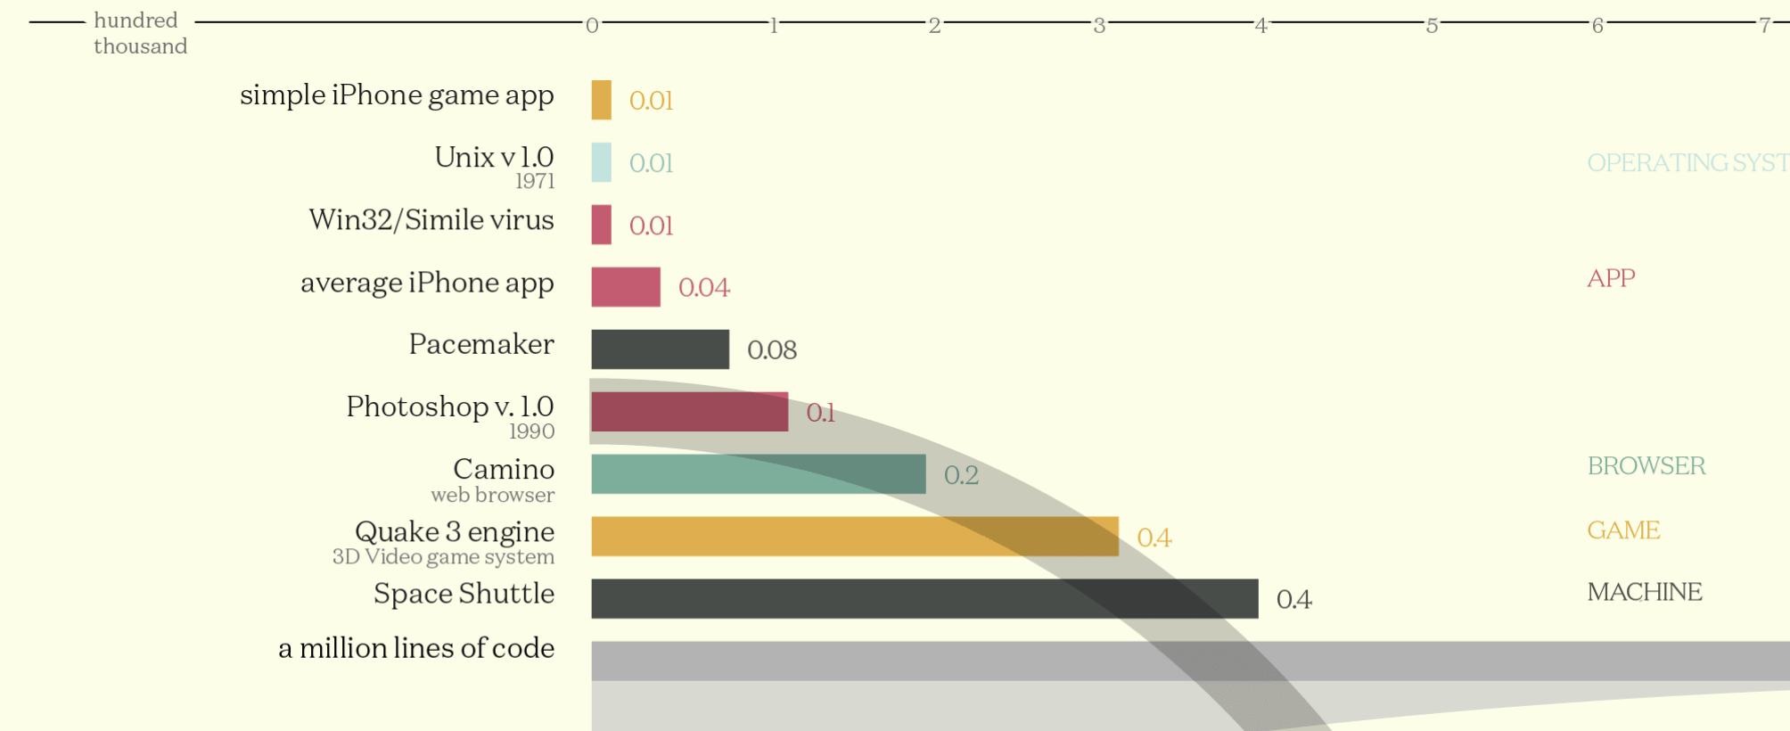
Some Statistics for better Context
https://www.informationisbeautiful.net/visualizations/million-lines-of-code/

Slide 5
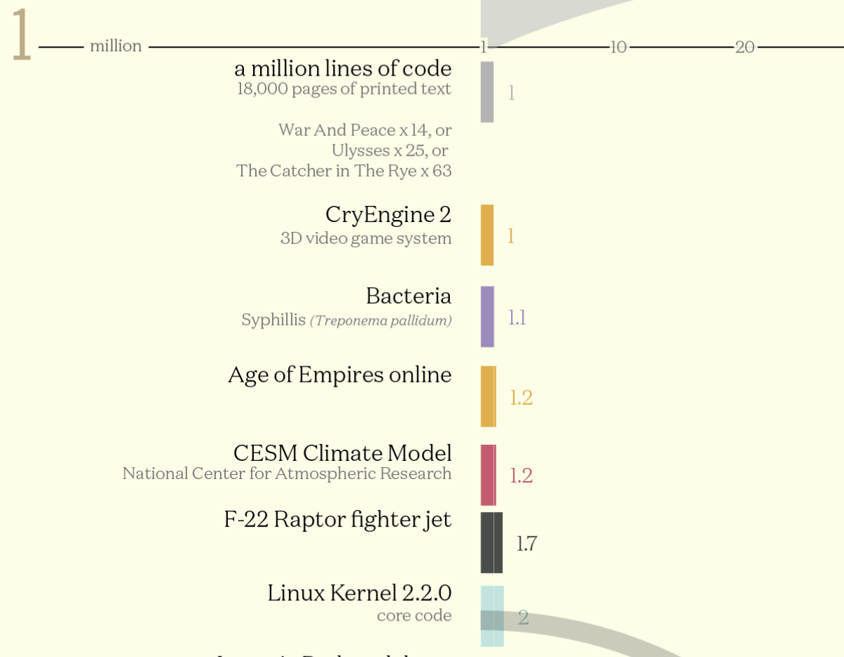
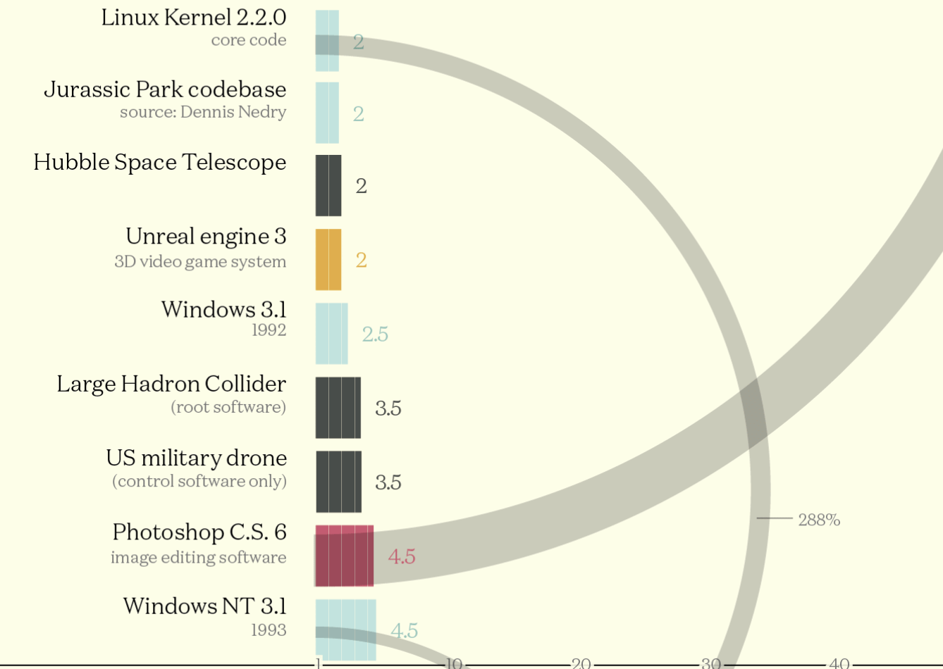
Some Statistics for better Context
https://www.informationisbeautiful.net/visualizations/million-lines-of-code/

Slide 6
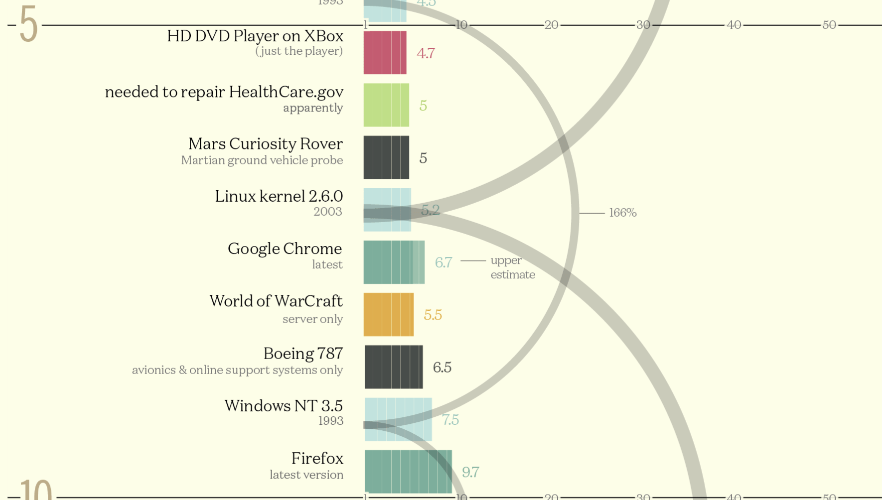
Some Statistics for better Context
https://www.informationisbeautiful.net/visualizations/million-lines-of-code/

Slide 7
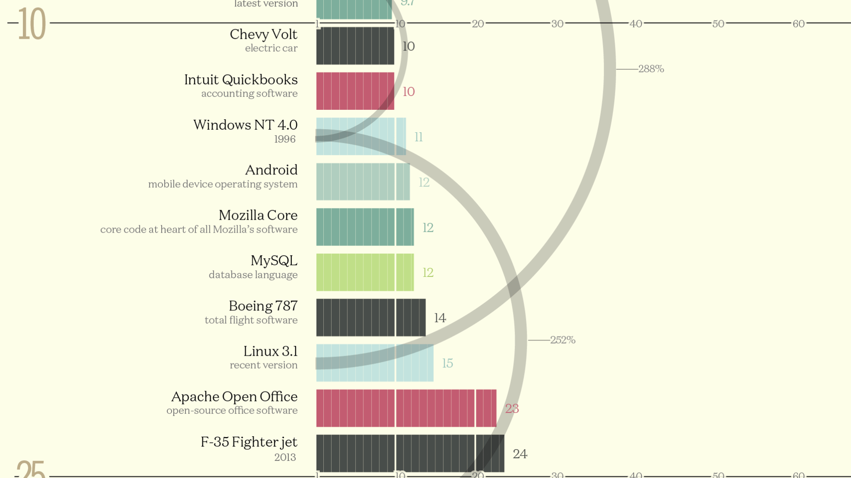
Some Statistics for better Context
https://www.informationisbeautiful.net/visualizations/million-lines-of-code/

Slide 8
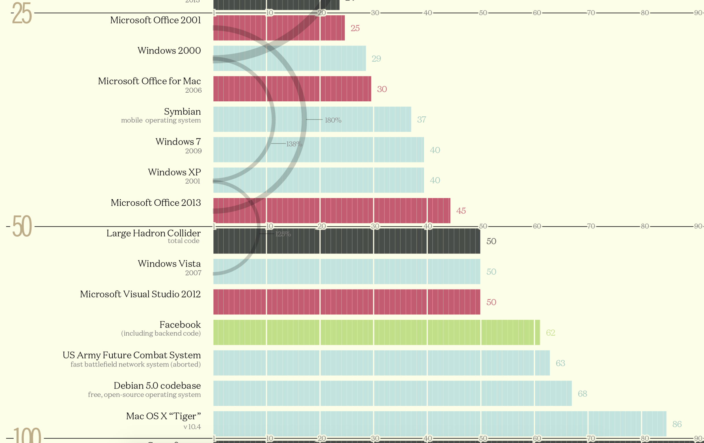
Some Statistics for better Context
https://www.informationisbeautiful.net/visualizations/million-lines-of-code/

Slide 9
Lines of Code in GCC
Taken from: https://www.phoronix.com/

Slide 10
Lines of Code in LLVM
Does not include
LLVM’s sub-projects
such as Clang, Compiler-RT, and many others
https://www.phoronix.com/scan.php?page=news_item&px=MTU1MzY

Slide 11
Preliminaries
First language: machine instructions
Assembly: mnemonics, macro expansion
Originally, each computer had its own language
Need for “machine independent language”: code portability, reuse
1950s: first version of Fortran (Formula Translator), followed by Lisp and Algol
Languages are implemented as compilers and interpreters
Compilers translate from source ”high-level” language to machine instructions

Slide 12
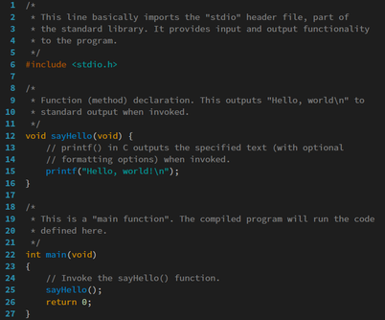
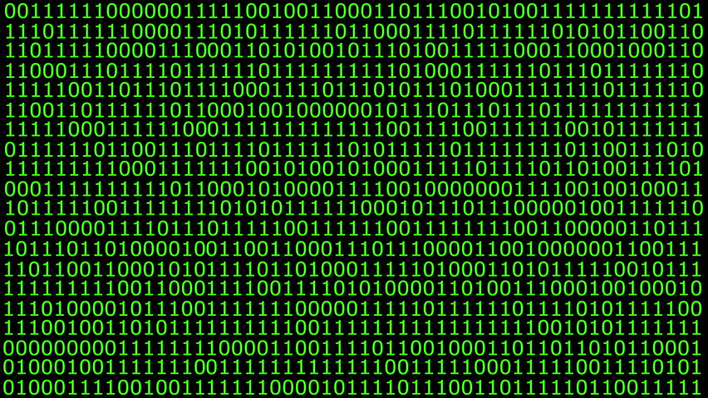
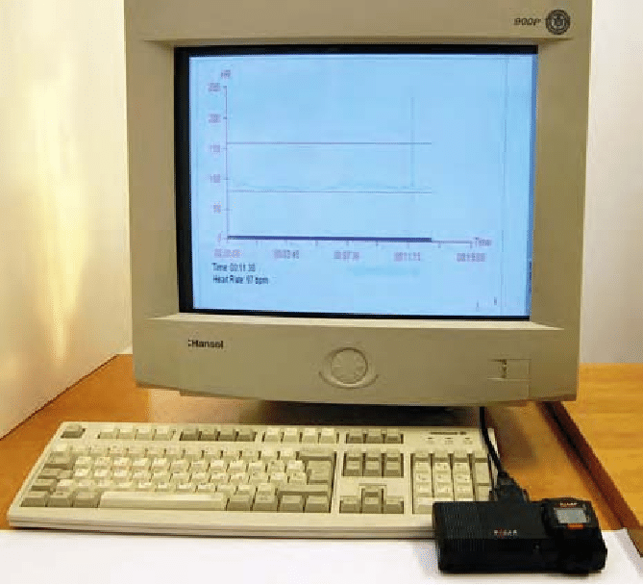
Preliminaries
Compilers translate programs from a source language to a target language
Commonly speak of the source language as a “high-level” language (but everything is relative)
Compilers can also perform:
Source-to-source translation
Decompilation: from low to high-level
Interpreters: similar to compilers, but execute commands
Compiler

Slide 13
Brief History
Languages evolve (or die), c.f. C++ standards
Late 60s and early 70s: structured programming:
GoTo-based control-flow (Fortran, Cobol, Basic) ➔ Explicit Control (loops, if/switch)
Late 80s - Nested block structure (Algol, Pascal, Ada) ➔ precursor of Object-Oriented Programming (OOP)
90s : Smalltalk, C++, Eiffel, Java
Late 90s and 00s: scripting languages (PHP, Python, Ruby)

Slide 14
Evolution of Programming Languages
PLs evolve or disappear
Changes come by need:
Productivity:
machine code → assembly
writing shorter, more compact code, e.g. array slices
Code reusability and maintainability: structures, functions, objects
New areas and domains:
Classical scientific computations
Web
Circuit design
Quantum computing
Cool video: https://youtu.be/Og847HVwRSI

Slide 15
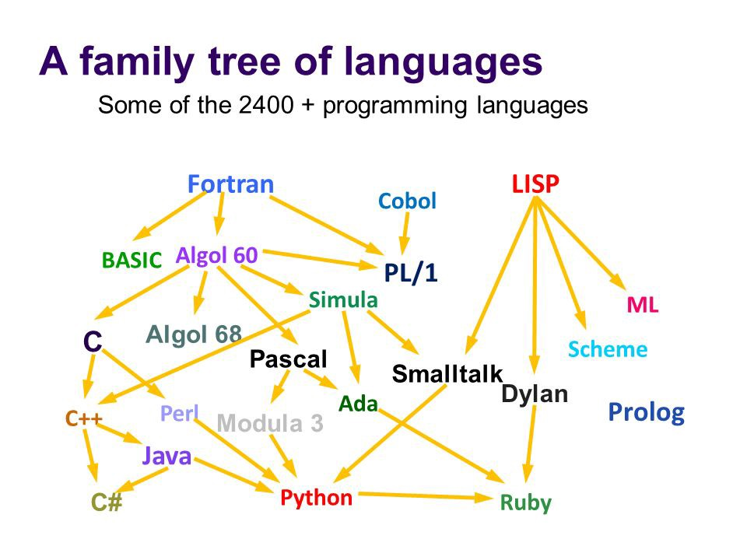
X
Source: History of Programming Languages by Ursula Lewis

Slide 16
Examples of Programming Languages
void PrintArray(int a) {
printf("Array Element = %d \n", a);
}
int main() {
int array[] = {1, 2, 3, 4, 5, 6};
for (int i = 0; i < 6; i++) {
PrintArray(array[i]);
}
return 0;
}
template <class T>
T GetMax (T a, T b) {
T result;
result = (a>b)? a : b;
return (result);
}
int main () {
int i=5, j=6, k;
long l=10, m=5, n;
k=GetMax<int>(i,j);
n=GetMax<long>(l,m);
cout << k << endl;
cout << n << endl;
return 0;
}
(define (my-max3 x y z)
(if (and (> x y) (> x z))
x
(if (> y z)
y
z)))
public static
int getMaxValue(int[] numbers) {
int maxValue = numbers[0];
for (int i=1; i<numbers.length; i++) {
if(numbers[i] > maxValue){
maxValue = numbers[i];
}
}
return maxValue;
}
m=0
myList=(1,2,3,4)
x=myList[2:] for i in range(len(myList)): if m<myList[i]: m=myList[i]
my @array=(1..10);
for(my $count=0;$count<10;$count++) {
print "index $count = $array[$count]";
print "\n";
}

Slide 17
Classification
Declarative Languages
Imperative Languages
Focus on what to do
Usually ”higher-level”
Compiler / interpreter have great implementation freedom
Some gap between algorithm and low-level implementation
Focus on ”how”
Spans several abstraction levels
Close enough to detail / implementation ➔ algorithms

Slide 18
Classification
Declarative Languages
Imperative Languages
Functional:
Lisp/Scheme,
Haskell
Von Neumann: C, Ada, Pascal, Fortran
Dataflow:
Id, Val, Dot
?
Object-Oriented: Smalltalk, Java, C++
Logic/Constraint-based:
Prolog, Spreadsheet, SQL
Scripting: Perl, Python, PHP, Javascript, Bash

Slide 19
von Neumann Model
Central Processing Unit
Classical computation model
Consist of:
Main memory
Central Processing Unit: Control Unit, Arithmetic/Logic Unit and Machine Registers
Input and output mechanisms
Control
Unit
ALU
Input
Device
Registers
Output
Device
Main Memory (DRAM)

Slide 20
PL Spectrum
Logic and Constraint-based Languages
Von Neumann Languages
Provides mechanisms to specify relationships and constraints
Goal directed
Rule-based
Examples: Prolog, Excel, SQL
Prolog example:
likes(mary,food).
likes(mary,wine).
likes(john,wine).
likes(john,mary).
% The following queries
% yield the specified answers.
?- likes(mary,food).
yes.
?- likes(john,wine).
yes.
?- likes(john,food).
no.
Based on statements, expressions and assignments:
X := 0.5 * Y + Z;
Allow side-effects and modification of variables
Examples: Fortran, Ada, C
SQL example:
SELECT column1, column2 FROM table1, table2
WHERE column2='value';

Slide 21
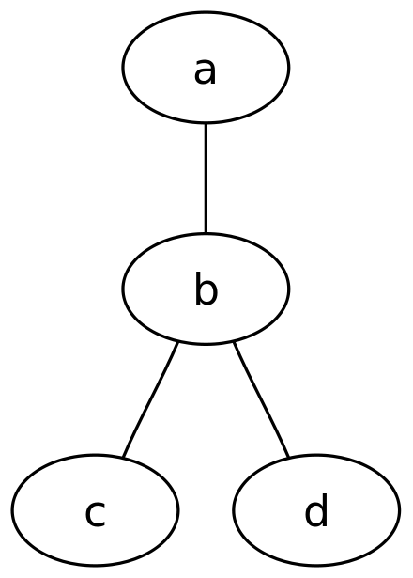
PL Spectrum
Dataflow Languages
Functional Languages
Graph-like languages: nodes connected by edges
Describes information flow
Inherently parallel model
Computational model: recursive definition of functions
Inspired on Church’s lambda-calculus (ca 1930)
Program is considered a function, from inputs to outputs
Data cannot mutate (no side-effects): pure functions, no variables to modify
Examples: Lisp, Scheme, Caml, Ocaml, Scala
// The graph name and the
// semicolons are optional
graph graphname {
a -- b -- c;
b -- d;
}

Slide 22
PL Spectrum
Scripting Languages
Object-oriented Languages
Originated as languages for “gluing together”
Developed for specific purposes:
Shell, Bash: job control
PHP, Javascript: dynamic web pages
Other general purpose: Perl, Python, Ruby, Matlab PL
Derived from Simula 67
Related to von Neuman languages
Data and operations bundled together
Pure OO languages do not support “free functions”
Examples: C++, Java, C#, Scala, OCaml
Markup Languages
Motivated by ”marking up” paper manuscripts
Tag-based, uses delimiters such as <begin> and </end>
Examples: GenCode, Tex / LaTex, Scribe, Markdown, HTML, XML

Slide 23
Why study Programming Language Design?
It’s cool!
Eventually you may create your own language and name it whatever you want (See: https://tutorialzine.com/2013/12/the-10-weirdest-programming-languages)
Makes you a better programmer and developer: faster and more portable code
Help understanding internals and behavior of other tools: debuggers, IDEs, assemblers, etc

Slide 24

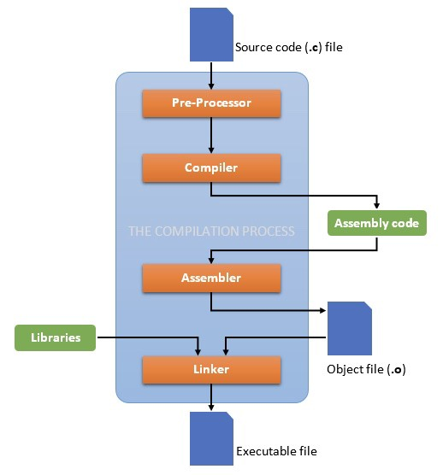
Remove comments;
Search and expand macros;
C-include, Python import
Translate each compilation unit to assembly
Translate from assembly to object (machine code)
Bind various compilation units together (.o files)

Slide 25
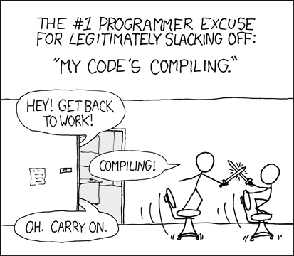
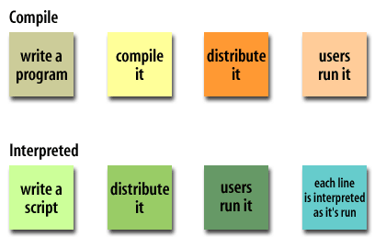
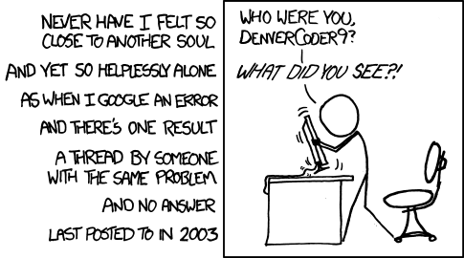
Compilation and Interpretation
From XKCD.com

Slide 26
Other compilation schemes
Source-to-source: from C to C
Cross compilation, e.g. from C to Pascal
Self-hosting:
Bootstrapping: used to build progressively more sophisticated version of a compiler
Starts with simple first version (likely interpreted)
Read Niklaus Wirth Pascal compiler (page 21 in textbook): Pascal compiler, P-code and Pascal Interpreter
Just-in-Time (JIT) compilation:
on demand
Common for interpreted languages: Java (bytecode), Lisp, C# (Common Intermediate Language or CIL)
Optimize hot-spots

Slide 27
Compilation Overview
Front End
Back End
Semantic
Analysis and
Intermediate
Code Generation
Lexical
Analysis
(aka Scanning)
Syntactic
Analysis
(aka Parsing)
Machine Independent Optimizations
Target
Code
Generation
Target
Specific
Optimizations
Symbol Table
Output
(for instance, a binary file)
Input (*.c file)

Slide 28
Compilation Overview
Front-End
(Lexical, Syntactical and Semantic Analysis
Back-End
(Target Dependent)
x86
C/C++
Language and Machine Independent Analyses, Transformations (Optimizations)
PTX
https://docs.nvidia.com/cuda/parallel-thread-execution/index.html
Fortran
Python
C/C++
Matlab
Playstation 4
Scala
Library Calls (MPI, OpenMP)

Slide 29
Lexical Analysis (Scanning)
Output: Recognized strings and tokens
String / Lexeme | Token
“for” | KEYWORD_FOR
“(“ | LEFT_PAR
“i” | IDENTIFIER
“=“ | OP_ASSIGN
…
“++” | PLUS_PLUS
…
“A” | IDENTIFIER
“[” | LEFT_SQR_BRACKET
”i” | IDENTIFIER
…
“+” | PLUS
”1.0” | NUMBER
“;” | SEMICOLON
Decompose the input file (stream of characters) into stream of strings
Ignore white space (tab, return, etc)
Assign token (a category) to each string
Job performed by the scanner
Automatic tools available: Scanner Generators (e.g. Lex, Flex, Jflex, etc) that take regular expressions (a DFA) and produce compilable code
Input:
for (i = 0; i < 10; i++)
A[i] = B[i] + 1.0;

Slide 30
Syntactic Analysis (Parsing)
Example 1 (Legal token stream): “x = 1.0;”
IDENTIFIER
OP_ASSIGN
NUMBER
SEMICOLON
Checks the high-level structure (syntax) of a program
Job performed by the parser
Parser implemented as a PDA
Automatic tools available: Parser Generators (e.g. YACC, Bison, etc) that take Context Free Grammars (CFGs) and produce compilable code
Parser either ACCEPTS or REJECTS a stream of tokens
Example 2 (Illegal token stream): “x = ;”
IDENTIFIER
OP_ASSIGN
NUMBER
SEMICOLON

Slide 31
Syntactic Analysis (Parsing)
x + 4 * y;
start
Syntactic rules of programming language defined in a Context Free Grammar (or just grammar)
Conceptually, attempts to construct a parsing tree:
e
e
+
t
PASS
Simple arithmetic grammar:
start → e ;
e → e + t
e → t
t → t * f
t → f
f → ID
f → NUM
t
t
f
*
f
f
ID
ID
NUM

Slide 32
Syntactic Analysis (Parsing)
x + 4 * ;
start
Syntactic rules of programming language defined in a Context Free Grammar (or just grammar)
Conceptually, attempts to construct a parsing tree:
e
e
+
t
FAIL
Simple arithmetic grammar:
start → e ;
e → e + t
e → t
t → t * f
t → f
f → ID
f → NUM
// rule f does not produce the empty string
t
t
f
*
f
f
ε
ID
NUM

Slide 33
Semantic Analysis
Determine the “meaning” of the program:
Check for type consistency:
1 + 2.0 : PASS
sqrt(“hi”) : FAIL
Check array bounds: A[-1]
Check variable declaration: query Symbol Table
Actually interleaved with scanning and parsing

Slide 34
Intermediate Code Generation
Construct an intermediate representation (IR) of the program
Representation is machine / target independent
Compiler can have multiple IRs
IR should permit optimizations
Also interleaved with scanning, parsing and semantic analysis
Updates symbol table, creates temporary variables
a := a + b* 1.5
load _t1_ , __ , a
load _t2_, __ , b
mul _t3_ , _t2_, 1.5
add _t4_ , _t1_ , _t3_
store a , __ , _t4_

Slide 35
Intermediate Code Generation
while ( c < 10 ) { …
}
printf (“%d”, result);
Conceptually very similar to assembly code, but machine independent
High-level program constructs decomposed into simpler operations, e.g. “for” → JUMPs and conditions
…
K: load _t1_ , __ , c
K+1: lessthan _t2_, _t1_ , 10
K+2: jumpzero _t2_ , __ , K+Q
…
K+Q-1: goto __ , __ , K
K+Q: pusharg __ , __ , result
K+Q+1: call printf , __ , __

Slide 36
Machine Independent Optimizations
load _t1_ , __ , a
load _t2_, __ , b
mul _t3_ , _t2_ , 1.5
add _t4_ , _t1_ , _t3_
store a , __ , _t4_
Perform program transformations that are independent of the target machine
Some optimizations include:
Removal of redundant load and stores
Arithmetic simplification
In general:
Avoid redundant work
Use cheaper operations
Eliminate unused code
a := a + b* 1.5
load _t1_ , __ , a
load _t2_, __ , b
mul _t3_ , b , 1.5
add _t4_ , _t1_ , _t3_
store a , __ , _t4_

Slide 37
Machine Independent Optimizations
while ( c < 10 ) { …
x = 3;
…
}
x = 3;
while ( c < 10 ) { …
x = 3;
…
}
…
K: load _t1_ , __ , c
K+1: lessthan _t2_, _t1_ , 10
K+2: jumpzero _t2_ , __ , K+Q
…
K’: store x , __ , 3
…
…
K-1: store x , __ , 3
K: load _t1_ , __ , c
K+1: lessthan _t2_, _t1_ , 10
K+2: jumpzero _t2_ , __ , K+Q
…

Slide 38
Machine Code Generation
a := a + b* 1.5
load _t1_ , __ , a
load _t2_, __ , b
mul _t3_ , _t2_ , 1.5
add _t4_ , _t1_ , _t3_
store a , __ , _t4_
fload freg1, __ , #AB100
fload freg2, __ , #AB104
fmul freg3, freg2 , 1.5
fadd freg4 , freg1 , freg3
fstore #AB100 , __ , freg4

Slide 39
Machine Specific Optimization
a := a + b* 1.5
fload freg1, __ , #AB100
fload freg2, __ , #AB104
fmul freg3, freg2 , 1.5
fadd freg4 , freg1 , freg3
fstore #AB100 , __ , freg4
fload freg1, __ , #AB100
fload freg2, __ , #AB104
fmadd freg1 , freg2 , 1.5
fstore #AB100 , __ , freg1

