Slide 1
Lexical Analysis

Slide 2
Lexical Analysis
Deals with “low level” syntactic structure
Strings with the same structure aggregated into the same class
Implemented as the scanner
Scanner invoked by parser
Can be written:
By hand or
Using a scanner generator with regular expressions

Slide 3
Lexical Analysis
Job: assemble arbitrary stream of characters into strings (lexemes) recognizable by the language ➔ source tokenization
Removing comments
Storing the actual values of some strings:
identifiers
numbers
literal strings
Recording source location information such as file, line number and column for possible error reporting

Slide 4
Regular Expressions (RE)
A regular expression is one of the following:
A character
The empty string, denoted by ε
Two regular expressions concatenated
Two regular expressions separated by | (i.e., or)
A regular expression followed by the Kleene star * (concatenation of zero or more strings)
Note: syntax of RE programs and functions might vary a bit (e.g +)

Slide 5
Regular Expressions
Rules to recognize numbers:
number → integer | real
integer → digit digit *
real → integer exponent | decimal ( exponent | ε )
decimal → digit * ( . digit | digit . ) digit *
exponent → (e | E ) ( + | - | ε ) integer
digit → [0 – 9]

Slide 6
Scanner Rules
What strings should the language recognize?
Identifiers: i, my_sum, _count_, sum
key words (special case of identifiers): for, while, if, switch, return …
Numbers: integer and floating point, in various formats
Operators: =, +=, +, ++, <, <=, != …
Other: (, ), [, ], {, }, ;

Slide 7

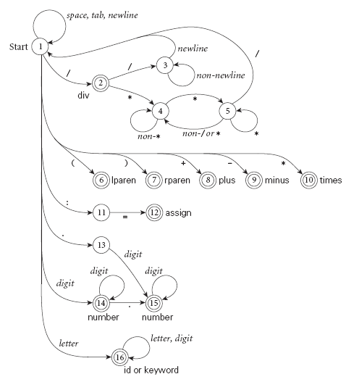
DFA for numbers Taken from the “Programming Language Pragmatics” by Michael Scott

Slide 8
Implementation Options
Scanners tend to be built three ways
Semi-mechanical, pure DFA (usually realized as nested case statements)
Table-driven DFA: write rules, generator produces code
Ad-hoc: very case specific

Slide 9
Semi-Mechanical, Pure DFA
Essentially translate REs to code
Example
Rule:
identifier → char +
Pseudocode:
lexeme = “”;
do {
c := read_character (my_file);
if (is_letter (c)) lexeme := lexeme + c;
} while (is_letter (c));
put_character_back (my_file, c);
if (lexeme != “”)
return TRUE;
return FALSE;

Slide 10
Semi-Mechanical, Pure DFA
char * lexeme;
int mylex (FILE * f) {
if (is_identifier (f))
return T_IDENTIFIER;
if (is_keyword (f))
return find_keyword(lexeme);
if (is_number (f))
return T_NUMBER;
if (is_operator (f))
return find_operator(lexeme);
if (is_other (f))
return find_other(lexeme);
return get_next_character (f);
}
char * lexeme;
int mylex (FILE * f) {
if (is_keyword (f))
return find_keyword(lexeme);
if (is_identifier (f))
return T_IDENTIFIER;
if (is_number (f))
return T_NUMBER;
if (is_operator (f))
return find_operator(lexeme);
if (is_other (f))
return find_other(lexeme);
return get_next_character (f);
}

Slide 11
General Rules for writing a DFA by Hand
We run the machine over and over to get one token after another
Nearly universal rule:
always take the longest possible token from the input thus foobar is foobar and never f or foo or foob
more to the point, 3.14159 is a real const and never 3, ., and 14159
Exceptions: keywords!

Slide 12
General Rules for writing a DFA by Hand
Note that the rule about longest-possible tokens means you return only when the next character can't be used to continue the current token
the next character will generally need to be saved for the next token
In some cases, you may need to peek at more than one character of look-ahead in order to know whether to proceed
In Pascal, for example, when you have a 3 and you a see a dot
do you proceed (in hopes of getting 3.14)? or
do you stop (in fear of getting 3..5)?

Slide 13
Using a Scanner Generator
Takes a set of rules and produces code
Often uses Extended Regular Expressions (e.g + for 1 or more repetitions)
Essentially a compiler: has it’s own input language!

Slide 14
Simple Flex Example
int num_lines = 0, num_chars = 0;
%% \n ++num_lines;
++num_chars;
. ++num_chars;
%%
int main() {
yylex();
printf( "# of lines = %d, # of chars = %d\n", num_lines, num_chars );
}

