Slide 1
Control Flow

Slide 2
Language Mechanisms
Sequencing: intuition of linear order between back-to-back statements
Selection: to represent conditions and choices; if/case/switches
Iteration: repeat some piece of code
Procedural abstraction: logical aggregation of work (and probably data)
Recursion: expression or entity defined in (simpler) terms of itself, directly or indirectly; computational model requires a stack on which to save information

Slide 3
Language Mechanisms
Concurrency: parts of a program to be executed at the same time, either partially or in full
Exception handing and speculation: program fragment executed with the knowledge and possibility that something could go wrong; mechanisms to handle the wrong part; state back-tracking; different forms of speculation
Non-determinacy: ordering or choice of statements or expression left deliberately unspecified; implies same results

Slide 4
Expression Evaluation
An expression is either a simple object (literal or variable) or some function of these
For the latter, we use the terms operators and operands
Languages provide ”simple”, pre-built math functions via operators
Operators are applied to operands
FYI: ”simple” is relative; compare C vs. Python
Some languages could have more than a single name for an operator, and rely on syntactic sugar to simplify writing; examples:
Ada: a + b is short for “+”(a,b)
C++: a+b is short for a.operator+(b) or operator+(a,b)
Other (some language): 0 <= i,j < N could be short for 0 <= i < N and 0 <= j < N

Slide 5
Expression Evaluation
Language defines the operator notation: infix, prefix, postfix
prefix: op a b or op(a,b) or (op a b)
infix: a op b
postfix: a b op
Most imperative languages use infix notation for binary operators and prefix notation for unary ones
Lisp uses prefix notation for all functions, in Cambridge Polish notation:
(* (+ 1 3) 2)
(append a b c my_list)
ML-family languages avoid parentheses, except for disambiguation:
max (2 + 3) 4;;

Slide 6
Precedence and Associativity
In what order should operators be evaluated?
Example with Fortran: a + b * c ** d ** e / f
Choices:
((((a + b) * c ) ** d) ** e) / f or
a + (((b * c) **) ** (e/f))
a + ((b * (c ** (d ** e))) / f)
Fortran opts for the last one, exponentiation being right associative, and having higher precedence than multiplicative operators
Recall:
Precedence: in which order should operators of different categories be evaluated, e.g. {+,-} and {*,/}
Associativity: in what order should operations in the same category be evaluated, i.e. left-to-right or right-to-left?

Slide 7
Precedence and Associativity
I like this statement from the book:
”The precedence structure of C (…, of its descendants, C++, Java, C#) is substantially richer than that of most other languages …”
And this other statement:
“It is probably fair to say that most C programmers do not remember all of their language’s precedence levels.”
When in doubt: consult the language reference or add parentheses
Now, compare with Pascal:
if (A < B and C < D) then (* good luck *)

Slide 8
Precedence and Associativity
Rules for basic arithmetic operators are mostly standard and uniform across languages, i.e. associate left-to-right
Example 1: 9 – 3 – 2 == 4, not 8
Example 2 (Fortran): 4 ** 3 ** 2 == 4 ** 9 and not 256 ** 2
Example 3 (Ada): exponentiation does not associate, so explicit parenthesis are necessary: (4 ** 3) ** 2 or 4 ** (3 ** 2)
Example 4 (C): multiple assignments as ”a = b = a + c”, obviously is right associative

Slide 9
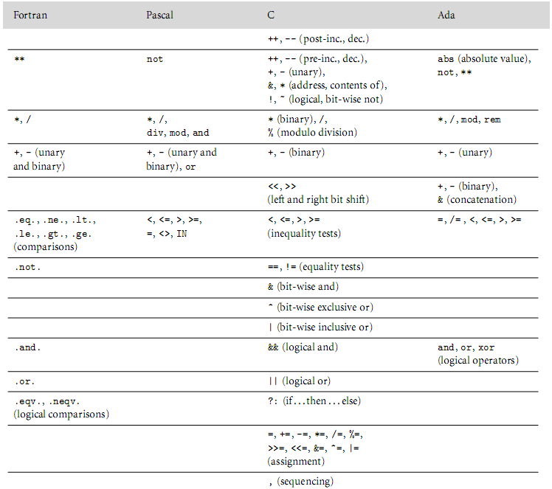
Taken from the book
“Programming
Language Pragmatics”
by Michael L. Scoot

Slide 10
Assignments
Pure functional languages:
rely solely on expressions
computation = expression evaluation
complex computations employ recursion to generate values, expressions and contexts
Imperative programming:
Attempts to model memory state
Sequences of changes/updates on/to memory
Assignment = abstraction for memory write
Assignments = {value, references/address} → value stored to address

Slide 11
Assignments
Side effect: influence of a program construct on subsequent computations
Best example, the assignment in imperative languages, two parts:
right-hand side evaluation
more importantly, writing the result of the rhs expression to the address of the variable on the lhs
Some PL distinguish between expressions and statements:
expressions may have side effects, e.g. a = ++c * 2
statements used to provide side effects
Purely functional languages: no side effects, value of expression depends only on the referencing environment

Slide 12
References and Values
Consider the following assignments in C:
d = a;
a = b + c;
RHS: value
LHS: location / address, where to store something
Variables are named containers for values
Distinction between l-values (address) and r-values (proper values, which could actually be addresses)
Bunch of subtle rules:
not all expressions can be l-values → why?
Compare two (potential) assignments: 2 + 3 = a and a = 2 + 3, when will these be valid (if ever)
Not all l-values are simple names, consider:
(f(a)+3)->b[c] = 2;

Slide 13
References and Values
Value model vs reference model
Value model: values flow from rhs to lhs
Reference model:
references (i.e. address/locations) flow from lhs to rhs
All variables are l-values
Variables automatically dereferenced when they appear in r-value contexts
Becomes important to distinguish 2 cases:
variables that refer to the same object
variables that refer to different objects, but with the same value
b := 2;
c := b;
a := b + c;
Pascal and Clu example
C example: int a; int * ptra;
Java == and equals

Slide 14
References and Values
Value Model
Consider: a = b + c; // in C
Variables in rhs have values associated to them,
so fetching their value is automatic
Actions for the above:
Get the address associated to b
Dereference the address of b and get the value stored there
Repeat the above for c
Compute new value
Store value at the address of a (lhs)
Reference Model
a := b + c; // Apparently as in Clu
a, b and c are essentially addresses
Actions for the above:
Get the value stored in the address of b
Get the value stored in the address of c
Compute new value
Store the value in the address of a
Read page 232, example 6.16: Boxing

Slide 15
Orthogonality
Means: independent, consistent, to be used in any combination
The book uses it as ”stuff that you would expect to appear somewhere, but they may or may not”
It’s a design principle
Example: Algol68 was expression oriented ➔ expression basically the same as statement
Expressions could appear in places where statements would be expected (this again is relative)
Similar constructs of other languages could appear as expressions
begin
a := if b < c then d else e;
a := begin f(b); g(c) end;
g(d);
2 + 3
end
BTW, in Pascal,
; wasn’t mandatory
in the last statement
of a block

Slide 16
Orthogonality
C takes a middle-of-the-road approach
C has “expression statements”
Idea: expressions can appear where statements are expected, but the reverse does not hold
C computes values for expression statements, then discards them
C and Algol68 allow assignments in expressions
(Return ) value of assignment is the rightmost value
Check example 6.19 of book (assignment and equality operators)

