Slide 1
Scripting Languages

Slide 2
Overview
What are Scripting languages?
Characteristics
Some examples
BASH 101
Python introduction (by examples)

Slide 3
What are Scripting Languages?
Hard to say
Glue languages: put things together
Coordination languages
Programming languages such as C, C++ or Java are too “clunky”
If system performance is not a priority, then C/C++ is not necessary
If safety and modularity is not necessary, why use Java?
Usually just want to write something small, quickly, and for a very specific purpose: scripting

Slide 4
General Characteristics of Scripting Languages
Weakly typed:
Can easily convert from string to numbers
Use of variants
Dynamically typed: heavy reliance of type inference, type compatibility
Interpreted languages (with likely some capability for Just-In-Time/JIT compilation)
Implicit variable declaration: first use instantiates the variable
Relatively easy and simple I/O mechanisms
Usually very compact syntax, which translates to little bloat
High-level data types built-in (lists, sets, maps, strings, arrays, REGULAR EXPRESSIONS)

Slide 5
Some Scripting Languages
Sh / C-Shell / Bash
Python
Perl
PHP
Javascript (eeeewwww)
MatLab, R
Visual Basic Scripting (you can program your own macros in Excel)

Slide 6
PHP
<!DOCTYPE html>
<html>
<body>
<h1>Developer News</h1>
<?php echo ”A PHP Example"; ?>
</body>
</html>
Interpreter
Allows to generate “dynamic web pages”
Static web page is one with .html extension
Works in tandem with a web server (e.g. Apache)
<?php
// Assign the value "Hello!" to the variable "greeting"
$greeting = "Hello!";
// Assign the value 8 to the variable "month"
$month = 8;
// Assign the value 2019 to the variable "year"
$year = 2019;
?>

Slide 7
Shell / Bash
Shell: command line interface available in Unix/Linux systems (also Mac OSX)
BASH (Bourne Again Shell)
(I prefer BASH)
Available in command line / terminal environments
Close interaction with Operating Systems
File management:
Search for files in the file system
List files in directory
Create, rename, delete and move files
Usual control-flow constructs:
Iterate
Decision control

Slide 8
Bash 101
Open a Linux / Mac OSX command line and try
Comments: command line interpreter ignores all characters in a single line after finding a ‘#’
Listing files:
ls -l # list all file in wide format
ls -lh # same as above, and print file size in human legible form
ls -lhr # same as above and show most recent below
For more, do:
man ls

Slide 9
Bash 101
Try this:
x=1
if [ $x -eq 1 ]; then
echo ”x”
else
echo “$x”
fi
The above will print “x”
Now set x to 2 (x=2) and re-run the rest, you will get 2 as output
Always leave at least one space between left ‘[‘ and right ‘]’
Other comparison operators: -ne, -lt, -leq, -gt, -geq
For more options do: man test

Slide 10
Bash 101
Now try this:
touch emptyfile.txt
ls –lh emptyfile.txt
if [ -s emptyfile.txt ]; then
echo “File exists and has size GT zero”
else
echo “File doesn’t exist or size not GT zero”
The above:
Creates a file with size 0
Shows that it exists (but has size 0 bytes)
The IF uses the -s option for file test: must exist and have size 0

Slide 11
Bash 101
Now try this:
c=1
for myfile in `ls *.c`; do
echo “$c : $myfile”
c=$(($c+1))
done
echo “Final count: $c”
The above:
Collects the files with .c extension in the current directory and captures it in a sub-shell
Iterates over the files collected, increments the counter
For each file, shows a number and its name
Print the final count of files collected

Slide 12
Bash 101
for myfile in `ls *.c`; do has=`grep switch $myfile`; if [ ! "x$has" == "x" ]; then echo "File $myfile has a switch"; else echo "File $myfile not matched"; fi; done
The above program uses grep, a regular expression matcher/search utility
It will return a non-empty string if a file matches the regular expression provided, which is “switch”
The IF, checks that variable $has is not empty

Slide 13
Bash 101
My personal favorites:
sed (utility for regular expressions):
echo “programming languages” | sed –e ‘s/a/A/g’
top #list processes running, quit with ‘q’
ps ax #somewhat similar to top, different format
head -10 filename #shows first 10 lines of a file
cat filename # shows contents of file
seq N # try with N=5
grep switch *.c # search for ‘switch’ in all *.c
wc # “word count”, but counts many things, try with –w and –l
ls –l | wc -l
tail -10 filename #shows last 10 lines of a file
find (finds a file in some directory):
find . -name grammar.y # if you know the exact name
find . | grep gram # try it

Slide 14
Bash 101
Read about:
Redirections: > >> < |
Other commands:
mv from to
cp from to
rm afile
which anycommandyouknow
NEVER DO: rm *

Slide 15

Python
Some Python features:
Syntax and block scoping: indentation
Has Lambda support
Interpreted and cross platform
Automatic garbage collection
Support object oriented features
C/C++ bindings (i.e. you can call C/C++ code from it)
BASH is cool, but if you need to compute a few statistics from files, or to plot, Python is much much better
So I personally like Python for two things:
Plotting figures
Searching files with strings and regular expressions: import re

Slide 16
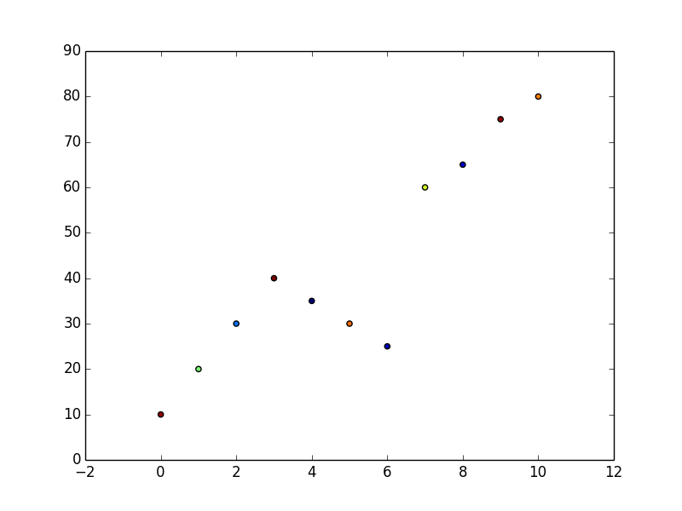
Python Example 1
#!/usr/bin/python
import numpy as np
import matplotlib.pyplot as plt
y = [10,20,30,40,35,30,25,60,65,75,80]
N = len(y)
x = range(len(y))
colors = np.random.rand(N)
plt.scatter(x, y, c=colors)
plt.show()

Slide 17
Python Example 2
#!/usr/bin/python
import os
import sys
if ( len(sys.argv) != 2):
print ("Usage: ./show-file.py <filename>")
sys.exit (1)
filename=sys.argv[1]
print ("Filename received: {}".format (filename))
ff = open (filename, "r")
for line in ff.readlines ():
line = line.strip ()
print (line)
ff.close ()

Slide 18
Python Example 3
filename=sys.argv[1]
print ("Filename received: {}".format (filename))
ff = open (filename, "r")
for line in ff.readlines ():
line = line.strip ()
a = myavg (line)
print ("{} ==> {}".format (line,a))
ff.close ()
#!/usr/bin/python
import os
import sys
def myavg (line):
parts = line.split (":")
s = 0
for pp in parts:
v = float (pp)
s += v
s = s / len(parts)
return s
if ( len(sys.argv) != 2):
print ("Usage: ./my-average.py <filename>")
sys.exit (1)
1:2:3
3:4:6:7
3:4
1:2:3 ==> 2.0
3:4:6:7 ==> 5.0
3:4 ==> 3.5

