Slide 1
Type Systems
(Chapter 7 and 8 in book)

Slide 2
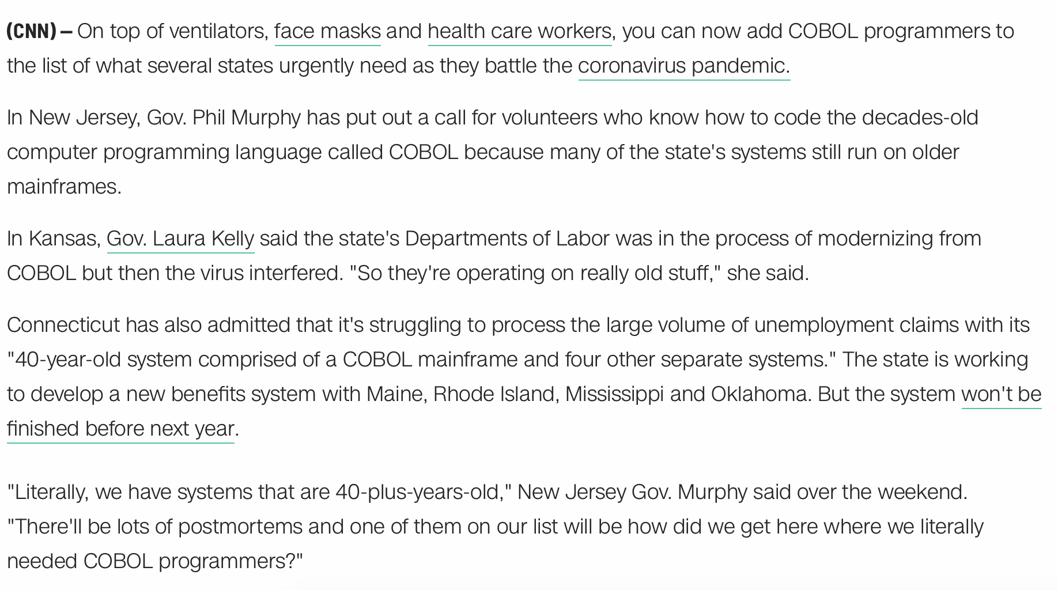
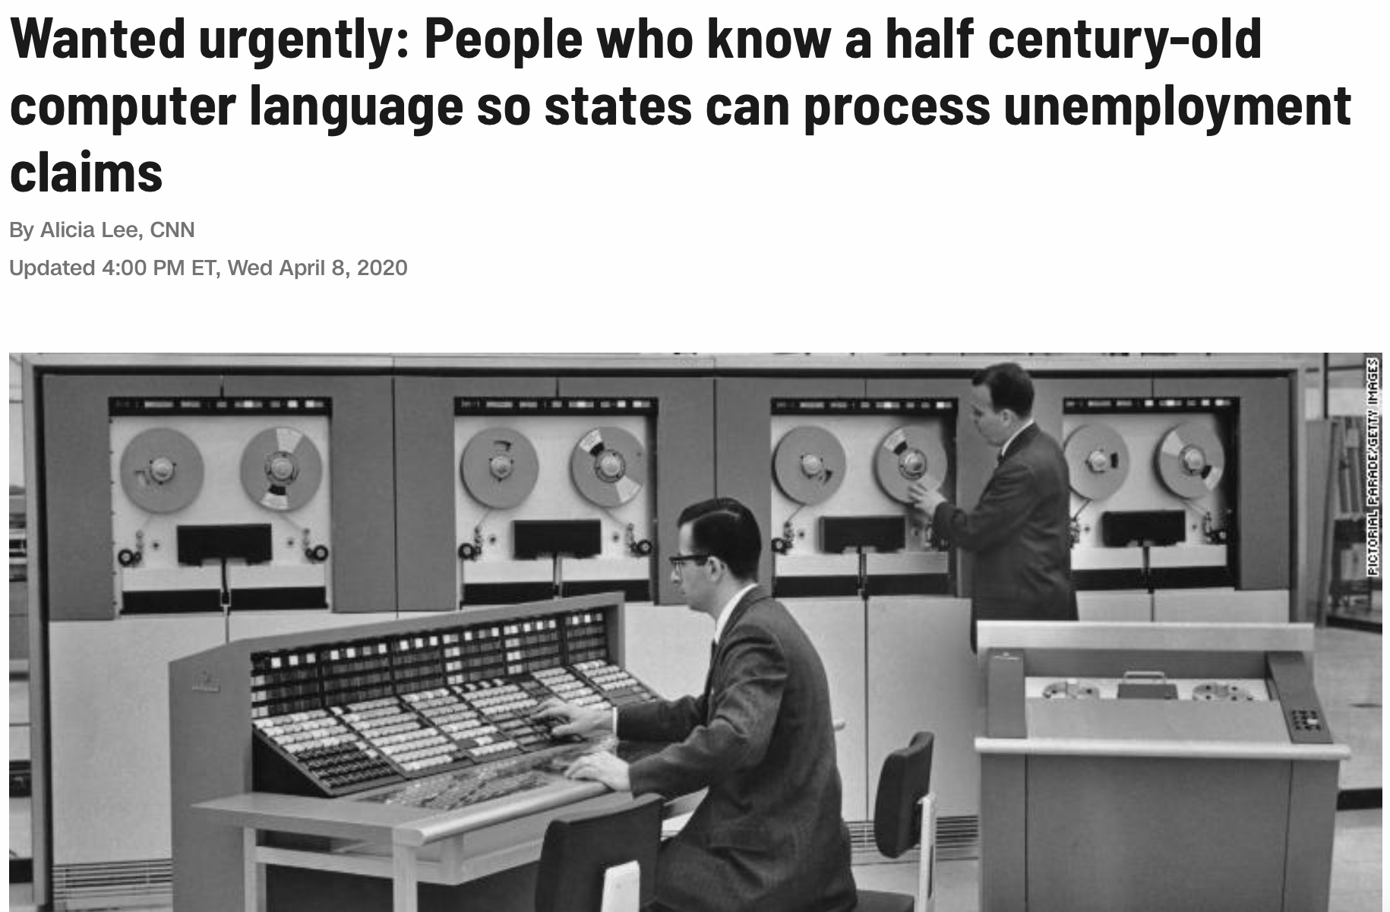
Reminder: PL are important to Society
Taken from here

Slide 3
Overview
Mechanisms to define types and associate them with language constructs
Set of rules for:
type equivalence: type(var1) = type(var2)?
type compatibility: in what context can var of type type be used?
type inference: what is the type of expression “a + 2 * b”?
Type checking:
Does the program obey the language compatibility rules?
Type clash: rule violation
Strongly typed languages limit and enforce application of operations based on type
Weakly typed languages: variables not bound to specific types (e.g. C, PHP), several/all conversions are implicit
Statically typed languages are usually strongly typed and can be enforced at compile-time

Slide 4
What are Types?
Depends on the view …
Denotationally (as in what it denotes or represent): set of values, value in set? object is of a type if its value is in the set
Structurally: type is built-in (e.g. int, char, etc) or composite (arrays, structures, classes, enumerations)
Abstraction-based: interface consisting of operations (think of operations as functions being called) → what behavior is valid?

Slide 5
Classification of Types
Booleans
Characters and strings
Numerics
Enumerations
Arrays
Structures

Slide 6
Classification of Types
Numerics: Integer and floating point numbers (real numbers such as 0.09482)
Discrete types: integer, Boolean, characters
Some languages (e.g. C and Fortran) provide several built-in numeric types varying in precision (the size of the type, and the range of values they can represent). See also GNU Multi-Precision Library or GMP and the Boost C++ Library.
Numeric types in general not portable across languages
Languages can provide signed (e.g. -128 to 127) and unsigned (0 to 255)
Unsigned integers: cardinals
Some languages provide complex types: imaginary, tuples
Other languages (e.g. Scheme and Common Lisp) provide rational types, symbols, lists, or other things (See Coq types),etc.

Slide 7
Classification of Types
Enumerations (Introduced in Pascal):
Example: type weekday = (sun, mon, tue, wed, thu, fri, sat);
Values are ordered, e.g. sun < thu
Mechanisms for finding the next greater value (succ for successor) and the previous lower value (pred for predecessor)
Example (Pascal): tomorrow := succ(today)
Can be used in loops:
Example (Pascal): for today := mon to fri do begin …
Also: Pascal only allows enumeration types in loops (integer, char), no real
Enumerations define new types in Pascal, not compatible with integers

Slide 8
Subrange
Also introduced in Pascal
Contiguous subset of values of some discrete base type:
0 to 10 vs -10 to 5
Can “rename” them
Example (Pascal):
type score = 0..10;
workday = mon..fri;
if (day in mon..fri) then …

Slide 9
Composite Types
Scalars (non-composite): any type that will represent one element:
Example (C ): int c = 50; // whatever value c has, it’s only 1 value
Contrast with non-scalar types: several values referable by a single variable (as in an array or list)
Composite types: values have many parts
Record (introduced in COBOL): consist of fields, each of a “simpler” type; its type is the cartesian product of the types of the fields
Example (C ):
struct height { int feet; int inches; };
struct person { char * name; int age; float weight; struct height };
Variant record (union): similar to record, but only one field can be used at any time; its type is the disjoint union of its fields
Example (C ):
union number { int n_int; long long int n_llint; float n_flt; };

Slide 10
Composite Types
Arrays: formally, functions from an index type to a component type;
Sets (also introduced in Pascal): the set type is the powerset of its base type; Pascal restricted sets to have at most 256 different values
Pointers (l-values): reference to an object of the pointer’s base type
Lists: sequence of elements, but no notion of mapping or index (at least conceptually) → no direct access
Files: represent data on devices; conceptually, a function mapping an index type (like an integer) to a component type; include notion of “current position”
Example (C ): FILE * f; // a file of char
Pascal allows to define files of user-defined record types:
Read and write operations on multiples of Record

Slide 11
Type Checking
Most common in statically typed languages, but also widely used in dynamic scripting language (e.g. Python)
Type required when defining variables, constants, functions
Involves checking for:
type compatibility: conversion, coercion, non-converting type casts
type inference: decide the type of expression from its subexpressions
type equivalence: stricter version of type compatibility

Slide 12
Type Equivalence
Answers the question: How to decide when two types are the same?
Two main strategies:
Structural equivalence: ”same components, in the same order”
Name equivalence: type names matter, each definition is a new type
Example (in some artificial language similar to C):
typedef int intb;
typedef int inta; // inta and intb would be quite different types

Slide 13
Structural Equivalence
In Structural Equivalence:
Format does not matter: spacing ignored
Order of fields usually matters
Language design question: Should the order of fields change the type?
type R1 = record
a, b : integer
end;
type R1 = record
a : integer;
b : integer
end;
Why?
Ideas?
type R1 = record
b : integer;
a : integer
end;

Slide 14
Structural Equivalence
Same array size
Different indexing schemes
Pascal allowed to define arbitrary bounds for arrays
Should they be considered different types?
type str1 = array [1..10] of char;
?
type str2 = array [0..9] of char;
Why?
Ideas?
Question: Should the compiler warn the programmer when assigning arrays from one variable of type str1 to a variable of type str2?

Slide 15
Name Equivalence
Design question: should both names be considered the same type or different types?
Two types of name equivalence:
Strict name equivalence (aliased types are distinct types)
Loose name equivalence (aliased types are the same type)
Can achieve both with derived types and subtypes
Consider the following:
type new_type = old_type; // Algol syntax
typedef old_type new_type; // C syntax
new_type is an alias for old_type
compatibility among parent/child types

Slide 16
Type Conversion and Casts
Type conversion (aka cast): tells the compiler to treat a variable or expression as some other type
Examples:
a := floor(3.75 * b);
r = (float) n;
n = (int) r;
Scenarios:
Types could be structurally equivalent, but language uses name equivalence
Types have different values, but share a common range of values (and the programmer knows what he/she is doing)
Types have different low-level implementation (usually boils down to some architecture specific function for converting types) → matters more for built-in types

Slide 17
Type Compatibility
Most languages do not require equivalence of types in every context
Resort to loser rules: type compatibility
Examples:
Assignment: type(lhs) must be compatible with type(rhs)
Operands: types of operands must be compatible with some common type that supports the operator
Subroutine calls: types of arguments should be compatible with types of formal parameters

Slide 18
Type Compatibility
Type coercion: automatic type conversion performed by the language/compiler
Example: C has a relatively weak type system, performs a lot of coercion under the hood
Not limited to built-in types, languages could allow coercion of arrays and records (structs)
Example (in Fortran):
Permits coercion of arrays if they have the same shape: same number of dimensions, same size along each dimension, same shape on base type; the keyword here is shape
Records: same number of fields, fields of same shape (order matters), names do not matter

Slide 19
Type Inference
Question: what determines the overall type of an expression?
A few examples:
Result of arithmetic expression is the types of the operands, possibly by coercing one of them into the more general one
Result of a comparison is a Boolean
Result of an assignment is the type of the left-hand side (lhs)
More complicated example, subranges:
Assume two ranges are defined, range1 as -10..10 and range2 as 0..40
Assume a is of type range1 and b is of type range2
What is the type of a+b?
Depends, but usually is the type of the base type, i.e. typeof(-10)

Slide 20
Composite Types
Records / Structures (as in C/C++): struct keyword
Variant Records / Unions
Arrays
Record of arrays
Arrays of records
Pointers
Objects
As machine memory addressing is linear, all composite types are laid out in some form ➔ flattened

Slide 21
Records and Structures
Basic principle: To put together data in some way that “makes sense”, i.e. to structure it
For example, to logically gather the information of a student in In C/C++:
struct student {
char * names[10];
char ID[10];
char fourx2[10];
int major;
};
Originally introduced in COBOL (COmmon Business-Oriented Language) circa 1960, then followed by Algol 68; Fortran 90 calls it types

Slide 22
Records and Structures
struct student {
float GPA;
char * names[10];
char ID[10];
char fourx2[10];
int major;
};
struct student s1;
struct student s2;
Student s1 is declared somewhere in the program
Assume the memory address used by s1 is M
In general, the compiler is free to do many things, among them changing the layout of the structure
If no changes are made to the original layout, the address offsets of s1’s fields would be the following:
GPA: 0
names: 4
ID: 4 + 10*4 = 44
fourx2: 4 + 10*4 + 10*1 = 54
major: 4 + 10*4 + 10*1 + 10*1 = 64
Total size of an instance of struct student would be 64 + 4 bytes
The base address of s2 would then be M + 68.
GPA
names
ID
fourx2
major

Slide 23
Variants and Unions
Informally, bundling of several data types, each identified by a field (as in the structure case)
Memory allocated only for the largest field
Field name determines how the memory is used / accessed
Union can only be used in ONE WAY AT A TIME; otherwise bits and bytes are just interpreted “as is”
Think about: How would you implement records/structs and variants/unions in your project compiler?
union student {
double gpa; // 8 bytes
char letter; // 1 byte
float pct; // 4 bytes
};

Slide 24
Arrays
Homogeneous data collection, i.e. a finite number of instances of some base data type
Stored contiguously in memory
Can be multi-dimensional:
int A[N]; // 1-dimensional
int B[M][N]; // 2-dimensional
int C[M][N][P]; // 3-dimensional
Each individual element of the array identified by some multi-dimensional integer tuple, e.g. <i,j,k> = <0,2,4>
Language and compiler map the integer tuple to some memory location:
Ζ^{n} → N

Slide 25
Arrays
Declaration obviously varies per language
Language can define things as:
What data types can one use to access elements in the array?
Minimum address of an array along each dimension:
Zero-based arrays in C/C++
1-based arrays as in Pascal
Arbitrary bounds (also in Pascal): part of the array type declaration
Special operators to access arrays:
Index operator, usually [] or ()
Slice operator, usually “:”
Storage mechanisms for dense arrays (mostly non-zeros) vs sparse arrays (very high fraction of zeros, 90% or more of zeros)
Lexicographic comparison: A, B arrays, A < B
[3,4,10] < [2,5,6] = FALSE;
[3,4,10] < [4,0,1] = TRUE
Intrinsic functions to determine size of: whole array, each dimension, etc

Slide 26
Arrays
Fortran:
real, dimension (10,10) :: mat
Modula-3:
VAR mat: ARRAY [1..10],[1..10] OF REAL;
VAR mat: ARRAY [1..10] OF ARRAY [1..10] OF REAL;
C:
double mat[10][10];

Slide 27
Arrays
0
1
2
3
0
1
2
3
0
A
B
C
D
A
B
C
D
1
E
F
G
H
E
F
G
H
Array slices (or Sections)
Probably introduced in Fortran (circa 1957)
Popular access mechanism in Matlab, Python, etc
Allows to access subset or regions of multi-dimensional arrays
Examples:
matrix(3:6, 4:7): from 3 to 6 and from 4 to 7
matrix (6:, 5) : from 6 onwards and only 5
matrix(:4, 2:8:2): up to 4, and starting from 2, up to 8, every 2
matrix(:, (/2, 5, 9/)): everything and only 2, 5 and 9
2
I
J
K
L
I
J
K
L
3
M
N
O
P
M
N
O
P
matrix(1:2, 1:2)
matrix(1:3, 2:2)
0
1
2
3
0
1
2
3
0
A
B
C
D
A
B
C
D
1
E
F
G
H
E
F
G
H
2
I
J
K
L
I
J
K
L
3
M
N
O
P
M
N
O
P
matrix(0:3:2, 1:3:2)
matrix(:, (/0,3\))

Slide 28
Arrays: Memory Layout
Row Major Order (e.g. C):
A
B
C
D
E
F
G
I
A
B
C
D
E
F
G
I
J
K
L
M
J
K
L
M
Column Major Order (e.g. Fortran):
2D array of 3 x 4
A
E
J
B
F
K
C
G
L
D
I
M

Slide 29
Arrays Memory Layout
In general, given an array A[d₁,d₂,…,d_{n}]:
Row Major Order: each dimension d_{k} consists of [d_{k+1},…,d_{n}] arrays
Column Major Order: each dimension d_{k} consists of [d₁,…,d_{k-1}] arrays
In memory:
Row Major Order stores dimensions “from left to right”
Column Major Order stores dimensions “for right to left”
Address calculation, assume an array A[L1..U1,L2..U2,…LN..UN]:
Row Major Order: A[d1,d2,…,dN] = Σ _{k=1 to N} dk x Π _{j=k+1 to N} (U_{j}–L_{j}+1)
Column Major Order: A[d1,d2,…,dN] = Σ _{k=N to 1} dk x Π _{j=1 to k-1} (U_{j}–L_{j}+1)
Think about: How would you implement static (stack) multi-dimensional arrays in your compiler?

Slide 30
Row Major Order – Memory Layout
A [3] [4] [4]
a1
a2
a3
a4
planes
b1
b2
b3
b4
Row Major Layout
rows
columns
c1
c2
c3
c4
d1
d2
d3
d4
a1
a2
a3
a4
”rows”
a1..a4,b1..b4,..d4
a1..a4,b1..b4,..d4
a1..a4,b1..b4,..d4
b1
b2
b3
b4
c1
c2
c3
c4
d1
d2
d3
d4
A[d1,d2,…,dN] = Σ _{k=1 to N} dk x Π _{j=k+1 to N} (U_{j}–L_{j}+1)
Address calculation example:
A[2][3][1] : 2 x 4 x 4 + 3 x 4 + 1
a1
a2
a3
a4
“Planes”
b1
b2
b3
b4
c1
c2
c3
c4
d1
d2
d3
d4
“columns”

Slide 31
Column Major Order - Memory Layout
Column 1
a1
a2
a3
a4
b1
b2
b3
b4
a1
a1
a1
b1
b1
b1
c1
c1
c1
d1
d1
d1
c1
c2
c3
c4
d1
d2
d3
d4
Column 2
a1
a2
a3
a4
a2
a2
a2
b2
b2
b2
c2
c2
c2
d2
d2
d2
”planes”
”rows”
b1
b2
b3
b4
c1
c2
c3
c4
Column 3
d1
d2
d3
d4
a3
a3
a3
b3
b3
b3
c3
c3
c3
d3
d3
d3
a1
a2
a3
a4
b1
b2
b3
b4
Column 4
c1
c2
c3
c4
a4
a4
a4
b4
b4
b4
c4
c4
c4
d4
d4
d4
d1
d2
d3
d4
A [3] [4] [4]
planes
rows
columns
“columns”

Slide 32
Pointers
Introduced in PL/I (“Programming Language One”)
Language abstraction for “raw address” handling and dynamic memory allocation
Requires abstractions for
Assigning chunks of memory during program execution
Reclaiming chunks of memory
Keeping track of what was assigned where (bookkeeping and accounting done by compiler and runtime system)
Operators accessing, storing and retrieving data to/from pointers

Slide 33
Pointers
Behavior of pointers normally defined by a couple of things:
Imperative or functional language, e.g. C or Lisp?
Employment of reference model or value model
Functional languages allocate memory as needed (everything in the heap), and use a reference model for names
Variables in imperatives languages may use reference or value model:
C uses a value model: A = B puts value B into (address) of A
If B should refer to A, both should be pointers
Java uses a mix: value model for built-in types, and reference model for user-defined types (objects)
C# introduces the unsafe qualifier to permit usage of raw pointers

Slide 34
Pointer Operators
Dereferencing operator (prefix * in C or postfix ^ in Pascal/Modula) permits to access the value to which a pointer refers to
In C, pointers and arrays are closely related:
Subscript operators [] are syntactic sugar for pointer arithmetic:
a[3] is equivalent to *(a+3)
a[3] is equivalent to 3[a]
Pointer arithmetic is one of C’s strengths:
while (*p++); // same as while (p[i++] != 0); p being char *
a[i][j] = (*(a+i))[j] = *(a[i]+j) = *(*(a+i)+j)
sizeof operator: returns the size in bytes of an object or type; when given a pointer, it returns the size of the pointer itself:
double *a; // sizeof(a) = 4 bytes while sizeof(*a) = 8 bytes
double (*b)[10]; // pointer to array of 10 doubles, sizeof(*b) = 80

Slide 35
Garbage Collection
Mechanism for reclaiming memory
Provided by managed languages such as Java, C#, Scala, Go
C uses a wonderful abstraction for garbage collection: the programmer
Main classes of garbage collection:
Reference counting:
Smart pointers
Tracing collection: Mark-and-sweep (See here if interested)
Most algorithms differ in terms of memory space (overhead) required for bookkeeping and the time overhead required to perform the static and runtime analyses, as well as the execution of the collection

Slide 36
Garbage Collection
Reference counting:
Keep counters for each chunk of dynamically assigned memory
Counter started at 1 with “new”
Doing: A = B, decrements the counter of A
Subroutines epilogue decrement the counters of all references
Reclamation performed when counter reach zero, i.e. when nothing is using some memory previously assigned
Weakness : when is an object useful?
#references = 0: perfectly useless
#references > 0: could still be useless, for instance, a circular list
See tombstones

Slide 37
Garbage Collection: Reference Counting
Example:
ptr_type ptr1 = allocate (); // ref_count(object1) = 1
ptr_type ptr2 = ptr1; // ref_count(object1) = 2
ptr_type ptr3 = allocate (); // ref_count(object2) = 1
ptr2 = ptr3; // ref_count(object1) = 1, ref_count(object2) = 2
ptr1 = NULL; // ref_count(object1) = 0 ➔ deallocate object1

Slide 38
Garbage Collection
Smart pointers:
Usually provided as libraries
They provide: reference counting, bounds checking, debugging instrumentation, among other things
See unique_ptr, shared_ptr, weak_ptr in C++:
unique_ptr: single owner of an object, pointer assignment transfers ownership
shared_pointer: implements reference counting; bad for circular data structures
weak_ptr: can be used in tandem with shared_pointers but do not increment the reference count

