Slide 1
Subroutines

Slide 2
Overview
How can subroutines access each other’s environment (We already saw this, but some things will make more sense now)
How to pass parameters:
Pass by reference
Pass by value
Pass by name
Others
How are results returned

Slide 3
Stack-based Allocation
Arguments to called routines
Stack
Pointer
(sp)
Recursion complicates static allocation of variables
Number of instances of a variable (e.g., a variable named “count” in a function “sum”) is, in theory, unbounded
Natural nesting of functions allows to allocate memory on the stack
Each instance (call) of a subroutine assigns memory from the stack for the various variables and constants used in the subroutine
Subroutine D
Temporaries
Subroutine C
Frame
Pointer
(fp)
Local
variables
Subroutine B
Misc.
Bookkeeping
Called next:
Subroutine B
Return Address
Called first:
Subroutine A
Frame
Pointer
(fp)

Slide 4
Stack-based Allocation
Arguments to called routines
Stack
Pointer
(sp)
Memory of subroutine allocated in a frame or activation record
Frame also allocated memory for temporary variables (produced by compiler)
Bookkeeping information includes: return address, reference to frame of caller (dynamic link), saved values of registers needed by caller and callee (e.g., the program counter)
Subroutine D
Temporaries
Subroutine C
Frame
Pointer
(fp)
Local
variables
Subroutine B
Misc.
Bookkeeping
Subroutine B
Return Address
Subroutine A
Frame
Pointer
(fp)

Slide 5
Stack-based Allocation
Arguments to called routines
Arguments passed to subroutines lie at the top of the frame (it’s much more convenient)
Subroutine actual arguments usually pushed into the stack
Memory layout very implementation and language dependent
Stack maintenance responsibility of the caller, before and after calling sequence
Two parts: prologue and epilogue
Stack
Pointer
(sp)
Subroutine D
Temporaries
Subroutine C
Frame
Pointer
(fp)
Local
variables
Subroutine B
Misc.
Bookkeeping
Subroutine B
Return Address
Subroutine A
Frame
Pointer
(fp)

Slide 6
Stack-based Allocation
Arguments to called routines
Stack
Pointer
(sp)
Location (actual address) of stack frame not determinable at compile-time, but offsets within frame are
Frame pointer (fp) points to known location within the new activation frame; useful for external access such as copying results
Other addresses accessed by known offsets w.r.t. fp
FP, SP, PC usually correspond to machine registers
Subroutine D
Temporaries
Subroutine C
Frame
Pointer
(fp)
Local
variables
Subroutine B
Misc.
Bookkeeping
Subroutine B
Return Address
Subroutine A
Frame
Pointer
(fp)

Slide 7
Typical Calling Sequence
Save registers
Compute values of arguments, move them into stack / registers
(if language with nested subroutines) Compute static link and pass it as a hidden argument
Use special instruction to jump to address start of subroutine (includes saving the return address in the stack or in a register)
Moves returned values to wherever needed
Restores pending registers
Caller
Allocates a frame by deducting some constant offset from the sp
Saves old frame pointer into the stack, update to the newly allocated frame
Move return value (if any) to a register, or specific address given by the caller (possibly in the stack)
Restores register values from the caller (inc. fp and sp)
Jumps to return address
Callee
Prologue
Epilogue

Slide 8
Stack Layout (Review)
A
B
FP
C
C
Static Link: pointer to the stack frame of the lexically surrounding subroutine
Dynamic link: pointer to the stack frame making the call to the current subroutine
Static and dynamic need not be the same
Surrounding subroutine will always be active (it needs to be), hence always visible to the callee
In Figure: all five subroutines are visible from B, C and D; A and E can see themselves and B (but can’t see C nor D)
In the example (Figure), D is called from B, but can’t be called from A nor E, as B must be active
D
D
B
E
E
A
Dynamic Links
Static Links

Slide 9
Displays
Disadvantage of static chains / links: access to object in a scope K levels out requires dereferencing frames K times (following the list of links)
Replace static links by a small array
The jth element of the display stores a reference to the frame of the most recently active subroutine at lexical nesting level j
For instance, if the current subroutine is nested i > 3 levels in, elements i-1, i-2 and i-3 of the display contain the equivalent of the first three static links
An object k levels out can be found statically from the offset of the address stores in the element j = i-k of the display
Displays mainly useful in languages supporting nested scoping (C doesn’t)

Slide 10
In-Line Expansion
Language implementations allow certain subroutines to be expanded in-line (function inlining) at point of call
Essentially copy-paste called function into caller → replicates code
inline int func (int a, int b) {
return a+b;
}
int main () {
int x = 1;
int y = 2;
int z = func(x,y);
}
inline int func (int a, int b) {
return a+b;
}
int main () {
int x = 1;
int y = 2;
int z = x+y;
}

Slide 11
In-Line Expansion
Language implementations allow certain subroutines to be expanded in-line (function inlining) at point of call
Essentially copy-paste called function into caller → replicates code
Advantages:
Avoids overheads: space allocation, branch overheads from call and return, maintenance of static chain and displays, and saving/restoring registers (potentially)
Gives a better view to compiler: improves potential for code optimization (principle: can do better knowing more), for instance in global register allocation, instruction scheduling and common subexpression elimination across function boundaries
Usually just a hint
Disadvantages:
Potential increase for code size → function body replicated for every call site
Not viable for recursive functions

Slide 12
Parameter Passing
First distinction: formal parameters vs actual parameters
Formal parameters: used in function definition
Actual parameters: what is passed during program execution (can be a temporary variable holding the value of an expression)
Passing modes:
By value
By reference
By value/result
Read only
By name
Default and others
Implementation-wise the main decision is: pass address of original entity or a copy to it? Copy implies extra work (the copying) and space

Slide 13
Parameter Passing: By Value
Creates a fresh new copy of the actual variable being passed
Copies all the contents of the actual parameter from the caller stack frame to the callee stack frame
Some languages only provide this mechanism (e.g. C)
That’s why:
Passing a pointer as a parameter is how we can update variables passed as arguments to function calls in C
Modifying an actual parameter in C never changes the original value
Even when passing a pointer argument in C, we can change the value pointed to, but not the address stored in the pointer itself
void swap (int * a, int * b)
{
int temp = *a;
*a = *b;
*b = temp;
}

Slide 14
Parameter Passing: By Reference
void swap (int & a, int & b)
{
int temp = a;
a = b;
b = temp;
}
The reference stores the address to the actual parameter
Essentially just a new name to the variable being passed by reference
Notice that this implies a mechanism for accessing non-local variables
Most languages would deem illegal to pass an expression (e.g. a+2*i) as an actual parameter with by reference mode: only l-values (not r-values = right-side values)
Original purpose: efficiency. In older computers, the overhead of Pass By Value could be significant (e.g not the same to pass a 4-byte variable as to pass a 10x10 matrix of an 8-byte datatype). Also program protection: disallow certain modifications to data

Slide 15
Parameter Passing: By Value/Result
Hybrid between passing By Value and By Reference
Similarity with By Value: On call, the runtime copies the value of the actual parameter into the formal parameter; local changes don’t affect (mostly) the actual parameter;
Distinction with By Value and Similarity with By Reference: the final value / result of the formal parameter is copied back into the actual parameter (caller side). So the actual parameter is in fact changed.
Distinction with by Reference: still passing values, no actual reference or address is being used; callee doesn’t really know the real address of the actual parameter; it’s the runtime who does the copy-in and copy-out work

Slide 16
Other Types of Parameter Passing
Pass by Name: boils down to textual replacement (as in C macro expansion); implies re-evaluation of passed parameter
Named parameters (not to be confused with pass by Name): arguments are usually positional, this requires explicitly stating the name of a formal argument in the calling sequence:
polynomial(1,2,3); polynomial(x=1,y=2,z=3); polynomial(y=2,z=3,x=1);
Default parameters: no need to actually pass them, they have a default value (e.g. parameters with initialization in C++)
Also see variadic macros here and here and variadic functions here too
#define max(x,y) ((x) >= (y)? (x) : (y))
…
z = max(a+b, a-b+10);
replacing/expanding:
z = ((a+b) >= (a-b+10) ? (a+b) : (a-b+10));
// Use with “–E” compiler option with C compilers
BTW, always parenthesize arguments in macros:
#define mysum(x,y) x + y
w = mysum(3,4) * 5; // will produce 3 + 4 * 5

Slide 17
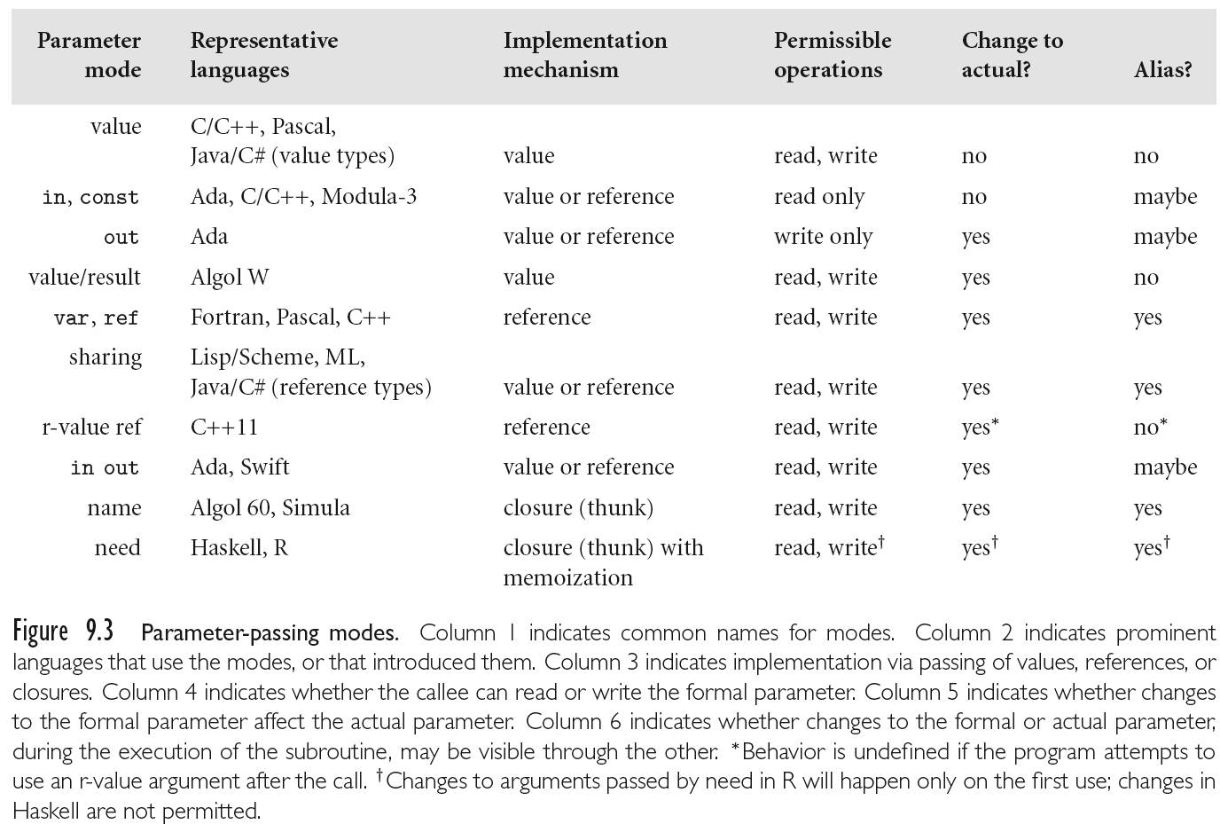
Parameters in Programming Languages

Slide 18
Function Returns
On subroutine return a compiler must:
Recover the previous state (machine registers)
Copy/move results depending on available passing mechanisms
Transfer back control (jump back to some address by changing the value of the program counter, PC register)
Copying results can be responsibility of the caller or callee:
Caller can know where to copy the result from (assuming that nothing else executes in between the ending of the called subroutine and the next instruction)
Callee can know where to copy the result to (in the activation record of the caller) ➔ that’s when access links, displays and dynamic links become useful.

