Slide 2
Preliminaries
First language: machine instructions
Assembly: mnemonics, macro expansion
Originally, each computer had its own language
Need for “machine independent language”: code portability, reuse
1950s: first version of Fortran (Formula Translator), followed by Lisp and Algol
Languages are implemented as compilers and interpreters
Compilers translate from source ”high-level” language to machine instructions

Slide 3
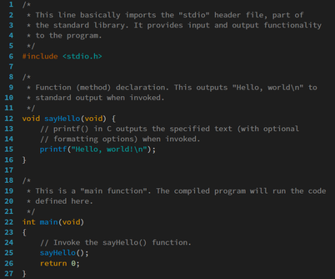
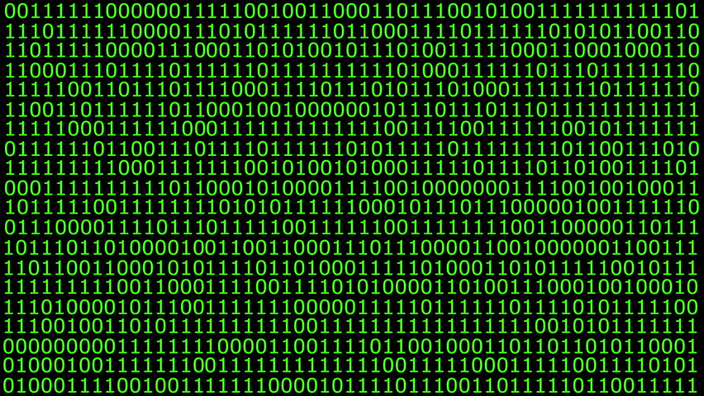
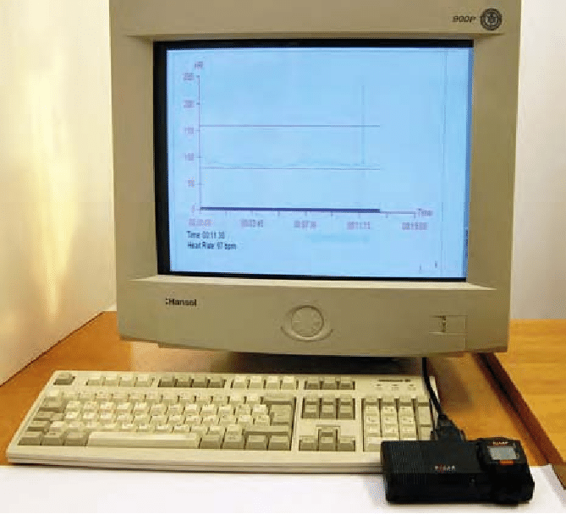
Preliminaries
Compilers translate programs from a source language to a target language
Commonly speak of the source language as a “high-level” language (but everything is relative)
Compilers can also perform:
Source-to-source translation
Decompilation: from low to high-level
Interpreters: similar to compilers, but execute commands
Compiler

Slide 4
Brief History
Languages evolve (or die), c.f. C++ standards
Late 60s and early 70s: structured programming:
GoTo-based control-flow (Fortran, Cobol, Basic) ➔ Explicit Control (loops, if/switch)
Late 80s - Nested block structure (Algol, Pascal, Ada) ➔ precursor of Object-Oriented Programming (OOP)
90s : Smalltalk, C++, Eiffel, Java
Late 90s and 00s: scripting languages (PHP, Python, Ruby)

Slide 5
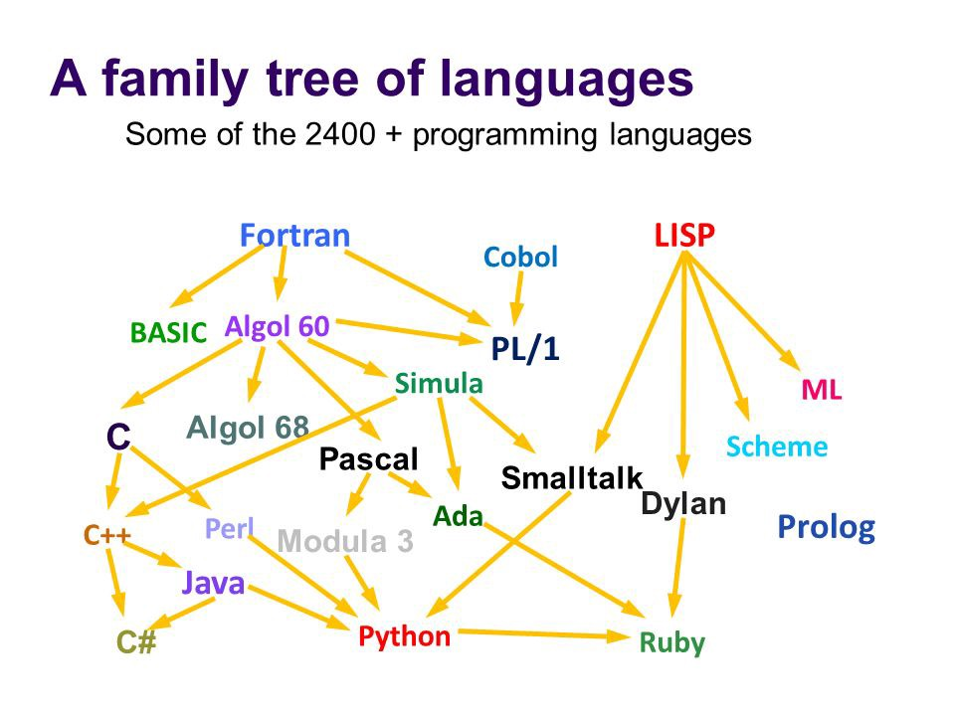
X
Source: History of Programming Languages by Ursula Lewis

Slide 6
Classification
Declarative Languages
Imperative Languages
Focus on what to do
Usually ”higher-level”
Compiler / interpreter have great implementation freedom
Some gap between algorithm and low-level implementation
Focus on ”how”
Spans several abstraction levels
Close enough to detail / implementation ➔ algorithms

Slide 7
Classification
Declarative Languages
Imperative Languages
Functional:
Lisp/Scheme,
Haskell
Von Neumann: C, Ada, Pascal, Fortran
Dataflow:
Id, Val, Dot
?
Object-Oriented: Smalltalk, Java, C++
Logic/Constraint-based:
Prolog, Spreadsheet, SQL
Scripting: Perl, Python, PHP, Javascript, Bash

Slide 8
PL Spectrum
Logic and Constraint-based Languages
Von Neumann Languages
Provides mechanisms to specify relationships and constraints
Goal directed
Rule-based
Examples: Prolog, Excel, SQL
Prolog example:
likes(mary,food).
likes(mary,wine).
likes(john,wine).
likes(john,mary).
% The following queries
% yield the specified answers.
?- likes(mary,food).
yes.
?- likes(john,wine).
yes.
?- likes(john,food).
no.
Based on statements, expressions and assignments:
X := 0.5 * Y + Z;
Allow side-effects and modification of variables
Examples: Fortran, Ada, C
SQL example:
SELECT column1, column2 FROM table1, table2
WHERE column2='value';

Slide 9
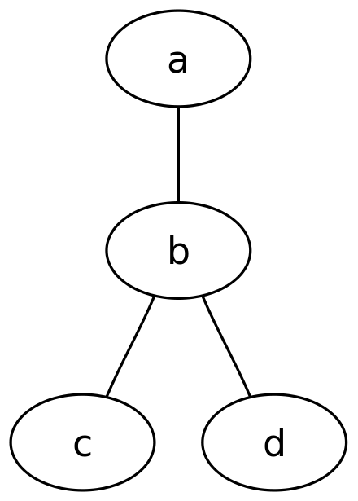
PL Spectrum
Dataflow Languages
Functional Languages
Graph-like languages: nodes connected by edges
Describes information flow
Inherently parallel model
Computational model: recursive definition of functions
Inspired on Church’s lambda-calculus (ca 1930)
Program is considered a function, from inputs to outputs
Data cannot mutate (no side-effects): pure functions, no variables to modify
Examples: Lisp, Scheme, Caml, Ocaml, Scala
// The graph name and the
// semicolons are optional
graph graphname {
a -- b -- c;
b -- d;
}

Slide 10
PL Spectrum
Scripting Languages
Object-oriented Languages
Originated as languages for “gluing together”
Developed for specific purposes:
Shell, Bash: job control
PHP, Javascript: dynamic web pages
Other general purpose: Perl, Python, Ruby, Matlab PL
Derived from Simula 67
Related to von Neuman languages
Data and operations bundled together
Pure OO languages do not support “free functions”
Examples: C++, Java, C#, Scala, OCaml
Markup Languages
Motivated by ”marking up” paper manuscripts
Tag-based, uses delimiters such as <begin> and </end>
Examples: GenCode, Tex / LaTex, Scribe, Markdown, HTML, XML

Slide 11
Why study Programming Language Design?
It’s cool!
Eventually you may create your own language and name it whatever you want (See: https://tutorialzine.com/2013/12/the-10-weirdest-programming-languages)
Makes you a better programmer and developer: faster and more portable code
Help understanding internals and behavior of other tools: debuggers, IDEs, assemblers, etc

Slide 12

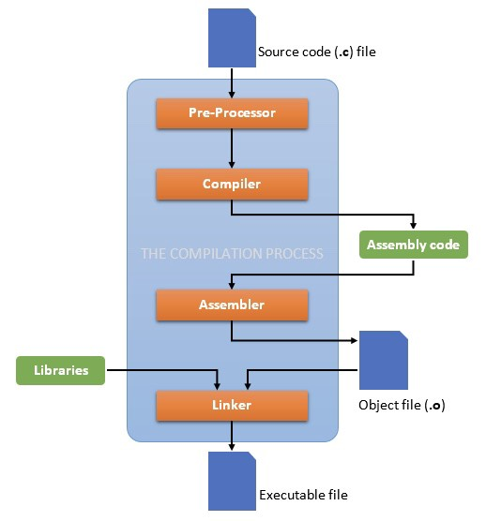
Remove comments;
Search and expand macros;
C-include, Python import
Translate each compilation unit to assembly
Translate from assembly to object (machine code)
Bind various compilation units together (.o files)

Slide 13
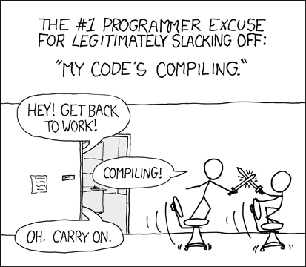
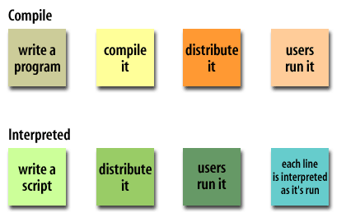
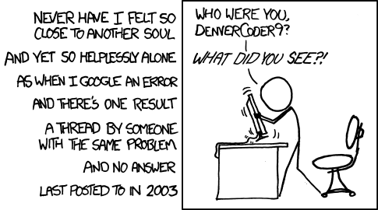
Compilation and Interpretation
From XKCD.com

Slide 14
Other compilation schemes
Source-to-source: from C to C
Cross compilation, e.g. from C to Pascal
Self-hosting:
Bootstrapping: used to build progressively more sophisticated version of a compiler
Starts with simple first version (likely interpreted)
Read Niklaus Wirth Pascal compiler (page 21 in textbook): Pascal compiler, P-code and Pascal Interpreter
Just-in-Time (JIT) compilation:
on demand
Common for interpreted languages: Java (bytecode), Lisp, C# (Common Intermediate Language or CIL)
Optimize hot-spots

Slide 15
Compilation Overview

