Slide 1

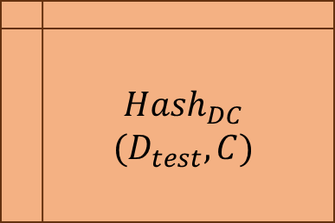
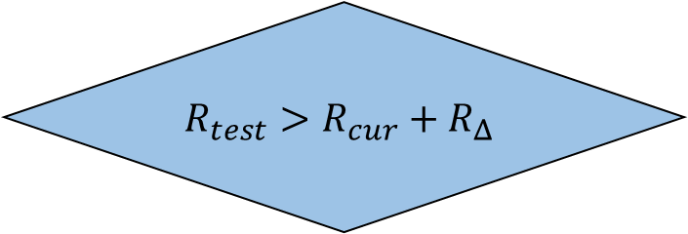

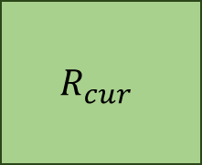
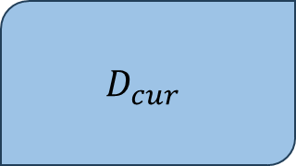
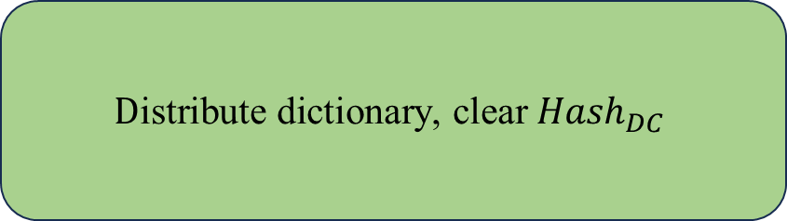
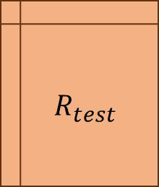
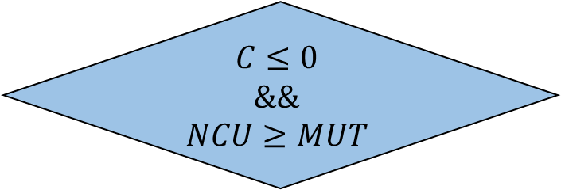
$$D_{cur}$$
(Sampled in the current cycle)
$${{Message}_{train} Message}_{test}$$
$$R_{cur}$$
$$R_{test}>R_{cur}+R_{Δ}$$
$${Hash}_{DC}$$
$$(D_{test}, C)$$
$$R_{test}$$
Yes
$$C←C−1$$
$$D\text{istribute} \text{dictionary}\text{, }\text{clear}{ Hash}_{DC}$$
$$C≤0$$
$$\&\&$$
$$NCU≥MUT$$

