Slide 1
Analytical Calendar
A new approach for analytics
By Dr. Kongson Cheung 2024-03-16

Slide 2
Agenda
Traditional Approach of using Calendar in Analytics
Introduction of Analysis Calendar
Introduction to Comparison Calendar
Introduction to Analytical Calendar
Analytical Calendar - Analysis Calendar
Analytical Calendar - Comparison Calendar
Analytical Calendar – Advanced Comparison Calendar
Practical Example
In Qlik Sense
In PowerBI

Slide 3

Traditional Method
2020
2021
2022
2023
2024
Q1
Q2
Q3
Q4
⬅Can skip selection
Master Calendar
Jan
Feb
Mar
Apr
May
Jun
Jul
Aug
Sep
Oct
Nov
Dec
1
2
3
4
5
6
7
8
9
10
11
12
13
14
15
16
17
18
19
20
21
22
23
24
25
26
27
28
29
30
31
Pick the required value of any date components.
Then, it will form the date in different granularity
e.g. Year = 2023, Month = Mar and Day = 6 ➔ it becomes 2023-Mar-06 ➔ it is a date.
It is very widely used and very simple to start. It has been used for many many years.

Slide 4
Traditional Method Date Integrity Issue
2020
2021
2022
2023
2024
Q1
Q2
Q3
Q4
Master Calendar
Jan
Feb
Mar
Apr
May
Jun
Jul
Aug
Sep
Oct
Nov
Dec
Date integrity is wrong ➔
1
2
3
4
5
6
7
8
9
10
11
12
13
14
15
16
17
18
19
20
21
22
23
24
25
26
27
28
29
30
31
However, it may cause date integrity issues if it is selected wrongly.
e.g. Year = 2023, Quarter = Q2, if then Mar is selected, what will happen? The selection is ignored? Mar overrides other selection?
It is very important that user has to interpret the correct date components and pick the correct values one by one.

Slide 5

Traditional Method Cross Year Selection Issue
2020
2021
2022
2023
2024
Q1
Q2
Q3
Q4
Master Calendar
Jan
Feb
Mar
Apr
May
Jun
Jul
Aug
Sep
Oct
Nov
Dec
1
2
3
4
5
6
7
8
9
10
11
12
13
14
15
16
17
18
19
20
21
22
23
24
25
26
27
28
29
30
31
It is also unable to select cross year dates.
e.g. To select 2022-Dec and 2023-Jan, is it to choose Year = 2022, 2023 and Month = Jan, Dec?
It seems there is a confusion between the combination of year and month.

Slide 6
Traditional Method How to interpret?
2020
2021
2022
2023
2024
Q1
Q2
Q3
Q4
Master Calendar
Jan
Feb
Mar
Apr
May
Jun
Jul
Aug
Sep
Oct
Nov
Dec
1
2
3
4
5
6
7
8
9
10
11
12
13
14
15
16
17
18
19
20
21
22
23
24
25
26
27
28
29
30
31
Base on the above, how to interpret the selection?
e.g. Year = 2023, Month = Jan, Feb, Mar. Is it 2023-Mar YTM? Is it 2023-Q1? Or Just 2023-Jan, 2023-Feb and 2023-Mar? How to understand this more appropriately?
The Master Calendar is not able to provide the analysis perspective.

Slide 7
Introduction of Analysis Calendar
Analysis Calendar aims at making an easier way for analysis period selection. It aligns both human and system for same interpretation of what to select. It has three main components:
Date Perspective
It selects the date granularity.
Unique Date
It has the values of all the unique dates, i.e. the date in different granularity, e.g. 2023 for Year, 2023-Q1 for Quarter, 2023-Jan for Month, 2023-W01 for Week and 2023-01-01 for Date.
Analysis Perspective
It represents the date range, e.g. YTD, YTM, Rolling N Years/Quarters/Months/Weeks/Days, etc.
Analysis Calendar

Slide 8
Analysis Calendar how to use
How to use Analysis Calendar?
* The date selection is now in a more standardized approach.
1. Select Date Perspective
Year
Quarter
Month
Week
Date
What is the granularity for the analysis period?
The irrelevant combinations of date components are filtered out .
2. Select Unique Date
2024
2024-Q1
2024-02
2024-W9
2024-02-29
Analysis Calendar
What is the date for the analysis period with respect to the date granularity selected?
2023
2023-Q4
2024-01
2024-W8
2024-02-28
3. Select Analysis Perspective
The irrelevant analysis perspective are filtered out.
Actual
Actual
Actual
Actual
Actual
What is date range required?
YTQ
YTM
YTW
YTD
QTM
QTD
MTD
WTD
Rolling 2 Years
Rolling 2 Quarters
Rolling 2 Months
Rolling 2 Weeks
Rolling 2 Days

Slide 9
How about Comparison?
In analytics, analysis period is basic. How about comparison?
Master Calendar (Traditional Calendar)
It requires another set of master calendar to handle comparison selection.
Analysis Calendar
It cannot handle comparison at all. But it does not require to duplicate the same components for comparison selection. Instead, it can be extended to have Comparison Perspective for selection. It is Comparison Calendar.

Slide 10
Introduction of Comparison Calendar
Comparison Calendar is an extension of the Analysis Calendar with additional Comparison Perspective for selection. It aims at making an easier way for comparison selection with clear indication of what have been selected. It has four main components:
Date Perspective (same as analysis calendar)
It selects the date granularity.
Unique Date (same as analysis calendar)
It has the values of all the unique dates, i.e. the date in different granularity, e.g. 2023 for Year, 2023-Q1 for Quarter, 2023-Jan for Month, 2023-W01 for Week and 2023-01-01 for Date.
Analysis Perspective (same as analysis calendar)
It represents the date range, e.g. YTD, YTM, Rolling N Years/Quarters/Months/Weeks/Days, etc.
Comparison Perspective
It represents the comparison, e.g. N Years/Quarters/Months/Weeks/Days before.
Comparison Calendar

Slide 11
Comparison Calendar How to use
How to use Comparison Calendar?
1. Select Date Perspective
Year
Quarter
Month
Week
Date
What is the granularity for the analysis period?
Comparison Calendar
The irrelevant combinations of date components are filtered out
2. Select Unique Date
2024
2024-Q1
2024-02
2024-W9
2024-02-29
What is the date for the analysis period with respect to the date granularity selected?
2023
2023-Q4
2024-01
2024-W8
2024-02-28
3. Select Analysis Perspective
The irrelevant analysis perspective are filtered out.
Actual
Actual
Actual
Actual
Actual
What is date range required?
YTQ
YTM
YTW
YTD
4. Select Comparison Perspective
The irrelevant comparison perspective are filtered out.
N/A
N/A
N/A
N/A
N/A
What is the comparison required?
1 Year Before
1 Quarter Before
1 Month Before
1 Week Before
1 Day Before
2 Years Before
2 Quarters Before
2 Months Before
2 Weeks Before
2 Days Before
2024
2024-Q1
2024-02
2024-W9
2024-02-29
* The Comparison Perspective is still in a standardized approach.
2023
2023-Q4
2024-01
2024-W8
2024-02-28

Slide 12
Introduction of Analytical Calendar
Analytical Calendar is come up with the design of Analysis and extended to Comparison Calendar. It makes use of both to maximize the functionality of Calendar usage.
Analytical Calendar
Analytical Calendar
Analysis Calendar
Comparison Calendar

Slide 13
Analytical Calendar
It standardizes the date input and benefit for a clear perspective of selecting the analysis and comparison periods.
It simplifies the overall date selection for input and avoids the incorrect date selections and unexpected behaviors.
It allows to be applied in modern analytic tools such as Qlik Sense, QlikView, PowerBI, etc.
It also has benefits for developer but it does not cover in this deck.

Slide 14
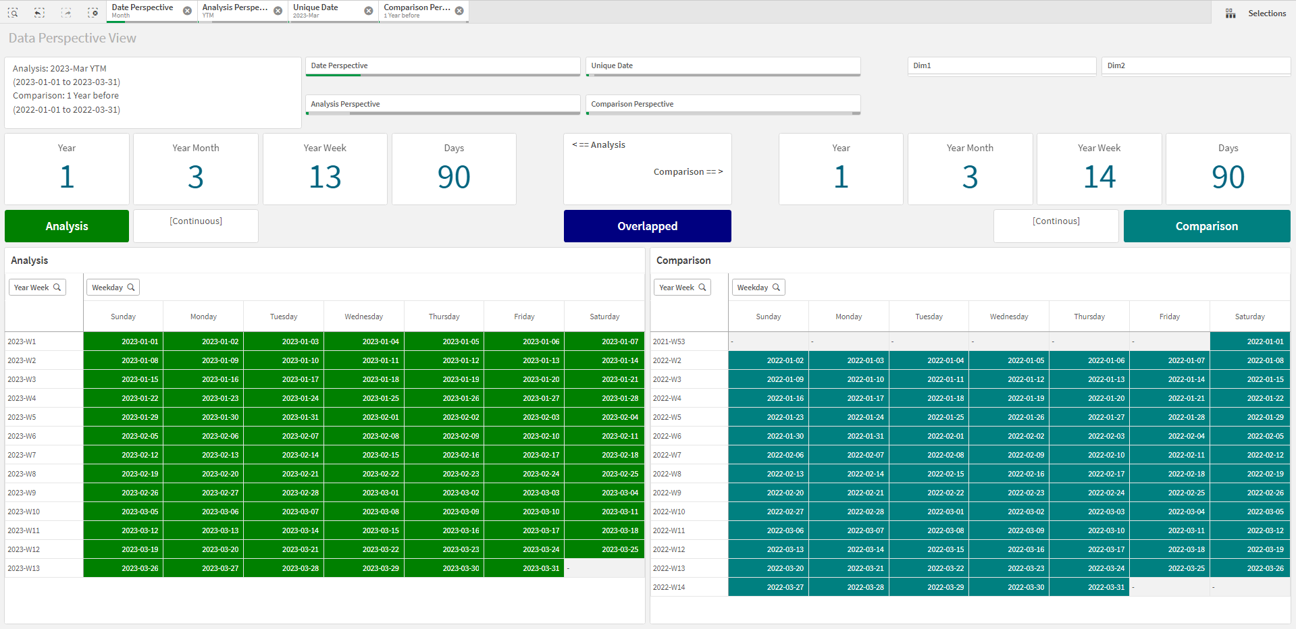
Analytical Calendar in Qlik Sense

Slide 15
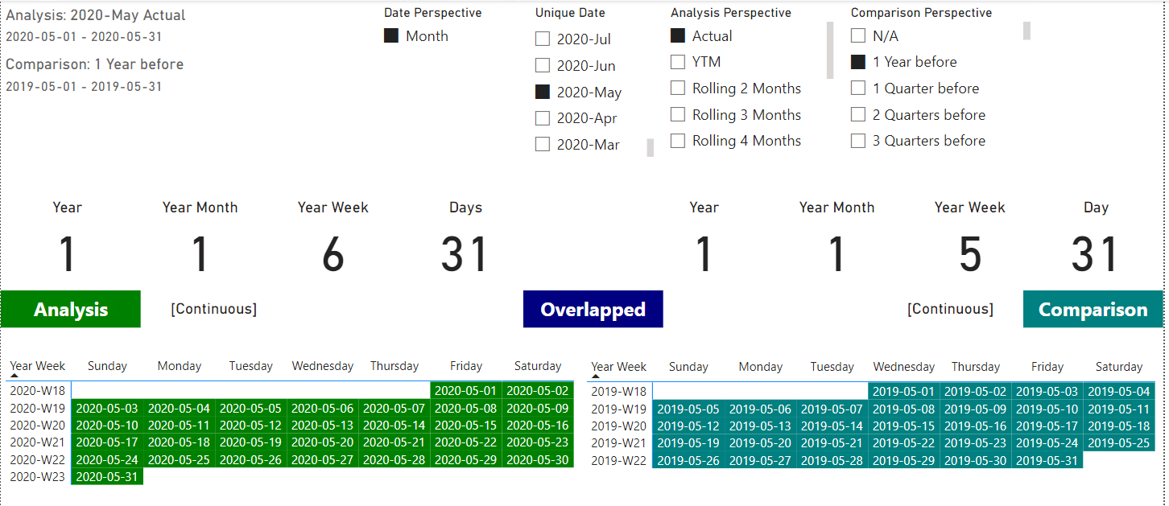
Analytical Calendar in PowerBI

Slide 16
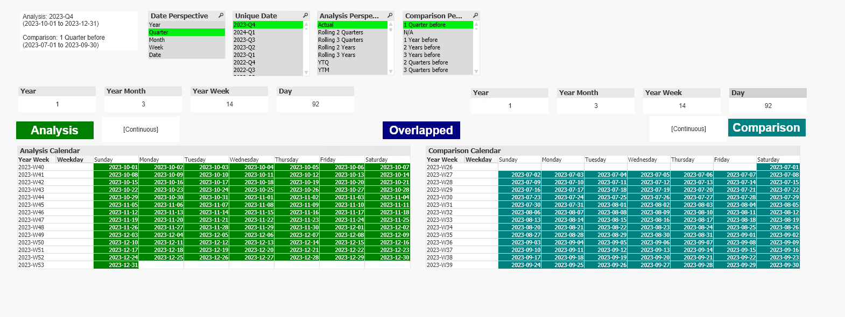
Analytical Calendar in QlikView

Slide 17
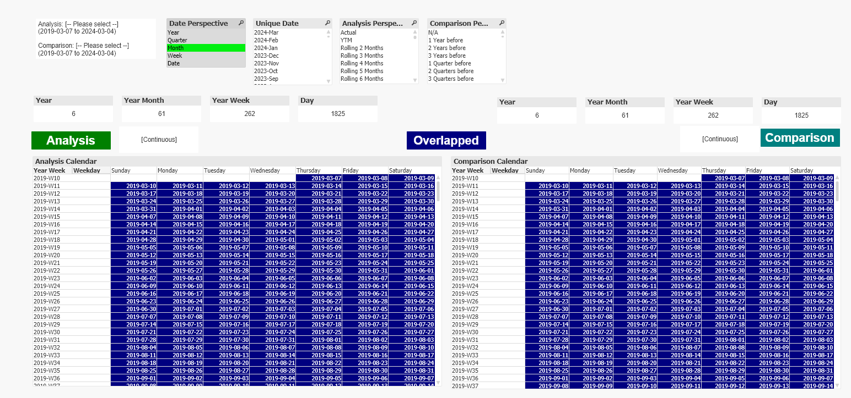
A Step by Step Guide
Step 1
Select Date Perspective, e.g. Month meaning it is a month level analysis.
Backend the scene
It filters out the date granularity in Unique Date, Analysis Perspective and Comparison Perspective, i.e. Month

Slide 18
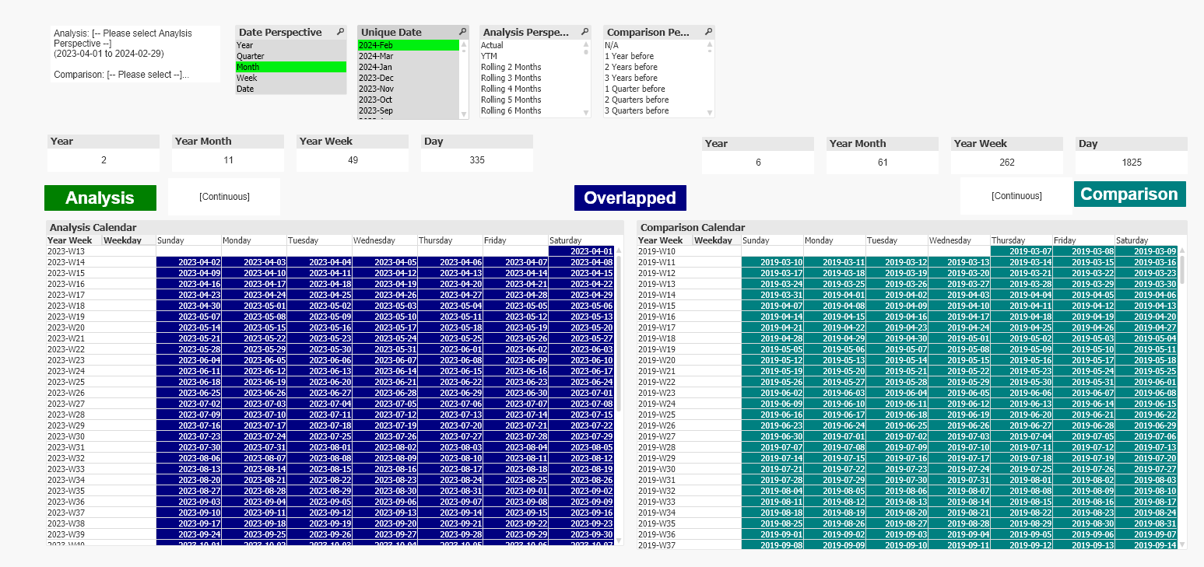
A Step by Step Guide
Step 2
Select Unique Date, e.g. 2024-Feb meaning the date required analysis.
Backend the scene
It further reduces to any related Analysis Perspective and Comparison Perspective in the selected Unique Date, i.e. 2024-Feb.

Slide 19
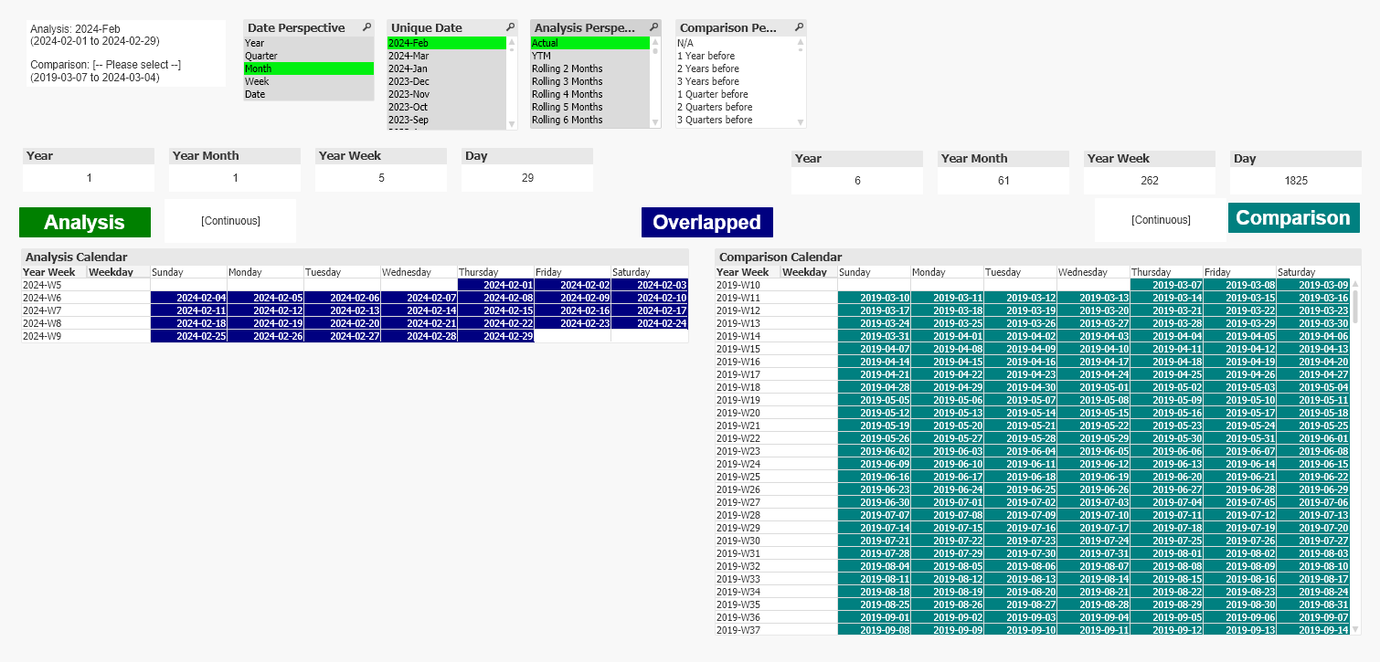
A Step by Step Guide
Step 3
Select Analysis Perspective, e.g. Actual meaning the selection itself is the range.
Backend the scene
The analysis period is completed as shown in the top left display box.
It also reduces the Comparison Perspective related to the analysis period selected.

Slide 20
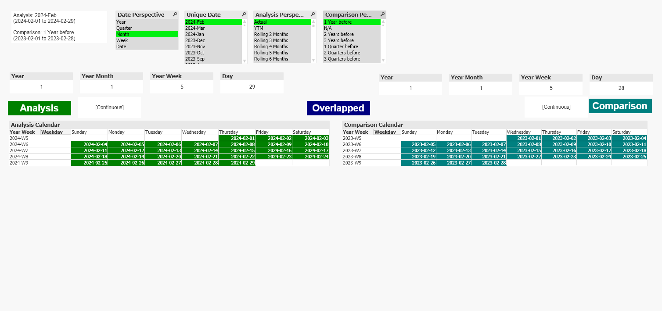
A Step by Step Guide
Step 4
Select Comparison Perspective, e.g. 1 Year before meaning the comparison period is 2024-Jan.
Backend the scene
The analysis and comparison period are completed as shown in the top left display box.
The chart

Slide 21
Conclusion
Analytical Calendar has standardize the date selection by four elements:
Date Perspective
Unique Date
Analysis Perspective
Comparison Perspective
Analytical Calendar can be customized into three modes:
Analysis Mode
Comparison Mode
Advanced Comparison Mode (in Appendix)
Analytical Calendar can be applied in Qlik Sense, QlikView, PowerBI and is still exploring to expand to other analytic tools.
Analytical Calendar is still evolving. Please visit my blog from time to time for an update.
https://kongsoncheung.blogspot.com/

Slide 22
Appendix

Slide 23
Advanced Comparison Calendar
Advanced Comparison Calendar is further to extend the functionality of comparison instead of the concept of “N Date Components Before”. It adds the flexibility to compare against individual date. They are named custom date selection.
Example of Usage
Chinese Lunar New Year requires custom selection.
Marketing Campaign period
The usage is same as the custom dates are available in the Comparison Perspective. However, the design behind has some tricky steps to be involved.
Comparison Calendar

Slide 24
Thank you
By Dr. Kongson Cheung
2024-03-16
https://kongsoncheung.blogspot.com/
https://github.com/kongson-cheung/analytical-calendar/tree/main

