Slide 1
Movie industry
Wei Kong

Slide 2
Executive Summary
Decisions to be impacted
Business value
Personal Interest

Slide 3
Morphism
Scraping Data
Outlier Removal
Detailed Tuning
Feature Selection and Engineering
Hyperparameter Tuning

Slide 4

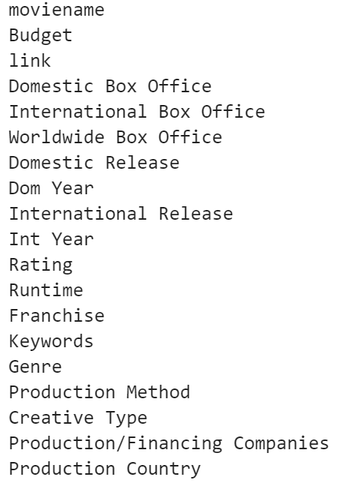
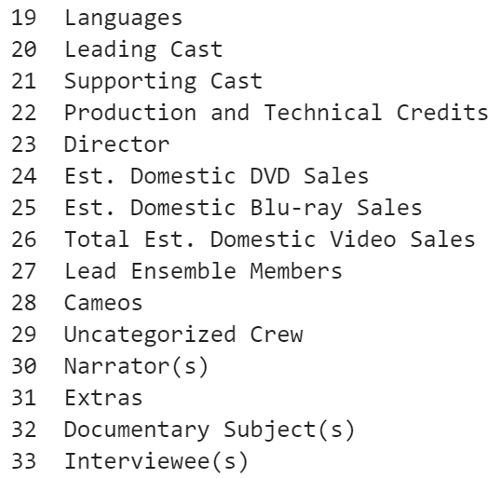
Scraping Data
a website operated by Nash Information Services, LLC., 6382 Movies

Slide 5
Feature Selection and Engineering
ROI = (Revenue-Budget)/Budget*100%
Revenue Release Year Release Month
Is Franchise?
Leading Casts

Slide 6
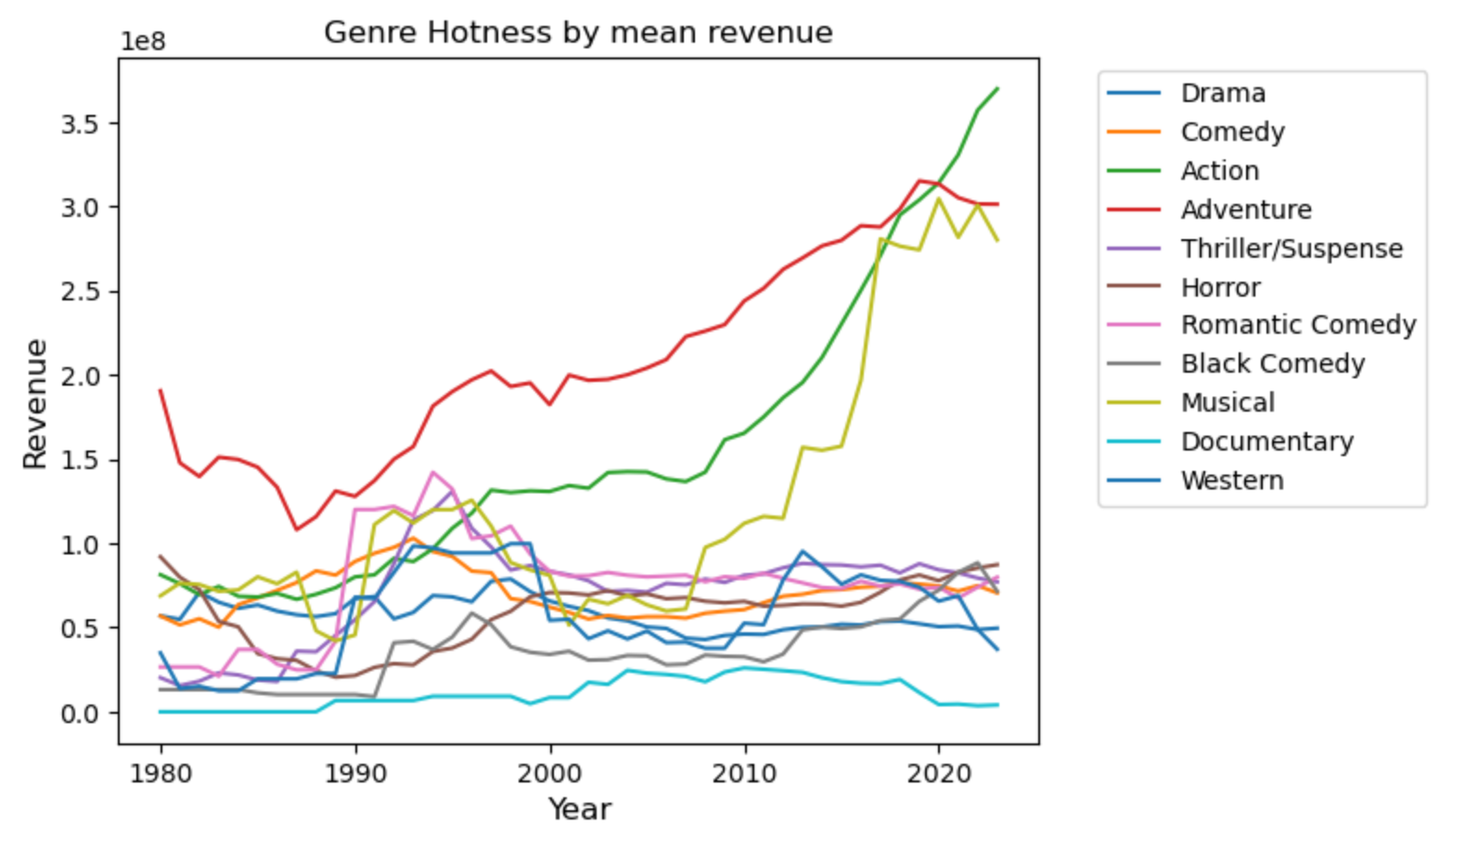

Slide 7


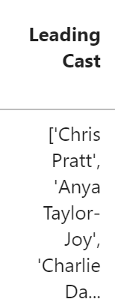
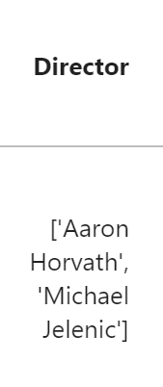
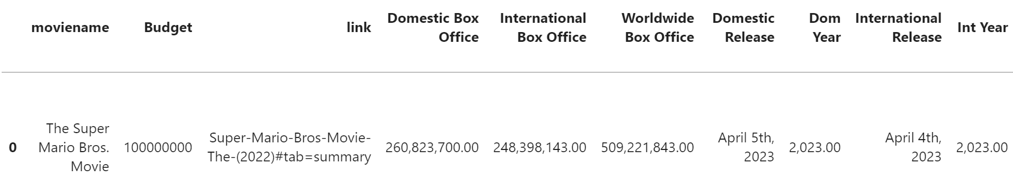
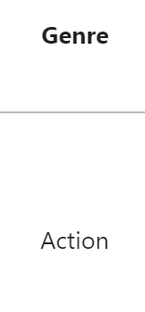
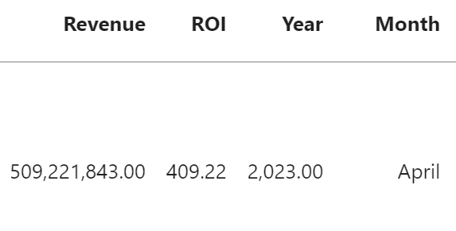
Feature Selection and Engineering
Time window of y = 3 years
Production Period
Release
… | 2018 | 2019 | 2020 | 2021 | 2022 | 2023
How much each Actor made in this time window?
Directors? How much does actors in this movie made in the past time window? Directors? Movie of this Genre?
Top n_1 actors? Top n_2 directors?
Has star actor? Has star director? Sum of actors’ past revenue Sum of directors’ past revenue
Sum of genre performance

Slide 8
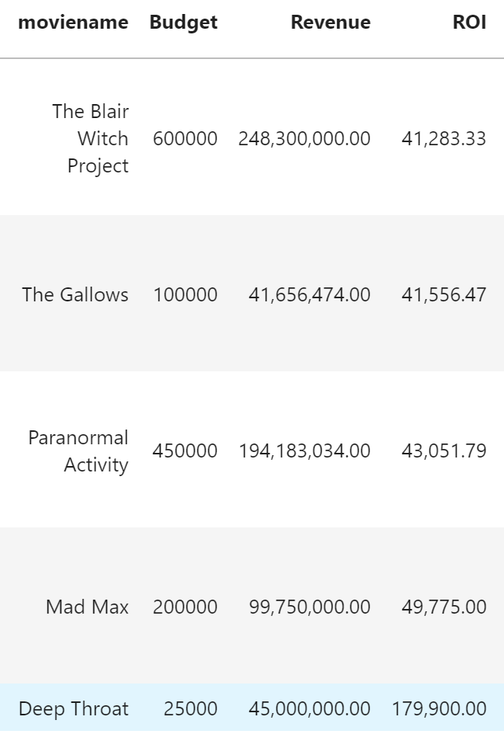
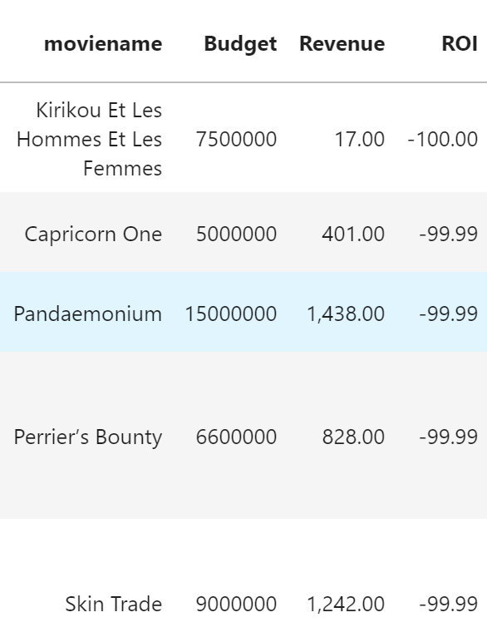
Outlier Detection
Fact Check based on ROI -95 to 50000

Slide 9
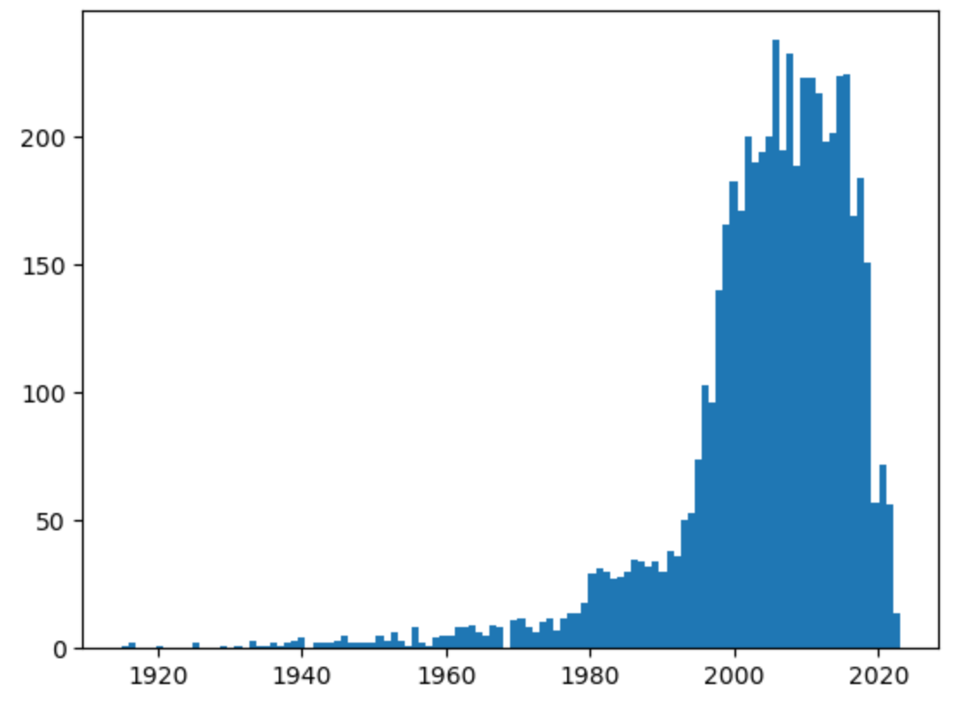
Number of movie by year

Slide 10
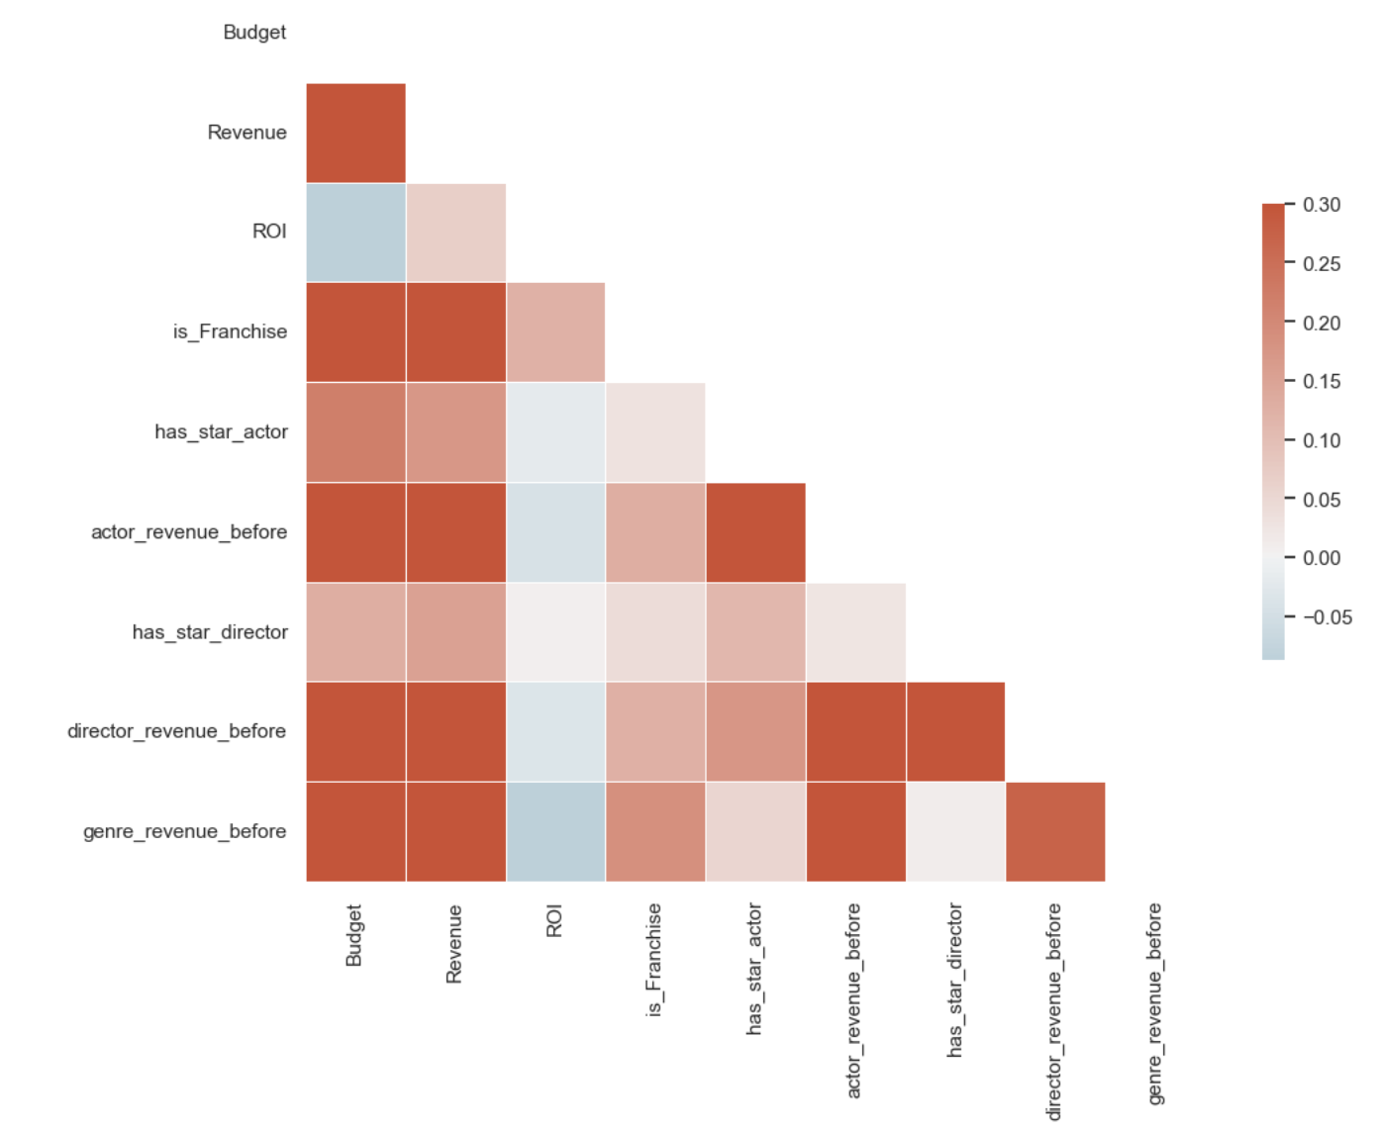
Correlation Plot

Slide 11
Model Selection
Random Forest and XGBoost

Slide 12
Hyper- Parameter Tuning
Grid Search
Time window length for actor, directors, and genre [3, 5, 10] Number of star actor and director to be considered in the time window [3, 5, 10] Criteria: RMSE
Grid Search Cross Validation
5 Folds Max Depth Max Features
Criteria: RMSE
Best Hyperparameters

Slide 13
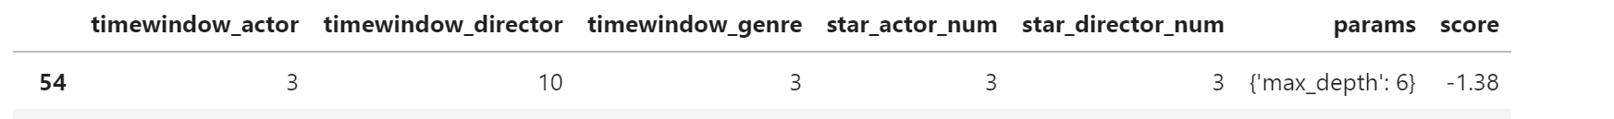
Do Grid Search Cross Validation Again Tune more details of XGBoost Model
Hyper- Parameter Tuning

Slide 14


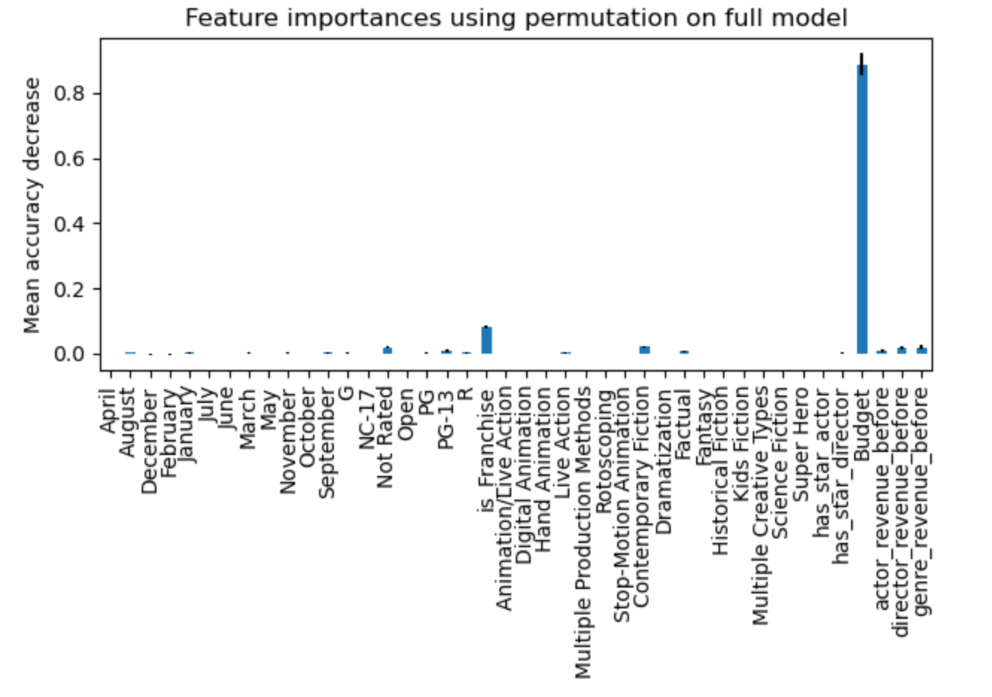
Results

Slide 15
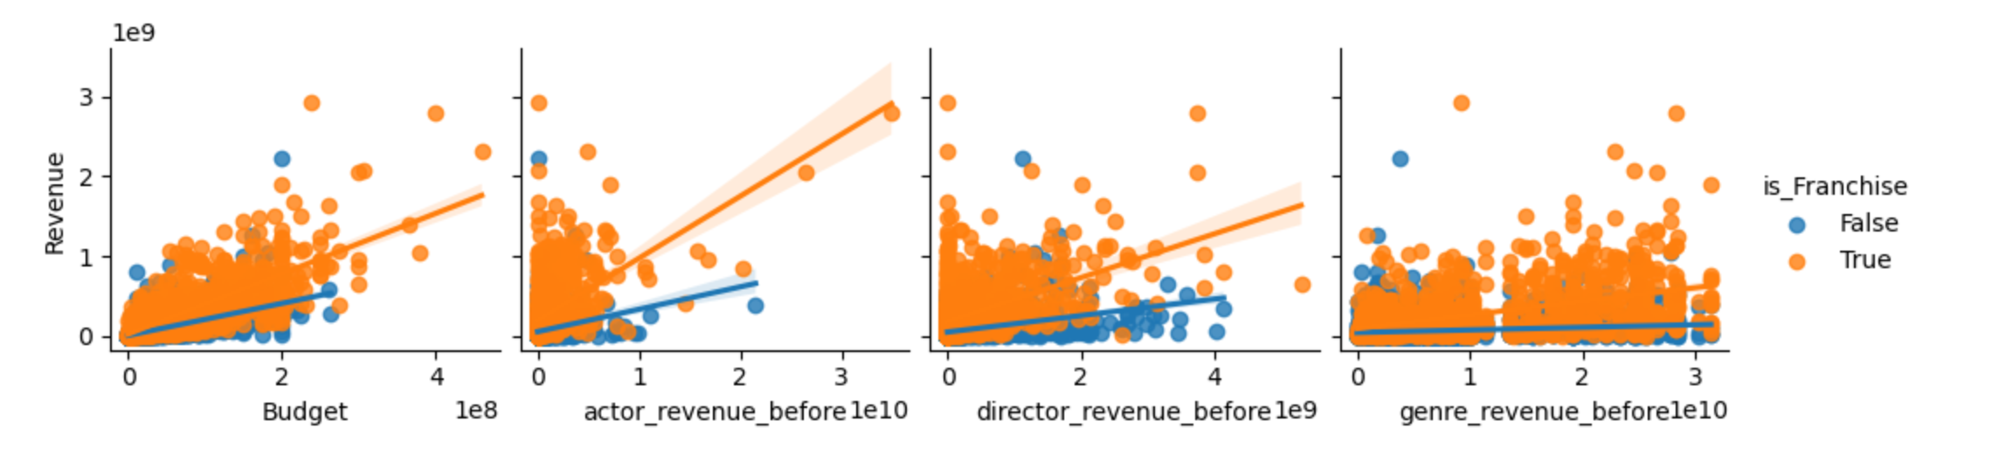




OLS Model for Franchise only
OLS Model
OLS Model for non-Franchise only
XGBoost model for non-Franchise

Slide 16
Takeaways
Franchise movies and non-Franchise movies are two different species
Invest in higher budget movies are more likely to succeed, as they usually have more successful directors and actors that has proved their ability before
It is much harder to predict the success of non-franchise individual movies and they exhibits more randomness

