Slide 1
Review and Improvements
Proof of Fundamental Theorem of the Local Theory of Curves
Beijing 101 Middle School: Yuanchenxi Gao
Shenzhen Yaohua Experimental School: Kongwing Wu
2023.1.29

Slide 2
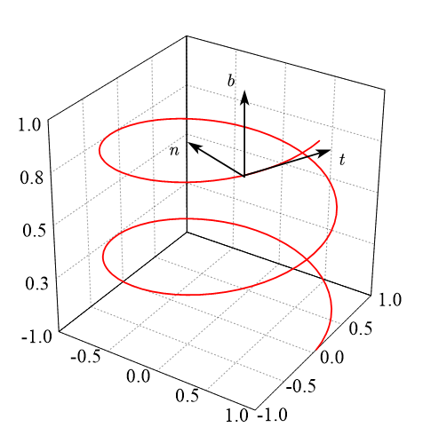
Construction of Frenet Formulas
A parametrized differentiable curve
arc length reparametrized
Define:
Frenet formulas:
Figure1: Frenet trihedron
Kaixin, W. Fundamental Theorem of The Local Theory of Curves.

Slide 3
Proof of Existense and Uniqueness of Contraction Mapping Theorem
A has unique fixed point
.
There is a unique function
.
contraction mapping theorem
1. F is continuous.
2. F(t,x) is globally Lipschitz in second variable.
3.
proved by mathematical induction
Kaixin, W. Fundamental Theorem of The Local Theory of Curves.

Slide 4
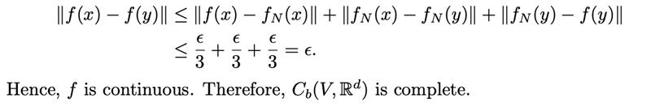
Proof of Completeness of
Figure2: graphical representation of the proof of continuity
Kaixin, W. Fundamental Theorem of The Local Theory of Curves.

Slide 5
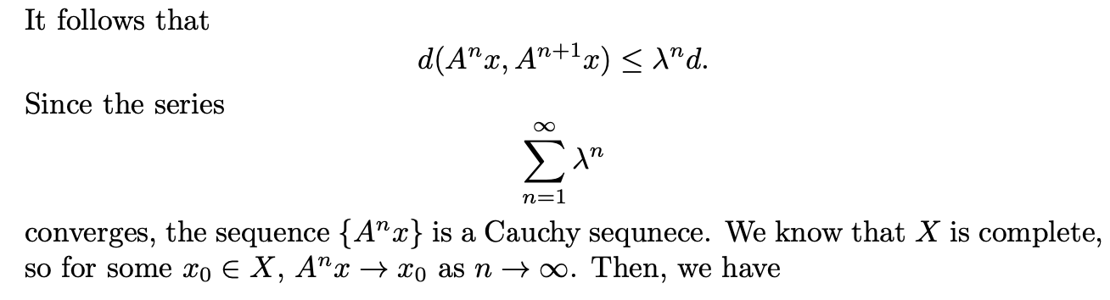
Improvements on the Proof of Contraction Mapping Theorem
sum of ratiometric sequence
Kaixin, W. Fundamental Theorem of The Local Theory of Curves.

Slide 6
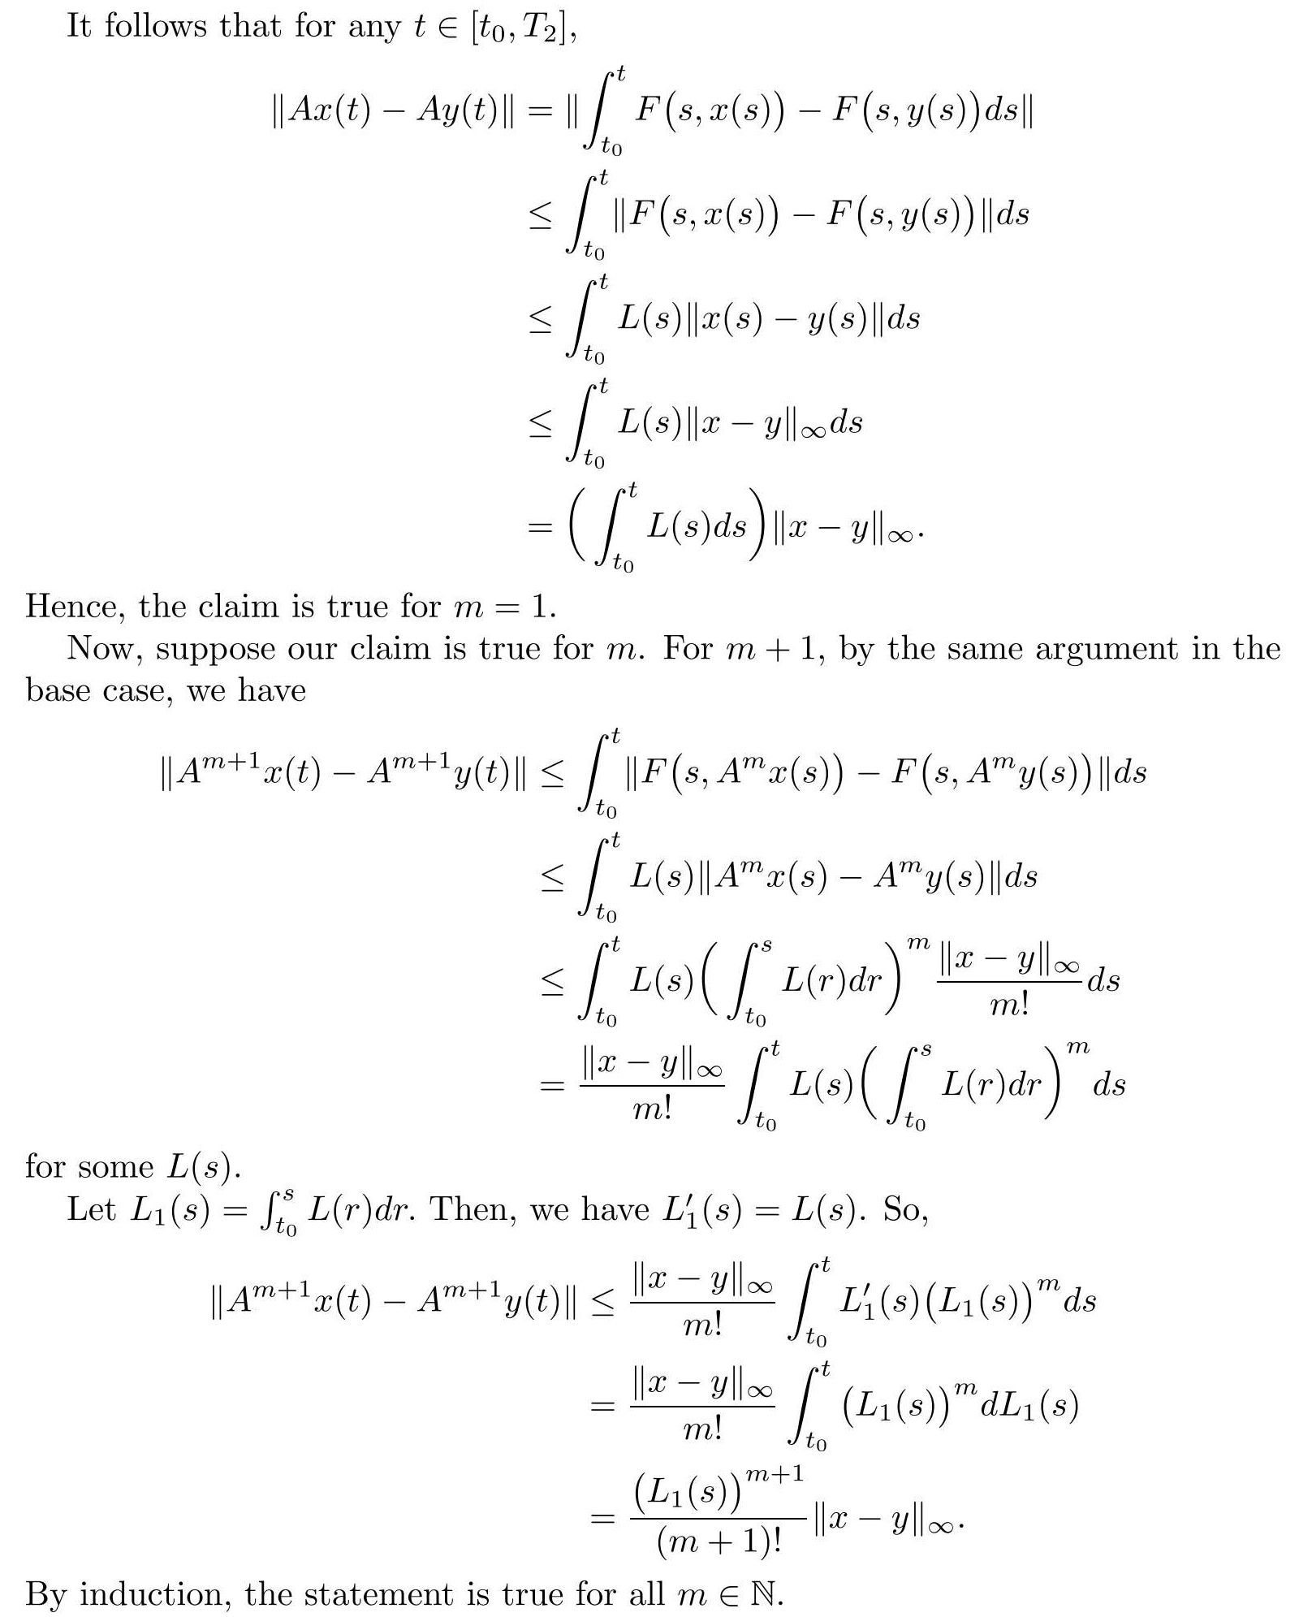
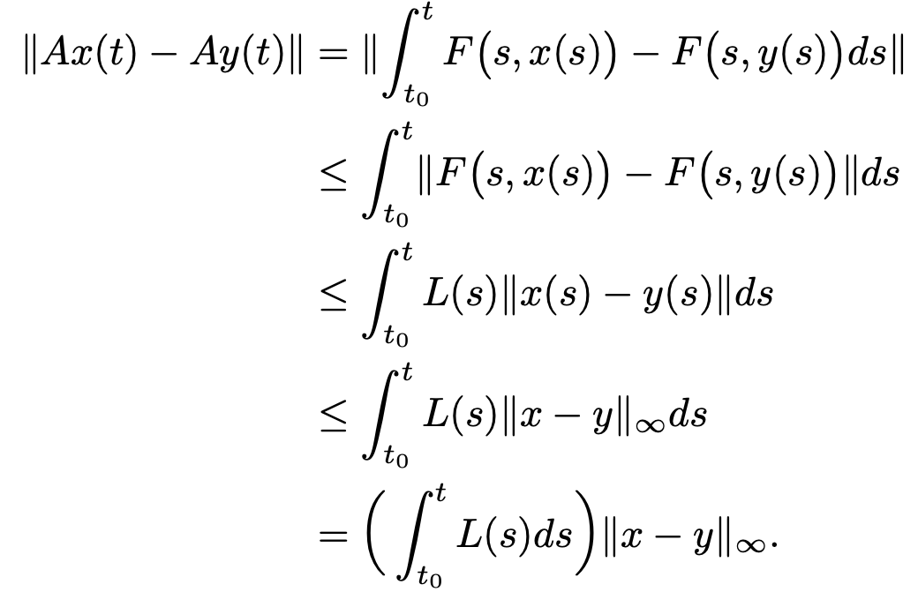
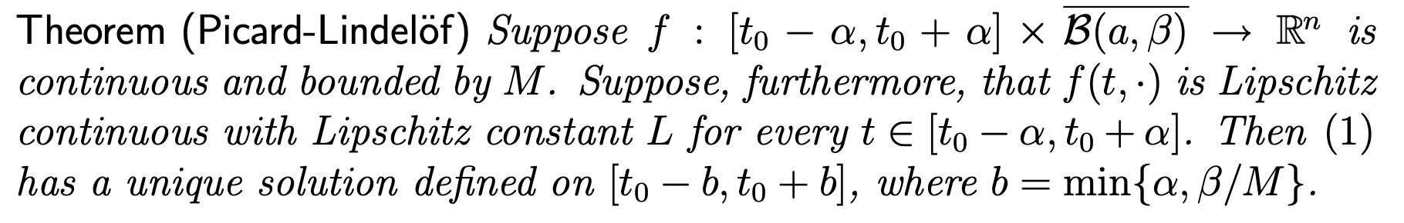
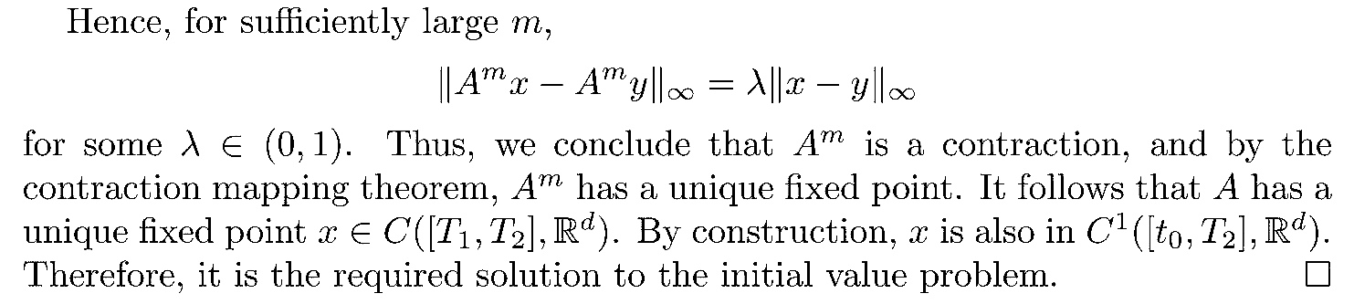
Another proof of Contraction Mapping A
Picard-Lindelöf Theorem
Mean Value Theorem
Kaixin, W. Fundamental Theorem of The Local Theory of Curves.

Slide 7
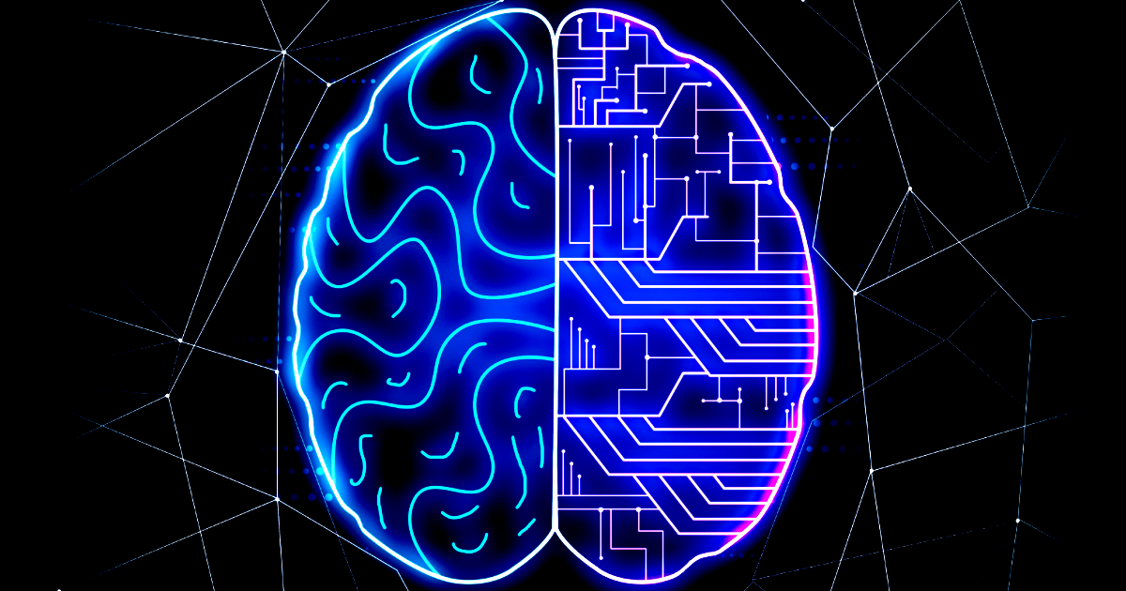
Application of Riemannian Manifold
Machine Learning
Machine learning (ML) is a field of inquiry devoted to understanding and building methods that 'learn', that is, methods that leverage data to improve performance on some set of tasks.
Brain-Computer Interface
A brain-computer interface (BCI), sometimes called a brain-machine interface (BMI) or smartbrain, is a direct communication pathway between the brain's electrical activity and an external device, most commonly a computer or robotic limb. BCIs are often directed at researching, mapping, assisting, augmenting, or repairing human cognitive or sensory-motor functions.

Slide 8
Applications
We present of research of applications of Riemann manifold on a website, focusing on machine learning and brain-computer interface.
Please check it here: https://kongwingwu.github.io/AXIS/

Slide 9
Reference
1. Kaixin, W. Fundamental Theorem of The Local Theory of Curves.
2. Picard-Lindelöf Theorem; 1999;
‌

Slide 10
请老师批评指正

