Slide 1

Chapter 7
Internet Protocol Version4
(IPv4)
Copyright © The McGraw-Hill Companies, Inc. Permission required for reproduction or display.
Notes:
前面介绍了IP的逻辑编址，路由交付和转发的机制，接下来看看网络层基于IP的分组格式，即狭义的IPv4协议

Slide 2
OBJECTIVES:
To explain the general idea behind the IP protocol and the position of IP in TCP/IP protocol suite.
To show the general format of an IPv4 datagram.
To discuss fragmentation and reassembly of datagrams.
To discuss several options that can be in an IPv4 datagram and their applications.
To show how a checksum is calculated for the header of an IPv4 datagram at the sending site and how the checksum is checked at the receiver site.
To discuss IP over ATM and compare it with IP over LANs and/or point-to-point WANs.
To show a simplified version of the IP package and give the pseudocode for some modules.
Notes:
包括IP协议的服务类型，数据包格式，分片和拼接，校验，以及其它的一些细节设计

Slide 3
Chapter Outline
7.1 Introduction
7.2 Datagrams
7.3 Fragmentation
7.4 Options
7.5 Checksum
7.6 IP over ATM
7.7 Security
7.8 IP Package

Slide 4
7-1 INTRODUCTION
The Internet Protocol (IP) is the transmission mechanism used by the TCP/IP protocols at the network layer.
RFC 791
Application Layer
Transport Layer
Network
Layer
ICMP
IGMP
IP
ARP
RARP
Network
Access
Layer
LANs
MANs
WANs
Notes:
Relationship of IP to the rest of the TCP/IP Suite

Slide 5
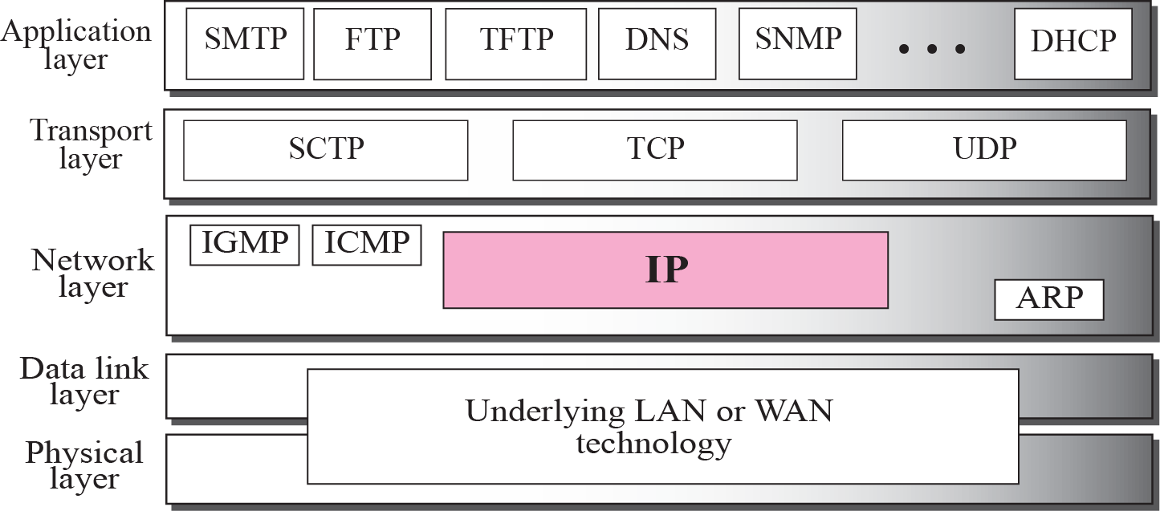
Figure 7.1 Position of IP in TCP/IP protocol suite
Notes:
其他层发生了较大变化，特别是应用层，但IP协议一直是网络层的核心协议

Slide 6
The Features of IP Communication
Features
Connectionless: 跨越多个异构物理网→ 通用性
Unreliable: 可靠性问题交由高层协议解决
Best-effort delivery
Connection vs. Reliable
Connection and connectionless
Reliable: error control, flow control, …
面向连接不一定保证可靠，无连接不一定不可靠
在连接上容易实现可靠性机制

Slide 7
7-2 DATAGRAMS
Packets in the network (internet) layer are called datagrams. A datagram is a variable-length packet consisting of two parts:
header and data.
The header is 20 to 60 bytes in length and contains information essential to routing and delivery. It is customary in TCP/IP to show the header in 4-byte sections. A brief description of each field is in order.
Notes:
Datagram，分组，数据报， 所包含的信息需要能支持上节课所提到的 路由和交付功能，比如包含源和目的地逻辑地址

Slide 8
Topics Discussed in the Section
Format of the datagram packet
Some examples

Slide 9
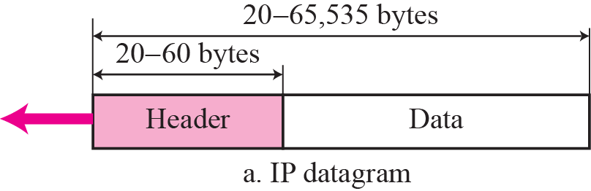
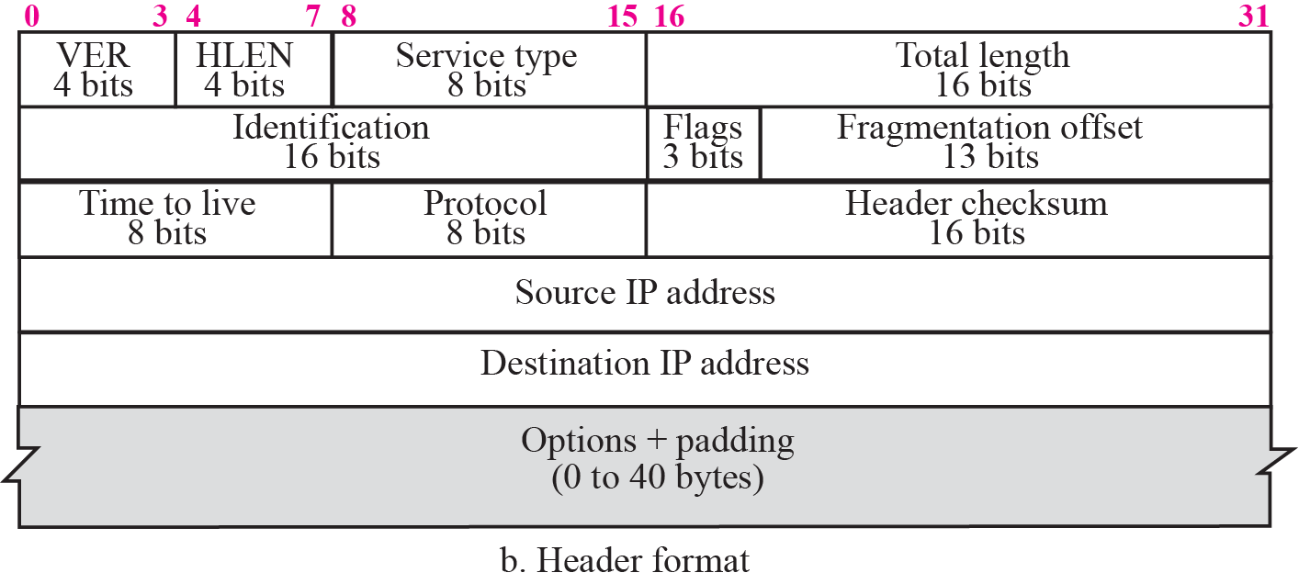
Figure 7.2 IP datagram
Notes:
版本号，首部长度，4个字节的32 bit值以下面的次序传输：首先是 0～7 bit，其次8～15 bit，然后1 6～23 bit， 最后是24~31 bit。这种传输次序称作big endian字节序。由于T C P / I P首部中所有的二进制整数 在网络中传输时都要求以这种次序，因此它又称作网络字节序。

Slide 10
Type of Service Field
TOS（服务类型）：8 bits
该分组所期望的服务质量
Precedence
D
T
R
Reserve
RFC 1349
Precedence
D
T
R
C
D: Minimize delay
R: Maximize reliability
T: Maximize throughput
指示对分组进行处理（排队或丢弃）的优先权，值从0（普通优先级）到7（网络控制）
该分组所希望的路由转发服务类型，不能同时设置
C: Minimize cost
RFC 2474
DSCP
CU
Differentiated Services Code Point，区分服务编码点
Currently
Unused
Notes:
The precedence subfield is not used in IPv4.

Slide 11
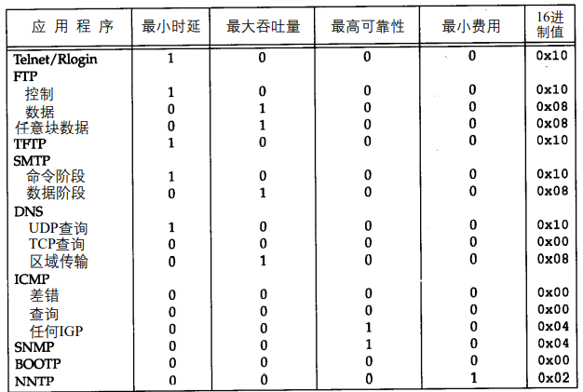
早期服务类型字段推荐值
现在大多数的T C P / I P实现都不支持TO S特性，新的路由协议如 O S P F和I S - I S都根据DSCP的值进行路由决策。
Notes:
TCP/IP协议详解 卷1 P25

Slide 12
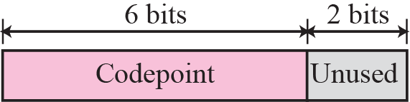
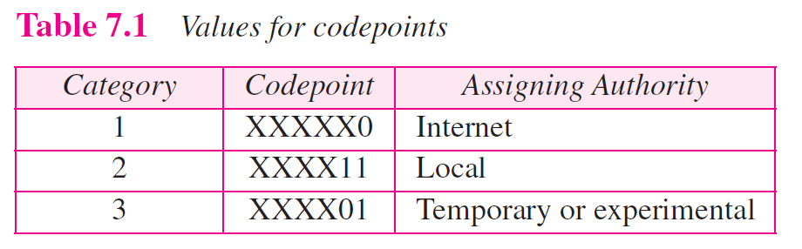
Figure 7.3 Service type
Notes:
目前沿用RFC2474，具体的服务类型定义如上表所示

Slide 13
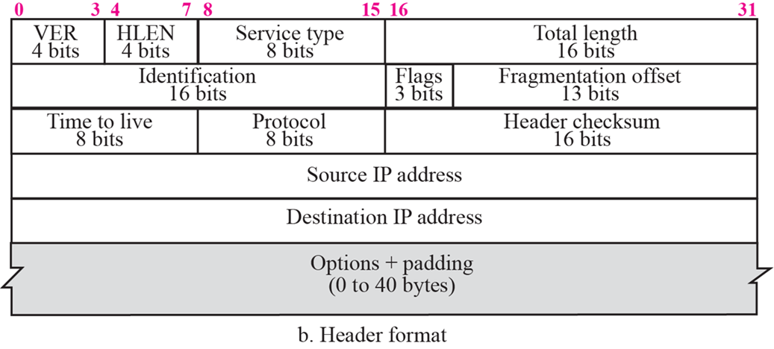
Length Fields
HLEN（首部长度字段）：4 bits
以4字节（即32bits）为单位
取值：5 ~ 15（即首部长度为 20 ~ 60 bytes）
Total length（总长度字段）：16 bits
以字节单位
首部长度（即4*HLEN）+ 数据长度
思考：IP分组的最大长度是多少？
65535

Slide 14

Note
The total length field defines the total length of the datagram including the header.

Slide 15
Example 7.1
An IP packet has arrived with the first 8 bits as shown:
The receiver discards the packet. Why?
Solution
There is an error in this packet. The 4 left-most bits (0100) show the version, which is correct. The next 4 bits (0010) show the wrong header length (2 × 4 = 8). The minimum number of bytes in the header must be 20. The packet has been corrupted in transmission.

Slide 16
Example 7.2
In an IP packet, the value of HLEN is 1000 in binary. How many bytes of options are being carried by this packet?
Solution
The HLEN value is 8, which means the total number of bytes in the header is 8 × 4 or 32 bytes. The first 20 bytes are the base header, the next 12 bytes are the options.

Slide 17

Figure 7.4 Encapsulation of a small datagram in an Ethernet frame
Notes:
实验1中，网络层分组长度为60字节

Slide 18

Encapsulation
Example：Ethernet fram
byte
6
6
2
46 ~ 1500
4
Packet
目的MAC
源MAC
0x0800
IP Packet
类型
FCS
Ethernet frame header
IP header
IP data

Slide 19
Example 7.3
In an IP packet, the value of HLEN is 5₁₆ and the value of the total length field is 0028₁₆. How many bytes of data are being carried by this packet?
Solution
The HLEN value is 5, which means the total number of bytes in the header is 5 × 4 or 20 bytes (no options). The total length is 40 bytes, which means the packet is carrying 20 bytes of data (40 − 20).

Slide 20
Fragmentation Fields
Identification（标识字段）：16 bits
源站每发送一个分组，标识值＋1
（源IP地址，标识）→ 全网唯一分组标识
Flags（标志字段）：3 bits
Fragmentation offset（片偏移字段）：13 bits
以8 bytes为单位
D: Do not fragment
M: More fragments
Flags
D
M
思考：IP数据报为什么需要被分片？
Notes:
如何判断一个IP分组是否被分片？是第一片、中间片、最后一片？
RFC 791 [Postel 1981a]认为标识字段应该由让IP发送数据报的上层来选择。假设有 两个连续的I P数据报，其中一个是由TCP生成的，而另一个是由UDP生成的，那么它们 可能具有相同的标识字段。尽管这也可以照常工作（由重组算法来处理），但是在大多 数从伯克利派生出来的系统中，每发送一个I P数据报，I P层都要把一个内核变量的值加 1，不管交给IP的数据来自哪一层。内核变量的初始值根据系统引导时的时间来设置。

Slide 21
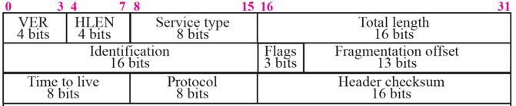
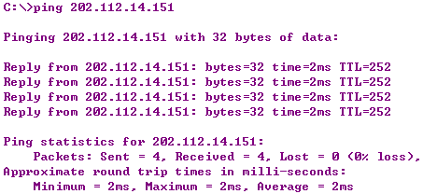
Time to Live Field
TTL（生存时间）：8 bits
分组寿命：防止路由成环时，IP被无限次转发
取值：分组传输时间+路由器转发处理时间 → 困难
实际：源和目的之间的路由器个数（跳数）
路由器转发时将 TTL值减1 ，TTL值为零时丢弃该分组
最大值？
255

Slide 22
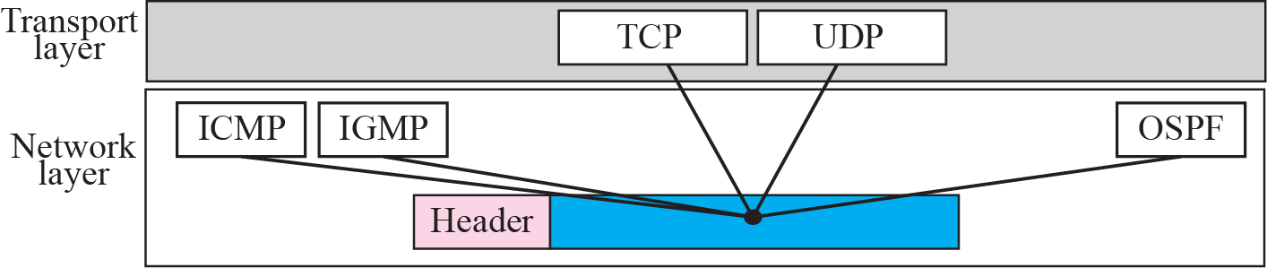
Figure 7.5 Multiplexing
使用IP服务的高层协议
1：ICMP 2：IGMP 4：IP 6：TCP
8：EGP 17：UDP 41：IPv6 89：OSPF

Slide 23
Example 7.4
An IP packet has arrived with the first few hexadecimal digits as shown below:
How many hops can this packet travel before being dropped? The data belong to what upper layer protocol?
Solution
To find the time-to-live field, we skip 8 bytes (16 hexadecimal digits). The time-to-live field is the ninth byte, which is 01. This means the packet can travel only one hop. The protocol field is the next byte (02), which means that the upper layer protocol is IGMP (see Table 7.2)

Slide 24
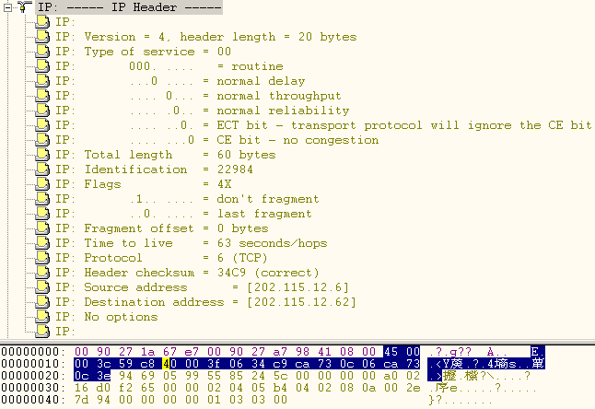
IP Datagram Example

Slide 25
Chapter Outline
7.1 Introduction
7.2 Datagrams
7.3 Fragmentation
7.4 Options
7.5 Checksum
7.6 IP over ATM
7.7 Security
7.8 IP Package

Slide 26
7-3 FRAGMENTATION
A datagram can travel through different networks. Each router decapsulates the IP datagram from the frame it receives, processes it, and then encapsulates it in another frame. The format and size of the received frame depend on the protocol used by the physical network through which the frame has just traveled. The format and size of the sent frame depend on the protocol used by the physical network through which the frame is going to travel.

Slide 27
Topics Discussed in the Section
Maximum Transfer Unit (MTU)
Fields Related to Fragmentation

Slide 28

Figure 7.6 MTU

Slide 29
Datagram
IP datagram
Frame
Header
MTU
Trailer
Physical Network | MTU
Token ring (16 Mbps) | 17914
Token ring (4 Mbps) | 4464
FDDI | 4352
Ethernet | 1500
X.25 | 576
PPP | 296
数据帧中封装的最大数据长度
Notes:
不同的物理网络，MTU是不同的， IP最大数据报长度为65536，经过不同的物理网络时，不得不分割数据报，是它们能通过这些网络

Slide 30
Note
Only data in a datagram is fragmented.

Slide 31

Figure 7.7 Flags field

Slide 32
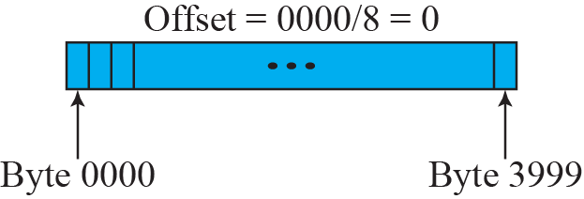
Figure 7.8 Fragmentation example

Slide 33
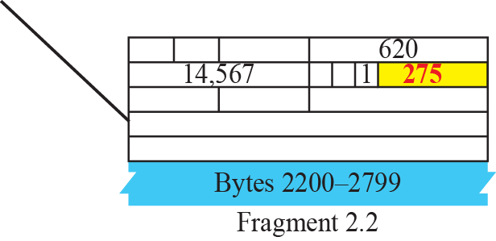
Figure 7.9 Detailed fragmentation example

Slide 34
Example 7.5
A packet has arrived with an M bit value of 0. Is this the first fragment, the last fragment, or a middle fragment? Do we know if the packet was fragmented?
Solution
If the M bit is 0, it means that there are no more fragments; the fragment is the last one. However, we cannot say if the original packet was fragmented or not. A non-fragmented packet is considered the last fragment.

Slide 35
Example 7.6
A packet has arrived with an M bit value of 1. Is this the first fragment, the last fragment, or a middle fragment? Do we know if the packet was fragmented?
Solution
If the M bit is 1, it means that there is at least one more fragment. This fragment can be the first one or a middle one, but not the last one. We don’t know if it is the first one or a middle one; we need more information (the value of the fragmentation offset). See also the next example.

Slide 36
Example 7.7
A packet has arrived with an M bit value of 1 and a fragmentation offset value of zero. Is this the first fragment, the last fragment, or a middle fragment?
Solution
Because the M bit is 1, it is either the first fragment or a middle one. Because the offset value is 0, it is the first fragment.

Slide 37
Example 7.9
A packet has arrived in which the offset value is 100, the value of HLEN is 5 and the value of the total length field is 100. What is the number of the first byte and the last byte?
Solution
The first byte number is 100 × 8 = 800. The total length is 100 bytes and the header length is 20 bytes (5 × 4), which means that there are 80 bytes in this datagram. If the first byte number is 800, the last byte number must be 879.
Notes:
未标明进制时，默认数字为十进制的

Slide 38
Reassembly（重组操作 ）
Only by destination host
Connectionless → 各分片的传输路径可不同
有重组时限
若丢失分片，则无法重组IP分组
目的主机能区分和重组不同的原IP报文
（源IP地址，标识）
MTU₃
620
50
0
75
R4
1200
1220
Net 3
B
75
0
75
50
0
Net 4
A
Net 1
MTU₄
820
R1
R2
Net 2
MTU₁
620
MTU₂
420
R3
Notes:
但数据报的重装只能在目的主机上进行，第一个分组的分片长度除以8 就是第二个片的偏移值

Slide 39
Chapter Outline
7.1 Introduction
7.2 Datagrams
7.3 Fragmentation
7.4 Options
7.5 Checksum
7.6 IP over ATM
7.7 Security
7.8 IP Package

Slide 40
7-4 OPTIONS
The header of the IP datagram is made of two parts: a fixed part and a variable part. The fixed part is 20 bytes long and was discussed in the previous section. The variable part comprises the options, which can be a maximum of 40 bytes.
Options, as the name implies, are not required for a datagram. They can be used for network testing and debugging. Although options are not a required part of the IP header, option processing is required of the IP software.

Slide 41
Topics Discussed in the Section
Format
Option Types

Slide 42
Option Field
选项：0 ~ 40 bytes
网络测试或调试
不是IP分组的必需部分，但其处理是IP软件的必需部分
Code
8 bits
Length
8 bits
Data
variable length
Copy
1 bit
Class
2 bits
Number
5 bits
Copy
0 Copy only in first fragment
1 Copy into all fragments
Number
00000 End of option
00001 No option
00011 Loose source route
00111 Record route
01001 Strict source route
Class
00 Datagram control
01 Reserved
Debugging and management
Reserved

Slide 43
无操作
No operation
单字节
Single-byte
Types
选项结束
End of option
选项
Option
记录路由
Record route
严格源路由
Strict source route
多字节
Multiple-byte
松散源路由
Loose source route
时间戳
Timestamp

Slide 44
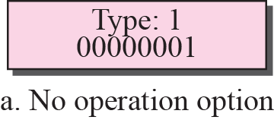
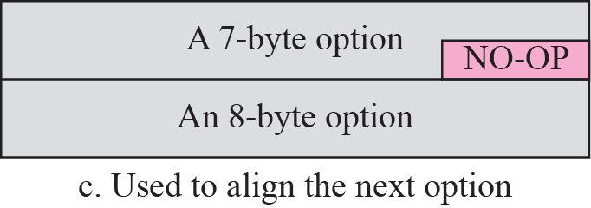
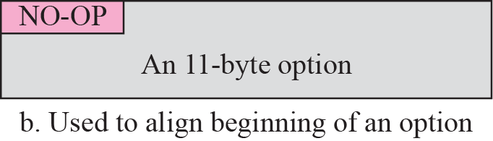
Figure 7.12 No operation option
Notes:
这六种选项中，第1种无操作选项，用来当作填充

Slide 45
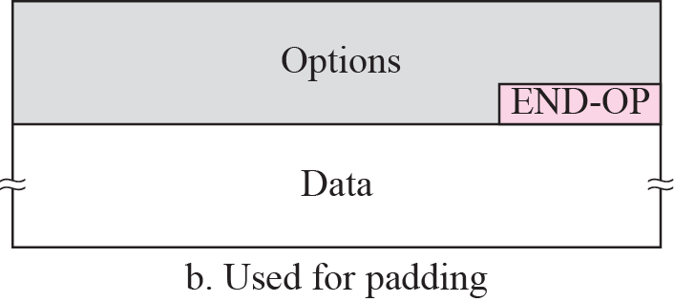
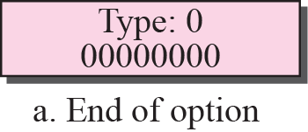
Figure 7.13 Endo-of-option option
Notes:
第2种，选项结束，只能用在选项字段的最后面，在后面就是payload数据了

Slide 46
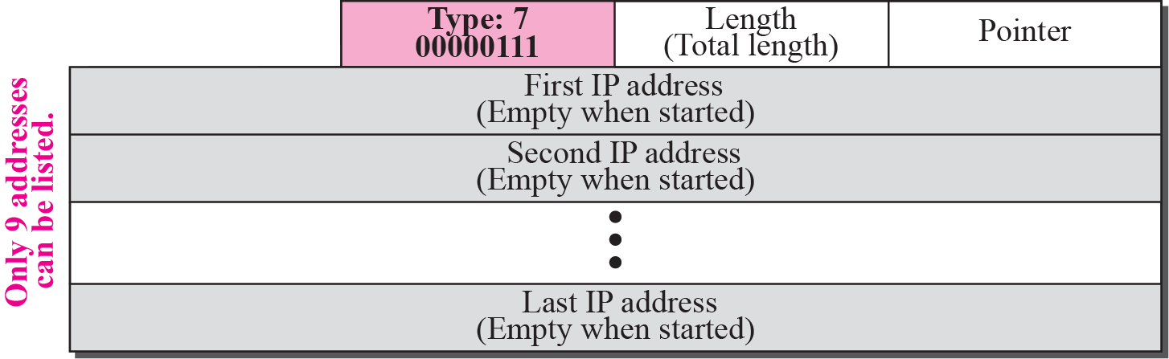
Figure 7.14 Record-route option
Notes:
记录路由选项，最多预留 40/4 -1 =9个IP地址，指针指向第一个空字号，从4开始

Slide 47
Figure 7.15 Record-route concept
4
8

Slide 48
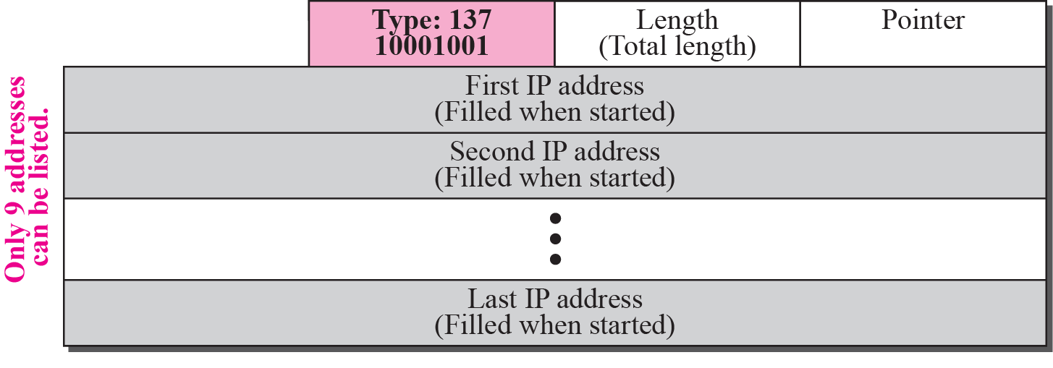
Figure 7.16 Strict-source-route option
Notes:
严格源路由，在开始时指定， 处于安全或其它特定需求

Slide 49
Figure 7.17 Strict-source-route option

Slide 50
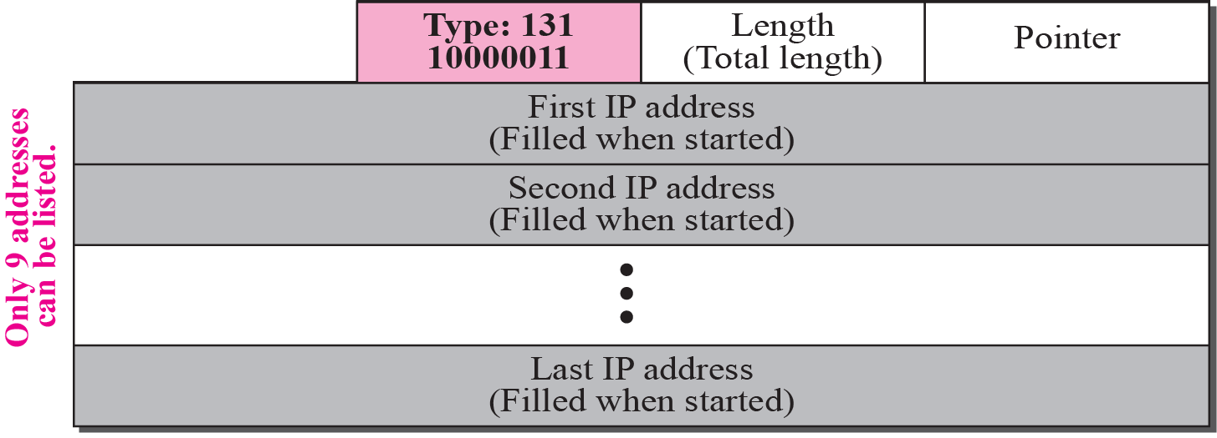
Figure 7.18 Loose-source-route option
Notes:
不严格路由

Slide 51
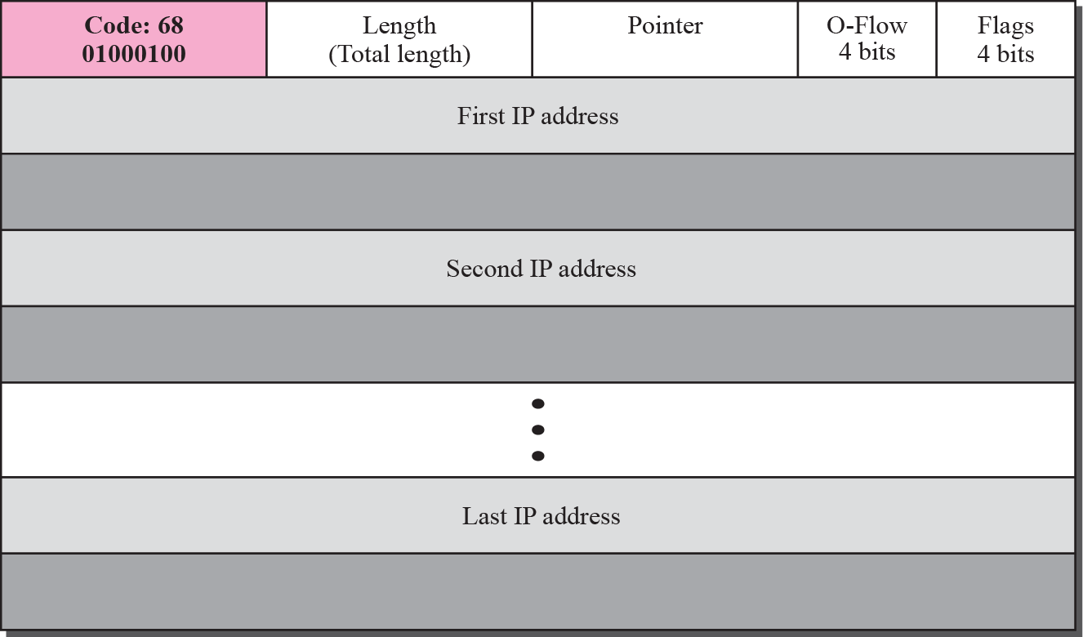
Figure 7.19 Time-stamp option
Notes:
时间戳， 所有的路由器都是用全球时间(原子钟)，但其本地时钟可能并不同步

Slide 52
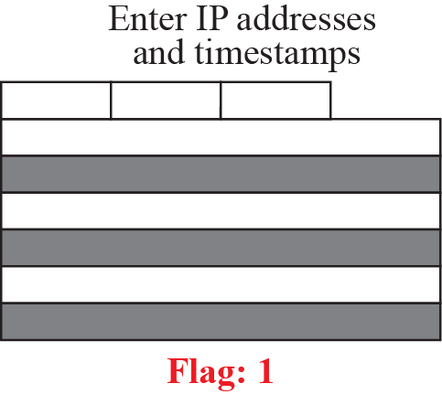
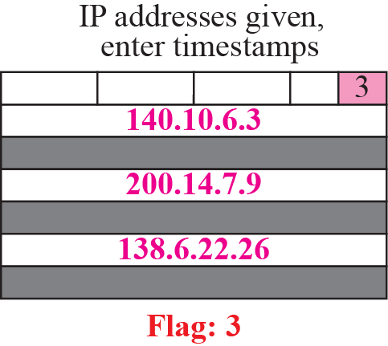
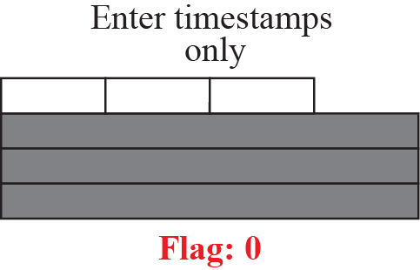
Figure 7.20 Use of flags in timestamp

Slide 53
Figure 7.21 Timestamp concept

Slide 54
Fragmentation with Options
哪些选项会复制到所有分片中？哪些只在第一个分片中出现？为什么？
哪些选项用于数据报控制？哪些选项用于调试管理？
No operation 0 00 00001
End of option 0 00 00000
Record route 0 00 00111
Strict source route 1 00 01001
Loose source route 1 00 00011
Timestamp 0 10 00100
No copy
Control
No copy
Control
No copy
Control
Copy
Control
Copy
Control
No copy
Debug
Notes:
只有时间戳用于调试管理

Slide 55
Example 7.12
One of the utilities available in UNIX to check the traveling of the IP packets is ping. In the next chapter, we talk about the ping program in more detail.
In this example, we want to show how to use the program to see if a host is available. We ping a server at De Anza College named fhda.edu. The result shows that the IP address of the host is 153.18.8.1. The result also shows the number of bytes used.

Slide 56
Example 7.13
We can also use the ping utility with the -R option to implement the record route option. The result shows the interfaces and IP addresses.

Slide 57
Example 7.14
The traceroute utility can also be used to keep track of the route of a packet. The result shows the three routers visited.

Slide 58
Example 7.15
The traceroute program can be used to implement loose source routing. The -g option allows us to define the routers to be visited, from the source to destination. The following shows how we can send a packet to the fhda.edu server with the requirement that the packet visit the router 153.18.251.4.

Slide 59
Example 7.16
The traceroute program can also be used to implement strict source routing. The -G option forces the packet to visit the routers defined in the command line.
The following shows how we can send a packet to the fhda.edu server and force the packet to visit only the router 153.18.251.4.

Slide 60
Chapter Outline
7.1 Introduction
7.2 Datagrams
7.3 Fragmentation
7.4 Options
7.5 Checksum
7.6 IP over ATM
7.7 Security
7.8 IP Package

Slide 61
7-5 CHECKSUM
The error detection method used by most TCP/IP protocols is called the checksum. The checksum protects against the corruption that may occur during the transmission of a packet. It is redundant information added to the packet. The checksum is calculated at the sender and the value obtained is sent with the packet. The receiver repeats the same calculation on the whole packet including the checksum. If the result is satisfactory (see below), the packet is accepted; otherwise, it is rejected.

Slide 62
Topics Discussed in the Section
Checksum Calculation at the Sender
Checksum Calculation at the Receiver
Checksum in the Packet

Slide 63
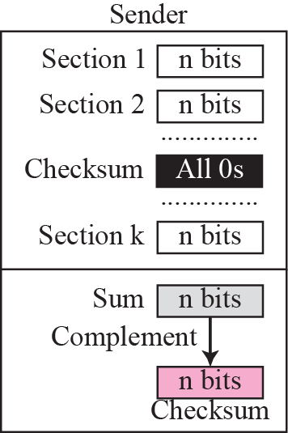
Figure 7.22 Checksum concept

Slide 64
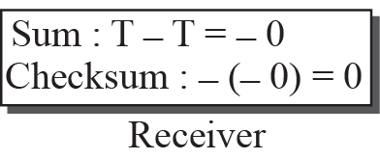
Figure 7.23 Checksum in one’s complement arithmetic

Slide 65
Note
Checksum in IP covers only the header, not the data.

Slide 66
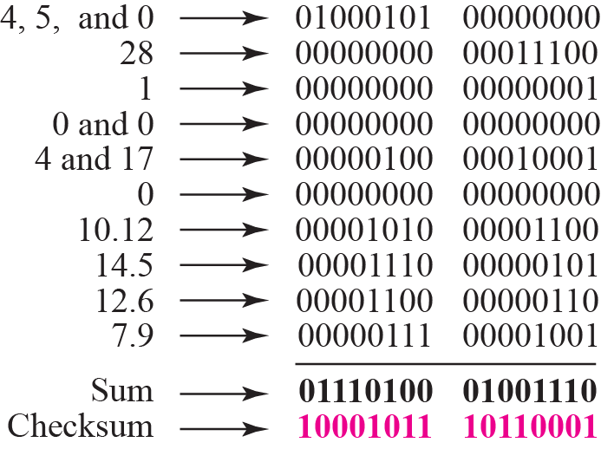
Example 7.17
Figure 7.24 shows an example of a checksum calculation at the sender site for an IP header without options. The header is divided into 16-bit sections. All the sections are added and the sum is complemented. The result is inserted in the checksum field.

Slide 67
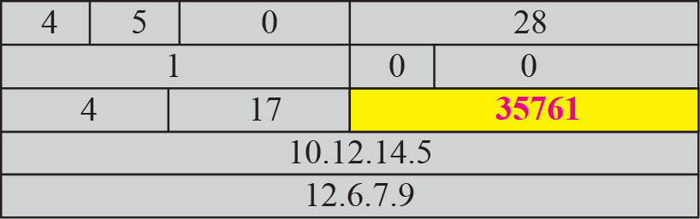
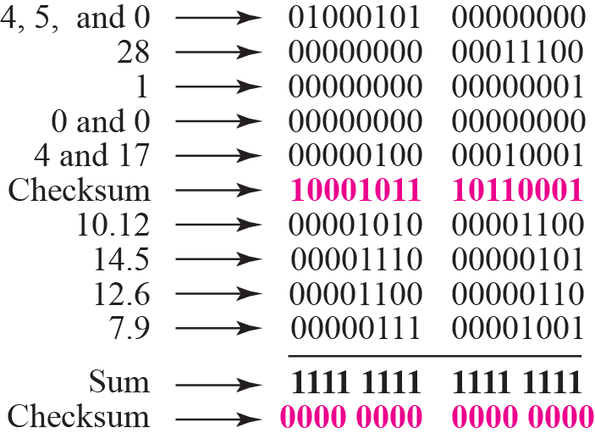
Example 7.18
Figure 7.25 shows the checking of checksum calculation at the receiver site (or intermediate router) assuming that no errors occurred in the header. The header is divided into 16-bit sections. All the sections are added and the sum is complemented. Since the result is 16 0s, the packet is accepted.

Slide 68
Note
Appendix D gives an algorithm for checksum calculation.

Slide 69
Chapter Outline
7.1 Introduction
7.2 Datagrams
7.3 Fragmentation
7.4 Options
7.5 Checksum
7.6 IP over ATM
7.7 Security
7.8 IP Package

Slide 70
7-6 IP OVER ATM
In the previous sections, we assumed that the underlying networks over which the IP datagrams are moving are either LANs or point-to-point WANs. In this section, we want to see how an IP datagram is moving through a switched WAN such as an ATM. We will see that there are similarities as well as differences. The IP packet is encapsulated in cells (not just one). An ATM network has its own definition for the physical address of a device. Binding between an IP address and a physical address is attained through a protocol called ATMARP.

Slide 71
Topics Discussed in the Section
ATM WANs
Routing the Cells

Slide 72
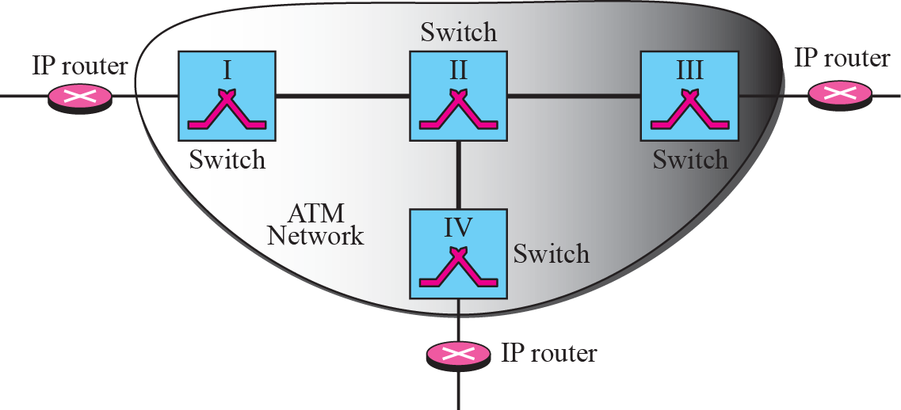
Figure 7.26 An ATM WAN in the Internet

Slide 73
Note
The AAL layer used by the IP protocol is AAL5.

Slide 74
Figure 7.27 Entering-point and exiting-point routers
Notes:
IP地址，物理地址，虚电路符号

Slide 75
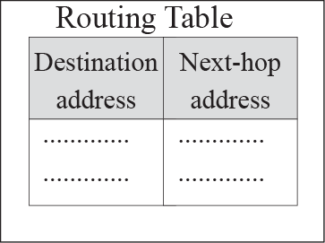
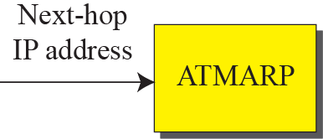
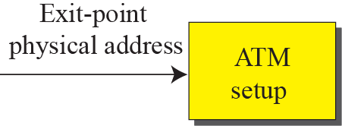


Figure 7.28 Address binding in IP over ATM
Notes:
IP地址，物理地址，虚电路符号

Slide 76
Chapter Outline
7.1 Introduction
7.2 Datagrams
7.3 Fragmentation
7.4 Options
7.5 Checksum
7.6 IP over ATM
7.7 Security
7.8 IP Package

Slide 77
7-7 SECURITY
The IPv4 protocol, as well as the whole Internet, was started when the Internet users trusted each other. No security was provided for the IPv4 protocol. Today, however, the situation is different; the Internet is not secure any more. Although we discuss network security in general and IP security in particular in Chapters 29 and 30, we give a brief idea about the security issues in IP protocol and the solution.

Slide 78
Topics Discussed in the Section
Security Issues
IPSec

Slide 79
7-8 IP PACKAGE
In this section, we present a simplified example of a hypothetical IP package. Our purpose is to show the relationships between the different concepts discussed in this chapter.

Slide 80
Topics Discussed in the Section
Header-Adding Module
Processing Module
Queues
Routing Table
Forwarding Module
MTU Table
Fragmentation Module
Reassembly Table
Reassembly Module

Slide 81
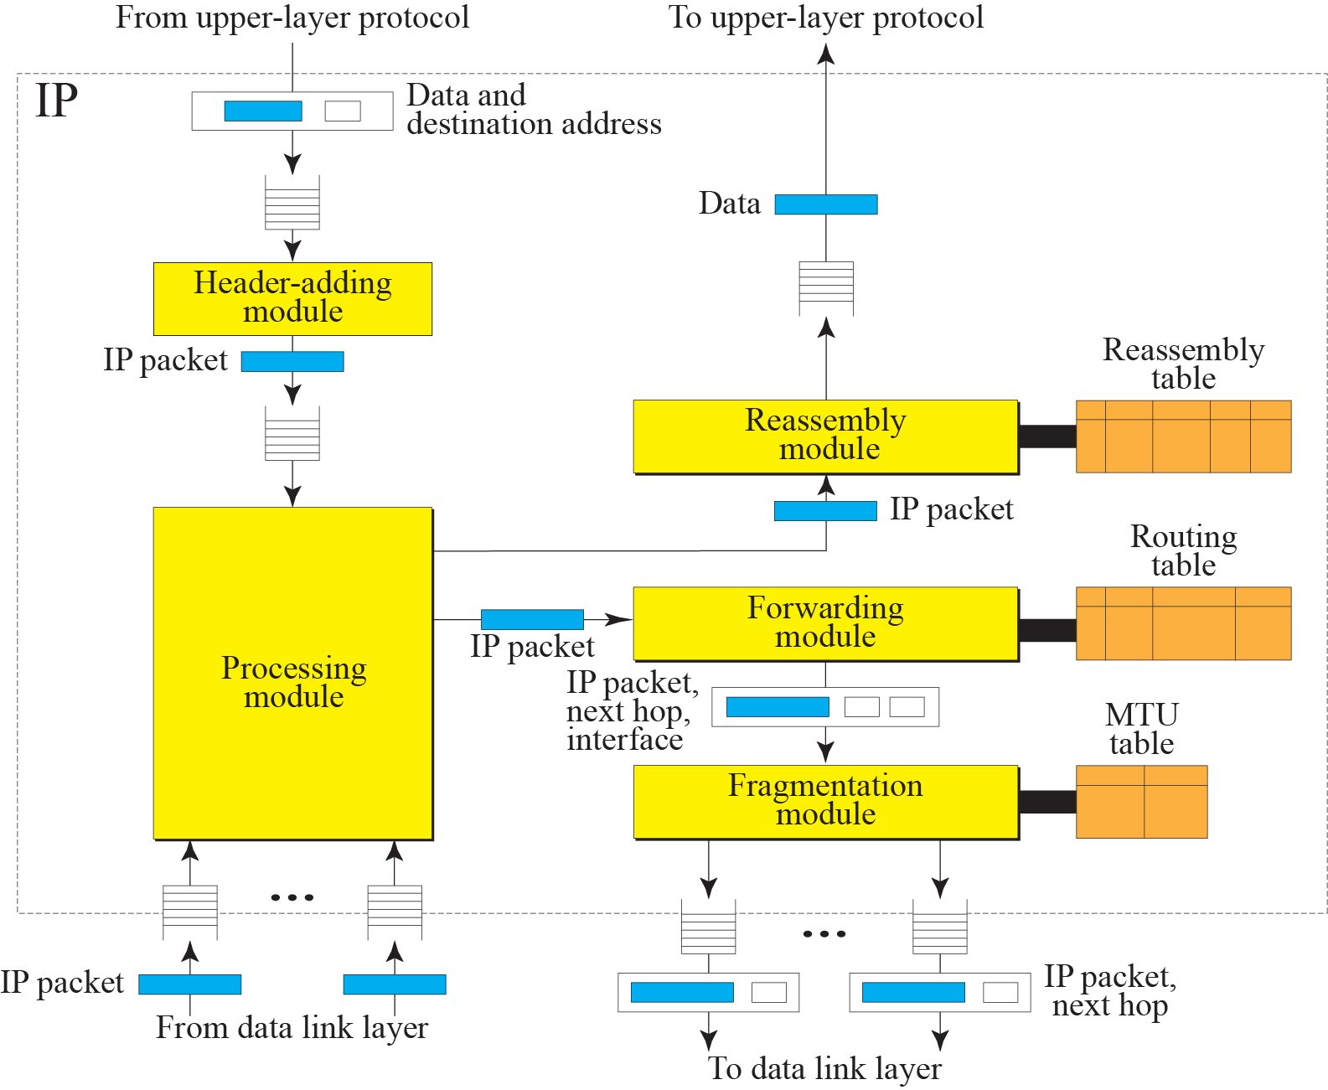
Figure 7.29 IP components

Slide 82
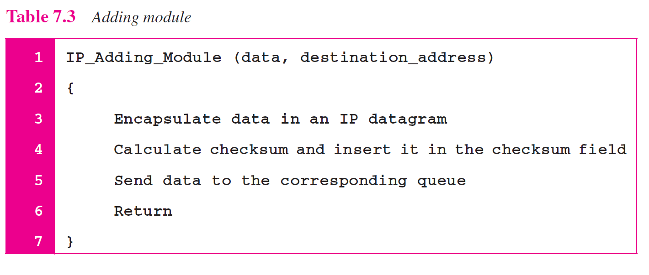

Slide 85
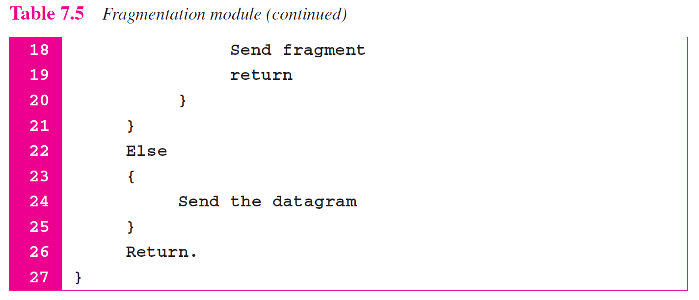

Slide 86
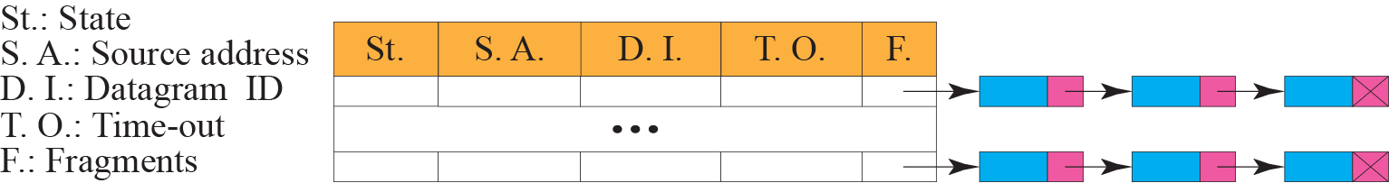
Figure 7.30 Reassembly table

Slide 88
Thanks

