Slide 1
Chapter 9 ICMP
Types of messages
Message format
Error reporting
Query
Checksum
ICMP package
Notes:
对应第4版的第9章

Slide 2
Overview
IP
Lack of error control
Lack of assistance mechanism
ICMP
A companion to the IP
Provide error reporting for IP
Provide assistance mechanism for other layers（TCP/UDP and application）
Notes:
缺少差错控制和辅助机制，如数据报TTL为零而被丢弃，路径不可达，目的主机在设定时间内没有收到全部的分片等情况， IP协议还缺少主机和管理查询所需要的机制，比如判断某个路由器是否活跃等

Slide 3
Error Reporting & Error Correction
IP传输过程中出现差错是不可避免的
IP分组传输出现差错时，会产生相应的ICMP报文
通过ICMP报文提供差错报告
ICMP差错报告只能送给IP分组的源站，协议只提供了差错处理建议
出错点可能不是当前的路由器
反向传输路径可能与原路径不同
源站可能无法确定差错源，
需要与网络管理员一起协作处理

Slide 4
Internet Control Message Protocol
RFC792: Internet Control Message Protocol, 1981
RFC1256: ICMP Router Discovery Messages, 1991
Application Layer
Transport Layer
Network
Layer
ICMP
IGMP
IP
ARP
RARP
Network
Access
Layer
LANs
MANs
WANs

Slide 5
Message delivery and Encapsulation
ICMP在IP之上实现，逻辑上与IP同在网络层
Connectionless communication
直接送达目的站点，沿途的转发路由器不能获知ICMP报文内容
Encapsulation
ICMP message
ICMP message
IP header
IP header
IP data
IP data
Protocol = 1
Frame header
Frame data
Trailer (if any)
Notes:
协议字段为1

Slide 6
9.1 Types of Messages
ICMP messages
Error-reporting
差错报告
Query
测试查询
To report problems that a router or a destination host may encounter when it processes an IP packet
To help a host or a network manager get specific information from a router or another host

Slide 7
Types
过时：
15 Information request
16 Information response
Category | Type | Message | Reason
Error-reporting messages | 3 | Destination unreachable | Unreachable
 | 4 | Source quench | Congestion
 | 11 | Time exceeded | Too long route
 | 12 | Parameter problem | Format error
 | 5 | Redirection | Route changed
Query messages | 8 or 0 | Echo request or reply | Reachability
 | 13 or 14 | Timestamp request or reply | Synchronization
 | 17 or 18 | Address mask request or reply | Mask maintenance
 | 10 or 9 | Router solicitation or advertisement | Coincidence between routers
Notes:
ICMP will send a source quench message when traffic becomes congested at a router.

Slide 8
9.2 Message Format
8 bits
8 bits
16 bits
Type
Code
Checksum
Data section
差错报文：引起差错的原始分组的一部分（首部 + 数据部分的前8个字节）
查询报文：基于查询类型的额外信息

Slide 9
Chapter 9 ICMP
Types of messages
Message format
Error reporting
Query
Checksum
ICMP package
Notes:
对应第4版的第9章

Slide 10
9.3 Error Reporting
Error reporting
Destination unreachable
Source quench
Time exceeded
Parameter problems
Redirection
ICMP just simply report errors
ICMP always reports error messages to the original source
ICMP error message will NOT be generated for:
A datagram carrying an ICMP error message
A fragmented datagram that is NOT the first fragment
A datagram having a multicast address
A datagram having a special address such as 127.0.0.0 or 0.0.0.0

Slide 11
Contents of Data Field for Error Messages
Received datagram
IP header
8 bytes
IP data
ICMP header
IP header
8 bytes
ICMP packet
IP header
ICMP header
IP header
8 bytes
Sent IP datagram
Provide information about TCP and UDP
Notes:
原始数据报首部 + 该数据报的前8个字节，因为首部包含数据报本身信息， 前8个字节包含传输层的参数信息

Slide 12
9.3.1 Destination Unreachable
When a router cannot route a datagram or a host cannot deliver a datagram
The datagram is discarded
The router or the host sends a destination unreachable message back to the source
不可达的原因
Type = 3
Code = 0~12
Checksum
0x00000000
IP header
+
8 bytes IP data
A router cannot detect all problems that prevent the delivery of a packet
供源站分析错误
Notes:
路由器无法检测出导致数据没有交付的所有问题

Slide 13
Destination Unreachable Codes
Code | Description | Code | Description
0 | 网络不可达 | 7 | 目的主机未知
1 | 主机不可达 | 8 | 源主机被隔离
2 | 协议不可达 | 9 | 与目的网络的通信被禁止
3 | 端口不可达 | 10 | 与目的主机的通信被禁止
4 | 需要分片，但DF=1 | 11 | 对指定TOS，网络不可达
5 | 源路由失败 | 12 | 对指定TOS，主机不可达
6 | 目的网络未知
哪些目的不可达报文只能由目的主机产生？
哪些目的不可达报文只能由路由器产生？

Slide 14
9.3.2 Source Quench
The lack of flow control for IP → congestion
主机产生的数据量可能比网络快
不适当的路由使流量过分集中，超过信道容量
路由器的转发性能低
路由器或主机因拥塞丢弃IP分组时，向源站发送ICMP源抑制报文，通知源站放慢分组的发送
Type = 4
Code = 0
Checksum
0x00000000
IP header
+
8 bytes IP data
Notes:
Quench，淬火，给IP协议增加某种程度的拥塞和流量控制，代码0表示，一是丢弃分组信息，二是通知源节点

Slide 15
The Solution of the Congestion
发送队列缓冲：缓解短暂的突发数据
丢弃报文，产生源抑制ICMP报文给源站
丢弃算法 —— QoS
源站减缓发送速率
源站没有收到源抑制报文后逐步提高发送速率
源抑制报文的拥塞控制能力
只能解决因主机问题造成的拥塞
对因路由或路由器问题造成的拥塞不起作用
Notes:
一对一，多对一场景中，源抑制的效果也不同

Slide 16
9.3.3 Time Exceeded
路由器或主机因分组超时而丢弃IP分组时，向源站发送ICMP超时报文
Code = 0 —— 路由器检测到分组的TTL值为0
Code = 1 —— 目的站在规定时间内没有收到所有分片
Type = 11
Code = 0,1
Checksum
0x00000000
IP header
+
8 bytes IP data
Notes:
代码0供路由器使用，说明TTL=0，代码1供目的主机使用，说明不是所有的分片都到了

Slide 17
9.3.4 Parameter Problem
路由器或主机因首部字段格式或取值错误而丢弃报文时，向源站发送ICMP参数问题报文
Code = 0 —— 首部字段错误，指针字段指向错误字节
Code = 1 —— 缺少所需的选项部分，指针字段无效
Type = 12
Code = 0,1
Checksum
Pointer
0x00000000
IP header
+
8 bytes IP data

Slide 18
9.3.5 Redirection
重定向
Net 1 | 直接交付
Net 2 | R2
0.0.0.0/0 | R1
A want to send datagrams to B, but it doesn’t know R2 is the better choice. What will it do?
Net 1 | 直接交付
0.0.0.0/0 | R1
Host A
Host B
R1
R2
Net 1
Net 2
IP packet to B
Redirection message
Notes:
因为主机不动态更新路由，但路由器动态更新路由，所以R1收到错误转发时，会通知主机正确的路由

Slide 19
Format
Type = 5
Code = 0~3
Checksum
IP address of the target router
IP header
+
8 bytes IP data
Code | Description
0 | Network specific
1 | Host specific
2 | Network specific (specified service)
3 | Host specific (specified service)
缩小路由改变的范围

Slide 20
思考
在以下情况中，重定向报文是否有用？
Host A
R1
重定向
R2
R3
Host B
分组
重定向
R2发出的重定向报文应该送给谁?
路由器
源主机
路由协议
路由器
Notes:
所以，重定向报文是路由器发给同一个网络的本地主机的

Slide 21
Chapter 9 ICMP
Types of messages
Message format
Error reporting
Query
Checksum
ICMP package
Notes:
对应第4版的第9章

Slide 22
9.4 Query
Query
Echo request and reply
Router solicitation and advertisement
Timestamp request and reply
Address mask request and reply
Ping
Trace route
Notes:
右边2个被DHCP替代，还有一个信息请求与应答，也过时了，被ARP替代

Slide 23
9.4.1 Echo Request and Reply
To test the reachability of a host
Type = 8,0
Code = 0
Checksum
Identifier
Sequence number
Ping command
Echo
Optional data
( Send by the request message;
repeated by the reply message)
TCP
UDP
ICMP
ICMP
Echo reply
Approximate
round-trip time
IP
IP

Slide 24
9.4.2 Timestamp Request and Reply
Type = 13, 14
Code = 0
Checksum
Identifier
Sequence number
Original timestamp (filled by source)
Receive timestamp (filled by destination)
Transmit timestamp (filled by destination)
Used to calculate the round-trip time（ms）
发时间= 收时戳- 初始时戳，收时间= 返回时间- 发时戳
往返时间 = 发时间 + 收时间
Used to synchronize two clocks in two machines
由于路径、传输，难以得到非常精确的时间
Notes:
13 请求 14回答

Slide 25
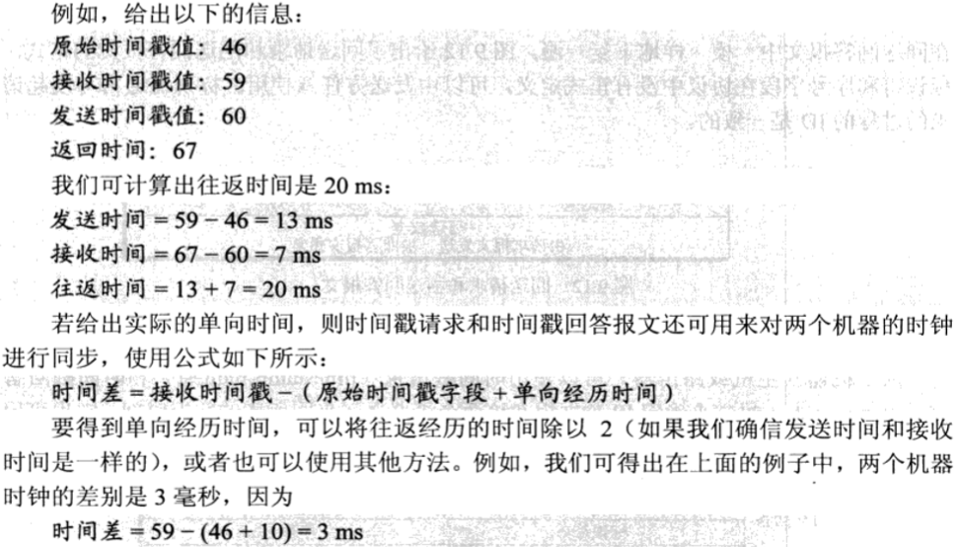
9.4.2 Timestamp Request and Reply
Notes:
13 请求 14回答

Slide 26
9.4.3 Mask Request and Reply
Type = 17, 18
Code = 0
Checksum
Identifier
Sequence number
Mask
应用
供IP协议软件使用
主机知道路由器地址时，可以向路由器发送请求
不知道路由器时，可广播发送，路由器作应答

Slide 27
9.4.4 Route Solicitation and Advertisement
主机发送路由器询问报文，查询本网中的路由器
路由器发送路由器通告报文，通告自己以及所知的本网中其他路由器的存在
Type = 10
Code = 0
Checksum
Identifier
Sequence number
Type = 10
Code = 0
Checksum
Identifier
Sequence number
Router address 1
Address preference 1
Router address 2
Address preference 2
……

Slide 28
Chapter 9 ICMP
Types of messages
Message format
Error reporting
Query
Checksum
ICMP package
Notes:
对应第4版的第9章

Slide 29
9.5 Checksum
Compare with IP
Algorithm: same
Range: difference
IP: only header
ICMP: header + data

Slide 30
9.6 Debugging Tools
Ping ( Packet InterNet Groper )
Used by a host to see if another host is reachable
Usage
Windows/Unix/Linux: ping destination_address
Trace route
Used to help finding the traveling path of packets
Usage
Windows: tracert destination_address
Unix/Linux: traceroute destination_address

Slide 31
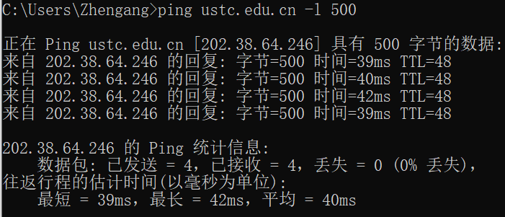
9.6 Debugging Tools

Slide 32
Chapter 9 ICMP
Types of messages
Message format
Error reporting
Query
Checksum
ICMP package
Notes:
对应第4版的第9章

Slide 33
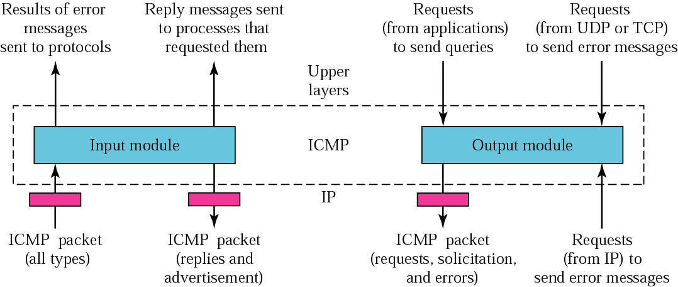
9.7 ICMP Package

Slide 34
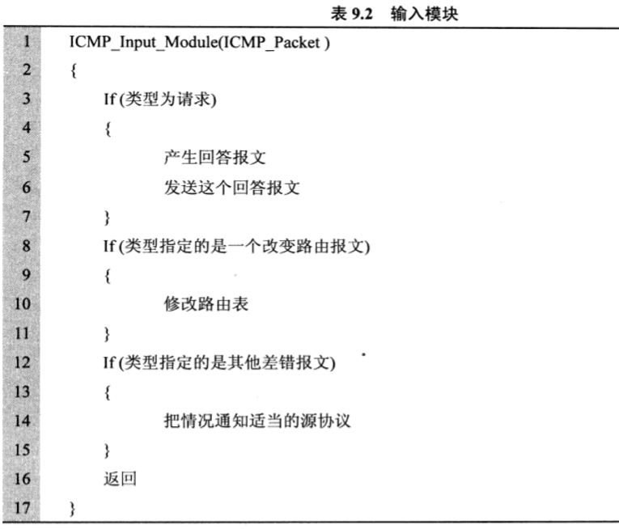
9.7 ICMP Package

Slide 35
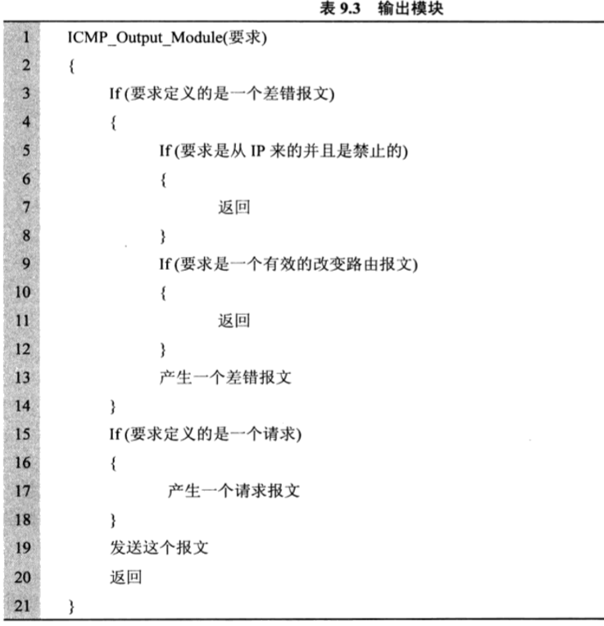
9.7 ICMP Package

Slide 36
Summary of ICMP
ICMP tries to solve problems in IP transmission
An ICMP message is encapsulated in an IP datagram
ICMP error messages are reported only to the source
The source does not always know how to solve the reported errors
ICMP is widely used, in spite of its limited ability to control and manage networks
Notes:
十六

Slide 37
9.8 Summary
ICMP
作用、通信方式
ICMP报文
封装：直接封装在IP分组中
类型：差错报告（传输特点）、测试查询
作用、特点

