Slide 1
Chapter 10 TCP
TCP services
Numbering bytes
Segment
Connection
Flow control
Error control
Congestion control
TCP timers
TCP package
Notes:
在学习了前面IP层协议(路由和交付，控制消息协议ICMP)的基础上，来看一下如何实现IP网络的可靠数据通信

Slide 2
Transport Layer
Functions: serve as the intermediary between the application programs and the network operations
Create a process-to-process communication
Provide a control mechanism at the transport layer
Provide a connection mechanism for the processes
Protocols
Transmission Control Protocol, TCP
User Datagram Protocol, UDP

Slide 3
Introduction
高层应用的需求：reliability
传输大量的数据，要求可靠的通信服务
自身的可靠性机制弱
底层网络和IP网络是不可靠、无连接投递
TCP
Process-to-process comm.: same with UDP
To add connection-oriented and reliability features to the services of IP
Notes:
传输层为应用层提供服务，而应用层存在大量的可靠服务需求，如email，数字支付等，同时底层的网络传输机制是 尽最大努力服务，为满足这些需求，设计了TCP协议，提供可靠的流交付服务

Slide 4
Overview
Transmission Control Protocol，TCP
RFC 793，传输控制协议
Application Layer
Transport
Layer
TCP
UDP
Network
Layer
ICMP
IGMP
IP
ARP
RARP
Network
Access Layer
LANs
MANs
WANs
Notes:
TCP最早是RFC793，又经历多个版本的修订，因此本章内容较多

Slide 5
10.1 TCP Services
Process-to-process communication进程到进程
Stream delivery 流传输
Full-duplex service 全双工
Connection-oriented service 面向连接的服务
Reliable service 可靠传输
Notes:
总体上说，TCP具备几个显著特点

Slide 6
Review: Process-to-Process Comm.
进程
Process
进程
Process
端点（endpoint）
协议端口（port）
IP地址
Internet
Domain of IP protocol
Domain of transport protocols

Slide 7
Review: Port Number
客户, Client
服务器, Server
…
…
52000
多目标
并发通信
13
传输协议
传输协议
Data
13
52000
13
52000
Data
0
1023
49152
65535
1024
49151
Well-known
Registered
Dynamic

Slide 8
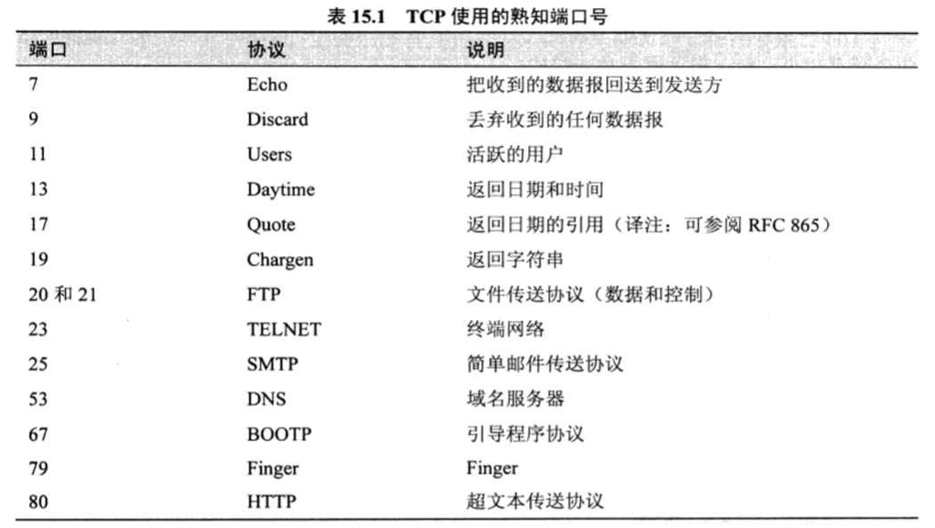
Review: Port Number

Slide 9
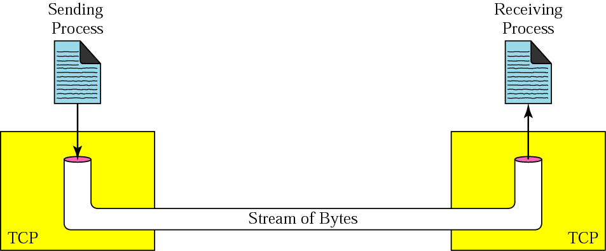
10.1.1 Stream Delivery
Sending buffer
Receiving buffer
An imaginary “tube”
Notes:
相对UDP由进程定义好报文边界，TCP提供字节流交付，即最小可以到一个字节为单元，屏蔽底层，把底层看作是一个 虚拟的管道，即不需要更多底层细节

Slide 10
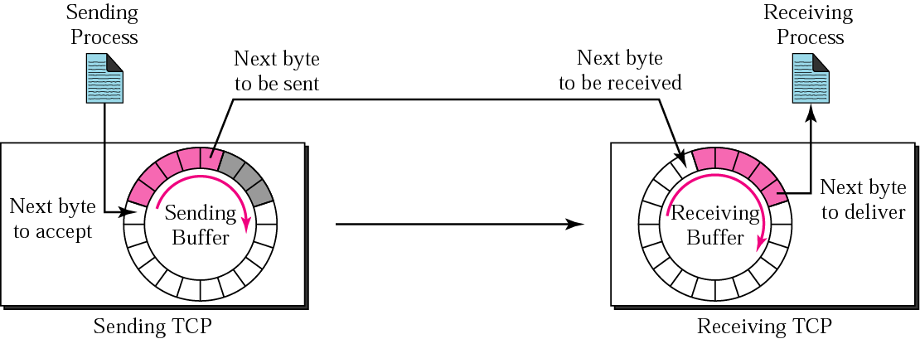

Buffers and Segments
Process
使用自己认为适宜的任何大小的数据片进行发送或接收（最小1字节）
TCP
根据网络情况选择适当的发送缓冲区（分割） 或接收缓冲区（合并）
Notes:
流控制的基础是缓冲和分段，因为通信的异步性，发送进程和接收进程可能以不同的速度写入和读取数据，因此需要缓存来存储数据，每个进程有2个缓存，因为每个方向各一个。一种实现方法是使用由1字节位置组成的环形阵列，环形队列可以使用数组实现，也可以使用循环链表实现，如java的ArrayQueue数据结构

Slide 11
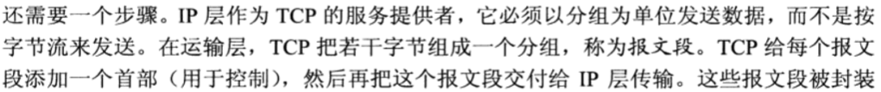
Buffers and Segments
Notes:
该工作由TCP完成，包括后续的 重传 重组，无需用户进程参与

Slide 12
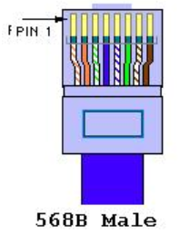
10.1.2 Full-Duplex Service
Data
Acknowledgment
Data can flow in both direction at the same time
Piggybacking
捎带
Notes:
全双工，因为有2个缓存，物理层有收发两路线路，以10/100兆太网网卡为例的DTE类型接口引脚定义为（对应上图从左到右）： 1—TX+Tranceive Data+ (发信号+) 2—TX-Tranceive Data- (发信号-) 3—RX+Receive Data+ (收信号+) 4—n/cNot connected (空脚) 5—n/cNot connected (空脚) 6—RX-Receive Data- (收信号-) ，1、2号线用于共同发送数据，3、6号线用于共同接收数据
信息捎带机制

Slide 13
10.1.3 Connection-Oriented Service
A virtual connection
No physical connection
“the situation is similar to creating a bridge that spans multiple islands and passing all of the bytes from one island to another in one single connection.”
IP网络
Notes:
仿照早期的电路交换，通信也包括建立连接，数据交换，断开连接3个阶段

Slide 14
TCP Port, Endpoint, and Connection
端口、端点概念与方式与UDP完全一样
连接：TCP上通信双方抽象的虚电路连接
80
16250
Port: 80
202.115.12.6
202.115.12.34
Endpoint: (202.115.12.6, 80)
Connection: (202.115.12.6, 80) and (202.115.12.34, 16250)

Slide 15
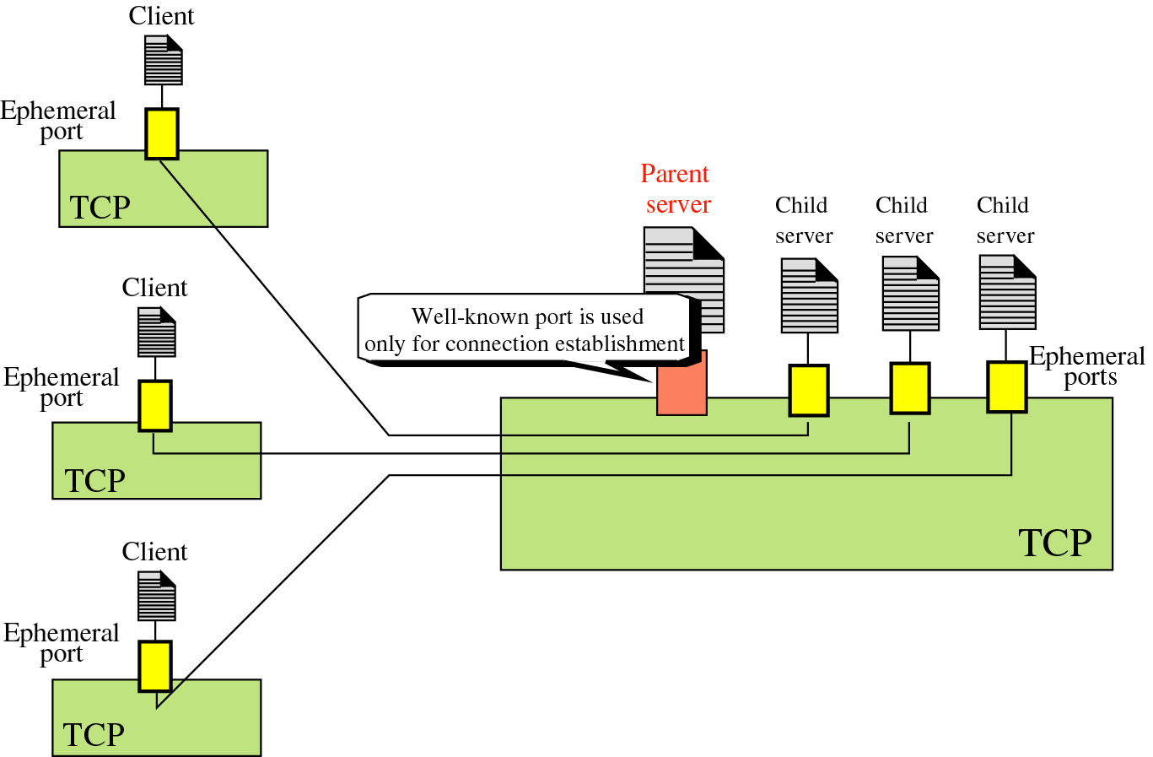
Connection-Oriented Concurrent Server
Notes:
临时端口号

Slide 16
10.1.4 Reliable Service
Reliability
Order, without error, and without any part lost or duplicated
Error control
An acknowledgment mechanism
Flow control
A sliding window protocol
Congestion control
Congestion avoidance
Notes:
可靠服务，包括确认机制，差错控制，流控制，拥塞控制
ICMP是不可靠的，TCP建立在网络层之上

Slide 17
10.2 Numbering Bytes
To number all data bytes, NOT segments
A segment’s sequence number is the number assigned to the first byte of data in this segment
Numbering is independent in each direction
The numbering starts randomly, NOT from 0
0 ~ 2³²-1
Sending
Date stream
Receiving
Sending buffer
Receiving buffer
Segment
Notes:
TCP报文首部中存放的不是报文段的编号，而是字节编号，并用于后续序号和确认号，编号不一定从0开始

Slide 18
Seq. Number and Ack. Number
Sequence number → RFC 793: section 3.3
The number of the first data byte carried in that segment
The initial sequence number is random
Acknowledgment number
To confirm the bytes it has received
The number of the next data byte a party expects to receive
The acknowledgment number is cumulative累积的

Slide 19
Discussion
Example 1: a segment with Seq #=X, Data Len=L
Then the Seq # of the next segment: X+L
Example 2: a segment with Ack #=X
This means all bytes from the beginning up to X has been received, that is ( X-beginning ) bytes NOT X bytes
Features
报文的顺序关系
数据流的位置，更便于流的复原
需较大的序号空间（32bit，4Gbyte）
序号不连续，n1<n2<n3…

Slide 20
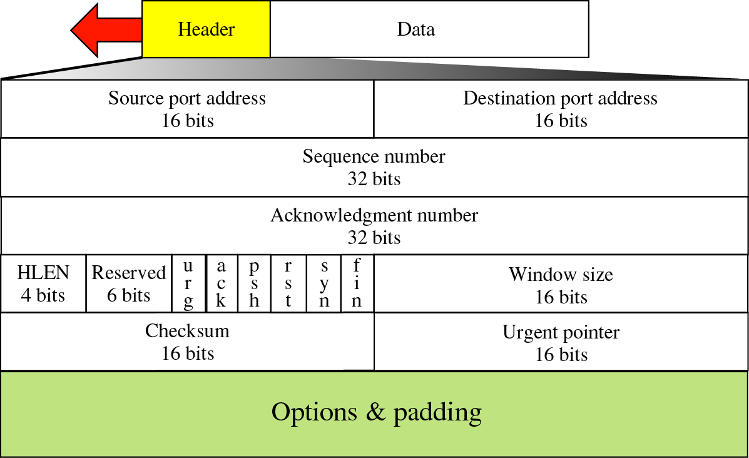
10.3 Segment
完成所有操作
Segment
标识应用进程
差错控制
以字节为单位
Initial sequence number
控制字段
流量控制
拥塞控制
同UDP
（0 ~ 40 bytes）
Notes:
报文段，20-60个字节， 首部长度的单位也是4字节

Slide 21
Review: UDP Checksum
UDP checksum
与IP校验和的计算方法相同
校验内容不同，包括三个部分：
Pseudo header + UDP header + Data
Pseudo header（伪首部）
根据IP首部的部分信息形成
不会与UDP报文一起发送到网络上
进一步确保UDP报文送到正确主机的正确端口上
Checksum → Optional
减少高可靠性网络上的传输开销
TCP的校验和是强制性的！

Slide 22
Review: Pseudo Header Format
Source IP address
Pseudo
header
Destination IP address
All 0s
Protocol
UDP total length
Header
Source port number
Dest. port number
……
Data

Slide 23
Control Field
To enable flow control, connection establishment and termination, and the mode of data transfer in TCP
URG
ACK
PSH
RST
SYN
FIN
URG: Urgent pointer is valid 有紧急数据要处理
RST: Reset the connection 强制断开连接
ACK: Acknowledgment is valid
SYN: Synchronize sequence numbers
PSH: Request for push 强制传送
FIN: Terminate the connection

Slide 24
Option
无操作/No operation
单字节
Single-byte
选项结束
End of option
RFC
793
选项
Option
最大报文段长度
Max segment size
窗口扩大
Window scale
RFC
1323
多字节
Multiple-byte
时间戳/Timestamp
允许选择性确认
Sack-Permitted
RFC
2018
选择性确认/Sack

Slide 25
MSS Option
MSS: maximum receive segment size at the TCP which sends this segment 最大报文段
The value of MSS is only the data size, not include TCP header size
MSS = MTU - 20 - 20 → RFC 879
MSS option
Must only be sent in the initial connection request
i.e., in segments with the SYN control bit set
If not used, any segment size is allowed
The value of MSS does not change during the connection

Slide 26
Chapter 10 TCP
TCP services
Numbering bytes
Segment
Connection
Flow control
Error control
Congestion control
TCP timers
TCP package
Notes:
在学习了前面IP层协议(路由和交付，控制消息协议ICMP)的基础上，来看一下如何实现IP网络的可靠数据通信

Slide 27
10.4 TCP Connection
Connection
Virtual:（IP₁，port₁）--（IP₂，port₂）
连接数量受机器内存容量限制
一个机器上某个TCP端口号可被多个连接共享
Server
Client 1
App 2
Client 2
App 1
App 1
App 3
App 3
App 2
TCP
TCP
TCP

Slide 28
10.4.1 Connection Establishment
Active open（主动建立连接）
发起建立连接，Clinet
Passive open（被动建立连接）
接受建立连接，Server
被动连接方一般先于主动连接方启动，但不发起连接建立过程，而是在某个端口上等待主动方的连接请求
TCP连接的任意一方都可以主动打开连接

Slide 29
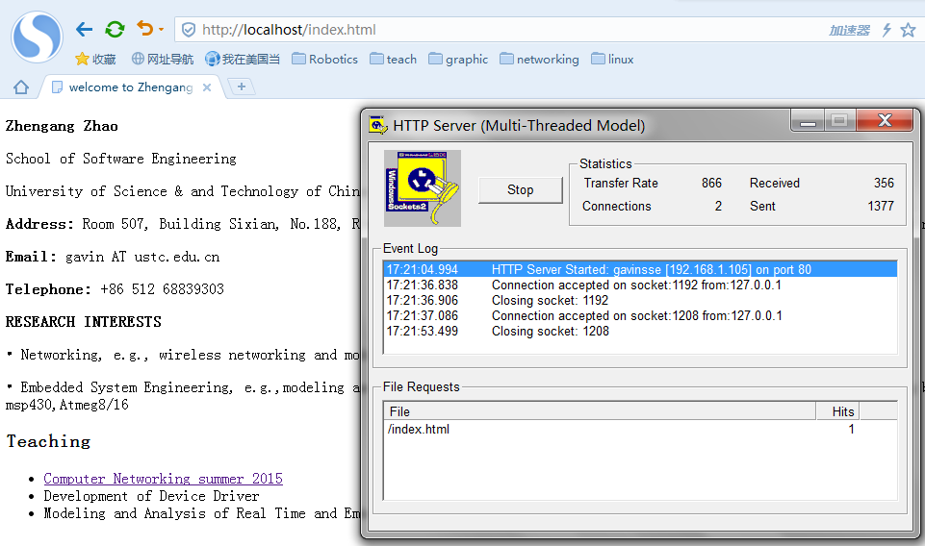
10.4.1 Connection Establishment
example

Slide 30
3-way Handshaking
SYN控制位
占1个序号
Client
Server
Waits for
passive open
Requests for
active open
Segment 1: SYN
seq: 100, ack: --, rwnd: 1000
Client’s wish to make a connection
Segment 2: SYN+ACK
seq: 300, ack: 101, rwnd: 5000
Server’s ack. and own request
Segment 3: ACK
Client’s ack. to server’s request
seq: 101, ack: 301, rwnd: 1000
Data can be sent with the 3rd packet
Notes:
SYN报文不携带任何数据，但消耗一个序号，接收窗口「rwnd」往往取决于BDP的大小，也就是带宽和延迟的乘积

Slide 31
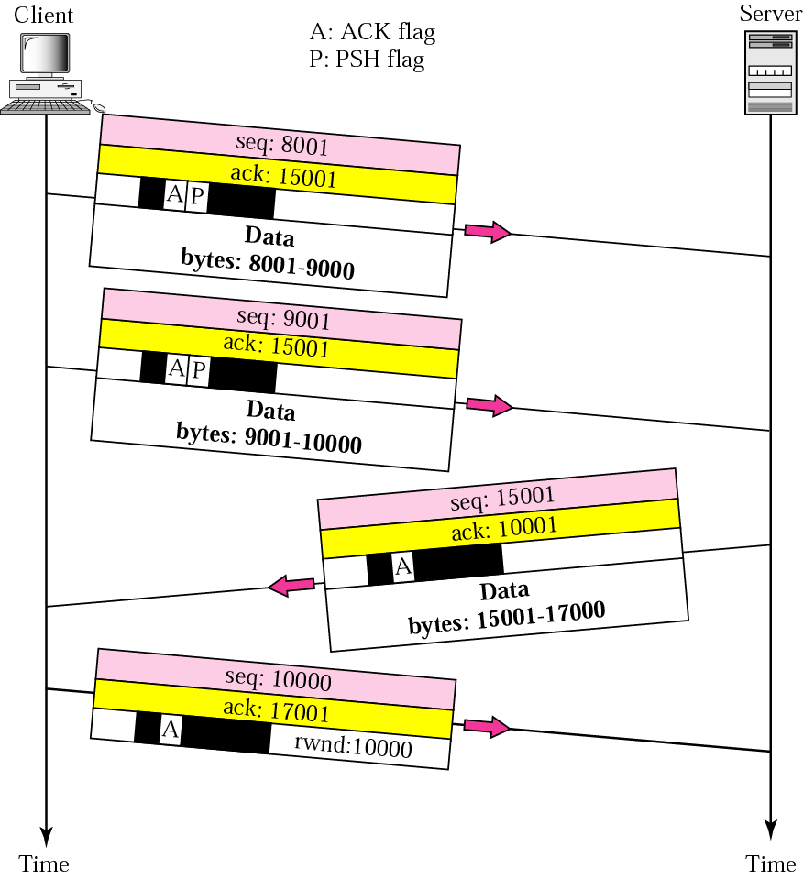
10.4.2 Data Transfer

Slide 32
Pushing Data
Pushing data，推送数据
interactive communication（交互式通信）
TCP can choose whether or not to use it
Operation
Sender
Set PSH bit
Send immediately
Receiver
Deliver to the receiving process as soon as possible

Slide 33
Urgent Data
Urgent data，紧急数据
out-of-band data，带外数据
Sender
Set the URG bit, and insert the urgent data at the beginning of the data field
The urgent pointer field in the header defines the end of the urgent data
Receiver: deliver it out of order to receiving process
urgent
Receiving buffer
Notes:
紧急指针定义了紧急字段结束位置

Slide 34
10.4.3 Connection Termination
通信是双向的，但连接终止是单向的
网络上两个方向所走的路径可能不同
报文段从网络上陆续到达主机
RFC 793: CLOSE is an operation meaning "I have no more data to send."
连接拆除的发起方只能关闭自己的发送方向，接收方向由对方拆除
不能发送数据，可接收数据，可发送确认
发送方向
接收方向
TCP
TCP
接收方向
发送方向

Slide 35
4-way Handshaking: Normal Close
Client
Server
FIN控制位
占1个序号
Requests
for close
Segment 1: FIN
Server’s ack.
to client’s
request
Seq: 100, ack: 300
Client’s wish
to close the
connection
Segment 2: ACK
Seq: 300, ack: 101
Segment 3: FIN
Requests
for close
Client’s ack.
to server’s
request
Seq: 300, ack: 101
Server’s wish
to close the
connection
Segment 4: ACK
Seq: 101, ack: 301

Slide 36
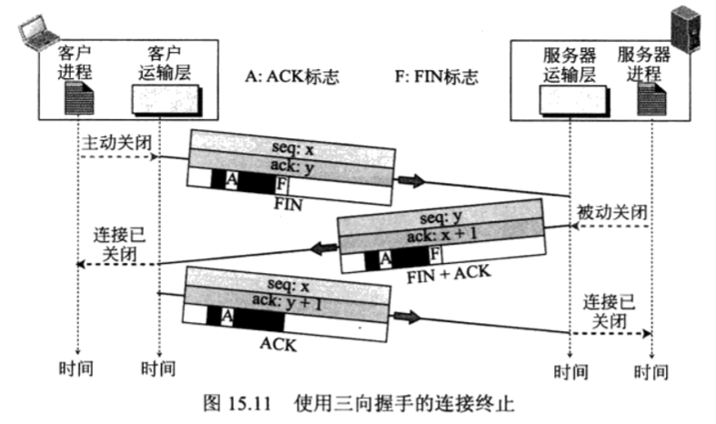
3-way Handshaking: Normal Close
Notes:
服务器端还有个超时机制

Slide 37
Half Close
Client
Server
Requests for
shutdown
FIN (m)
ACK (m+1)
Data (..)
ACK (n)
FIN (n)
Requests for
close
ACK (n+1)
Notes:
半关闭: 一方停止发送数据，但仍可以接收数据的状态

Slide 38
10.4.4 Connection Resetting
Resetting
The current connection is destroyed
In both direction
Cases
The TCP on one side may annul the connection requested to a nonexistent port
One TCP may want to abort the connection due to an abnormal situation
The TCP on one side may destroy the connection because the other side is idle for a long time
Notes:
连接复位/重置，某一端的TCP可能会拒绝一个连接请求，也可能异常终止一条在用的连接

Slide 39
10.4.5 State Transition Diagram
TCP states: connection progresses
CLOSED: The fictional state, no connection
LISTEN, SYN-SENT, SYN-RECEIVED
ESTABLISHED
FIN-WAIT-1, FIN-WAIT-2, CLOSE-WAIT, CLOSING, LAST-ACK, TIME-WAIT
State transition
State 1
状态1
Event / Action
事件 / 动作
State 2
状态2

Slide 40
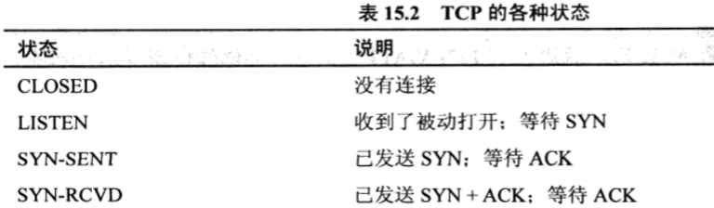
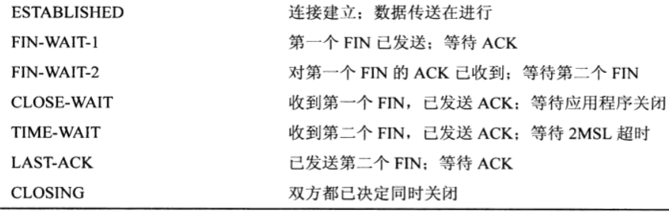
TCP State

Slide 41
TCP State Transition Diagram
CLOSED
RFC 1122
Active open/SYN
Active open/SYN
Passive open/--
Passive open/--
RST/--
Close/--
SYN/SYN+ACK
SYN/SYN+ACK
LISTEN
Close or time-out
/--
Time-out
/RST
RST/--
Send/SYN
SYN-RCVD
SYN/SYN+ACK
SYN-SENT
(simultaneous open)
ACK/--
ACK/--
SYN+ACK/ACK
ESTABLISHED
SYN+ACK/ACK
Close/FIN
FIN/ACK
Close/FIN
Close/FIN
FIN/ACK
FIN WAIT-1
FIN/ACK
CLOSING
CLOSE WAIT
ACK/--
FIN+ACK/ACK
ACK/--
Close/FIN
ACK/--
Close/FIN
FIN/ACK
FIN WAIT-2
FIN/ACK
TIME-WAIT
LAST ACK
(Time-out)
(Time-out)
ACK/--
ACK/--
Notes:
兰色：服务器状态转换，黄色：客户端转换， 紫色：客户/服务器转换

Slide 42
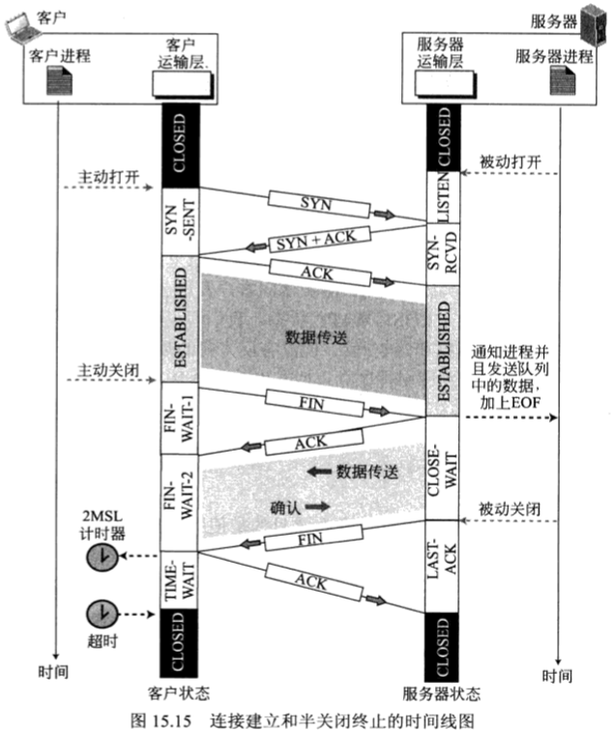
TCP Timing

Slide 43
Discussion: Connection Termination
问题：被动关闭（Passive Close）？
教材：图15.11、15.12、15.14和15.15
参考
RFC793中没有定义passive close事件，只有
Active OPEN，Passive OPEN，CLOSE
应用程序调用相关的socket函数产生这三种事件
connect( ) → active OPEN
listen( ) → passive OPEN
close( ) 或 shutdown( ) → CLOSE
Notes:
被动关闭其实就是处于正常通信的状态

Slide 44
Discussion: Connection Termination
问题：TCP能否发出FIN+ACK报文段？
教材：图15.11和15.15
使用三向握手的连接终止 → 找不到可供参考的RFC
教材：图15.13 状态转换图，主模块流程P383
FIN-WAIT-1 TIME-WAIT → RFC1122
参考
Linux 2.6.11内核的TCP源代码
TCP收到FIN后立刻发送ACK，并没有发送FIN+ACK的操作
在FIN-WAIT-1状态下，只有收到FIN或ACK的状态转换处理
用Sniffer软件捕获FTP或HTTP的TCP连接终止报文段
只有四向握手过程，捕获不到三向握手的连接终止过程
FIN+ACK/ACK
Notes:
取决于操作系统内核的实现

Slide 45
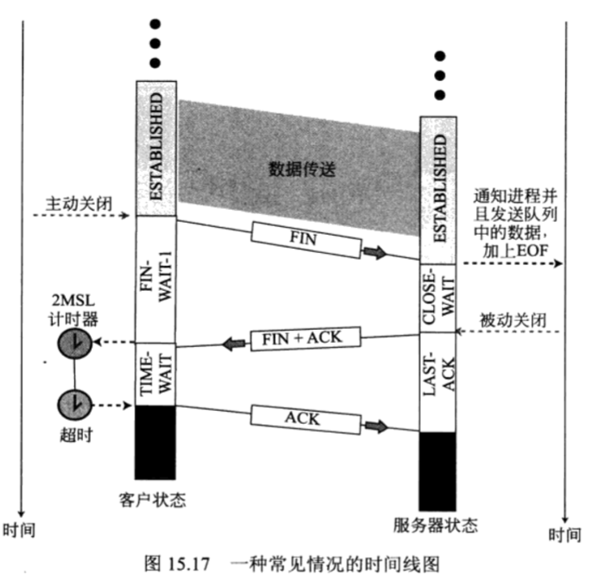
TCP Timing

Slide 46
Discussion: Connection Termination
MSL：Max Segment Lifetime，TTL
30~60 seconds
Last ACK Lost
Closed in 2MSL
Restart timer if received new FIN+ACK
Duplicated segment received in new connection
2MSL delay
Sequence Num. ＞ end Num in previous conn.
Notes:
被动关闭其实就是处于正常通信的状态

Slide 47
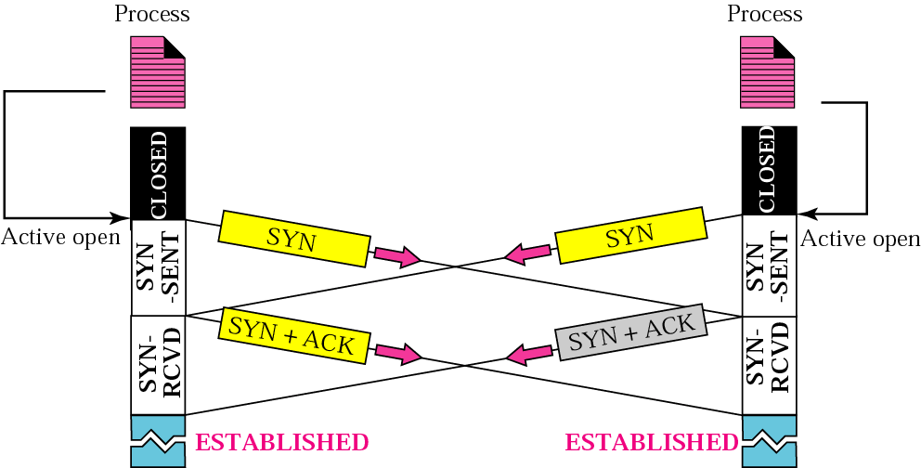
Simultaneous Open
Notes:
通信双方是对等的，两个进程在同一时刻既充当了客户端又充当了服务器

Slide 48
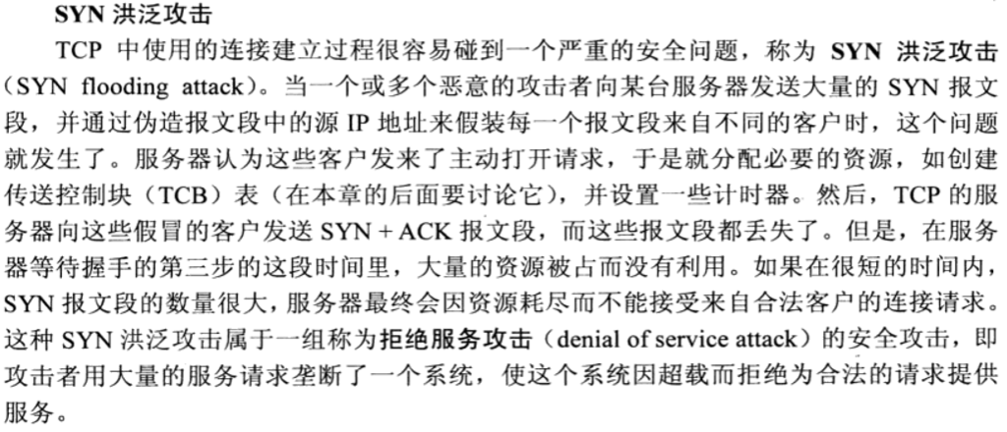
Simultaneous Open

Slide 49
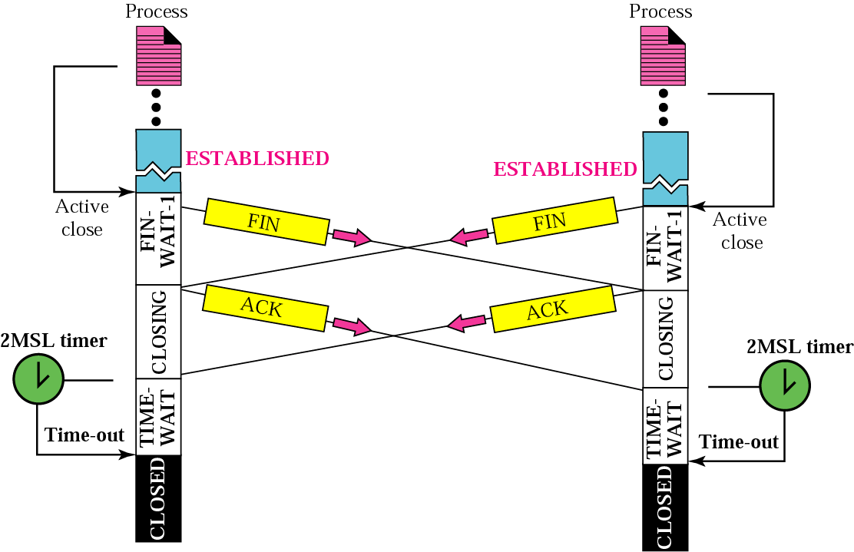
Simultaneous Close
Notes:
双方都进入了FIN-WAIT-1状态，接收到FIN后直接到了closing状态，再接收到ACK就启动超时计时器，此外还有异常终止情况，双方直接进入closed状态

Slide 50
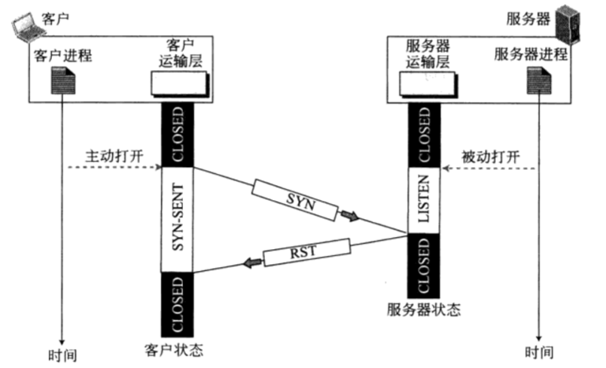
Refuse connection

Slide 51
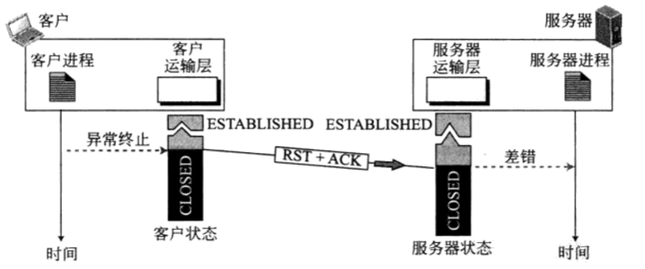
Reset connection

Slide 52
Chapter 10 TCP
TCP services
Numbering bytes
Segment
Connection
Flow control
Error control
Congestion control
TCP timers
TCP package

Slide 53
10.5 Flow Control
Concept
To define the amount of data a source can send before receiving an acknowledgment from the destination
Purpose
To make transmission more efficient
To control the flow of data so that the destination does not become overwhelmed with data
Method
Sliding window protocol
Notes:
十八

Slide 54
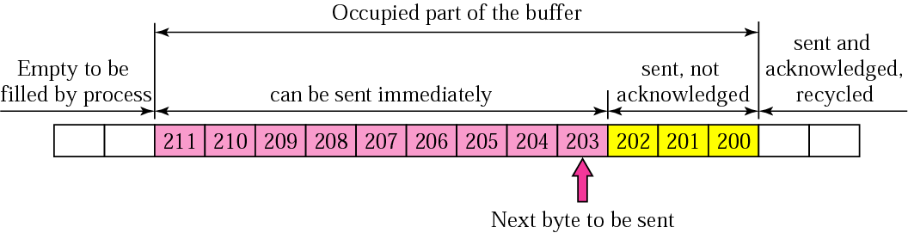
Sender Buffer & Sender Window
can be sent
immediately
sent, not
acknowledged
Sender Window
next byte
to be sent
Notes:
Left edge, right edge

Slide 55
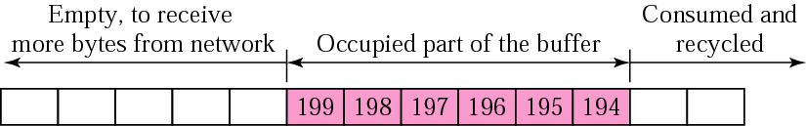
Receiver Window
Receiver buffer
To store TCP segments in order
Receiver window
The size of free bytes in the receiver buffer
next byte
to be received
Consider: How to process an out-of-order TCP segment? ( accept or not)
RFC 1122: section 4.2.2.20 and 4.2.2.21
Notes:
4.2.2.20 Event Processing: RFC-793 Section 3.9 While it is not strictly required, a TCP SHOULD be capable of queueing out-of-order TCP segments. Change the "may" in the last sentence of the first paragraph on page 70 to "should".

Slide 56
Sliding the Sender Window
sender
0
0
1
1
2
2
3
3
4
4
5
5
6
6
7
7
8
8
9
10
11
12
13
14
15
16
ACK1
ACK4
Window = 5
receiver
The source does not have to send a full sender window’s worth of data
The sender window can slide over the sender buffer as an acknowledgment is received from the receiver
The destination can send an acknowledgment at any time

Slide 57
The Size of Sender Window
SND.WND = RCV.WND
Expanding the sender window
The receiving process consumes data faster than it receives
↑ RCV.WND → faster sending
Shrinking the sender window
The receiving process consumes data slower than it receives
↓ RCV.WND → slower sending
Closing the sender window
The receiver buffer is totally full
RCV.WND = 0 → stop sending
Consider:
When to start sending?
Notes:
窗口扩大，收缩，关闭

Slide 58
Window Management
Sender
Receiver
Segment 1
Buffer
Seq: 1001, 4000B
4000
Ack: 5001, Win: 0
1000
3000
Ack: 5001, Win: 1000
Segment 2
Seq: 5001, 1000B

Slide 59
Discussion
Sender
Sender buffer
Sender window
How much to send?
When to send?
Receiver
Receiver buffer
Receiver window
How much to receive?
When to ack?
Problem
网络的缓冲：窗口的流控机制不会立即起作用
网络中间的拥塞
▪ 确认丢失→滑动 ▪ 窗口通告丢失→窗口大小

Slide 60
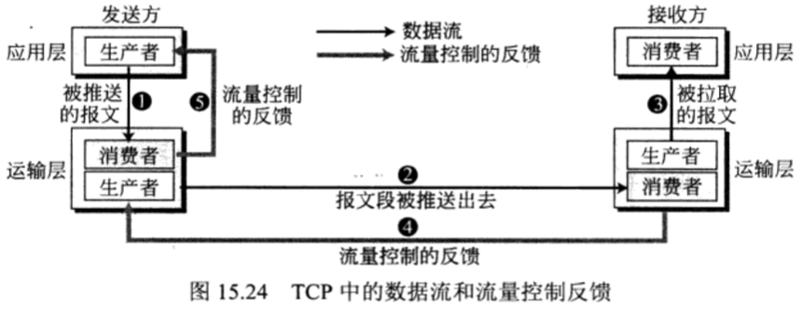
Flow Control
Notes:
发送进程到发送的TCP，1 2 3到达接收方TCP，根据其缓冲区大小反馈给sender，为了实现流量控制，发送方和接收方必须一直调节其窗口大小

Slide 61
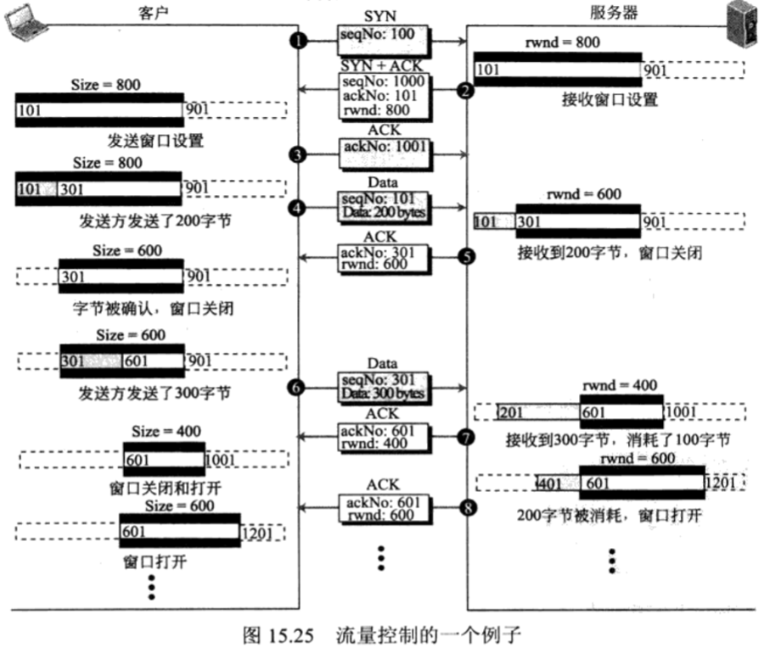
Flow Control

Slide 62
Silly Window Syndrome
SWS：糊涂窗口综合症，RFC 813
Symptom
To send data in very small segments, which reduces the efficiency of the operation
Example: 1 byte of data, 40 bytes of TCP and IP headers
Cause
The sending application program creates data slowly
The receiving application program consumes data slowly
or both
Solution
Sender: Nagle’s algorithm
Receiver: Clark’s solution, delayed acknowledgment
Notes:
比较犯傻的状态：发送方发送的数据，只要一个大大的头部，携带数据很少，比如如果接收很慢，一次接收1个字节或者几个字节，这个时候接收端 缓冲区很快就会被填满，然后窗口通告为0字节，这个时候发送端停止发送，应用程序收上去1个字节后，发出窗口通告为1字节，发送方收到通告之后，发出1个字节的数据，这样周而复始，传输效率会非常低，措施：
接收端，窗口为0时，应用程序有收上去数据，但是并不立即会送窗口为1的通告，而是等待窗口大小满足一定的条件之后再发窗口通告；
发送端，Nagle算法，对非起始报文，协议栈会进行累计并等待，或者收到一个接收端发出一个ACK，或者累计到一个最大报文段，然后再发送数据

Slide 63
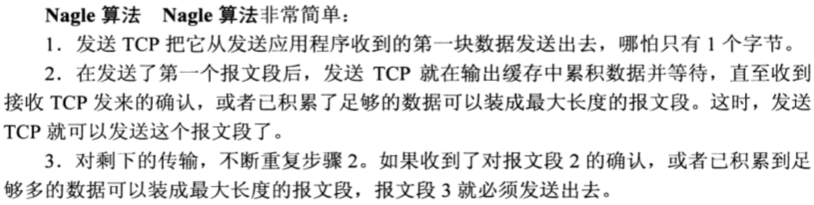
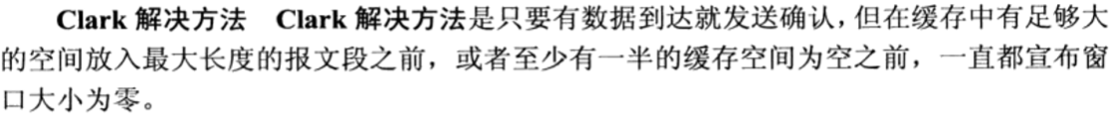
Silly Window Syndrome
Sender：
Receiver：

Slide 64
Chapter 10 TCP
TCP services
Numbering bytes
Segment
Connection
Flow control
Error control
Congestion control
TCP timers
TCP package

Slide 65
10.6 Error Control
Detecting and correcting
Corrupted segments
Lost segments
Out-of-order segments
Duplicated segments
Tools
Checksum
Acknowledgment: positive and cumulative
Selective Ack (SACK): Out-of-order segments, RFC2018
Time-out: retransmission
How to detect ?
How to correct?
Notes:
TCP依靠差错控制来提供可靠性，每个报文段都单独校验
ACK最早是累计确认，越来越多地通过option字段提供选择性确认机制

Slide 66
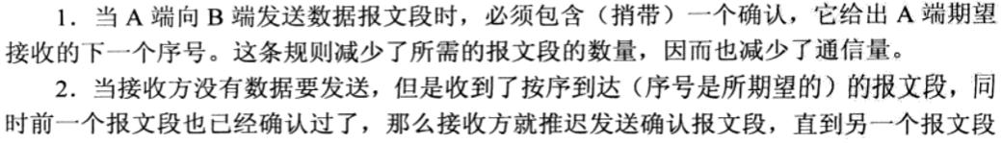
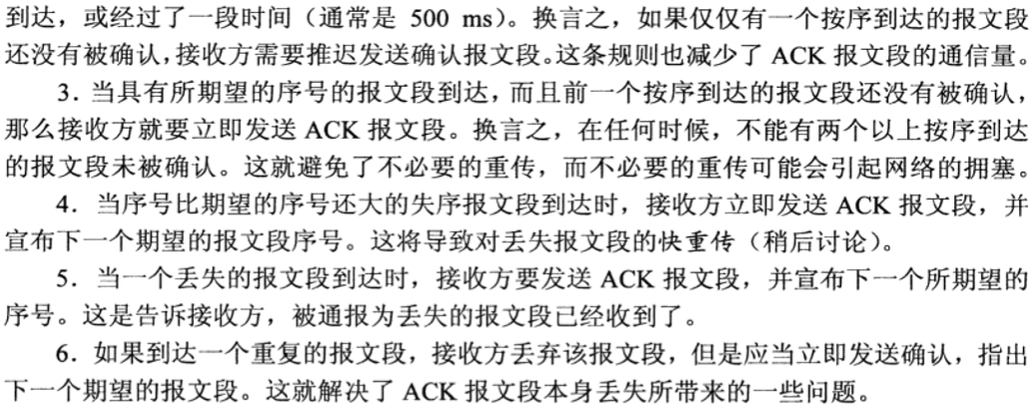
10.6 Error Control
When to send ?
Acknowledgment

Slide 67
Corrupted Segment
Sender
Receiver
Segment 1
Seq: 1201, 200bytes
Segment 2
Delayed ACK
Seq: 1401, 200bytes
Segment 3
Immediate
ACK
Seq: 1601, 200bytes
Ack: 1601
Segment
3
corrupted
OK
OK
Time
-out
Segment 3, retransmitted
Seq: 1601, 200bytes
Ack: 1801
OK
Time
Time
Notes:
报文出错

Slide 68
Lost Data Segment
Sender
Receiver
Segment 1
Seq: 1201, 200bytes
Segment 2
Seq: 1401, 200bytes
Segment 3
Seq: 1601, 200bytes
Ack: 1601
OK
OK
Segment
3 lost
Time
-out
Segment 3, retransmitted
Seq: 1601, 200bytes
Ack: 1801
OK
Time
Time
Notes:
报文丢失

Slide 69
Lost Ack Segment
Sender
Receiver
Segment 1
Seq: 1201, 200bytes
Segment 2
Seq: 1401, 200bytes
Segment 3
Seq: 1601, 200bytes
Ack: 1601
Time-out
Ack: 1801
OK
OK
OK
Acknowledgment
lost
Time
Time
Notes:
ACK丢失，可以通过后续的累计Ack 忽略前面的丢失

Slide 70
Lost Ack Segment-→Duplicate Segment
Cause
When the acknowledgment does not arrive before the time-out
Handling —— the destination TCP
Detecting: sequence number
Correcting: simply discard the packet
Notes:
重传

Slide 71

premature timeout/ delayed ACK
sender
receiver
send pkt0
pkt0
rcv pkt0
ack0
send ack0
rcv ack0
send pkt1
pkt1
rcv pkt1
send ack1
ack1
timeout
resend pkt1
pkt1
rcv pkt1
rcv ack1
pkt0
(detect duplicate)
send pkt0
send ack1
ack1
rcv pkt0
rcv ack1
ack0
send ack0
send pkt0
pkt0
rcv pkt0
ack0
(detect duplicate)
send ack0

Slide 72
Performance considering
Ack is correct, but performance stinks
e.g.: 1 Gbps link, 15 ms prop. delay, 8000 bit packet:
L
8000 bits
D_{trans} =
=
=
8 microsecs
R
10⁹ bits/sec
U _{sender}: utilization – fraction of time sender busy sending
if RTT=30 msec, 1KB pkt every 30 msec: 33kB/sec thruput over 1 Gbps link
network protocol limits use of physical resources!

Slide 73
stop-and-wait operation
sender
receiver
first packet bit transmitted, t = 0
last packet bit transmitted, t = L / R
first packet bit arrives
RTT
last packet bit arrives, send ACK
ACK arrives, send next
packet, t = RTT + L / R

Slide 74
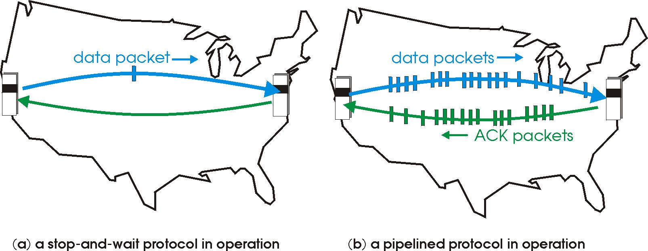

Pipelined protocols
pipelining: sender allows multiple, “in-flight”, yet-to-be-acknowledged pkts
range of sequence numbers must be increased
buffering at sender and/or receiver
two generic forms of pipelined protocols: go-Back-N, selective repeat

Slide 75
Pipelining: increased utilization
sender
receiver
first packet bit transmitted,
t = 0
last bit transmitted, t = L / R
first packet bit arrives
RTT
last packet bit arrives, send ACK
last bit of 2nd packet arrives, send ACK
last bit of 3rd packet arrives, send ACK
ACK arrives, send next
packet, t = RTT + L / R
3-packet pipelining increases
utilization by a factor of 3!

Slide 76
Pipelined protocols: overview
Go-back-N:
sender can have up to N unacked packets in pipeline
receiver only sends cumulative ack
doesn’t ack packet if there’s a gap
sender has timer for oldest unacked packet
when timer expires, retransmit all unacked packets
Selective Repeat:
sender can have up to N unacked packets in pipeline
rcvr sends individual ack for each packet
sender maintains timer for each unacked packet
when timer expires, retransmit only that unacked packet
Notes:
两种确认机制，累计确认，分别确认

Slide 77
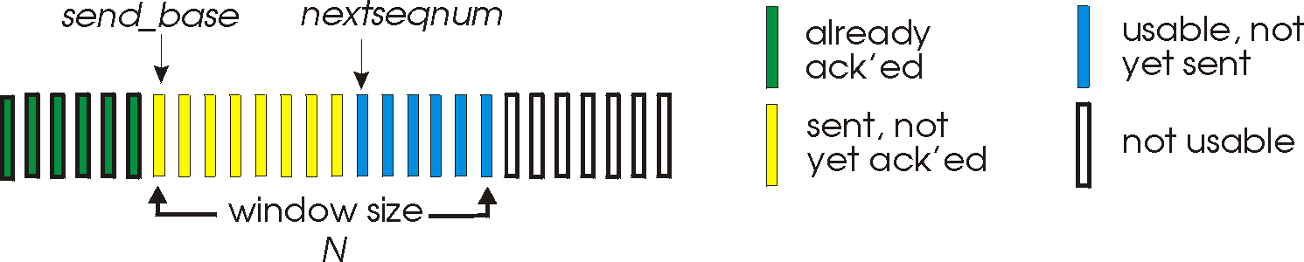
(1)Go-Back-N: sender
k-bit seq # in pkt header
“window” of up to N, consecutive unack’ed pkts allowed
ACK(n): ACKs all pkts up to, including seq # n - “cumulative ACK”
may receive duplicate ACKs (see receiver)
timer for oldest in-flight pkt
timeout(n): retransmit packet n and all higher seq # pkts in window

Slide 78
GBN in action
sender window (N=4)
sender
receiver
0 1 2 3 4 5 6 7 8
send pkt0
send pkt1
send pkt2
send pkt3
(wait)
0 1 2 3 4 5 6 7 8
receive pkt0, send ack0
receive pkt1, send ack1
receive pkt3, discard,
(re)send ack1
0 1 2 3 4 5 6 7 8
X
0 1 2 3 4 5 6 7 8
loss
0 1 2 3 4 5 6 7 8
rcv ack0, send pkt4
rcv ack1, send pkt5
0 1 2 3 4 5 6 7 8
receive pkt4, discard,
(re)send ack1
ignore duplicate ACK
receive pkt5, discard,
(re)send ack1
pkt 2 timeout
0 1 2 3 4 5 6 7 8
send pkt2
send pkt3
send pkt4
send pkt5
0 1 2 3 4 5 6 7 8
0 1 2 3 4 5 6 7 8
rcv pkt2, deliver, send ack2
rcv pkt3, deliver, send ack3
rcv pkt4, deliver, send ack4
rcv pkt5, deliver, send ack5
0 1 2 3 4 5 6 7 8

Slide 79
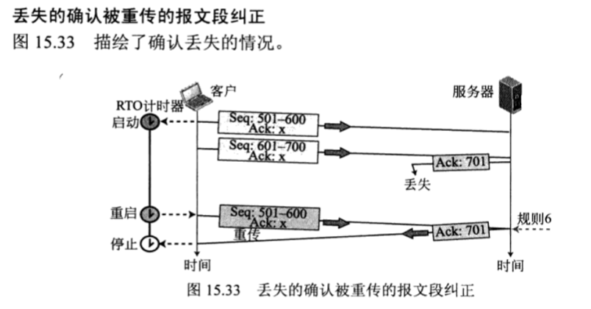
one scenario

Slide 80
(2) SR: Selective repeat
receiver individually acknowledges all correctly received pkts
buffers pkts, as needed, for eventual in-order delivery to upper layer
sender only resends pkts for which ACK not received
sender timer for each unACKed pkt
sender window
N consecutive seq #’s
limits seq #s of sent, unACKed pkts

Slide 81
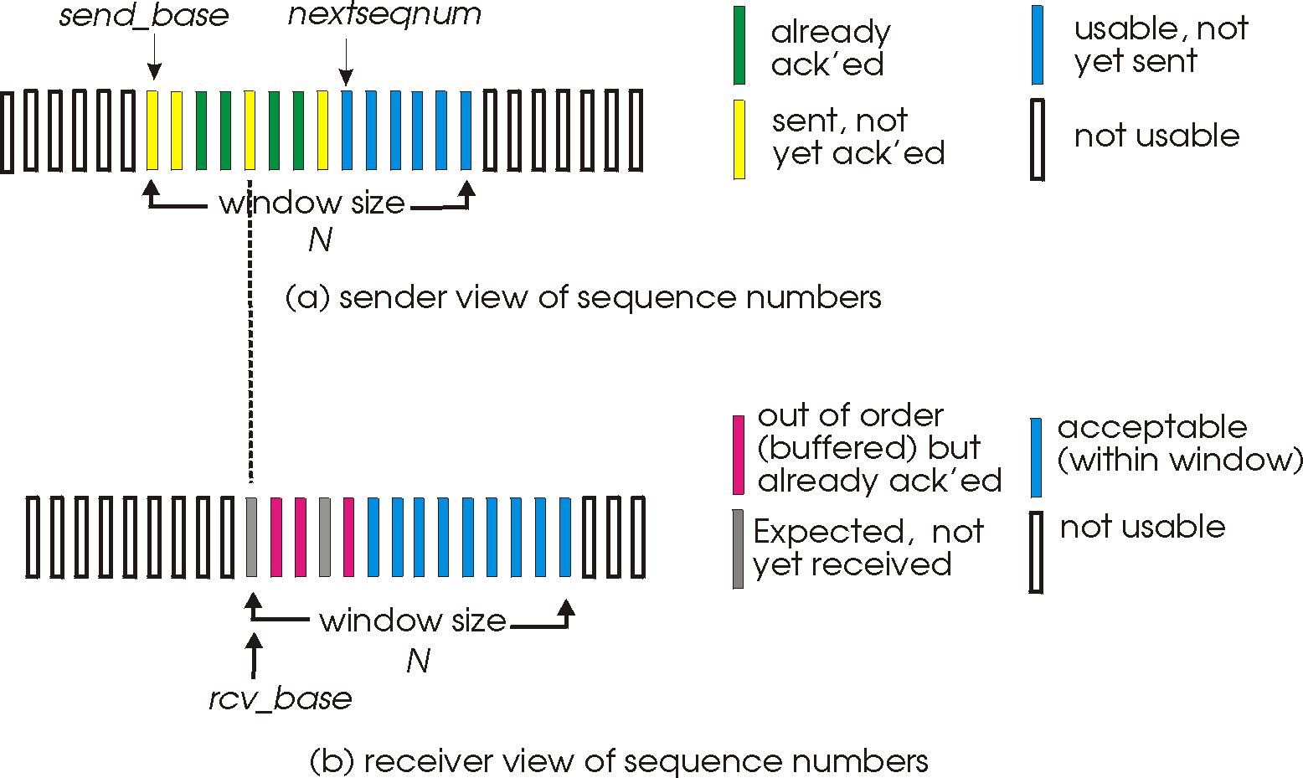
Selective repeat: sender, receiver windows

Slide 82
Selective repeat
sender
receiver
data from above:
if next available seq # in window, send pkt
timeout(n):
resend pkt n, restart timer
ACK(n) in [sendbase,sendbase+N]:
mark pkt n as received
if n smallest unACKed pkt, advance window base to next unACKed seq #
pkt n in [rcvbase, rcvbase+N-1]
send ACK(n)
out-of-order: buffer
in-order: deliver (also deliver buffered, in-order pkts), advance window to next not-yet-received pkt
pkt n in [rcvbase-N,rcvbase-1]
ACK(n)
otherwise:
ignore

Slide 83
Selective repeat in action
sender window (N=4)
sender
receiver
0 1 2 3 4 5 6 7 8
send pkt0
send pkt1
send pkt2
send pkt3
(wait)
0 1 2 3 4 5 6 7 8
receive pkt0, send ack0
receive pkt1, send ack1
receive pkt3, buffer,
send ack3
0 1 2 3 4 5 6 7 8
X
0 1 2 3 4 5 6 7 8
loss
0 1 2 3 4 5 6 7 8
rcv ack0, send pkt4
rcv ack1, send pkt5
0 1 2 3 4 5 6 7 8
receive pkt4, buffer,
send ack4
record ack3 arrived
receive pkt5, buffer,
send ack5
pkt 2 timeout
0 1 2 3 4 5 6 7 8
send pkt2
0 1 2 3 4 5 6 7 8
record ack4 arrived
0 1 2 3 4 5 6 7 8
rcv pkt2; deliver pkt2,
pkt3, pkt4, pkt5; send ack2
record ack5 arrived
0 1 2 3 4 5 6 7 8
Q: what happens when ack2 arrives?

Slide 84

Selective repeat: dilemma
sender window
(after receipt)
receiver window
(after receipt)
0 1 2 3 0 1 2
pkt0
0 1 2 3 0 1 2
pkt1
0 1 2 3 0 1 2
example:
seq #’s: 0, 1, 2, 3
window size=3
0 1 2 3 0 1 2
pkt2
0 1 2 3 0 1 2
0 1 2 3 0 1 2
0 1 2 3 0 1 2
pkt3
X
0 1 2 3 0 1 2
pkt0
will accept packet
with seq number 0
receiver sees no difference in two scenarios!
duplicate data accepted as new in (b)
Q: what relationship between seq # size and window size to avoid problem in (b)?
(a) no problem
receiver can’t see sender side.
receiver behavior identical in both cases!
something’s (very) wrong!
0 1 2 3 0 1 2
pkt0
0 1 2 3 0 1 2
pkt1
0 1 2 3 0 1 2
0 1 2 3 0 1 2
pkt2
0 1 2 3 0 1 2
X
0 1 2 3 0 1 2
X
timeout
retransmit pkt0
X
0 1 2 3 0 1 2
pkt0
will accept packet
with seq number 0
(b) oops!
Notes:
dilemma dɪˈlemə 困境

Slide 85
TCP round trip time, timeout
Q: how to set TCP timeout value?
longer than RTT
but RTT varies
too short:
premature timeout,
unnecessary
retransmissions
too long: slow reaction to segment loss
Q: how to estimate RTT?
SampleRTT:
measured time from
segment transmission until
ACK receipt
ignore retransmissions
SampleRTT will vary, want estimated RTT “smoother”
average several recent measurements, not just current SampleRTT
Notes:
receipt 收到

Slide 86
TCP round trip time, timeout
EstimatedRTT = (1- α)*EstimatedRTT + α*SampleRTT
exponential weighted moving average
influence of past sample decreases exponentially fast
typical value: α = 0.125
RTT: gaia.cs.umass.edu to fantasia.eurecom.fr
RTT (milliseconds)
sampleRTT
EstimatedRTT
time (seconds)

Slide 87

TCP round trip time, timeout
timeout interval: EstimatedRTT plus “safety margin”
large variation in EstimatedRTT -> larger safety margin
estimate SampleRTT deviation from EstimatedRTT:
DevRTT = (1-β)*DevRTT +
β*|SampleRTT-EstimatedRTT|
(typically, β = 0.25)
TimeoutInterval = EstimatedRTT + 4*DevRTT
estimated RTT
“safety margin”

Slide 88
TCP fast retransmit
time-out period often relatively long:
long delay before resending lost packet
detect lost segments via duplicate ACKs.
sender often sends many segments back-to-back
if segment is lost, there will likely be many duplicate ACKs.
TCP fast retransmit
if sender receives 3 ACKs for same data
(“triple duplicate ACKs”), resend unacked segment with smallest seq #
likely that unacked segment lost, so don’t wait for timeout

Slide 89

TCP fast retransmit
Host A
Host B
Seq=92, 8 bytes of data
Seq=100, 20 bytes of data
X
ACK=100
timeout
ACK=100
ACK=100
ACK=100
Seq=100, 20 bytes of data
fast retransmit after sender
receipt of triple duplicate ACK

Slide 90
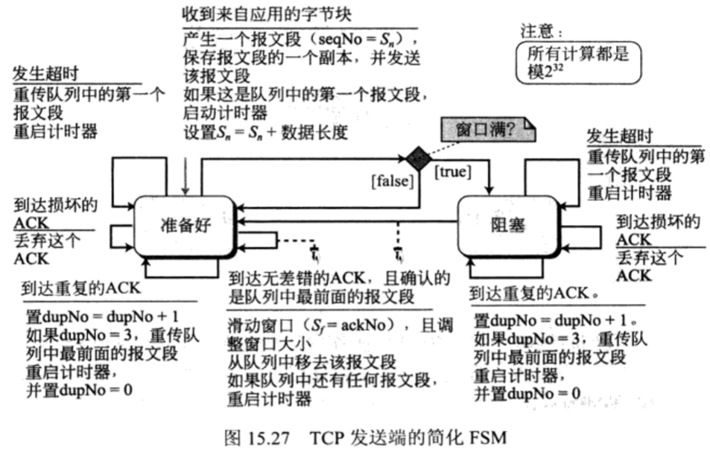
FSM

Slide 91
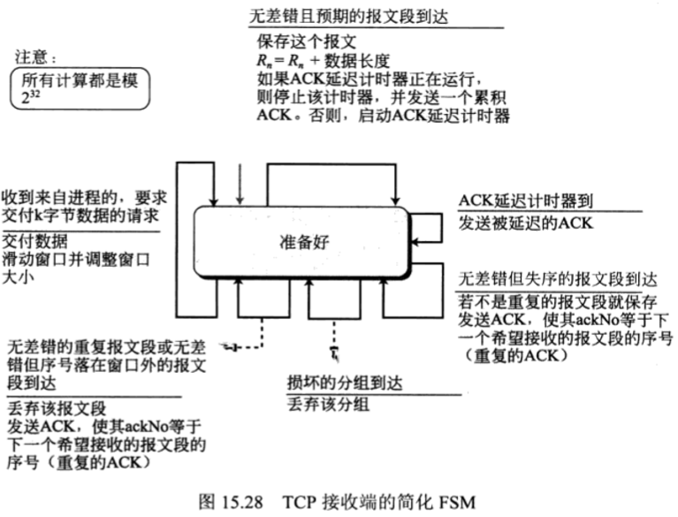
FSM

Slide 92
10.7 Congestion Control
Network congestion
Network performance
Congestion control mechanisms
Congestion control in TCP

Slide 93
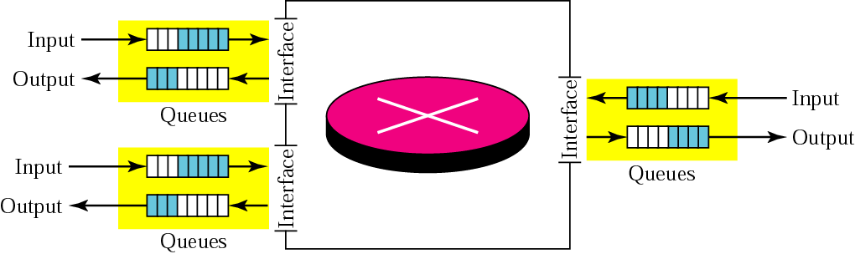
10.7.1 Network Congestion
Main reason to create congestion
The queues in routers and switches
到达速率 > 处理速率 → 输入队列长度 ↑
离开速率 < 处理速率 → 输出队列长度↑
Notes:
informally: “too many sources sending too much data too fast for network to handle”

Slide 94
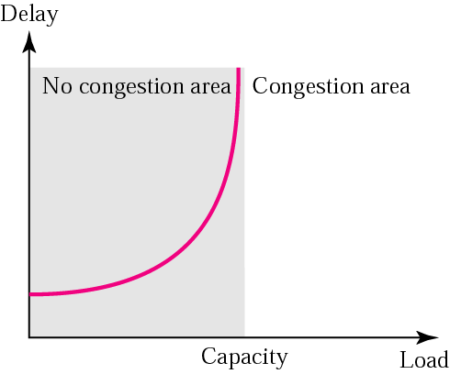
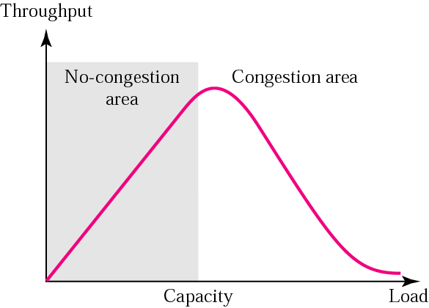
10.7.2 Network Performance
Delay
延时
Throughput
吞吐量
Notes:
long delays (queueing in router buffers)，lost packets (buffer overflow at routers),堵车现象

Slide 95
10.7.3 Congestion Control Mechanisms
Open loop congestion control
开环拥塞控制
Prevent
Closed loop congestion control
闭环拥塞控制
Detect, feedback and correct
Notes:
end-end congestion control:no explicit feedback from network，congestion inferred from end-system observed loss, delay，approach taken by TCP
network-assisted congestion control: routers provide feedback to end systems，single bit indicating congestion (SNA, DECbit, TCP/IP ECN, ATM)，explicit rate for sender to send at

Slide 96
10.7.4 Congestion Control in TCP
Congestion is the network problem, but when it occurs:
Some packets could be dropped by the router
→ no ack is sent from the TCP receiver
→ the TCP sender retransmits the lost packet
To create more congestion and more dropping
→ more retransmission and more congestion
Finally, the whole system collapses

Slide 97
Congestion Window
TCP assumes
The cause of a lost segment is due to congestion in the network
In flow control
Sender window = Receiver window
congestion → lost segments → retransmission → more congestion
Sender window = Min ( rwnd, cwnd)
rwnd: receiver window —— a receiver-side limit
cwnd: congestion window —— a sender-side limit
Notes:
different from flow control!

Slide 98
RFC2581: Congestion Control Algorithms
Slow start and congestion avoidance
MUST be used by a TCP sender to control the amount of data that has been sent but not yet acknowledged
教材：慢启动－指数增大，拥塞避免－加法增大，拥塞检测－乘法减小
Fast retransmit/Fast recovery
1 or 2 duplicate ACKs → reordering of segments
A TCP receiver SHOULD send an immediate duplicate ACK when an out-of-order segment arrives
3 or more duplicate ACKs → a segment has been lost
TCP performs a retransmission of what appears to be the missing segment, without waiting for the retransmission timer to expire
教材：拥塞检测－乘法减小

Slide 99
TCP Slow Start
Host A
Host B
when connection begins, increase rate exponentially until first loss event:
initially cwnd = 1 MSS
double cwnd every RTT
done by incrementing cwnd for every ACK received
summary: initial rate is slow but ramps up exponentially fast
one segment
RTT
two segments
four segments
time

Slide 100
TCP Slow Start : additive increase
approach: sender increases transmission rate (window size), probing for usable bandwidth, until loss occurs
additive increase: increase cwnd by 1 MSS every RTT until loss detected
multiplicative decrease: cut cwnd in half after loss
additively increase window size …
…. until loss occurs (then cut window in half)
AIMD saw tooth
behavior: probing
for bandwidth
cwnd: TCP sender
congestion window size
time

Slide 101
TCP: detecting, reacting to loss
loss indicated by timeout:
cwnd set to 1 MSS;
window then grows exponentially (as in slow start) to threshold, then grows linearly
loss indicated by 3 duplicate ACKs: TCP RENO
dup ACKs indicate network capable of delivering some segments
cwnd is cut in half window then grows linearly
TCP Tahoe always sets cwnd to 1 (timeout or 3 duplicate acks)

Slide 102
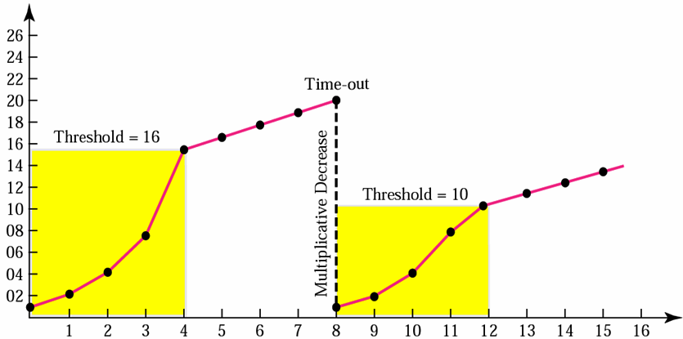
Slow Start and Congestion Avoidance
RFC 2581
Congestion window size
( in segments)
IW = min (4*SMSS, max ( 2*SMSS, 4380 bytes ) )
LW = 1 full-sized segment, i.e., 1 SMSS
sst1 = any, i.e. rwnd
sst2 = max ( FlightSize/2, 2*SMSS )
Congestion
avoidance
SMSS: Sender MSS
FlightSize: The amount of data that has been sent but not yet acknowledged
sst1
Slow
start
LW: the cwnd size after a TCP sender detects loss
sst2
IW: the initial size of the cwnd
Number of transmitted segments

Slide 103
Fast retransmit and Fast recovery
Fast retransmit
To detect and repair loss based on incoming duplicate ACKs
Fast recovery
To govern the transmission of new data until a non-duplicate ACK arrives
Usually implement together
拥塞避免阶段仅在收到重复ACK时进行，一旦收到新ACK后cwnd立刻减至门限值

Slide 104
TCP Congestion Control: details
sender sequence number space
TCP sending rate:
roughly: send cwnd bytes, wait RTT for ACKS, then send more bytes
cwnd
last byte
ACKed
last byte sent
sent, not-yet ACKed
(“in-flight”)
rate
cwnd
sender limits transmission:
cwnd is dynamic, function of perceived network congestion
~
bytes/sec
~
RTT
LastByteSent-
LastByteAcked
cwnd
<

Slide 105
TCP throughput
avg. TCP thruput as function of window size, RTT?
ignore slow start, assume always data to send
W: window size (measured in bytes) where loss occurs
avg. window size (# in-flight bytes) is ¾ W
avg. thruput is 3/4W per RTT
avg TCP thruput =
3
W
4
RTT
bytes/sec
W
W/2

Slide 106
Chapter 10 TCP
TCP services
Numbering bytes
Segment
Connection
Flow control
Error control
Congestion control
TCP timers
TCP package

Slide 107
10.8 TCP Timer
Retransmission timer，重传计时器
To control a lost or discarded segment
The waiting time for an ack of a segment
Persistence timer，持久计时器
To deal with the zero window-size advertisement
The waiting time for an ack with a non-zero window size
Keepalive timer，保活计时器
To prevent a long idle connection between two TCP
The waiting time for some data from a client
Time-waited timer等待计数器
To be used during connection termination
Notes:
等待计时器 用于连接的时候

Slide 108
Retransmission Timer
Usage
When TCP sends a segment, it creates a retransmission timer for that segment
If an ack is received for that segment before time-out, the timer is destroyed
Otherwise the segment is retransmitted and the timer is reset
Calculation
Retransmission timer = 2 x RTT
RTT = α x previous RTT + ( 1- α ) x current RTT, α = 90%
Karn’s algorithm
Notes:
重传计时器
累计ACK
选择性重传
2RTT 允许延迟一个报文段的时间

Slide 109
Persistence Timer
Usage
When the sending TCP receives an ack with a window size of zero, it starts a retransmission timer
If an ack with a non-zero window size is not received from the receiver before time-out, then send a probe segment and the value of the timer is doubled and reset
The value of the timer is set to the value of the retransmission timer
The sender continues sending the probe segment and doubling and resetting the value of the timer until the value reaches a threshold (usually 60 s)
Notes:
持久计时器：如果收到一个ACK 接收窗口=0，启动定时器，时间到后发送一个探针，并且计时器加倍，一直没有回应，直到定时器设定为60s后，不再增加。

Slide 110
Keepalive Timer
Usage
Each time the server hears from a client, it resets this timer
The time-out is usually 2 hours
If the server does not hear from the client after 2 hours, it sends a probe segment
If there is no response after 10 probe, each of which is 75 s apart, then the server assumes that the client is down and terminates the connection
Notes:
保活计时器：服务器没有收到客户端的数据，就发送一个探针，并且重启计时器（2小时），时间到后发送探针，十次探针第一没有接收到就终止连接。
之后被心跳包代替，以免浪费资源

Slide 111
Time-waited Timer
Usage
When TCP closes a connection, it does not consider the connection really closed. The connection is held in limbo for a time-waited period
The value for this timer is usually 2 times the expected lifetime of a segment ( Maximum Segment Lifetime, MSL)
2 minutes: an engineering choice
Notes:
停等计时器：TCP挥手的时候，客户端在最后一次ACK发送时启动，设置时间为2MSL,如果超时就关闭连接。
为什么要设置这个定时器？
如果第三次握手超时，服务器端会重传第三次握手的数据包，此时客户端还可以接收到。
等待这个连接过程中的所有报文消失在连接中。屏蔽这个客户端向服务器端发送到下一次连接的报文。
*********考试的时候：四个定时器必考
前面的计时器发生在连接正常的情况下，这个计时器发生在 处于半连接
区别TTL RTT MSL
MSL（120s)》》RTT

Slide 112
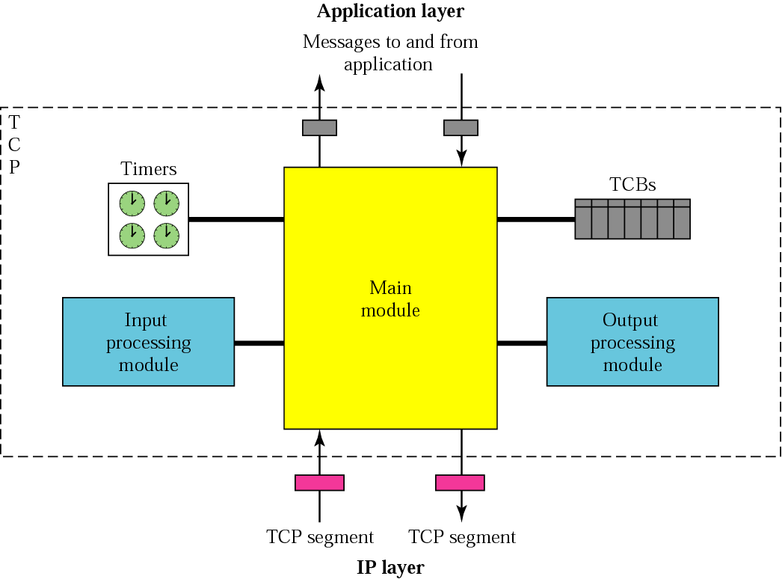
10.9 TCP Package

Slide 113
Reference
RFC 2525: know TCP implementation problems (status: information)
18 problems
RFC 4614: a roadmap for TCP specification documents (status: information)
To provide a brief summary of the documents defining TCP and various TCP extensions that have accumulated in the RFC series

Slide 114
10.11 Summary
TCP协议
通信特点：可靠、数据流
连接：概念、表示（源端点，目的端点）
TCP报文段
格式：各字段的含义、作用、取值要求（重点：序号、确认号、控制字段、窗口大小）
封装：直接封装在IP分组中
TCP的差错控制——带重传的肯定确认机制
确认：肯定、累计
重传：超时机制

Slide 115
（续）
TCP的流控和拥塞控制——TCP滑窗机制
概念：流控、TCP拥塞、滑动窗口
方法：流控——收发速率匹配，拥塞控制——减少TCP报文段的发送量
TCP滑窗机制：工作原理、窗口大小的调整机理（何时调整？怎样调整？）
TCP连接管理——TCP有限状态机
连接建立、连接拆除：过程

Slide 116
Thanks

