Slide 2
SLOT MACHINE

Slide 3
SLOT MACHINE
+
ROCK PAPER SCISSOR

Slide 4
SLOT MACHINE
+
ROCK PAPER SCISSOR
+
ACTION

Slide 5
SLOT MACHINE
+
ROCK PAPER SCISSOR
+
ACTION
+
MULTIPLAYER

Slide 6
SLOT MACHINE
+
ROCK PAPER SCISSOR
+
ACTION
+
MULTIPLAYER
+
LUCK

Slide 7
SLOT MACHINE
+
ROCK PAPER SCISSOR
+
ACTION
+FAST
+
MULTIPLAYER
+
LUCK

Slide 8
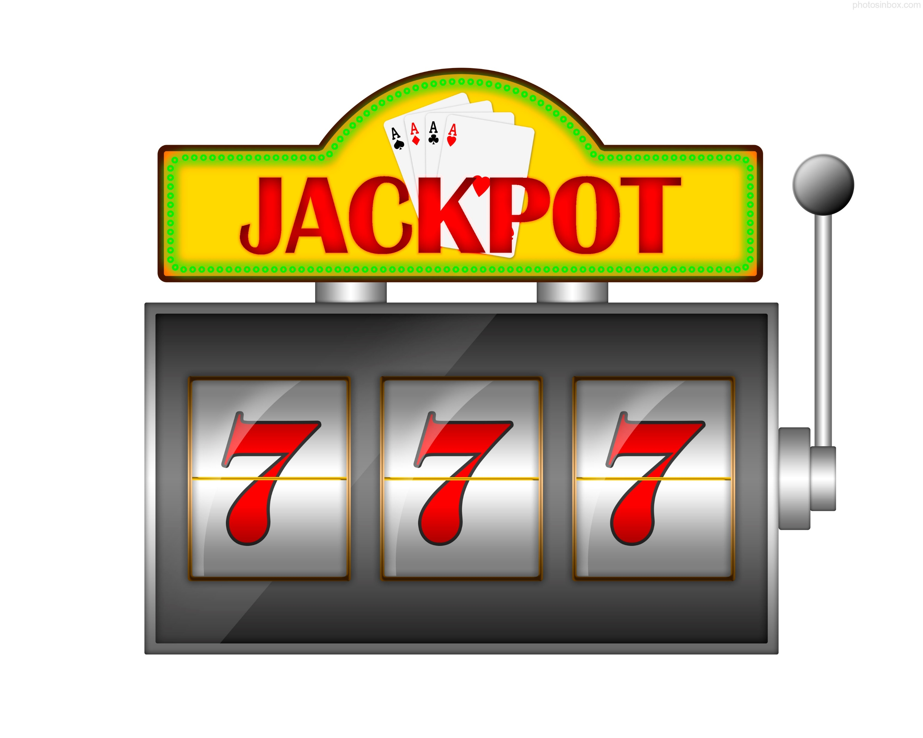
1. TWO PLAYERS
ROLL SLOT 9 Times in 60 seconds
SLOT PHASE

Slide 9

Rock
RUNEs
Grass
Scissor
Shield
Paper

Slide 10

Paper Rock Scissor
Shield Paper Grass
Grass Scissor Paper
Rock Shield Grass
Paper Grass Shield
SLOT RESULT !
All DIFFERENT
Look in the middle !
Get that Item

Slide 11
Paper Rock Rock
Paper Paper Grass
Rock Scissor Rock
Grass Scissor Grass
SLOT RESULT !
2 SAME
GET BIGGER ITEM !
(Except grass, no big grass)

Slide 12

Rock Rock Rock
Paper Paper Paper
Scissor Scissor Scissor
Grass Grass Grass
Shield Shield Shield
SLOT RESULT !
All SAME
GET ‘TORPEDO’ ITEM

Slide 13
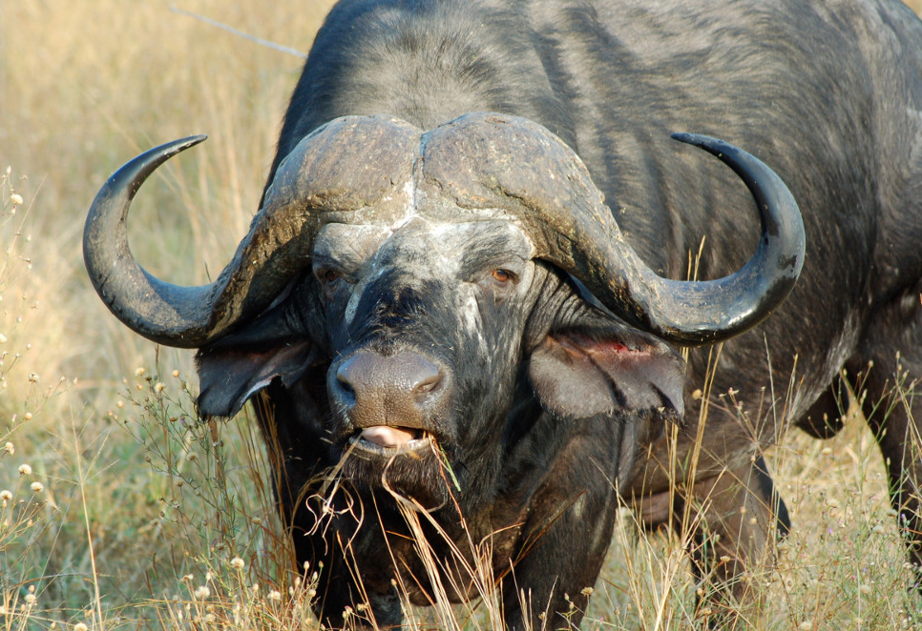
TIME OUT BEFORE 9 TIMES
= GET GRASS

Slide 14
Now players get 9 items
ROCK | PAPER | SCISSOR
PAPER | BIG SHIELD | BIG ROCK
GRASS | BIG SCISSOR | SHIELD
ROCK | BIG PAPER | SCISSOR
PAPER | PAPER | TORPEDO
SCISSOR | BIG SHIELD | GRASS
1
2
3
1
2
3
4
5
6
4
5
6
7
8
9
7
8
9

Slide 15
2. Swap order until time’s up
ROCK | PAPER | SCISSOR
PAPER | BIG SHIELD | BIG ROCK
GRASS | BIG SCISSOR | SHIELD
ROCK | BIG PAPER | SCISSOR
PAPER | PAPER | TORPEDO
SCISSOR | BIG SHIELD | GRASS
1
2
3
1
2
3
4
5
6
4
5
6
7
8
9
7
8
9

Slide 16
2. Swap order until time’s up
PAPER | ROCK | SCISSOR
PAPER | BIG SHIELD | BIG ROCK
GRASS | BIG SCISSOR | SHIELD
ROCK | BIG PAPER | SCISSOR
PAPER | PAPER | TORPEDO
SCISSOR | BIG SHIELD | GRASS
1
2
3
1
2
3
4
5
6
4
5
6
7
8
9
7
8
9

Slide 17
2. Swap order until time’s up
PAPER | ROCK | SCISSOR
PAPER | BIG SHIELD | BIG ROCK
GRASS | BIG SCISSOR | SHIELD
ROCK | BIG PAPER | SCISSOR
PAPER | PAPER | TORPEDO
SCISSOR | BIG SHIELD | GRASS
1
2
3
1
2
3
4
5
6
4
5
6
7
8
9
7
8
9

Slide 18
2. Swap order until time’s up
PAPER | ROCK | SCISSOR
PAPER | BIG SHIELD | BIG ROCK
GRASS | BIG SCISSOR | SHIELD
SCISSOR | BIG PAPER | ROCK
PAPER | PAPER | TORPEDO
SCISSOR | BIG SHIELD | GRASS
1
2
3
1
2
3
4
5
6
4
5
6
7
8
9
7
8
9

Slide 19
ROCK PAPER SCISSOR PHASE
MATCH EACE NUMBER Of Two players
PAPER
SCISSOR
1
1

Slide 20
USE NORMAL RULE
PAPER
SCISSOR
WINS
1
1

Slide 21
BLUE PLAYER DEALS 1 DAMAGE
Total Damage dealt : 0
Total Damage dealt : 1
PAPER
SCISSOR
WINS
1
1

Slide 22
SPECIAL RULE !
Big item deals 2 Damage
PAPER
2
BIG SCISSOR
WINS

Slide 23
SPECIAL RULE !
But big item can’t defend anyway
1
SCISSOR
BIG PAPER
WINS

Slide 24
SPECIAL RULE !
Torpedo wins everything and deals 2 damage
PAPER
2
TORPEDO
SCISSOR
WINS
ROCK
Grass

Slide 25
SPECIAL RULE !
Grass loses to everything ☹
SCISSORS
GRASS
1
WINS
PAPER
ROCK

Slide 26
SPECIAL RULE !
Shield can defend small damage. Make it 0
SCISSORS
SHIELD
0
WINS
PAPER
ROCK

Slide 27
SPECIAL RULE !
Shield can half defend big damage. Make it 1
BIGSCISSORS
SHIELD
1
WINS
BIGPAPER
BIGROCK

Slide 28
SPECIAL RULE !
Big Shield can defend everything.
SCISSORS
0
BIG SHIELD
WINS
BIGPAPER
TORPIDO

Slide 29
Who dealt more damage wins
Total Damage dealt : 0
Total Damage dealt : 6
PAPER | ROCK | SCISSOR
PAPER | BIG SHIELD | BIG ROCK
GRASS | BIG SCISSOR | SHIELD
SCISSOR | BIG PAPER | ROCK
PAPER | PAPER | TORPEDO
SCISSOR | BIG SHIELD | GRASS
1
2
3
1
2
3
4
5
6
4
5
6
7
8
9
7
8
9
WINS !!!

Slide 30
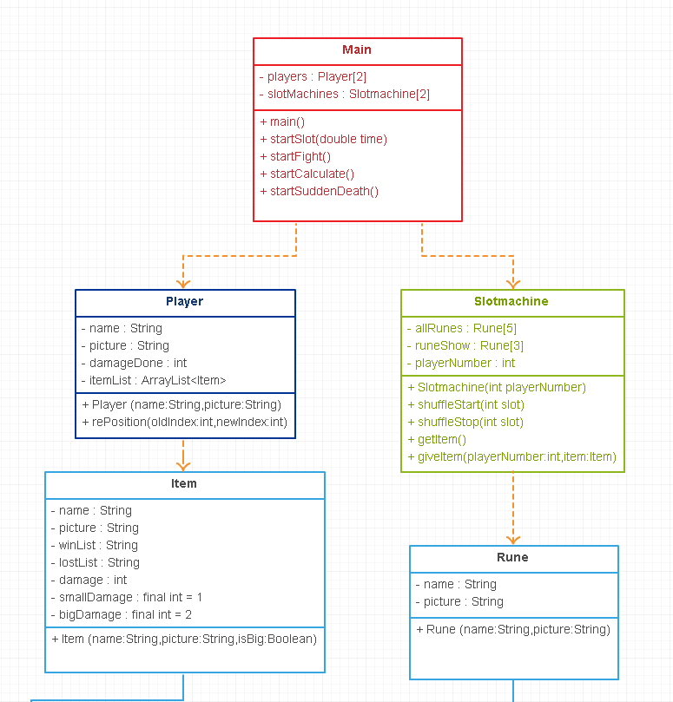

Slide 31
