Slide 1
A12 Docs RAG (On premise)
Build a RAG pipeline with Milvus
AI VN Team - 5.2026

Slide 2
Agenda
Compare Architecture between Azure AI Search and Milvus
Compare their chunking strategy
Compare their retrieval strategy
Compare their performance

Slide 3
RAG architecture with Milvus
Replace Azure AI Search with Milvus Vector Database
Don’t use Azure Storage anymore alt text

Slide 4
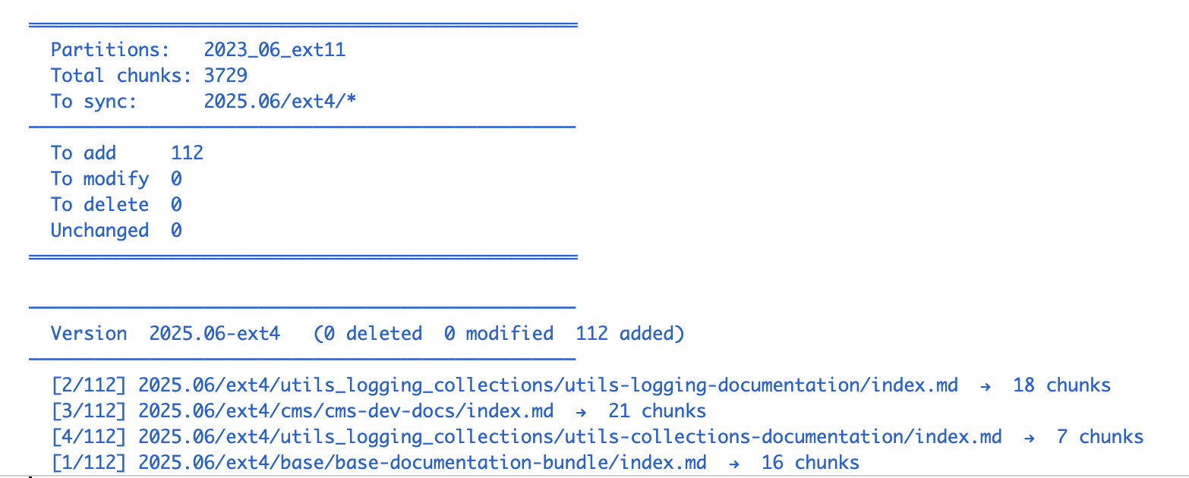
Custom ingestion with Milvus
Use Milvus to manage sync changes from MinIO to Milvus alt text
alt text

Slide 5
Custom ingestion with Milvus
Manage sync state in Milvus alt text

Slide 6
Compare chunking strategy
Azure AI Search | Milvus Search
Split by headings (h1-h3) | Split by headings (h1-h4)
Chunk by character limit (2000 char, 500 overlap) | Chunk by rescursive splitter, char cap limit = 3000, no overlap
None | Detect inline code and table (Future: preserve table header across multiple chunks, get full block code)
None | Detect intra-references in the chunk (Future: return thems in chunk)
None | Detect sections that overflow in multiple chunks

Slide 7
Chunks in Milvus
Schema
Data

Slide 8
Leverage relationship among A12 components
There are five layers in A12

Slide 9
Enhance Chunking Strategy
Split documents based on headings h1-h4
Use recursive splitter for heading body
Don’t split chunk in middle of text, table row
Don’t use overlap size
Embedding Model: text-embedding-3-large (dim=3072)
Chunk info
Size: 3000 chars
Embedding models
Commercial model: text-embedding-3-large (OpenAI)

Slide 10
Retrieve Relevance Chunks
Azure AI Search | Milvus Search
Use hybrid search | Use hybrid search
Use RRF | Use RRF
Use semantic reranker | None

Slide 11
Compare A12 RAG Evaluation
Azure AI Search alt text
Milvus Search alt text

