Slide 1
PAYMENT AND OPERATIONS
Explainable Healthcare
Claims Anomaly Detection
Transparent rules, Isolation Forest, and a Streamlit review workflow
Konidala Devasri Choudary
Cotiviti Internship Assessment
01
Notes:
0:00–0:15. Hello, I am Devasri Choudary Konidala. My project explores pattern recognition for healthcare payment and operations. I combined explicit review rules with Isolation Forest and built a Streamlit application to investigate unusual synthetic claims.

Slide 2
Pattern recognition for payment integrity
Anomaly detection prioritizes claims with unusual financial or billing patterns for expert review.
Earlier intervention
Governance readiness
Cotiviti’s Proactive COB uses AI at enrollment, before claims arrive.
More than 70% of survey respondents use AI. Fewer than 40% report detailed employee-use policies.
Opportunity: extend existing AI and rules with traceable review evidence and measured operational value.
Sources: Cotiviti (2026a, 2026b). Survey findings describe respondents.
02
Notes:
0:15–0:40. The aim is to prioritize expert review. Cotiviti already combines AI with deterministic rules. Earlier intervention is growing, as its enrollment-stage coordination-of-benefits capability illustrates. At the same time, Cotiviti’s survey highlights a governance gap. I see an opportunity to make review evidence traceable while testing whether anomaly ranking improves operational value.
Sources: https://www.cotiviti.com/solutions/payment-accuracy
https://www.cotiviti.com/press-release/cotiviti-introduces-ai-enabled-proactive-cob-to-resolve-coordination-of-benefits-issues-at-enrollment
https://www.cotiviti.com/press-release/cotiviti-and-medcity-news-index-finds-healthcare-ai-adoption-is-outpacing-governance-and-cybersecurity-preparedness

Slide 3
Validated data and chronological evaluation
117,889
Fabric and PySpark
Clean and type source records
Aggregate transactions per claim
Validate joins and financial totals
synthetic claims
711,238 transactions
61,459 encounters
1,163 patients
94,333 training claims
Through November 14, 2017
23,556 evaluation claims
November 15, 2017 onward
Training determines preprocessing and cutoffs. Some patients appear in both periods.
03
Notes:
0:40–1:05. I prepared synthetic Synthea data in Fabric using PySpark, aggregated transactions before joining patient and encounter context, and reconciled row counts and financial totals. I trained on earlier claims and evaluated on later claims. Some patients appear in both periods. This is chronological claim evaluation, rather than a test exclusively on new patients. The model does not perform time-series forecasting.
Sources: Project feature validation and notebook 07 outputs. Synthea: https://github.com/synthetichealth/synthea

Slide 4
Rules and model inputs
Transparent rules
Isolation Forest inputs
Payments exceed charges
by more than $0.01
Column | What it measures
total_charge_amount | Total recorded charges
diagnosis_count | Populated diagnosis slots
charge_count | Charge entries
payment_count | Payment entries
transfer_count | Transfer entries
unique_charge_procedure_count | Distinct charge procedure codes
Service occurs after
recorded death
Charges exceed the
encounter-class training
99th percentile
log1p transformation 200 trees 256 claims per tree
Review cutoff: training-score 99th percentile = 0.676036
Rules are separate from model training. Scores indicate unusual patterns.
04
Notes:
The rules check three explicit conditions: payments exceeding charges by more than one cent, service after recorded death, and high charges compared with training peers in the same encounter class. Separately, Isolation Forest uses six columns: total charge amount, populated diagnosis slots, charge entries, payment entries, transfer entries, and distinct procedure codes on charge entries. These describe financial size and billing activity. Entry counts are not counts of confirmed duplicate payments. I apply log1p to reduce skew, fit preprocessing on training data, and train 200 trees with 256 claims sampled per tree. Records that separate more easily receive higher anomaly scores. The review cutoff is the training-score 99th percentile, approximately 0.676036. Rules do not serve as training labels. A model score is not a fraud probability.
Sources: Project notebook 07 and models/rule_config.json. https://scikit-learn.org/stable/modules/generated/sklearn.ensemble.IsolationForest.html

Slide 5
326 model-only candidates extend rule selection
23,556 evaluation claims
2,899
combined candidates
12.31%
of evaluation claims
20,657 claims trigger neither method. Counts indicate review activity, not accuracy or confirmed savings.
05
Notes:
1:40–2:10. Rules flagged 2,573 claims and the model flagged 597. After removing the overlap of 271, the combined queue has 2,899 distinct claims, or 12.31 percent of evaluation claims. The model identifies 326 additional candidates beyond the implemented rules. That demonstrates complementary selection. Without expert labels, it does not establish true errors, accuracy, or savings.
Source: Notebook 07 evaluation outputs. Exclusive categories: 2302 rules only + 326 model only + 271 both + 20657 neither = 23556. Combined queue: 2573 + 597 - 271 = 2899.

Slide 6
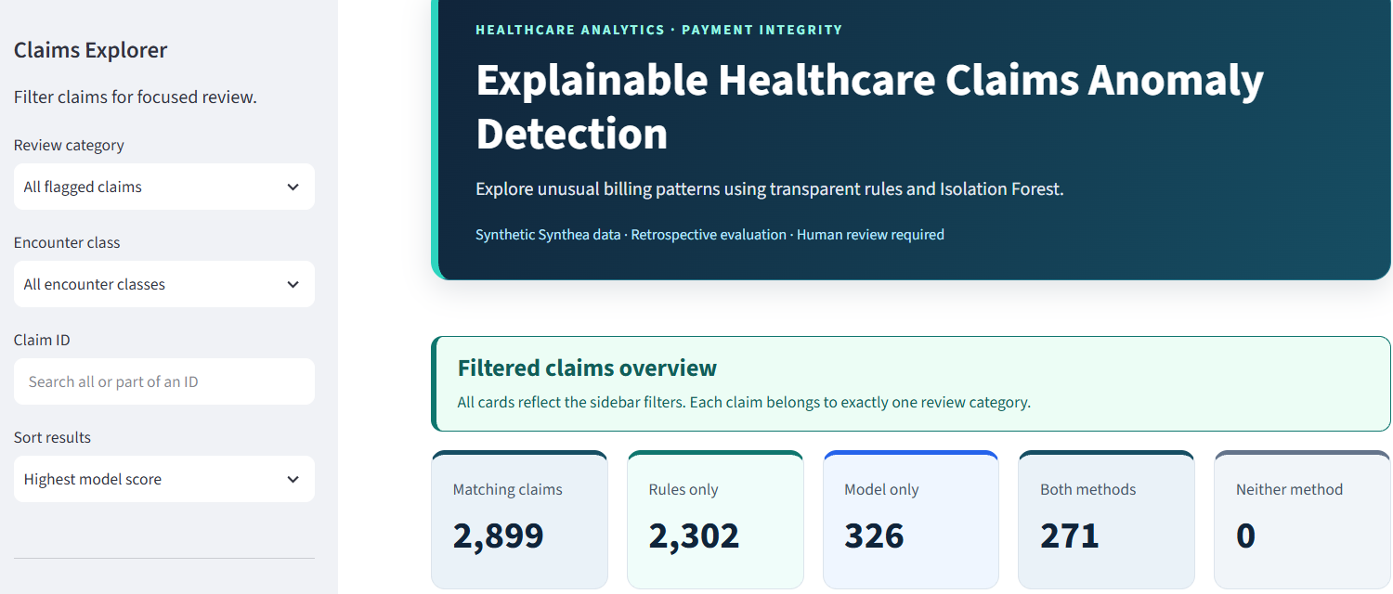
Streamlit claim review demonstration
06
Notes:
2:10–3:35. Switch to the running Streamlit app for approximately 85 seconds. Show All claims and the 23,556 total, then select Model only. Search for claim 70315484-c4af-a090-d4a2-961bc3d32d86. Its score is 0.773027, above the model cutoff. Its charge is $21,415.62, below the inpatient charge rule threshold of $23,506.46. Show the absence of rule triggers. Scroll to training peer comparisons and point out 26 charge entries, 27 payment entries, and 52 transfer entries. Explain that these comparisons give context but do not establish individual feature contributions. Clear search, select Both, demonstrate updated counts, then show the filtered CSV download. Return to the deck. Keep your camera visible in the recording.
Visual source: User-provided application screenshot dated November 2, 2026, cropped to application content. Screenshot shows an earlier styling iteration. Demonstrate current live application during recording. Claim details from the supplied notebook outputs.

Slide 7
Strategic options for Cotiviti
90-day retrospective pilot
Evidence and feedback
Compare rules alone and combined ranking under equal reviewer capacity.
Track reviewer findings, versions, appeals, and false positives across relevant populations.
Success measures
Deployment conditions
Confirmed actionable findings
Review time and net validated value
Provider burden
Expert approval for AI summaries
Privacy controls and drift monitoring
Rebuild features before prepayment use
Scale after demonstrated operational gains and acceptable review burden.
07
Notes:
3:35–4:20. My recommendation is a controlled retrospective pilot. Compare both approaches with equal reviewer capacity, then measure confirmed actionable findings, review time, validated value after costs, and provider burden. Record evidence and reviewer feedback so outcomes can improve the system. Synthetic data and unavailable labels limit the current demonstration. AI summaries should remain source-linked and expert-approved. Any move to prepayment requires rebuilding inputs, because completed payment histories are unavailable before payment. Scale only after a pilot demonstrates value.
Sources: Proposed actions based on project findings. Tabassi (2023), https://doi.org/10.6028/NIST.AI.100-1. Waibel (2024), https://blog.cotiviti.com/podcast-deploying-ai-in-payment-integrity-responsibly

Slide 8
Sources and methods
Cotiviti. (n.d.). Healthcare claim payment accuracy solutions. cotiviti.com/solutions/payment-accuracy
Cotiviti. (2026a, September 8). Healthcare AI adoption and governance readiness [Press release].
Cotiviti. (2026b, August 13). AI-enabled Proactive COB at enrollment [Press release].
scikit-learn developers. (n.d.). IsolationForest documentation. scikit-learn.org
Tabassi, E. (2023). Artificial intelligence risk management framework (AI RMF 1.0). doi.org/10.6028/NIST.AI.100-1
Waibel, B. (2024, July 29). Podcast: Deploying AI in payment integrity responsibly. Cotiviti.
Synthetic Health. (n.d.). Synthea patient generator. github.com/synthetichealth/synthea
Project outputs supply the metrics. ChatGPT assisted with coding guidance and drafting.
Full source URLs and presentation guidance appear in the speaker notes.
08
Notes:
4:20–4:30. My report includes the bibliography, and these slides include source details in their notes. ChatGPT supported coding guidance and drafting. Thank you. The workflow demonstrates how transparent rules and anomaly detection can support a traceable claims review process. Leave approximately 30 seconds of buffer within the five-minute limit.
Full references:
Cotiviti. (n.d.). Healthcare claim payment accuracy solutions. https://www.cotiviti.com/solutions/payment-accuracy
Cotiviti. (2026a, September 8). Cotiviti and MedCity News index finds healthcare AI adoption is outpacing governance and cybersecurity preparedness. https://www.cotiviti.com/press-release/cotiviti-and-medcity-news-index-finds-healthcare-ai-adoption-is-outpacing-governance-and-cybersecurity-preparedness
Cotiviti. (2026b, August 13). Cotiviti introduces AI-enabled Proactive COB to resolve coordination of benefits issues at enrollment. https://www.cotiviti.com/press-release/cotiviti-introduces-ai-enabled-proactive-cob-to-resolve-coordination-of-benefits-issues-at-enrollment
scikit-learn developers. (n.d.). IsolationForest. https://scikit-learn.org/stable/modules/generated/sklearn.ensemble.IsolationForest.html
Tabassi, E. (2023). Artificial intelligence risk management framework (AI RMF 1.0). National Institute of Standards and Technology. https://doi.org/10.6028/NIST.AI.100-1
Waibel, B. (2024, July 29). Podcast: Deploying AI in payment integrity responsibly. https://blog.cotiviti.com/podcast-deploying-ai-in-payment-integrity-responsibly
Synthetic Health. (n.d.). Synthea patient generator. https://github.com/synthetichealth/synthea
OpenAI. (n.d.). ChatGPT [Large language model]. https://chatgpt.com/

