Slide 1

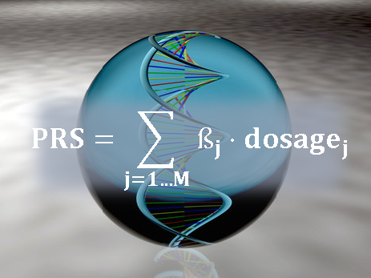
ELSI considerations on
polygenic scores
PD Dr. Amke Caliebe
Institut of Medical Informatics and Statistics Christian-Albrechts-Universität zu Kiel
ELSI committee of IGES IGES education workshop 2024

Slide 2
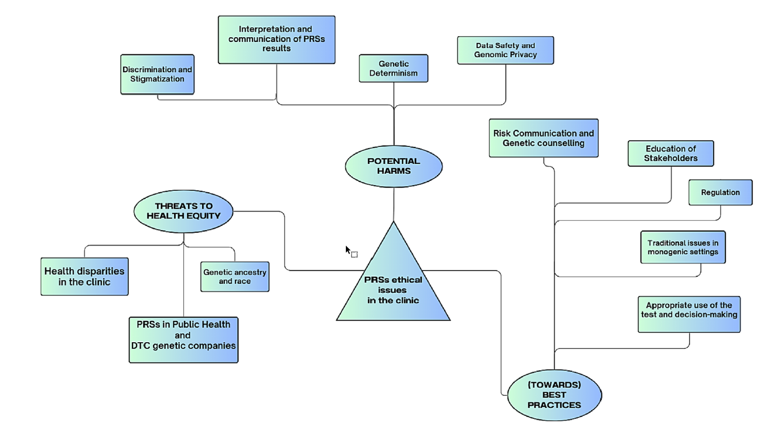
Andreoli L et al. (2024) Am J Med Genet A 194:e63584

Slide 3

Understanding PGS
No reliable individual predictions
Danger of overinterpretation or misinterpretation by doctors or patients, probability illiteracy
Potential actions
Teaching of health care professionals, communication training
Studies about patient perspectives and perceptions of PGS
3

Slide 4
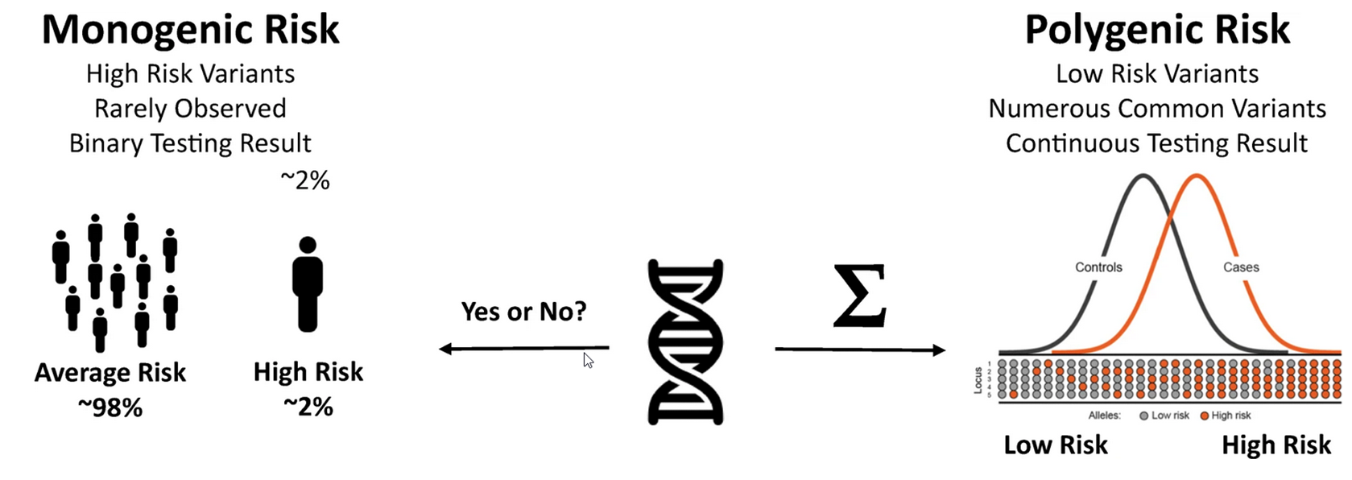
Genetic determinism
Confusion with penetrance in the monogenic situation
Muse ED et al. (2021) Curr Cardiol Rep 23:107
4

Slide 5
Environmental contribution
G
E
Ignoring of environmental components or gene-environment interactions
Reducing the motivation for lifestyle changes
Changing the focus for public health prevention strategies
PGS
GxG
GxE
Adapted from Caliebe A et al. (2021) Dtsch Ärztebl 118:A-410
5

Slide 6
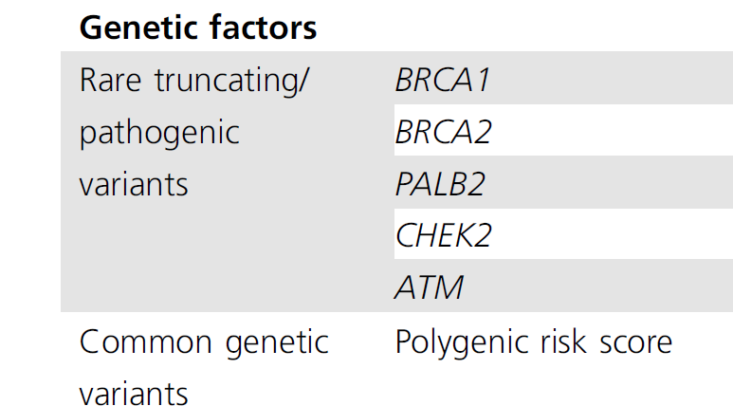
Clinical application
Clinical studies of the improvement versus standard-of-care are (yet) missing. Diagnostic potential/ clinical validity: Differentiating between cases and controls Clinical utility: benefit > risk
Application of PGS without sufficient evidence
Overdiagnosis, overtreatment
What about preventive medication in young, healthy persons? Statins in young persons with high CAD-PGS?
Genetic factors in BOADICEA, v6
Lee A et al. (2019) Genet Med 21:1708-1718
6

Slide 7
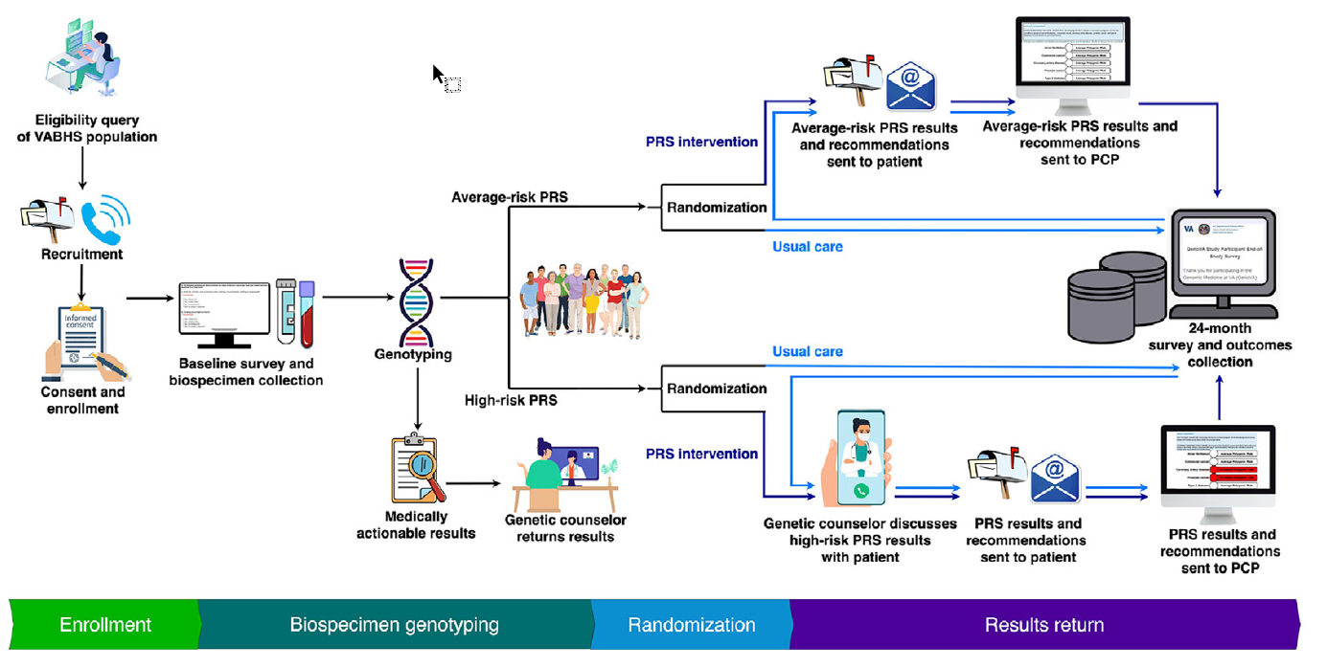
Randomized studies vs standard of care
Potential actions
More randomized studies!
Some studies ongoing
WISDOM – breast cancer screening Risk estimation: personal history, family history, and genetic testing (9 high/moderate risk gene; PGS)
GenoVA six diseases: coronary artery disease; type 2 diabetes; atrial fibrillation; breast, colorectal, and prostate cancers
Esserman LJ (2017) NPJ Breast Cancer 3:34
Vassy JL et al. (2023) AJHG 110:1841-1852
Vassy JL et al. (2023) AJHG 110:1841-1852
7

Slide 8
Others
Stigma/discrimination
Especially for psychiatric diseases
Negative self-labelling
High heritability might result in stigmatizing family members
Even more problematic in monogenic diseases
Missing prevention or treatment options
Potential actions
Good genetic counseling
Data protection issues
Access by insurance companies
Direct-to-consumer companies
Potential actions
Legal protection of data, regulation
Chapman CR (2023) J Community Genet 194:441-452
Andreoli L et al. (2024) Am J Med Genet A 194:e63584
8

Slide 9
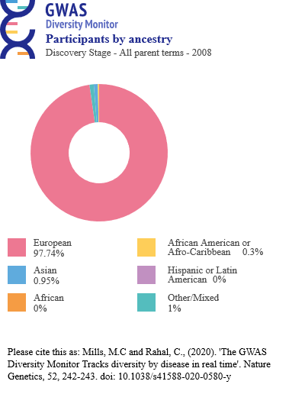
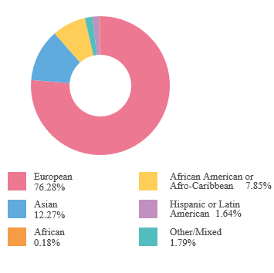
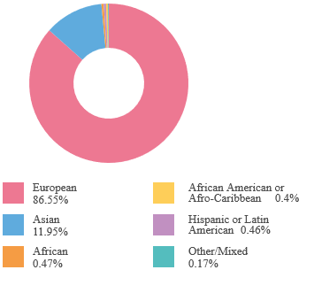
GWAS Diversity Monitor
2008
2012
2023
Mills, MC, Rahal, C (2020) Nat Genet 52:242-243
9

Slide 10
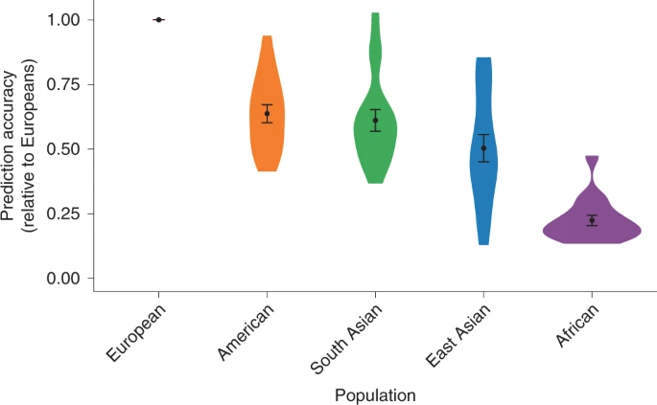
PGS for diverse populations
PGS do not transfer well across populations.
“Clinical use of current polygenic risk scores may exacerbate health disparities”
Potential actions
Adapt for diversity, be inclusive!
Martin AR, …, Daly MJ (2019) Nat Genet 51:584-591

Slide 11
Conclusion
PGS offer exciting new possibilities in research and clinical applications.
Beware of limitations and ELSI concerns.
Concerns can be addressed with appropriate actions.
Caliebe A et al. (2021) Dtsch Ärztebl 118:A-410
11

