Slide 1
Potential applications of PRS
Support earlier disease risk prediction (augmenting screening approaches)
Facilitate improvements in disease prevention strategies (e.g. better identifying who would benefit most from statin therapies beyond standard clinical-based prediction equations)
Refine accuracy of diagnoses of diseases/conditions
Increase precision of therapeutic treatments
Slowing disease progression and recurrence
And more…
Polygenic Risk Score Task Force of the International Common Disease Alliance. Responsible use of polygenic risk scores in the clinic: potential benefits, risks and gaps. Nature Medicine. volume 27, pages 1876–1884 (2021)

Slide 2
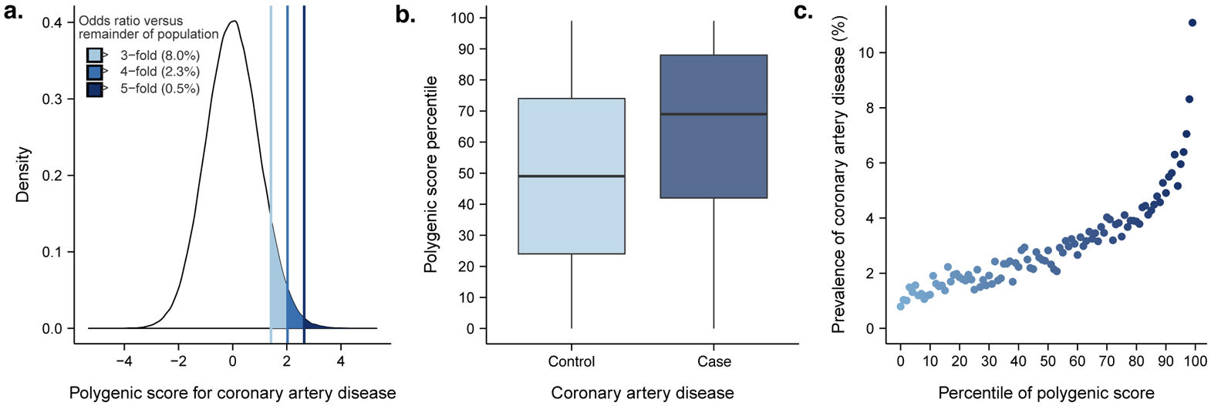
Interpreting PRS
From: Khera et al., Genome-wide polygenic scores for common diseases identify individuals with risk equivalent to monogenic mutations. Nat Genet. 2018 Sep;50(9):1219-1224. PMID: 30104762

Slide 3
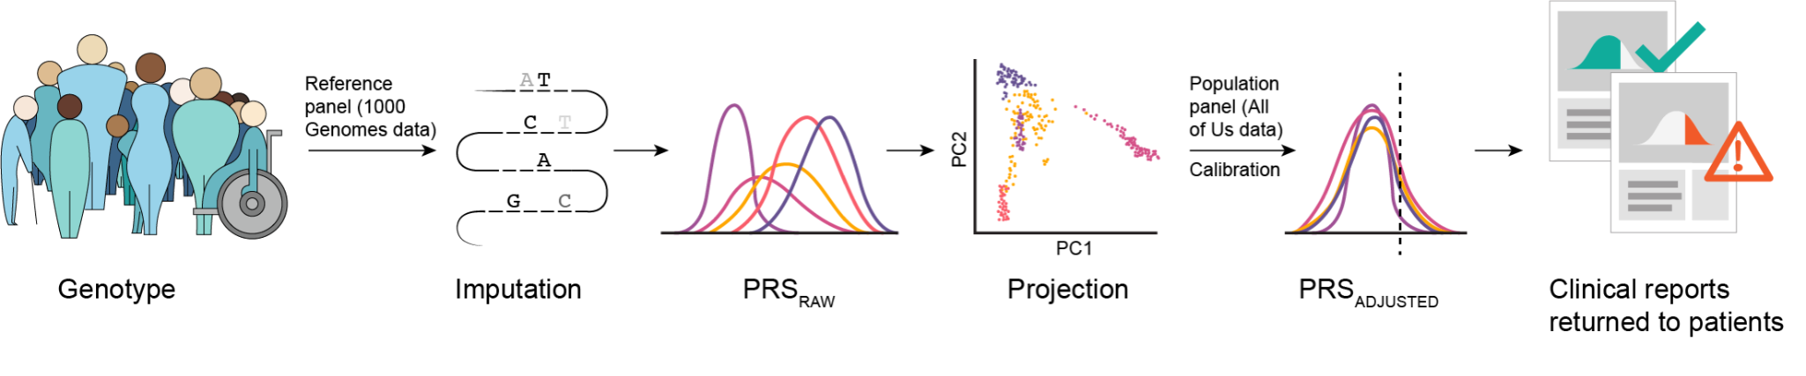
Ancestry calibration
From: Lennon et al., Selection, optimization, and validation of ten chronic disease polygenic risk scores for clinical implementation in diverse populations. medRxiv [Preprint]. 2023 Jun 5:2023. PMC10275001.

Slide 4
PRS and environment
Approaches to include environmental measures with PRS:
Include individual environmental traits in models with PRS. Can also test interactions between environmental traits and PRS.
Create a composite measure(s) for environmental traits (e.g. socioeconomic risk score; diet/nutrition risk score; etc.) to include in models with PRS
Integrate environmental traits directly with genetic variants to make a genetic-environment risk score
Active area of research

Slide 5
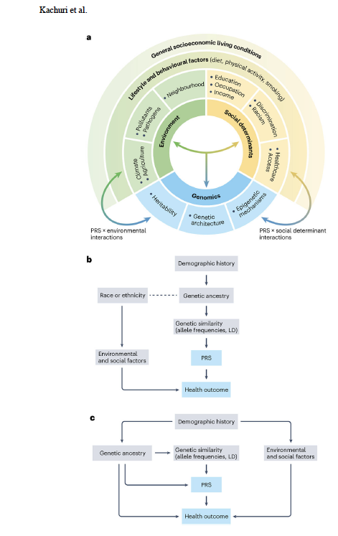

From: Principles and methods for transferring polygenic risk scores across global populations. Kachuri et al. Nat Rev Genet. 2024 Jan;25(1):8-25. PMID: 37620596

Slide 6
Improving the power of PRS, especially in understudied and genetically admixed populations
Increase sample sizes of non-European populations in GWAS, PRS model (training) building and PRS validation studies.
Assess PRS x Environment interactions and effect modification of PRS by non-genetic risk factors and incorporate knowledge in application of PRS.
Explicitly model population-specific variant effects in the construction of PRS in genetically admixed populations.
Expand focus on biologically functional variants that are likely more transportable across populations.
Expand PRS prediction models to incorporate PRS from related traits.

Slide 7
Modeling Population-Specific Effects in PRS in Genetically Admixed Populations (GAUDI)
Fused lasso penalized regression models, balancing fusion and sparsity penalties.
Software: Genetic Ancestry Utilization in polygenic risk scores for aDmixed Individuals (GAUDI)
Uses local ancestry estimates to allow for population specific effect estimates for each variant included in the PRS.
Explicitly allows for ancestry specific effects. A population-specific weight for each variant is included in the PRS model and the choice of the weight assigned to each individual at that variant is dependent on the ancestry of that individual’s haplotype segment containing the variant.
The fusion penalty component encourages similar ancestry specific effects while the sparsity penalty parameter penalizes inclusion of too many variants in the model.
Simulations and real examples demonstrated improvement in model performance in genetically admixed individuals across a range of simulation conditions and real data observations compared to alternative methods (PRSice, PRS-CSx).
` Reference: Sun Q et al. Nature Communications. (2024)15:1016.

Slide 8
Including Functional Information In PRS
Most PRS are agnostic to which variants are causally important.
When testing PRS in the same discovery population used to construct the PRS, the impact on prediction of using non-functional variants is typically small.
However, when applying a PRS built in one population (typically European ancestry) to another (non-European), the LD differences between the GWAS discovery/PRS training population and the test population can significantly erode power and prediction accuracy, as the unincluded underlying causal variant is more poorly “captured” by the surrogate ”LD buddy” that is included in the PRS function in genetically distant testing populations.
Methods, such as PolyPred, are being built to attempt to include estimated causal effects of included variants to circumvent the problem of LD differences between populations.
Rationale: By directly including the causal effects (whose effects are assumed to be relatively homogenous across populations), the methods can overcome some of the decay in prediction accuracy of PRS in testing populations that have different LD structures than the (likely largely European dominated) discovery/training populations.
Reference for PolyPred: Weissbrod et al., Nature Genetics. (2022) 54(4):450-458.

Slide 9
Including Multiple Trait PRSs in Prediction Models
Many traits have underlying risk factors that also contribute to risk of disease. These risk factors also have underlying genetic risk factors.
Many traits also share many genetic risk factors with other traits.
It has been shown that building a composite PRS based on your trait and related traits can improve prediction over inclusion of the single trait PRS by itself.
An example of this is GPS_{Mult}, a composite PRS for coronary artery disease (CAD) based on combining individual PRS scores for CAD and it’s risk factors and associated traits, including diabetes, LDL and HDL cholesterol, triglycerides, systolic and diastolic blood pressure, BMI, PAD, estimated glomerular filtration rate (eGFR) and ischemic stroke.
GPS_{Mult} was shown to significantly outperform PRS constructed based on CAD alone.
Reference: Patel AP, et al. Nature Medicine (2023) 29, 1793–1803.

Slide 10
Polygenic Risk Methods in Diverse Populations (PRIMED) Consortium
@PRSdiversity. primedconsortium.org/

Slide 11
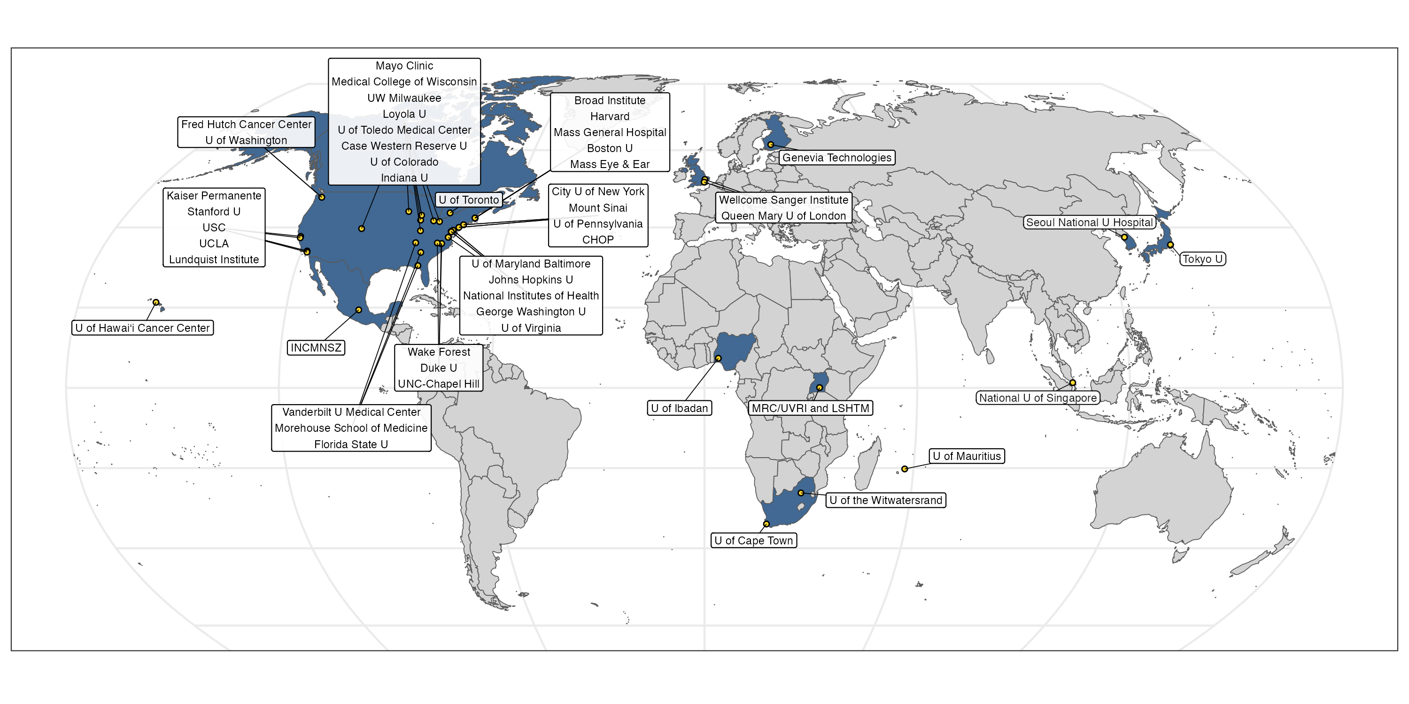
Funded by NHGRI in 2021 to develop and evaluate methods to improve the use of PRS to predict disease and health outcomes in diverse ancestry populations.
PRIMED investigators are located across 49 institutions in 12 countries.

Slide 12
Some recent PRIMED publications
Truong et al., Integrative polygenic risk score improves the prediction accuracy of complex traits and diseases. Cell Genom. 2024 Apr 10;4(4):100523. PMID: 38508198
Kangcheng et al., Admix-kit: an integrated toolkit and pipeline for genetic analyses of admixed populations. Bioinformatics. 2024 Mar 29;40. PMID: 38490256
Sun et al., Improving polygenic risk prediction in admixed populations by explicitly modeling ancestral-differential effects via GAUDI. Nat Commun. 2024 Feb 3;15(1):1016. PMID: 38310129
Kachuri et al., Principles and methods for transferring polygenic risk scores across global populations. Nat Rev Genet. 2024 Jan;25(1):8-25. PMID: 37620596
Patel et al., A multi-ancestry polygenic risk score improves risk prediction for coronary artery disease. Nat Med. 2023 Jul;29(7):1793-1803. PMID: 37414900

