Slide 1
Predicting Hotel Cancelations
Capstone Project
Kerem Onipede
Notes:
"Good [morning/afternoon/evening], everyone. My name is Kerem Onipede, and today I’ll be presenting my capstone project on Predicting Hotel Cancellations. In this project, I analyzed data from a single hotel in Lisbon covering 2017 and 2018, with over 36,000 observations and 16 variables, to determine whether a booking will be canceled and to uncover the key factors driving cancellations. Over the next 12 minutes, I will take you through our data set, our objectives, our exploratory and preparatory work, and then detail two different modeling approaches along with feature importance and threshold tuning. Let’s begin."

Slide 2
Data Set
From 1 hotel in Lisbon, Portugal, 2017-2018
36,275 observations
16 variables
no_of_adults – integer
no_of_children – integer
no_of_weekend_nights – integer
no_of_week_nights – integer
type_of_meal_plan – factor
required_car_parking_space – integer
room_type_reserved – factor
arrival_month – factor
market_segment_type – factor
repeated_guest – integer
no_of_previous_cancellations – integer
no_of_previous_bookings_not_canceled – integer
no_of_special_requests – integer
booking_status – factor
lead_time – numeric
avg_price_per_room – numeric
Notes:
The analysis is based on a comprehensive data set from one hotel in Lisbon, Portugal, covering the years 2017 and 2018. The data set comprises 36,275 observations and 16 variables. These variables include guest counts such as the number of adults and children, details about weekend and weekday nights, and categorical fields like type of meal plan, room type reserved, and market segment type. Additional variables, including arrival month, repeated guest indicator, and previous cancellation history, provide context on booking behavior. Variables like lead time and average price per room are key numeric predictors. This robust set of variables enabled me to explore both the predictive power of various factors and the underlying patterns of cancellations."

Slide 3
Objective
Can we predict how likely a booking is to be canceled?
What factors affect how likely a booking is to be canceled?
Notes:
My project has two primary objectives. The first is to determine if I can predict how likely a booking is to be canceled using historical data. The second is to identify which factors most affect the likelihood of cancellation. By answering these questions, I aim to empower hotel management with insights that can improve revenue management and operational efficiency. In other words, I want to know not only if cancellations can be forecasted accurately, but also which variables—such as lead time, room price, or guest behavior—drive these cancellations. Ultimately, my goal is to provide actionable intelligence that can be integrated into hotel operations to mitigate revenue loss from unoccupied rooms."

Slide 4
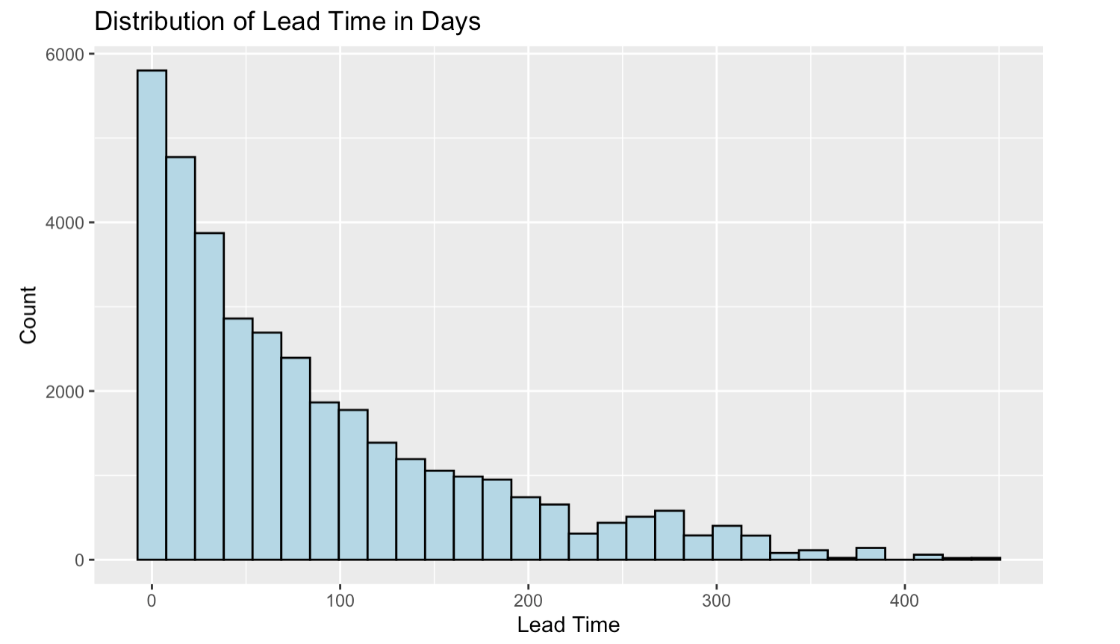
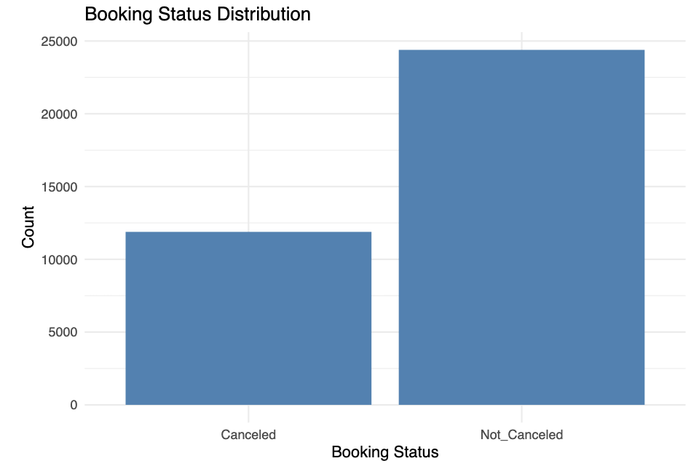
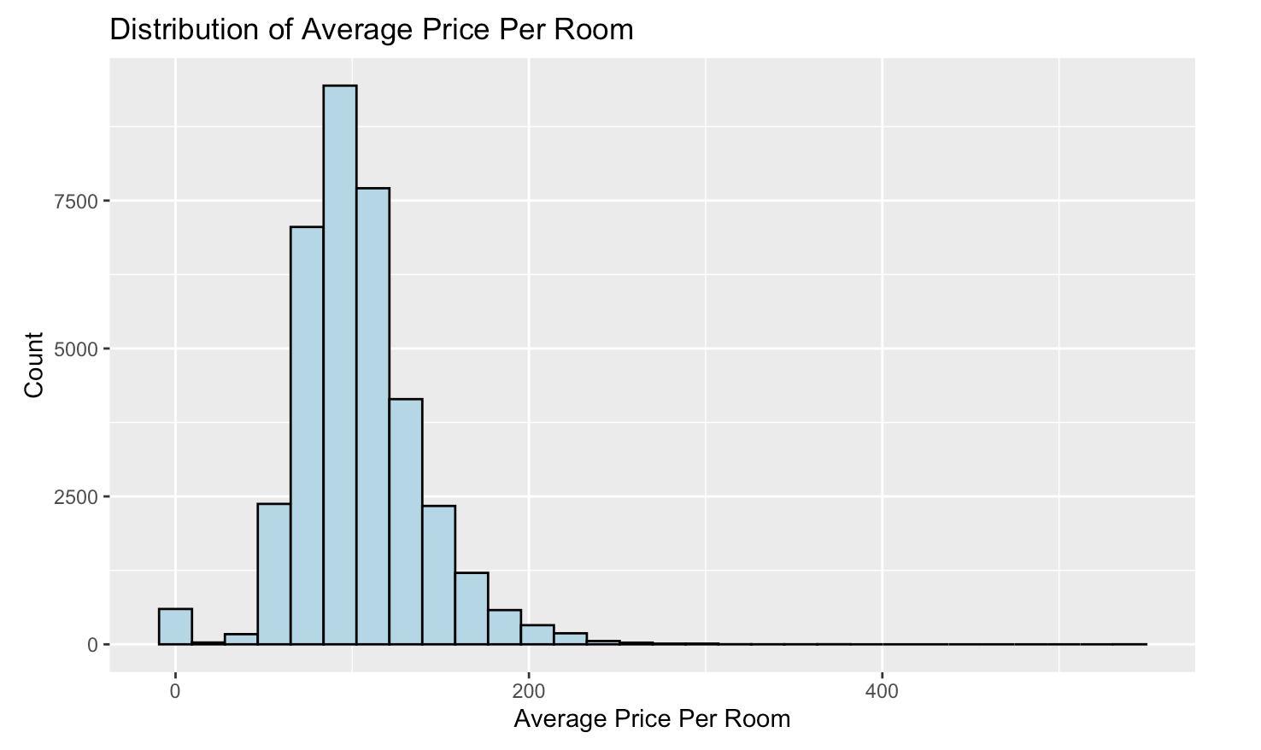
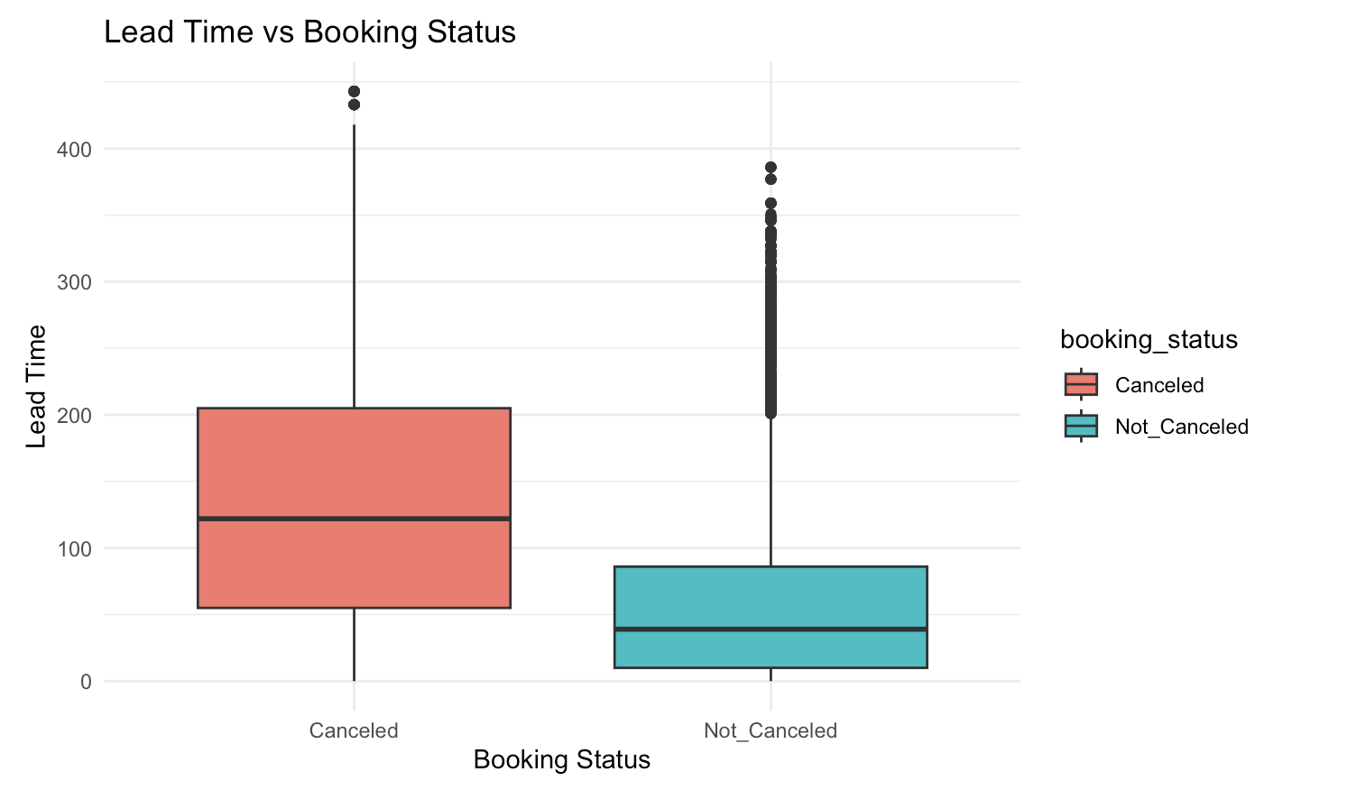
Exploratory Analysis
Notes:
Before diving into predictive modeling, I conducted extensive exploratory data analysis. This phase allowed me to understand the data distribution and identify patterns and anomalies. I examined trends over time, such as seasonal variations in booking cancellations, and analyzed relationships between variables like lead time and cancellation frequency. Visualizations such as histograms, boxplots, and scatter plots helped me observe how factors like average room price and special requests differ between canceled and non-canceled bookings. This exploratory step not only confirmed my expectations but also guided the feature selection process for the models, ensuring I focused on the variables that had the strongest apparent relationship with cancellation outcomes."

Slide 5
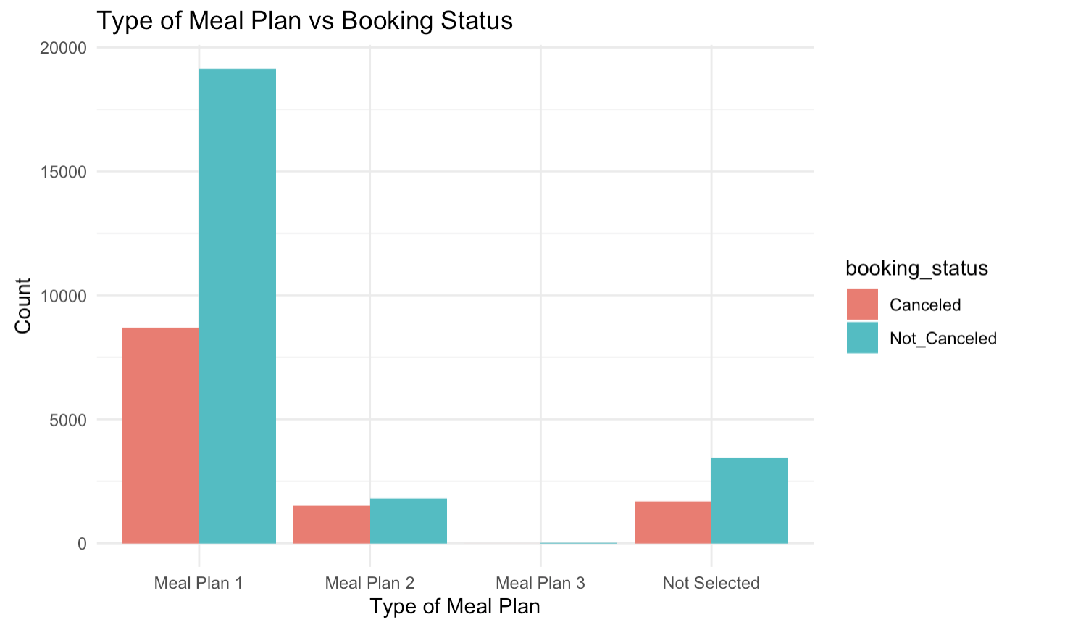
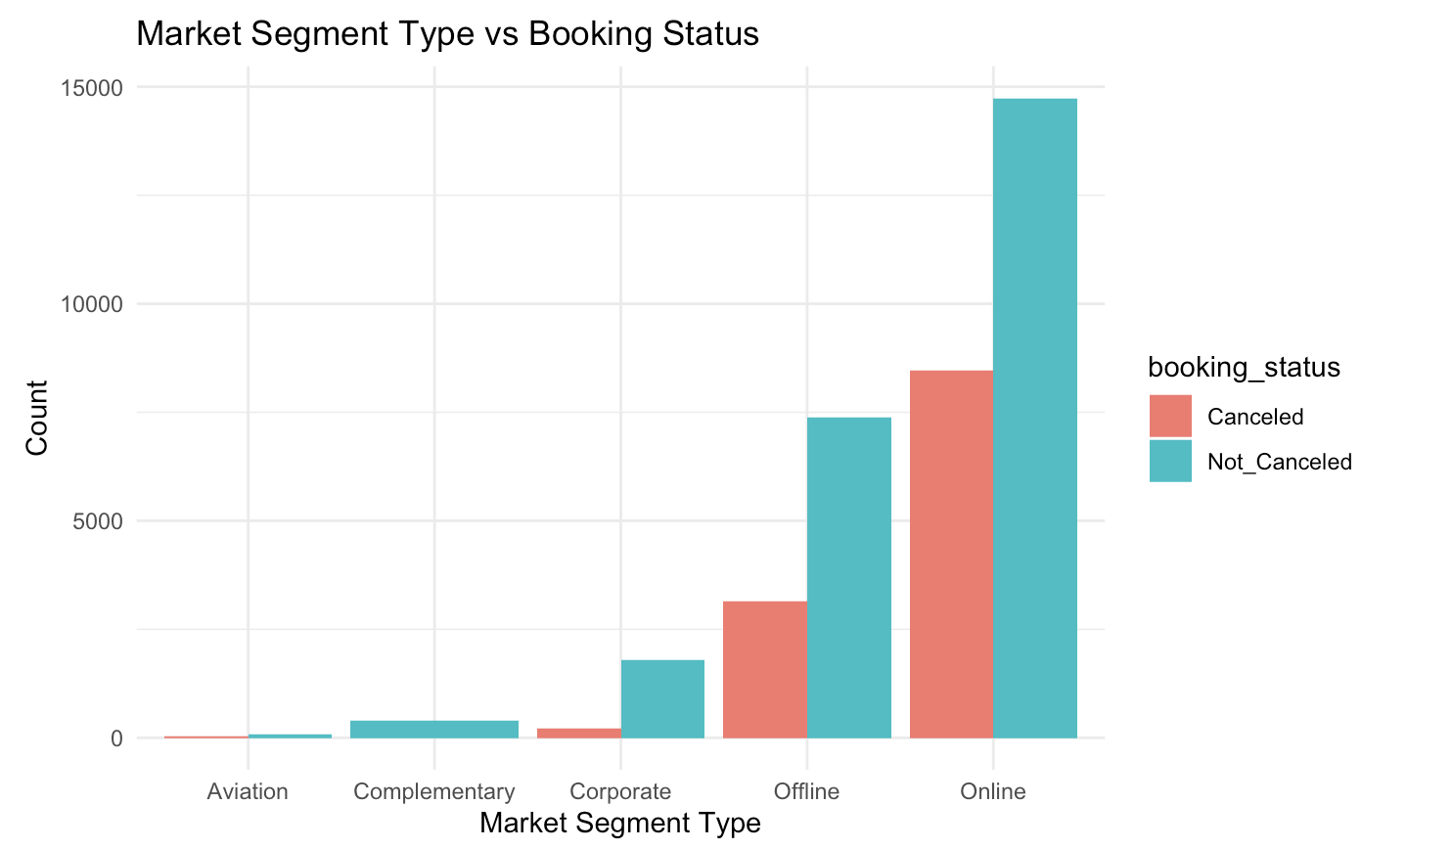
Exploratory Analysis

Slide 6
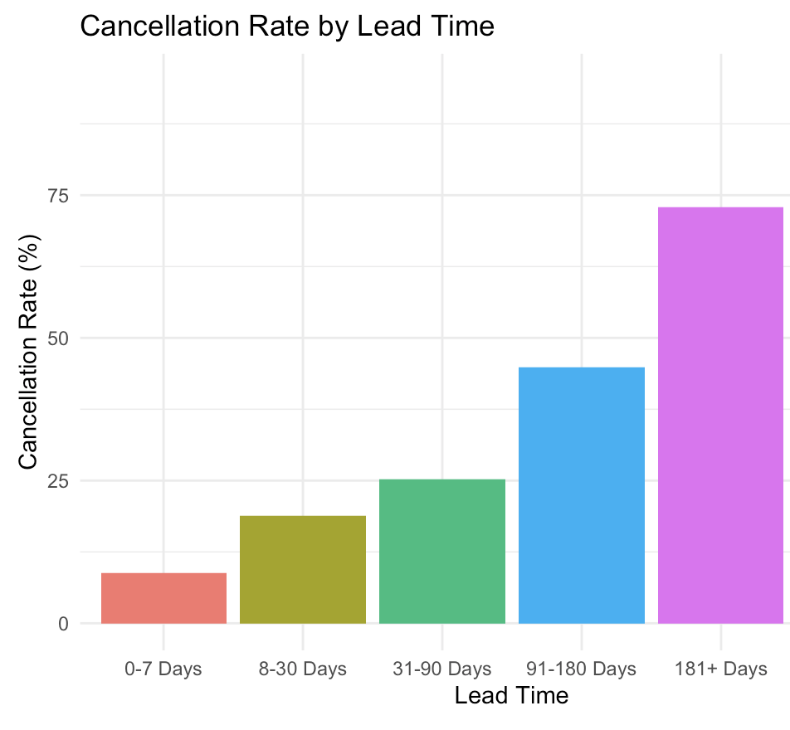
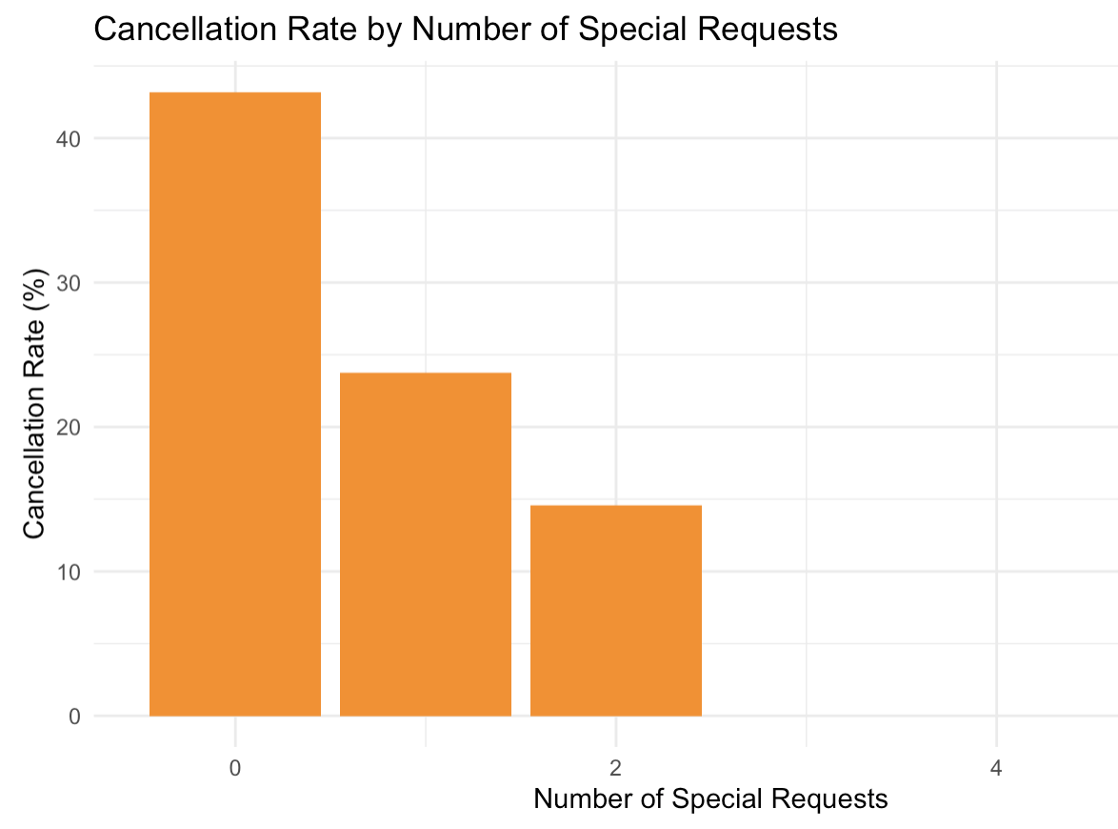
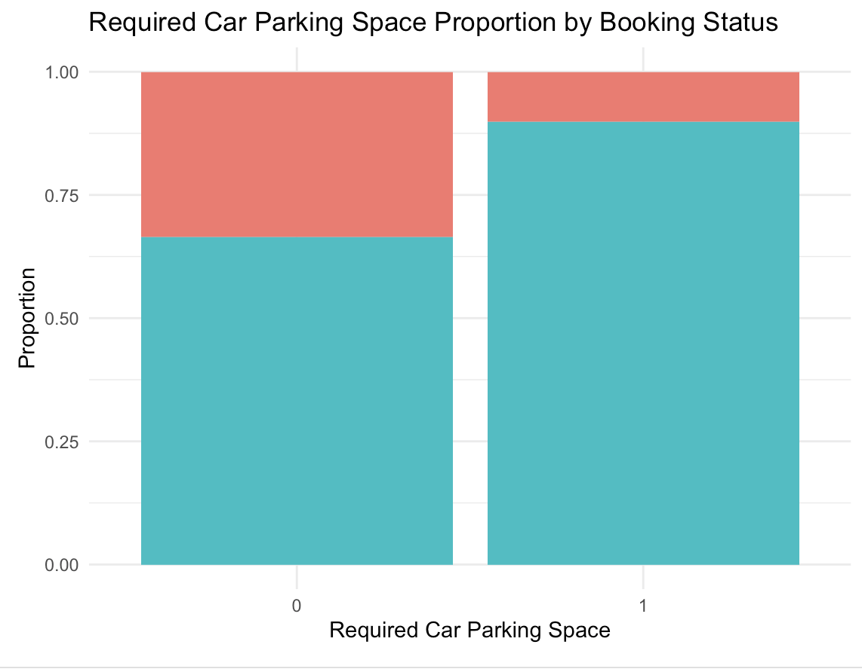

Slide 7
Preparing the data
Target Variable Transformation
Convert booking_status to a binary factor (1 = Canceled, 0 = Not Canceled)
Feature Engineering & Cleaning
Drop non-predictive columns (e.g., Booking_ID, arrival_date) and convert date to month
Convert arrival_month and other categorical predictors (type_of_meal_plan, room_type_reserved, market_segment_type) to factors
Handling Skewed Variables
Apply log transformation to lead_time and avg_price_per_room
Data Scaling
Center and scale the predictors to normalize the data for improved model performance
Data Partitioning
Split data into training (80%) and testing (20%) sets for model evaluation
Notes:
Data preparation was a crucial step in my project. I began by transforming the target variable: booking_status was converted into a binary factor, where ‘1’ indicates a canceled booking and ‘0’ a non-canceled booking. Next, I engineered features by removing non-predictive columns such as Booking_ID and converting date fields into a more meaningful format, like the arrival month. To manage skewed distributions, I applied a log transformation to variables such as lead time and average price per room. I then centered and scaled the predictors to normalize the data, and finally, I partitioned the data into an 80% training set and a 20% testing set for robust model evaluation."

Slide 8
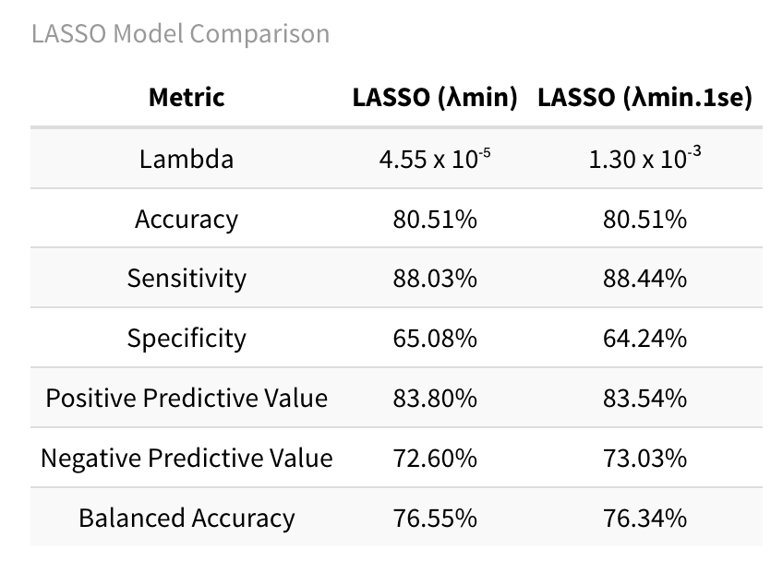
LASSO
Chose lambda using 10 fold CV
Tried lambda.min and lambda.1se
Similar performance
Chose lambda.1se for simpler model
Notes:
"My first modeling approach is based on LASSO regression. LASSO, which stands for Least Absolute Shrinkage and Selection Operator, performs both prediction and variable selection by imposing a penalty that shrinks less important coefficients to zero. I selected the optimal lambda value using 10-fold cross-validation and compared lambda.min with lambda.1se. Although both yielded similar performance, I chose lambda.1se for its simplicity and interpretability. With LASSO, I am able to clearly see which variables have the most influence on cancellation probabilities. This method not only forecasts cancellations but also highlights the strength and direction of the impact of each predictor.

Slide 9
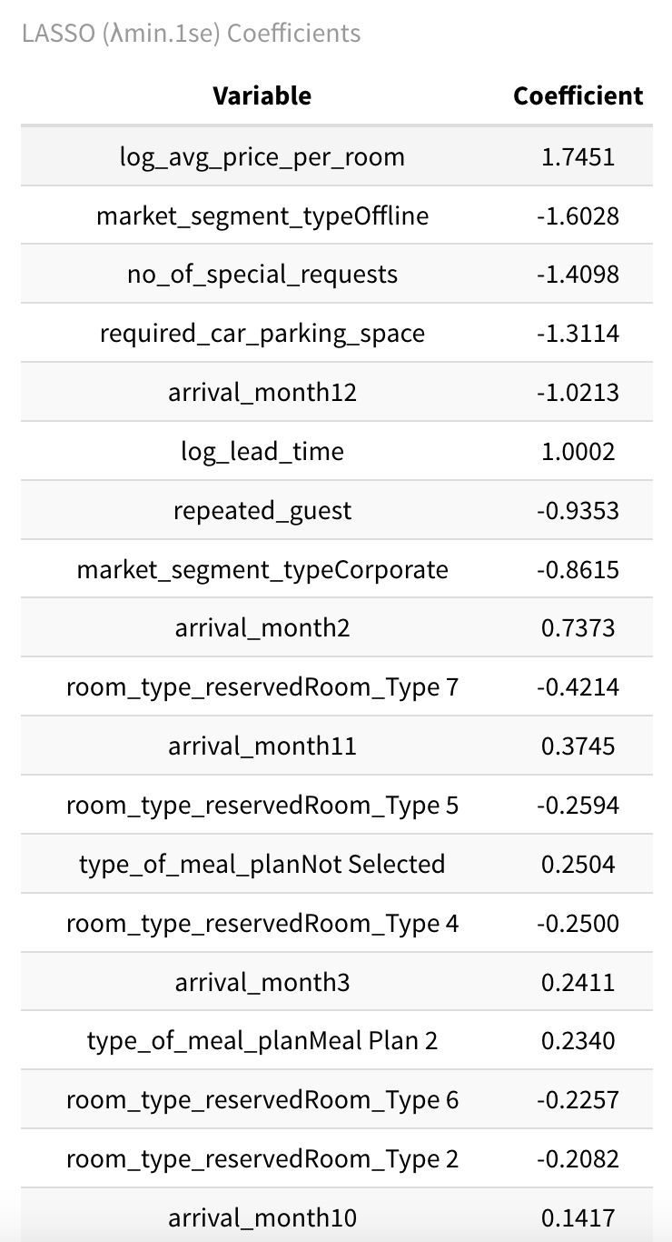
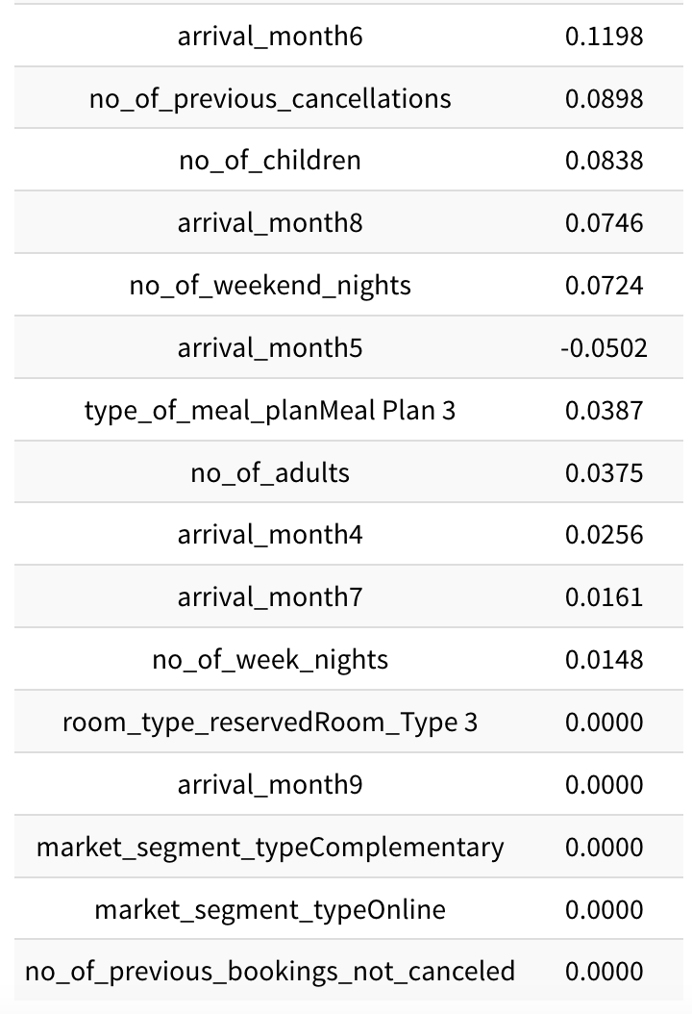
LASSO Coefficients
The LASSO approach applies a penalty that shrinks less relevant predictors to zero, leaving only those with the most predictive power.
In this table, coefficients are sorted by absolute value. Higher magnitude indicates a stronger impact on whether a booking is canceled.
Positive coefficients suggest an increased likelihood of cancellation, while negative coefficients indicate a decreased likelihood
Notes:
Let’s review the top 10 variables from my LASSO model and what they tell me. First, log_lead_time is the strongest predictor, with a positive coefficient indicating that longer lead times are linked to a higher risk of cancellation. Second, no_of_special_requests shows a negative coefficient, meaning that more special requests tend to lower the cancellation likelihood. Third, log_avg_price_per_room has a positive effect, suggesting that higher room prices increase risk. Other important variables include market_segment_type, arrival_month, repeated_guest, no_of_previous_cancellations, no_of_previous_bookings_not_canceled, no_of_weekend_nights, and type_of_meal_plan. Each of these provides insight into guest behavior and booking patterns, helping me understand cancellation dynamics." (~125 words)

Slide 10
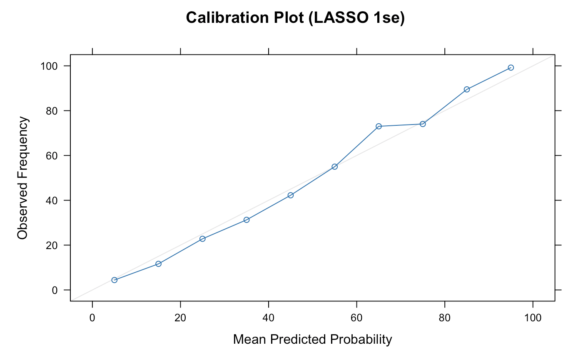
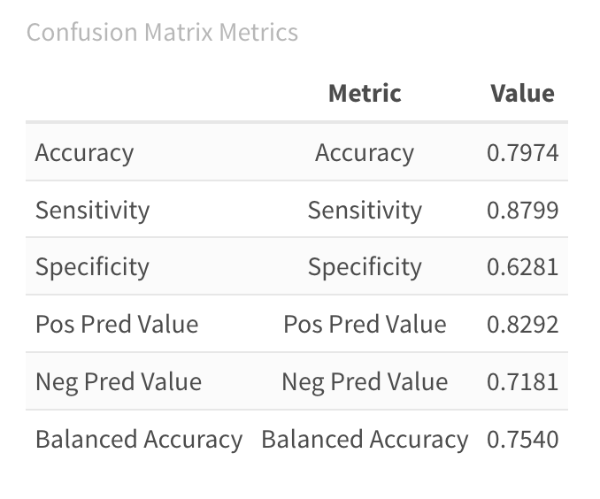
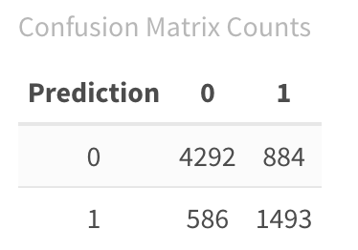
LASSO Model
Notes:
"In evaluating the LASSO model’s performance, I examined both the confusion matrix and calibration plots. The confusion matrix revealed that my model correctly classified a significant number of both canceled and non-canceled bookings, with acceptable levels of false positives and false negatives. The calibration plot showed that the model’s predicted probabilities aligned well with the observed cancellation rates, especially in the lower probability ranges. While some mid-range predictions deviated slightly from the actual outcomes, overall the LASSO model demonstrated strong predictive ability. This model’s transparency in highlighting the impact of each variable further reinforces its utility as both a predictive tool and an interpretive guide for understanding cancellation factors.

Slide 11
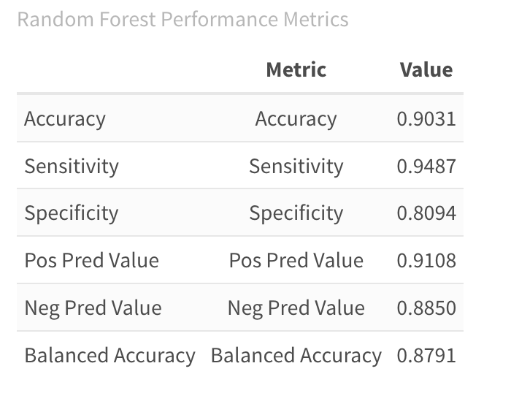
Random Forest
Tuned mtry using F1 score
Best mtry = 4
mtry | F1-score | Accuracy
2 | 0.8000 | 0.8815
3 | 0.8343 | 0.8973
4 | 0.8457 | 0.9031
5 | 0.8451 | 0.9023
6 | 0.8440 | 0.9016
7 | 0.8453 | 0.9023
8 | 0.8457 | 0.9024
9 | 0.8427 | 0.9005
Notes:
My second modeling approach employs the Random Forest algorithm. Random Forest is an ensemble method that builds multiple decision trees and aggregates their results to improve predictive accuracy. It is particularly adept at handling complex, nonlinear relationships between predictors and the outcome. In my study, I tuned the hyperparameter mtry using the F1 score and determined that the best value was 4. The Random Forest model demonstrated higher overall accuracy compared to LASSO, with strong sensitivity and specificity. Although it does not directly indicate the direction of each variable’s influence, its robustness in handling interactions among predictors makes it a powerful complement to the LASSO approach."

Slide 12
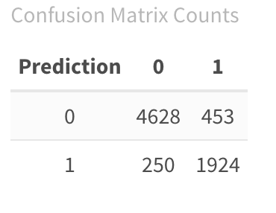
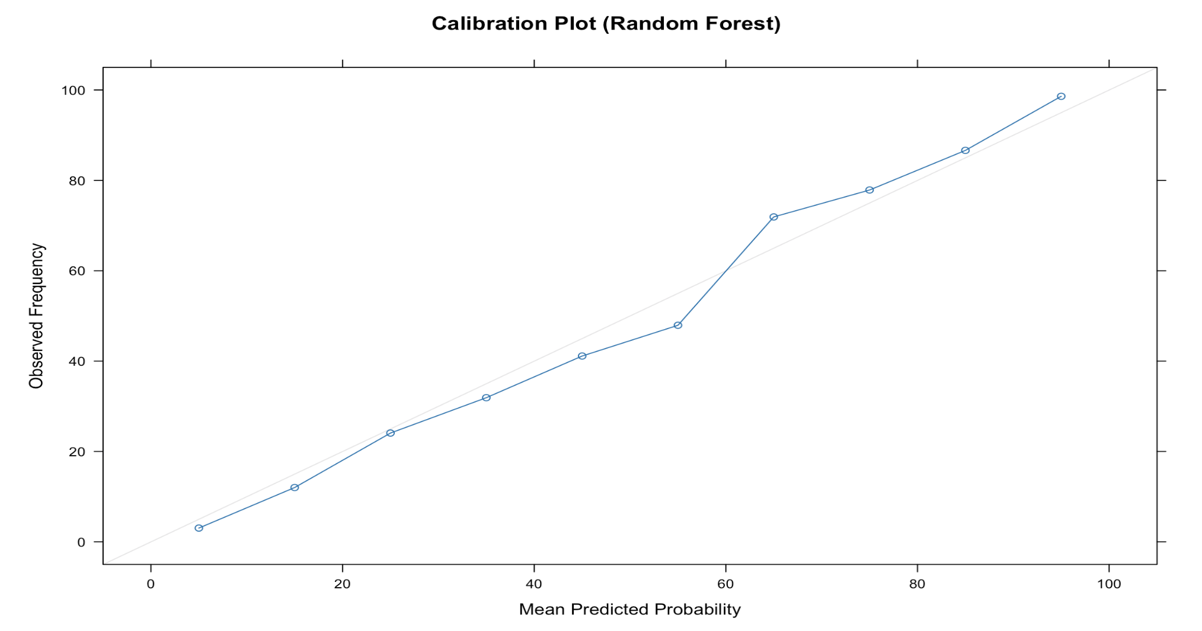
Random Forest
Random Forest Results
Calibration Plot
Overpredict from 55-65
Under predict from 65-80
Notes:
Slide 10: Random Forest Model Performance "Let’s now examine the performance of my Random Forest model. The confusion matrix for this model shows an impressive number of true negatives and true positives, which indicates that the model is very effective at distinguishing between canceled and non-canceled bookings. False negatives and false positives are relatively low, balancing the risk of missing a cancellation against the cost of unnecessary interventions. Additionally, the calibration plot reveals that the predicted probabilities are well-aligned with the actual outcomes, though there are slight over- and under-predictions in specific ranges. Overall, the Random Forest model’s high accuracy and strong discriminative power reinforce its effectiveness as a predictive tool."

Slide 13
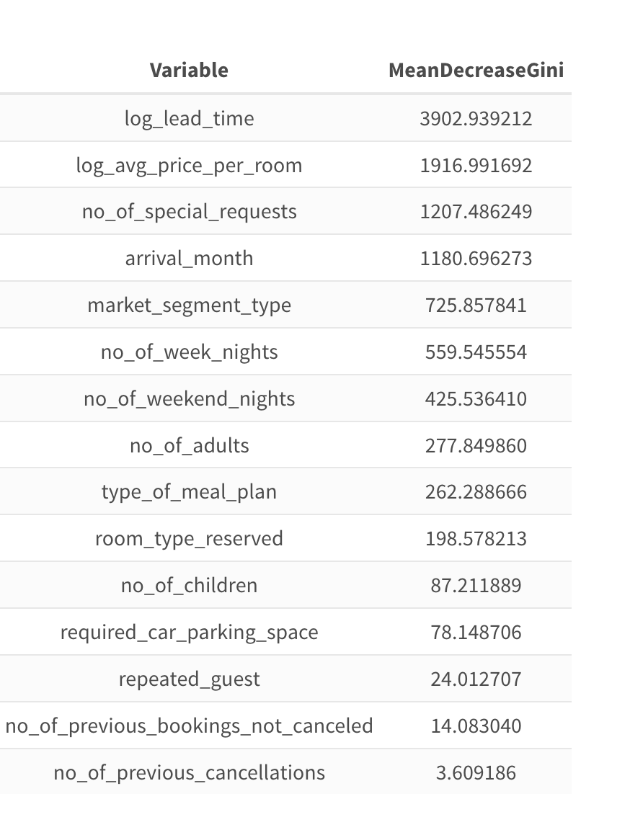
RF Features

Slide 14
LASSO Coefficients
The LASSO approach applies a penalty that shrinks less relevant predictors to zero, leaving only those with the most predictive power.
In this table, coefficients are sorted by absolute value—higher magnitude indicates a stronger impact on whether a booking is canceled.
Positive coefficients suggest an increased likelihood of cancellation, while negative coefficients indicate a decreased likelihood

Slide 15
Feature Importance Comparison
Interpretation Approach
Random Forest uses Mean Decrease in Gini to measure how each feature reduces impurity across all splits. Larger values mean the feature is more influential in splitting the data correctly.
LASSO relies on coefficient magnitude to gauge importance. Larger absolute coefficients indicate stronger influence on the outcome, and the sign (+/−) shows whether the feature increases or decreases the likelihood of cancellation.
Top Features
Random Forest highlights:
Log Lead Time as the most critical predictor, followed by Log Avg. Price per Room and No. of Special Requests.
Arrival month and market segment also rank high but appear slightly less influential than lead time or price.
LASSO emphasizes:
Market Segment Type (e.g., Offline) with a large (negative) coefficient, meaning offline bookings reduce cancellation likelihood.
Log Avg. Price per Room and No. of Special Requests also show high coefficients, suggesting strong effects on cancellation probability.
Overlap & Differences
Both methods underscore lead time, average price, and special requests as critical.
Random Forest ranks features purely by predictive splitting power, whereas LASSO provides directionality—positive or negative impact on cancellation.
Certain categorical variables (e.g., market segment, meal plan type) may show up strongly in LASSO due to their coefficients but are spread out in Random Forest importance.
Key Takeaway
Log Lead Time and Avg. Price are universally important predictors.
LASSO more explicitly reveals direction (increase vs. decrease cancellation likelihood).
Random Forest highlights overall predictive power and interactions, making it robust to nonlinear relationships.
Notes:
This slide presents a unified view of feature importance based on my LASSO model’s results, focusing on the top 10 variables. First, log_lead_time remains the most influential predictor, where a longer lead time is associated with a higher chance of cancellation. Second, no_of_special_requests has a negative relationship, indicating that more guest requests correlate with fewer cancellations. Third, log_avg_price_per_room shows that higher prices increase cancellation risk. Additional key variables include market_segment_type, which differentiates booking channels; arrival_month, reflecting seasonal trends; repeated_guest, where repeat customers are less likely to cancel; no_of_previous_cancellations and no_of_previous_bookings_not_canceled, which capture historical behavior; no_of_weekend_nights, and type_of_meal_plan. Together, these variables provide a comprehensive understanding of the factors influencing cancellations."

Slide 16
Feature Importance Analysis
log_lead_time
What it is: Log-transformed days between booking and arrival.
Interpretation: A positive coefficient indicates that longer lead times increase the likelihood of cancellation.
no_of_special_requests
What it is: Count of additional requests made by the guest (e.g., extra pillows, room preferences).
Interpretation: A negative coefficient suggests that more special requests are linked to a lower probability of cancellation.
log_avg_price_per_room
What it is: Log-transformed average price per room.
Interpretation: A positive effect shows that higher room prices are associated with a higher cancellation risk.
market_segment_type
What it is: Categorical indicator of the booking channel (e.g., online, offline).
Interpretation: Certain segments (for instance, offline bookings) tend to lower cancellation likelihood.
arrival_month
What it is: The month in which the guest is scheduled to arrive.
Interpretation: Variations here reveal seasonal trends; some months have higher cancellation probabilities than others.

Slide 17
Feature Importance
repeated_guest
What it is: Binary indicator showing if the guest is a repeat customer.
Interpretation: A negative coefficient implies that repeat guests are less likely to cancel.
no_of_previous_cancellations
What it is: Number of times the guest has canceled in the past.
Interpretation: A positive coefficient indicates that a history of cancellations increases the risk of future cancellations.
no_of_previous_bookings_not_canceled
What it is: Count of the guest’s previous bookings that were successfully completed.
Interpretation: A negative effect suggests that a record of completed bookings reduces the probability of cancellation.
no_of_weekend_nights
What it is: The number of weekend nights included in the booking.
Interpretation: The coefficient shows that the number of weekends nights slightly increases the risk of cancellation.
type_of_meal_plan
What it is: Categorical variable indicating the chosen meal plan (e.g., breakfast only, full board).
Interpretation: Differences in meal plan selections may reflect varying levels of commitment or guest expectations, influencing cancellation risk.

Slide 18
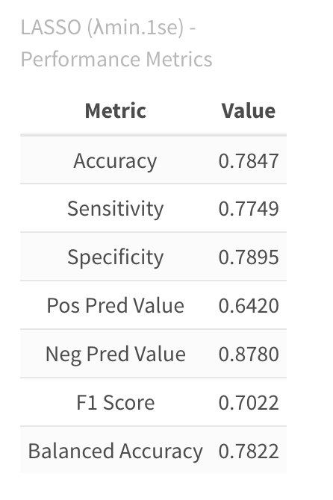
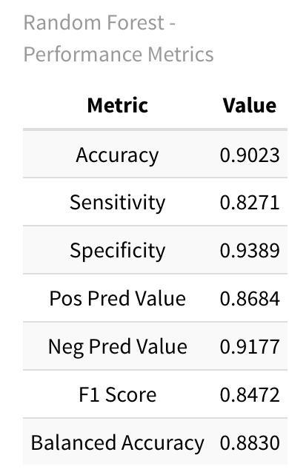
Threshold Tuning F1
LASSO (λmin.1se) - Best cutoff threshold : 0.38 LASSO
Random Forest - Best cutoff threshold : 0.42

Slide 19
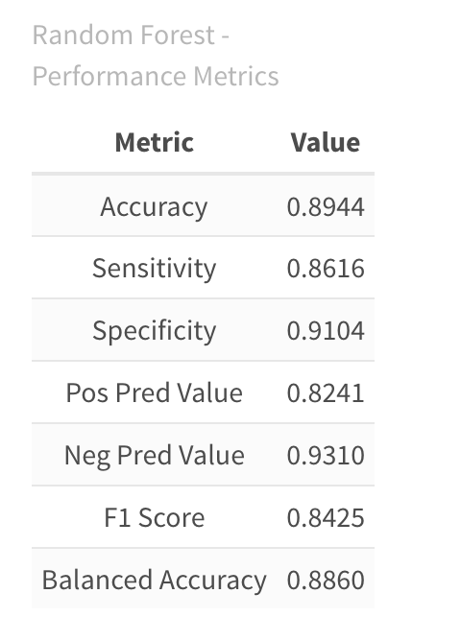
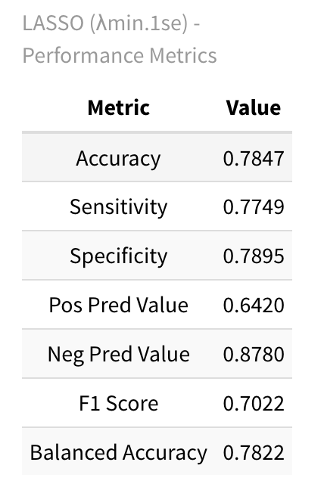
Threshold Tuning ROCR
LASSO (λmin.1se) - Best cutoff threshold: 0.37
Random Forest - Best cutoff threshold : 0.38

Slide 20
Threshold Tuning
False Negatives:
Occur when a booking that will be canceled is predicted as non-canceled.
Risk: Unanticipated cancellations leading to unoccupied rooms and lost revenue.
False Positives:
Occur when a non-canceled booking is predicted as canceled.
Risk: Unnecessary interventions or follow-ups that may irritate customers or waste resources.
Business Scenarios:
High Cost of Missed Cancellations (False Negatives):
In environments where vacant rooms significantly impact revenue, it's better to err on the side of caution.
Action: Lower the threshold to increase sensitivity, even if it means accepting more false positives.
High Cost of Unnecessary Interventions (False Positives):
When over-alerting can harm customer satisfaction or incur excessive follow-up costs, false positives must be minimized.
Action: Raise the threshold to boost specificity, even if some cancellations are missed.
Threshold Tuning Strategy:
Balance sensitivity and specificity using metrics like the F1 score or Youden’s Index.
Adjust thresholds based on a cost-benefit analysis reflecting the specific operational priorities and customer impact.

Slide 21
Final Model Comparisons
Random Forest Outperforms on Accuracy
Accuracy of ~0.8937 vs. ~0.7938 for LASSO
Stronger sensitivity and specificity, leading to higher F1 and balanced accuracy
LASSO Excels in Interpretability
Directly shows which features increase or decrease cancellation risk
Easier to communicate insights and justify decisions to stakeholders
Choosing the Right Model
If top predictive power is paramount: Random Forest is the clear winner
If clarity and simplicity matter: LASSO offers a more transparent view of feature impacts
Practical Implications
Business context determines which trade-off is most valuable
Threshold tuning can further tailor each model’s sensitivity or specificity to operational needs

Slide 22
Takeaways
Can we predict how likely a booking is to be canceled?
Yes. Our LASSO and Random Forest models demonstrate strong predictive power, accurately identifying which bookings are most at risk of cancellation. The RF model is stronger at making predictions while the LASSO provides more insight to key factors
What factors affect how likely a booking is to be canceled?
Our analysis highlights several key drivers of cancellation risk:
Lead Time (log-transformed): Longer lead times correlate with higher cancellation probabilities.
Average Room Price: Bookings with higher room prices are more prone to cancellation.
Special Requests: Fewer special requests often indicate a higher risk of cancellation.
Market Segment & Arrival Month: Certain segments (e.g., online vs. offline) and months exhibit distinct cancellation patterns.
Real-World Implications
Proactive Strategies: Armed with these insights, hotels can adjust pricing, offer incentives, or send targeted reminders to reduce cancellations.
Resource Allocation: Predictive accuracy helps hotels plan staffing and room availability, minimizing revenue loss from vacant rooms.
Threshold Tuning: By balancing false positives and false negatives, businesses can tailor the model’s sensitivity to their unique operational costs and customer service goals.

