Slide 1
“Local TV” Description
Koni

Slide 2
Revision History
Version | Date | Description | Author
1.0 | 2013.12.28 | Initial Version of this Document Initial Version of the App “Local TV” | Koni

Slide 3
Contents
UI Structure
Usage Scenario
Menu & function description
Key policy
How to change languages

Slide 4
UI Structure
1st depth
2nd depth
Station list and
empty TV screen
Watch selected station
in TV screen
Description of station
Volume & Keys

Slide 5
Usage Scenario
Open the app
Choose a TV channel by using “Up” or “Down” on remote
Press “Play” or “Enter” key to play a TV station
Press “Enter” for full screen (hide station list)
Press “Enter” again to leave full screen (show station list)
Press “Stop” key to stop a playing station

Slide 6
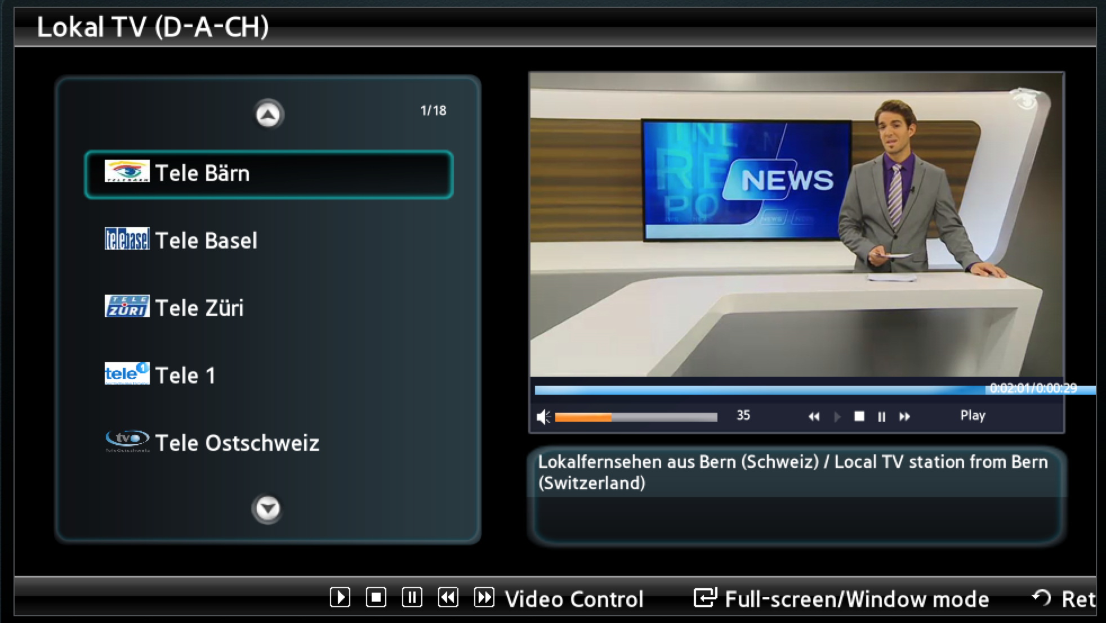
Menu & function description
1.) Station list 2.) TV Screen 3.) Volume & Keys
4.) Description 5.) Help
1
2
3
4
5

Slide 7
Key Policy
Button | Action | Remarks
ENTER | When TV stations is not playing ENTER starts the station. When TV station is playing ENTER change window screen to full screen or full screen to window screen.
Ch. Up/Down | Choose channel
UP/DOWN | Choose channel
PLAY | Plays TV station
STOP | Stops TV station
RETURN | Move to previous page
EXIT | Close the app and show broadcasting channel
RETURN/EXIT | Exit

Slide 8
How to change languages
Items | Contents
How to change languages | First version of LocalTV has only one language

