Slide 1
“Local TV” Description
Koni

Slide 2
Revision History
Version | Date | Description | Author
1.0 | 2013.12.28 | Initial Version of this Document Initial Version of the App “Local TV” | Koni
1.0.1 | 2014.01.19 | Functionality of ENTER key | Koni

Slide 3
Contents
UI Structure
Usage Scenario
Menu & function description
Key policy
How to change languages

Slide 4
UI Structure
1st depth
2nd depth
Station list and
empty TV screen
Watch selected station
in TV screen
Description of station
Volume & Keys

Slide 5
Usage Scenario
Open the app
Choose a TV channel by using “Up” or “Down” on remote
Press “Play” or “Enter” key to play a TV station
Press “Enter” for full screen (hide station list)
Press “Enter” again to leave full screen (show station list)
Press “Stop” key to stop a playing station

Slide 6
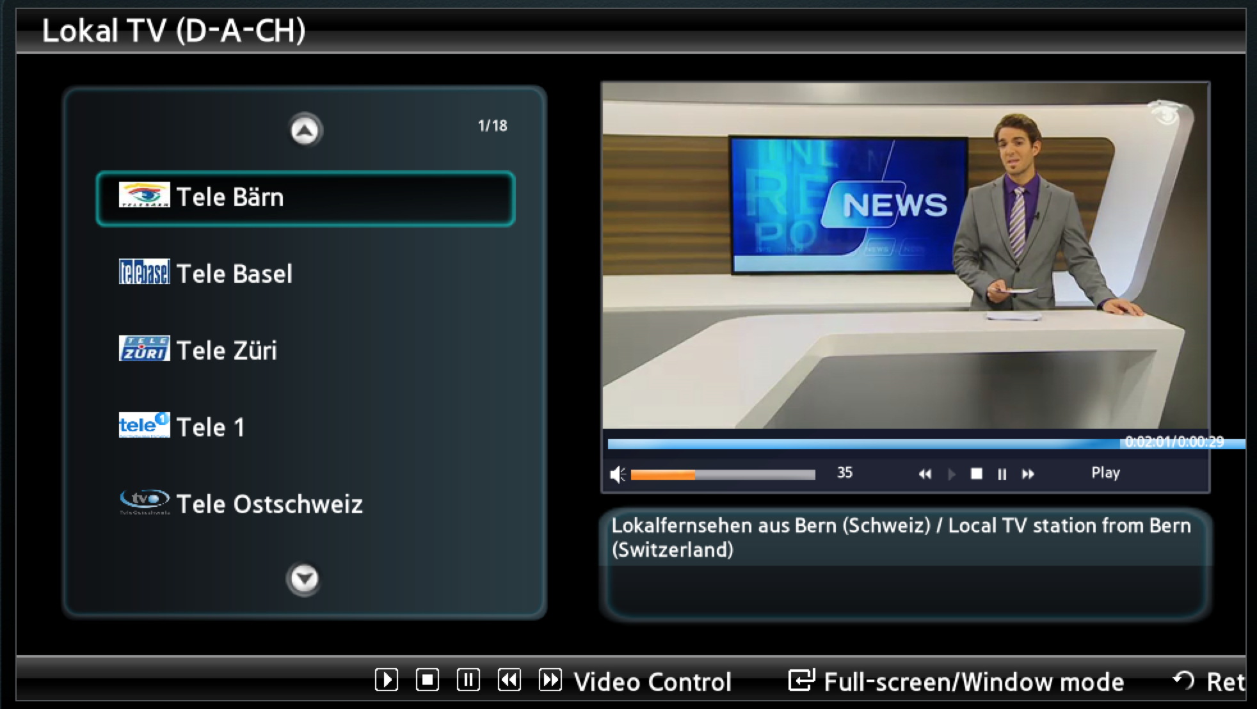
Menu & function description
1.) Station list 2.) TV Screen 3.) Volume & Keys
4.) Description 5.) Help
1
2
3
4
5

Slide 7
Key Policy
Button | Action | Remarks
ENTER | When TV Station is not playing ENTER starts playing the station. When TV station is playing ENTER changes window screen to full screen or full screen to window screen.
Ch. Up/Down | Choose channel
UP/DOWN | Choose channel
PLAY | Plays TV station
STOP | Stops TV station
RETURN | Move to previous page
EXIT | Close the app and show broadcasting channel
RETURN/EXIT | Exit

Slide 8
How to change languages
Items | Contents
How to change languages | First version of LocalTV is in one language only

