Slide 1
US Residential Mortgage PD Scorecard
Vojtěch Grebeníček, Jan Koňařík

Slide 2
Data Engineering & Methodology
Target definition
  Rolling 12-Month Window (Default = 1)
  Exclusion of partial years
Sampling strategy
  Stratified Random Split (70% Train / 30% Test)
  Ensures identical risk distribution for ranking validation
Feature Engineering
  Weight of Evidence (WoE)
  Handled missing values/outliers automatically

Slide 3
Variable Selection & Compliance
Selection Method
  Stepwise Logistic Regression (AIC)
Filters Applied
  Information Value (IV > 0.02, removed weak predictors)
  Correlation (< 0.5, removed redundant features)
  Multicollinearity (VIF max 2.05, passes < 5)
Key risk predictors
  FICO Score, Loan-to-Value (LTV), Interest Rate

Slide 4
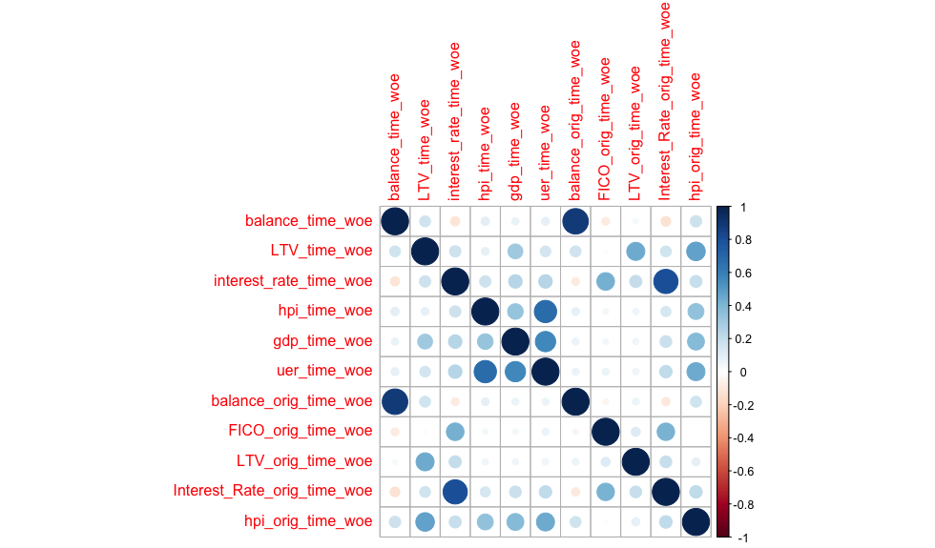
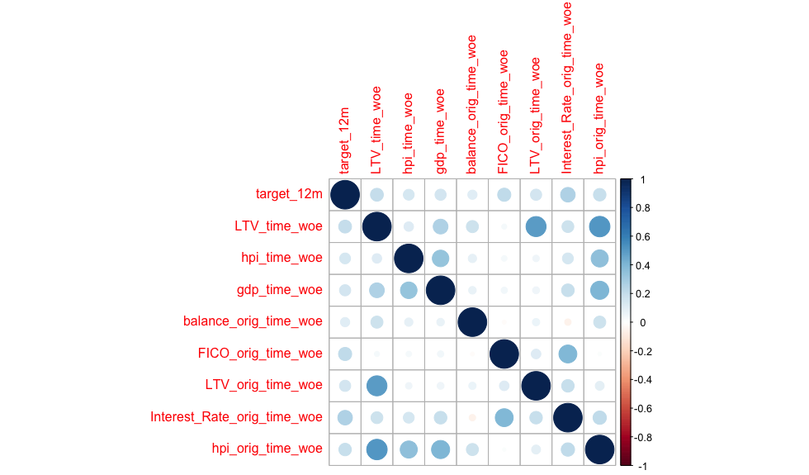
Correlation Matrix Before Cleaning

Slide 5
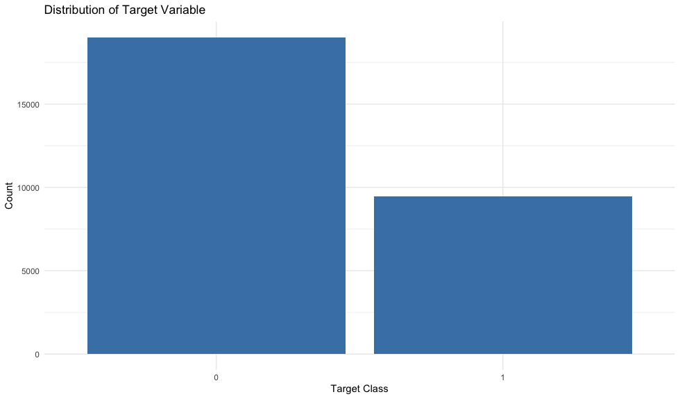
Target Value Distribution

Slide 6
Predictive Power (Performance)
GINI Coefficient
  Train GINI 44.42%
  Test GINI 44.51%
Performance Gap
  -0.09 points
Good Generalization, No Overfitting

Slide 7
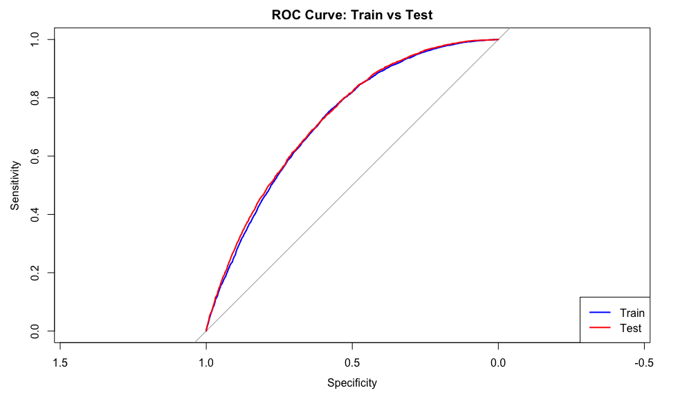
Result ROC Curve

Slide 8
Deployment Stability (PSI)
Validation Data
  Private Sample (Out-of-Sample)
Population Stability Index (PSI)
  0.0527 (< 0.10)
  Stable/Good for Deployment

Slide 9
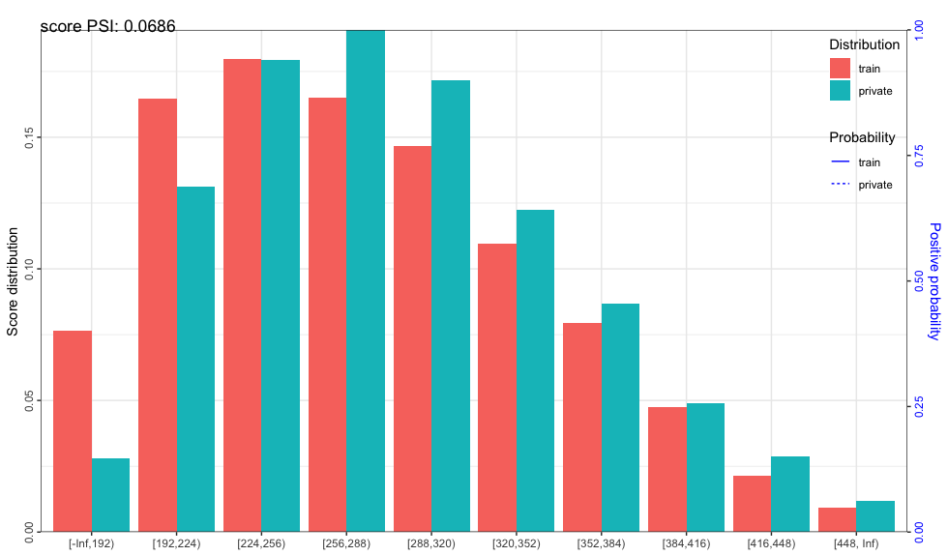
PSI Deployment chart

Slide 10
Challenger Model (LASSO)
LASSO Regression
  Compare Machine Learning and Standard Regression (Stepwise)
Results
  Stepwise 44.51% GINI
  LASSO 44.51% GINI
Same Model Selection/Performance

Slide 11
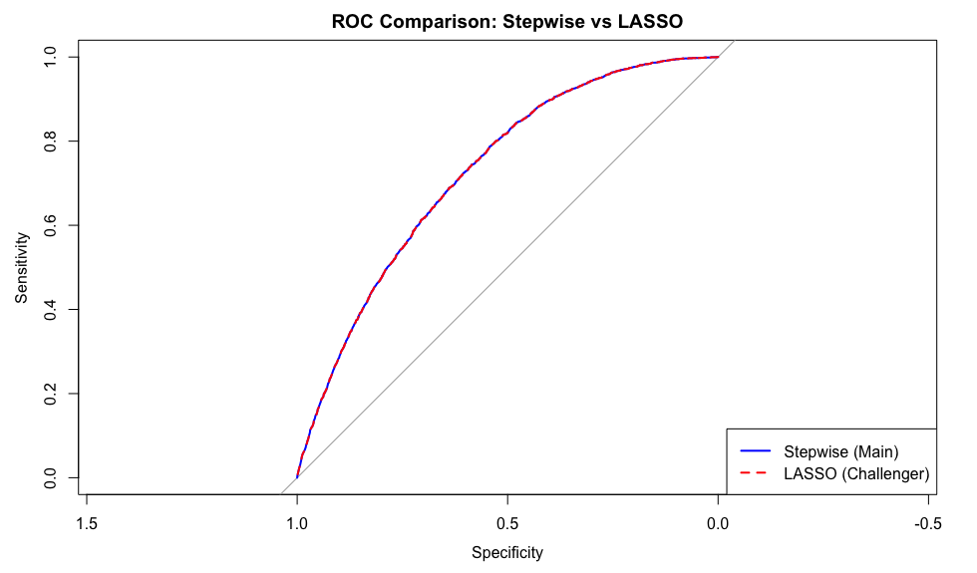
Stepwise vs LASSO Comparison

Slide 12
Summary
Target 12-Month Window (Default = 1)
Stratified Random Split (70/30) with WoE Binning
Stepwise Logistic Regression (AIC Selection)
Checks for Correlation and VIF
GINI 44.5% (Strong predictive power)
No Gap between Train/Test (Robust)
PSI 0.05 on Blind Data (Stability)
ML LASSO Same Performance

Slide 13
Thank You

