Slide 1

IBM DA capstone project
By Kon Mez

Slide 2

OUTLINE
Introduction
Methodology
Results
Visualization – Charts
Dashboard
Discussion
Findings & Implications
Conclusion
Appendix

Slide 3

EXECUTIVE SUMMARY
• Current vs. Future Technology Preferences
• Programming Language Evolution
• Database Technology Preferences
• Platform and Framework Adoption
• Demographics Analysis

Slide 4
EXECUTIVE SUMMARY Key Insights from Developer Technology Preferences and Demographics
• Current vs. Future Technology Preferences reveal significant shifts in developer priorities, with emerging technologies gaining momentum while traditional tools maintain strong adoption rates
• Programming Language Evolution shows clear trends toward modern, versatile languages with strong community support and industry demand
• Database Technology Preferences indicate a move toward cloud-native and NoSQL solutions, reflecting changing application architectures
• Platform and Framework Adoption demonstrates the continued dominance of web technologies while highlighting growing interest in cross-platform development solutions
• Demographics Analysis reveals a globally diverse developer community with varying educational backgrounds, providing insights into the accessibility and reach of software development careers

Slide 5

INTRODUCTION Understanding the Developer Landscape Through Data
• Survey Significance
Strategic Importance
• Current Market Context
• Research Objectives

Slide 6
INTRODUCTION Understanding the Developer Landscape Through Data
• Survey Significance: Stack Overflow's annual developer survey represents one of the largest and most comprehensive datasets on global developer preferences, technologies, and demographics
• Strategic Importance: Technology adoption trends directly impact hiring decisions, project planning, and strategic technology investments across organizations
• Current Market Context: The software development landscape continues to evolve rapidly, with new frameworks, languages, and platforms emerging while established technologies adapt and maintain relevance
• Research Objectives:
Identify current technology usage patterns among developers
Understand future technology preferences and emerging trends
Analyze demographic distribution and educational backgrounds
Provide actionable insights for technology strategy and workforce planning

Slide 7

METHODOLOGY Data Analysis Approach and Visualization Strategy
• Data Source
• Analysis Framework
• Visualization Strategy
Bar and Column Charts
Hierarchy Bubble Charts
• Dashboard Design
Current Technology Usage
Future Technology Trends
Demographics Analysis

Slide 8
METHODOLOGY Data Analysis Approach and Visualization Strategy
• Data Source: Stack Overflow Annual Developer Survey dataset (survey_data_updated.csv)
• Analysis Framework: Multi-dimensional analysis covering current usage, future preferences, and demographic characteristics
• Visualization Strategy: Strategic use of different chart types to optimize data comprehension:
Bar and Column Charts: For ranking and comparison of technology adoption
Word Clouds: For highlighting prominence and relative importance
Hierarchy Bubble Charts: For showing relationships and proportional representation
• Dashboard Design: Three-tier analytical approach:
Current Technology Usage: Understanding present-day adoption patterns
Future Technology Trends: Identifying emerging preferences and growth areas
Demographics Analysis: Contextualizing findings within developer population characteristics

Slide 9
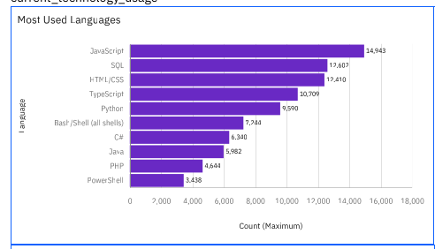
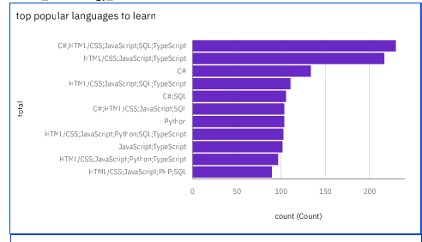
PROGRAMMING LANGUAGE TRENDS
Current Year
Next Year

Slide 10
PROGRAMMING LANGUAGE TRENDS - FINDINGS & IMPLICATIONS
Finding 1: Established Languages Maintain Strong Position
Traditional programming languages like JavaScript, Python, and Java continue to dominate current usage statistics
These languages benefit from extensive ecosystems, mature tooling, and widespread industry adoption
Finding 2: Emerging Languages Show Growing Interest
Future preference data indicates rising interest in modern languages designed for specific use cases
Languages with strong performance characteristics and developer experience improvements gain traction
Finding 3: Gap Analysis Reveals Transition Opportunities
Comparison between current usage and future preferences highlights technologies developers want to adopt
This gap represents both learning opportunities for developers and strategic considerations for organizations
Implication 1: Skill Development Priorities
Developers should maintain proficiency in established languages while building expertise in emerging technologies
Organizations should provide training paths that bridge current capabilities with future technology needs
Implication 2: Technology Strategy Planning
Companies should consider long-term adoption trends when making technology stack decisions
Early adoption of growing languages can provide competitive advantages in talent acquisition and system performance
Implication 3: Market Positioning
Understanding language trends helps predict future talent availability and demand
Organizations can better position themselves by aligning technology choices with developer preferences

Slide 11
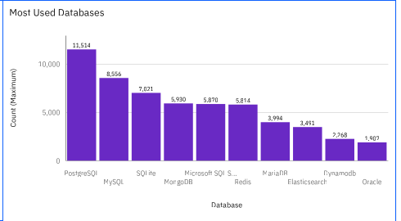
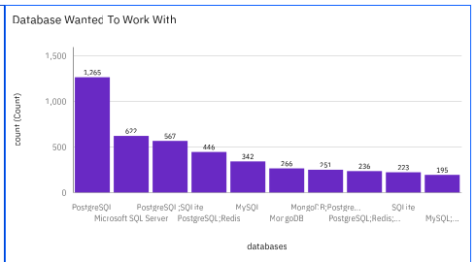
DATABASE TRENDS
Current Year
Next Year

Slide 12
DATABASE TRENDS - FINDINGS & IMPLICATIONS
Findings
Current Database Landscape
Relational databases maintain strong presence in current usage patterns
Cloud-native and NoSQL solutions show increasing adoption rates
Traditional databases demonstrate resilience through continuous innovation
Future Database Preferences
Growing interest in specialized databases for specific use cases
Increased preference for managed database services and cloud solutions
Performance and scalability considerations drive technology choices
Implications
Strategic Database Planning
Organizations should evaluate current database strategies against emerging trends
Investment in cloud-native and specialized database solutions may provide competitive advantages
Data architecture decisions should consider both current needs and future scalability requirements

Slide 13

DASHBOARD
Here come Dashboards

Slide 14
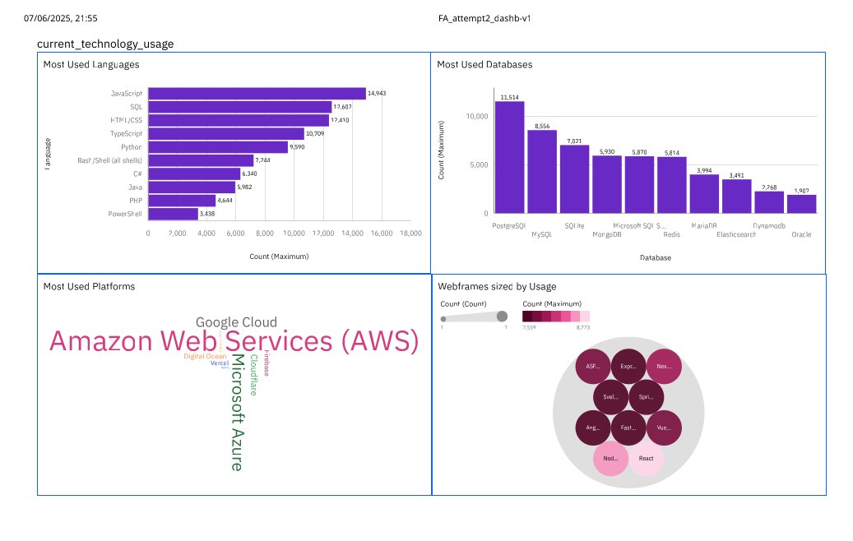
DASHBOARD TAB 1
Screenshot of dashboard tab 1 goes here

Slide 15
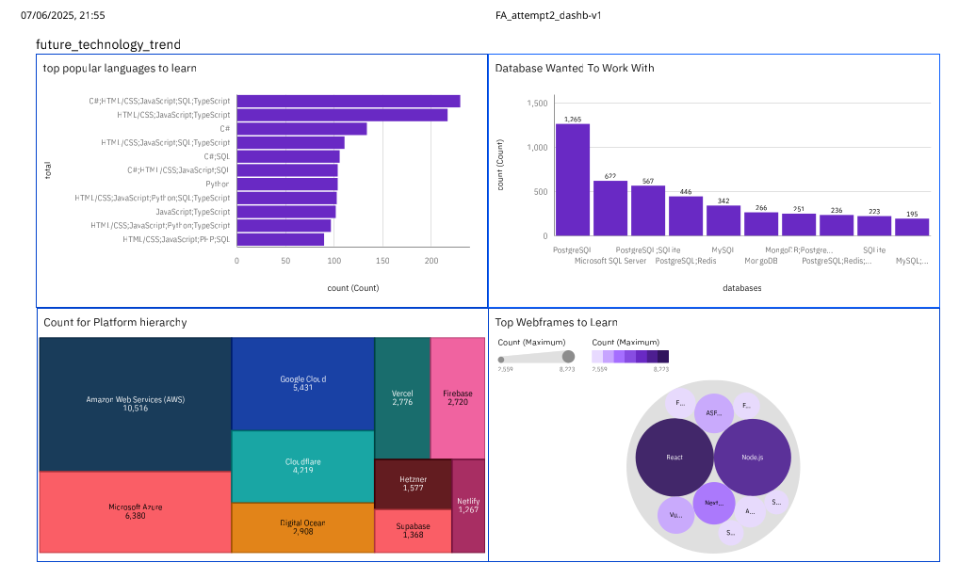
DASHBOARD TAB 2
Screenshot of dashboard tab 2 goes here

Slide 16
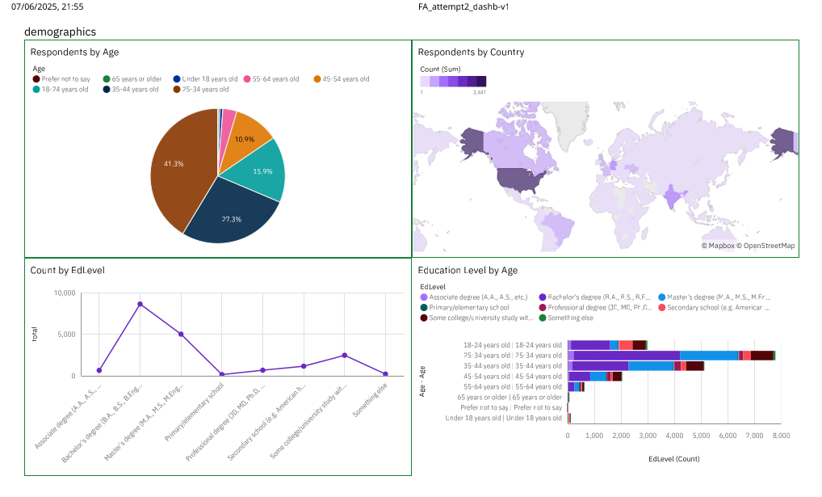
DASHBOARD TAB 3
Screenshot of dashboard tab 3 goes here

Slide 17
DISCUSSION
Synthesizing Technology Trends with Developer Demographics
Technology Adoption Patterns
Community Insights
Platform and Framework Evolution

Slide 18
DISCUSSION
Synthesizing Technology Trends with Developer Demographics
The intersection of technology preferences and demographic data reveals important insights about the global developer community. The geographic distribution of survey respondents provides context for understanding regional technology adoption patterns, while education level analysis helps explain the accessibility and learning pathways into software development.
Technology Adoption Patterns
Current usage data reflects practical, production-ready technology choices
Future preferences indicate aspirational technologies and emerging trends
The gap between current and desired technologies represents market opportunities
Community Insights
Age distribution suggests a healthy mix of experienced and emerging developers
Educational background diversity indicates multiple pathways into technology careers
Geographic distribution reflects the global nature of software development
Platform and Framework Evolution
Web technologies continue to dominate platform preferences
Cross-platform development frameworks gain popularity for efficiency and reach
Cloud platforms show strong adoption aligned with industry digital transformation trends

Slide 19
OVERALL FINDINGS & IMPLICATIONS
Strategic Technology Insights
Key Patterns Identified:
Continuity with Innovation: Established technologies evolve and maintain relevance while new solutions address emerging needs
Performance and Developer Experience: Technology choices increasingly balance performance requirements with developer productivity
Cloud-Native Adoption: Strong trend toward cloud-based solutions across all technology categories
Global Developer Community: Diverse, worldwide participation in technology trends with regional variations
Business Implications:
Talent Strategy: Understanding technology preferences helps predict talent availability and inform hiring strategies
Technology Investment: Balancing investment in current productive technologies with emerging future solutions
Training and Development: Structured approach to skill development addressing both current and future technology needs
Market Positioning: Aligning technology choices with industry trends and developer preferences for competitive advantage
Future Considerations:
Monitor emerging technologies that show strong preference growth
Consider regional variations in technology adoption for global operations
Evaluate the sustainability and community support of technology choices
Plan migration strategies for evolving from current to preferred technologies

Slide 20

CONCLUSION
Transforming Data into Strategic Action
The Stack Overflow survey data analysis reveals a dynamic technology landscape where established solutions maintain strong positions while innovative technologies gain momentum. The developer community demonstrates both practical decision-making in current technology use and forward-thinking preferences for future adoption.
Key Takeaways:
Technology decisions should balance current production needs with future strategic positioning
Developer preferences provide valuable indicators for technology investment and career development planning
The global and diverse nature of the developer community creates opportunities for inclusive technology adoption
Understanding the gap between current usage and future preferences identifies areas for strategic focus
Recommended Actions:
Develop technology roadmaps that incorporate both current usage patterns and future preference trends
Invest in training and development programs that prepare teams for emerging technologies
Consider community strength and developer satisfaction when evaluating technology choices
Monitor demographic trends to understand the evolving developer landscape
This analysis provides a foundation for data-driven technology strategy decisions that align with developer community trends and market evolution.

Slide 21

APPENDIX
Link to dashboard:
https://lookerstudio.google.com/reporting/aa255d66-f2d3-431a-a0bc-a30480b18bc0
https://eu1.ca.analytics.ibm.com/bi/?perspective=dashboard&pathRef=.my_folders%2FFAcapstone%2B%25281%2529%2FFA_attempt2_dashb-v1&action=view&mode=dashboard&subView=model000001974b4ce3b0_00000002

Slide 22
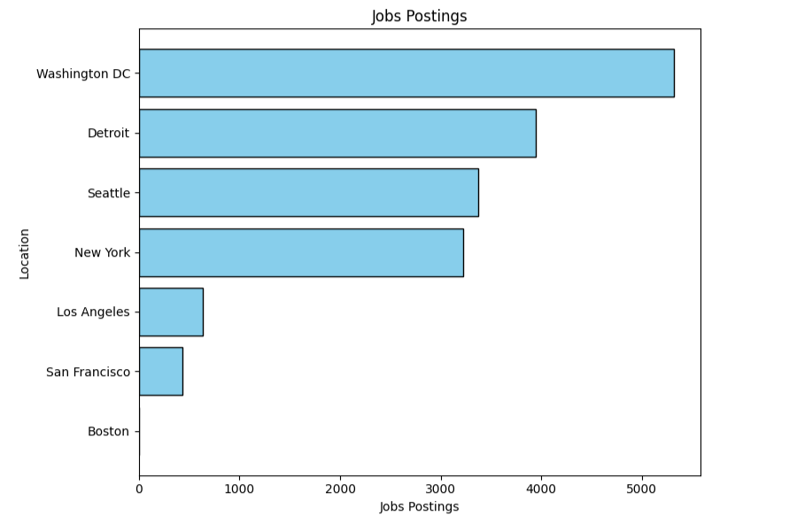
JOB POSTINGS
In Module 1 you have collected the job posting data using Job API in a file named “job-postings.xlsx”. Present that data using a bar chart here. Order the bar chart in the
descending order of the number of job postings.

Slide 23
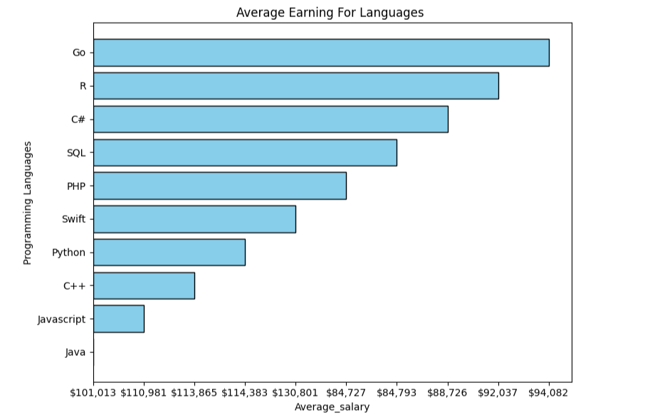
POPULAR LANGUAGES
In Module 1 you have collected the job postings data using web scraping in a file named “popular-languages.csv”. Present that data using a bar chart here. Order the bar chart in the descending order of salary.

