Slide 1
Introduction to RPC
Distributed Systems

Slide 2
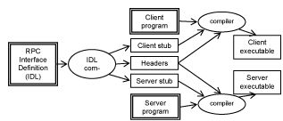

Slide 3
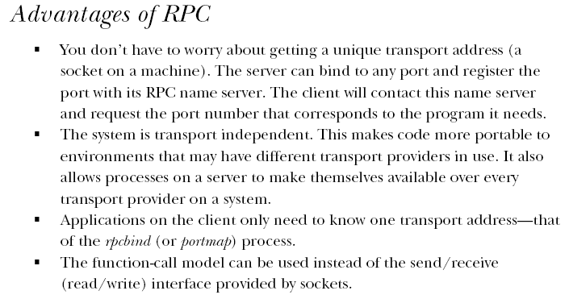

Slide 4
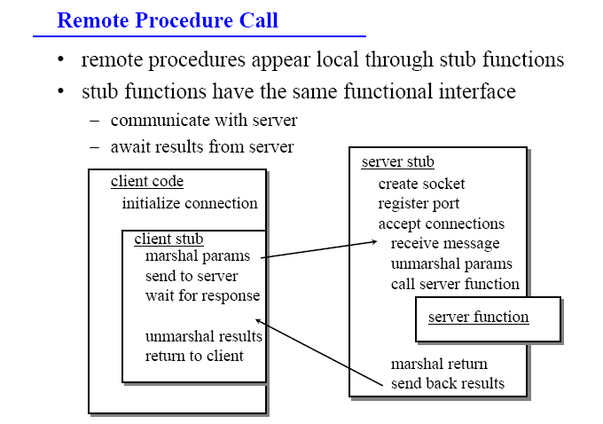

Slide 5
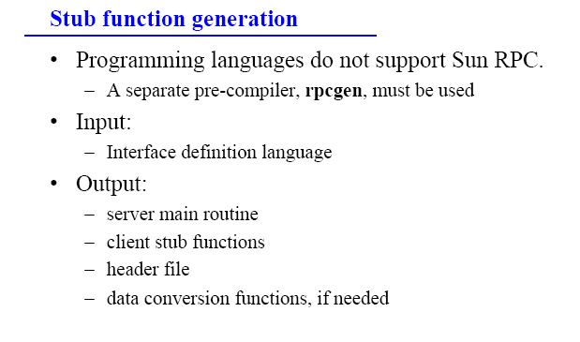

Slide 6
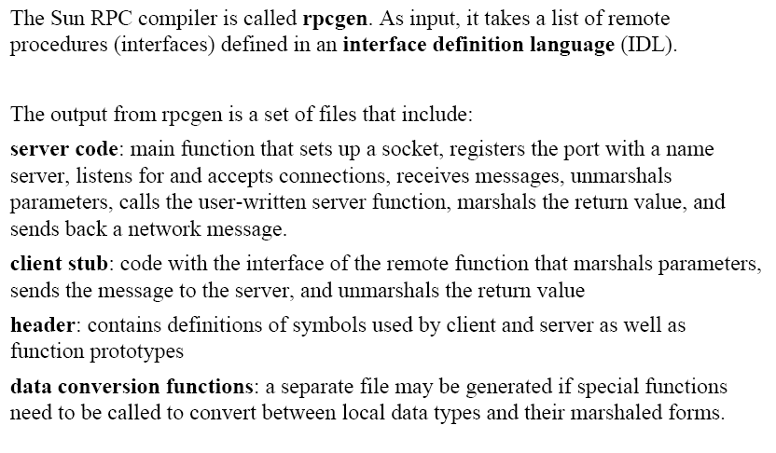

Slide 7
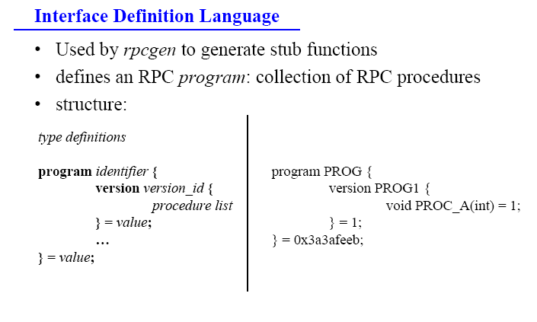

Slide 8
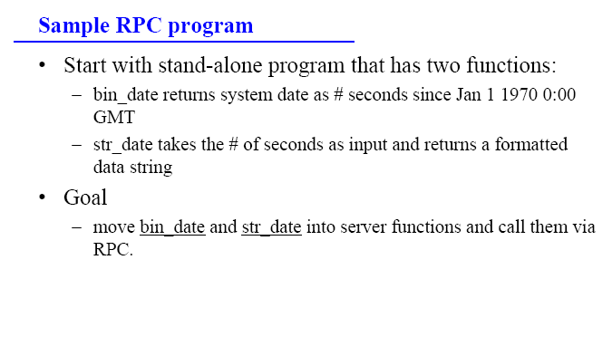

Slide 9
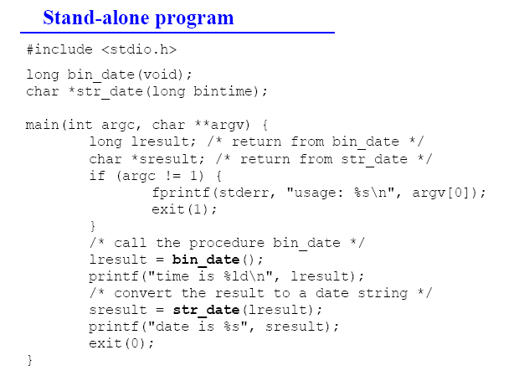

Slide 10
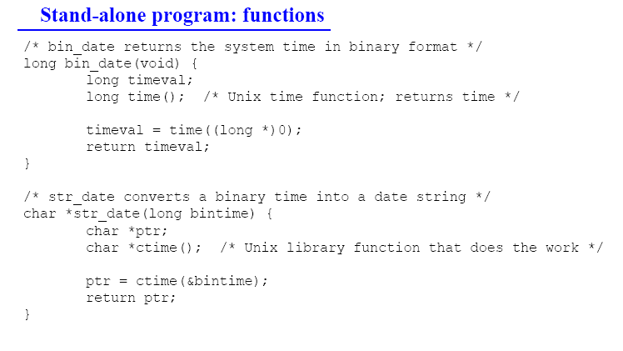

Slide 11
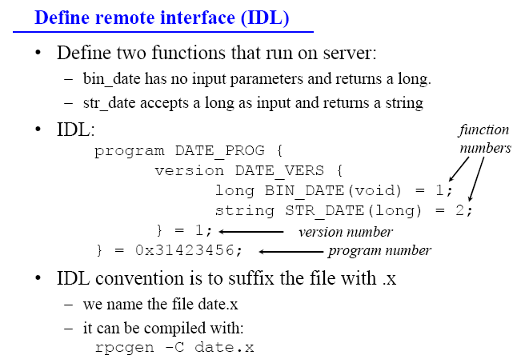

Slide 12
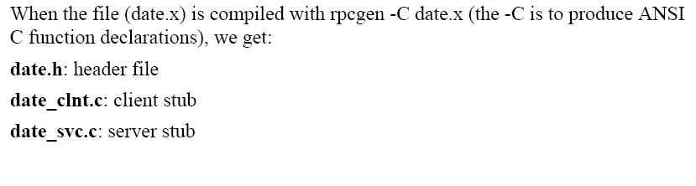

Slide 13
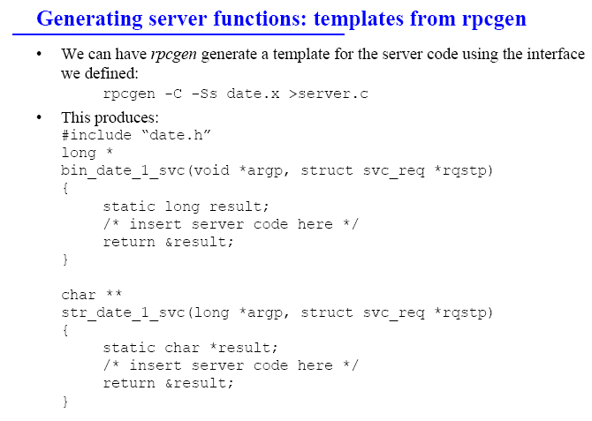

Slide 14
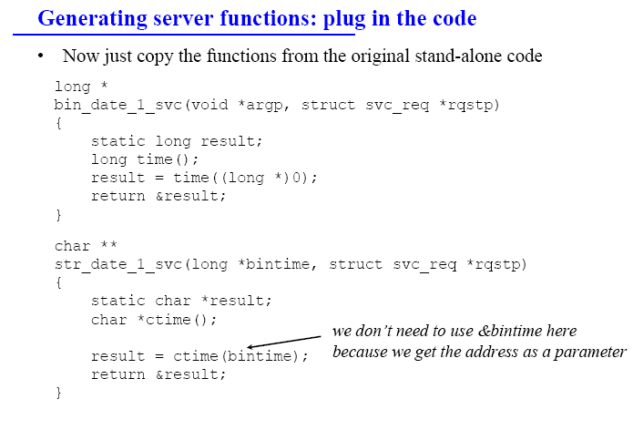

Slide 15
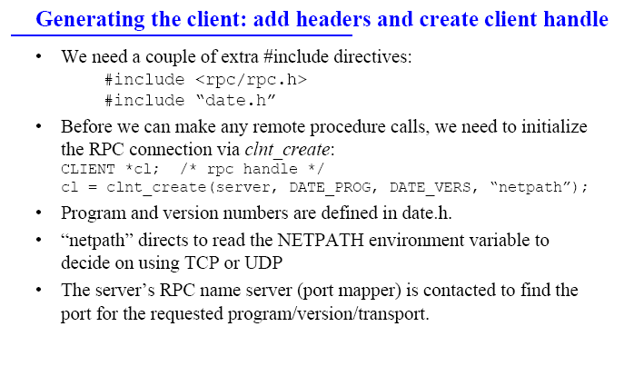

Slide 16
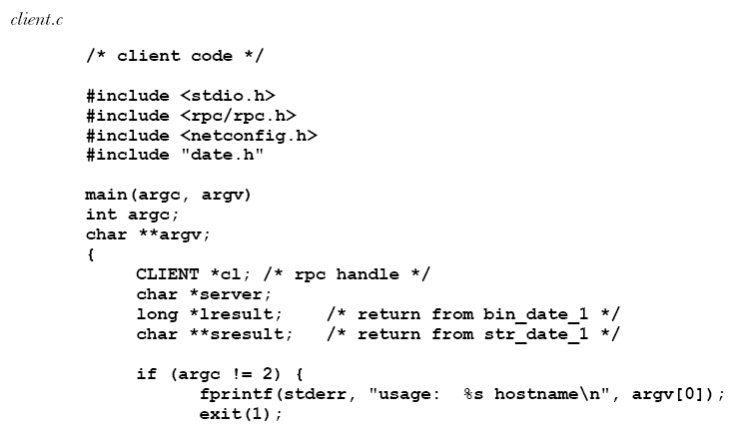

Slide 17
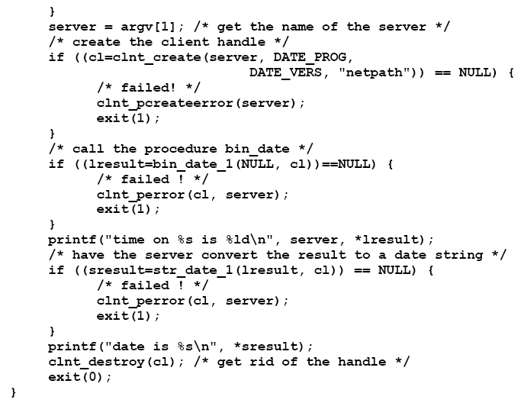

Slide 18
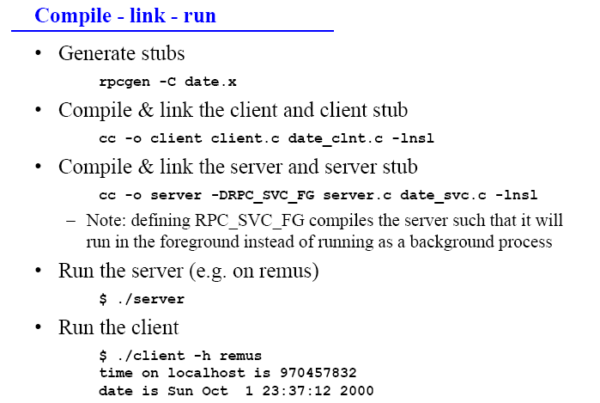

Slide 19

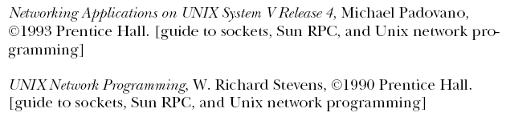

Slide 20
Exercises
Design a distributed application which generates and displays current time in several machines, and:
One server object/procedure/node generates the current time and displays it on local machines.
Other two/more client objects/procedures/nodes get time to be displayed from the server, and display it in digital mode/per second or analogue mode/per minute.
You need to handle:
The communication delay between client and server.
Only authorized clients could get time from server.

Slide 21
Other requirements
You should use Go language! (learn it)
Subsequent assignments will also be implemented in Go
Break tight coupling between client and server during developing.
Break tight coupling between client and server at runtime, say, against fixed machines, fixed number of clients, etc.
Several clients may submit requests to the server simultaneously.

Slide 22
Setup
Go Installation
You will need a working Go environment for the assignments. Your version should be at least Go 1.5.
There are instructions to install from source or with a package installer for several operating systems at Google's Go site: golang.org.
Tools
Three useful tools in the Go ecosystem : Go fmt (https://golang.org/cmd/gofmt/) , Go vet (https://golang.org/cmd/vet ), and Golint (https://github.com/golang/lint ).
Go tutorial
(https://tour.golang.org), go through it!

Slide 23
作业说明
1）邮件标题格式
MG/F123WXYZ+姓名+DisEX01
2）附件格式
报告为pdf，代码rar
文件名：MG/F123WXYZ+姓名+DisEX01
3）报告内容与格式
详细说明如何达到目标：背景简述、系统分析与设计、实现演示、总结；
4）杜绝任何形式的代码拷贝与报告抄袭，遵循学术规范。
5）本作业占总成绩10分
未按照1、2中格式要求的，每项扣1分；
未按照3中格式要求的，扣2分；
未遵守4的，取消本课程成绩。
6）提交邮箱：nju_dissys2017@sina.com，截止日期：2017年10月31日

