Slide 1



Velotix ex on amazon Reviews DS

Slide 2
Demo
5 star (Waffle maker)
It works great, beeps when it's done with the timer. Cleans fairly easily if you are not making any big messes, and even if you do, the plates come off and are dishwasher safe. great product
4 star (Woman pants)
This pair was supposed to be a sort of dusty purple, and it's a bit more grayish with a purple tinge. Well I wanted purple, this color makes it more of a neutral color that goes with many things. Fit is great; as a petite person, the legs were just the right length and not too long. The styling is flattering and I like the cuff style at the bottom. The material is a more athletic-y and silky than I expected; I was hoping for something a bit more soft and cottony feeling, but they are growing on me. These pants are good for lounging but you could wear them out and about as well.
3 star (Salad Cutter)
I bought this on a whim. My hands and wrists have been giving me trouble, and I grate alot of cheese in our family. This product definitely does help cut down on the physical labor part of the job. The set up was easy, and the suction feature really stabilizes the grater to the counter. Two big issues for me. One, the grater shoot is no where near long enough. First I tried to grate right into my gallon size bag, but that did not work. Then I just used a paper plate to catch the shreds, which worked better, but still got cheese all over my counter. I wouldn't say I wasted much, but I was annoyed. Secondly, I got tired of having to scrape cheese from the inside of the grater. I even tried to scrape in between each small block I was shredding, thinking that would help it stop catching inside. But I still ended up having shredded hunks I had to fish out using a butter knife. I could understand if I was using warmer or room temp cheese, but I just pulled this block from the fridge. Overall, I'll probably keep using it. But only if I have at least a pound of cheese to grate at a time. Otherwise it's too much of a hassle.
2 star (Shaver)
It worked alright for about a year. About six months in, it started having trouble charging because the contacts between the body and the stand corroded. A bit of vinegar cleaned that up, then I made sure to thoroughly dry it each time before charging. Recently it stopped trimming entirely. I opened up the trimmer head to see if I could fix it and discovered the springs that hold the blades together had totally rusted.
1 star (Book)
This book was not at all what the review was like. It was a horrible book…very slow with little action. I could not read it after several chapters and went to the end of the book to see how it finished. Absolutely terrible!
Me encantó!!! Lo que necesitaba, esta muy práctico, las recetas están muy ricas y la verdad es un aparato funcional que me hacía falta ya que me encantan los waffles y comprarlos salen caros

Slide 3
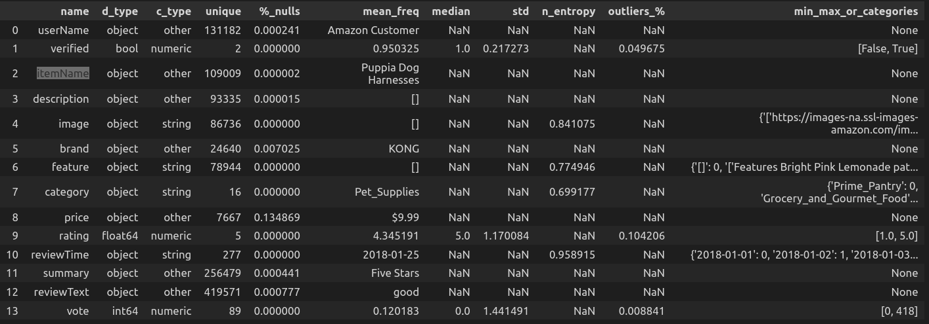
DS
551159 rows — 14 columns

Slide 4
What to use?
size - ~550k reviews
userName - String, 131k unique, not seems to contribute to rating
verified - Bool, if the buy is verified, can contribute - YES
itemName - String, 109k unique, not seems to contribute to rating
description - String, 93k unique, might have some connection to to rating
image - Strig, 86k unique, not seems to contribute to rating
brand - String, 24K unique, may have some connection to to rating
feature - String, 78K unique, may have some connection to to rating
category - String, 16 unique, can contribute - YES
price - String, 7k unique, with $ sign, can contribute - YES
reviewTime - String, 277 unique, not seems to contribute to rating
summary - String, 256k unique, may have some connection to to rating
reviewText - String, 419k unique, the main even for ratings
vote - int, 89 unique, not seems to contribute to rating
rating - float, 5 unique values - the main target

Slide 5
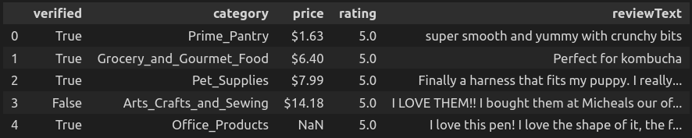
DS After Reduction

Slide 6
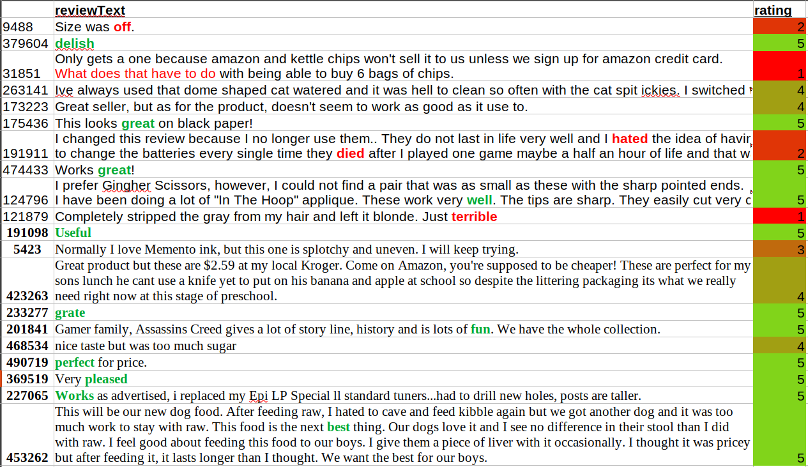
Focus on reviewText

Slide 7
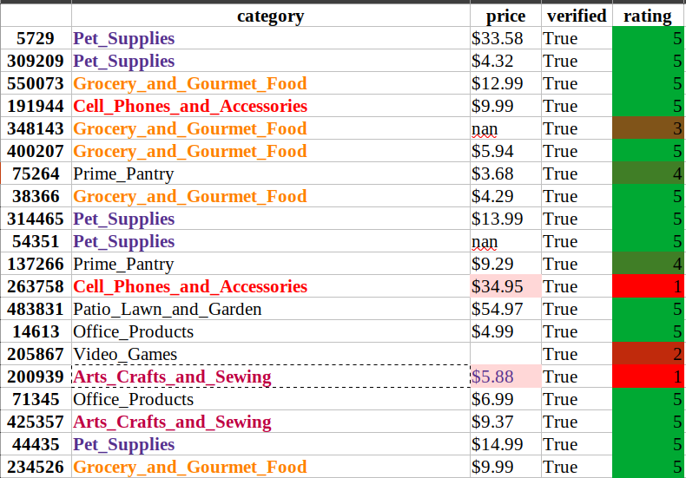
Focus on category, price, verified

Slide 8
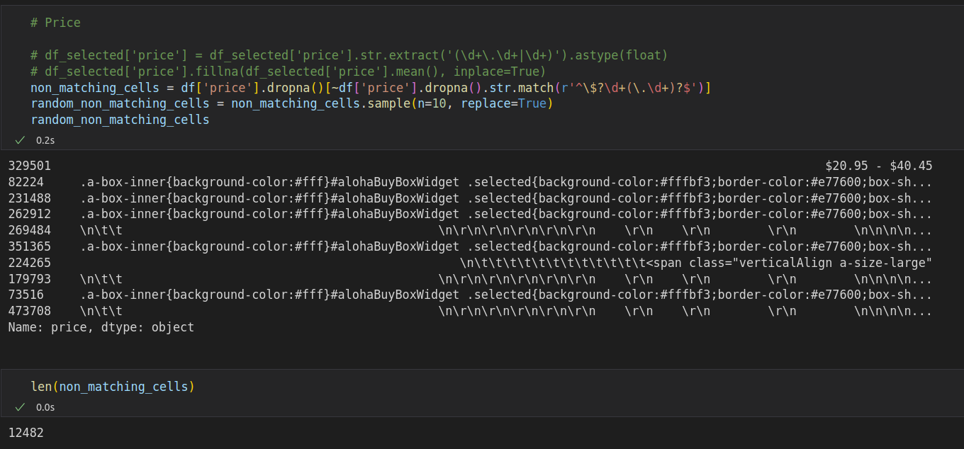
‘price’ is a shady field

Slide 9
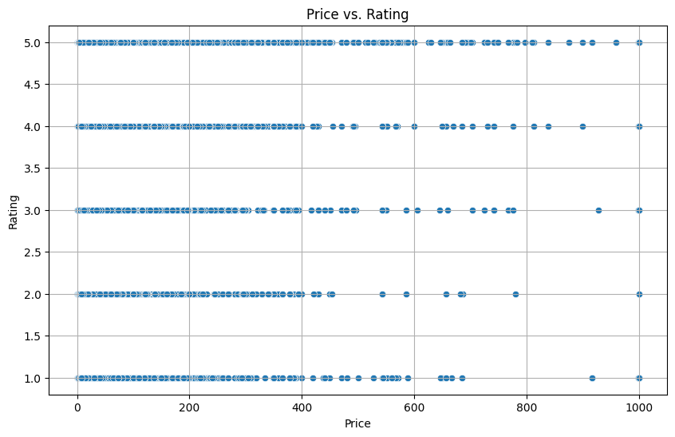
Price Correlation = Good Bye price
Price to Rating correlation
-0.0029685055688718066

Slide 10
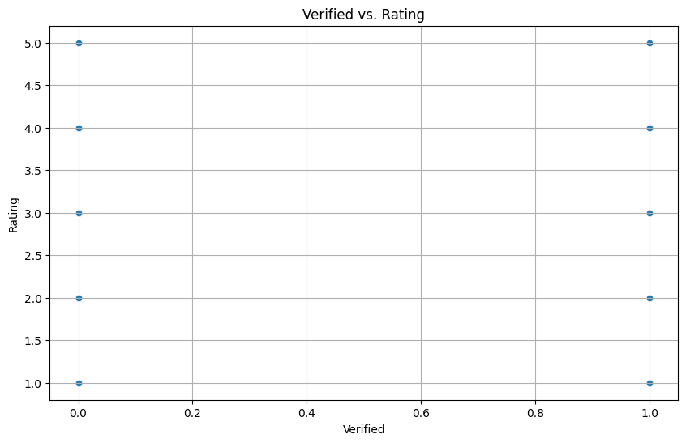
Verified correlation = Good Bye
Verified to Rating correlation
0.06549039489689133

Slide 11
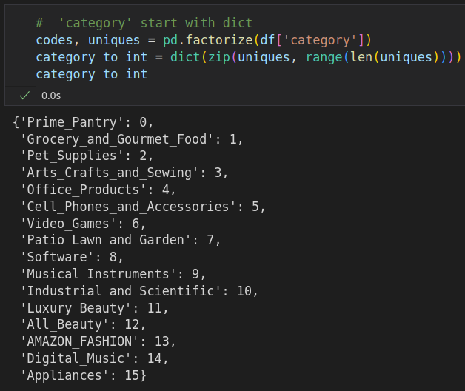
Working on Category

Slide 12
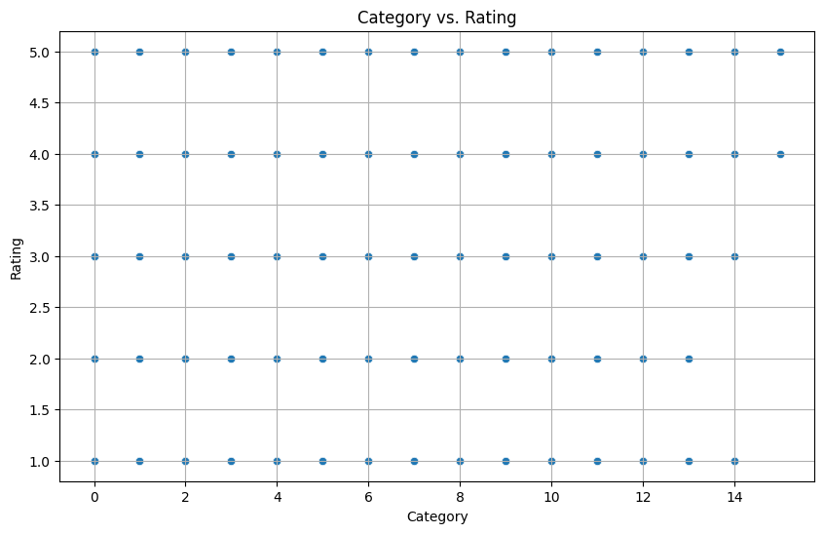
Category Correlation = Good Bye
Verified to Rating correlation
-0.003978745662907449

Slide 13
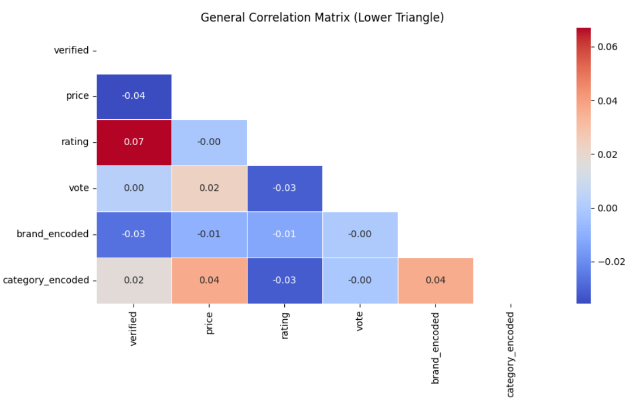
In general – No real correlation

Slide 14
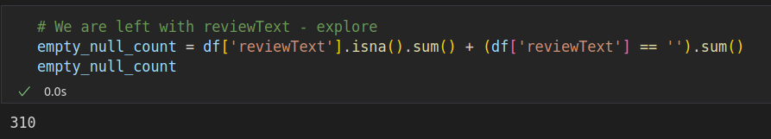
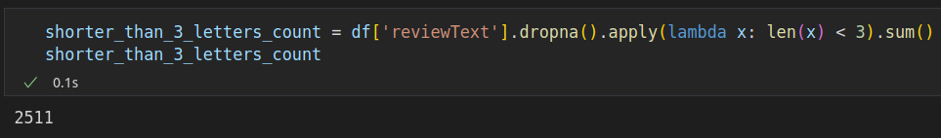
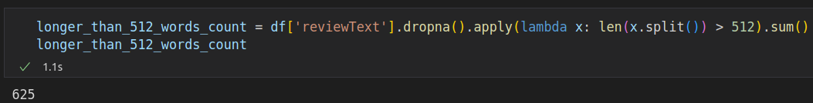
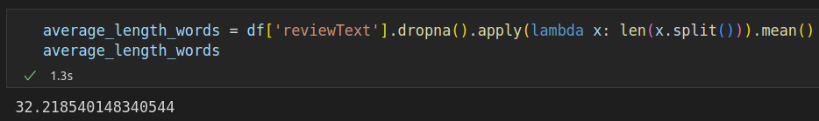
Working on reviewText

Slide 15
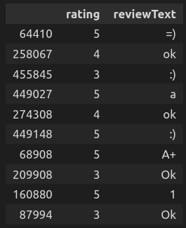
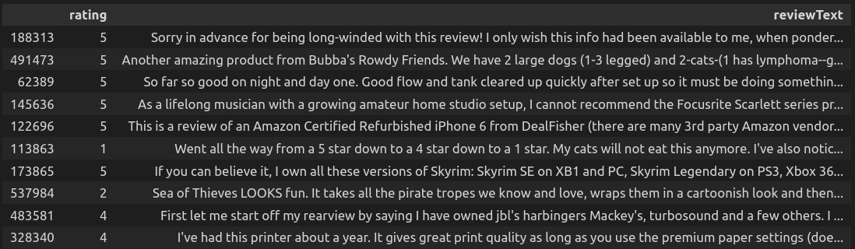
Short / Long reviewText

Slide 16
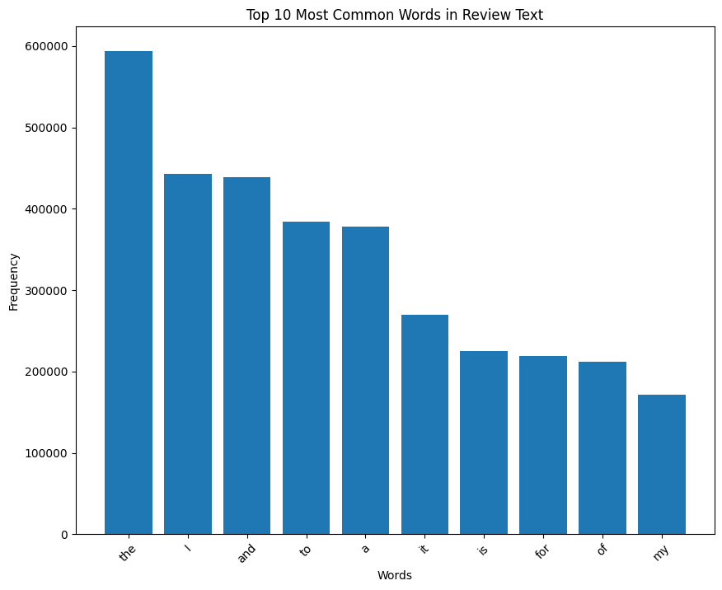
ReviewText – Naive word count

Slide 17
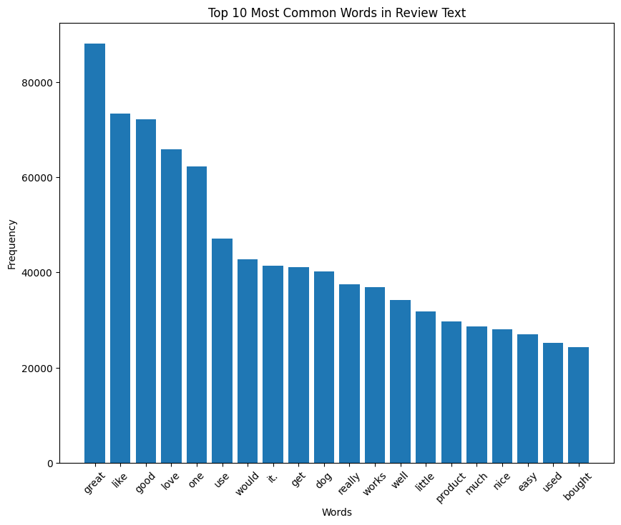
ReviewText – word count

Slide 18
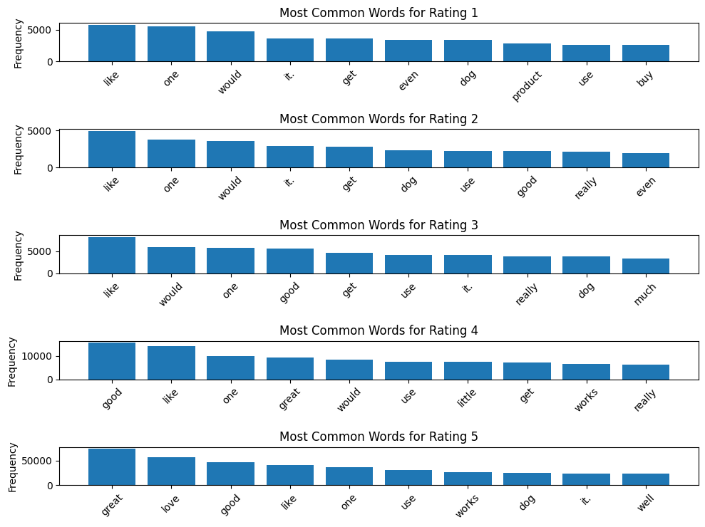
ReviewText – words by rating

Slide 19
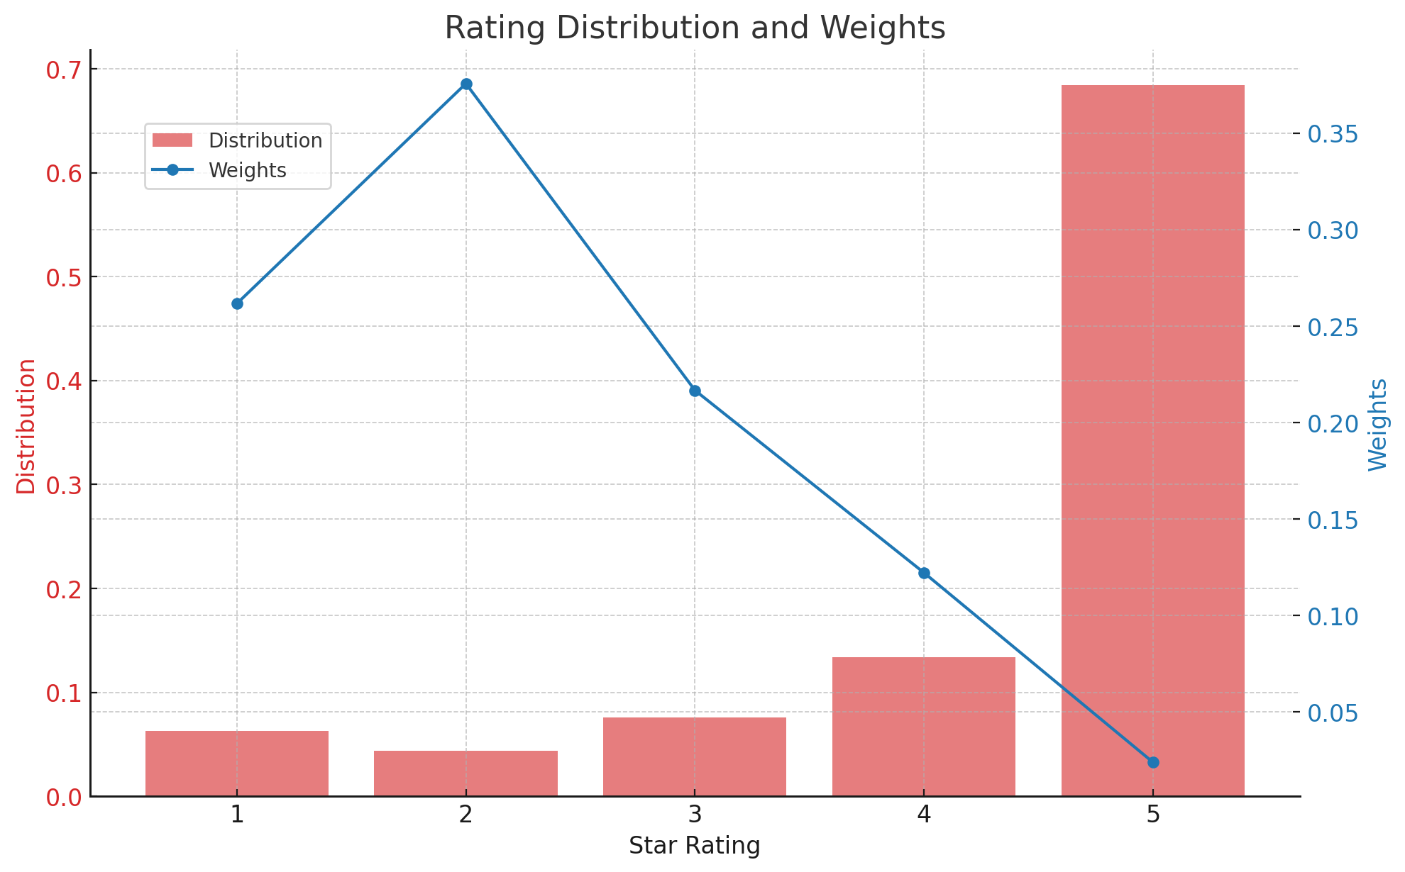
Rating Distribution and weights

Slide 20
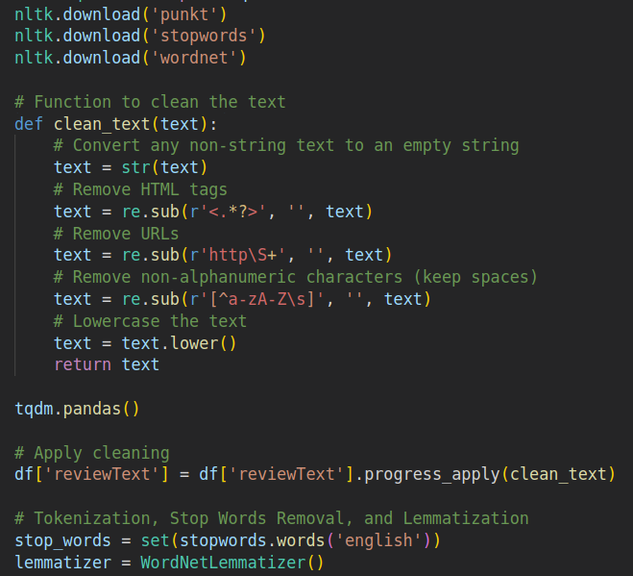
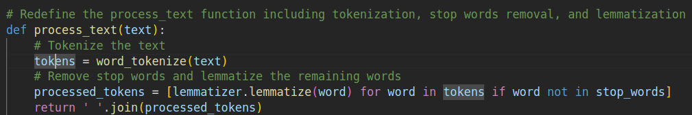

Initial method - ML

Slide 21
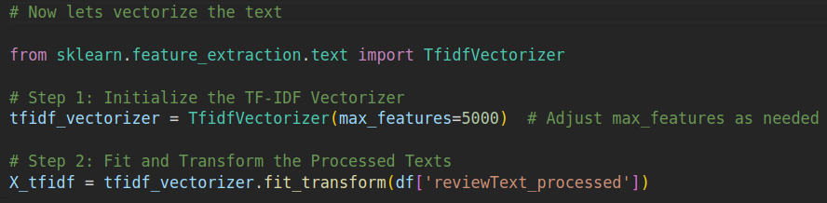
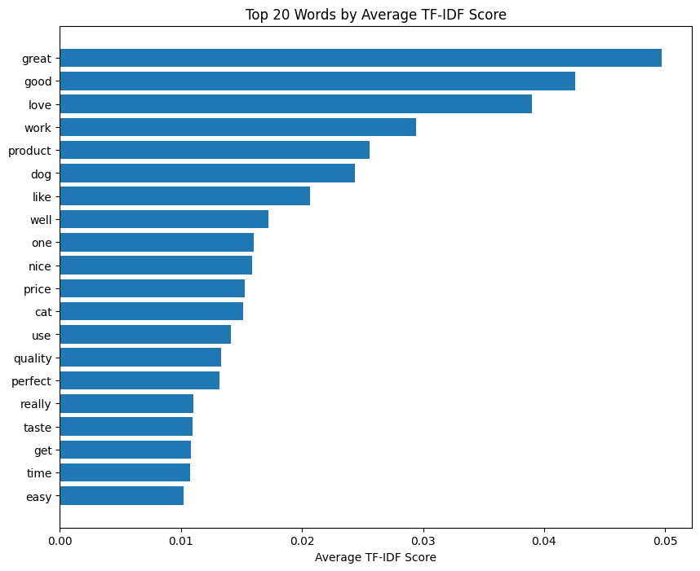
Vectorize by TF-IDF

Slide 22
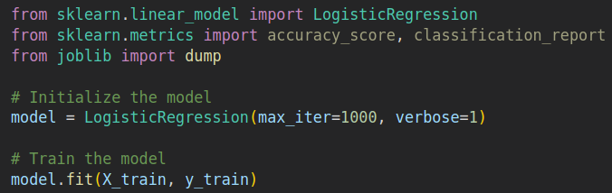
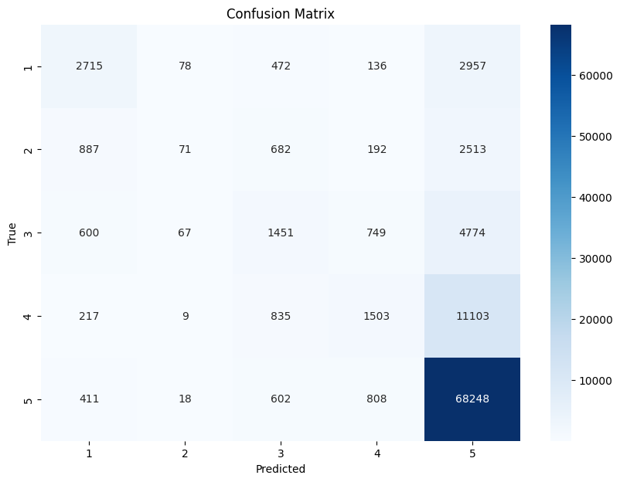
Simplest – LogisticRegration
Accuracy: 0.7247
Precision: 0.6566
Recall: 0.7247
F1 Score: 0.6605

Slide 23
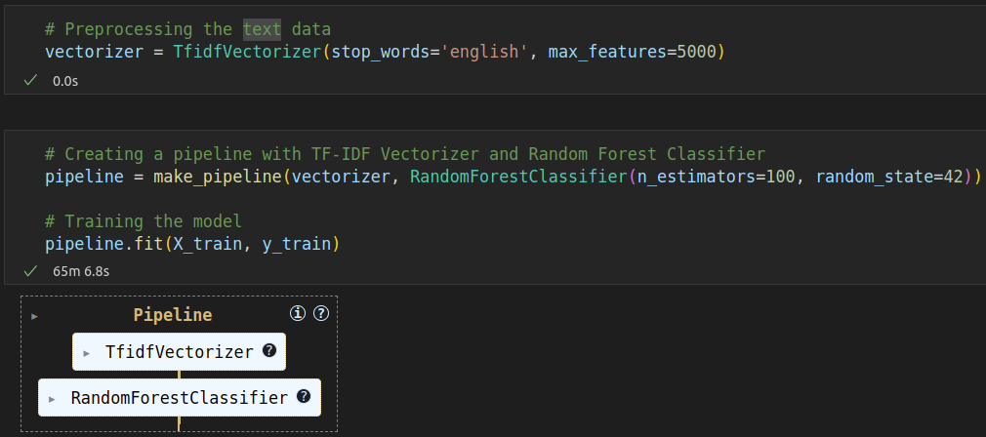

Random Forest - better

Slide 24
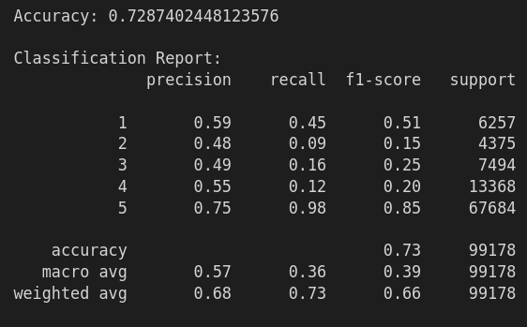
Random forest report

Slide 25
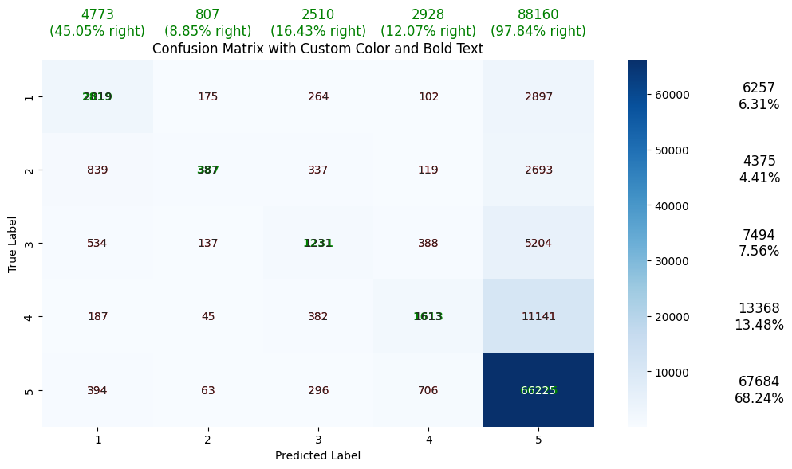
Random Forest – better view

Slide 26

Second approach - DL

Slide 27
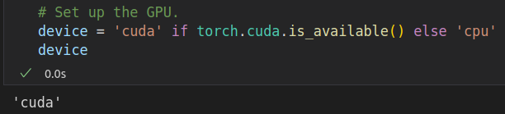
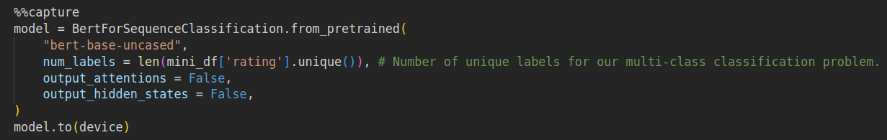
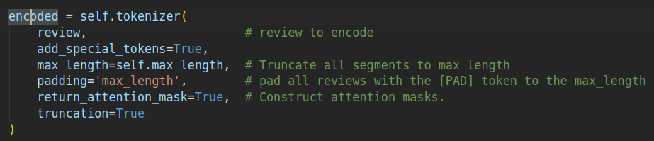
Bert - reviewText encode + predict

Slide 28
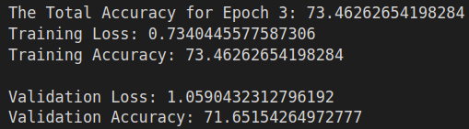

Choose – epoc 3 / 4
50% of the data
3 epocs
5500 batches
GPU – RTX3080, 16GB, Mobile
Elapsed – 488m
>

Slide 29
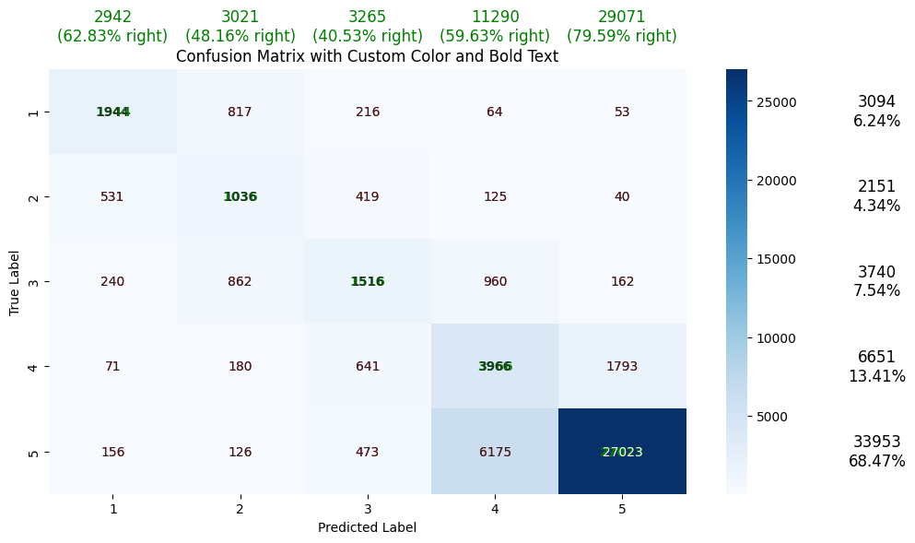
Bert 50% - better look
Much better on the middle parts !

Slide 30
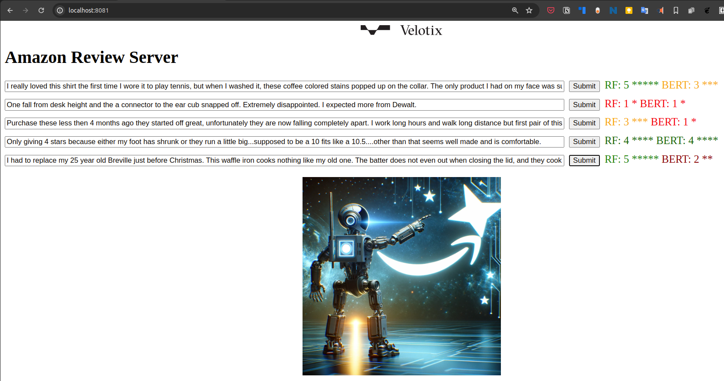
Who is better?

Slide 31
Results
Random Forest – Traditional ML:
  Simple to use
  Fast predict
Bert – DL, the future (is heavy):
  Harder to inference, train and explain.
  Much better at understanding semantics
Others ?
  XGBoost
  DL, better embeddings

