Slide 1
Customized AIoT Implementation
M11015201 llia Konnov M11115029 彭宏鈞

Slide 2
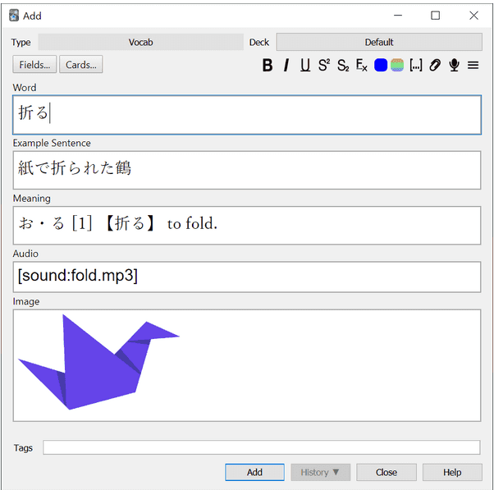
Motivation
我們組員當初在學習中文時，有使用到Anki這個間隔重複系統的Flash Card軟體

Slide 3
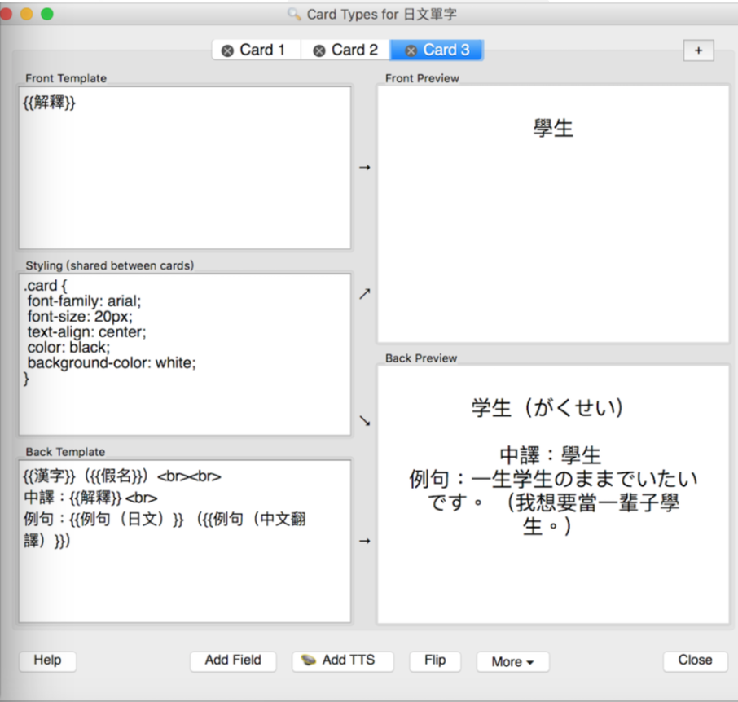
Motivation
Anki Interface
Edit Cards

Slide 4
Motivation
在Anki的使用上有:
必須經常透過拿出手機來確認所顯示字卡的缺點
初次設定字卡要花費許多時間
因此我們希望可以結合穿戴式裝置，如智慧手錶來提升便利性及即時性

Slide 5
Application Scenario
User downloads the flashcard database onto the phone. This only needs to be done once.
Once in some time period. For example, every two hours watches show a word to the user
User sees the words, tries to remember it. Clicks the button. Then the definition of the word is shown.
If user remembers this word, he clicks “✓”,otherwise clicks “x”.

Slide 6
Development tools
Android Studio
Wear OS SDK + Jetpack libraries
JUnit automated testing
SQLite
Apache server (for storing online data)
Github, Github Actions for CI/CD

Slide 7
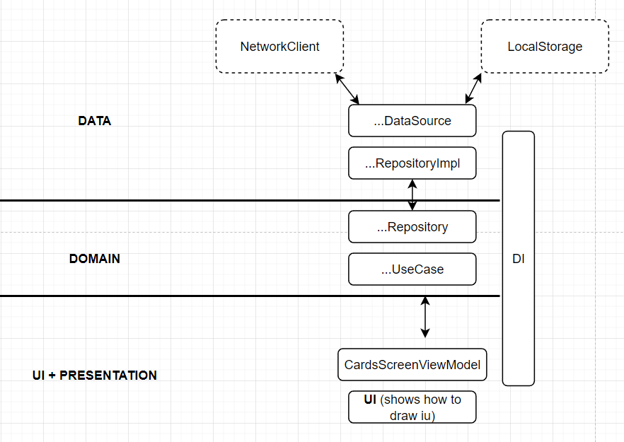
Architecture
Overview

Slide 8
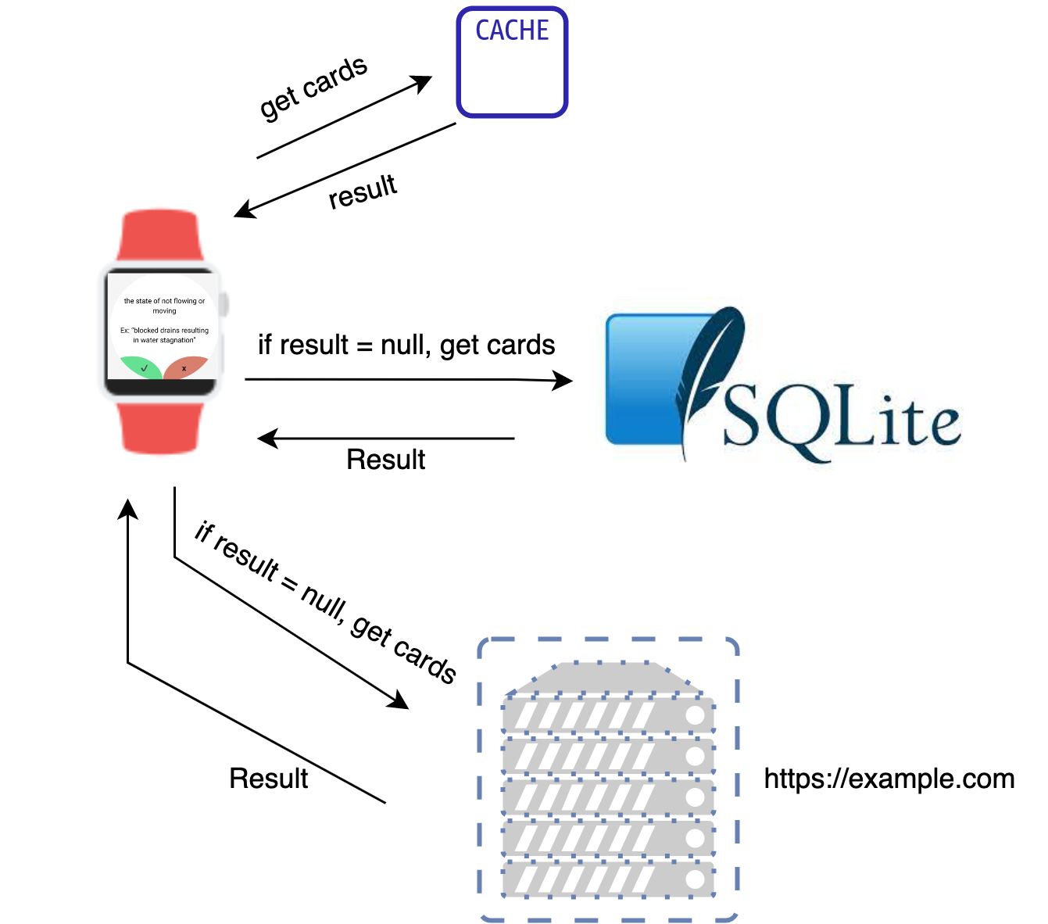
Architecture
Get flashcards data

Slide 9
Our Contribution
A software similar to Anki for wearable devices with more advance space repetition algorithm

Slide 10
Demo

Slide 11
Further work
Bring word frequency into the equation (see api.cng.tw/v1/hanzi)
Use curve fitting problem to train the model and make decisions
Generate cards, definitions, and examples automatically using open source dictionaries and messengers chat history

