Slide 1
PQC Final Project NTT Multiplication in NTRUHPS2048677
組員: 洪逸霖(D09921011)、林亮昕(B07901100)

Slide 2
Outline
Multiplication in NTRU
Prior work
Our scheme: twisted/no twisted
Experiments
Performance and Comparison

Slide 3
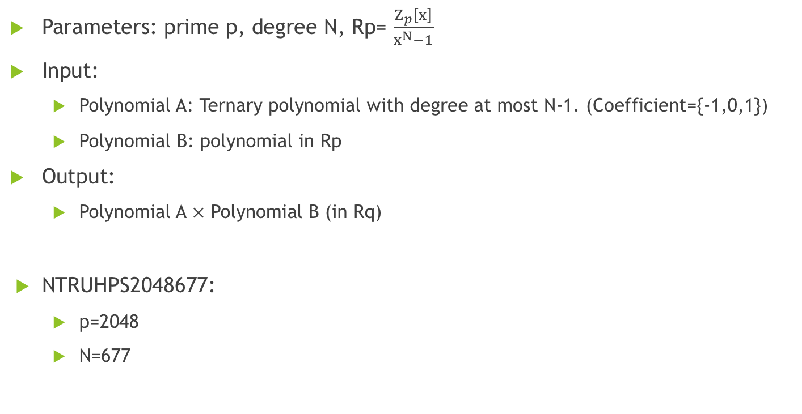
Multiplication in NTRU
Parameters: prime p, degree N, Rp= $\frac{Z_{p}\left[x\right]}{x^{N}−1}$
Input:
Polynomial A: Ternary polynomial with degree at most N-1. (Coefficient={-1,0,1})
Polynomial B: polynomial in Rp
Output:
Polynomial A $×$ Polynomial B (in Rq)
NTRUHPS2048677:
p=2048
N=677

Slide 4
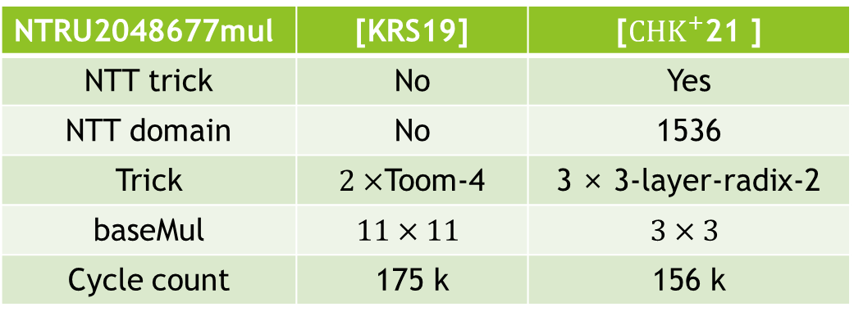
Prior Work
NTRU2048677mul | [KRS19] | [${CHK}^{+}$21 ]
NTT trick | No | Yes
NTT domain | No | 1536
Trick | $2×$Toom-4 | 3 × 3-layer-radix-2
baseMul | $$11×11$$ | $$3×3$$
Cycle count | 175 k | 156 k
[KRS19]Faster multiplication in Z2m[x] on Cortex-M4 to speed up NIST PQC candidates
[${CHK}^{+}$21 ]NTT Multiplication for NTT-unfriendly Rings
New Speed Records for Saber and NTRU on Cortex-M4 and AVX2

Slide 5
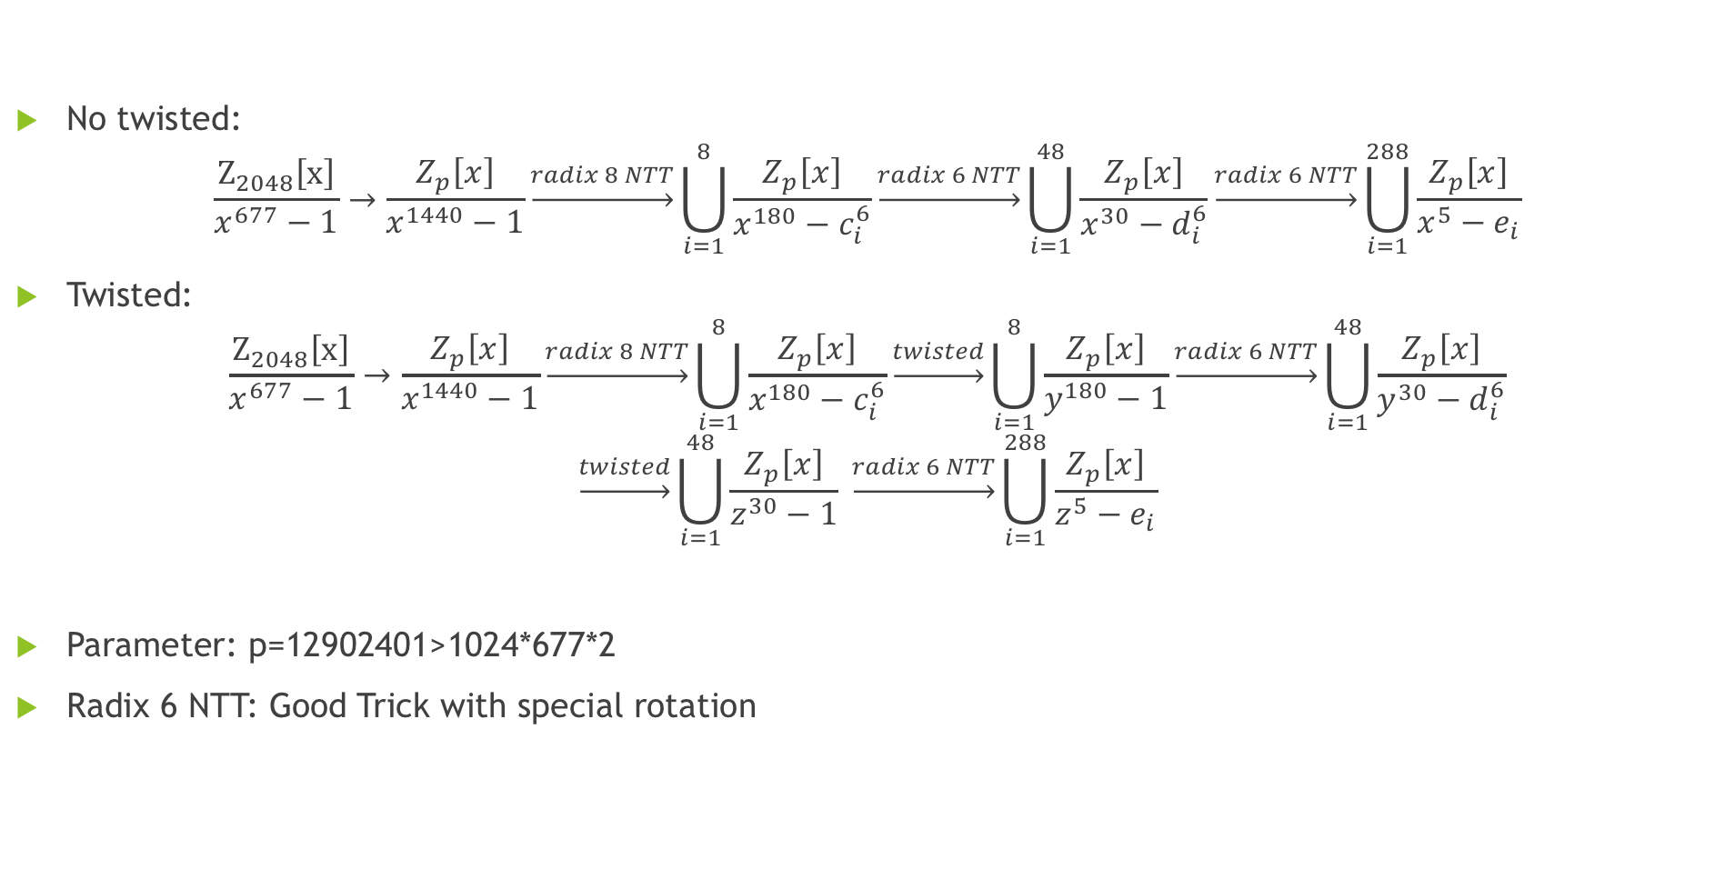
Our scheme
No twisted:
$$\frac{Z_{2048}\left[x\right]}{x^{677}−1}→\frac{Z_{p}\left[x\right]}{x^{1440}−1}\underset{→}{radix 8 NTT}\bigcup_{i=1}^{8}{\frac{Z_{p}\left[x\right]}{x^{180}−c_{i}^{6}}}\underset{→}{radix 6 NTT}\bigcup_{i=1}^{48}{\frac{Z_{p}\left[x\right]}{x^{30}−d_{i}^{6}}}\underset{→}{radix 6 NTT}\bigcup_{i=1}^{288}{\frac{Z_{p}\left[x\right]}{x^{5}−e_{i}}}$$
Twisted:
$$\frac{Z_{2048}\left[x\right]}{x^{677}−1}→\frac{Z_{p}\left[x\right]}{x^{1440}−1}\underset{→}{radix 8 NTT}\bigcup_{i=1}^{8}{\frac{Z_{p}\left[x\right]}{x^{180}−c_{i}^{6}}}\underset{→}{twisted}\bigcup_{i=1}^{8}{\frac{Z_{p}\left[x\right]}{y^{180}−1}}\underset{→}{radix 6 NTT}\bigcup_{i=1}^{48}{\frac{Z_{p}\left[x\right]}{y^{30}−d_{i}^{6}}}$$
$$\underset{→}{twisted}\bigcup_{i=1}^{48}{\frac{Z_{p}\left[x\right]}{z^{30}−1}} \underset{→}{radix 6 NTT}\bigcup_{i=1}^{288}{\frac{Z_{p}\left[x\right]}{z^{5}−e_{i}}}$$
Parameter: p=12902401>1024*677*2
Radix 6 NTT: Good Trick with special rotation

Slide 6
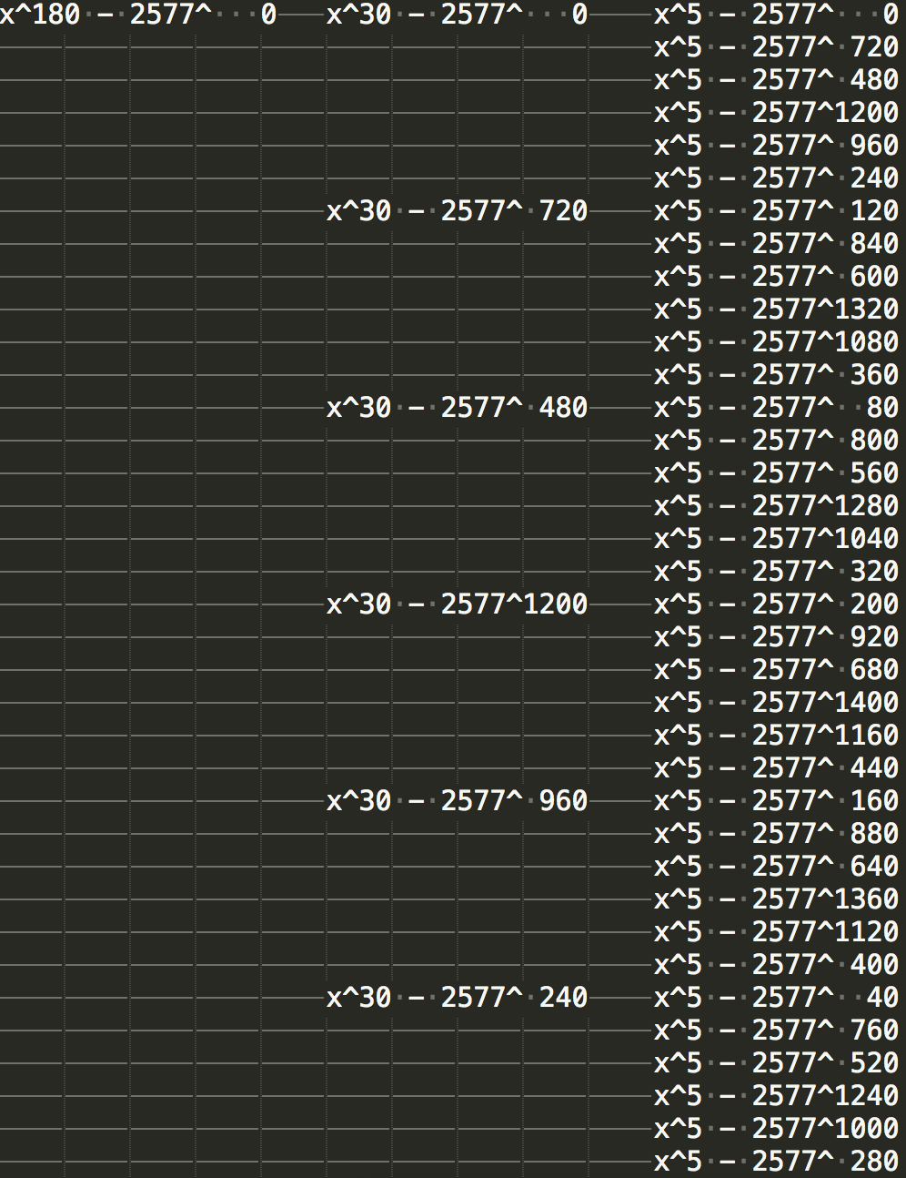
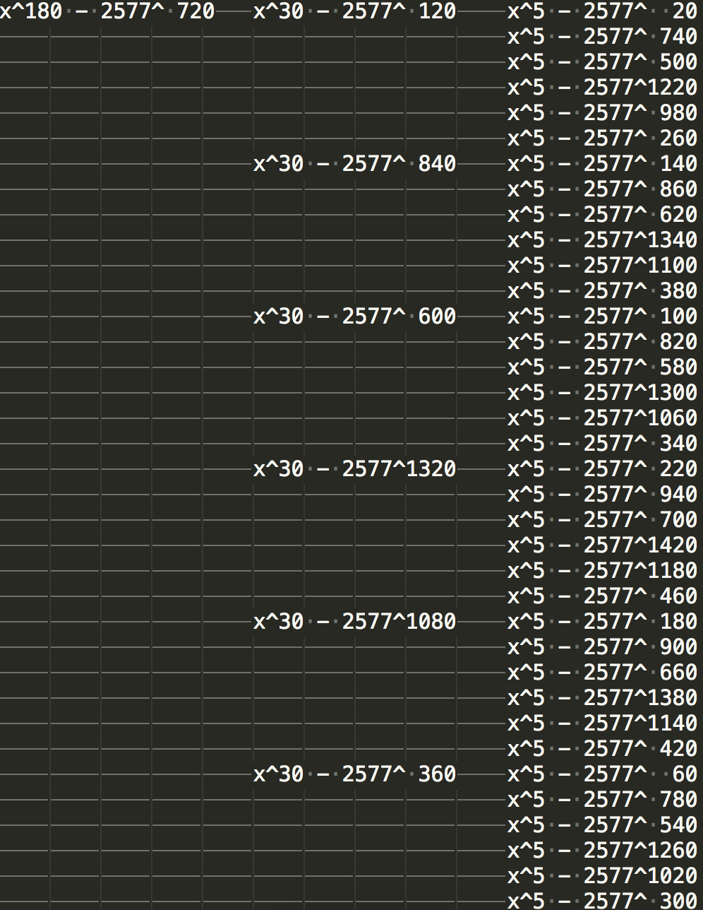
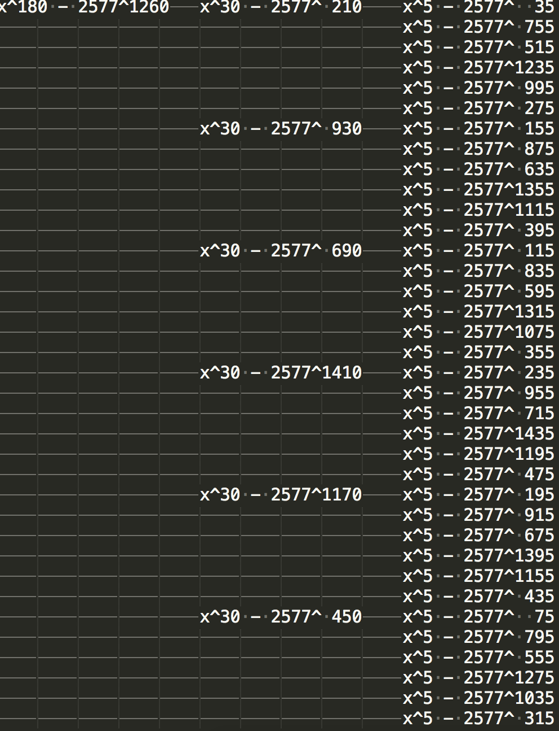
The map of no twisted NTT
…

Slide 7
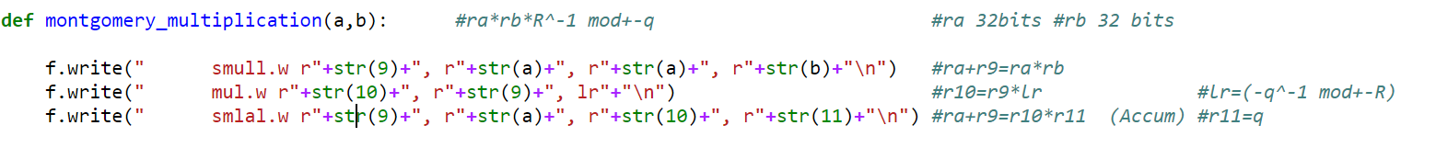
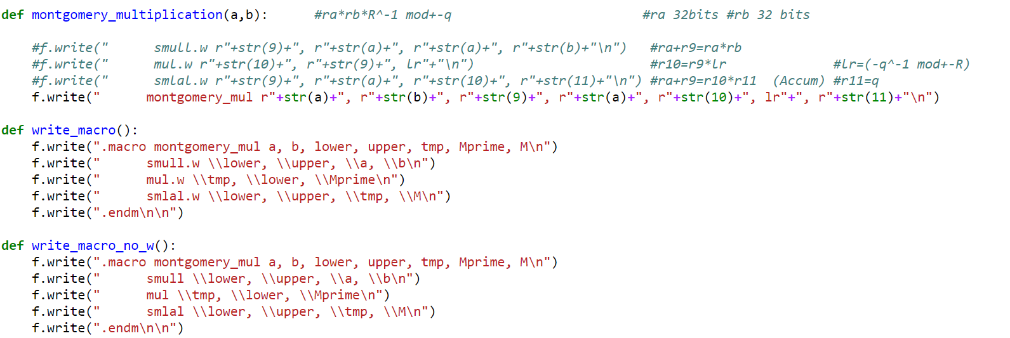
Montgomery reduction

Slide 8
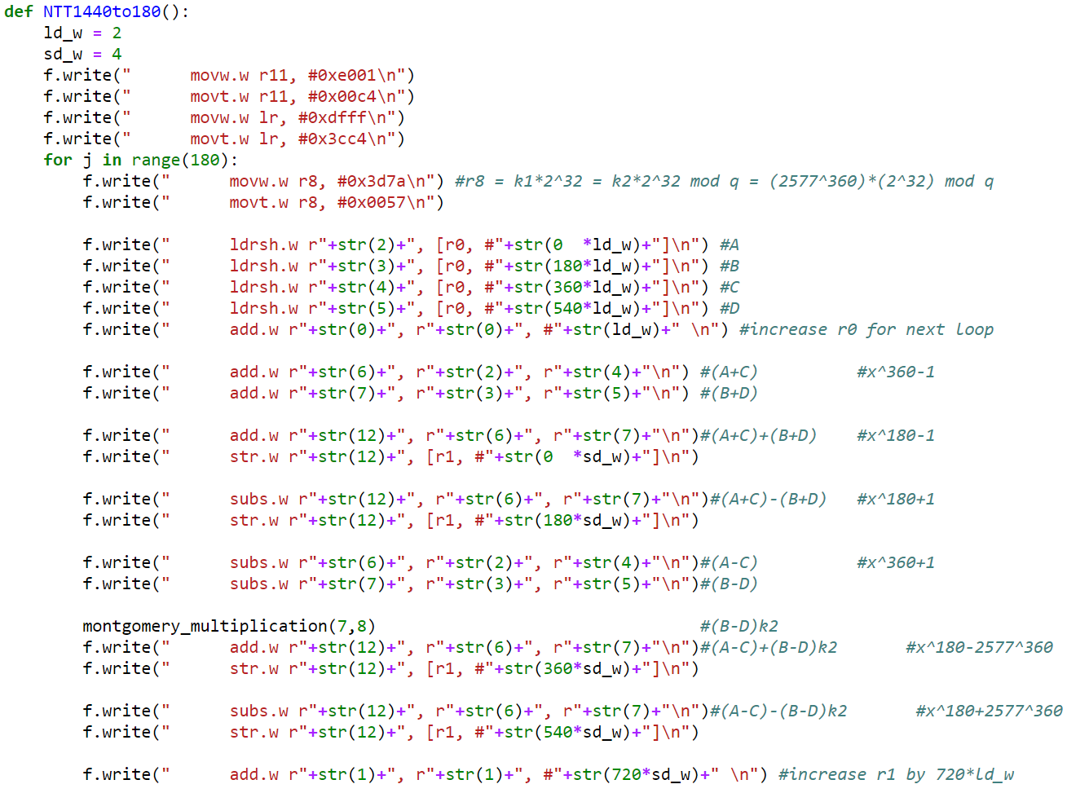
Tricks tried 1440-180(8-NTT) (Not optimization)

Slide 9
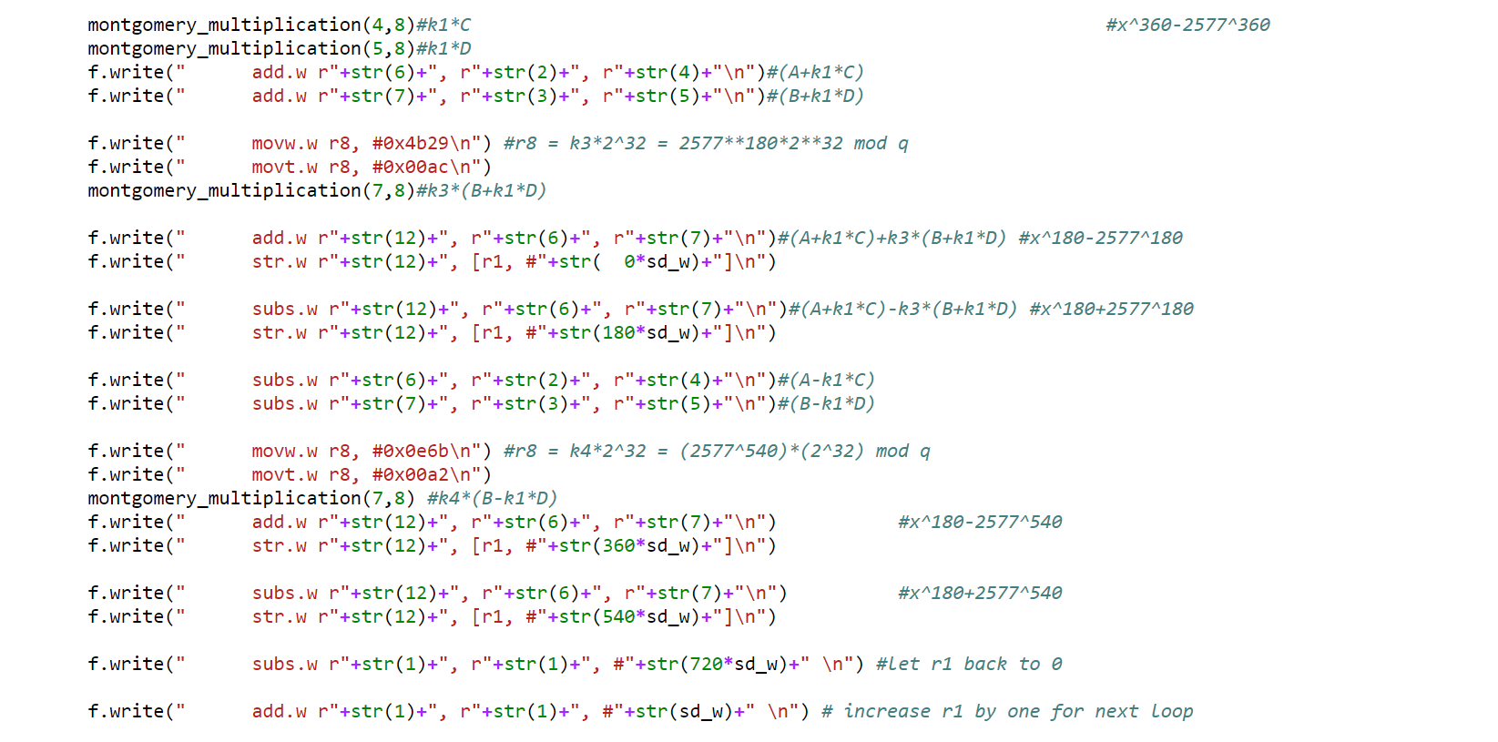
Tricks tried 1440-180(8-NTT) (Not optimization)

Slide 10
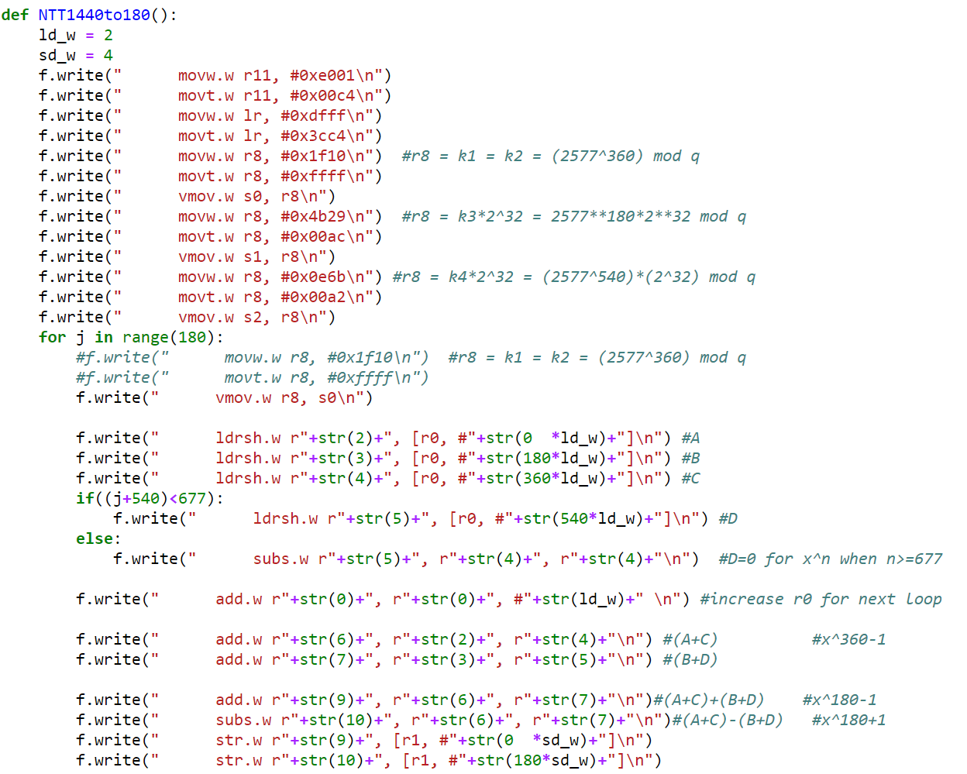

Tricks tried 1440-180(8-NTT) (Optimization)
We store value to s0, s1, s2
Notice that ${2577}^{360}=−57584 mod q$
Where $\left|1024∗\left(−57584\right)\right|<2^{32}$

Slide 11
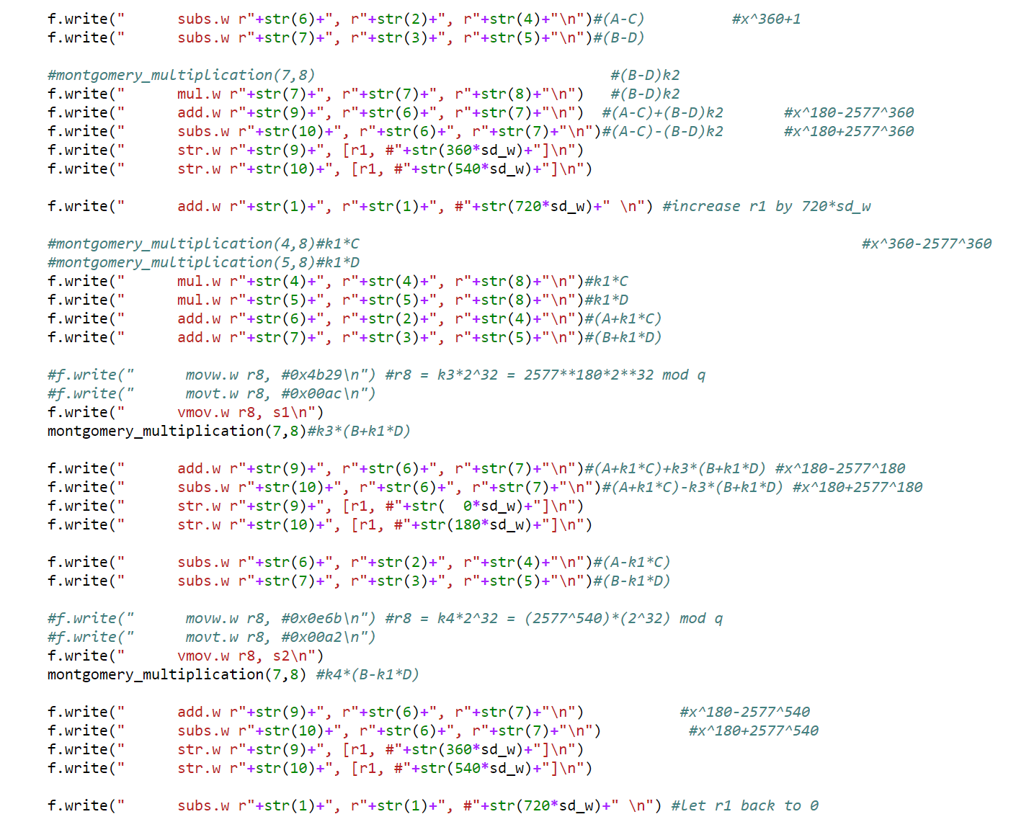
Tricks tried 1440-180(8-NTT) (Optimization)
We reconstruct some Montgomery
multiplication to save cycle

Slide 12
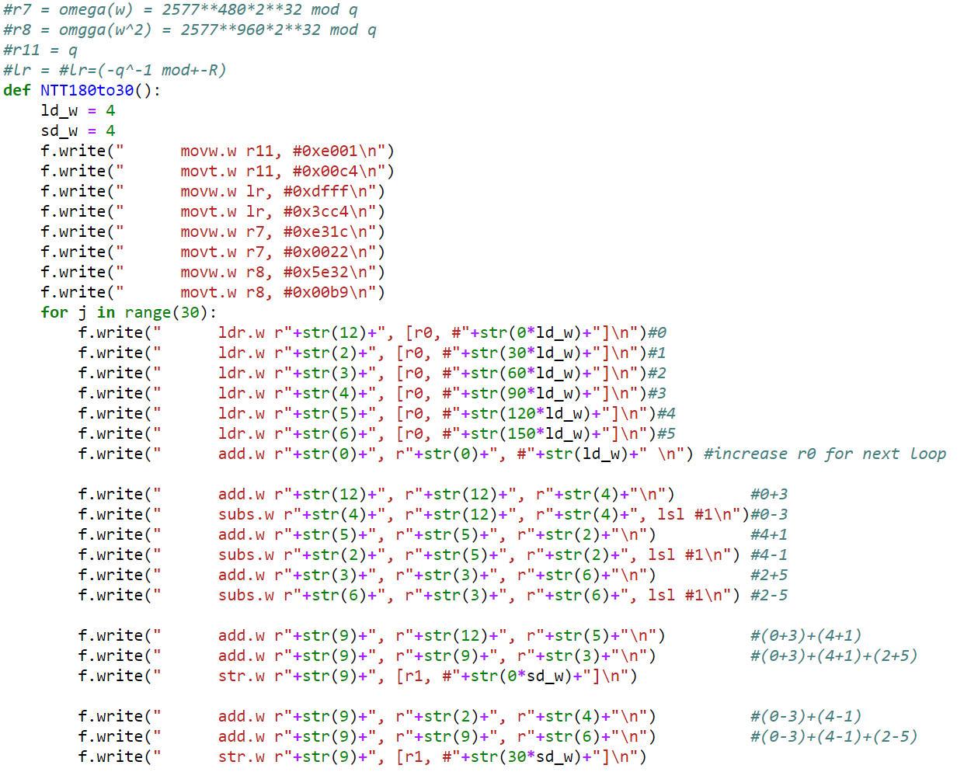
Tricks tried 180-30(6-Good’s trick) (Not optimization)

Slide 13
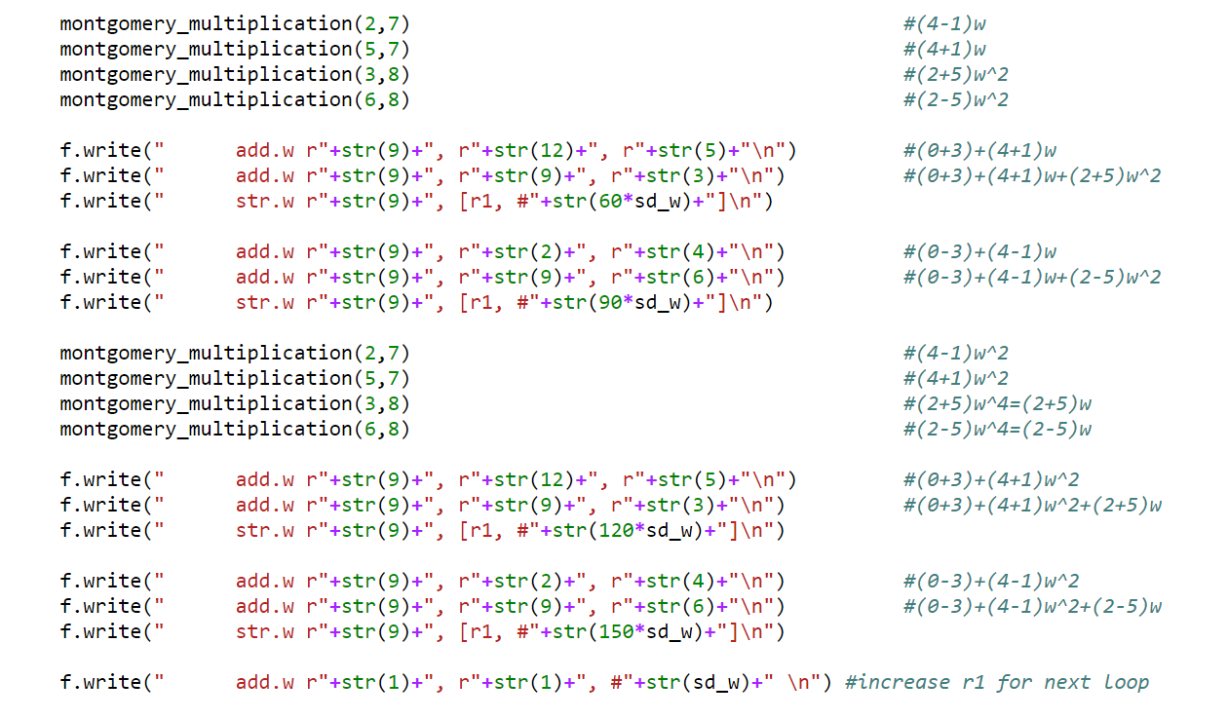
Tricks tried 180-30(6-Good’s trick) (Not optimization)

Slide 14

Tricks tried 180-30(6-Good’s trick)
Notice that $1+w+w^{2}=0$
We can do $w^{2}=−1−w$
To do $\left(0+3\right)+\left(4+1\right)w^{2}+\left(2+5\right)w$
Let $A=\left(0+3\right)+\left(4+1\right)+(2+5)$, $B=\left(0+3\right)+\left(4+1\right)w+\left(2+5\right)w^{2}$
We can do $3×\left(0+3\right)−A−B$

Slide 15
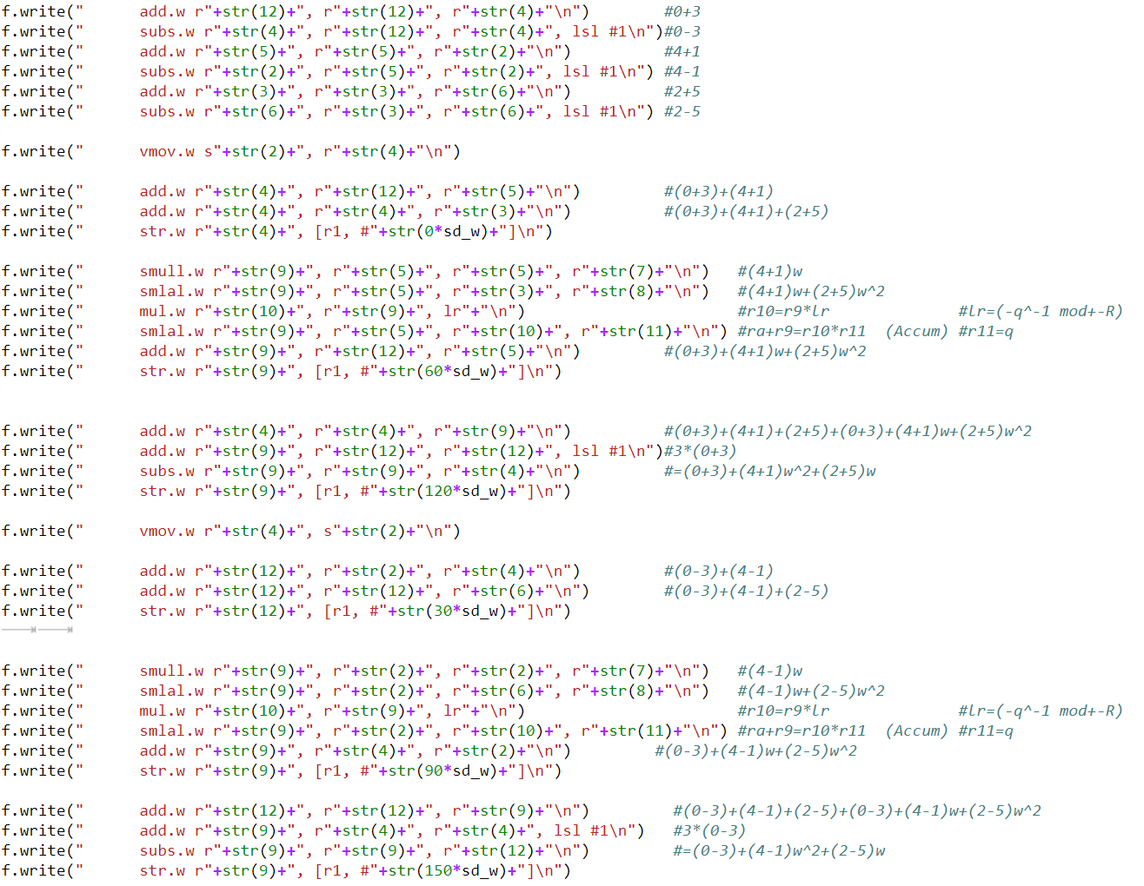
Tricks tried 180-30(6-Good’s trick) (Optimization)

Slide 16
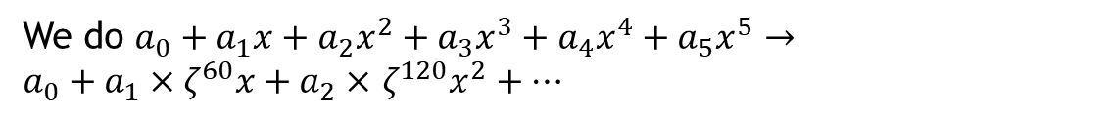
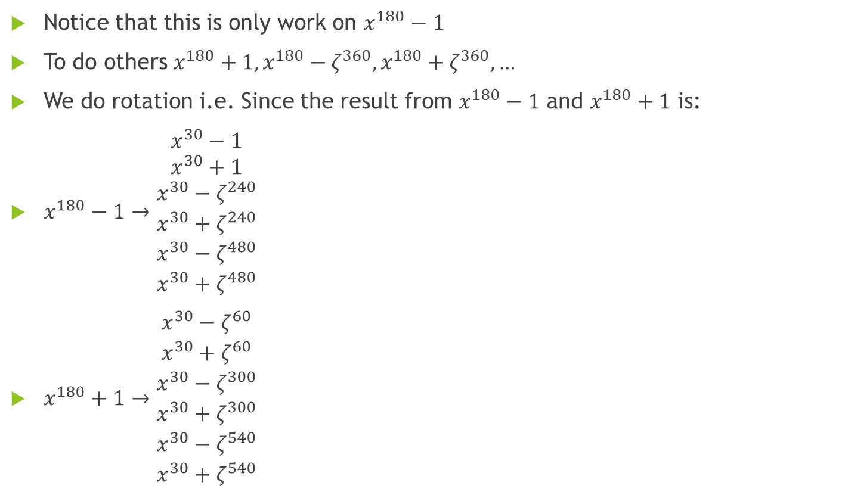
Tricks tried 180-30(6-Good’s trick) (Optimization)
Notice that this is only work on $x^{180}−1$
To do others $x^{180}+1, x^{180}−ζ^{360}, x^{180}+ζ^{360}, …$
We do rotation i.e. Since the result from $x^{180}−1$ and $x^{180}+1$ is:
$x^{180}−1→\begin{matrix}\begin{matrix}x^{30}−1 \\ x^{30}+1\end{matrix} \\ \begin{matrix}x^{30}−ζ^{240} \\ x^{30}+ζ^{240}\end{matrix} \\ \begin{matrix}x^{30}−ζ^{480} \\ x^{30}+ζ^{480}\end{matrix}\end{matrix}$
$x^{180}+1→\begin{matrix}\begin{matrix}x^{30}−ζ^{60} \\ x^{30}+ζ^{60}\end{matrix} \\ \begin{matrix}x^{30}−ζ^{300} \\ x^{30}+ζ^{300}\end{matrix} \\ \begin{matrix}x^{30}−ζ^{540} \\ x^{30}+ζ^{540}\end{matrix}\end{matrix}$
We do $a_{0}+a_{1}x+a_{2}x^{2}+a_{3}x^{3}+a_{4}x^{4}+a_{5}x^{5}→$
$a_{0}+a_{1}×ζ^{60}x+a_{2}×$ $ζ^{120}x^{2}+…$

Slide 17
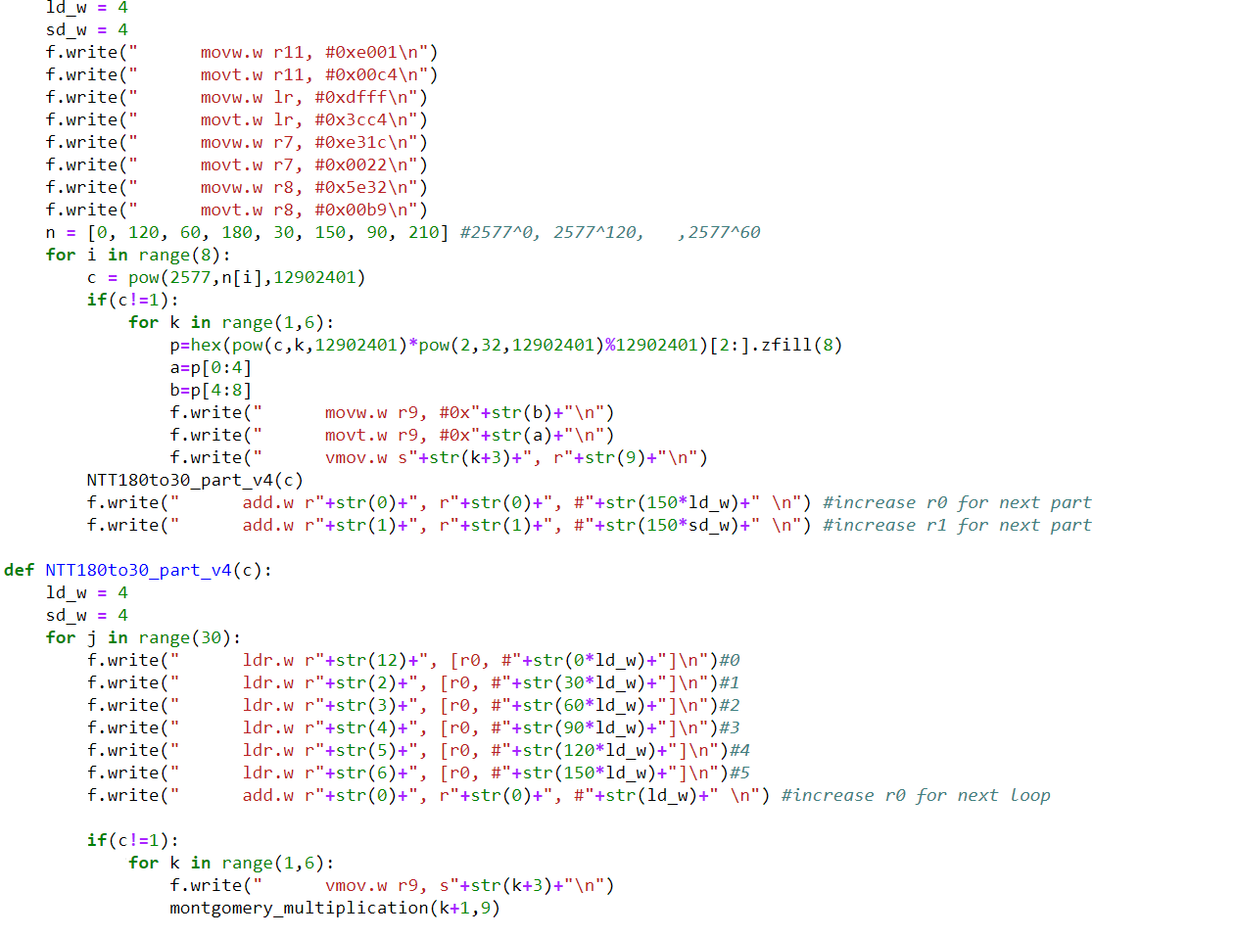
Tricks tried 180-30(6-Good’s trick) (Optimization)

Slide 18
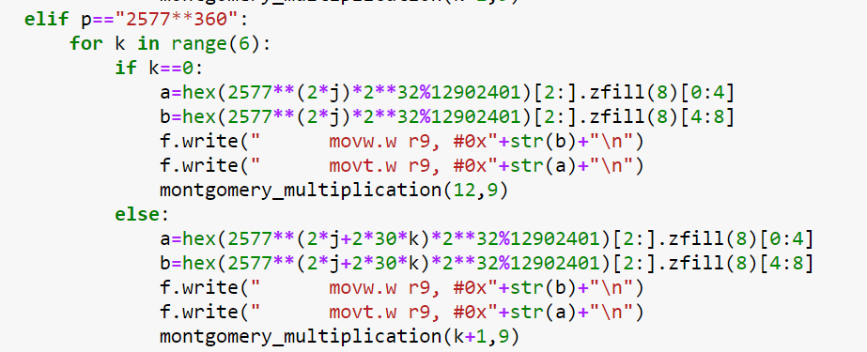
Tricks tried 180-30(6-Good’s trick) (Twisted)
To do twisted We do Like this

Slide 19
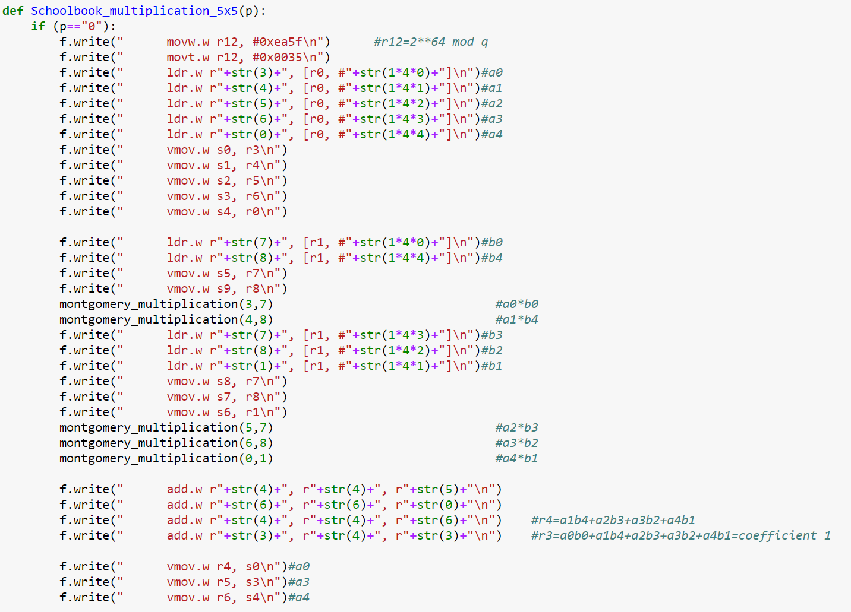

Tricks tried $5×5$(School book) (Not Optimization)

Slide 20
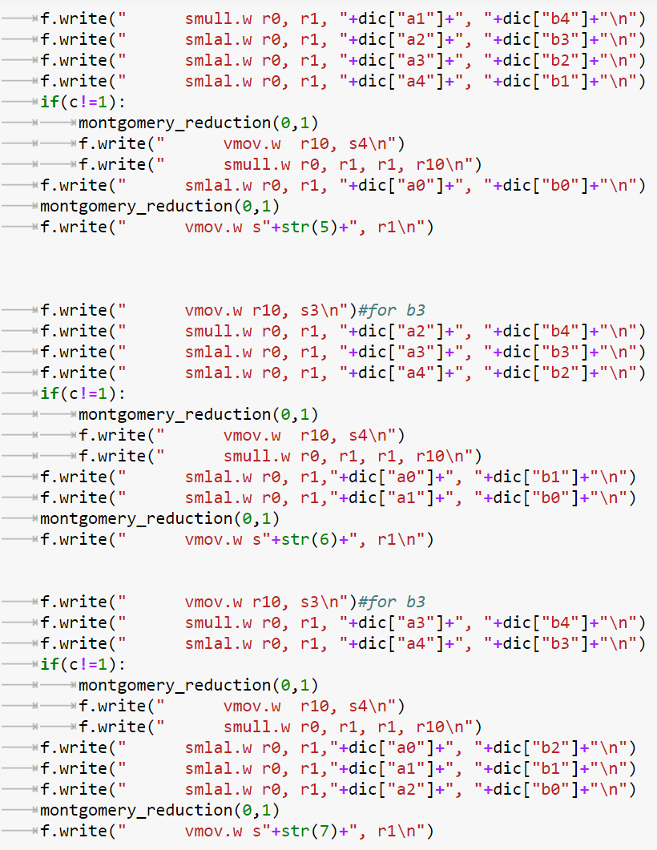

Tricks tried $5×5$(School book) (Optimization)

Slide 21
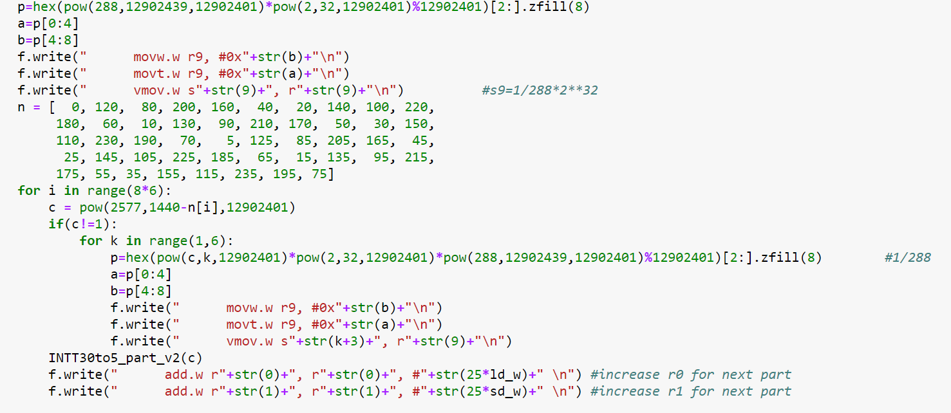
The coefficient 1/288

Slide 22
Barrett reduction
Notice that round(R/q)=333

Slide 23
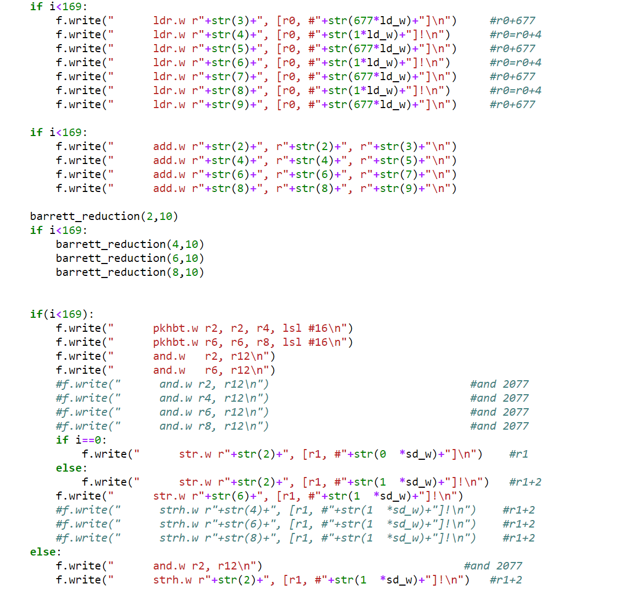
Tricks tried x^1352tox^677_mod2048

Slide 24
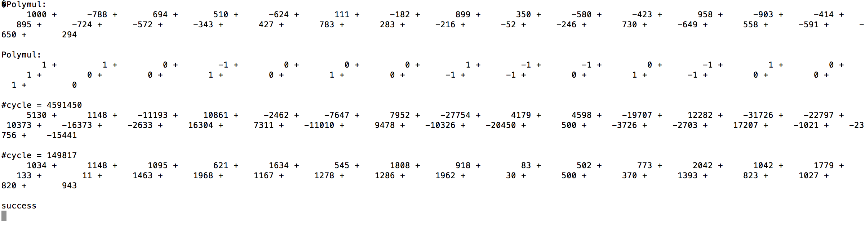
Experiments
Compare our NTT multiplication with school book multiplication:

Slide 25
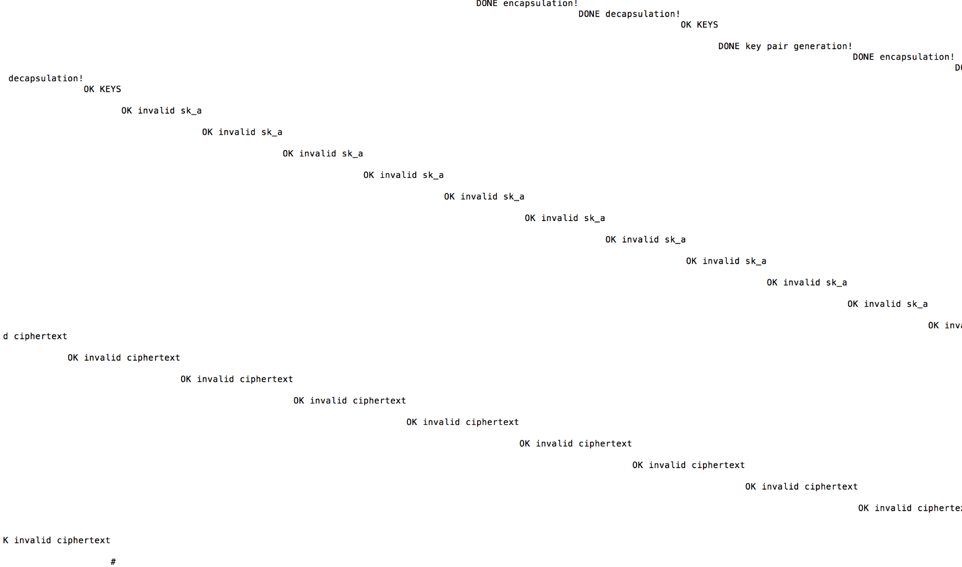
Experiments
Run on pqm4:

Slide 26
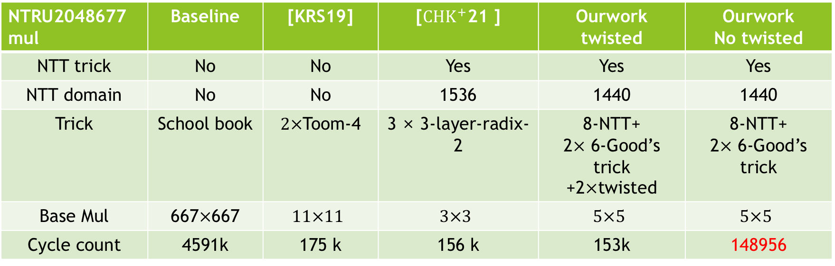
Performance and Comparison
NTRU2048677mul | Baseline | [KRS19] | [${CHK}^{+}$21 ] | Ourwork twisted | Ourwork No twisted
NTT trick | No | No | Yes | Yes | Yes
NTT domain | No | No | 1536 | 1440 | 1440
Trick | School book | $2×$Toom-4 | 3 × 3-layer-radix-2 | 8-NTT+ 2$×$ 6-Good’s trick +2$×$twisted | 8-NTT+ 2$×$ 6-Good’s trick
Base Mul | 667$×$667 | $$11×11$$ | $$3×3$$ | $$5×5$$ | $$5×5$$
Cycle count | 4591k | 175 k | 156 k | 153k | 148956

Slide 27
NTRU | m4f | m4f w/ our NTT
KeyGeN | 143,740k | 143,719k
Encaps | 827k | 820k
Decaps | 814k | 807k
Key | OK | OK

