Slide 1
SmartLife & Budget
Balance Platform
A unified platform for schedule, notes, and personal finance
Team: I See You 17 (Konpong Chaovanakittikun, Narongchai Thathong, Natkamol Petcharat)
Project: 110191 Project in Digital Technology, Semester 1/2569
Institution: Suranaree University of Technology

Slide 2
The Problem
3+ apps
Time lost switching between applications (context switching)
Scattered data across Google Calendar, OneNote, and Money Lover
15 min / day
Lost every day to context switching alone
~60 hours wasted per semester — time that should go to studying
No safety net
No stress tracking, leaving students at risk of burnout
Manual expense logging is tedious, so most students give up on budgeting
2

Slide 3




The Solution — SmartLife Ecosystem
Unified Dashboard
Smart Schedule Importer
One screen for everything
Timetable OCR, auto-synced
SmartLife
Smart Schedule Builder
Personal Finance Tracker
Adaptive AI, burnout-aware
Scan, categorize, alert
3

Slide 4
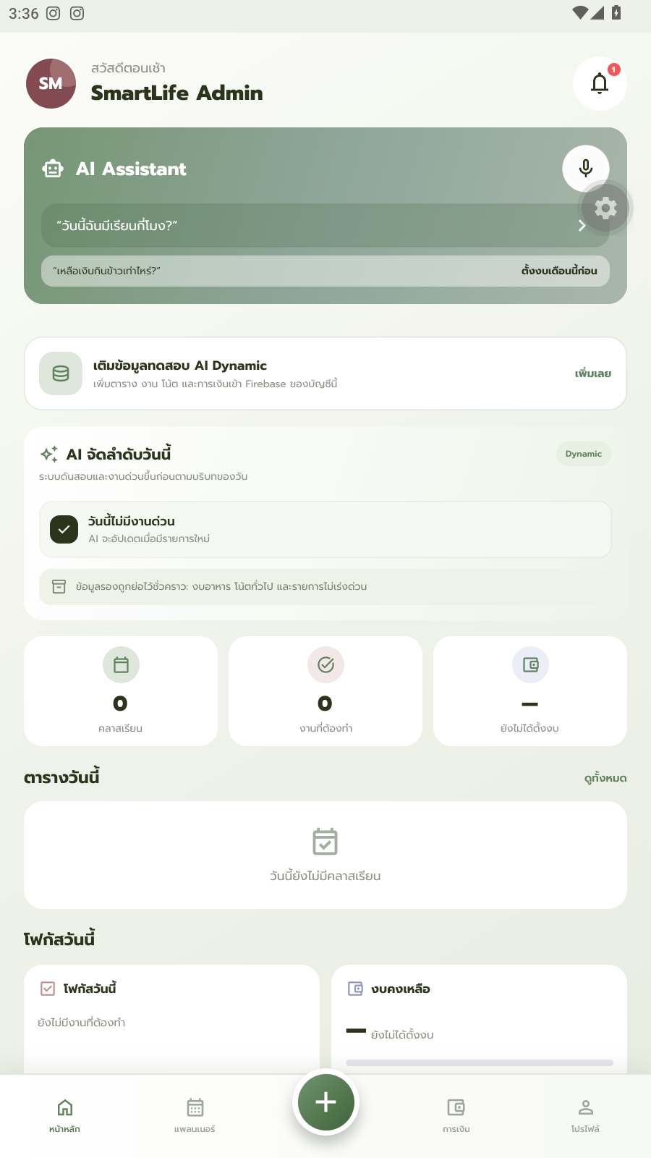
1
Unified Dashboard
AI Smart Assistant
Ask by voice or text — “What time is my class today?” or “How much do I have left for food?” Answered instantly from real data.
AI-Assisted Prioritization
The dashboard highlights the most urgent item for the day first, so an exam reminder never gets buried.
Unified View
Schedule, tasks, and remaining budget together on one screen.
Real screenshot — Dashboard
4

Slide 5
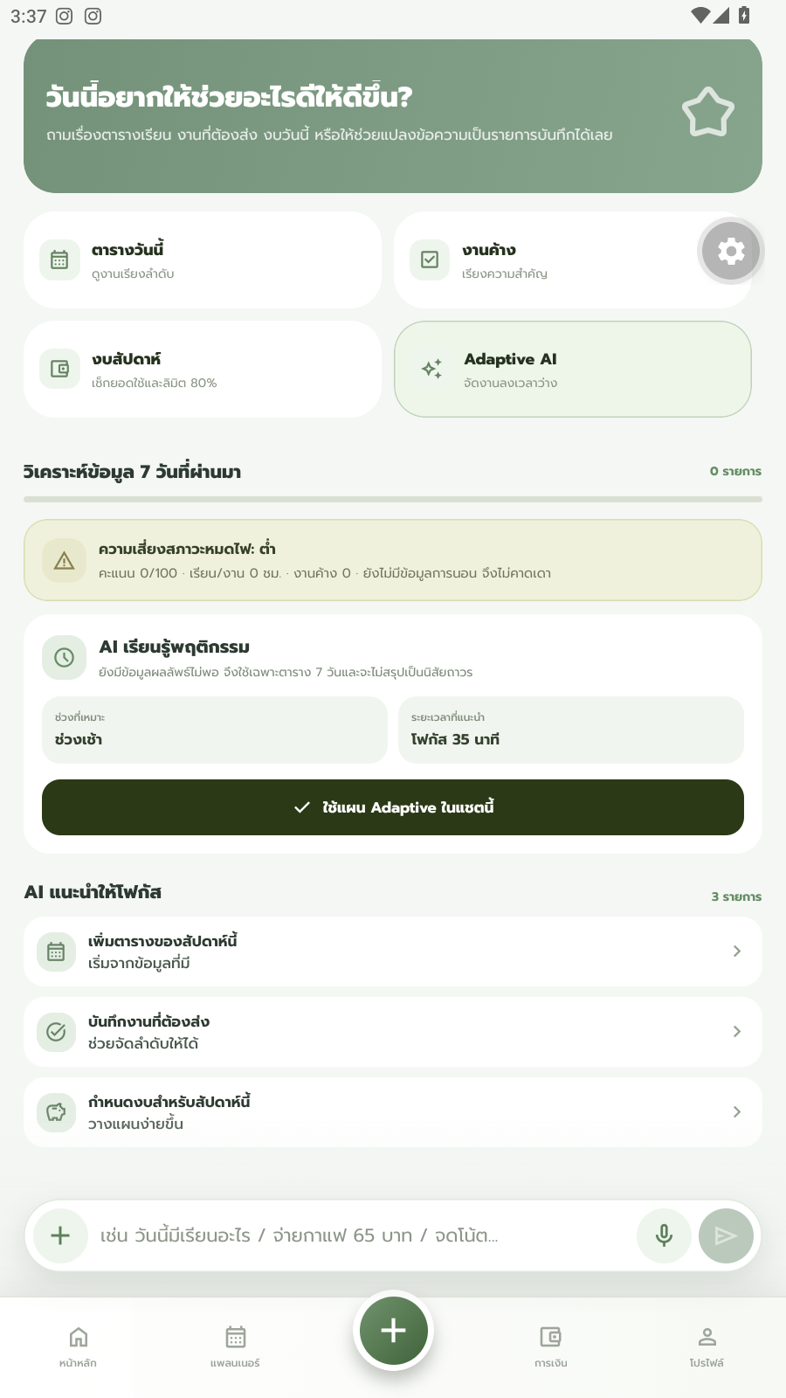
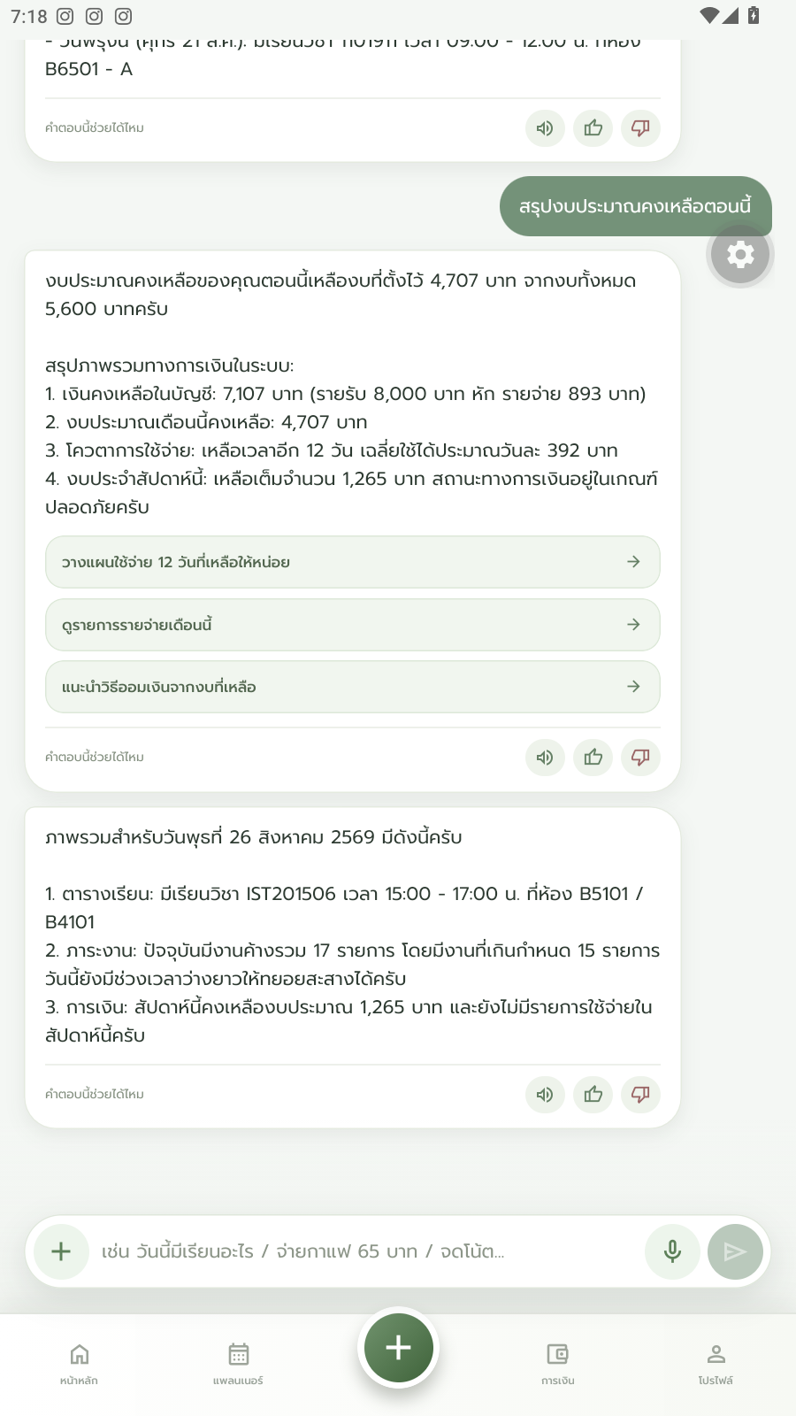
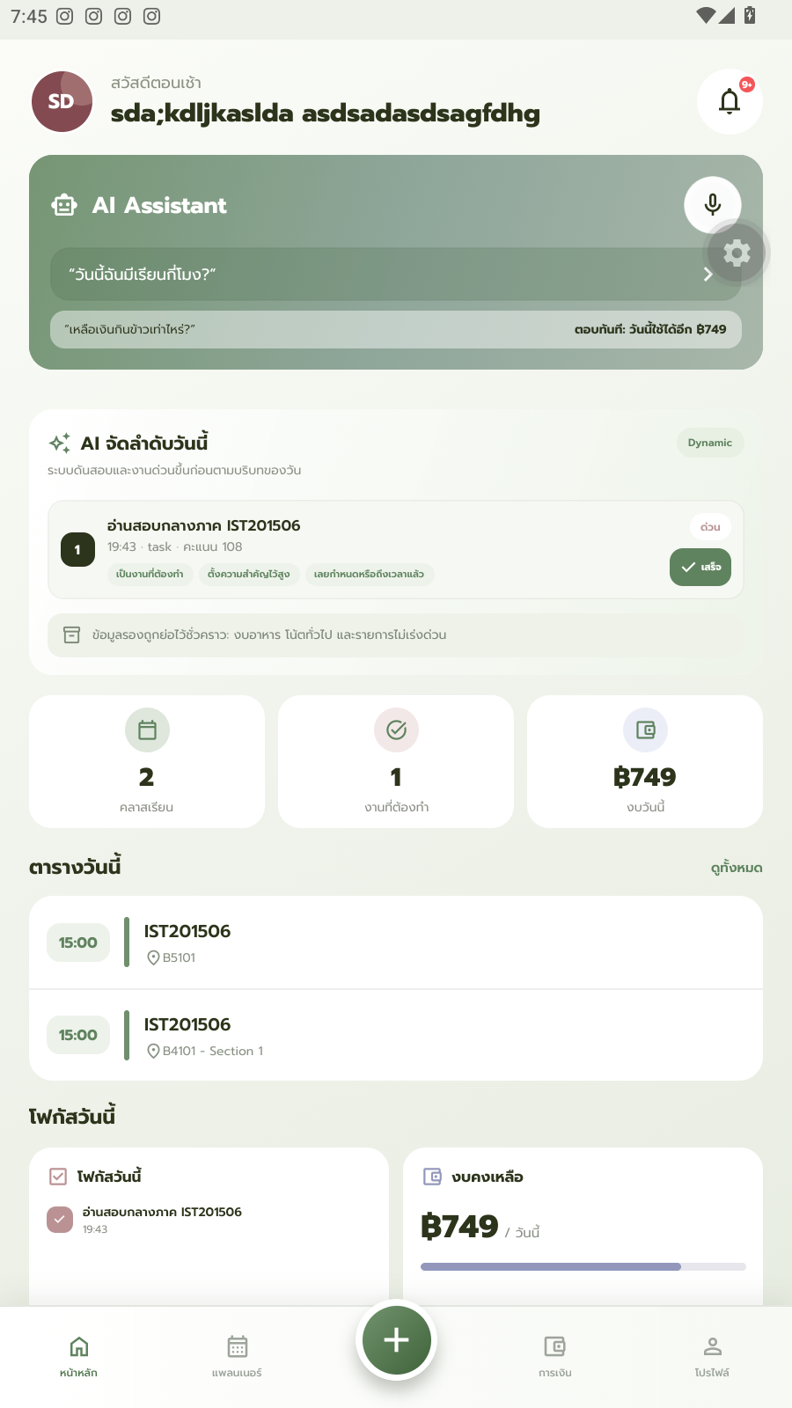
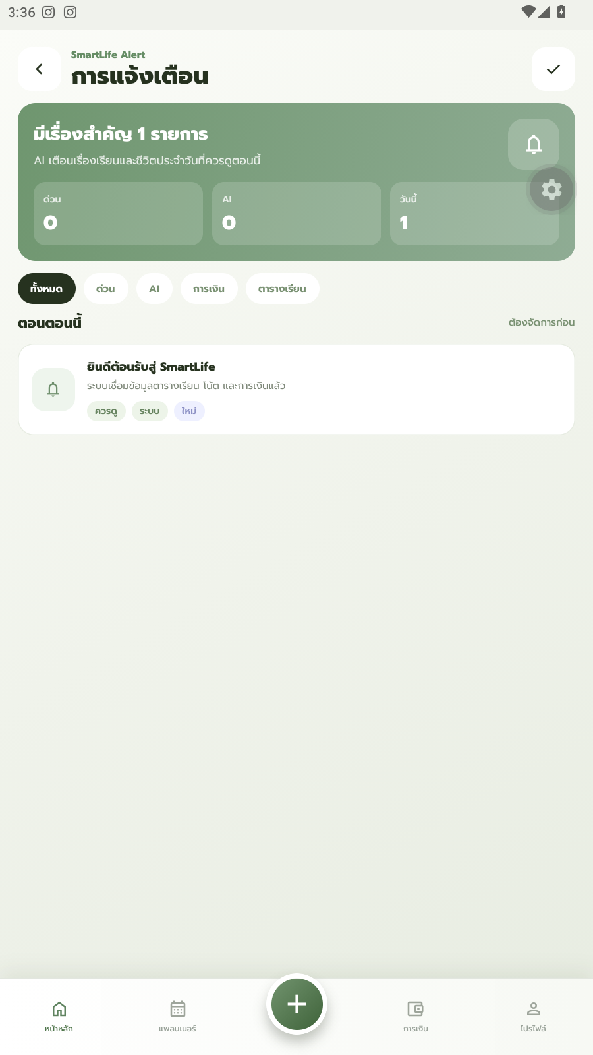
UNIFIED DASHBOARD
More From Your Dashboard
Ask by voice or by text, catch today's top priority first, and never miss an update.
Type your question
Or ask out loud
Today's top priority
Every update, in one place
5

Slide 6
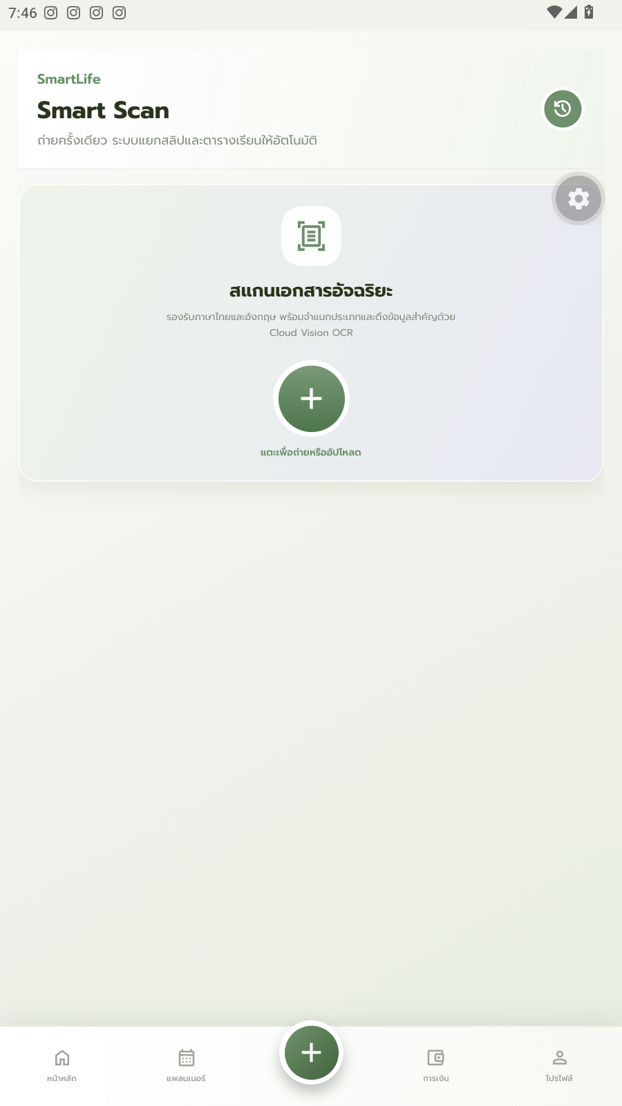
2
Smart Schedule Importer
Smart Timetable Scan
Upload a photo of your class timetable — no manual typing.
Cloud Vision OCR
Automatically extracts the subject code, time, and room.
Two-Way Sync
Keeps everything in sync with Google Calendar automatically.
Upload a timetable photo
6

Slide 7
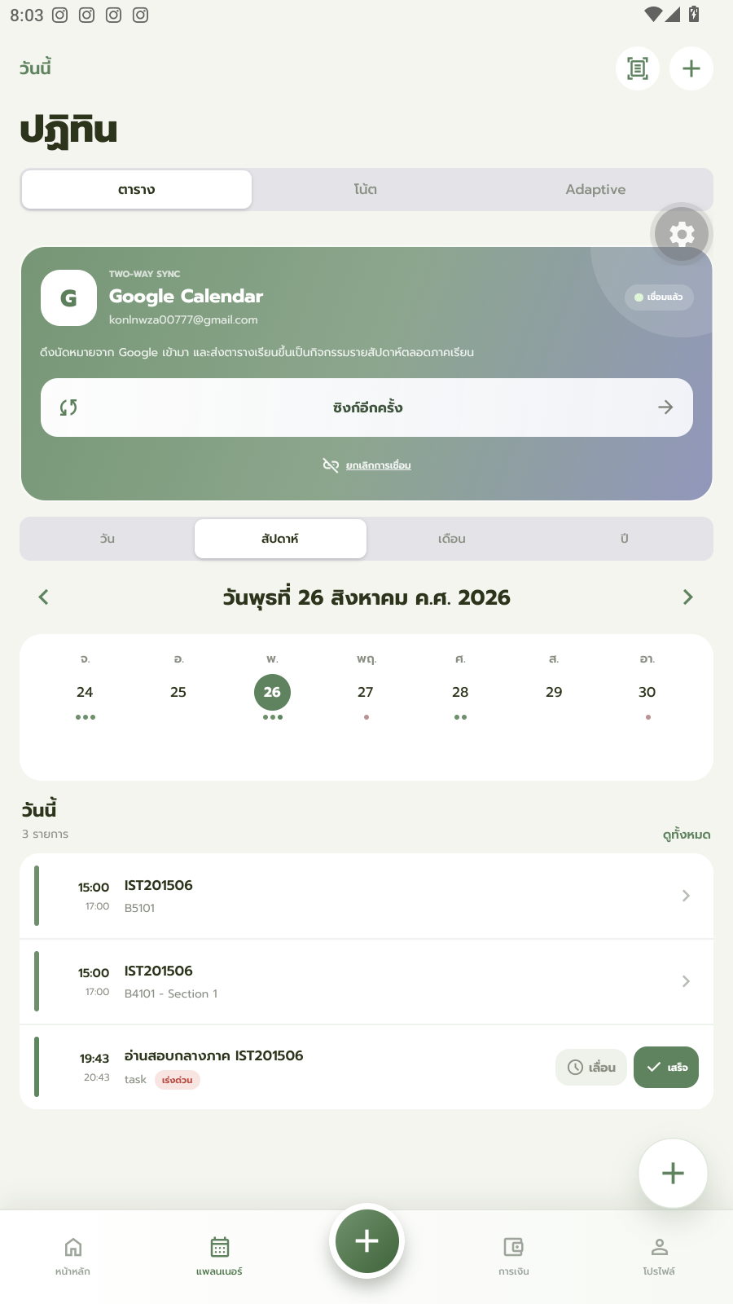
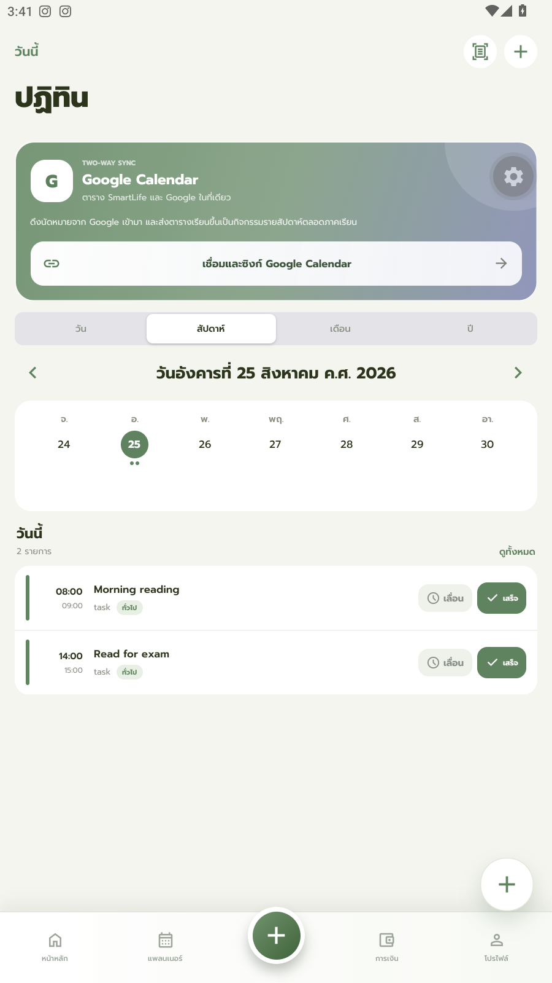
SMART SCHEDULE IMPORTER
From Photo to Full Calendar
Once extracted, every class syncs straight into Google Calendar — viewable in SmartLife or your calendar app, side by side.
Synced to Google Calendar
Your full week, at a glance
7

Slide 8
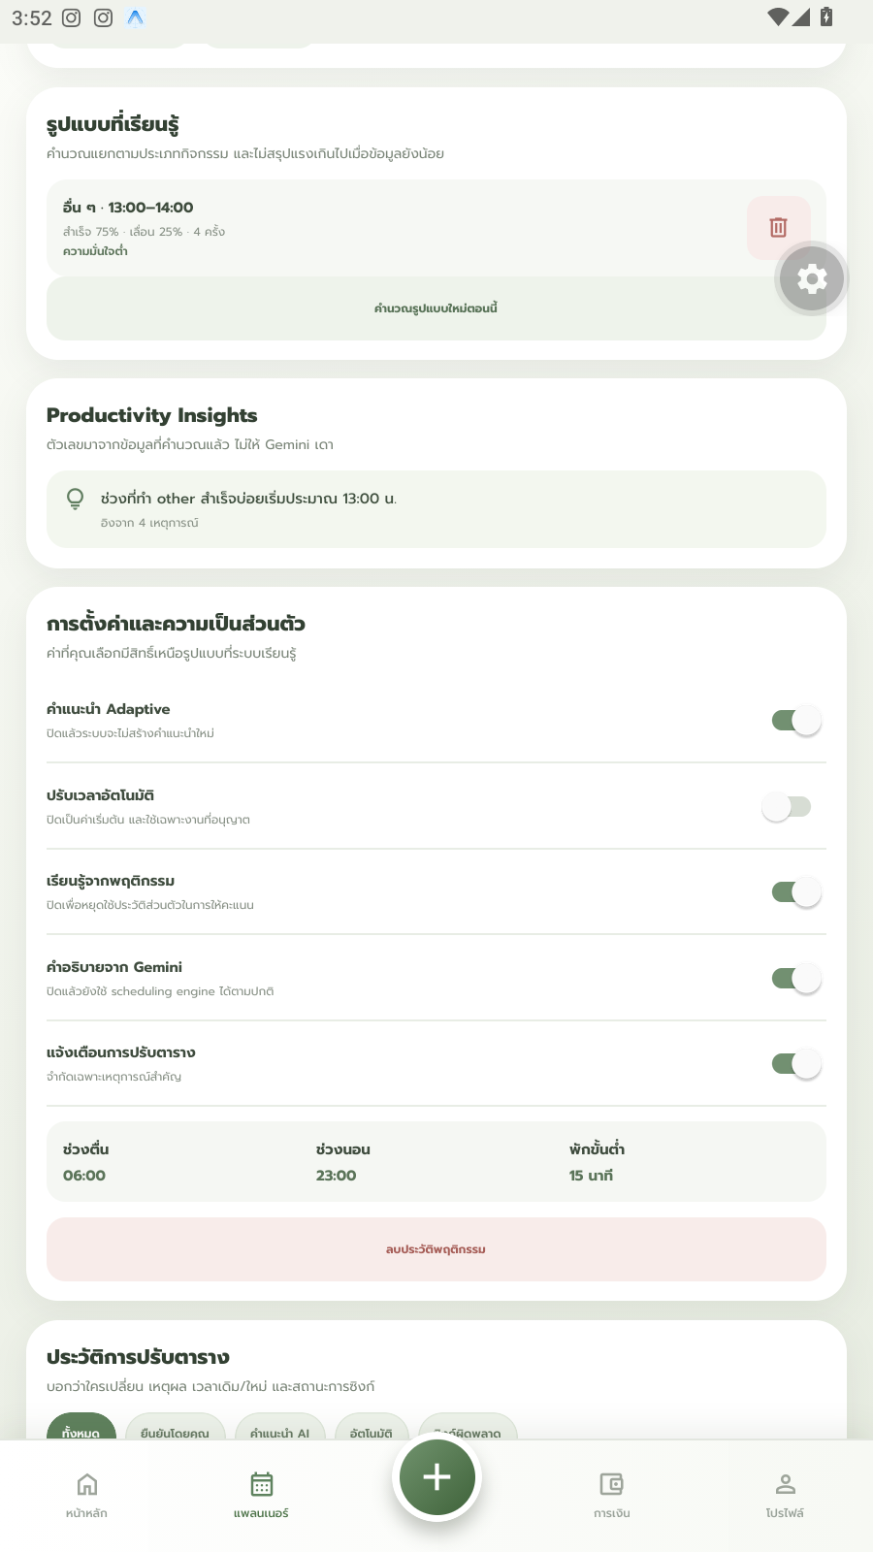
3
Smart Schedule Builder
Adaptive Scheduling
Learns your behavior — keep postponing a morning study session, and it starts suggesting the afternoon instead.
Burnout Awareness
Looks at your study/rest balance and gives a short, supportive check-in when things look unbalanced.
The app learns your patterns over time
8

Slide 9
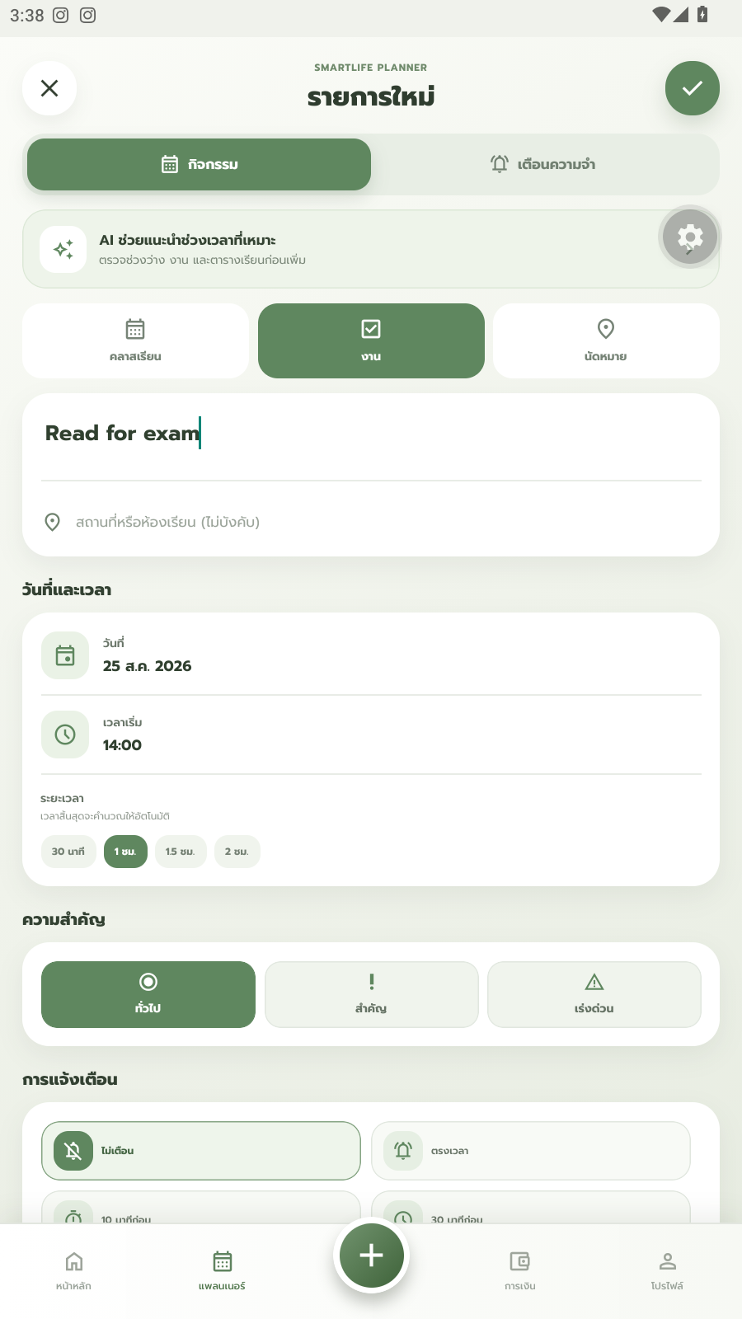
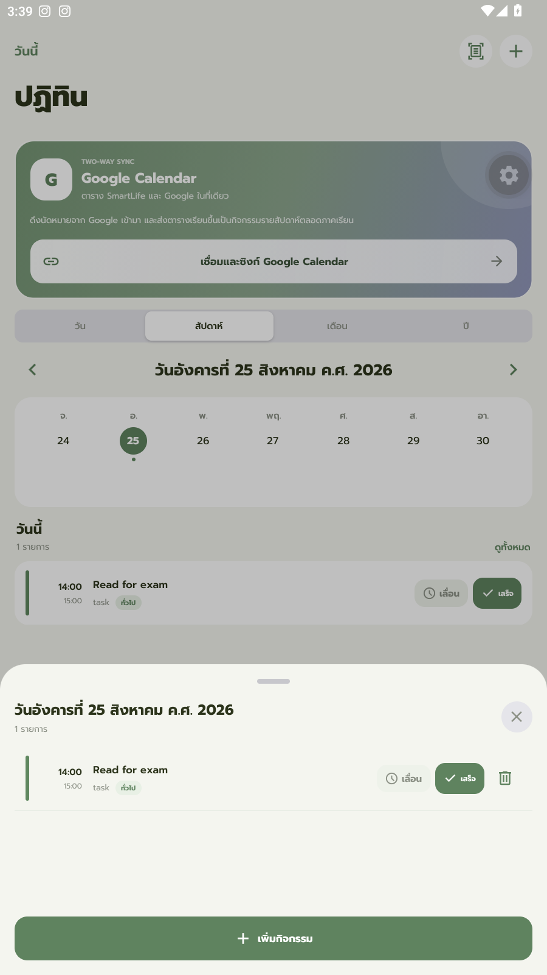
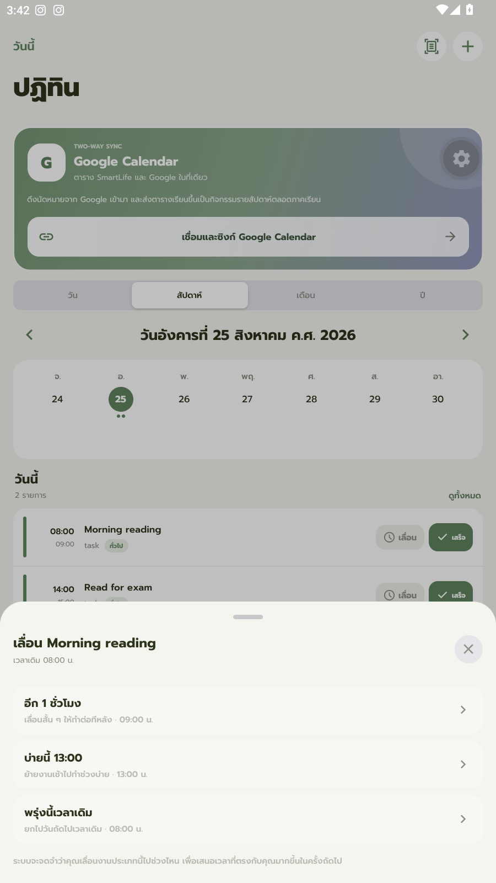
SMART SCHEDULE BUILDER
Quick, Everyday Actions
Creating, completing, and postponing a task all take just seconds — the app learns from every one.
Create a task
Mark it done
Postpone with a tap
9

Slide 10
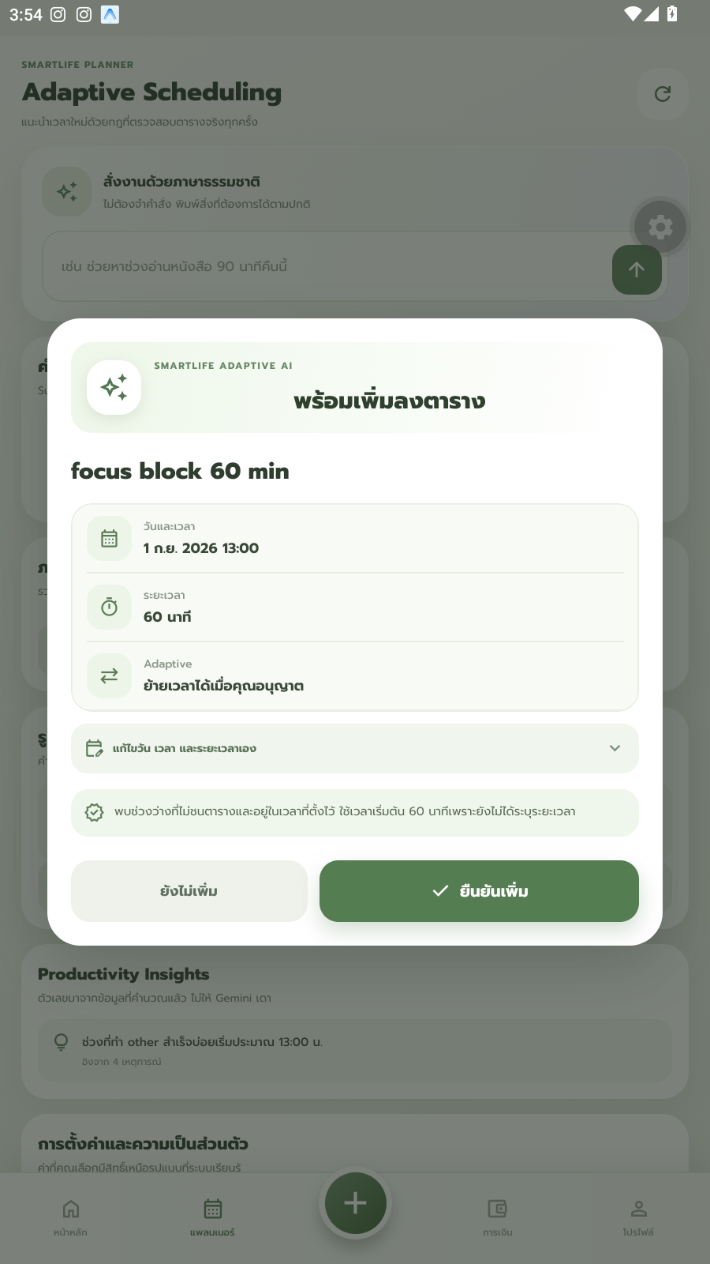

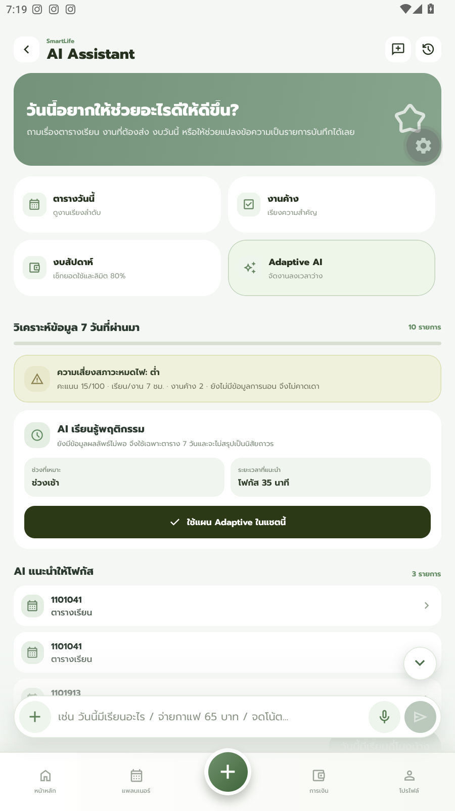
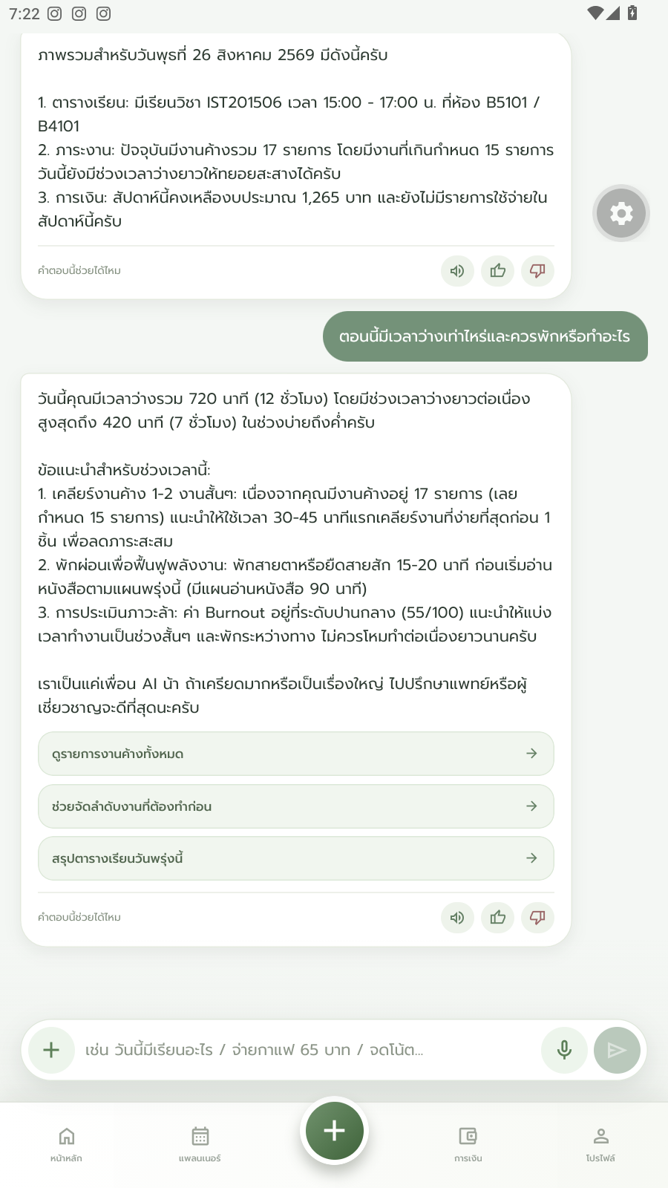
SMART SCHEDULE BUILDER
Adaptive & Burnout-Aware
Suggestions shift with your habits, and a supportive check-in appears when your balance looks off.
Learning ON — 13:00
Learning OFF — 16:30
Burnout risk analysis
A supportive check-in
10

Slide 11
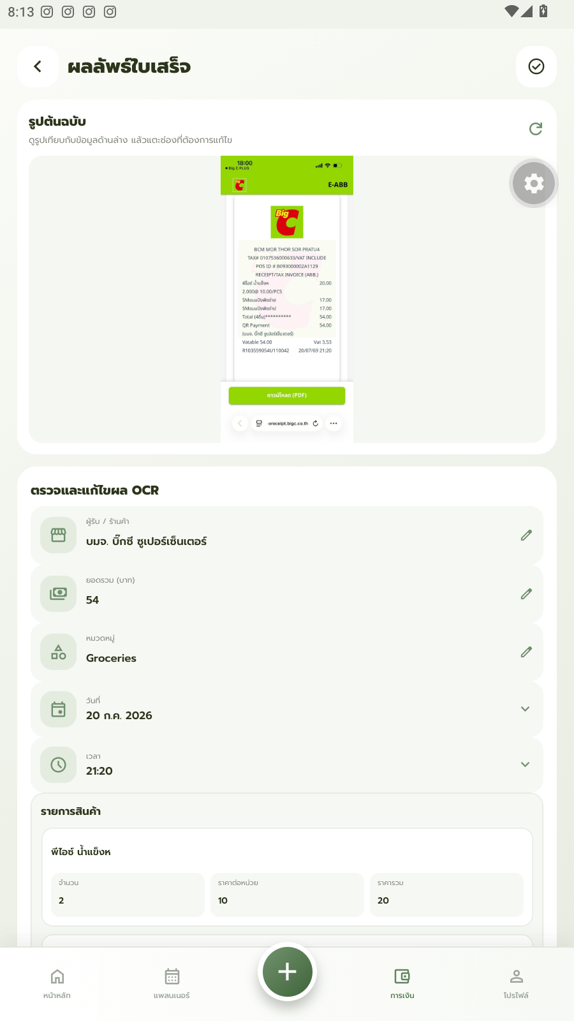
4
Personal Finance Tracker
Smart Scan
Uses OCR to read the amounts and line items straight from a receipt photo.
Auto-Categorization
NLP analyzes and tags the spending category automatically — a grocery receipt is tagged “Groceries” instantly.
Budget Alerts
Sends an early warning the moment spending gets close to the monthly budget.
Real screenshot — Auto-categorized receipt
11

Slide 12

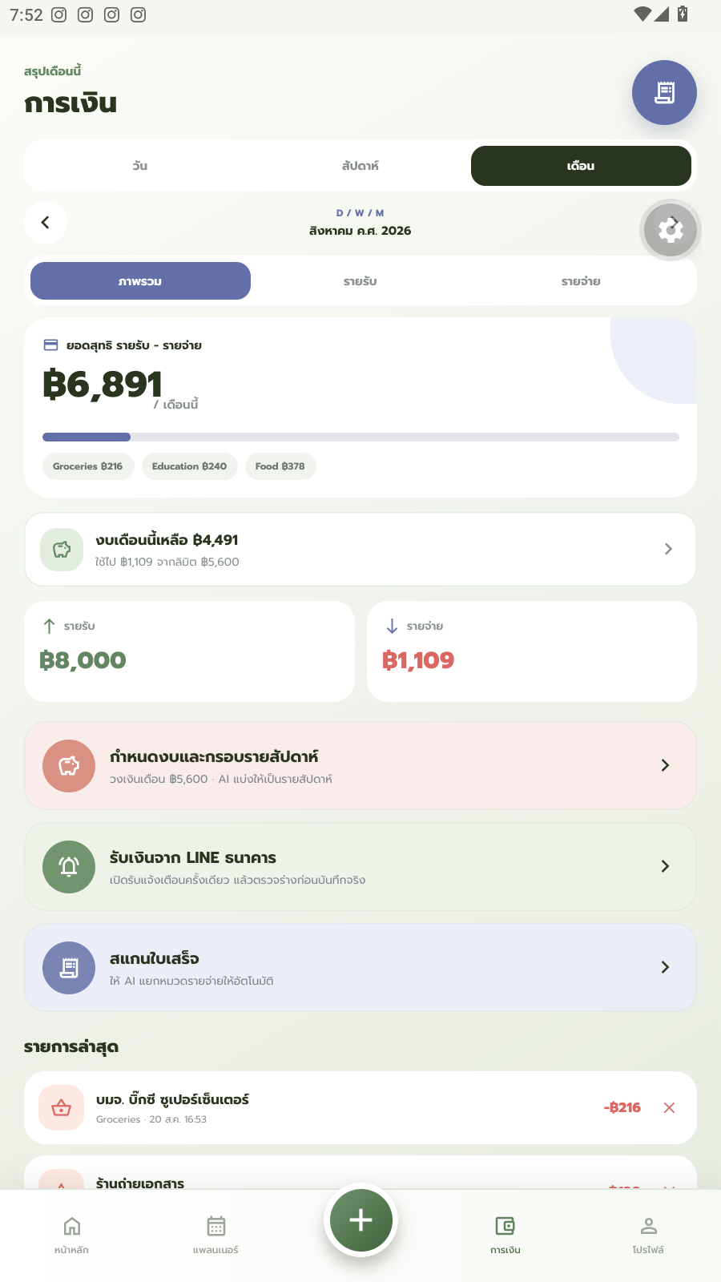
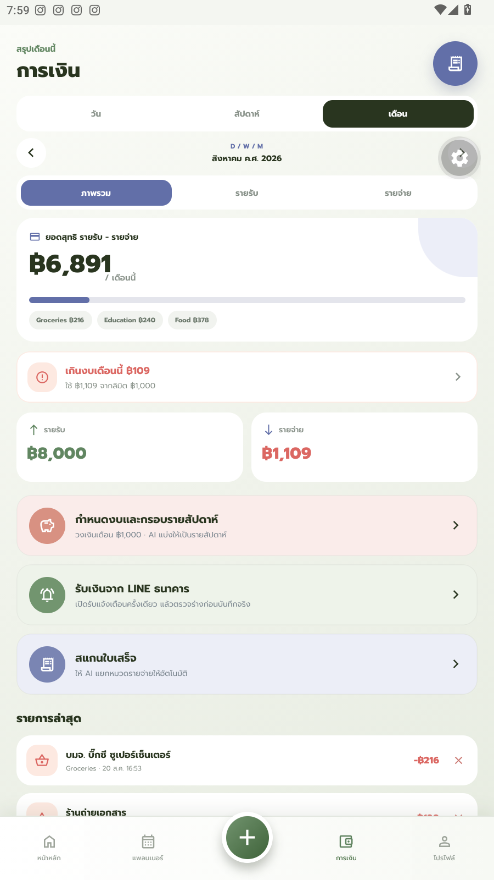
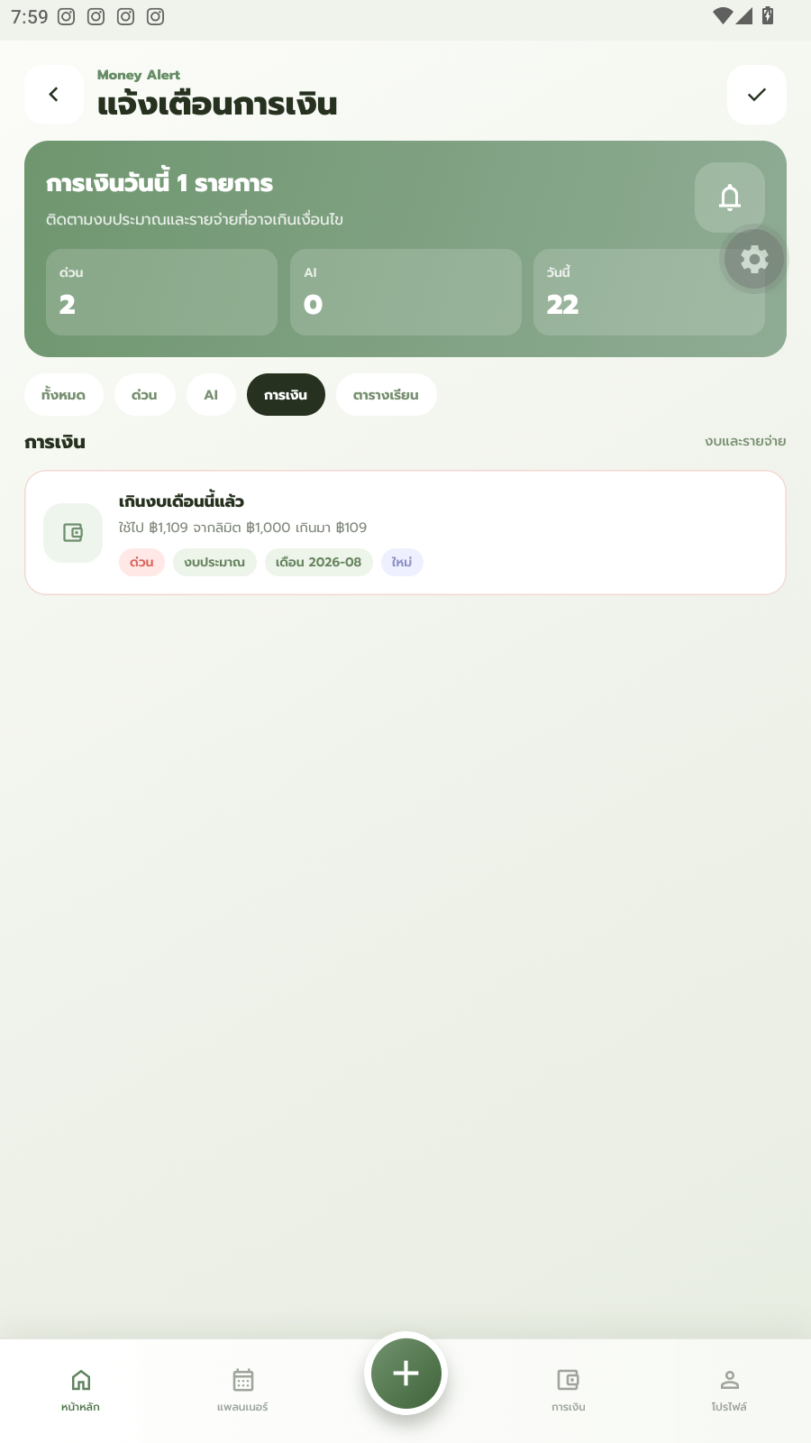
PERSONAL FINANCE TRACKER
From Scan to Spending Control
Every receipt is scanned, categorized, and checked against your monthly budget automatically.
Scan in progress
Finance overview
In-app alert
Push notification
12

Slide 13
From Complexity to Simplicity
Saves Time
One Clear View
Cuts time lost to app-switching
~60 hours returned per semester
Schedule, notes, and finances
finish on a single screen
Better Wellbeing
Financial Discipline
Prevents burnout with alerts
and a balanced schedule
Real spending control through
seamless automation
13

Slide 14
Technology Behind SmartLife
Front-end
Expo, React Native, TypeScript, Expo Router
Back-end & Database
Firebase — Firestore, Authentication, Storage, Cloud Functions
AI & API Intelligence
Google Cloud Vision API (OCR) · Gemini AI (NLP & Smart Assistant) · Google Calendar API
14

Slide 15
Thank You
Questions are welcome.
SmartLife & Budget Balance Platform — Team I See You 17 — Suranaree University of Technology

