Slide 1
SmartLife & Budget Balance Platform
A unified schedule, notes, and personal-finance platform for university students
Project in Digital Technology (110191) — Semester 1/2569
Team: I See you 17 — Konpong Chaovanakittikun · Narongchai Thathong · Natkamol Petcharat
English for Business Presentations — Week 9 material

Slide 2
Background & Problem
University students juggle a heavy academic schedule, projects, exams, and extracurricular activities alongside a limited monthly budget — all at the same time.
There is no central tool to manage all of this, so students rely on several separate apps together: Google Calendar for schedules, OneNote for notes, apps like Money Lover for expenses, plus social media.
Constant switching between apps (“context switching”) wastes an average of 15 minutes a day — about 60 hours per semester.
Traditional schedule planning is rigid and has no way to track stress levels, leaving many students at risk of burnout.
Manually logging every expense is tedious, so most students eventually give up on budgeting altogether.
Source: Project Proposal — ที่มาและความสำคัญ

Slide 3
Project Overview — 4 Core Scope Areas
1. Unified Dashboard — one screen for today's schedule, budget, and an AI assistant
2. Smart Schedule Importer — upload a timetable photo, OCR extracts it, syncs to Google Calendar
3. Smart Schedule Builder — adaptive scheduling that learns user behavior, plus burnout awareness
4. Personal Finance Tracker — scan a receipt, auto-categorize the expense, get budget alerts
Source: Project Proposal — ภาพรวมและขอบเขตของโครงงาน

Slide 4
Feature Area 1 — Unified Dashboard
AI Smart Assistant — ask questions by voice or text, e.g. “What time is my class today?” or “How much do I have left for food?” — answered instantly from real data.
AI-assisted prioritization — the dashboard highlights the most urgent items for the day, so an exam reminder is not buried under less important information.

Slide 5
Feature Area 2 — Smart Schedule Importer
Upload a photo of the class timetable.
OCR (Google Cloud Vision) extracts subject codes, times, and rooms automatically.
Calendar Syncing — two-way sync with Google Calendar / the university system.

Slide 6
Feature Area 3 — Smart Schedule Builder
AI Adaptive Scheduling — learns user behavior and adjusts the schedule automatically. Example: if a user keeps postponing a morning study session, the system suggests an afternoon slot instead.
AI Burnout Predictor & Coach — analyzes the study/rest time ratio to assess burnout risk, and offers short, supportive check-ins and break suggestions.

Slide 7
Feature Area 4 — Personal Finance Tracker
Smart Expense Categorization — OCR reads the text on a receipt photo, and NLP automatically identifies and tags the spending category.
Example: a receipt from a grocery store is automatically tagged “Groceries”.
Budget alerts notify the user when monthly spending goes over the set budget.

Slide 8
Expected Benefits
Saves time — clearly reduces time lost to managing scattered data and switching between apps.
Clear overview of daily life — schedule, notes, and finances together on a single screen (Unified Dashboard).
Supports mental wellbeing — early warning when study/work load is too high, helping reduce stress and the risk of burnout.
Builds financial discipline — better control over monthly spending through budget planning and overspending alerts.
Source: Project Proposal — การนำไปใช้ประโยชน์

Slide 9
Users, Technology, and Innovation
Target users: university students
Technology stack (as built): Expo & React Native, TypeScript, Expo Router; Firebase Authentication, Firestore, Storage, and Cloud Functions
AI & API services: Google Cloud Vision API (OCR), Gemini AI (NLP / assistant), Google Calendar API
Innovations applied: (1) AI Smart Assistant & NLP engine, (2) specialized OCR for timetables and receipts, (3) heuristic & adaptive scheduling algorithm with behavior learning and burnout analysis
Note: proposal listed React/Next.js for front-end; the shipped app uses Expo/React Native — tech stack above reflects the actual build.

Slide 10
Project Timeline (16 Weeks)
1. Topic, background, objectives, benefits, and scope
2. UI/UX design and development
3. Database design (ER diagram) and data retrieval
4. Data manipulation system development
5. Frontend development — Dashboard & Finance Tracker
6. Backend API development and database connection
7. Google Cloud Vision API (OCR) integration
8. Heuristic Schedule Builder and predictive AI (Deep Work / Burnout analysis) — build and test
9. System integration and debugging
10. Performance testing, project presentation, and final report
Source: Project Proposal — แผนการดำเนินโครงงาน (16 สัปดาห์)

Slide 11
Analytics Canvas — Summary
Stakeholders
Data
Business Problems
Students (primary users) · I See You 17 development team · course instructor
Timetable photos · notes · income/expense data · task/collaboration data
Students must manage schedules, notes, and finances separately; ~15 min/day lost to context switching; no stress tracking; hard to control spending
Techniques
Deployment
Benefits
OCR (Google Cloud Vision API) · Heuristic Schedule Builder · Predictive Behavioral AI
Web / Mobile app — Dashboard & Notification
~60 hours saved per semester · unified view of daily life · reduced stress, burnout prevention · sustainable financial discipline
Source: Project Proposal — Analytics Canvas

Slide 12
Feature Walkthrough
Screenshots captured from the real application (Android, adb screencap) — not mock-ups

Slide 13
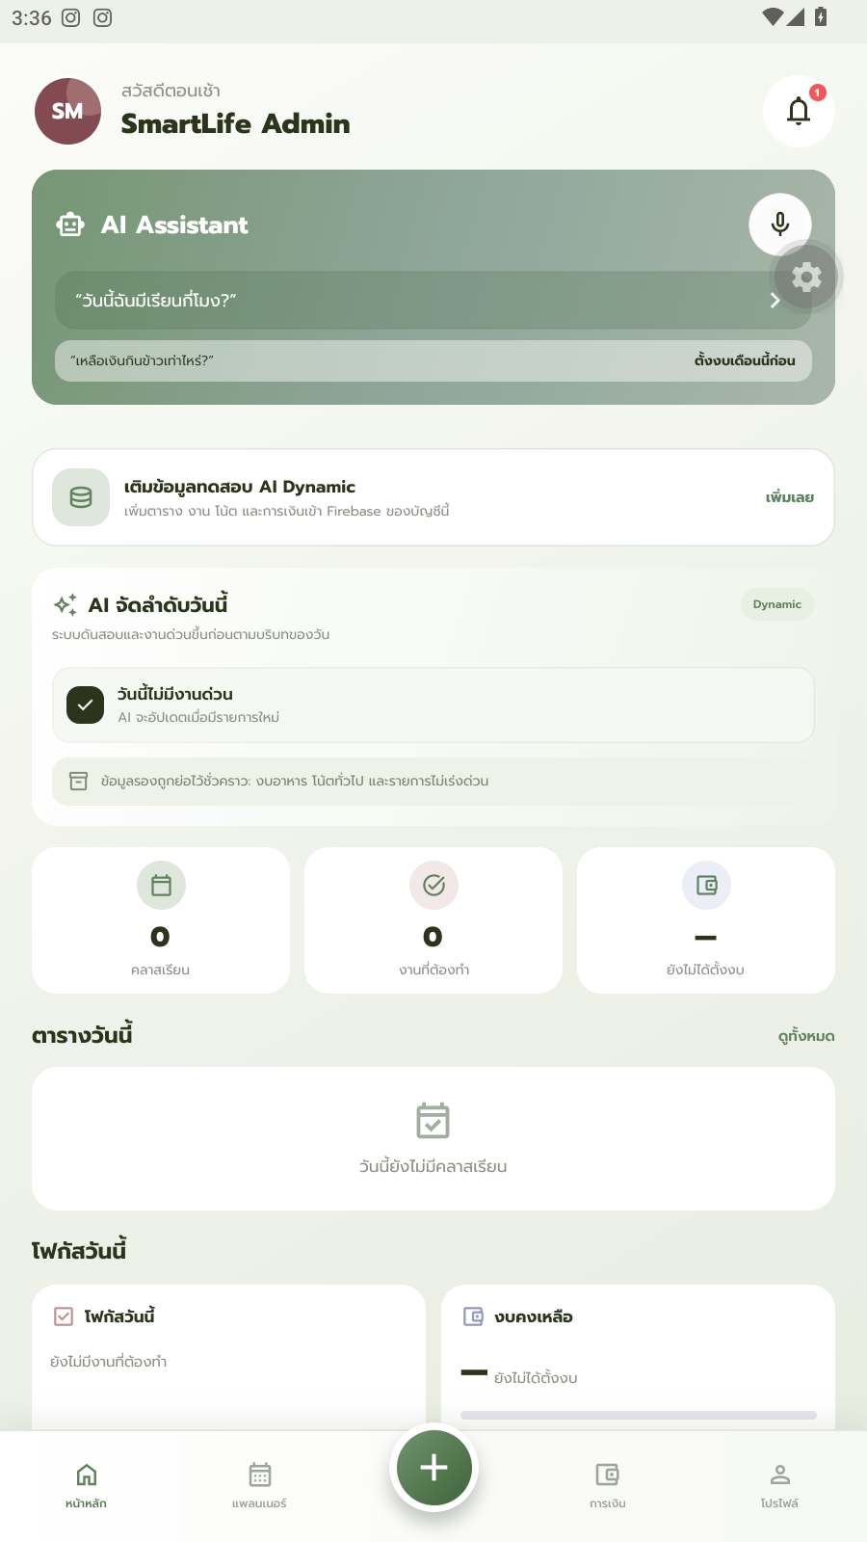
1. Dashboard
Home screen — today's summary, budget overview, and upcoming activities.

Slide 14
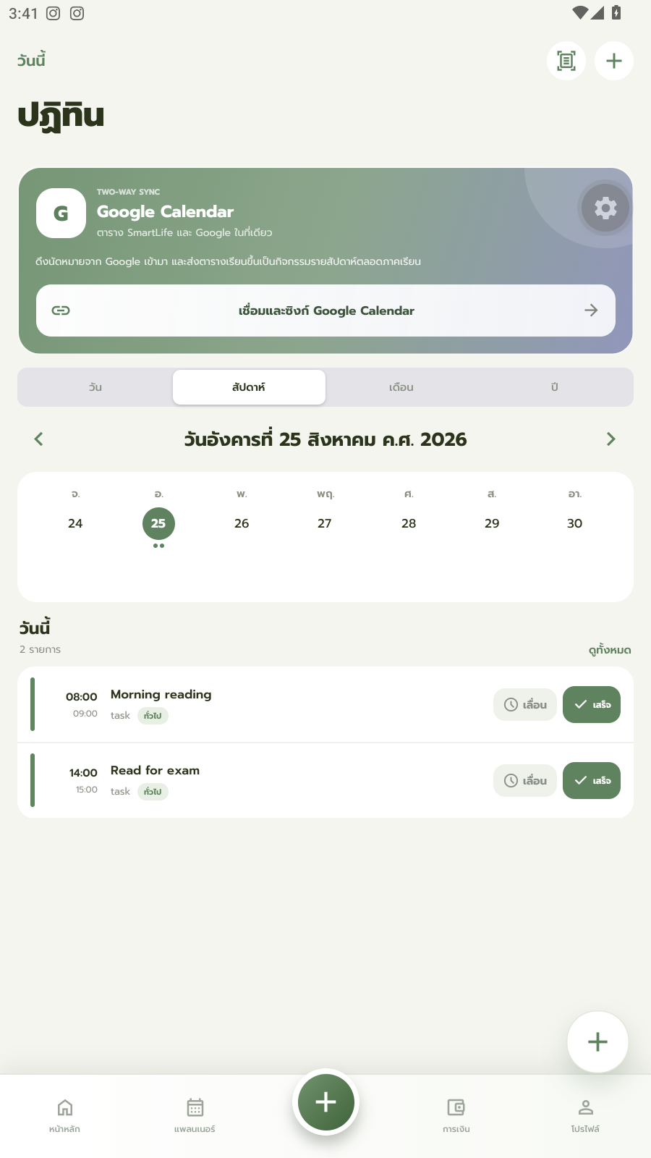
2. Calendar (Week view)
Weekly calendar with today's tasks and inline Postpone / Done actions.

Slide 15
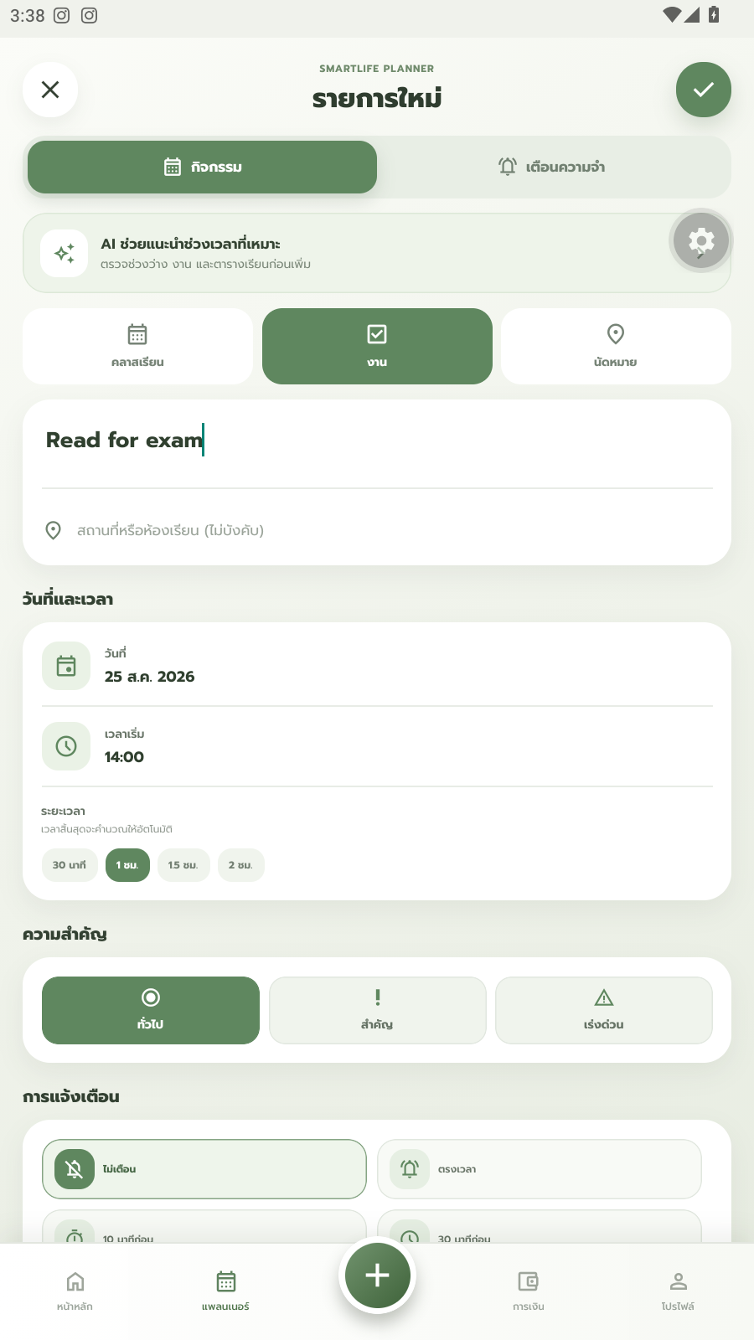
3. Create Task form
Task creation form — name, date, time, and a default 1-hour duration.

Slide 16
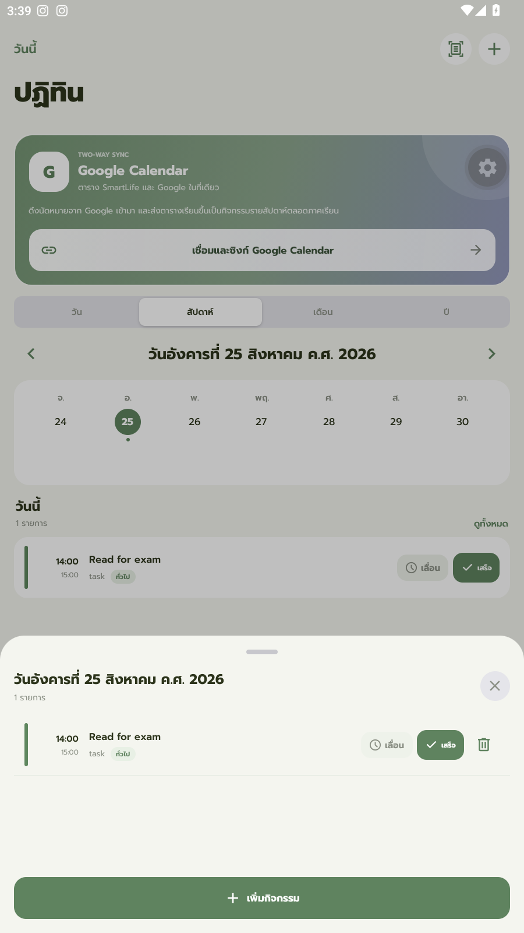
4. Task actions
Day-detail sheet with Postpone / Done / Delete actions for each task.

Slide 17
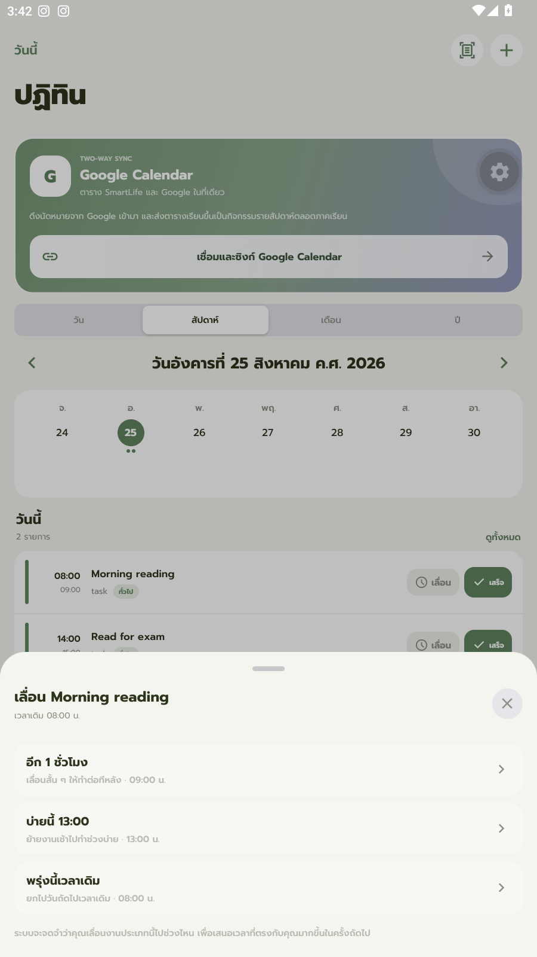
5. Postpone sheet
Reschedule options: +1 hour, this afternoon (13:00), or the same time tomorrow.

Slide 18
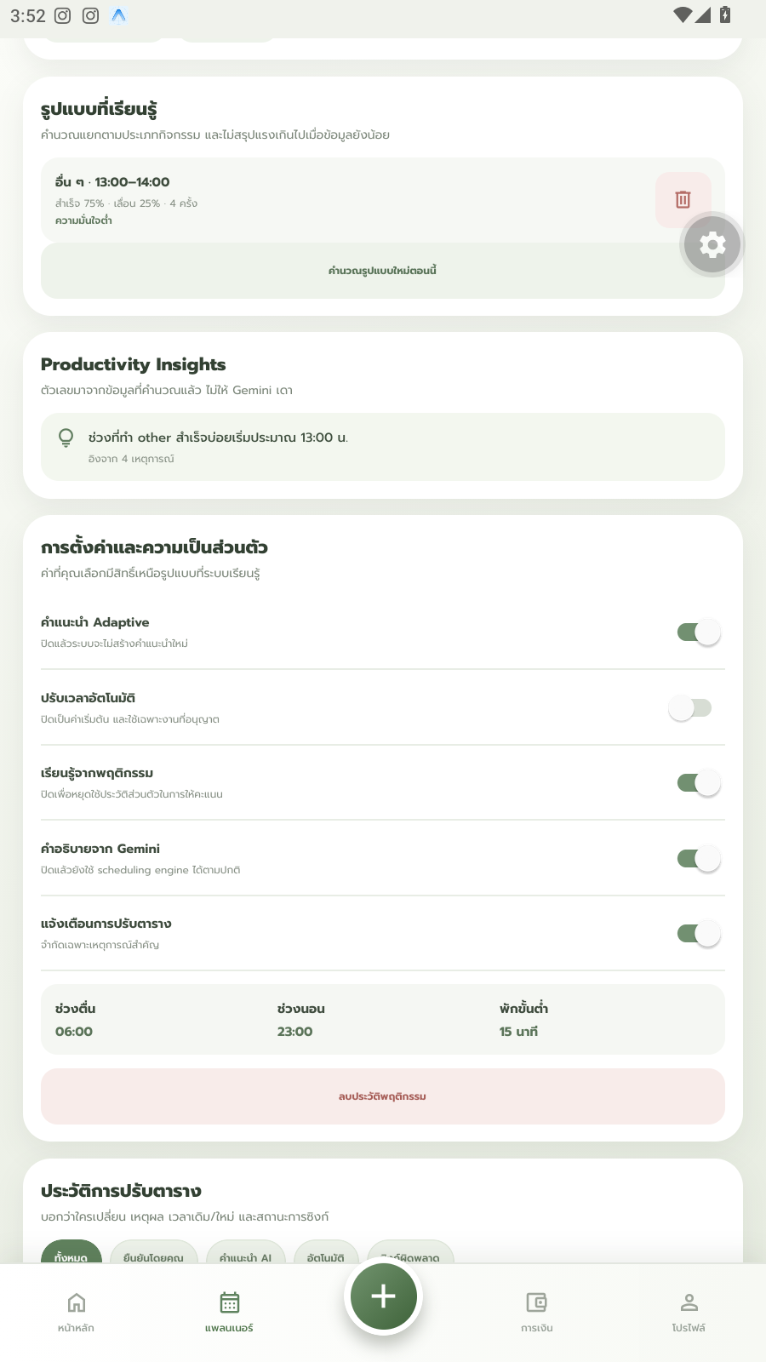
6. Adaptive scheduling — learned pattern
A real pattern the AI learned: “Other · 13:00-14:00 · 75% completed · 25% postponed · 4 occurrences.”

Slide 19
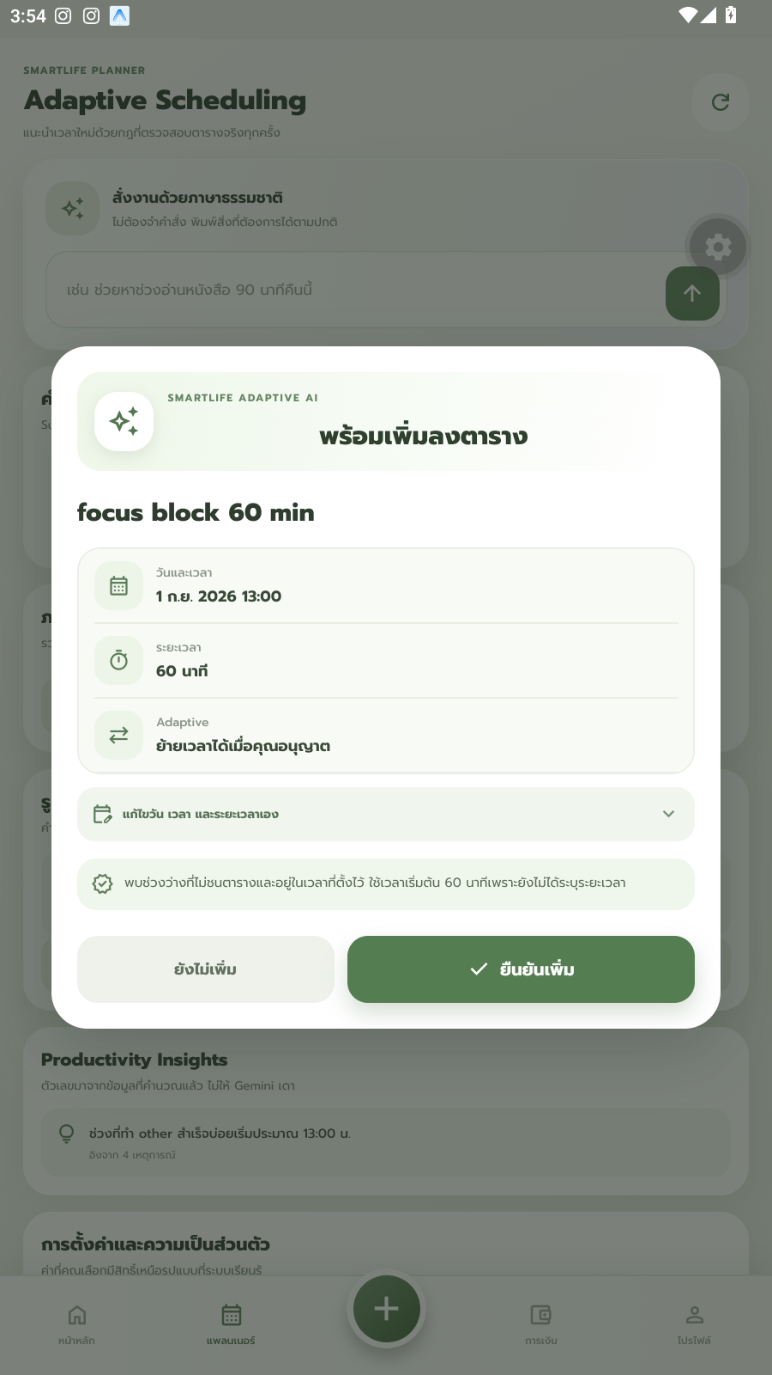
7a. Suggested time — learning ON
“Learn from behavior” ON → the system suggests Sep 1, 2026, 13:00, matching the learned pattern.

Slide 20

7b. Suggested time — learning OFF
Same request with learning OFF → falls back to the default suggestion, Aug 25, 2026, 16:30.

Slide 21
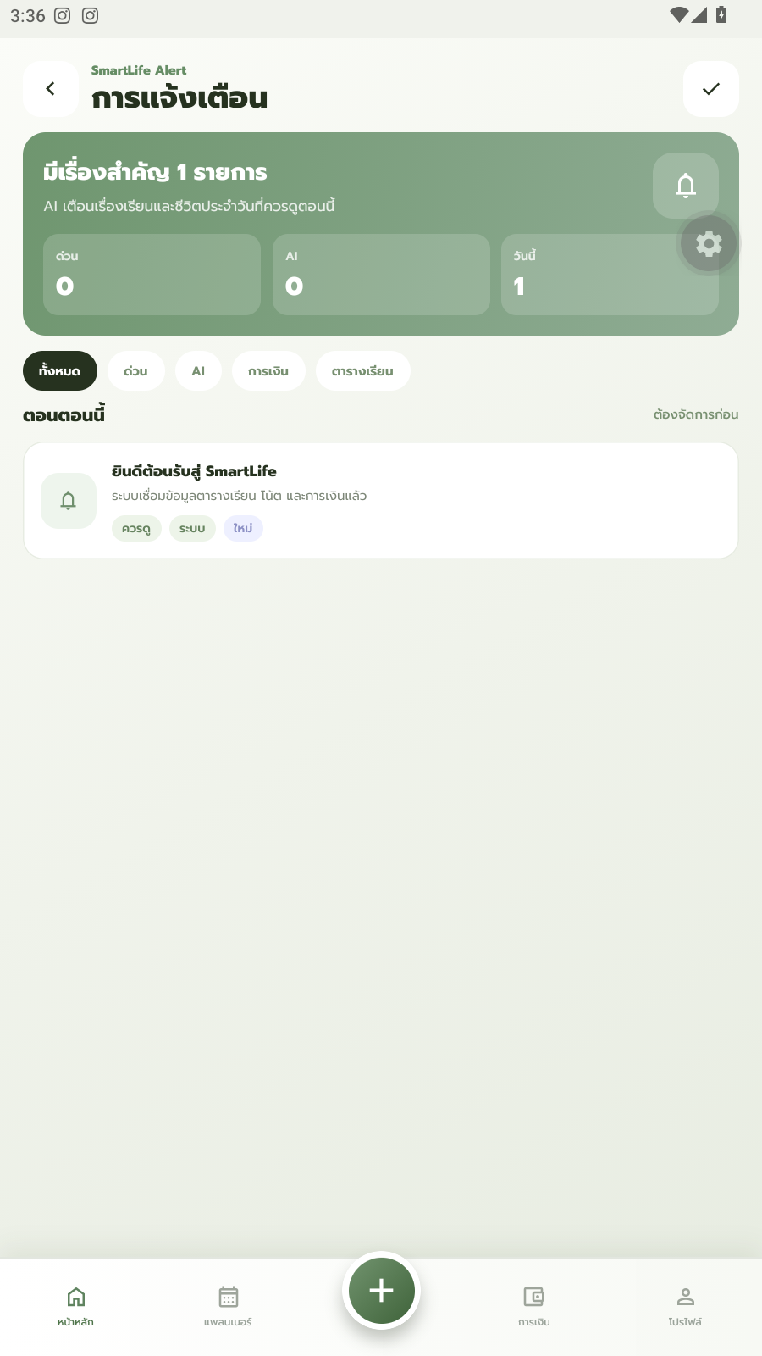
8. Notifications
Notification center for schedule, finance, and AI alerts.

Slide 22
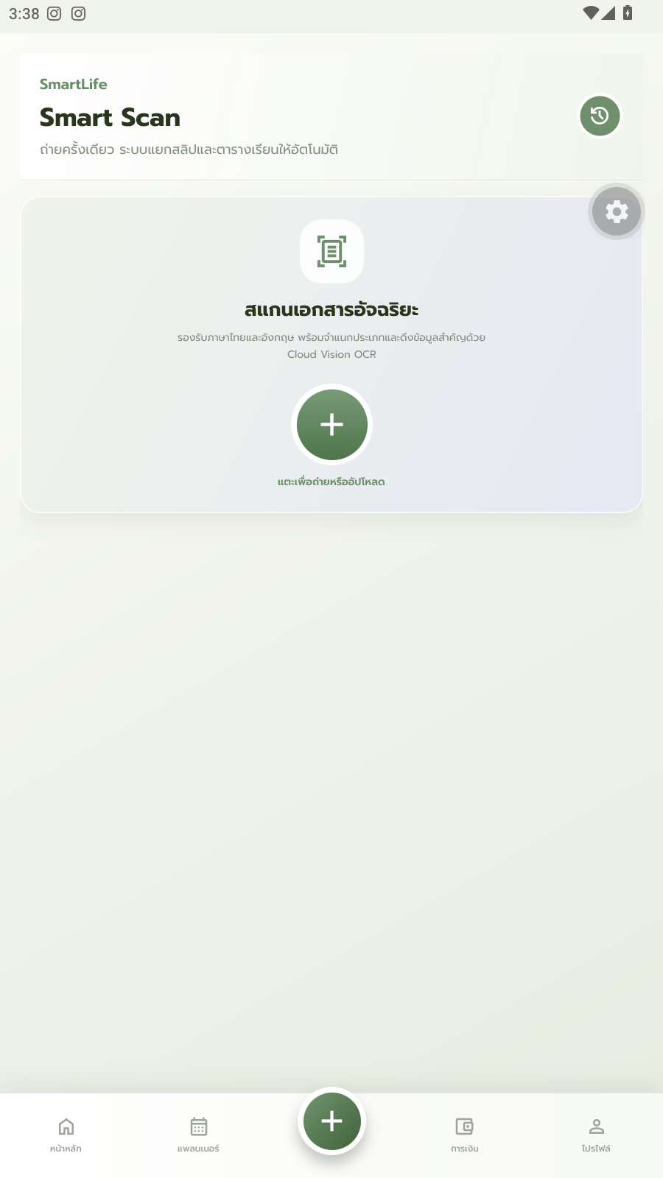
9. Smart Scan (receipt OCR)
Receipt-scanning screen using Cloud Vision / iApp OCR — empty state.

Slide 23
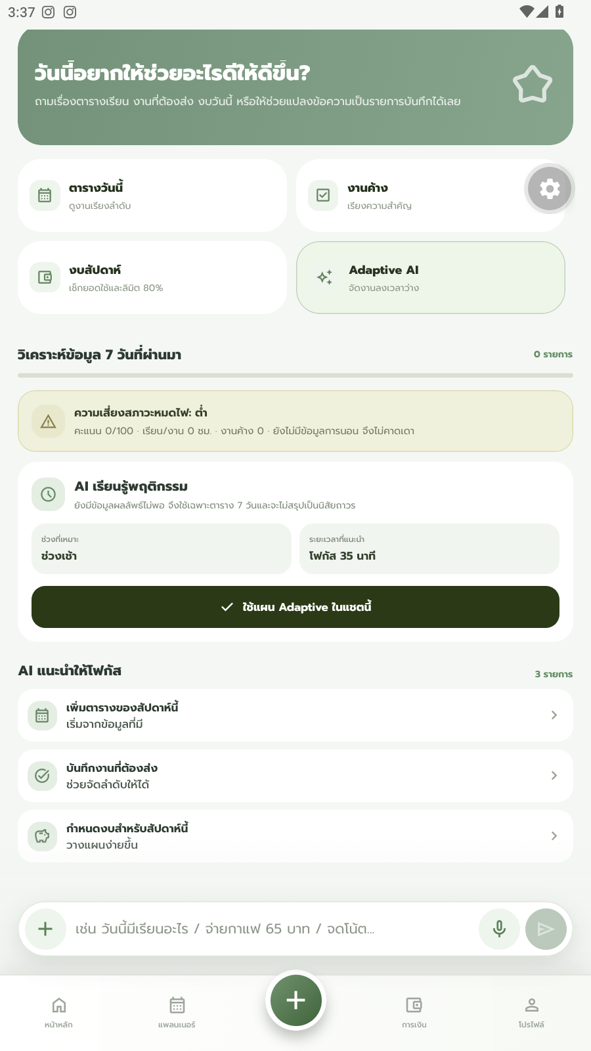
10. AI Assistant
Conversational AI assistant for schedule and finance questions.

Slide 24
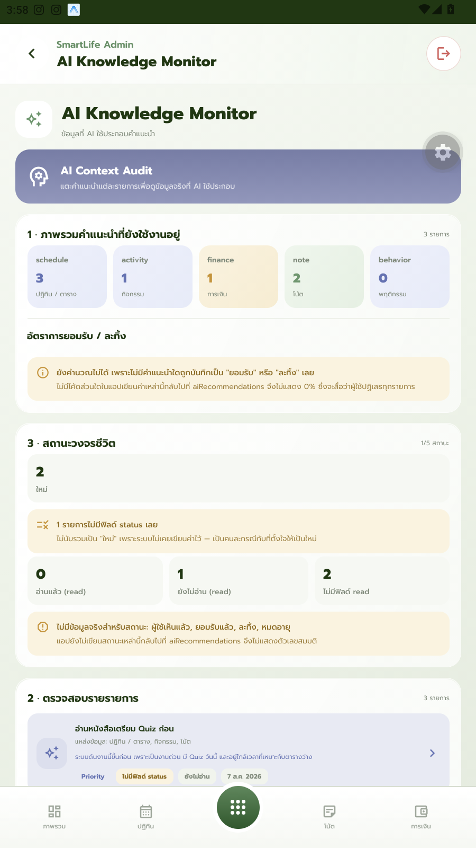
11a. Admin — AI Knowledge Monitor (summary)
Overview and lifecycle view of what the AI has learned across all users.

Slide 25
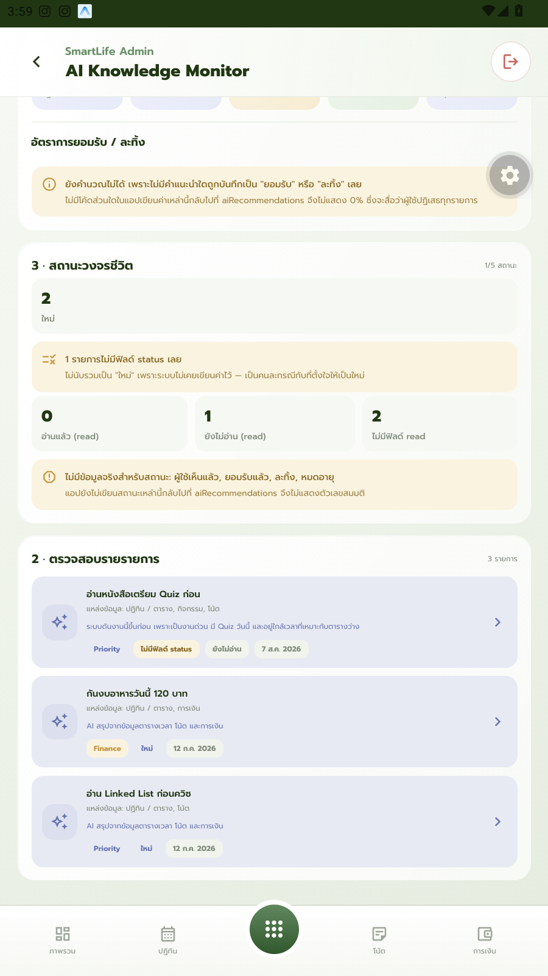
11b. Admin — AI Knowledge Monitor (per item)
Three individual learned items, each with the AI's own reasoning.

Slide 26
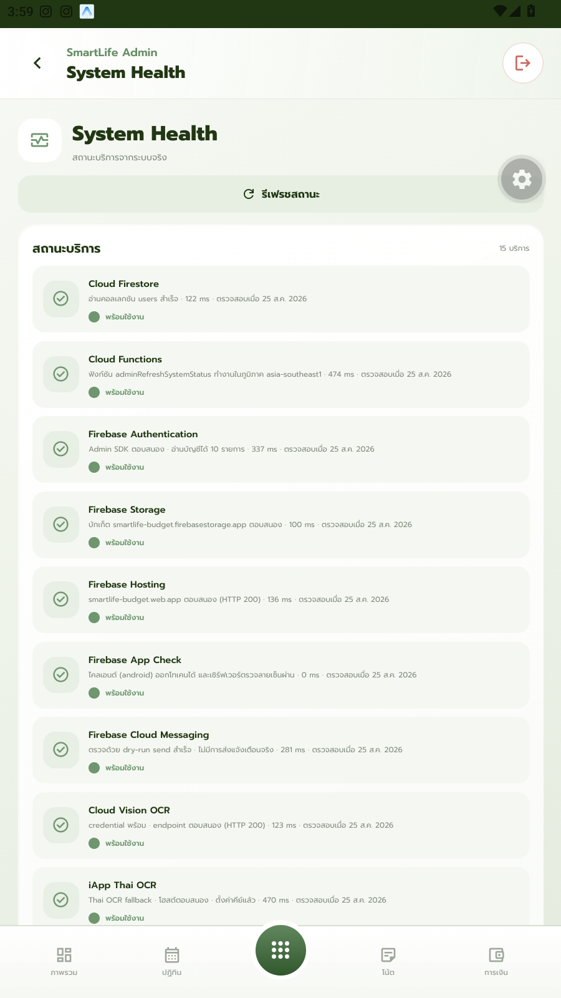
12. Admin — System Health
Live status for 15 backend services, all shown healthy.

Slide 27
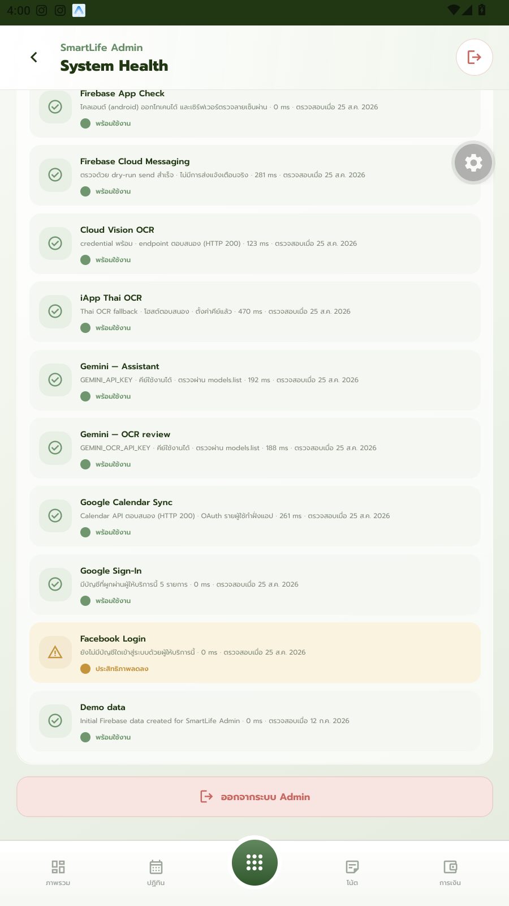
12b. Admin — Integrations detail
Integrations broken out individually: Gemini (Assistant), Gemini (OCR), Facebook Login.

Slide 28
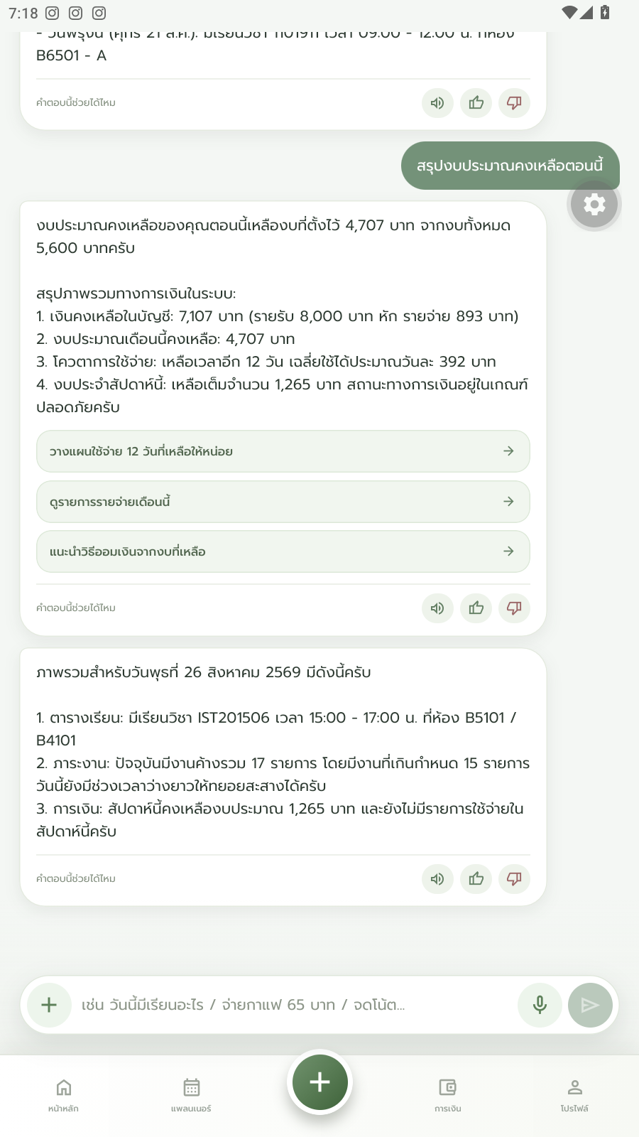
13. AI Assistant — real query
A real answered question: today's overview and remaining food budget (฿4,707 of ฿5,600).

Slide 29
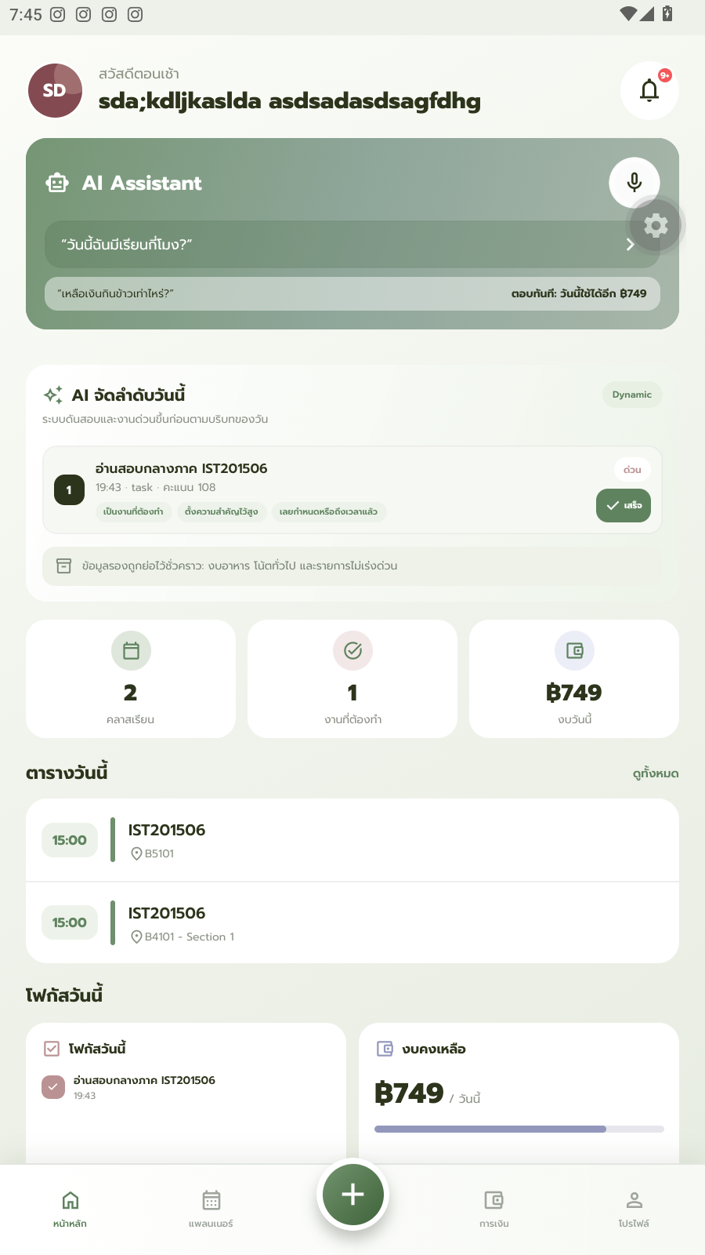
14. Dashboard prioritization
An urgent exam-prep task ranks #1 with score 108, an ‘urgent’ badge, and 3 reason chips.

Slide 30

15. Smart Schedule Importer — upload
Upload screen before scanning a class timetable photo.

Slide 31
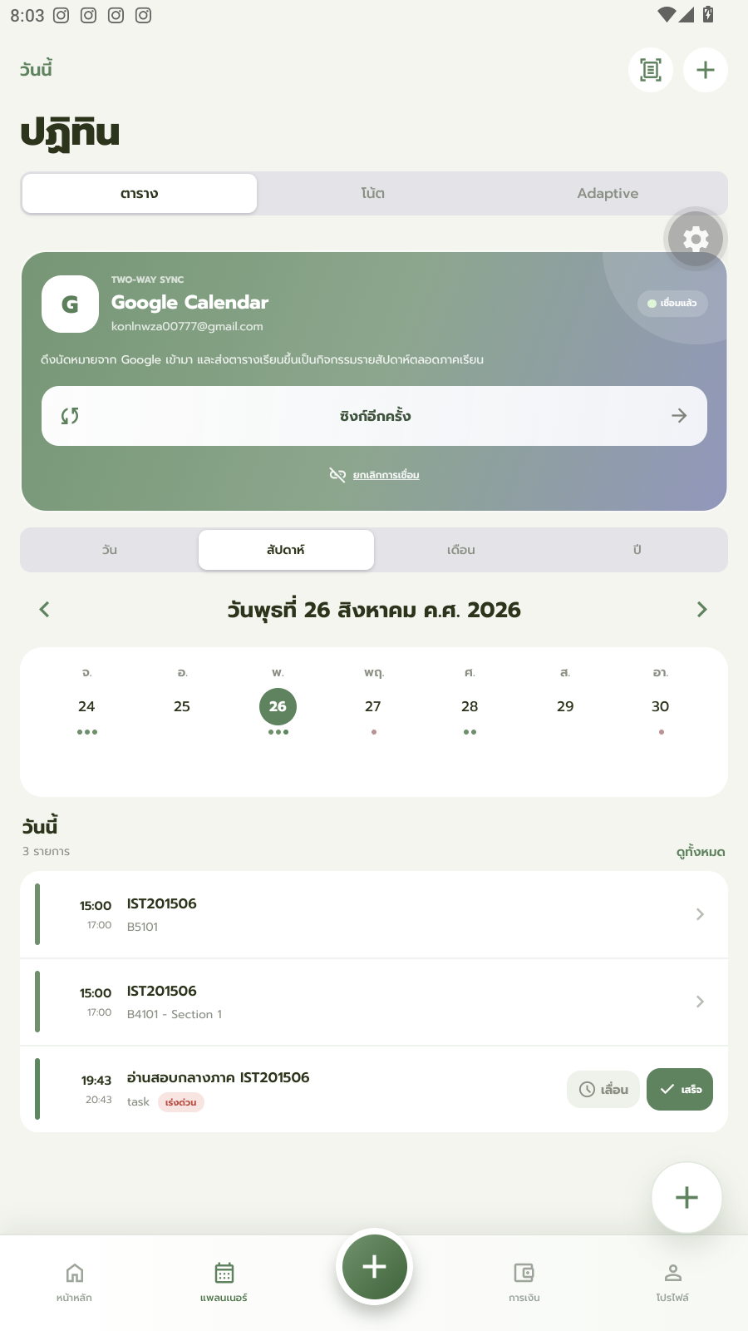
17. Google Calendar sync
Google Calendar connected, two-way sync confirmed.

Slide 32
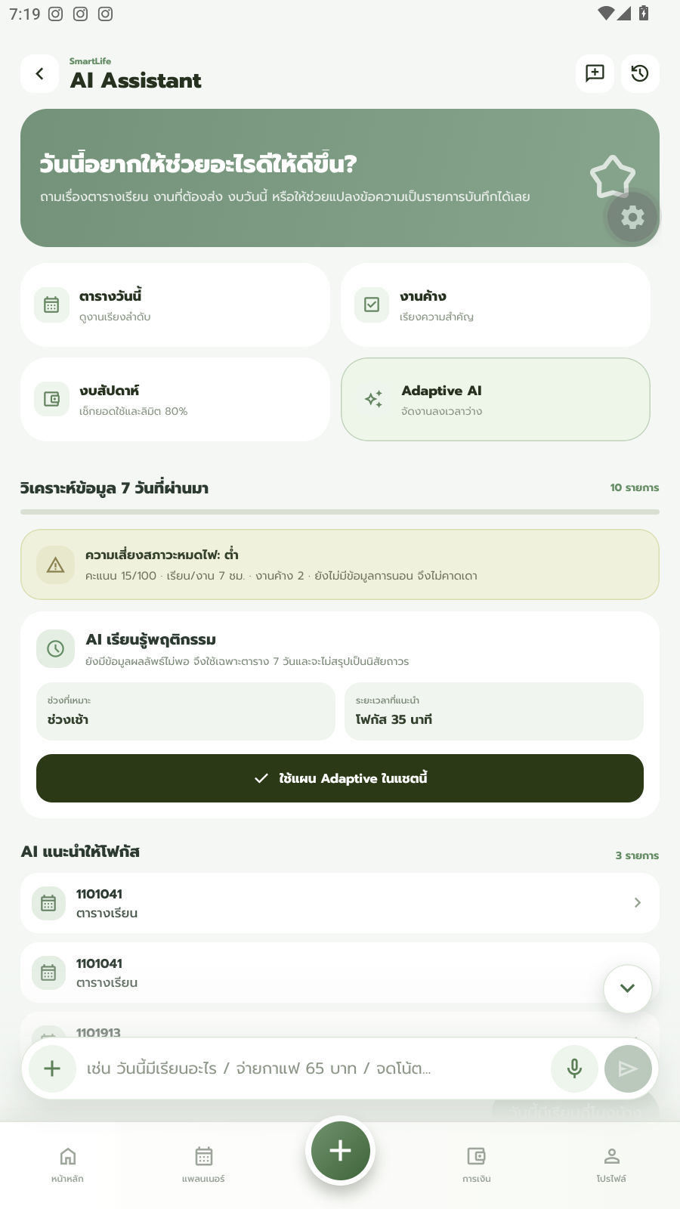
18. Burnout risk analysis
Burnout risk: Low, 15/100, based on about 7 hours of study/work.

Slide 33
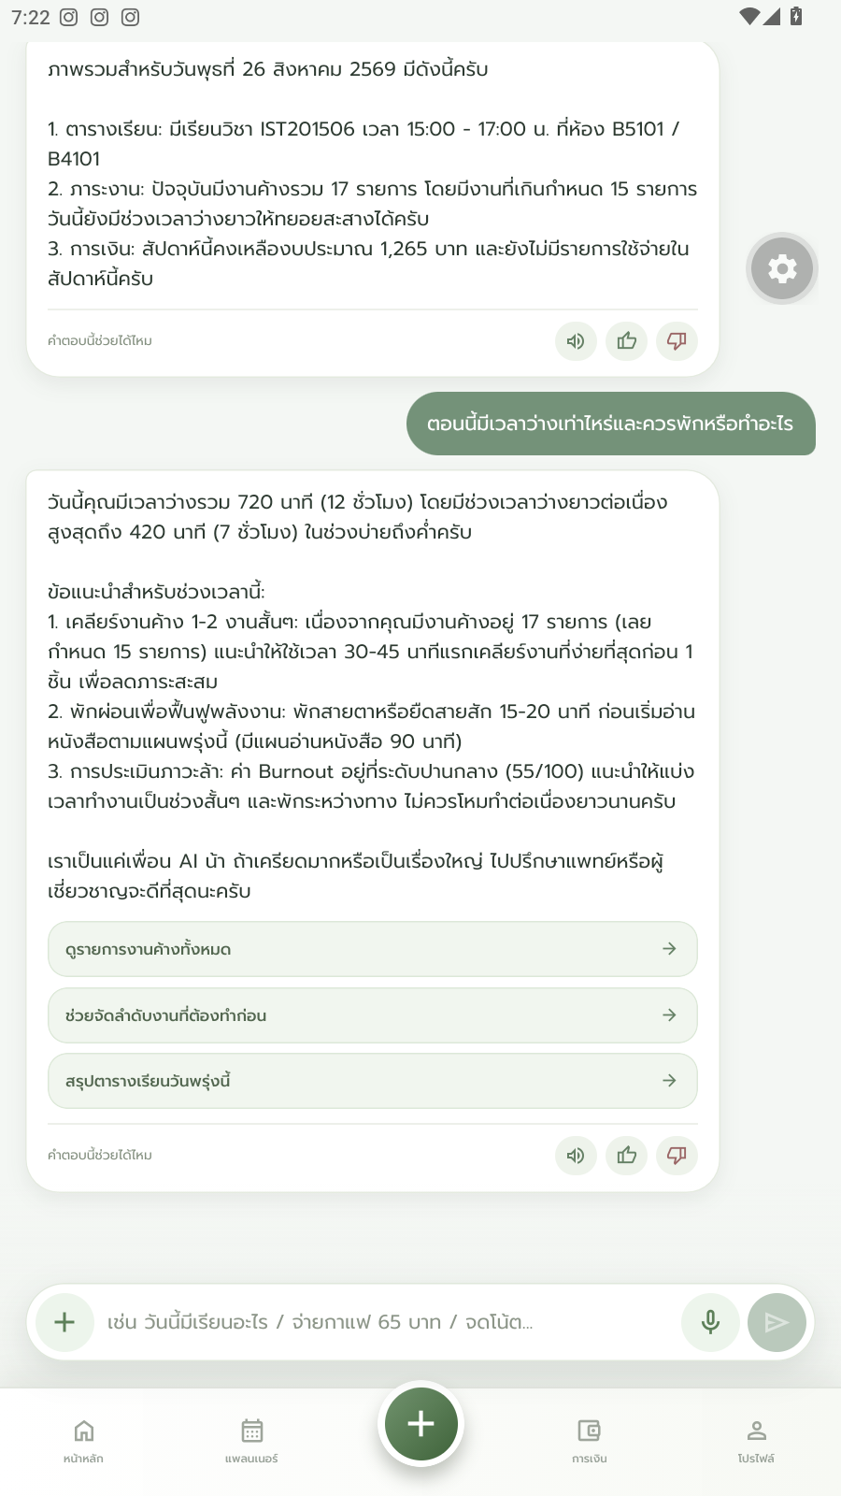
19. AI Assistant — break advice
AI Assistant suggesting a 15–20 minute break (answered as a normal assistant reply).

Slide 34
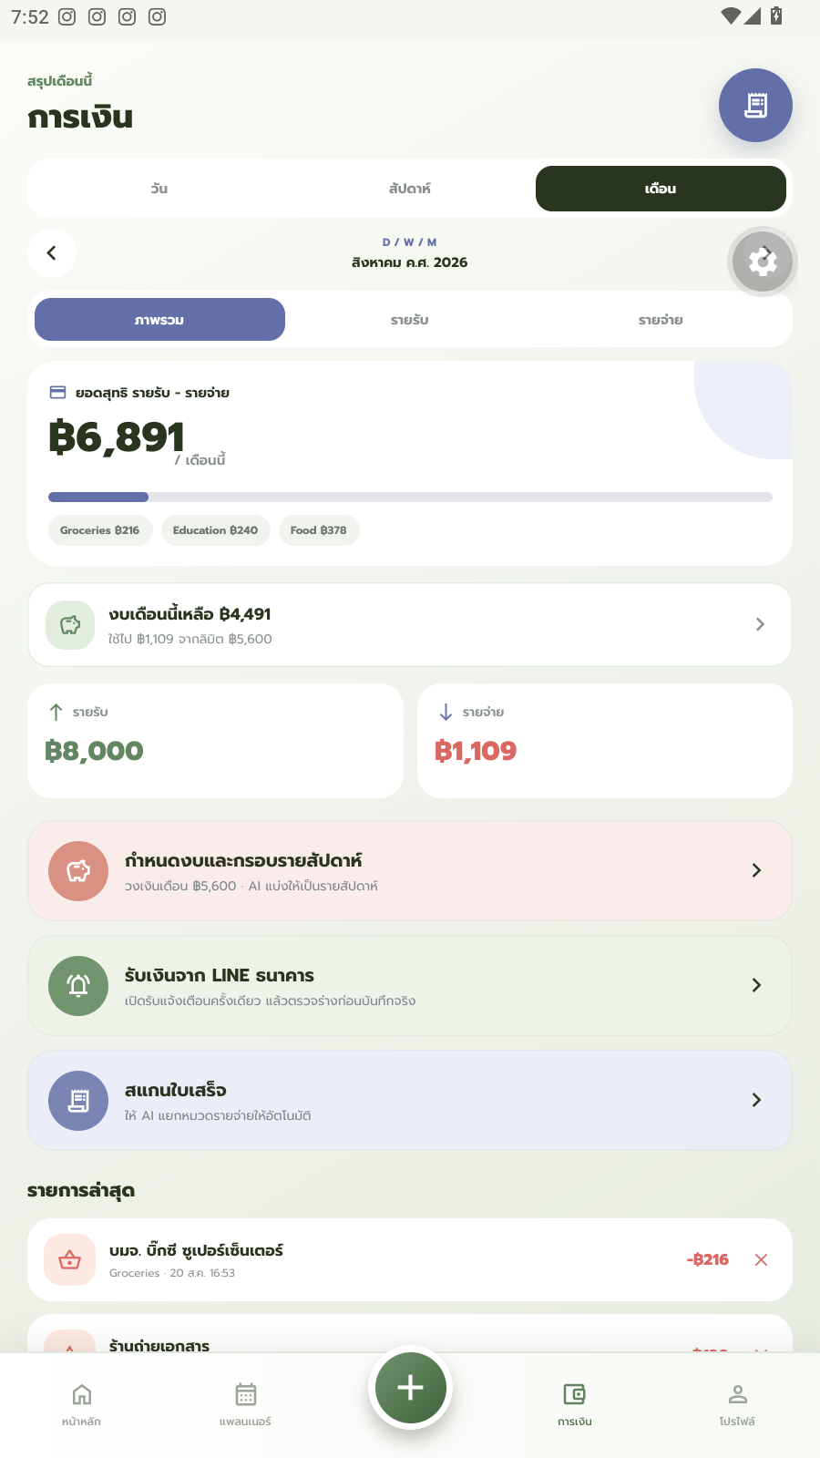
20. Personal Finance Tracker
Monthly overview: ฿6,891 net, ฿8,000 income vs ฿1,109 spent, with category breakdown.

Slide 35
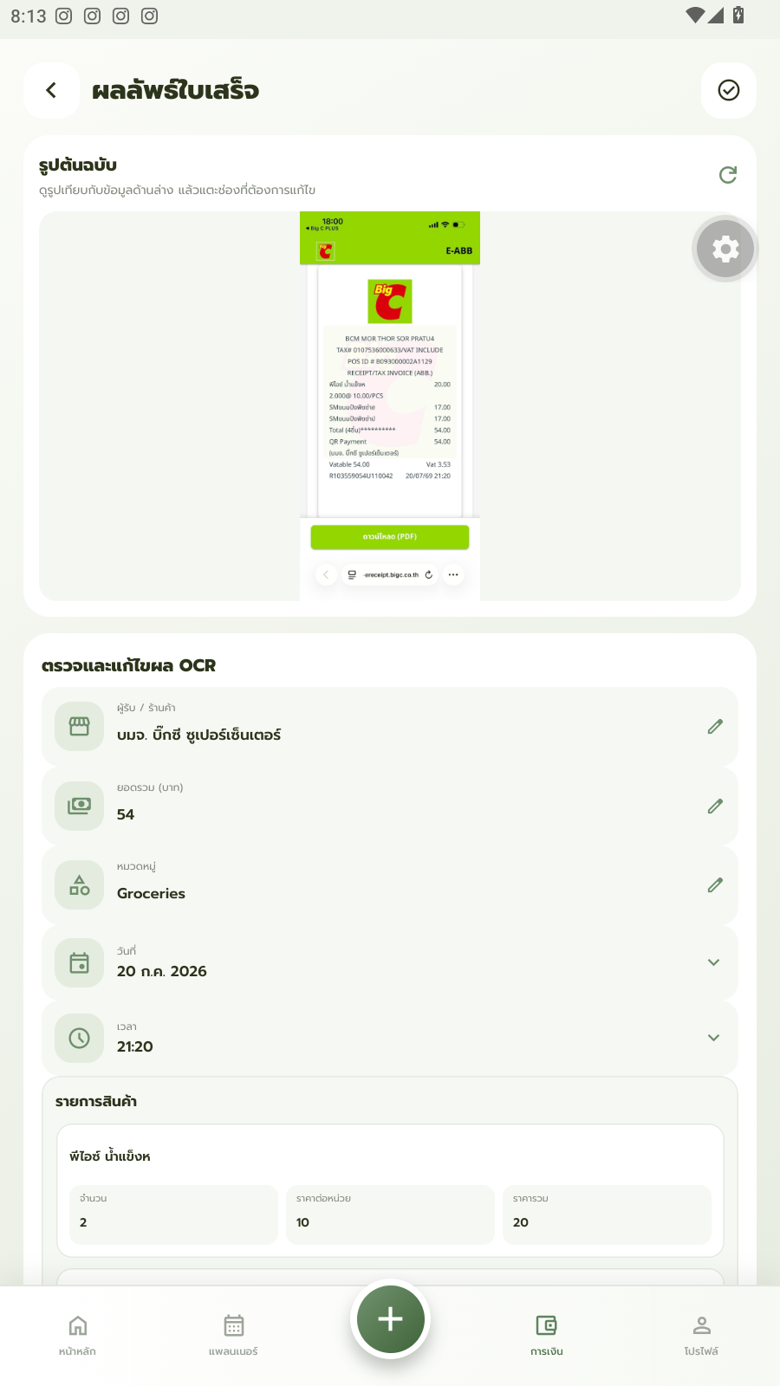
21. Receipt scan — auto-categorized
A real receipt (Big C, ฿54) automatically categorized as Groceries.

Slide 36
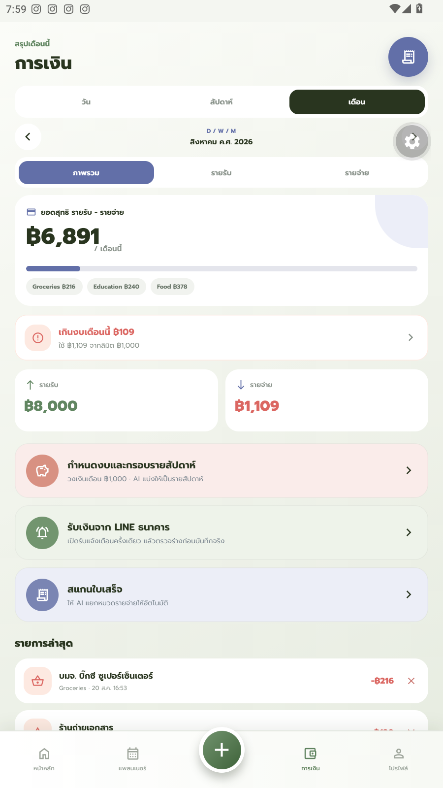
22. Budget alert
Alert shown when spending goes ฿109 over this month's budget.

Slide 37
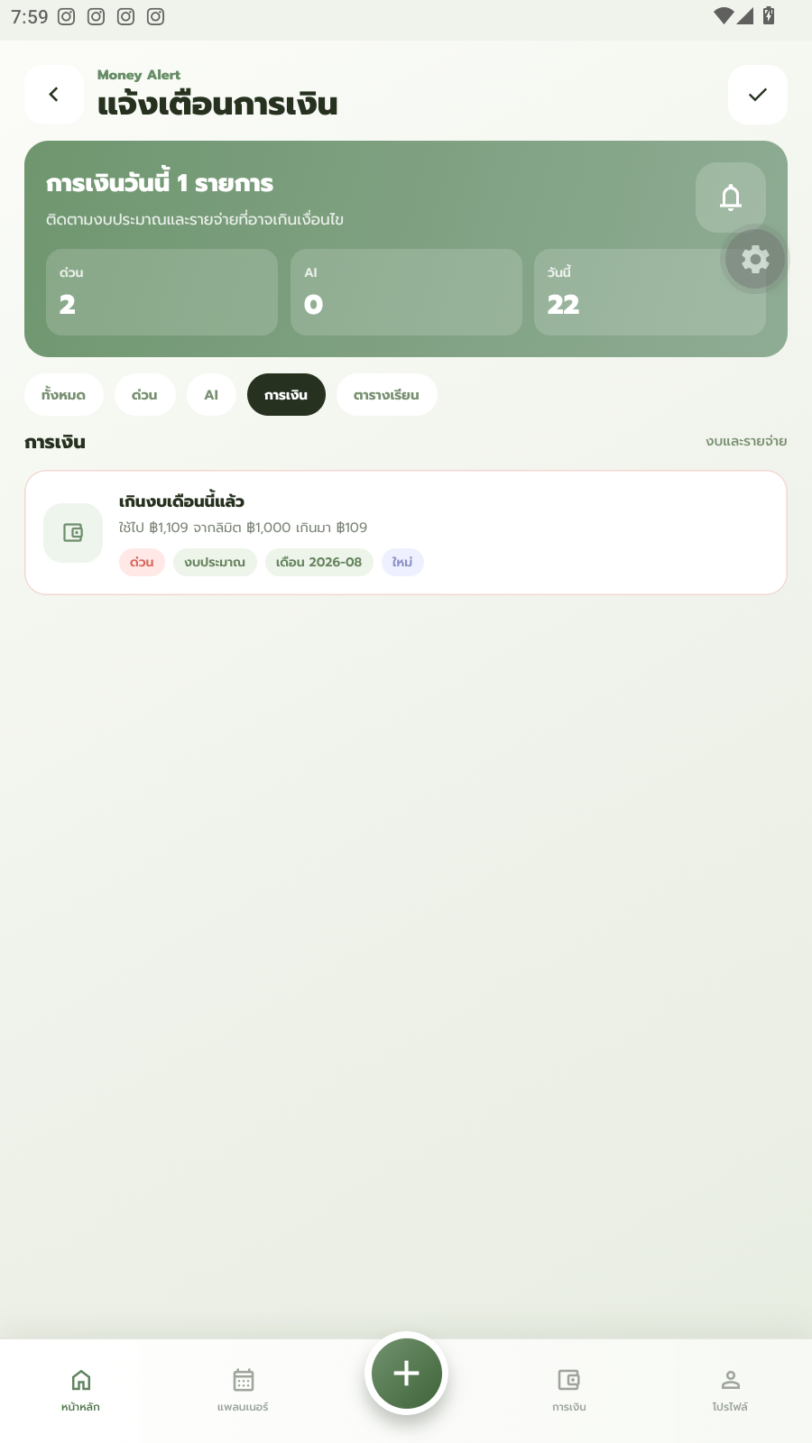
22b. Budget alert — notification
The same budget alert shown in the notification center.

Slide 38
Presentation Script
English, under 7 minutes — Week 9 video pitch

Slide 39
Part 1 — Opening & Introduction
Good morning everyone. Thank you for being here today. My name is Narongchai Thathong, and this project is developed together with my teammates, Konpong Chaovanakittikun and Natkamol Petcharat. Today, I would like to present our project called ‘SmartLife & Budget Balance Platform’, or SmartLife for short. The purpose of this talk is to show how SmartLife helps university students manage their daily academic life and personal finances in a single application. This topic is important because, right now, students like us have to juggle several separate apps just to get through a normal day — one for class schedules, another for notes, and another for tracking expenses. That constant switching between apps wastes time and mental energy that should go into studying instead.

Slide 40
Part 2 — Structure & Housekeeping
I have divided my presentation into three parts. First, I will talk about the problem students currently face when managing their time and money. Then, I will walk you through the core features of SmartLife and show you how it solves these problems. Finally, I will summarize the benefits our users can expect. This presentation will take no more than seven minutes, and I will be happy to answer any questions afterward. SmartLife is built as a real, working application using Expo and React Native, connected to a live Firebase backend, so everything I show you today is captured directly from the actual app — not a mockup.

Slide 41
Part 3 — Main Point 1: Current Problems
Let's start with the problem. As students, we constantly deal with class schedules, project deadlines, exams, extracurricular activities, and a limited monthly budget — all at the same time. Because there is no central tool to manage all of this, we end up relying on several different apps together: Google Calendar for our schedule, OneNote for notes, and apps like Money Lover for tracking expenses. Switching between these applications, or ‘context switching’, costs us about fifteen minutes a day on average. Over one semester, that adds up to roughly sixty wasted hours. On top of that, traditional schedule planning is rigid and gives us no way to track stress levels, which leaves many students at risk of burnout. And when it comes to money, manually logging every expense is tedious, so most of us simply give up on budgeting altogether. SmartLife was built to solve exactly these problems, in one single application.

Slide 42
Part 4 — Main Point 2: Core Features
Now let's move on to the solution. SmartLife brings four core features together. First, the Unified Dashboard gives you one screen that shows today's schedule, your budget, and an AI Smart Assistant you can simply ask questions like ‘How many classes do I have today?’ or ‘How much money do I have left for food this month?’ — and it answers instantly using your real data. The dashboard also highlights your most urgent tasks first, so an exam deadline never gets buried under less important items. Second, our Smart Schedule Importer lets you upload a photo of your class timetable, and OCR technology automatically extracts the subject codes, times, and rooms, then syncs everything with Google Calendar. Third, the Smart Schedule Builder learns from your behavior — for example, if you keep postponing a study session in the morning, it starts suggesting an afternoon slot instead. It also includes a burnout-awareness feature that looks at your study and rest balance and gives you a short, encouraging check-in when things look unbalanced. Finally, the Personal Finance Tracker lets you scan a receipt, and the app automatically reads and categorizes the expense for you — for example, tagging a grocery receipt as ‘Food’ — and it alerts you when you go over your monthly budget.

Slide 43
Part 5 — Conclusion & Q&A
This brings me to the end of my presentation. To summarize, SmartLife identifies the real pain point of juggling multiple apps for schedule and money management, and replaces it with one smart, unified platform. It saves students time, gives a clear overview of daily life on a single screen, supports better mental wellbeing through balanced scheduling, and builds healthier financial habits. I want to stress that every screen I've shown you today is from our real, working application, running on real data — this is not just a concept. We built this specifically for students at Suranaree University of Technology, using the digital technology skills we've learned in this program to solve a problem we face ourselves, every single day. Thank you very much for your time and attention. I would be glad to answer any questions you may have.

