Slide 1
TNT.NET Day
Sudoku Solver

Slide 2
What?
Create a Sudoku solver which can work with images
It should be possible to parse a real-life photo
Slight noise, rotation and skewness of a photo are taken into account
An actual solving of the board is real-time
Solution is printed onto the original photo

Slide 3
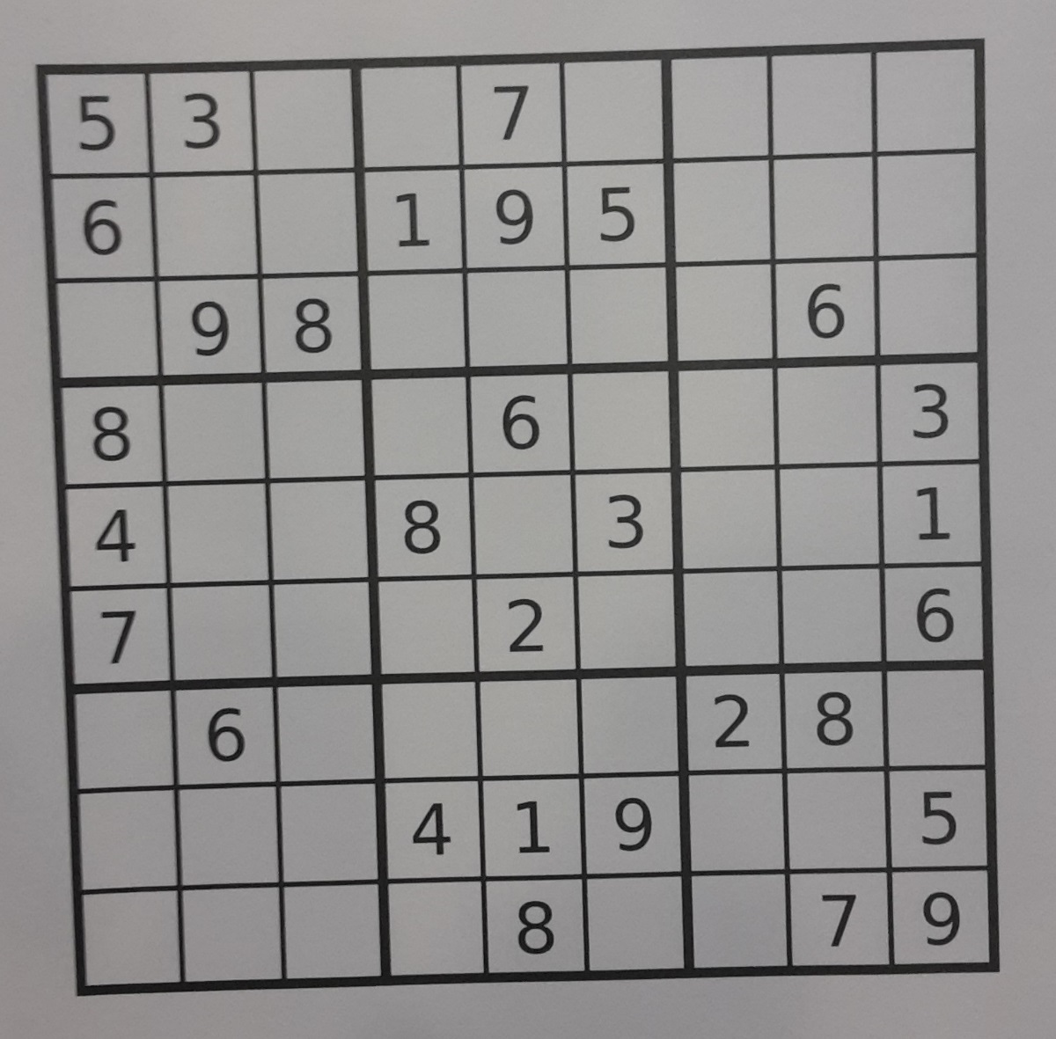
How?
Preprocess the image
Parse all digits in the image
Solve the board
Print solution onto the board

Slide 4
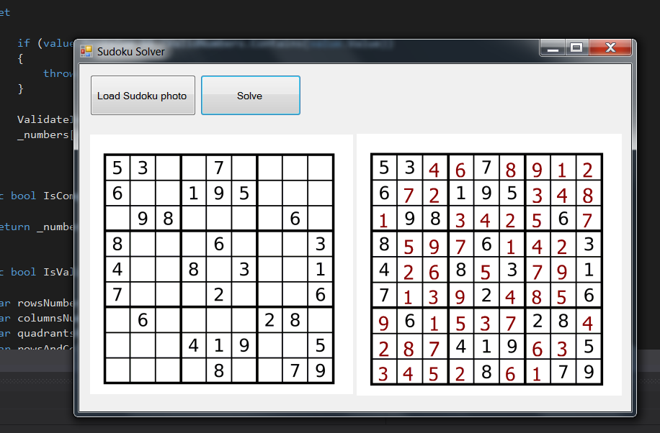
Demo
<Live deme or code samples>

Slide 5
Results?
It is possible to parse slightly deformed images
A solution is found fast enough
A solution can be previeved
An initial version of mobile app is working

Slide 6
Why? What have you learned?
Image preprocessing is the trickiest part
Brute-force algorithm is not fast enough, backtracking to the rescue
Some libraries used are not working with Xamarin

